Slide 1
How SNOMED CT can help in the ICD-10-CM transition
Kin Wah Fung, MD, FRCSEd, MS, MA
National Library of Medicine
National Institutes of Health

Slide 2
SNOMED CT
Systematized Nomenclature of Medicine - Clinical Terms
The most comprehensive, multilingual clinical healthcare terminology in the world
Created by the merging of SNOMED RT (Reference Terminology) with CTV3 (Clinical Terms version 3) in 2002

Slide 3
An international standard
Owned by IHTSDO (International Health Terminology Standards Development Organisation)
18 member countries so far, including
US, UK, Canada, The Netherlands, Spain, Denmark, Australia, New Zealand
SNOMED CT can be used by
Anyone with an Affiliate License (free for all member countries)
40 low income countries (defined by the World Bank)
Qualifying research/humanitarian/charitable projects

Slide 4
Terminology for the EHR
As a clinical terminology, SNOMED CT is inherently more suitable than other terminologies/classifications for clinical documentation in the EHR (electronic health record)
This is not to say that ‘SNOMED CT is superior to ICD’, since they are designed for different purposes and each should each be used for the purpose for which it was designed

Slide 5
Content coverage
SNOMED CT has better clinical coverage than ICD
Number of codes:
SNOMED CT (Clinical finding): 100,000
ICD-9-CM: 14,000
ICD-10-CM: 68,000
ICD’s focus is statistical – less common diseases get lumped together in “catch-all” categories e.g. J15.8 Pneumonia due to other specified bacteria, which could result in loss of information
SNOMED CT is clinically-based – document whatever is needed for patient care

Slide 6
Differences Between ICD-9-CM, ICD-10-CM and SNOMED CT
 | ICD-9-CM | ICD-10-CM | SNOMED CT
Asperger’s disorder | 299.8 Other specified pervasive developmental disorders | F84.5 Asperger’s disorder | 23560001 Asperger’s disorder
Apert syndrome | 755.55 Acrocephalosyndactyly | Q87.0 Congenital malformation syndromes predominantly affecting facial appearance | 205258009 Apert syndrome
Metabolic acidosis | 276.2 Acidosis | E87.2 Acidosis | 59455009 Metabolic acidosis
Respiratory acidosis | 276.2 Acidosis | E87.2 Acidosis | 12326000 Respiratory acidosis
Lactic acidosis | 276.2 Acidosis | E87.2 Acidosis | 91273001 Lactic acidosis

Slide 7
Clinical orientation
Different users and usage
SNOMED CT - direct use by healthcare providers during the process of care
ICD – use by coding professionals after the episode of care
It may be problematic for healthcare providers to use ICD directly
Some terms are not ‘clinical user-friendly’
Some contents have little clinical relevance
Presumed knowledge of coding rules and conventions

Slide 8
“Unfriendly” terms
Apparently “awkward” names (embedded coding guidelines)
E878.2 Surgical operation with anastomosis, bypass, or graft, with natural or artificial tissues used as implant causing abnormal patient reaction, or later complication, without mention of misadventure at time of operation (ICD-9-CM)
Clinically “irrelevant” details
V30.2xxD Person on outside of three-wheeled motor vehicle injured in collision with pedestrian or animal in nontraffic accident, subsequent encounter (ICD-10-CM)

Slide 9
ICD coding rules and conventions
Patient admitted with gastrointestional bleeding and found to be anemic. Which is the correct code?
280 Iron deficiency anemias secondary to blood loss (chronic), OR
285.1 Acute posthemorrhagic anemia
There is no general code to cover both cases of acute and chronic blood loss
In ICD convention, words in parenthesis e.g. (chronic) are known as “non-essential modifiers” – whether they are present or not doesn’t affect coding, so 280 is the correct code if the clinical course is not certain. But clinical users may not be aware of this convention.
SNOMED CT: 413532003 Anemia due to blood loss

Slide 10
Flexible data entry and retrieval
ICD dictates level of granularity of coding
NOS (Not otherwise specified) codes - cases with insufficient information for more specific codes
NEC (Not elsewhere classified) codes - cases with more specific information but not covered by existing codes
SNOMED CT allows coding at any level of granularity as appropriate for the clinical situation - no need for NOS, NEC codes
Flexible data retrieval
SNOMED CT has multiple hierarchy (single hierarchy for ICD)
SNOMED CT concepts are defined logically by their attributes (only textual rules and definitions in ICD)

Slide 11
Clinical guideline for hypertension
ICD-9-CM
If one uses only codes in the range HYPERTENSIVE DISEASE (401-405), will be missing
410.9 Myocardial infarction with hypertension
642 Hypertension complicating pregnancy, childbirth, and the puerperium
SNOMED CT
All descendants of 38341003 Hypertensive disorder

Slide 12
Data retrieval using attributes
Find all diseases caused by occlusion of artery affecting any artery except mesenteric or renal arteries
SNOMED CT
Find all descendants of 2929001 Occlusion of artery
Exclude those with “Finding site” = ‘Structure of mesenteric artery’ or ‘Structure of renal artery’
ICD-9-CM
440 Atherosclerosis and descendants (except 440.1 Of renal artery)
433 Occlusion and stenosis of precerebral arteries and descendants
437.0 Cerebral atherosclerosis
414.0 Coronary atherosclerosis
416.0 Idiopathic pulmonary arteriosclerosis
443.9 Peripheral vascular disease, unspecified…
List needs to be reviewed with each update

Slide 13
Extensibility
No single terminology will be complete for every use case - there is always a need for extension
ICD – no available method for extension provided by the classification
SNOMED CT – well-defined rules to extend coverage by combining existing concepts (post-coordination) e.g.
“Left kidney stone” can be represented by adding the laterality attribute 7771000 Left to 95570007 Kidney stone
Advantages:
Can compute equivalence of new concepts to existing concepts
The new concept will be recognized as a sub-class of existing concepts

Slide 14
Meaningful Use Criteria for EHR
Stage1Meaningful Use – problem list data should be encoded in either SNOMED CT or ICD-9-CM
NPRM (Notice of Proposed Rule Making) for 2014 EHR Certification Criteria (for Stage 2 Meaningful Use) – SNOMED CT proposed as the preferred problem list terminology

Slide 15
Direct generation of ICD-10-CM codes from clinical data
Clinical data coded in SNOMED CT can be used to generate ICD-10-CM codes (“code once, use multiple times”)
Implementation of SNOMED CT in the EHR will not only improve the quality of data, but can also help the transition to ICD-10-CM

Slide 16
SNOMED CT to ICD-10-CM Map
NLM project with participation from National Center for Health Statistics (NCHS)
Re-use of methodology, tools and data from the IHTSDO/WHO project to map SNOMED CT to ICD-10
Rule-based map because
One SNOMED CT concept may need more than one ICD-10-CM codes to fully represent its meaning e.g. etiology and manifestation, injury codes
One SNOMED CT concept may have multiple alternative ICD-10-CM target codes
Dual independent mapping – as built-in quality assurance

Slide 17
Scope of the map
Only mapping those SNOMED CT concepts suitable for the problem list: clinical findings, events and situation
Commonly occurring concepts are mapped first
CORE Problem List Subset
Donated content from Kaiser Permanente’s Convergent Medical Terminology (CMT)
Preview publication released in February - covers 7,000 concepts
Final release in June – about 15,000 concepts

Slide 18
Intended uses of the map
Embedded in the EHR to find ICD-10-CM codes in real-time – the I-MAGIC (Interactive Map-Assisted Generation of ICD Codes) use case
To assist coding professionals by suggesting ICD codes based on SNOMED CT-encoded problems

Slide 19
I-MAGIC demo tool
http://imagic.nlm.nih.gov/imagic/code/map

Slide 20
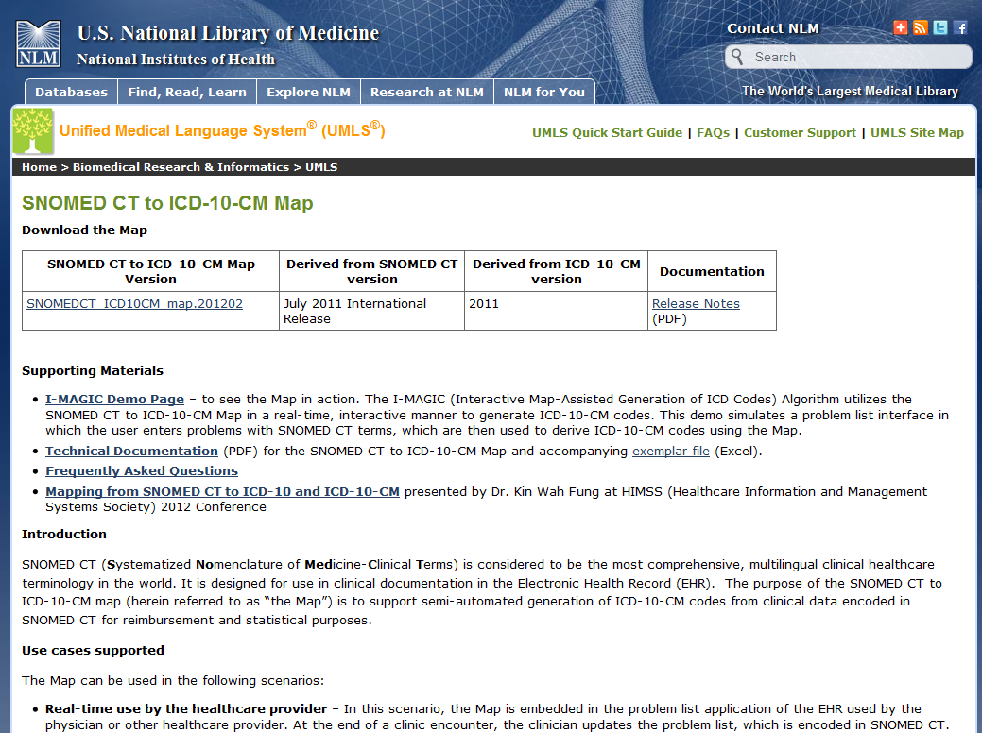
Link to I-MAGIC Demo Tool
http://www.nlm.nih.gov/research/umls/mapping_projects/snomedct_to_icd10cm.html
Link to I-MAGIC demo tool

Slide 21
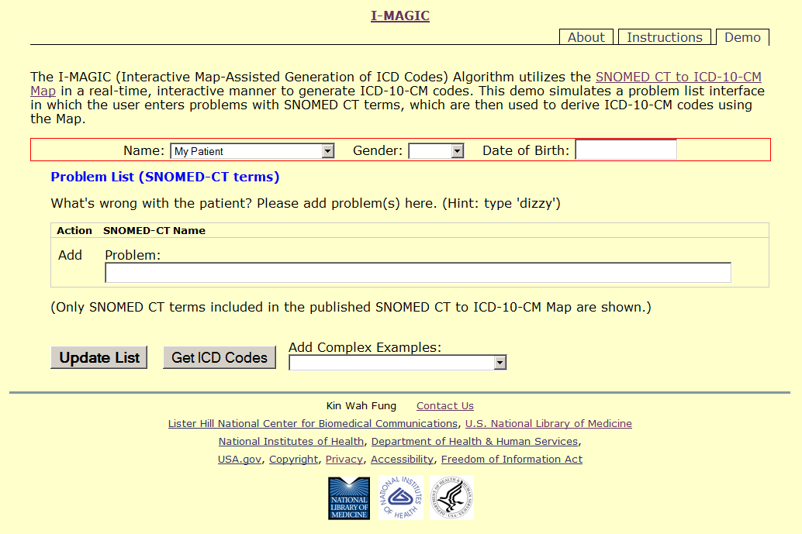
I-MAGIC Screen Capture - Homepage
Information from EHR
Problem list entry interface

Slide 22
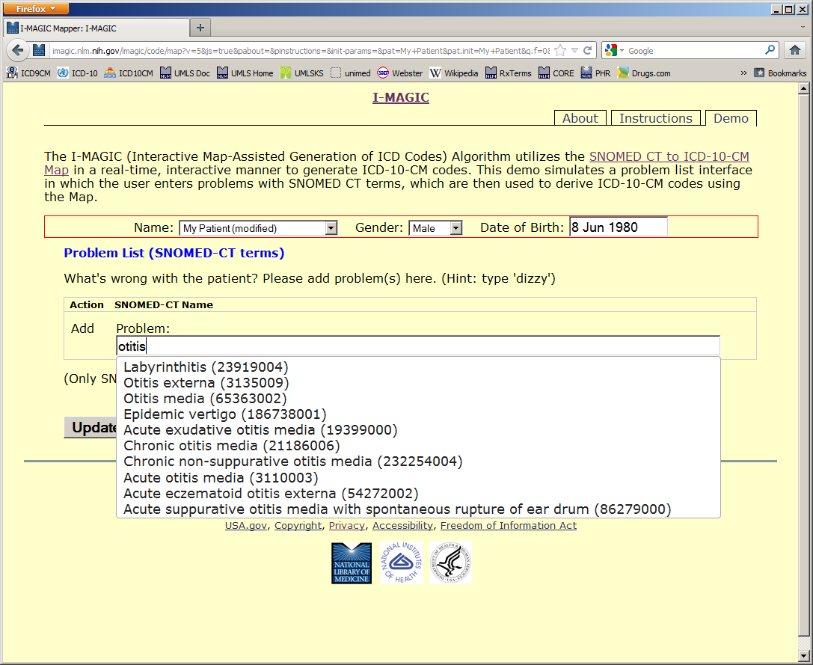
I-MAGIC Screen Capture – Problem List
SNOMED CT terms included in the published map

Slide 23
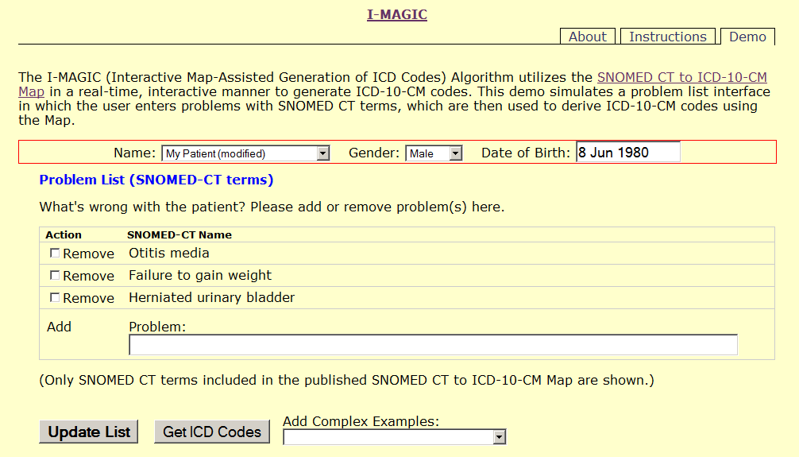
I-MAGIC Screen Capture – Get ICD Codes Button
Click here to see ICD-10-CM codes

Slide 24
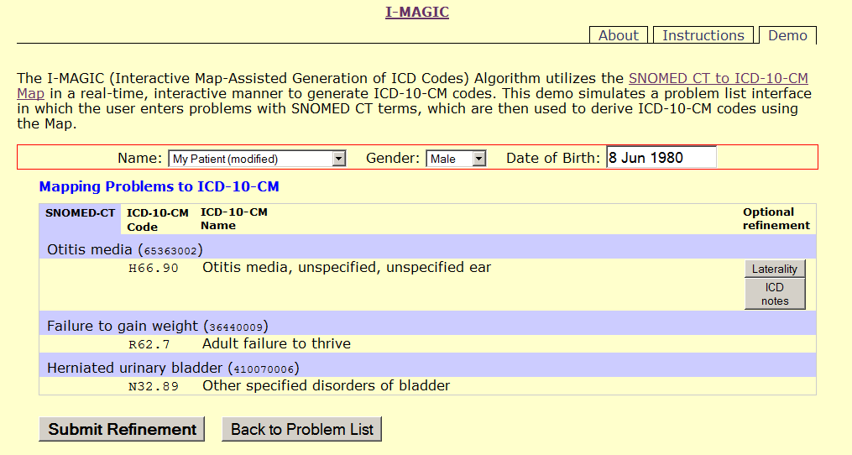
I-MAGIC Screen Capture – Refine ICD-10-CM Codes
Options to refine ICD-10-CM codes
ICD-10-CM codes

Slide 25
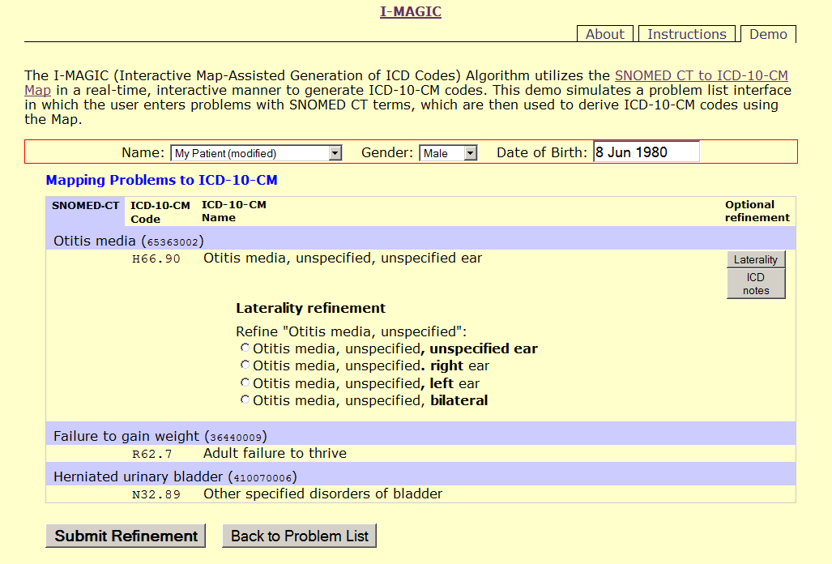
I-MAGIC Screen Capture – Laterality Refinement
Laterality refinement choices

Slide 26
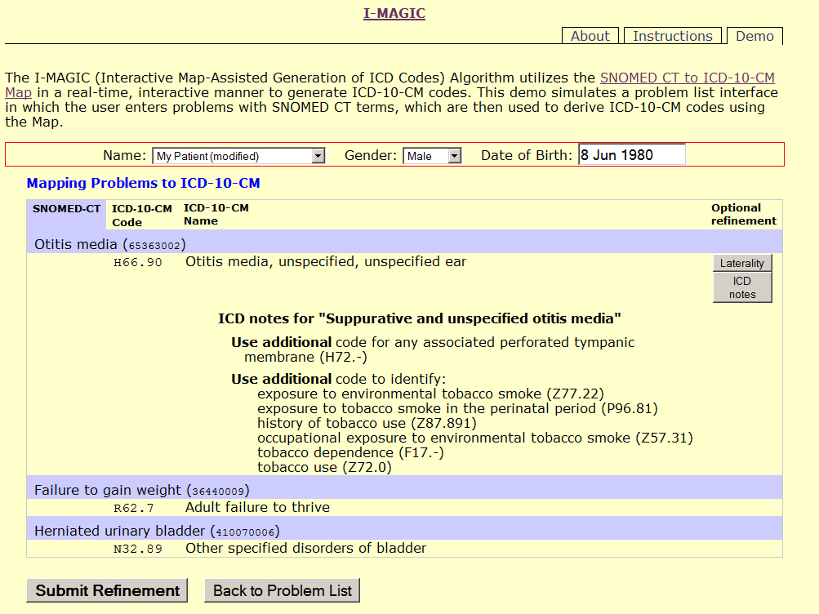
I-MAGIC Screen Capture – ICD Coding Notes
ICD coding notes

Slide 27
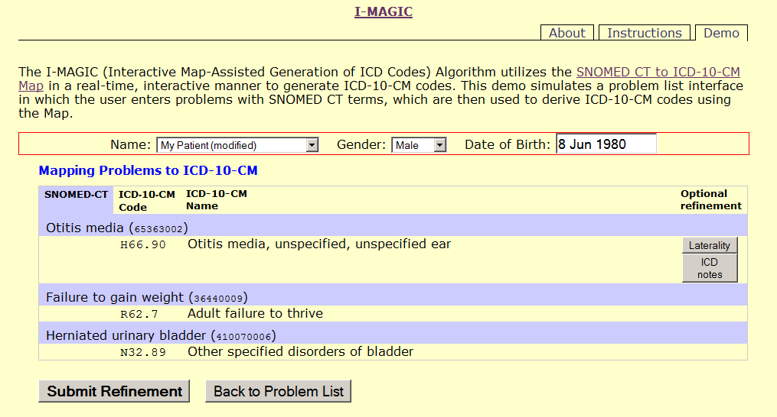
I-MAGIC Screen Capture – ICD-10-CM Code for Adult
ICD-10-CM code for adult

Slide 28
I-MAGIC Screen Capture – ICD-10-Code for Child
ICD-10-CM code for child

Slide 29
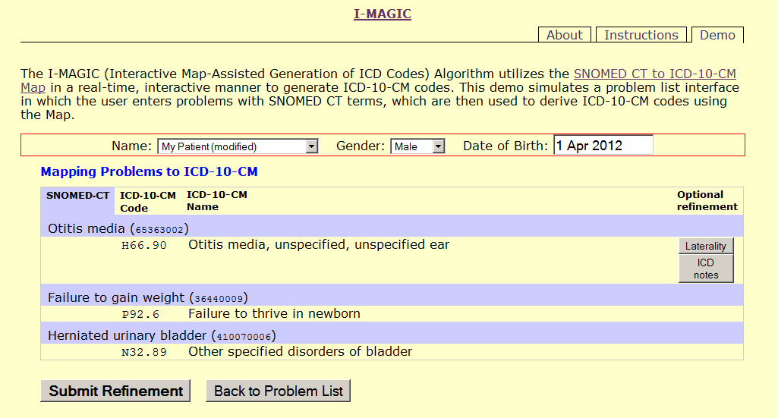
I-MAGIC Screen Capture – ICD-10-CM Code for Newborn
ICD-10-CM code for newborn

Slide 30
I-MAGIC Screen Capture – ICD-10-CM Code for Male
ICD-10-CM code for male

Slide 31
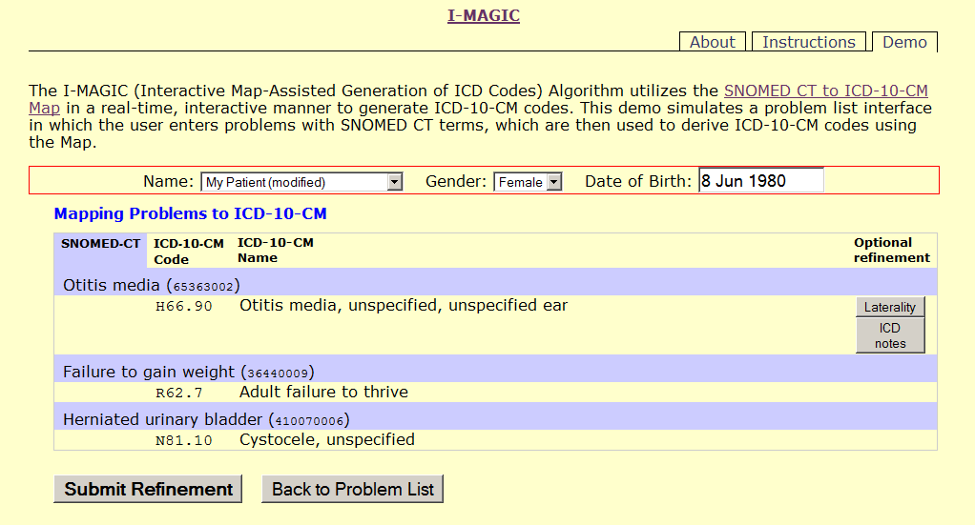
I-MAGIC Screen Capture – ICD-10-CM Code for Female
ICD-10-CM code for female

Slide 32
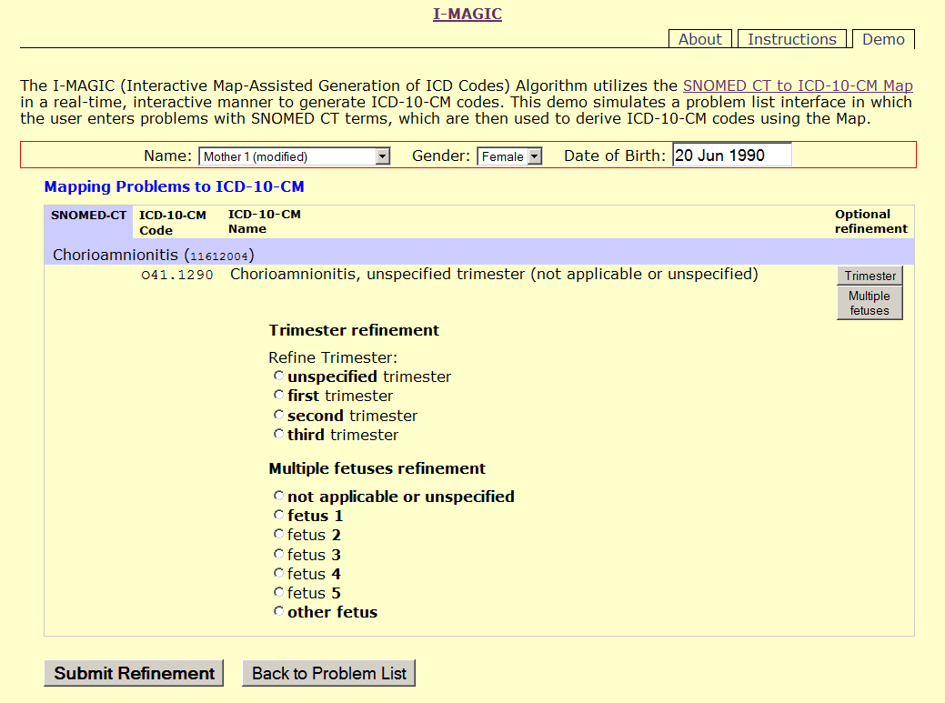
I-MAGIC Screen Capture – Trimester and Fetus Specification
Trimester specification
Fetus specification

Slide 33
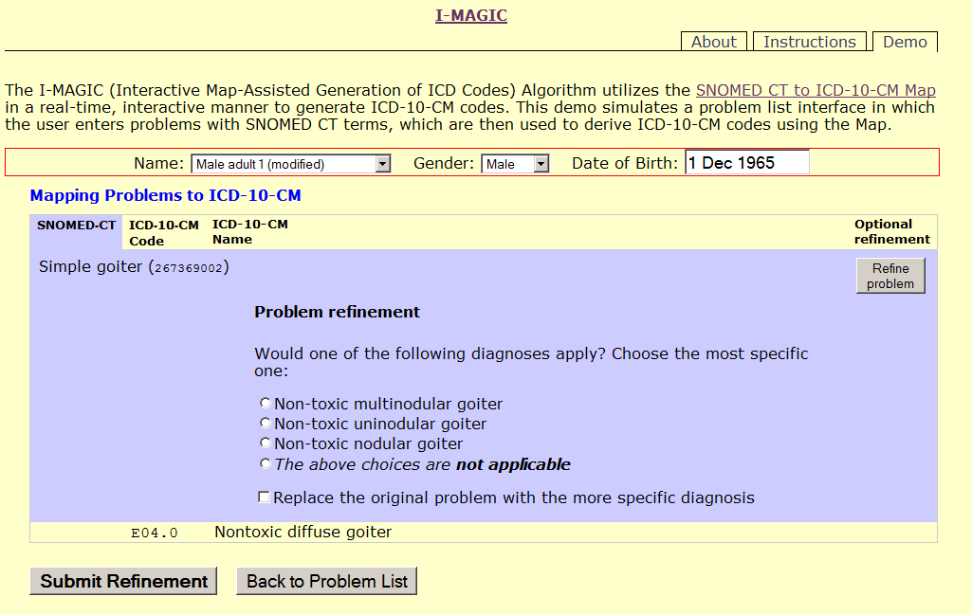
I-MAGIC Screen Capture – Problem Refinement
Different ICD-10-CM codes if these more specific conditions apply

Slide 34
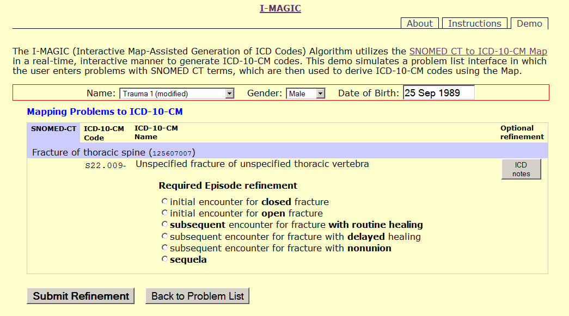
I-MAGIC Screen Capture – Mandatory Refinement Choices
No valid default ICD-10-CM code
Mandatory refinement choices

Slide 35
NLM SNOMED CT resources
Subsets
CORE Problem List Subset http://www.nlm.nih.gov/research/umls/Snomed/core_subset.html
Convergent Medical Terminology Subsets http://www.nlm.nih.gov/research/umls/Snomed/cmt.html
Nursing Problem List Subset http://www.nlm.nih.gov/research/umls/Snomed/nursing_problemlist_subset.html
Route of Administration Subset http://www.nlm.nih.gov/research/umls/Snomed/roa_subset.html
Mappings
SNOMED CT to ICD-10-CM Map http://www.nlm.nih.gov/research/umls/mapping_projects/snomedct_to_icd10cm.html
SNOMED CT to ICD-9-CM Map http://www.nlm.nih.gov/research/umls/mapping_projects/snomedct_to_icd9cm_reimburse.html
ICD-9-CM Map to SNOMED CT map (under development)
US Extension http://www.nlm.nih.gov/research/umls/Snomed/us_extension.html
US SNOMED CT Content Request System https://uscrs.nlm.nih.gov/
UMLS-enhanced SNOMED CT browser https://uts.nlm.nih.gov/snomedctBrowser.html

Slide 36
Questions?
kwfung@nlm.nih.gov

