Slide 1
LinkOut for Libraries: From Icons to Full Text and Everything in Between
Sarah Helson
National Library of Medicine

Slide 2
Support Structure
Library
Vendors
NNLM
National Library of Medicine

Slide 3
What is LinkOut for Libraries?
Libraries link directly from the PubMed citations to:
Full text of the article
Method to order the article (ILL)
Call number information in the library’s catalog

Slide 4
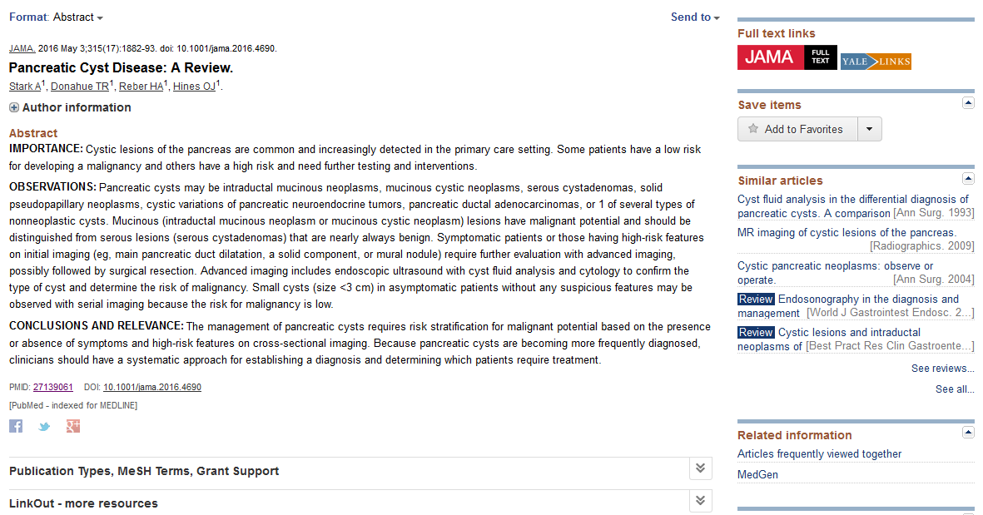
What does LinkOut look like?

Slide 5
LinkOut – More Resources

Slide 6
LinkOut Process
Registration
Set holdings
Activate Icon
Article
Full Text
ILL
Pick a service
Manual entry
PubMed Citation
Where you want to see your icon
XML file
Link Resolver

Slide 7
Three Services
LinkOut via Submission Utility
Just your holdings via Submission Utility interface
Just your holdings provided in XML by a vendor
Outside Tool
Every citation gets an icon
LinkOut Local
Just your holdings provided in XML by library

Slide 8
LinkOut via Submission Utility
Icon only on the library’s holdings
Holdings can be manually entered or supplied by a vendor
Registration: https://www.ncbi.nlm.nih.gov/books/NBK3808/

Slide 9
Outside Tool
Icon on every citation in PubMed
Uses a link resolver
Link must point to full text, ILL, or catalog record
Registration: https://www.ncbi.nlm.nih.gov/books/NBK3803/

Slide 10
LinkOut Local
Icon only on the library’s holdings
Uses a link resolver
Holdings supplied as an XML file by the library
Registration: https://www.ncbi.nlm.nih.gov/books/NBK3808/
Strict requirements

Slide 11
Compare the Services
 | LinkOut via Submission Utility | Outside Tool | LinkOut Local
Update Holdings | Submission Utility | Link Resolver Portal | Upload XML Files
Icon on Every Citation | No | Yes | No
Requires Link Resolver | No* | Yes | Yes
Create Filter in My NCBI | Yes | No | Yes
*Holdings file supplied by a vendor on behalf of a library will use a link resolver

Slide 12
How to See the Icons
Special URL
LinkOut, LinkOut Local: ncbi.nlm.nih.gov/pubmed?holding=mdtestlib
Outside Tool: ncbi.nlm.nih.gov/pubmed?otool=mdtestlib
My NCBI Preferences
Personal
Shared Settings: ncbi.nlm.nih.gov/pubmed?myncbishare=NCBIusername

Slide 13
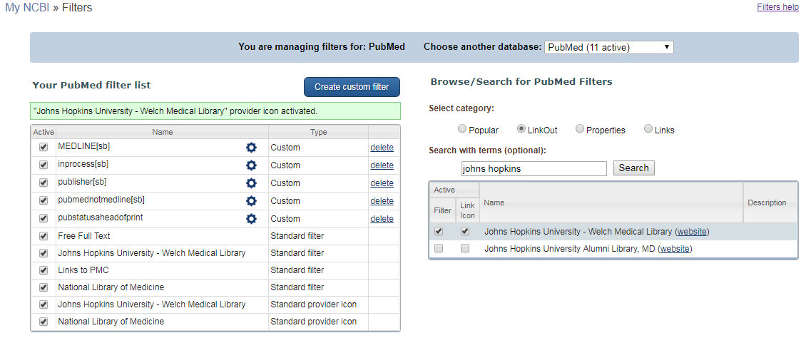
Demo: My NCBI – LinkOut Filters

Slide 14
Demo: My NCBI – Outside Tool Preferences

Slide 15
Demo: My NCBI – Shared Settings

Slide 16
Demo: Submission Utility
For LinkOut service:
Use to update your holdings, icon and contact information
Can add a LIBID to connect your holdings in DOCLINE
View list of vendors supplying holdings for the library
Submission Utility Link

Slide 17
Demo: Outside Tool Updates

Slide 18
Duplicate Icons

Slide 19
Troubleshooting Duplicate Icons
Confirm the service(s) you are using
Determine how are your holdings set up
Vendor file AND manually added holdings
Multiple vendors’ files
Check the icon URL in PubMed and determine which one is correct

Slide 20
Proxy Access
How you integrate a proxy is up to you
Methods we have seen:
With the special URL
As a part of the link resolver

Slide 21
Broken Links
Publisher Icon
Information supplied by the publisher, so they will need to submit correct information
Library Icon
Corrections depend on how the icon is created
For LinkOut: vendor supplied, or manually added?
For Outside Tool and LinkOut Local: link resolver not resolving correctly

Slide 22
How to Get Help
Submit a ticket
https://support.nlm.nih.gov
Email us
Lib-linkout@ncbi.nlm.nih.gov
Include:
NameAbbr (username) and the link you use to access PubMed

Slide 23
Questions?

