Slide 1
Clinical Information, Librarians and the NLM:
From Health Data Standards to Better Health

Slide 2
Introduction to Medical Terminologies and RxNorm
Mike Davidson, MLS
In Hye Cho, MS
National Library of Medicine
National Institutes of Health
U.S. Department of Health & Human Services

Slide 3
Agenda
What are medical terminologies?
The problem solved by RxNorm
RxNorm overview
Why should librarians care?
How RxNorm works
Accessing RxNorm

Slide 4
After this webinar, you will know…
What is a "medical terminology"?
What is RxNorm?
Why should I care about RxNorm?
How is RxNorm used?
Who uses RxNorm?
How do I search RxNorm?

Slide 5
Why do we need medical terminologies?
Sharing information is hard!
Meaning and context can be lost.
The same word can mean different things.
Different words can mean the same thing.
In a medical context, communicating clearly is critically important.

Slide 6
What is a medical terminology?
A set of specialized terms that facilitate precise communication by minimizing or eliminating ambiguity.
Features of a terminology
Unique Identifier (often a code)
Official Name
Synonyms (in many cases)
Examples:
CPT, ICD-10, SNOMED-CT, LOINC, RxNorm

Slide 7
Isn't that just a controlled vocabulary?
Yes!

Slide 8
Terminologies and Controlled Vocabularies
Used to disambiguate and facilitate clear communication.
Assign an identifier to describe/refer to a specific concept.
May be broad, or cover a specific domain.
Medical Subject Headings (MeSH) is both!

Slide 9
Wouldn't it be better to have just one?
In theory, yes.
Different standards have evolved over time.
Different concepts need to be described differently.
Different purposes require different features.

Slide 10
Some terminologies help solve this problem
Serve as a cross-walk or mapping.
Ensure interoperability between systems.
Provide their own unique identifiers for concepts…
…but also integrate with other terminologies.
Examples include the UMLS and RxNorm

Slide 11
The Problem: The US Lacks a Centralized Health Care Data System

Slide 12
The Problem: The US Lacks a Centralized Health Care Data System
Joe has a bad cough with a lot of mucous
OBREDON 2.5mg-200mg/5mL Solution; (9487)
HYDROCODONE BITARTRATE 2.5 mg in 5 mL / GUAIFENESIN 200 mg in 5 mL ORAL SOLUTION [OBREDON]; (6069433)

Slide 13
The Solution: RxNorm Standardized Drug Terminology
interoperability
HYDROCODONE BITARTRATE 2.5 mg in 5 mL / GUAIFENESIN 200 mg in 5 mL ORAL SOLUTION [OBREDON] (6069433)
OBREDON 2.5mg-200mg/5mL Solution (9487)
RxNorm Standardized Name and Code
Name: Guaifenesin 40 MG/ML / Hydrocodone Bitartrate 0.5 MG/ML Oral Solution [Obredon] Code: 1598284
OBREDON 2.5mg-200mg/5mL Solution (9487)
HYDROCODONE BITARTRATE 2.5 mg in 5 mL / GUAIFENESIN 200 mg in 5 mL ORAL SOLUTION [OBREDON] (6069433)

Slide 14
What is RxNorm?
Standardized naming system to codify clinical drugs.
National standard for coding clinical drugs in the U.S.
Tool for supporting semantic interoperation between different systems.
Humans
Computers
Health Care: Drug Information

Slide 15
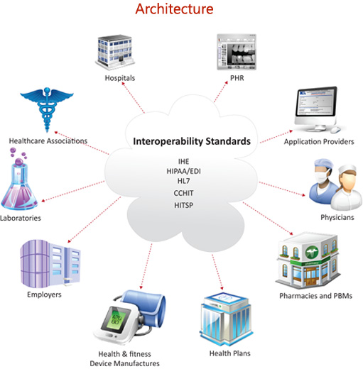
RxNorm in the Health Ecosystem
MTHSPL: HYDROCODONE BITARTRATE 2.5 mg in 5 mL / GUAIFENESIN 200 mg in 5 mL ORAL SOLUTION [OBREDON]
RxNorm:
Guaifenesin 40 MG/ML / Hydrocodone Bitartrate 0.5 MG/ML Oral Solution [Obredon]
RXCUI 1598284
GS: OBREDON 2.5mg-200mg/5mL Solution
MMSL: Obredon, 200 mg-2.5 mg/5 mL oral liquid

Slide 16
RxNorm Use Cases
e-Prescribing
Clinical Research
Aggregate and analyze prescription datasets
Research Data Management
Data management plans to make data FAIR:
Findable
Accessible
Interoperable
Reusable

Slide 17
Why should librarians care?
To better connect people and resources in a data driven world
Clinical Research
Inform researchers about RxNorm, associated tools, and where to get it.
Research Data Management (RDM)
Guide and influence researchers towards using standard vocabularies and terminologies in their RDM plans
???

Slide 18
RxNorm in Clinical Research
RxNorm allows population-based studies of prescription drugs.
Joe is taking an opioid.
Researchers want to know about the prescribing patterns in Joe’s county.
Prescription medications already coded with RxNorm can yield faster results.

Slide 19
RxNorm in Research Data Management
TEDDY Study
The Environmental Determinants of Diabetes in the Young
Epidemiologic study exploring genetic and environmental factors related to childhood diabetes in children (from birth to age 15) by collecting medication data.
Researchers decided to use RxNorm to code medications when developing the Research Data Management plan.

Slide 20
RxNorm Details
RxNorm is two things:
Standardized clinical drug terminology (i.e. naming system)
Curated collection of drug names (i.e. drug thesaurus)

Slide 21
RxNorm Details (continued)
Standardized clinical drug terminology (naming system)
ingredient + strength + dose form [+brand name]
RxNorm Concept Unique Identifier (RXCUI)
Guaifenesin 40 MG/ML / Hydrocodone Bitartrate 0.5 MG/ML Oral Solution [Obredon]; RXCUI 1598284
Guaifenesin 40 MG/ML / Hydrocodone Bitartrate 0.5 MG/ML Oral Solution; RXCUI 859383
“tradename_of” “has_tradename”

Slide 22
RxNorm Data Sources
2. Curated collection of drug information sources
SAB | Source Name | Source Restriction Level (SRL)
ATC | Anatomical Therapeutic Chemical Classification System | 0
CVX | Vaccines Administered | 0
DRUGBANK | DrugBank | 0
GS | Gold Standard Drug Database | 3
MDDB | Medi-Span Master Drug Data Base* | 3
MMSL | Multum MediSource Lexicon | 1
MMX | Micromedex RED BOOK | 3
MSH | Medical Subject Headings (MeSH) [subset] | 0
MTHCMSFRF | CMS Formulary Reference File [subset] | 0
MTHSPL | FDA Structured Product Labels | 0
NDDF | FDB MedKnowledge (formerly NDDF Plus) | 3
NDFRT | Veterans Health Administration National Drug File - Reference Terminology | 0
NDFRT_FDASPL | NDFRT FDASPL relationships | 0
NDFRT_FMTSME | NDFRT FMTSME relationships | 0
RXNORM | RxNorm normalized names and codes | 0
SNOMEDCT_US | US Edition of SNOMED CT [drug information subset]** | 9
USP | USP Compendial Nomenclature | 0
VANDF | Veterans Health Administration National Drug File | 0
*Medi-Span Master Drug Data Base (MDDB) has been removed from the RxNorm data until further notice starting with the October 2017 release.

Slide 23
Sample Drug Names from Data Sources
ranitidine 15 mg/mL oral syrup
RANITIDINE HCL 15 mg/mL ORAL SYRUP
RANITIDINE HCL 15 mg/mL ORAL SYRUP
RANITIDINE HCL@15 mg/mL@ORAL@SYRUP
Ranitidine HCl Syrup 15 MG/ML (75 MG/5ML)
Ranitidine Hydrochloride 15 MG/ML Oral Solution
Ranitidine Hydrochloride 15mg/1mL Oral solution
Ranitidine 15 MG/ML Oral Solution
RANITIDINE 15 MG ORAL SYRUP
RANITIDINE HYDROCHLORIDE 15 MG ORAL SYRUP
RANITIDINE HYDROCHLORIDE 16.8 MG ORAL SYRUP
RANITIDINE HYDROCHLORIDE 75 MG ORAL SOLUTION
RANITIDINE HYDROCHLORIDE 15 mg in 1 mL ORAL SYRUP
RANITIDINE HYDROCHLORIDE 15 MG ORAL SYRUP
Ranitidine 15 mg in 1 mL ORAL SOLUTION
RANITIDINE 15 MG ORAL SOLUTION
RANITIDINE HYDROCHLORIDE 16.8 MG ORAL SOLUTION
RxNorm Normalized Name: Ranitidine 15 MG/ML Oral Solution
RxNorm Concept Unique Identifier (RXCUI) = 705610

Slide 24
Sample National Drug Codes (NDCs) from Data Sources
049856-0351-*1
55111060216
50962-0203-60
55111-0602-16
121472710
050962-*203-60
173038354
68094031658
000121-0727-16
000121-4727-10
603941854
050383-*051-04
050962-*203-59
55648069401
472038316
051660-*851-16
49884-0396-33
68094-0316-58
RxNorm Normalized Name: Ranitidine 15 MG/ML Oral Solution
RxNorm Concept Unique Identifier (RXCUI)= 705610

Slide 25
RxNorm is a Set of Data Files in Text Format: https://www.nlm.nih.gov/research/umls/rxnorm/docs/rxnormfiles.html
Main Content
Data History
RXNCONSO
Drug Names
RXCUI
RXNREL
Relationships
RXCUI
RXNSAT
Attributes
NDC
RXNCUI
VER_START
VER_END
RXNCUICHANGES
OLD_RXCUI
NEW_RXCUI
RXNATOMARCHIVE
RXCUI
ARCHIVE_TIMESTAMP
Metadata
RXNSAB
Source Information
RXNDOC
Data Type Explanations
RXNSTY
Semantic Types

Slide 26
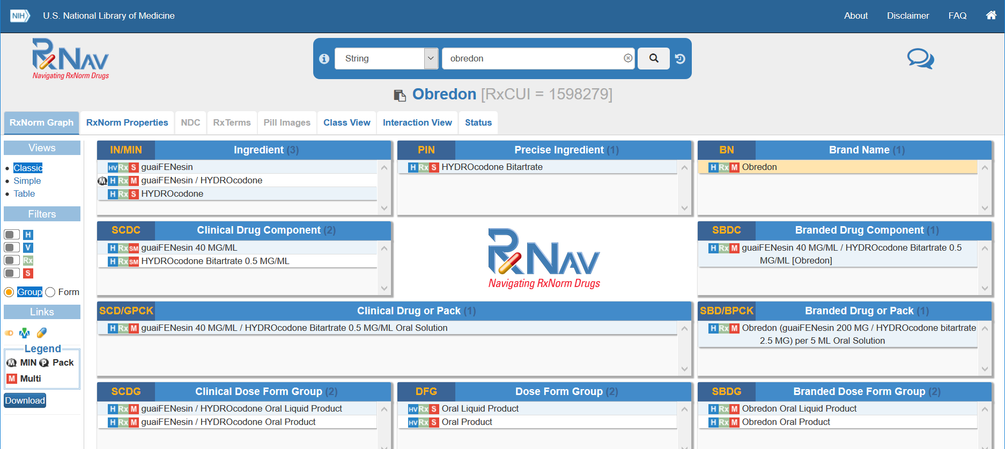
Accessing RxNorm Data
RxNorm Files Download page (UMLS License might be required).
RxNorm-related Application Programming Interfaces (APIs)
allows web-based access using pre-installed queries
RxNorm web-based browser (RxNav): https://rxnav.nlm.nih.gov/

Slide 27
You now know:
A medical terminology is:
A set of specialized terms used in health care that facilitate precise communication by minimizing ambiguity
Contains a computer readable code and a human readable name along with synonyms
2. RxNorm is:
A standardized drug terminology derived from various sources
3. I should care about RxNorm because:
Used in clinical research and research data management

Slide 28
You now know (continued):
4. RxNorm is used in:
Electronic systems to store and transmit drug data and to analyze drug data sets
5. Groups who use RxNorm include:
Clinicians, pharmacies, hospitals, insurance companies, IT developers, researchers
6. RxNorm can be accessed using:
RxNav, APIs, database query

Slide 29
RxNorm Resources
RxNorm Home Page: https://www.nlm.nih.gov/research/umls/rxnorm/index.html
RxNav and API Landing Page:
https://rxnav.nlm.nih.gov/
RxNorm Download Files Page: https://www.nlm.nih.gov/research/umls/rxnorm/docs/rxnormfiles.html

Slide 30
References
Zhong W, Maradit-Kremers H, St Sauver JL, Yawn BP, et al. Age and sex patterns of drug prescribing in a defined American Population. Mayo Clin Proc. 2013 Jul;88(7):697-707. doi: 10.1016/j.mayocp.2013.04.021. PubMed PMID: 23790544.
Richesson RL, Smith SB, Malloy J, Krischer JP. Achieving standardized medication data in clinical research studies: two approaches and applications for implementing RxNorm. J Med Syst. 2010 Aug;34(4):651-7. doi: 10.1007/s10916-009-9278-5. PubMed PMID: 20703919.
Lerner, Barron H. “A Case That Shook Medicine; How One Man's Rage Over His Daughter's Death Sped Reform of Doctor Training.” The Washington Post, 2006 Nov 6. www.washingtonpost.com/wp-dyn/content/article/2006/11/24/AR2006112400985.html.
RxNorm Overview. U.S. National Library of Medicine, National Institutes of Health, 2018 Sept 4. www.nlm.nih.gov/research/umls/rxnorm/overview.html.
McLaughlin, P. NLM Resources & Electronic Health Records: MedlinePlus Connect, RxNorm and UMLS [Webinar]. U.S. National Library of Medicine, National Institutes of Health. 2014 May 18. https://www.nlm.nih.gov/bsd/videos/p90p11467vj-2.mp4
Nelson, SJ. RxNorm: An Update [Webinar]. 2013 Dec 6. U.S. National Library of Medicine, National Institutes of Health. https://www.nlm.nih.gov/bsd/videos/p39513263-2.mp4
Grossman, JM, Boukus, ER, Cross, DA, Cohen, GR. Physician Practices, E-Prescribing and Accessing Information to Improve Prescribing Decisions. HSC Research Brief No. 20. 2011 May. http://www.hschange.org/CONTENT/1202/

Slide 31
Thank you!
Mike Davidson, MLS
In Hye Cho, MS
National Library of Medicine
National Institutes of Health
U.S. Department of Health & Human Services

