Slide 1
Clinical Information, Librarians and the NLM:
From Health Data Standards to Better Health

Slide 2
Introduction to the Unified Medical Language System (UMLS)
David Anderson, MLS
david.anderson@nih.gov
National Library of Medicine
National Institutes of Health
U.S. Department of Health & Human Services
Notes:
Thank you for the introduction, and thank you all for joining us for today’s session: Introduction to the Unified Medical Language System. My name is David Anderson. I am a librarian at the National Library of Medicine.

Slide 3
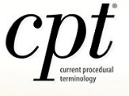
Some terminology problems for biomedical researchers:
There are many biomedical terminologies in use.
Terminologies come in a variety of formats and a variety of data models.
Terminologies do not necessarily link to each other.
Terminologies are not always freely available.
Notes:
I want to start by identifying some problems that a biomedical researcher might encounter with regard to terminology. I’ll ask you to imagine that you are studying a set of patient records from an electronic health record system. These patient records might include information about diagnoses, drugs prescribed, lab tests, procedures, and billing information, as well as free-text notes recorded by health professionals. How do you wrangle all of that information so that you can meaningfully analyze it. Standard terminologies provide the backbone for health systems by acting as a standard language for information exchange.
But there are many biomedical terminologies in use in different contexts. A few are displayed in this slide. There is no one unifying terminology for biomedicine. There are good reasons for this, but the sheer number of terminologies presents some challenges.
Terminologies come in a variety of formats and a variety of data models. They are curated by various organizations for various purposes. It can be challenging to understand how each terminology is organized, because they are all different.
Terminologies do not necessarily link to each other. You might have two different datasets that are annotated with different terminologies, and you need to link them together. Sometimes those links are not available, so where do you start?
Finally, terminologies are not always freely available. Imagine you need to look up some identifiers or codes from a terminology for your research project, only to find that there is no easily accessible version of that terminology for you to reference.

Slide 4
Solution: Unify the medical language in one system.
The National Library of Medicine has accomplished this with the Unified Medical Language System (UMLS), which provides:
Access to Terminology Data
A Common Data Model for Terminologies
Interoperability through Synonymy
Notes:
One solution is to unify the medical language in one system. The National Library of Medicine designed the Unified Medical Language System, or UMLS, to contend with these and other terminology problems. The UMLS provides access to terminology data, a common data model for terminologies, and interoperability through synonymy. I’ll return to these themes throughout this talk.

Slide 5
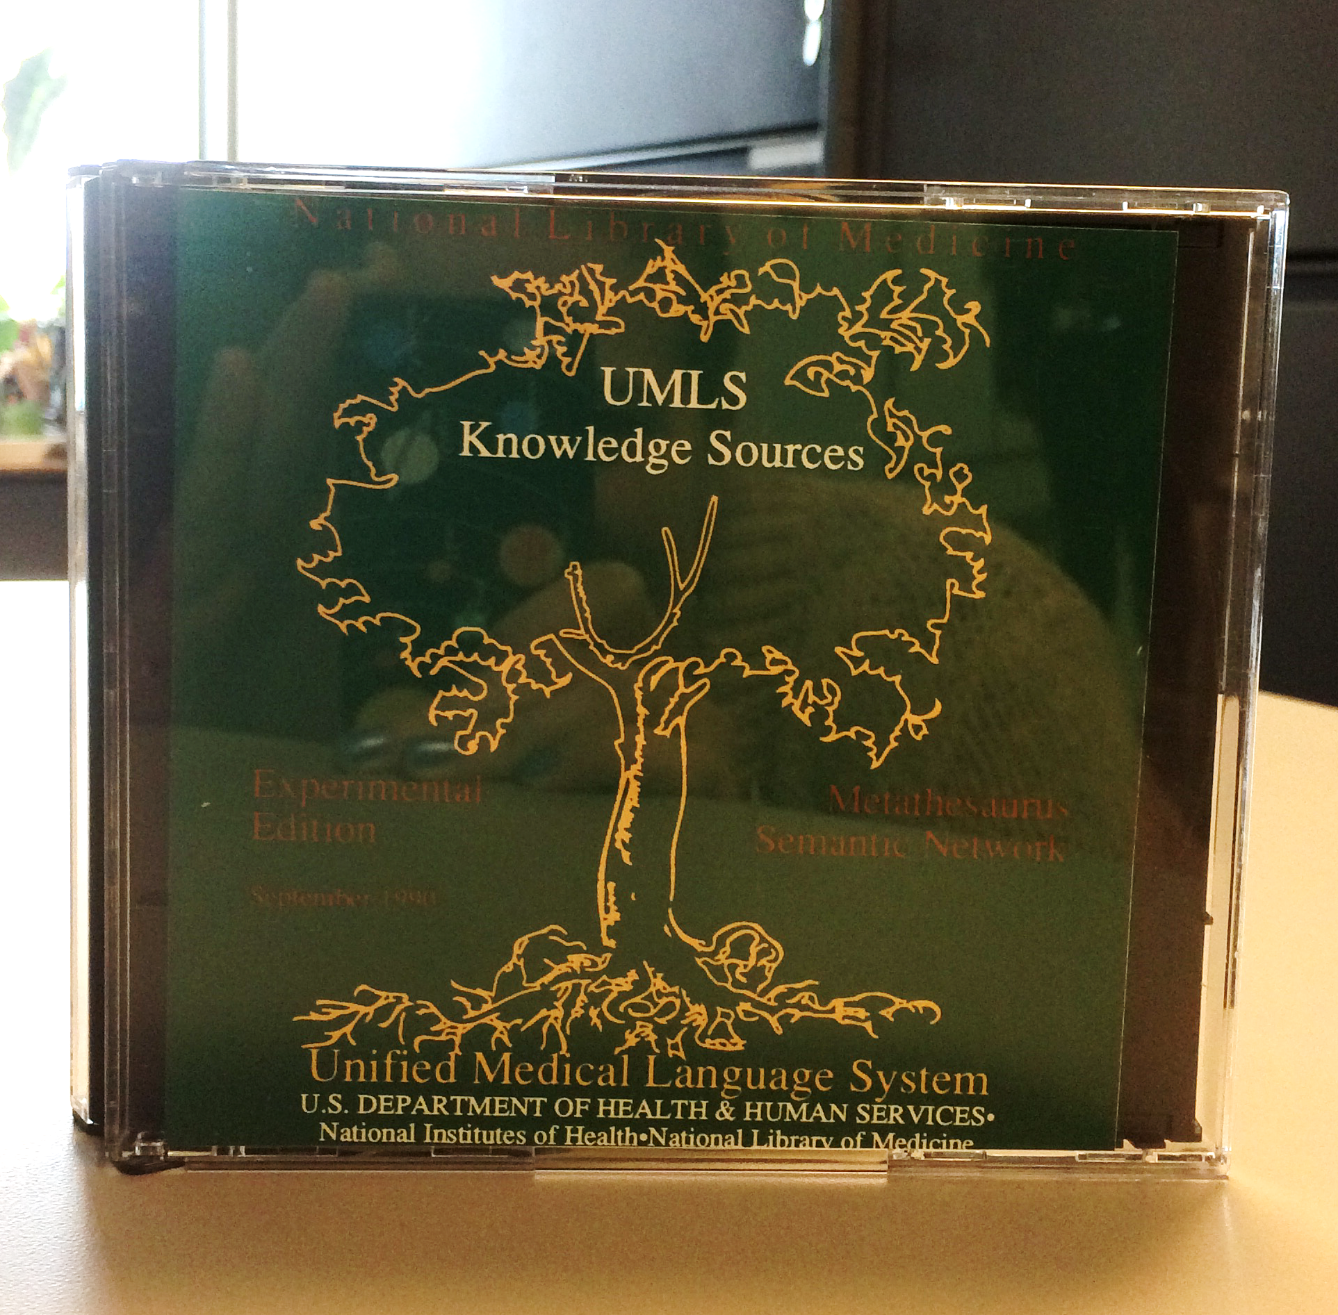
What is the UMLS?
Unified
Medical
Language
System
Notes:
So what is the UMLS? It is a set of files and software that brings together many biomedical terminologies and standards to enable interoperability between computer systems. The UMLS brings some amount of order to the very complex body of medical language. By medical language, I mean names of drugs, disorders, procedures, anatomical parts, organisms, and many more. The UMLS takes biomedical terminologies and integrates them into one system. The National Library of Medicine has been producing this system since 1990, when we first released the UMLS to the public on CD-ROM.

Slide 6
The UMLS provides:
Access to Terminology Data
A Common Data Model for Terminologies
Interoperability through Synonymy
Notes:
If you remember only a few things from this talk, remember these big ideas. The UMLS provides: Access to Terminology Data. A Common Data Model for Terminologies. And Interoperability through Synonymy. These ideas represent major contributions that NLM has made to the terminology world over the past few decades via the UMLS.

Slide 7
What is a medical terminology?
A set of specialized terms that facilitate precise communication by minimizing or eliminating ambiguity.
Features of a terminology
Unique Identifier (often a code)
Official Name
Synonyms (in many cases)
Examples:
CPT, ICD-10, SNOMED-CT, LOINC, RxNorm
Notes:
First let’s review a little bit what we mean by terminology. What is a medical terminology? It is a set of specialized terms that facilitate precise communication by minimizing or eliminating ambiguity. Think of a terminology as a set of names and concepts and the relationships between those names and concepts. Terminologies feature unique identifiers, which are often known as codes. They often have official names for concepts as well as synonyms, which are useful in cases where a single biomedical concept is referred to in different ways. Some examples of medical terminologies are CPT, ICD-10, SNOMED-CT, LOINC, RxNorm. There are also many different ways of referring to terminologies themselves. Sometimes they are called terminologies. Sometimes vocabularies. Sometimes ontologies, taxonomies, or code systems. These are all variations of the same thing. In this talk, I will stick with the word terminology, though you may see other descriptors for terminologies elsewhere, including in the UMLS documentation itself.

Slide 8
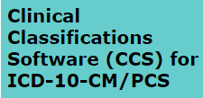
UMLS Terminologies
Snow
IS A
Natural Form of Water
Notes:
There are many different terminologies. The UMLS integrates over 200 biomedical terminologies in 25 different languages, mostly English. The terminologies in the UMLS are used for a variety of purposes – some are very general, like Medical Subject Headings, which is a subject terminology for the biomedical literature, or SNOMED CT, which is a broad, standard terminology for clinical systems. Others are more specific – RxNorm focuses on drugs. LOINC focuses on lab tests. CPT focuses on procedures for billing. Others cover anatomy, phenotypes, gene annotations, and many other areas. Some terminologies are used in specific subdomains of medicine like nursing, dentistry, oncology, or veterinary care. Some are standard terminologies developed for production systems and required by government regulation. Others are developed solely for research purposes. The point is – the UMLS includes terminologies that cover a wide range of topics in biomedicine, and they are curated and published by a variety of different organizations, both public and private, for a variety of purposes.

Slide 9
Why do we need medical terminologies?
Sharing information is hard!
Meaning and context can be lost.
The same word can mean different things.
Different words can mean the same thing.
In a medical context, communicating clearly is critically important.
Notes:
So why do we need them? Sharing information is hard. Meaning and context can be lost when data is transmitted from one system to another – for instance – between a hospital and a pharmacy. The same word can mean different things in different contexts. Different words can mean the same thing. In the medical context, communicating clearly is critically important, because of what’s at stake – people’s health and their lives. Terminologies provide a standard language for information exchange.

Slide 10
The UMLS provides:
Access to Terminology Data
A Common Data Model for Terminologies
Interoperability through Synonymy
Notes:
Let’s talk about how the UMLS provides access to terminology data.

Slide 11
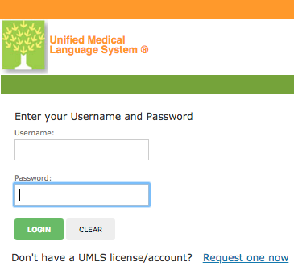
Access to Data
Problem: Terminology data is not always freely available.
Solution: NLM has negotiated the right to redistribute terminologies via UMLS for use in research. Users must sign up for a free account and agree to terms of the UMLS Metathesaurus License.
Learn more: https://uts.nlm.nih.gov/license.html
Notes:
The problem: Terminology data is not always freely available. Some terminologies are free to download on the web. Medical Subject Headings, for instance. Others are not available freely on the web, and in some cases are licensed for a fee. This makes it challenging for researchers to gather all of the terminology data that they might need for a particular project. As a solution, NLM has negotiated the rights to redistribute many terminologies via the UMLS for use in research. Users must sign up for a free account and agree to the terms of the UMLS Metathesaurus License. This license stipulates what can and cannot be done with individual terminologies in the UMLS. Some terminologies, such as those produced by the U.S. government have very few restrictions on their use. Others are restricted to research use only. Anyone can sign up for an account, including you. The account gives you access to the UMLS, as well as RxNorm, SNOMED CT, the Value Set Authority Center, and other NLM data and applications. Once you sign up for an account, you can use UMLS. There are three main ways to use the UMLS.

Slide 12
Three Ways to Access UMLS
Download
Web Interface
REST API
Notes:
There are three main ways to access the UMLS. Most users download the UMLS and use it locally in their own environment. There’s also a web interface and a REST API for machines to interface remotely with the UMLS.

Slide 13
UMLS Data Three Knowledge Sources
Metathesaurus (30GB)
14 million Names
209 Terminologies
25 Languages
3.8 Million Concepts
78 Million Relationships
Semantic Network (575KB)
127 Semantic Types
SPECIALIST Lexicon (1.5 GB)
500K lexical records
Notes:
I’m not going to demonstrate the UMLS in the presentation. The data is too complex to cover in the time allotted. But I do want to give you a sense of what you get when you download the UMLS. The UMLS download includes several gigabytes of data as well as some tools to help you use that data. The UMLS Metathesaurus is the primary data component of the UMLS. I want you to picture in your mind a list of 14 million names. These names come from 209 different source terminologies in 25 different languages grouped into 3.8 million concepts. In addition to the names, there are 78 million relationships both hierarchical (picture a taxonomy) and non-hierarchical. There are also definitions and other attributes as well as word indexes and other information.
Complementing the Metathesaurus is the Semantic Network. The Semantic Network is a classification scheme for the UMLS concepts. It includes 127 broad classes called Semantic Types and every UMLS Concept gets at least one Semantic Type.
Finally, there is the SPECIALIST Lexicon, which includes over 500 thousand lexical records that are useful in handling the lexical variation that occurs in natural language. When you download the UMLS, this is the data that you get.

Slide 14
UMLS Tools
Included in the UMLS Download:
MetamorphoSys – for subsetting the UMLS
Database Load Scripts – for loading UMLS into relational databases
A Local Browser Application – for browsing your UMLS subset locally
Lexical Tools – for normalizing strings, generating word indexes, generating lexical variants and more
Notes:
In addition to terminology data you also get tools. These help in configuring the UMLS, loading the data into relational databases and browsing the data locally on your machine. By providing access to terminologies and providing tools to use them, we make it easier for researchers and application developers to do their work.

Slide 15
The UMLS provides:
Access to Terminology Data
A Common Data Model for Terminologies
Interoperability through Synonymy
Notes:
Next, let’s talk about how UMLS provides a common data model for terminologies.

Slide 16
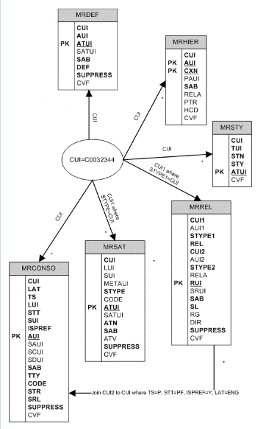
A Common Data Model
Problem: Terminology data is represented in a variety of formats according to a variety of data models.
Solution: The UMLS represents all terminology data according to a standard data model.
Notes:
The problem: Terminology data is represented in a variety of formats according to a variety of data models. If I want to use multiple terminologies in my information system, I have to first understand each one in order to implement properly.
UMLS does the work for me by representing terminologies according to a standard data model. Just to give you an example of how that works, I mentioned that there are 14 million names in the UMLS. All of those names and their identifiers and their source terminologies are presented in one table in the UMLS. If I want to use names and identifiers from various terminologies in my application, the UMLS provides them all in one file. Similarly, hierarchical and other relationships that are asserted in the UMLS source terminologies are presented in a single table according to a single model. This is incredibly convenient, because as an implementer, I do not have to do any modeling work. I can go ahead and use the data because every terminology is represented in the same manner.

Slide 17
Case Study: Cleveland Clinic
Problem: How do you make patient data ready for researchers to discover and use?
Solution: Integrate identifiers, hierarchies, and relationships from UMLS.
Milinovich A, Kattan MW. Extracting and utilizing electronic health data from Epic for research. Ann Transl Med. 2018;6(3):42. https://www.ncbi.nlm.nih.gov/pmc/articles/PMC5879514/
Notes:
Let’s take a look at an example of a UMLS implementation at the Cleveland Clinic as described in a manuscript published in 2018. The problem: how do you make patient data ready for researchers to discover and use? The Cleveland Clinic built a research-ready database that integrates identifiers, hierarchies and relationships from the UMLS.

Slide 18
Case Study: Cleveland Clinic
Cleveland Clinic converts electronic health record data from 185 tables to 18 research-ready tables annotated with UMLS identifiers. Data is updated on a weekly basis.
Result: “Cleveland Clinic can do live population exploration as well as produce datasets for analysis faster than it takes most organizations to simply identify their base population.”
Milinovich A, Kattan MW. Extracting and utilizing electronic health data from Epic for research. Ann Transl Med. 2018;6(3):42. https://www.ncbi.nlm.nih.gov/pmc/articles/PMC5879514/
Notes:
An electronic health record system is meant for handling all of the data that must be managed by a healthcare provider. They are not really designed for researchers to use. The Cleveland Clinic converts electronic health record data from 185 tables in an EHR to 18 research-ready tables annotated with UMLS identifiers. They update this data on a weekly basis.
The result, and I’m going to quote the claims from the manuscript here, is that “Cleveland Clinic can do live population exploration as well as produce datasets for analysis faster than it takes most organizations to simply identify their base population.”
“By mapping as many variables as possible to UMLS identifiers, a simplified data structure can be implemented to store and query the EHR data. Because the UMLS combines many disparate medical vocabularies […], queries become simpler yet more robust with the UMLS’s inclusion of relationships, hierarchies, and synonyms...”
“Simplifying the data structure into UMLS identifiers saves thousands of hours in defining populations and extracting normalized data sets for analysis.”

Slide 19
Identifying Patient Populations Diabetic patients on a GLP-1 medication with an HbA1c >10
2,666 different “diabetic” diagnoses
Get all descendants of:
Diabetes Mellitus (UMLS CUI: C0011847)
Acidosis due to type 1 diabetes mellitus
Acidosis due to type 2 diabetes mellitus
Acute complication with diabetes mellitus
Diabetic dyslipidemia associated with type 2 diabetes mellitus
Diabetic hyperosmolar non-ketotic state
Diabetic lumbosacral radiculoplexus neuropathy
Diabetic mastopathy
Diabetic severe hyperglycemia
Disorder of nerve co-occurrent and due to type 1 diabetes mellitus
Dyslipidemia due to type 1 diabetes mellitus
Hyperglycemia due to type 1 diabetes mellitus
Hyperglycemia due to type 2 diabetes mellitus
Hyperglycemic crisis in diabetes mellitus
Hyperlipidemia due to type 1 diabetes mellitus
Hyperlipidemia due to type 2 diabetes mellitus
Hyperosmolality due to uncontrolled type 1 diabetes mellitus
Hyperosmolar coma associated with diabetes mellitus
Hyperosmolarity co-occurrent and due to drug induced diabetes mellitus
Hypoglycemia due to type 1 diabetes mellitus
Hypoglycemia due to type 2 diabetes mellitus
Hypoglycemic coma in diabetes mellitus
Hypoglycemic state in diabetes
Ketoacidosis due to secondary diabetes mellitus
Lactic acidosis with diabetes mellitus
Malnutrition-related diabetes mellitus with multiple complications
Metabolic acidosis with diabetes mellitus
Mixed hyperlipidemia due to type 1 diabetes mellitus
Mixed hyperlipidemia due to type 2 diabetes mellitus
Multiple complications due to diabetes mellitus
Peripheral neuropathy due to type 1 diabetes mellitus
Radiculoplexoneuropathy due to diabetes mellitus
Type 1 diabetes mellitus with hyperosmolar coma
Type 2 diabetes mellitus with hyperosmolar coma
Diabetic acute painful polyneuropathy
Coma associated with malnutrition-related diabetes mellitus
Diabetic coma with ketoacidosis
Hyperosmolar coma associated with diabetes mellitus
Hypoglycemic coma co-occurrent and due to diabetes mellitus type II
ETC
Notes:
So how is this applied in the Cleveland Clinic’s research database? Imagine you want to study some patient records. You don’t want to study all of them. You want to identify a patient population. In this example from the manuscript, we’re identifying Diabetic patients on a GLP-1 medication with an HbA1c (that’s a blood test) of greater than 10. How do you isolate just those patients?
Turns out there are many different very specific diagnoses related to Diabetes Mellitus. Ultimately, it comes to over 26 hundred specific ways to code Diabetes. Fortunately, in the UMLS, there is a concept for Diabetes Mellitus, and because we aggregate hierarchies from multiple terminologies, it is possible to specify that concept and get a list of diagnoses that fall under or are descendants of that concept. Here’s just a sampling of terms from ICD9CM, ICD10CM and SNOMED CT that express the variety of ways in which diabetes mellitus can be described and qualified in standard terminologies. So using one UMLS concept, we have identified any patient diagnosed with some form of diabetes mellitus.

Slide 20
Identifying Patient Populations Diabetic patients on a GLP-1 medication with an HbA1c >10
69 different GLP-1 medications
Get all medications associated with a drug class:
Glucagon-like Peptide-1 (GLP-1) Agonists [MoA] (UMLS CUI: C2916791)
15 different HbA1c lab tests
Map lab tests in EHR to:
Hemoglobin A1c/Hemoglobin.total:Mass Fraction:Point in time:Whole blood:Quantitative (UMLS CUI: C0366781)
Notes:
We can do the same for medications and lab tests. GLP-1 is a class of drugs identified in a terminology called MED-RT, and there is a corresponding UMLS concept. Again, because of the relationships aggregated in the UMLS, it is possible to identify 69 different medications associated with that drug class.
Finally, there is a UMLS concept for an HbA1c lab test. And by specifying that concept, the system can identify 15 different lab tests from the Cleveland Clinic’s EHR system.

Slide 21
Identifying Patient Populations Diabetic patients on a GLP-1 medication with an HbA1c >10
2,666 different “diabetic” diagnoses
69 different GLP-1 medications
15 different HbA1c lab tests
1 patient population
Notes:
By specifying three values from the UMLS, we’ve quickly identified patients with 26 hundred different diagnoses, 69 different medications prescribed, and a score of greater than 10 on 15 different lab tests. Now, that patient data can be isolated and studied.
Hopefully that gives you a sense for how a common data model for terminologies might provide value for researchers who want to study data that includes multiple terminologies. This is an example of where UMLS was implemented on a large scale in a production system. Most users of the UMLS are implementing it on a smaller scale for research and development projects, but they get the same benefit of a common data model for terminologies.

Slide 22
The UMLS provides:
Access to Terminology Data
A Common Data Model for Terminologies
Interoperability through Synonymy
Notes:
For the final takeaway, I want to talk about how the UMLS provides interoperability through synonymy. I mention this last not because it’s the least important, but because if you remember anything from this talk, I want you to remember synonymy.

Slide 23
Interoperability through Synonymy
Problem: Terminologies are not always linked to each other.
Solution: UMLS asserts synonymy by grouping names from different terminologies into concepts. This can be used as a starting point for crosswalking from one terminology to another.
Notes:
Problem: Terminologies are not always linked together.
The solution: UMLS asserts synonymy by grouping names from different terminologies into concepts, or units of meaning. This can be used as a starting point for crosswalking from one terminology to another. This is one of the key features of the UMLS, and I have been hinting at it throughout this talk. Every name in the UMLS is grouped with its synonyms. This grouping is known as a UMLS Concept, and each Concept gets a unique identifier that we assign. NLM asserts synonymy between names from different terminologies through a combination of algorithms and human editing.

Slide 24
A UMLS Concept: Addison Disease
Name
Addison Disease
Addison’s disease
Addison’s Disease
Primary adrenal insufficiency
Primary adrenocortical insufficiency
Insufficiency, Primary Adrenocortical
Primary adrenocortical insufficiency (disorder)
Primary hypoadrenalism
Primary hypoadrenalism
Enfermedad de Addison
Source Terminology
MeSH
ICD-10-CM
MeSH
MedDRA
ICD-10-CM
MeSH
SNOMED CT
MedDRA
SNOMED CT
MeSH Spanish
Code
D000224
E27.1
D000224
S2164152
E27.1
D000224
373662000
S0718109
373662000
D000224
Atom Identifier
A6954527
A17799651
A26597849
A2018590
A17786892
A6970512
A3644299
A25720215
A3060485
A9175691
Concept Identifier
C0001403
C0001403
C0001403
C0001403
C0001403
C0001403
C0001403
C0001403
C0001403
C0001403
Notes:
I want to give you an idea what the UMLS data looks like. Let’s look at a specific UMLS Concept for Addison Disease. As I mentioned, the UMLS groups biomedical names into units of meaning or concepts. Here are some names used to refer to Addison Disease. You can see here the kind of variation that exists.
Each of these comes from a UMLS Source Terminology. I’ve selected terms from MeSH, ICD-10-CM, MedDRA, SNOMED CT and the Spanish translation of MeSH.
Each name has a code assigned by its source terminology. These are identifiers that are used in real-world systems. For example, you’ll find SNOMED CT codes in a clinical system. You’ll find MeSH Descriptor codes in PubMed.
This data comes from the main UMLS Metathesaurus table, which has 14 million rows, one for each of 14 million names. Each unique string from a unique source with a unique code is called an “atom,” and each gets a unique identifier.
Finally all of these names or atoms are considered synonyms in the UMLS, and they are given the same Concept Unique Identifier. This is how we link names and codes from different terminologies together in the UMLS.

Slide 25
Synonymy Applied
Crosswalking between Terminologies
Identifying Meaning in Text
Search and Retrieval
Notes:
How is this applied? I mentioned crosswalking from one terminology to another. Say you have a set of data that is annotated with one terminology, and but you need it to be annotated with another terminology for whatever reason. UMLS can provide the link to be able to do that. I do want to note that synonymy can be subjective. Synonymy as its represented in the UMLS may not always be valid in your specific context. That’s why we say that UMLS is a starting point for crosswalking between terminologies. Some additional review may be required. Even so, this is a common use for the UMLS. Another use is identifying meaning in text.

Slide 26
Identifying Meaning in Text (Natural Language Processing)
Problem: Medical data in the real world is often unstructured. Examples: clinical notes or the biomedical literature / abstracts.
Solution: The UMLS can help identify meaning in text in combination with various tools.
Notes:
The problem: Medical data in the real world is often unstructured. For example, clinical notes. A doctor might type up or dictate notes about a patient encounter. A radiologist might write up a report on MRI imaging for the doctor who requested the MRI. Or a psychiatrist might write up a discharge summary for a patient who is being discharged. All of this generates a lot of data that can be studied and analyzed. In addition to clinical notes, we can also study the contents of biomedical research databases, including literature abstracts and full text.
One of the ways that can be done is to use the UMLS to identify meaning in text in combination with various tools. The synonymy in the UMLS allows it to link words in text to UMLS concepts and by extension codes in standard terminologies.

Slide 27
Why Identify Meaning in Text?
Improve search and retrieval by annotating records in a research database
Find co-occurrences of concepts in text
Annotate clinical text on the fly
Identify a patient population
Notes:
So why identify meaning in text? One reason is to improve search and retrieval by annotating records in a research database. Identifying co-occurrences of concepts in text can help in formulating research hypotheses. Clinical notes like the ones described earlier can be processed on the fly in order to improve clinical documentation or provide coding suggestions. Finally, going back to our Cleveland Clinic example, it might be helpful to process text in order to help identify a patient population. The idea is to provide some structure to data that was previously unstructured.

Slide 28
Text Processing Tools
NLM Tools
MetaMap – A tool for recognizing UMLS concepts in text
Medical Text Indexer – A tool for automated indexing of the biomedical literature
MeSH on Demand – Uses the Medical Text Indexer to extract MeSH terms via UMLS Concepts.
SemRep – A tool for extracting assertions from sentences in biomedical text
Third-Party Tools that include UMLS
Apache cTakes – “…a natural language processing system for extraction of information from electronic medical record clinical free-text… Originally developed by the Mayo Clinic…”
CLAMP (Clinical Language Annotation, Modeling, and Processing Toolkit) – “…a comprehensive clinical Natural Language Processing (NLP) software that enables recognition and automatic encoding of clinical information in narrative patient reports.” (University of Texas Health Science Center at Houston)
And many many more.
Notes:
So how do we do this with UMLS? UMLS can be combined with tools that help with the processing of text. If you look at the biomedical literature, you will see some of these tools mentioned. MetaMap is an NLM tool for recognizing UMLS concepts in text. The Medical Text Indexer is a tool for automated indexing of the biomedical literature. MeSH on Demand uses the Medical Text Indexer to extract MeSH terms via UMLS Concepts. SemRep is a tool for extracting more complex assertions from text – for example – detecting if one condition complicates another.
There are also many third-party tools that have been developed for use with the UMLS. Apache cTakes and CLAMP are used to analyze clinical free-text, and they package subsets of the UMLS, which acts as a knowledge base for these tools.

Slide 29
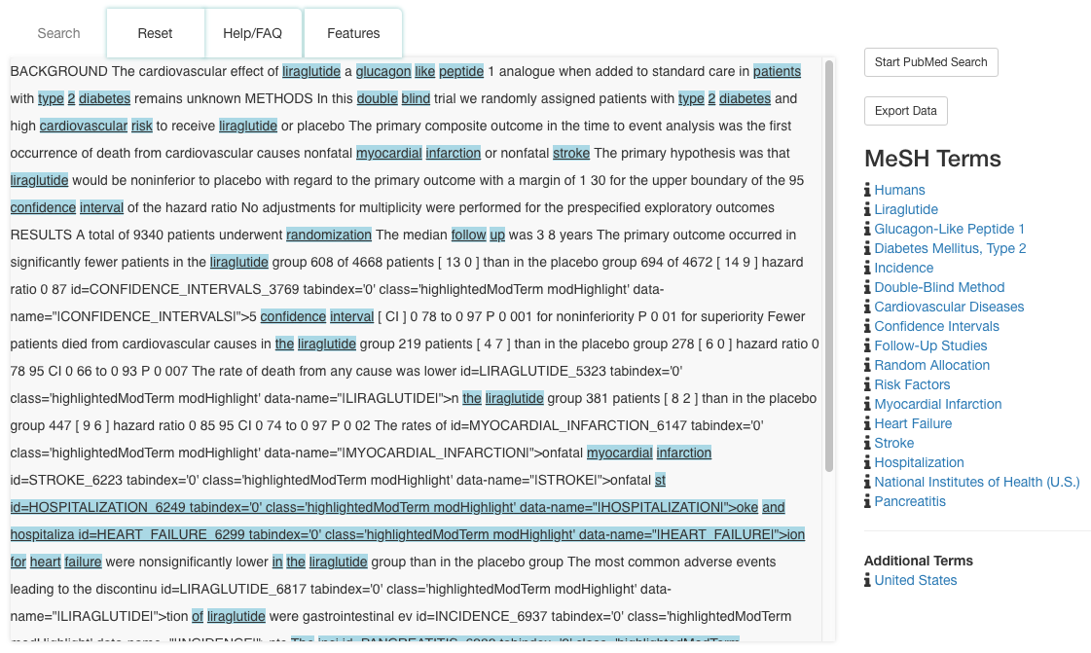
NLM MeSH on Demand
https://meshb.nlm.nih.gov/MeSHonDemand
Notes:
For a basic example of how you can identify meaning in text, let’s look at the NLM’s MeSH on Demand. This application looks at some text and finds subject terms via UMLS Concepts. Here we have an abstract from a highly-cited paper on Type 2 Diabetes. If we input that text into MeSH on Demand, it will output a set of MeSH terms that are mentioned in that text. Then it provides some options for searching PubMed.

Slide 30
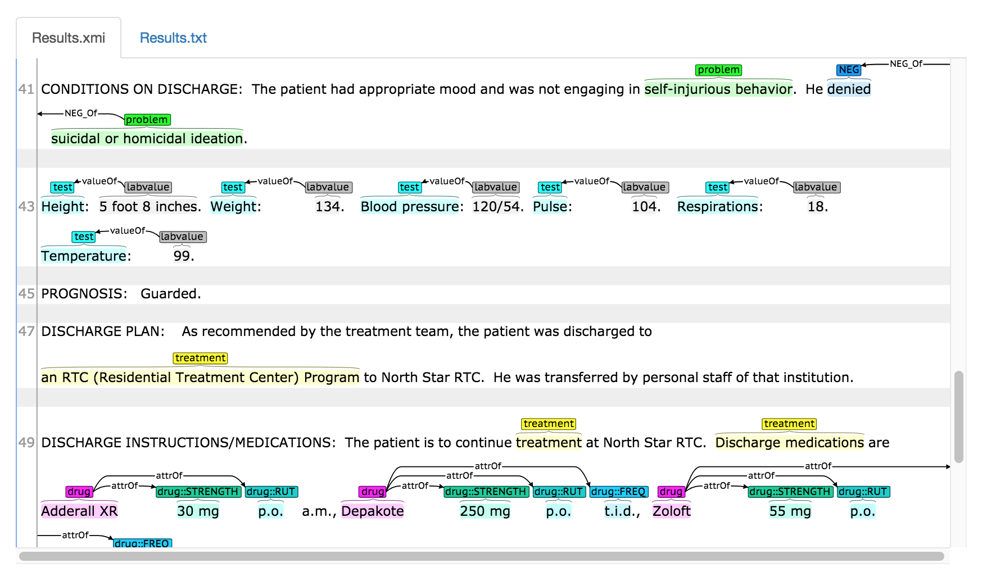
CLAMP
(Clinical Language Annotation, Modeling, and Processing Toolkit)
https://clamp.uth.edu/clampdemo.php
Notes:
Let’s look at one of the third-party tools. This is CLAMP: Clinical Language Annotation, Modeling and Processing Toolkit. And I want to show this one because it has a nice color-coded demo.
This is a psychiatric discharge summary for a patient with mood swings and oppositional defiant disorder. You can see that this mostly unstructured text. If you run the demo, we a get a nice color-coded summary that has classified the text in terms of problems, treatments, tests, drugs prescribed. Behind the scenes, it also identifies a UMLS Concept. This application detects some more complex ideas. For instance, it can detect a drug, its strength, and other attributes of the medication. You could imagine running this application on thousands of psychiatric discharge summaries in order to identify patterns in a set of documents.

Slide 31
The UMLS provides:
Access to Terminology Data
A Common Data Model for Terminologies
Interoperability through Synonymy
Notes:
Your homework is to remember these takeaways, and if anyone asks you about the UMLS, here are a few things you can tell them. The UMLS provides access to terminology data, a common data model for terminologies, and interoperability through synonymy. Users of the UMLS take advantage of these features in a wide variety of ways, and there are a few different kinds of users.

Slide 32
Who Uses the UMLS?
Top 10 Organizations Downloading UMLS:
Researchers
Health Application Developers
Health Service Providers
Educators
Notes:
Who uses the UMLS? We’ve been updating the UMLS for 29 years now. Even so, for the past few years, the number of downloads and the number of users of our interfaces have increased significantly. Most users fall into these main categories. Researchers are the primary user of the UMLS. Researchers focus on a few different areas. They might work to further the field of natural language processing and machine learning by developing tools and algorithms that can be used and reused in the analysis of health data. They might use those tools and algorithms in conjunction with UMLS to test hypotheses by processing patient records and insurance claims data. Researchers also study terminologies themselves in order to improve them.
Health Application Developers include developers of large electronic health record systems used by hospitals as well as developers of research databases, terminology services, and other specialized applications in the healthcare space. These applications might support clinical care, provide access to electronic health record data for research purposes, enable searching of the biomedical literature or other records, or target specific problems in the healthcare space.
Health Service Providers include hospitals and other healthcare providers, and they are typical users of the applications I just mentioned. They may rely on UMLS for displaying terms in their systems, performing complex queries, improving clinical documentation, automated coding suggestions, clinical decision support, and reporting information to registries and regulatory agencies.
Educators use UMLS as a teaching tool for natural language processing and medical terminology courses.
Not all users fall neatly into these categories. Other users of the UMLS include terminology publishers, pharmaceutical companies, insurance companies, regulatory agencies and standards organizations.

Slide 33
Use Examples
Clinical Systems:
Clinical documentation improvement products
An EHR virtual assistant and transcriptionist for doctors
Automated clinical coding systems
Clinical Research
Linking pharmacovigilance sources with clinical data
Identifying the presence of metastatic disease in radiology reports
Using AI techniques to match patients to clinical trials
Research Databases
A platform for visualizing research trends over time
Annotating a tissue research database
A commercial toolkit for classifying content in biomedical databases
Translation
PanLex, “the world’s largest translation database”
A translation tool for Brazilian Portuguese electronic health records
Automated enrichment of French biomedical ontologies
Notes:
It’s difficult to express the variety of uses of the UMLS. This presentation really only scratches the surface, so I wanted to share some more interesting recent implementations from the UMLS to give you a sense of the variety of scenarios where UMLS can play a role.
UMLS is implemented in clinical systems. Some examples include clinical documentation improvement products, an EHR virtual assistant and transcriptionist for doctors, and automated clinical coding systems.
UMLS is often used for clinical research. UMLS has been used for linking pharmacovigilance sources to clinical data. For identifying metastatic disease in radiology reports. One startup is using AI techniques to match patients to clinical trials.
It’s implemented in research databases to help with search and retrieval. One startup is building a platform for visualizing research trends over time. It’s been used to annotate a tissue research database. And in a commercial toolkit for classifying content in biomedical databases.
Finally I want to mention translation. UMLS has terms from 25 different languages, and it has been integrated in PanLex, which bills itself as the world’s largest translation database. Some other examples - We’ve also seen it used as a translation tool for Brazilian Portuguese electronic health records and it’s been used to automate enrichment of French biomedical ontologies.

Slide 34
What Skills and Knowledge are Useful for Implementing UMLS?
UMLS has a steep learning curve, but there are a growing number of tools available to help. To fully leverage the UMLS, knowledge in the following areas is useful:
Programming
Data Wrangling
Natural Language Processing and Machine Learning
Biomedical Domain Knowledge
Notes:
If you want to be a UMLS implementer, what skills and knowledge are useful? UMLS has a steep learning curve. It takes time and effort to learn how to extract the data and put it to use. However, there are many tools available to help. To fully leverage the UMLS, general data science skills are useful. Programming, Data Wrangling, and Natural Language Processing and Machine Learning. In addition, it’s useful to have some biomedical domain knowledge.
Not everyone can be an implementer of UMLS. You have to have the right project in mind, and the right skills. But hopefully this introduction will give you enough information to be conversant about the UMLS with colleagues and researchers at your institution, and I encourage you to have conversations about terminologies and the UMLS. And be sure to mention that we at the National Library of Medicine are here to help.

Slide 35
Further Reading
UMLS Homepage: https://www.nlm.nih.gov/research/umls/
UMLS Reference Manual: https://www.ncbi.nlm.nih.gov/books/NBK9676/
Find Research: https://www.ncbi.nlm.nih.gov/pubmed/?term=umls
Sign Up for a Free Account: https://uts.nlm.nih.gov/license.html
Notes:
If you want some additional homework, here is some further reading to get you better acquainted with the UMLS. The homepage is a good place to start – it has links to everything you need including documentation and downloads. The reference manual is an incredibly technical but very well-written resource on the UMLS. If you are interested in seeing what kind of research has been produced with the help of the UMLS, you can try searching for UMLS in PubMed. Finally, if you want to try searching and browsing the UMLS, you are encouraged to go ahead and sign up for an account, and give our web interface a try.

Slide 36
Thank you!
David Anderson, MLS
david.anderson@nih.gov
National Library of Medicine
National Institutes of Health
U.S. Department of Health & Human Services
Notes:
I want to thank the training and outreach unit at the National Library of Medicine for helping me with this presentation, and thanks to all of you in the audience for attending. I think we have some time to take some questions from the chat. Let me confer with my colleagues on that, just a moment.

Slide 37
Webinar Q&A (continued)
Q: Could you speak to selection process for new terminologies added to the UMLS?
A: You can find a set of criteria for inclusion in the UMLS here: https://www.nlm.nih.gov/research/umls/knowledge_sources/metathesaurus/source_evaluation.html.
Q: Is the UMLS continuously updated?
The UMLS brings in new content on a regular basis, and we release the UMLS twice a year in May and November. We update around 25 terminologies plus translations per 6 month release cycle. For a list of terminologies in the UMLS, see: https://www.nlm.nih.gov/research/umls/sourcereleasedocs/index.html
Q: How synonymy is established?
Algorithms help assign names to concepts. Editors who work on the UMLS review all new content and make final decisions on synonymy.

Slide 38
Webinar Q&A
Q: How does the UMLS deal with terminologies that may have conflicting hierarchies?
A: We represent hierarchies exactly they are represented in the source terminologies. We do not edit them. In some cases, they may conflict. For more information about hierarchies in the UMLS, see: https://lhncbc.nlm.nih.gov/system/files/pub2001023.pdf.
Q: Are there any possibilities for group licenses in the future?
A: This would be really nice, but at present we have no plans for group licenses. We license to individuals only. See the Licensing/Requirements section of our FAQ: https://www.nlm.nih.gov/research/umls/faq_main.html.
Q: How do we as librarians help our patrons use this?
Q: Would you suggest some effective ways to start a conversation with researchers about why they may want to incorporate UMLS into their research?
A: UMLS is primarily a research tool. Get to know the body of research where UMLS has been utilized: https://www.ncbi.nlm.nih.gov/pubmed/?term=umls. Are your patrons engaging in similar research? If they are, then the UMLS and its associated tools may be of use to them. Keep in mind that the UMLS has a steep learning curve and requires a very specific skillset.

