Slide 1

Clinical Information, Librarians and the NLM:
From Health Data Standards to Better Health

Slide 2

The goals of the series are for you to be able to:
Use the jargon
Name relevant health data standards and describe how they are used
Describe relevant NLM products and services
Identify (new?) roles for librarians

Slide 3
Improving the quality of hospital patient care:
The Value Set Authority Center
Maureen M. Madden
National Library of Medicine, National Institutes of Health
U.S. Department of Health and Human Services
10/04/2018

Slide 4
Question
  Have you heard of, or interacted with,
  the Value Set Authority Center?

Slide 5
Agenda
What are clinical terminology value sets?
What problem does Value Set Authority Center solve?
Why should librarians care?
VSAC overview
Accessing VSAC

Slide 6
After this webinar, you will know…
What are value sets?
What is the Value Set Authority Center (VSAC)?
Why should I care about VSAC?
How is VSAC used?
Who uses VSAC?
How do I help a library user search VSAC?

Slide 7
What is a Value Set?
  A list of codes and their terms derived from standard vocabularies and used to define clinical concepts (like diabetes, blood-sugar lab tests, smoking cessation, antibiotic prescriptions) to support effective and interoperable health information exchange.

Slide 8
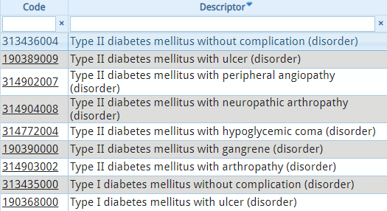
Example: “Diabetes” Value Set
Value Set Name: Diabetes Standard Vocabulary: SNOMED CT
Excerpt from https://vsac.nlm.nih.gov/valueset/2.16.840.1.113883.3.464.1003.103.11.1003/expansion

Slide 9
What is VSAC?
The Value Set Authority Center is a repository and authoring tool for public clinical terminology value sets created by external programs to be used for interoperability in health information technology tools.
  Holds lists of terminology codes and corresponding terms
  Hosts standard clinical vocabularies
  Allows federal agencies, academics and others to define sets of clinical concepts to support effective and interoperable health information exchange

Slide 10
Value Set Authority Center: NLM’s Role
  NLM staff neither create nor govern the content of the value sets. ---analogous to physical journals in the stacks
  VSAC implements most recent terminology updates and provides these for the value set authoring community.
  VSAC tools validate the codes within value sets and hold the value sets in a searchable public repository.

Slide 11
History and Purpose of VSAC
NLM is central coordinating body to manage standard terminologies for clinical health
Value sets were previously created manually in subject matter expert silos with minimal code validation
Centers for Medicare & Medicaid Services (CMS) were required to move clinical quality measures and value sets from paper to electronic format

Slide 12
Who Makes Value Sets?
  Federal Agency Programs
  Standards Development Organizations
  Medical Specialty Organizations
  Research Groups
  Local Health Systems

Slide 13
What are Value Sets Used For?
Clinical Quality Measurement
Clinical Data Registries
Data Segmentation for patient “Consent to Share”
EHR Structured Documents (C-CDA)
Public Health Reportable Conditions Alerts
…and many other use cases

Slide 14
Clinical Data Registries
“As medical specialty societies develop new measures using standardized coding systems, they should strongly consider using the VSAC as a source for distributing and standardizing these specifications.”²
²Council of Medical Specialty Societies (CMSS) Primer for the Development and Maturation of
Specialty Society Clinical Data Registries
January 2016
Example:
American Society of Clinical Oncology: 520 value sets in VSAC as of 10/3/2018

Slide 15
Example Use Case:
Centers for Medicare & Medicaid Services
Electronic Clinical Quality Measures
  CMS creates a portion of the current VSAC value sets, as data elements, for Clinical Quality Measures (eCQMs) used for Electronic Health Records (EHR) quality reporting and value-based purchasing programs.
  https://ecqi.healthit.gov/ecqms

Slide 16
Question 2
  In your library as you interact with your users, how have you encountered clinical quality measures or electronic health records?
  Please respond in the chat box!

Slide 17
CMS Clinical Quality Measures (eCQMs)
Example Measure Titles:
Venous Thromboembolism Prophylaxis
Exclusive Breast Milk Feeding
Hemoglobin A1c Test for Pediatric Patients

Slide 18
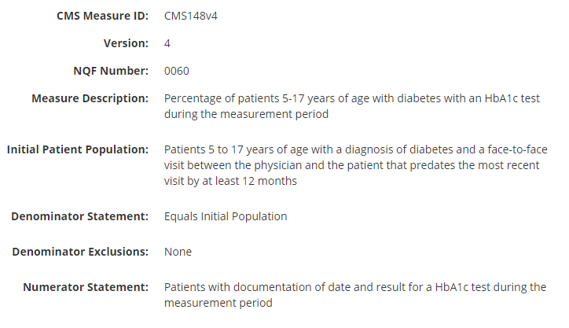
Hemoglobin A1c Test for Pediatric Patients https://ecqi.healthit.gov/ecqm/measures/cms148v4

Slide 19
Clinical Quality Measure
(implementation)
Hemoglobin A1c Test for Pediatric Patients
Numerator: # diabetic patients [age 5-17] tested for HbA1c
Denominator: # diabetic patients [age 5-17]
Slide adapted from Olivier Bodenreider, M.D.

Slide 20
Clinical Quality Measure
(implementation)
Hemoglobin A1c Test for Pediatric Patients
List of LOINC codes
Tests for HbA1c
Numerator: # diabetic patients [age 5-17] tested for HbA1c
Denominator: # diabetic patients [age 5-17]
Data Element
Type 1 or Type 2 diabetes
[Excludes gestational diabetes]
Requires date of birth
List of SNOMED CT or ICD-10-CM codes
Slide adapted from Olivier Bodenreider, M.D.

Slide 21
Diabetes Value Set
Value Set Name: Diabetes Standard Vocabulary: SNOMED CT
Excerpt from https://vsac.nlm.nih.gov/valueset/2.16.840.1.113883.3.464.1003.103.11.1003/expansion

Slide 22
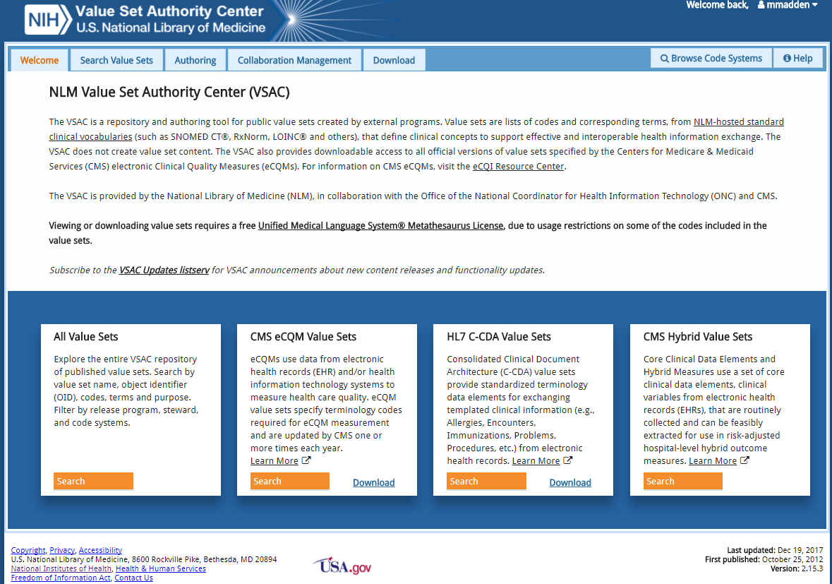
Value Set Authority Center: access eCQM value sets

Slide 23
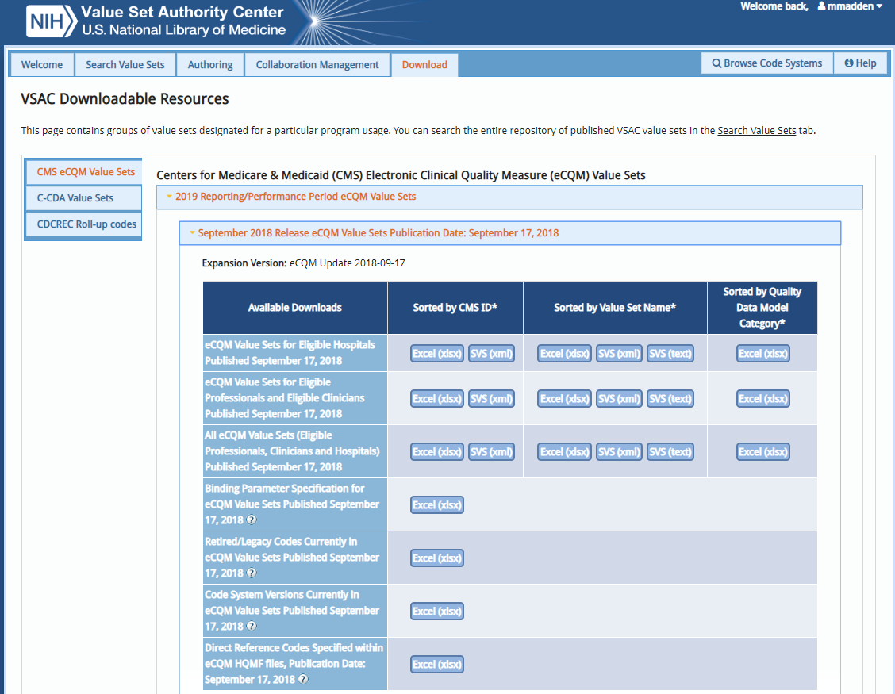
Use the Download tab in VSAC to find the prepackaged and up to date specified value sets required for each clinical quality measure reporting period.

Slide 24
You have learned…
Value sets are list of codes and their terms derived from standard vocabularies
VSAC is a repository for clinical terminology value sets
You care about VSAC because your users may need to access it.
One use case of VSAC is to specify codes in eCQMs
Hospital EHR implementers use VSAC, clinical data registries use VSAC, and many more…
How do I search VSAC?.....We didn’t tell you, but here is the support site, and you can search VSAC with a free UMLS license available here at NLM

Slide 25
What questions do you have?
https://vsac.nlm.nih.gov
Maureen M. Madden
Value Set Authority Center Coordinator
mmadden@mail.nih.gov

Slide 26
Upcoming:
10/11:
A bird’s eye view of health data standards

Slide 27

Survey Slide
Please complete our survey – It will open when you leave the session.
(You can ignore the WebEx blue survey. We care about the other one.)

