Slide 1

The Insider’s Guide to Accessing NLM Data
Welcome to E-utilities for PubMed
Download PubMed data your way!
Mike Davidson, MLS
National Library of Medicine
National Institutes of Health
U.S. Department of Health and Human Services

Slide 2
Today’s Agenda
Look at some challenging PubMed questions
Introduce you to a possible solution
Provide some background
Explore some practical tools, which can…
Answer our questions!

Slide 3
How can I get “X” out of PubMed in “Y” format?

Slide 4
An example:
Which authors are currently doing research on diabetes in pregnant women?
Which organizations are funding research on this topic?
PubMed CSV format groups all authors together, doesn’t include funders.
Notes:
e.g. (Diabetes AND pregnancy) AND ("2016/01/01"[PDAT] : "2016/12/31"[PDAT])

Slide 5
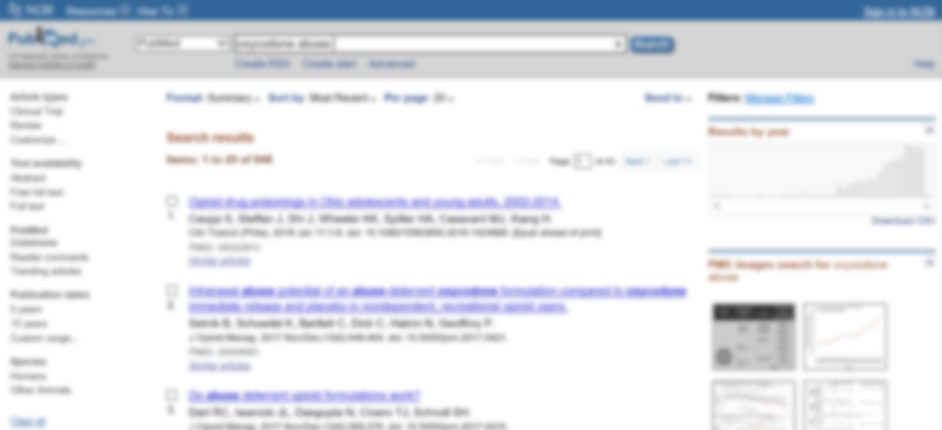
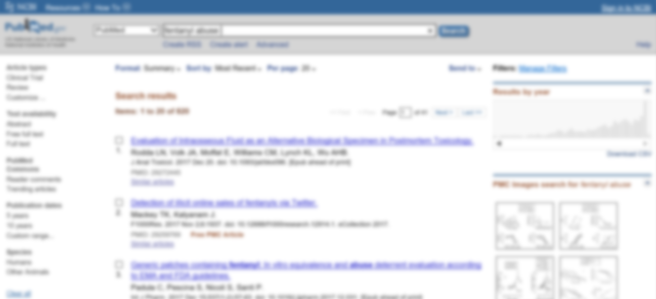

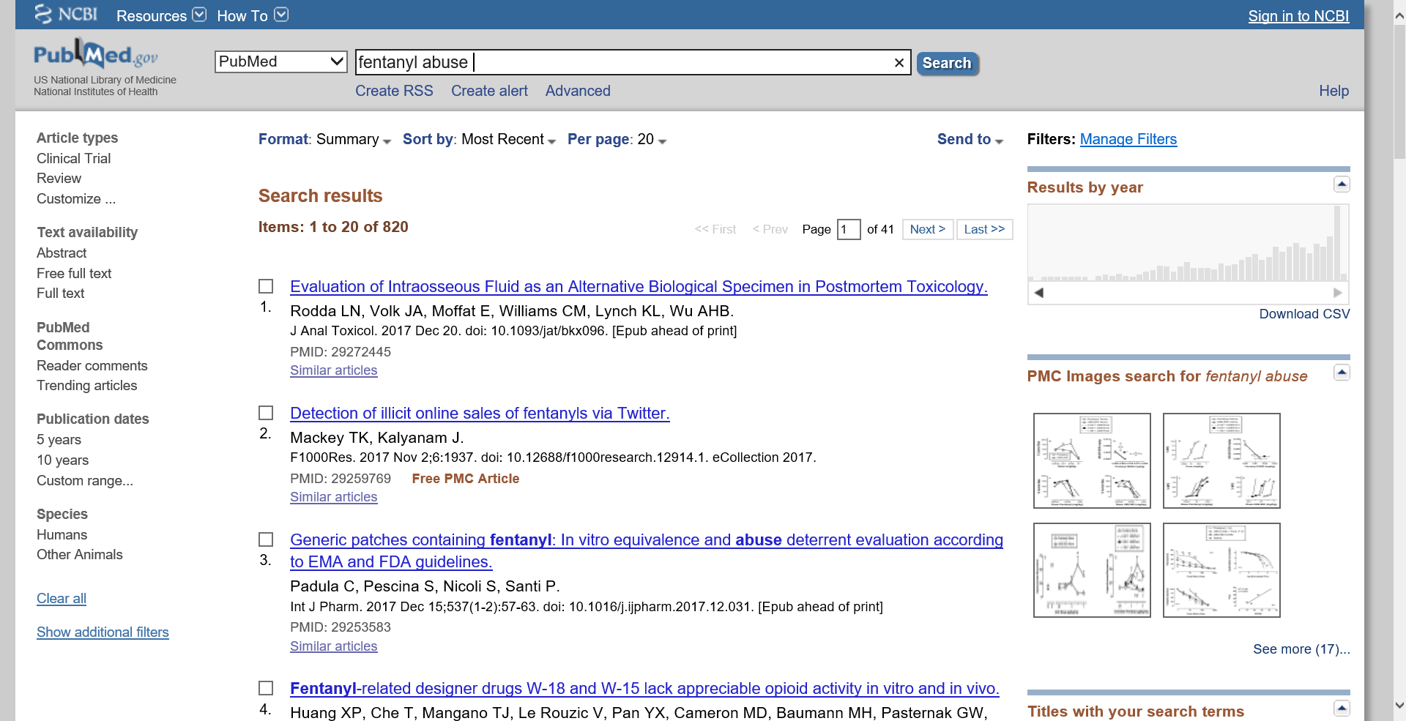
Another example:
“Results by year” graph not customizable, cannot compare multiple results sets.
oxycodone abuse
fentanyl abuse

Slide 6
What do you need your tools to do?
Get exactly the data you need
…and only the data you need
…in the format you need.

Slide 7
E-utilities
An API for accessing PubMed
and other NCBI databases

Slide 8
What does that mean?

Slide 9
What is an API?
API: Application Programming Interface
A set of tools, routines, and protocols for building software applications.

Slide 10
The E-utilities API
A set of tools, routines, and protocols that allow you to interact directly with the data in 20+ NCBI databases, including PubMed, the MeSH database, and PMC.

Slide 11
Okay, but what does that mean?

Slide 12
The E-utilities API is just a series of rules for querying a database.

Slide 13
URLs as Database Queries
Each query is a URL.
The response depends on how you build the URL.
There are tools that can build URLs for you, but…
First, we need to learn the basics.

Slide 14
The three parts of an E-utilities URL
Base URL
  The address of the E-utilities server
Utility name
  The specific tool you are using
Parameters
  The details of your query

Slide 15
The three parts of an E-utilities URL
Base URL
  https://eutils.ncbi.nlm.nih.gov/entrez/eutils/
Utility name
  esearch.fcgi?
Parameters
  db=pubmed&term=“science”[journal]+AND+breast+cancer+AND+2008[pdat]

Slide 16
The Base URL
  https://eutils.ncbi.nlm.nih.gov/entrez/eutils/

Slide 17
E-utilities Utilities
Each of the 9 utilities asks a different kind of question
ESearch (esearch.fcgi?)
  Searches a database and returns a list of unique identifiers (UIDs)
  Does NOT retrieve the full records
EFetch (efetch.fcgi?)
  Takes series of UIDs and retrieves the full records

Slide 18
E-utilities Utilities, cont’d
Plus seven more:
EInfo
ECitMatch
EPost
ESpell
ELink
ESummary
EGQuery
See https://dataguide.nlm.nih.gov for more details

Slide 19
Parameters
db (database)
  db=pubmed
term (search term)
  term=“science”[journal]+AND+breast+cancer+AND+2008[pdat]

Slide 20
Parameters, cont’d
id (list of UIDs)
  id=11748933,11700088
retmode/rettype (return format)
  retmode=xml
  retmode=text&rettype=abstract
Plus lots and lots more
  https://dataguide.nlm.nih.gov for full documentation.

Slide 21
The Three Parts…Together!
https://eutils.ncbi.nlm.nih.gov/entrez/eutils/esearch.fcgi?db=pubmed&term=“science”[journal]+AND+breast+cancer+AND+2008[pdat]
https://eutils.ncbi.nlm.nih.gov/entrez/eutils/esearch.fcgi?db=pubmed&term=“science”[journal]+AND+breast+cancer+AND+2008[pdat]
https://eutils.ncbi.nlm.nih.gov/entrez/eutils/esearch.fcgi?db=pubmed&term=science[journal]+AND+breast+cancer+AND+2008[pdat]
https://eutils.ncbi.nlm.nih.gov/entrez/eutils/esearch.fcgi?db=pubmed&term=science[journal]+AND+breast+cancer+AND+2008[pdat]
Base URL + Utility Name + Parameters =
E-utilities URL!
Base URL + Utility Name + Parameters =
E-utilities URL!
Base URL + Utility Name + Parameters =
E-utilities URL!
Base URL + Utility Name + Parameters =
E-utilities URL!
Notes:
Base URL
https://eutils.ncbi.nhlm.nih.gov/entrez/eutils
Utility name
E.g “esearch.fcgi?”
Parameters
E.g. “db=pubmed&term=science[journal]+AND+breast+cancer+AND+2008[pdat]”

Slide 22
Using an E-utilities URL
Just pop it in your browser and see what happens!
Notes:
LIVE DEMO
https://eutils.ncbi.nlm.nih.gov/entrez/eutils/esearch.fcgi?db=pubmed&term=“science”[journal]+AND+breast+cancer+AND+2008[pdat]

Slide 23
Another E-utilities URL
https://eutils.ncbi.nlm.nih.gov/entrez/eutils/efetch.fcgi?db=pubmed&id=11748933,11700088&retmode=text&rettype=abstract
Notes:
https://eutils.ncbi.nlm.nih.gov/entrez/eutils/efetch.fcgi?db=pubmed&id=11748933,11700088&retmode=xml
https://eutils.ncbi.nlm.nih.gov/entrez/eutils/esearch.fcgi?db=pubmed&term=fentanyl+abuse&retmax=1000

Slide 24
The real power of E-utilities
Combining multiple URLs in sequence
Using E-utilities in a programming environment
  Don’t have to create each URL by hand
  More options for easily manipulating output

Slide 25
Using E-utilities in a programming environment
Learn a programming language
Develop functions that create E-utilities URLs
Call functions that send URLs to the E-utilities server
Parse the XML response
But wait…

Slide 26
EDirect
Developed by NCBI
Set of tools with the E-utilities URL creation rules built in
Can extract the specific data you need from the PubMed XML
Beginner-friendly, but very powerful

Slide 27
What do I need to get started with EDirect?
Unix command line terminal
  Mac OS X, Linux: Built in
  Windows: install Cygwin, a free Unix terminal
EDirect installation package
  For instructions, see: https://dataguide.nlm.nih.gov/edirect/install.html

Slide 28
What do I need to know to use EDirect?
Some knowledge of Unix
  Or, someone to answer questions for you
  Lots of help online
Some familiarity with XML
Some programming (Perl, Python) knowledge
  Helpful but not required
The more you know, the more you can do.

Slide 29
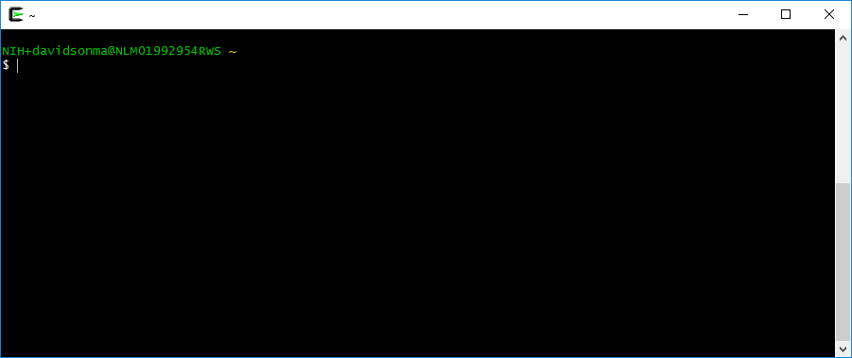
EDirect in Action
esearch –db pubmed –query "fentanyl abuse"
<ENTREZ_DIRECT>
<Db>pubmed</Db>
<WebEnv>NCID_1_219455512_130.14.18.34_9001_1516220928_859419657_0MetA0_S_MegaStore_F_1</WebEnv>
<QueryKey>1</QueryKey>
<Count>820</Count>
<Step>1</Step>
</ENTREZ_DIRECT>

Slide 30
Don’t Panic!
It’s all going to be okay.
(I promise!)

Slide 31
Where did the URLs go?
$ esearch -db pubmed -query “fentanyl abuse”
  https://eutils.ncbi.nlm.nih.gov/entrez/eutils/esearch.fcgi?db=pubmed&term=fentanyl+abuse

Slide 32
Where did the URLs go? (cont’d)
$ efetch -db pubmed –id 27196667,26954292,26768169,26552130,
26437235,26400564,26364787,26284230,26227404 –format xml
  https://eutils.ncbi.nlm.nih.gov/entrez/eutils/efetch.fcgi?db=pubmed&id=27196667,26954292,26768169,26552130,26437235,26400564,26364787,26284230,26227404&retmode=xml

Slide 33
Putting EDirect commands together
$ esearch -db pubmed -query “fentanyl abuse” | \
> efetch –format xml

Slide 34
Answering questions with E-utilities
Active authors on a topic
Agencies funding a topic
Comparing two Results by Year histograms

Slide 35
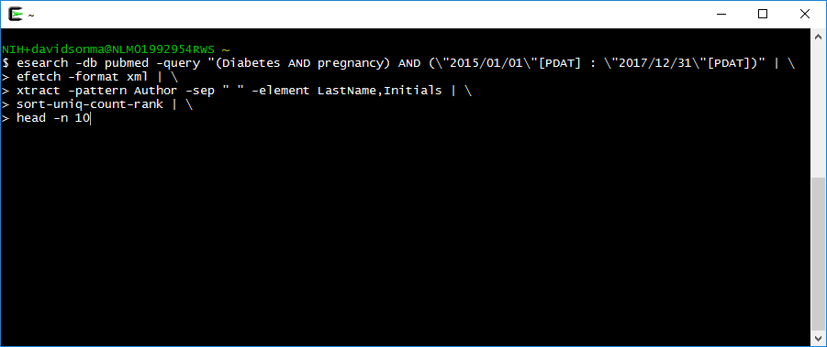
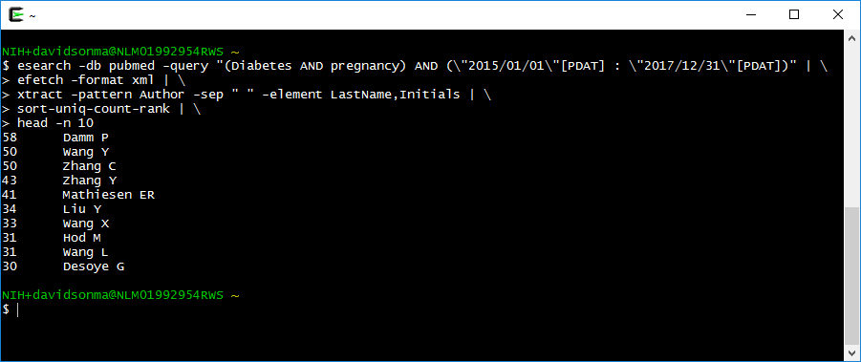
Active authors on a topic

Slide 36
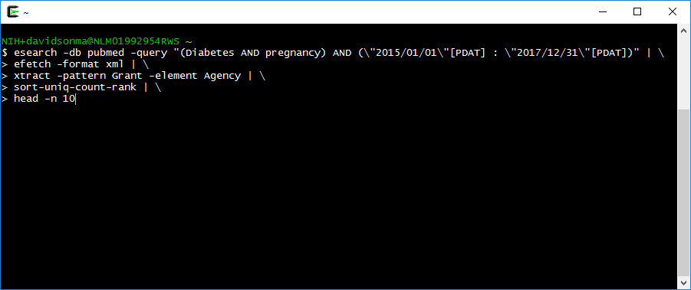
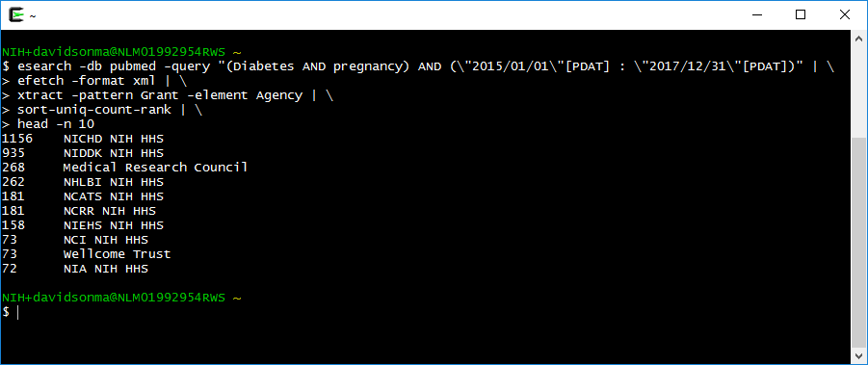
Agencies funding a topic

Slide 37
Comparing Results by Year

Slide 38
E-utilities: the bigger picture
Unix Terminal
EDirect
E-utilities API
Environment
Tool
API
PubMed Data

Slide 39
E-utilities: the bigger picture
R
RISmed, rentrez, etc.
E-utilities API
Environment
Tool
API
PubMed Data

Slide 40
E-utilities: the bigger picture
Other
???
E-utilities API
Environment
Tool
API
PubMed Data

Slide 41
E-utilities: the bigger picture
Web browser
E-utilities API
Environment
Tool
API
PubMed Data

Slide 42
Where do we go from here?
Hands-on workshops
  EDirect for PubMed
More classes to come!
What would you like to see?
https://dataguide.nlm.nih.gov/classes.html

Slide 43
Where can I get help?
The Insider’s Guide online
  https://dataguide.nlm.nih.gov
E-utilities documentation
  https://eutils.ncbi.nlm.nih.gov
EDirect documentation
  https://www.ncbi.nlm.nih.gov/books/NBK179288

Slide 44
One more example, to get you thinking…
We want to know what topics our organization is publishing on.
Our organization has many authors and research components with a variety of names.
How can we efficiently search for our organization and analyze the topics of published articles?

Slide 45
Questions?

