Slide 1
DOCLINE 2018 MLA UPDATE Network Statistics Supplement
Collection Access Section
Public Services Division
National Library of Medicine
National Institutes of Health
U.S. Department of Health & Human Services

Slide 2
DOCLINE Stats
2,052 libraries participating
Over 1.7 million serial holdings records
~ 947,000 print
~ 731,000 electronic (43%)
1.1 million ILL Requests in FY2017
Fill Rate is 93.2%
83% of Requests Filled by 1st lender
Notes:
Approximately 1,800 libraries log in to DOCLINE daily. Today, about 2,050 participant libraries, 10 years ago, there were more than 3,000 participants.
Print holdings have now dropped to fewer than 1 million, and e-holdings continue to grow rapidly.
They now constitute 43% of holdings, versus only 13% in May 2008 when we first started reporting e-journal numbers.

Slide 3
Requests and Libraries

Slide 4
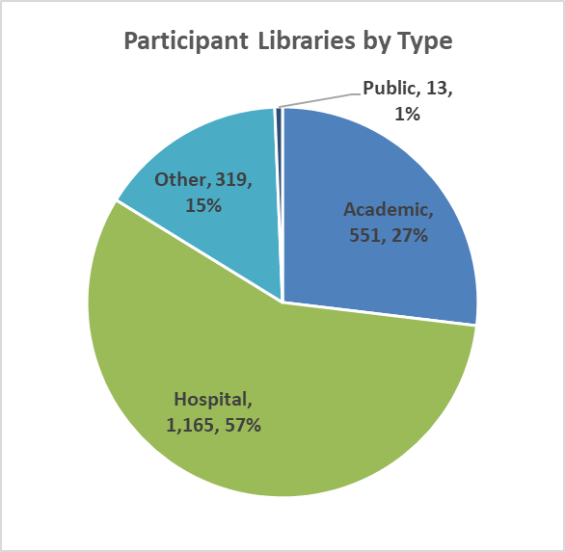
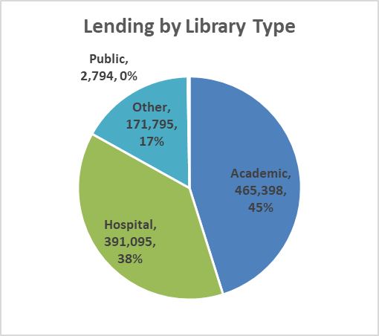
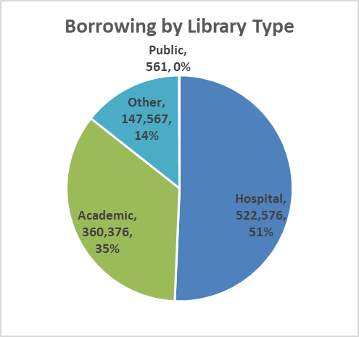
Libraries, Lending & Borrowing

Slide 5
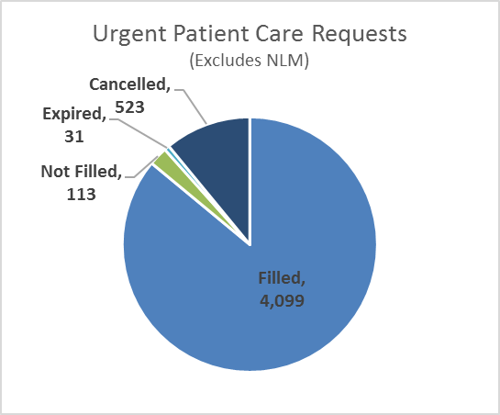
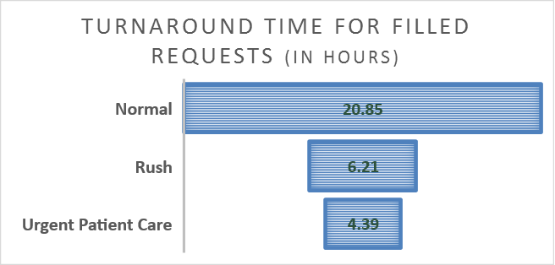
Turnaround Time | Urgent Patient Care

Slide 6
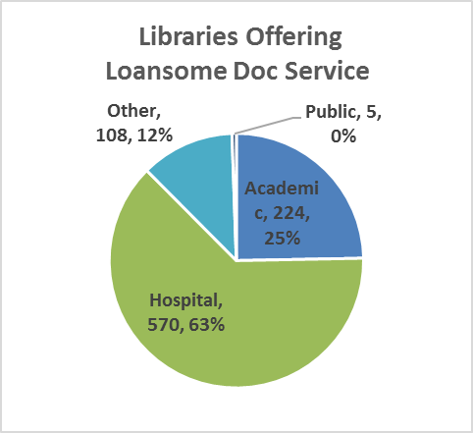
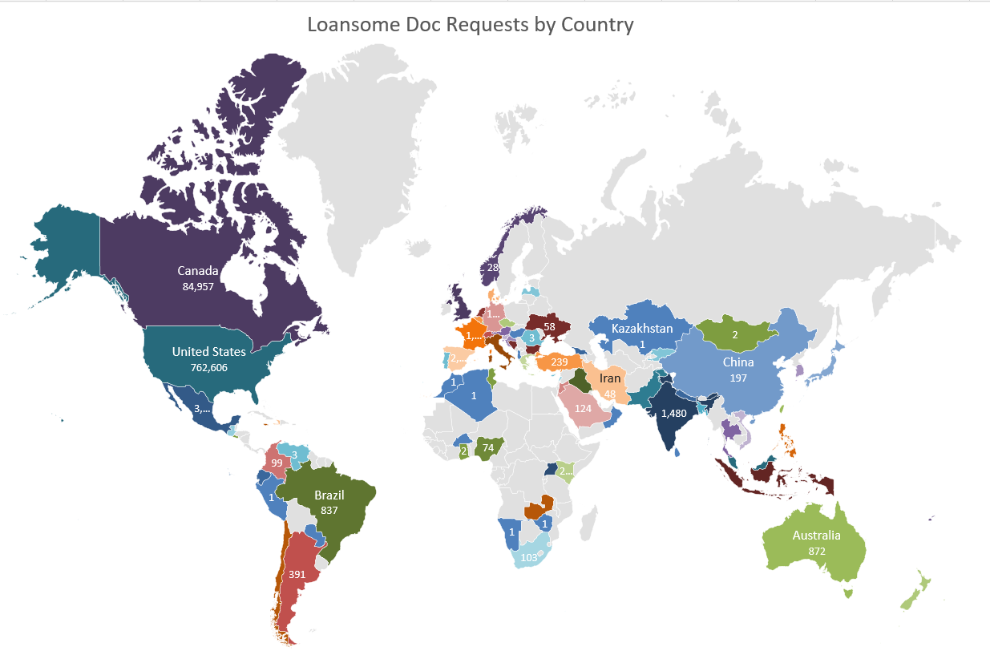
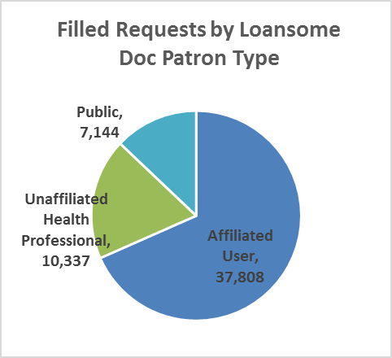
Loansome Doc
903,800 requests previous 26 months
55,289, previous 150 days

Slide 7
Questions | Feedback
DOCLINE@mail.nlm.nih.gov
or
NLM Customer Support
https://support.nlm.nih.gov
Notes:
Statistics reported here are for calendar 2017, unless otherwise specified.
If you have questions, or thoughts to share write directly to us at NLM.

