Slide 1
DOCLINE 2018 MLA UPDATE
Collection Access Section
Public Services Division
National Library of Medicine
National Institutes of Health
U.S. Department of Health & Human Services
Notes:
Hello, and welcome to the 2018 DOCLINE MLA Update. I’m Lis Unger, the NLM DOCLINE Team Lead.

Slide 2
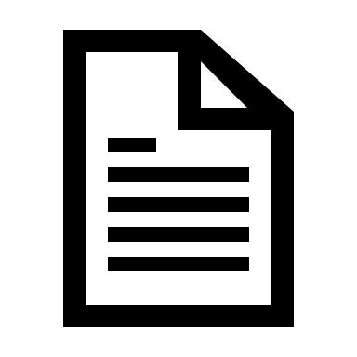
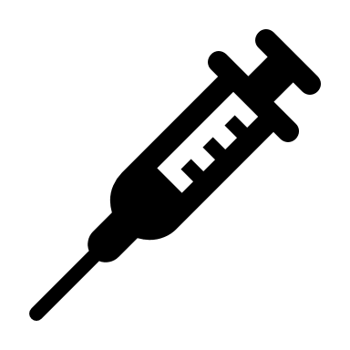
What’s New?
Big changes ahead for:
DOCLINE
Loansome Doc
Resource Sharing
Notes:
For over a year, a team of dedicated NLM staff and programmers have been working to develop a new and improved DOCLINE that will allow you to utilize an interlibrary loan system that’s easier to use, up to date, and, most importantly -- a system that will facilitate enhanced access to biomedical literature for your users -- through DOCLINE and Loansome Doc
We’ve been very busy since the 2017 MLA conference and our work to redesign DOCLINE will finally be available to you later this summer.
I’m here to tell you about the redesign, the new features and to share my enthusiasm for the new product.

Slide 3
The New DOCLINE
Created in response to your feedback
More efficient
Open source web platform
Adaptable
Notes:
For the last several years, we’ve been listening to your comments and feedback about DOCLINE. It’s clear that you want and need an easier to use and more efficient system that will allow you to better serve your users. We listened and heard you!
We are moving the system to an open source web platform that can be easily adapted in order to more rapidly respond to changes in cataloging and publishing models, changes in library processes and interlibrary loan workflows, and the resource sharing landscape in general. We hope that we’ve designed a system that will fit your library’s needs both now and in the future.

Slide 4
Timeline
Preview Period (Mid-summer)
Preview new features
Provide feedback
Continue using the current system
August Release and Launch
Remaining features added
Retirement of the current system
Future Releases (Fall 2018+)
Upgrades and enhancements
Notes:
The new DOCLINE is being developed in stages. We are a small team working to deliver a large project. In advance of a late-summer release, we intend to offer a preview period, during which you will be able to give the new system a test drive. You’ll be able to see the new features and changes we’ve made to DOCLINE, but you’ll continue to use the current system to place requests.
The initial launch of the new DOCLINE, including Loansome Doc, is expected be in August 2018. We anticipate that there will be new releases and upgrades to the system on a more frequent basis than in the current system.
We also intend to offer webinars that will provide an overview of the new functionalities. We think you’ll like what you see. Finally, we’ll be listening to your feedback, analyzing site performance, and monitoring user experience throughout this period. Watch for additional information later this year. Now, let’s take a look!

Slide 5
Notes:
The new DOCLINE home page provides a dashboard of information that you’ll see after you log in.
In the center of the screen, you’ll now see three sections or “cards.” Each of these cards contains links to tasks you need to complete when you’re working in the system. We designed this area to help you prioritize and manage the work that you need to do. The left hand card, My Lending, shows requests for materials that were submitted to your library by other institutions, organized by urgency and status. The card in the middle, My Borrowing, shows the status of the borrowing requests your library placed with other institutions. If you are a Loansome Doc library, you will see the third card on the right, which you can use to manage your Loansome Doc requests.
You can also manage your lending, borrowing, and Loansome Doc requests from the navigation bar at the top of every page. If you manage multiple libraries, you will now only need to use one login, a single email address, to manage multiple libraries, and you will be able to switch between multiple libraries using this link (here). We’re using more plain language throughout DOCLINE. For example, we’ve substituted the word “journals” for “serials” and “Library Profile” replaces “Institution Record.” Also, we have made numerous changes to the help text that appears throughout DOCLINE.

Slide 6
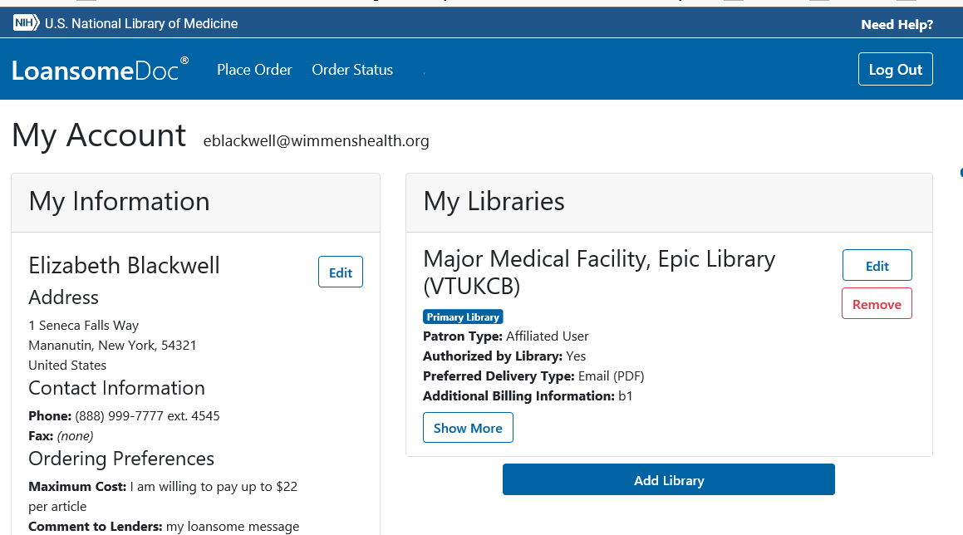
lis.unger@nih.gov
Lis.unger@nih.gov
Elisabeth Unger
Notes:
We expect to make a number of changes to Loansome Doc as part of this process, but we don’t have a full list of changes at this point. We do know that Loansome Doc functionality will closely mirror what is available in the current system. We’ll keep you updated when we do make changes in the future.

Slide 7
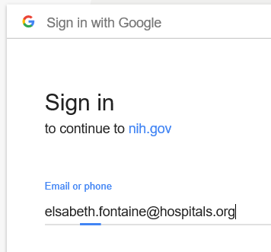
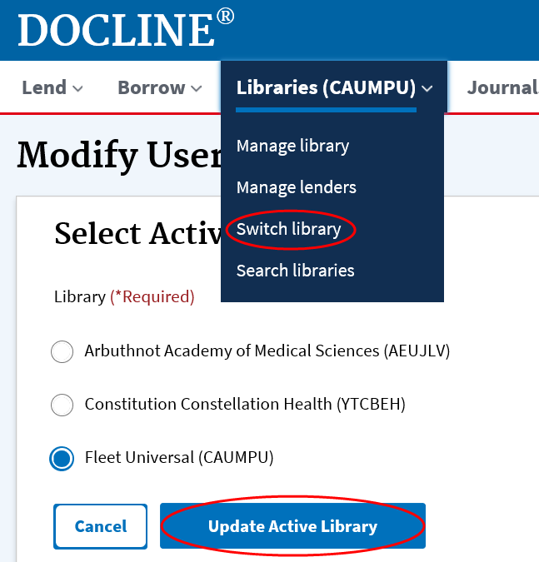
What you will see
Google account login
Simplified navigation
Plain language
Manage multiple libraries with one user ID (DOCLINE only)
Notes:
One the first things you’ll notice when logging into the new system is that you will use a Google account.
However - this doesn’t mean you have to use Gmail - you can create your Google account using your work email if you prefer.
Google accounts provide improved security, and there is an added benefit: you won’t have to remember a separate DOCLINE user ID and password. We think that’s progress! Those institutions with multiple DOCLINE libraries will be happy to learn they will only have to have one DOCLINE user account. We hope that the simplified navigation and plain language will make both systems easier and more pleasant to use than ever before. We’ll provide more information about these changes in the weeks ahead as we get closer to the preview period.

Slide 8
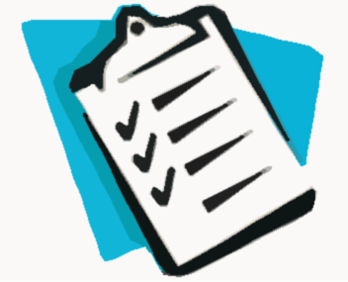
To-Do
Watch for an email from the DOCLINE staff this summer
Preview the new DOCLINE
Create EFTS transaction files
Save request reports
Notes:
What do you need to do to be ready for the new DOCLINE?
This summer, watch for an email notifying you when the preview period is open and how to access the new DOCLINE. Use this as an opportunity to log in to the system, try it out, and send us your feedback, suggestions, and questions.
If you use EFTS for billing, in the beginning of August, plan to create a file capturing the last transactions in the current system. This is important so that you can receive payment for any filled requests in the old system after we switch to the new one.
Not all existing data and reports will migrate to the new system. We suggest that you save any request reports documenting your lending and borrowing history so that this information is not lost. Also, run holdings reports which will help you to make updates to your library’s holdings in the new system. Reports for requests and serial holdings will not be immediately available in the new DOCLINE, however we are planning to have them available at the end of September. That’s it!

Slide 9
Questions | Feedback | Updates
NLM Booth: Erin Latta, NNLM DOCLINE Coordinator
DOCLINE@mail.nlm.nih.gov or
NLM Customer Support https://support.nlm.nih.gov
Subscribe DOCLINE-L https://www.nlm.nih.gov/docline/newdocline_l.html
Feedback:
Updates:
Notes:
If you have questions, or thoughts to share about the new system, there are multiple ways to do so.
You can contact the NNLM DOCLINE Coordinator, Erin Latta, at the NLM booth during the conference
Write directly to us at NLM.
Subscribe to DOCLINE-L and stay stay up to date about the new release.
Thank you for your interest in DOCLINE. We can’t wait to go live with the new version.

