Slide 1
Indexing SPL Data in Clinical Decision Support Systems
Dr. med. A. Leander Fontaine
Pharmiceutics LLC
Oct 2013

Slide 2
What is indexing? Why is it done?
Based on FDA’s 2010 indexing SPL FR notice
Indexing:
For a label, providing machine-readable tags that do not appear in actual printed labeling
An SPL “indexing file” will be linked to an SPL “content file”.
Purpose:
To enable users with clinical decision support tools and electronic prescribing systems to rapidly search and sort product information.
Contribution to the creation of a fully automated health information exchange system.
Can help prevent prescription errors and enhance the safe use of medical products.

Slide 3
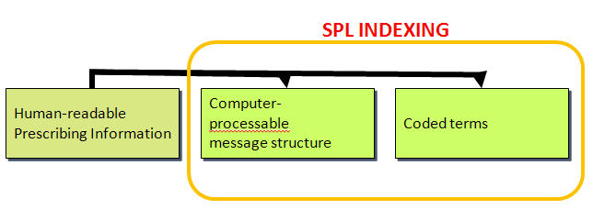
From Prescribing Info to Clinical Decision Support (1/3)
Human-readable Prescribing Information
Computer-processable message structure
  SPL Indexing
Coded terms
  SPL Indexing

Slide 4
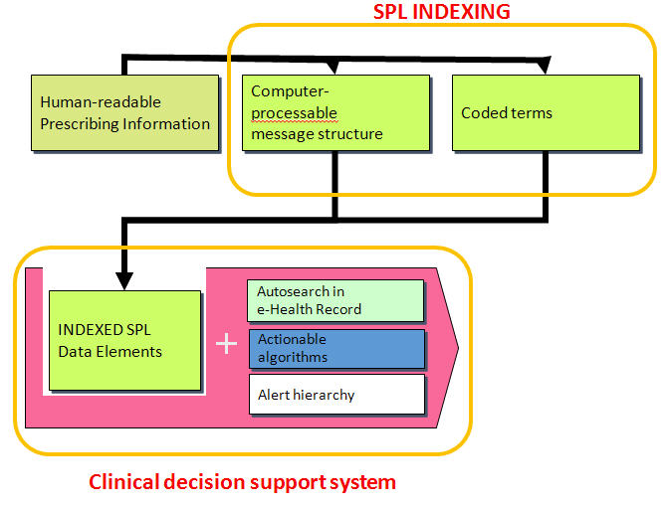
From Prescribing Info to Clinical Decision Support (2/3)
Clinical Decision Support
  Indexed SPL Data Elements
    Computer-processable message structure
    Coded Terms
  Autosearch in e-Health Record
  Actionable algorithms
  Alert Hierarchy

Slide 5
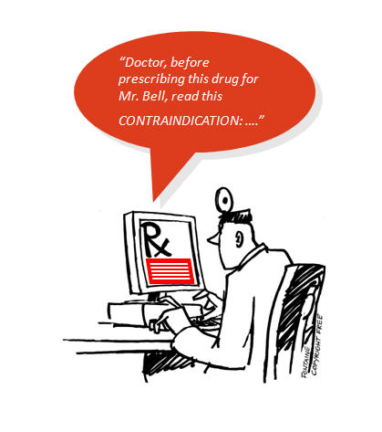
From Prescribing Info to Clinical Decision Support (3/3)

Slide 6
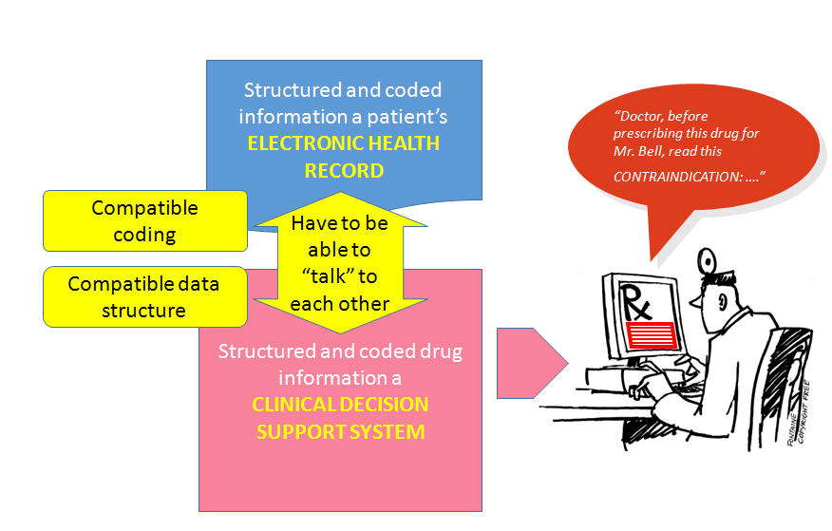
E-Health Record and Decision Support System
EHRs and Decision Support Systems have to be able to “talk” to each other
  Structured and coded information on a patient’s ELECTRONIC HEALTH RECORD
    Compatible coding
  Structured and coded drug information in a CLINICAL DECISION SUPPORT SYSTEM
    Compatible data structure

Slide 7
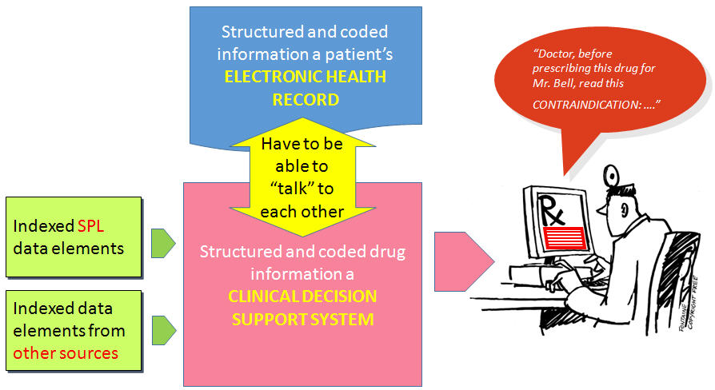
Sources of drug data elements
Structured and coded drug information in a CLINICAL DECISION SUPPORT SYSTEM
  Indexed SPL data elements
  Indexed data elements from other sources

Slide 8
Integrating indexing elements in existing systems
Vendors of proprietary systems may have to “translate” indexed SPL data elements
  Coding (e.g., from a SNOMED CT subset used in SPL to “proprietary codes” used in existing systems)
  Data structure

Slide 9
Phased implementation of SPL indexing (1/2)
Target: All prescription drugs and biologics
Step 1: Indexing of pharmacologic class
Step 2: Indexing of indications
Future steps: TBD

Slide 10
Phased implementation of SPL indexing (2/2)
Step 2: Indexing of indications
One reason to index indications early on: Later indexed elements (e.g., contraindications) may be
indication-specific.

Slide 11
Prudent restriction of indexing detail (1/3)
The SPL clinical information model is extremely powerful and permits a detailed capture of concepts and their relationships.
For example, the following could be captured and coded in full:
  “PRODUCT is indicated for reducing the risk of thrombotic stroke in patients who had stroke precursors or a completed thrombotic stroke. To be reserved for patients with aspirin intolerance or allergy, or who have failed aspirin therapy.”

Slide 12
Prudent restriction of indexing detail (2/3)
From FDA’s 2010 indexing SPL FR notice:
FDA’s current intent is to index the basic indication concepts without the more specific usage and limitations of use information.
Criteria are under development to determine the appropriate level of granularity and consistency in the choice of concepts indexed.

Slide 13
Prudent restriction of indexing detail (3/3)
From FDA’s 2010 indexing SPL FR notice
“ … first capture the main focus of the indication as a single existing concept using the 01312010 version of the SNOMED CT VA/KP Problem List subset. Additional indication modifiers found in approved product labeling such as disease severity or chronicity will not always be indexed.”

