Slide 1
Welcome to the DailyMed Jamboree Public Workshop!
October 28, 2013
SPL – Generic Drug Industry’s Perspective
Virginia Hogan - Generic SPL Sub Team Lead, Co-Chair of Downstream SPL Subteam, Pharmaceutical Consultant

Slide 2
Presentation outline
  SPL Generic Drug Industry’s Perspective
  Current Uses of DailyMed Data
  Possibilities of Downstream Uses
  Downstream Use of SPL Subgroup (DUSPLS)
  Testimonials

Slide 3
SPL – Generic Drug Industry’s Perspective
There is no other repository of all of Generic drug product’s labeling. Anywhere.
This is the number one importance of SPL to Generic companies in particular.

Slide 4
Current Uses of DailyMed Data (1/2)
Thinking outside the box:
Public safety & Quantifiable cost savings and return of investments:
  Permanent Link
  “Louisiana Project”
  Humanitarian Product Donation

Slide 5
Current Uses of DailyMed Data (2/2)
SPL on Hand-Held Devices
Consumer Use of DailyMed!
Company’s labeling MUST be in sync with DailyMed.

Slide 6
Possibilities of Downstream Uses (1/2)
Patient Scan Bar Code and Read Labeling at the point of service on App:
  Better Information Access Increases Self-Care
  More Informed Patient Empowers Health Care Professionals (H.C.P.)

Slide 7
Possibilities of Downstream Uses (2/2)
SPL Data Linked to Health Information
  Quickly Find Drug-Drug Interactions
  Comparison of Listing of Warnings, Precautions, Contraindications, Side Effects
  Immediate Cross-check to Dispensing Pharmacist
  Give H.C.P. Better Information Control

Slide 8
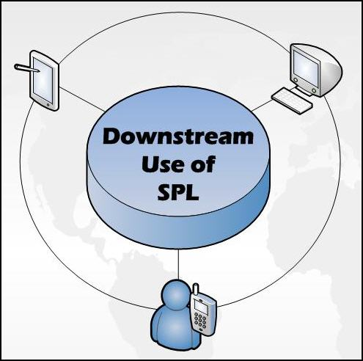
Downstream Use SPL Subgroup
(DUSPLS) Join us!
DUSPLSCR@gmail.com - DUSPLS Central Repository email

Slide 9
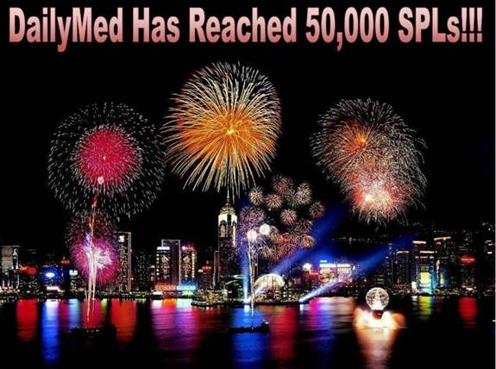
DailyMed – 50,000 SPLs!
The message to the right was sent out on May 15, 2013.
We are now above 55,000 unique SPL files on DailyMed!

Slide 10
Testimonials
Testimonials from consumers and healthcare professionals.
What do people REALLY think of DailyMed?

Slide 11
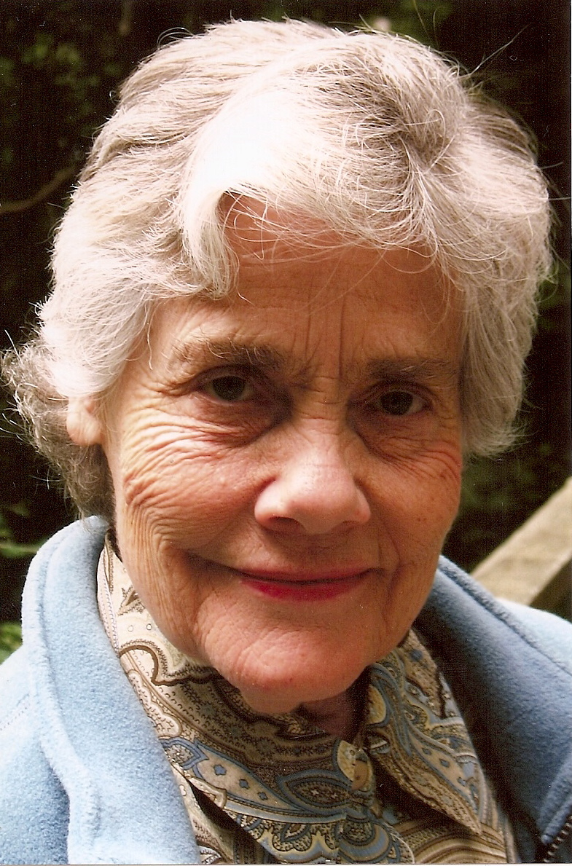
Testimonials - Consumer, age 77
Husband prescribed medication, there was some confusion regarding the indication once they got home.
Used DailyMed on her iPhone and read the indication.
Verified with the doctor that the medication was indicated for Hypertension and that it needed to be taken every day.
Now relies on DailyMed along with her doctor’s instructions to keep track of her medications and “feels much safer.”

Slide 12
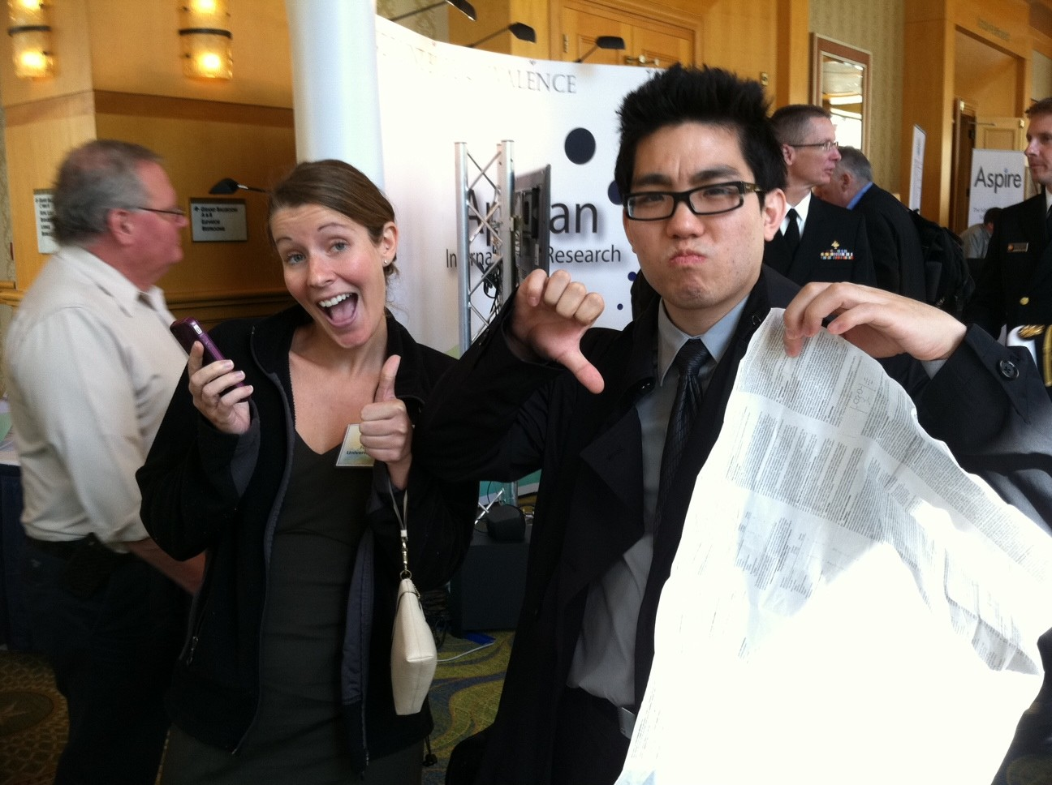
Testimonials -
Pharmacist Interns
University of MD pharmacist interns Rachel and Kevin show their support for DailyMed on the iPhone.
Kevin likes it better than the paper insert he is holding.

Slide 13
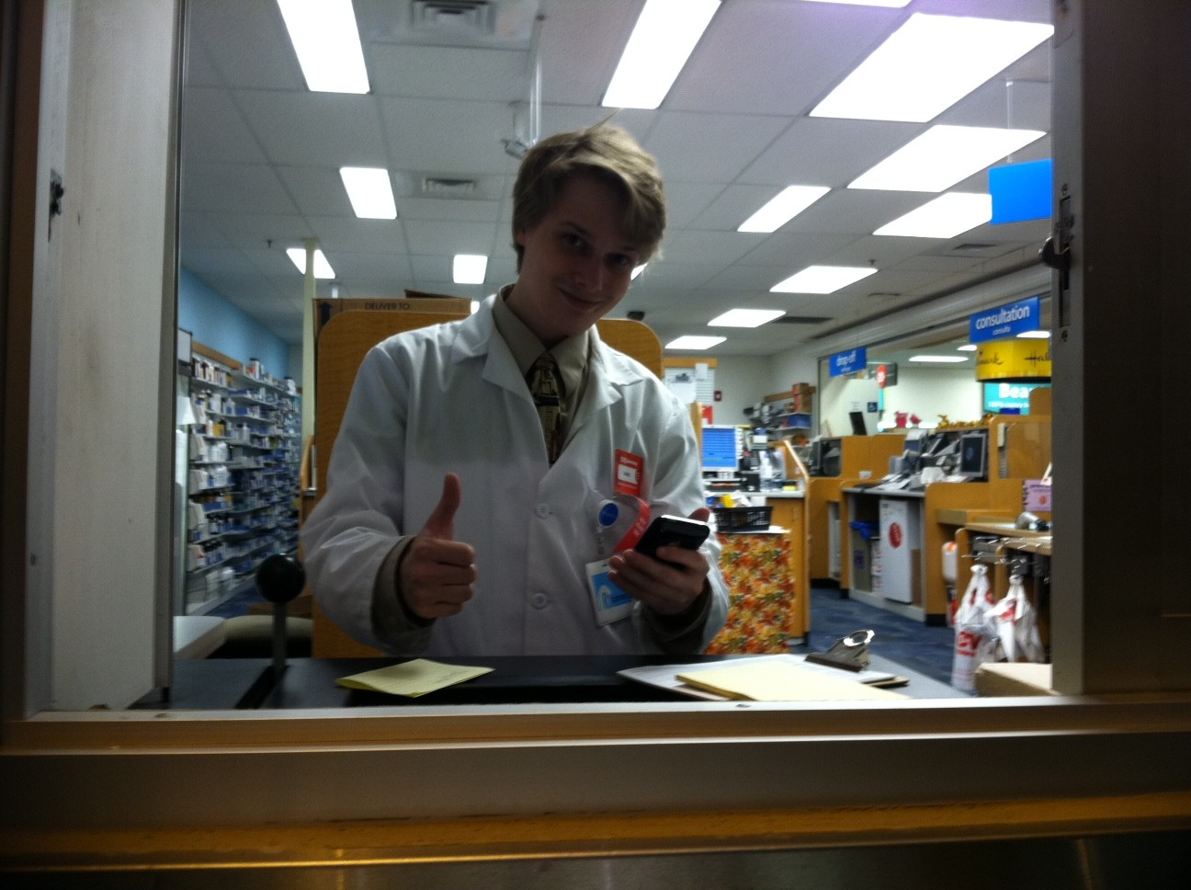
Testimonials -
Pharmacy Technician
Pharmacy Technician Dan just learned how to access DailyMed on his iPhone!

Slide 14
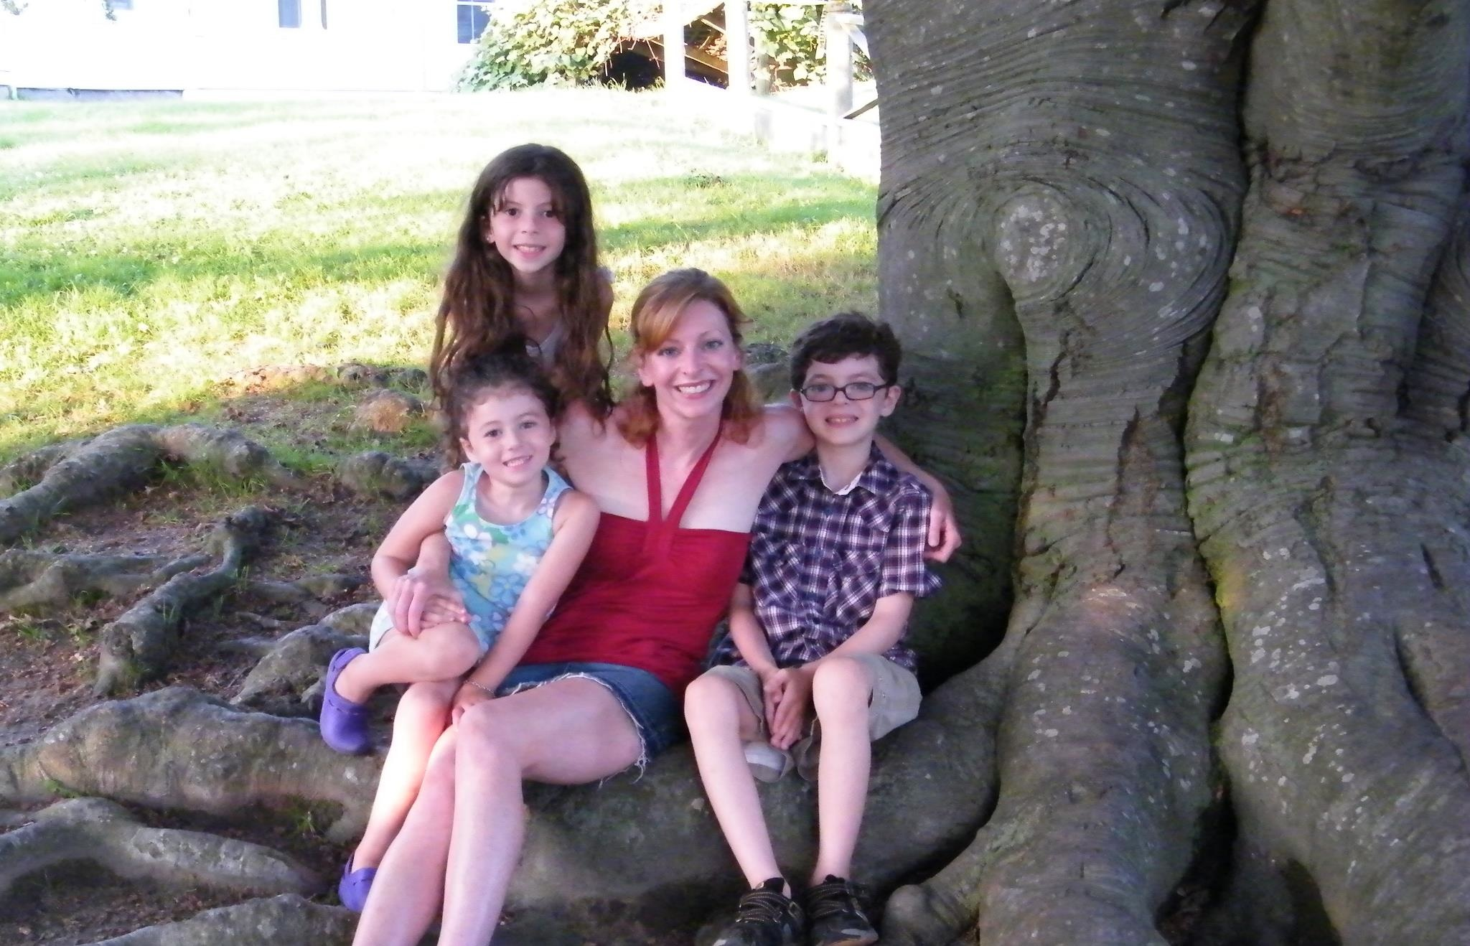
Testimonials -
Consumer with Family
Uses DailyMed on iPhone.
Her friend had a concern about her son having new symptoms.
Showed her friend how to use the “App” to look at possible adverse reactions.
Possible adverse reaction listed.
Called physician, changed medications and symptoms abated.

Slide 15
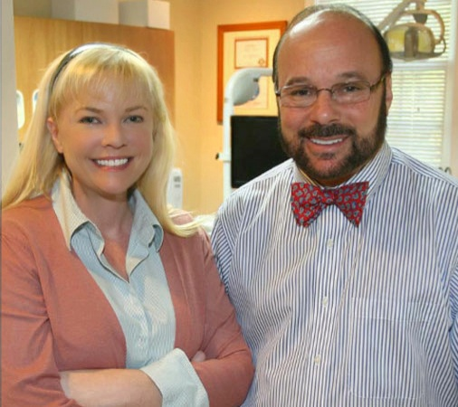
Testimonials -
Dr. Don E Millner, DDS
"My Office Manager, Vena Wilson uses DailyMed on a regular basis. We don't prescribe many medications, but like to always have current package inserts and/or medication guides on hand for patient safety. This is an extremely valuable website.”
Don E. Millner is a nationally recognized cosmetic dentist with a fulltime private practice in Yardley, Pennsylvania.
He has been voted "Best of Bucks" in 2005, 2006 and 2009 and has been featured in the New York Times, Philadelphia Inquirer and on Network TV.
He received his doctorate from Temple University and his commitment to advanced studies has earned him a Fellowship in The Academy of General Dentistry.

Slide 16
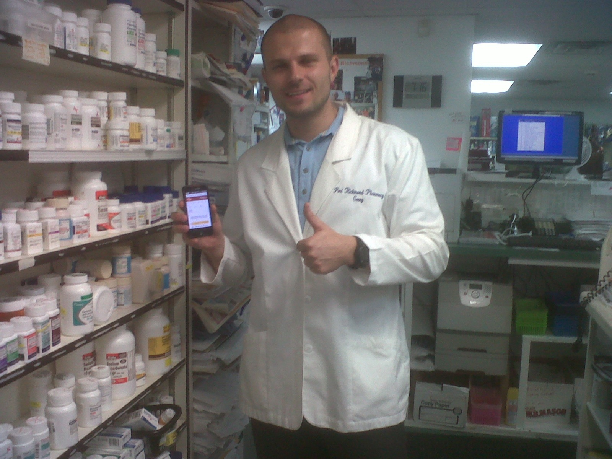
Testimonials -
Pharmacist
“I wanted to say thank you for making me aware of the DailyMed on my iPhone!”
“It is such a great tool, and the fact that I am able to use it whenever I please and wherever I am is priceless. As a pharmacist, my job does not end when I leave the pharmacy. I constantly have family members and friends asking me questions about the medication they're on or that they have seen on TV. Having access to a tool such as the DailyMed “App”, and not being tied to a desktop computer is a great help.”

Slide 17
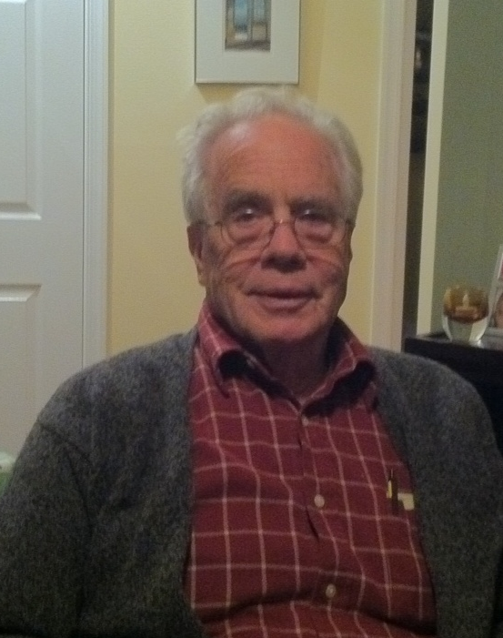
Testimonials -
Retired Physician
Was looking for a PDR to have on hand in his office.
I showed him how to use DailyMed and pull up PIs, MedGuides and other labeling that is current and easy to use.
When he returned home he made DailyMed a “Favorite” on his computer and consults it on a regular basis.

Slide 18
Thank you!
Contact Information:
Virginia Hogan
Pharmaceutical Consultant
newtownhogan@comcast.net
215-262-7457

