Slide 1
NLM SPL/DailyMed Jamboree Workshop: OTC Industry Perspective on DailyMed
Marcia D. Howard, Ph.D.
Senior Director, Regulatory & Scientific Affairs
28 October 2013
Bethesda, MD

Slide 2
Presentation Outline
What is CHPA?
Background on OTCs and electronic submissions
Downstream Uses: The intersection of DailyMed and OTCs
Recommendations to possibly enhance use of DailyMed

Slide 3
What is CHPA?
US-based trade association representing manufacturers and suppliers of over-the-counter (OTC/nonprescription) medicines and dietary supplements (e.g., multivitamin/minerals, fiber, calcium)
Founded in 1881
Host association for the SPL OTC sub-team (open to CHPA members and non-members)
Established in 2009
Industry chair: Paula Markert, GlaxoSmithKline Consumer Healthcare

Slide 4
Background: OTCs and Electronic Submissions
1 June 2009
OTC (and vet med) labeling required to be submitted in electronic (Structured Product Labeling) format
NDC Labeler Code Requests, Drug Listing, and Establishment Registrations also required to be submitted electronically in SPL format
Previously OTC submissions were in paper format
6 October 2010
OTCs were added to NLM’s DailyMed website
Over 6000 OTC drug listing files were added to DailyMed

Slide 5
OTC Industry Uses of Information on DailyMed (1/2)
Access current labeling information
Identify OTC medicine
Ingredients (active, excipients)
Indications
Identify manufacturers of specific OTC medicines of interest
FDA and/or industry initiatives
View historical records of drug listing information
For example, review before & after changes to the label

Slide 6
OTC Industry Uses of Information on DailyMed (2/2)
Pharmacologic Class
Identification of products, manufacturers
Medical
Look at prescriber information
Competitive analysis
Brands, products, SKUs, flavors, claims

Slide 7
Suggestions to Enhance DailyMed Site (1/5)
Enhance/facilitate consumers’ use of DailyMed
Consider developing a mobile app
Add search function based on corporate name
Currently results obtained only if corporate name is part of product name

Slide 8
Suggestions to Enhance DailyMed Site (2/5)
History
Helpful if changes from previous version could be highlighted or easily identified compared to current version
“Approval disclaimer” for monograph OTCs
Consider more consumer-friendly wording without losing context or intent of disclaimer

Slide 9
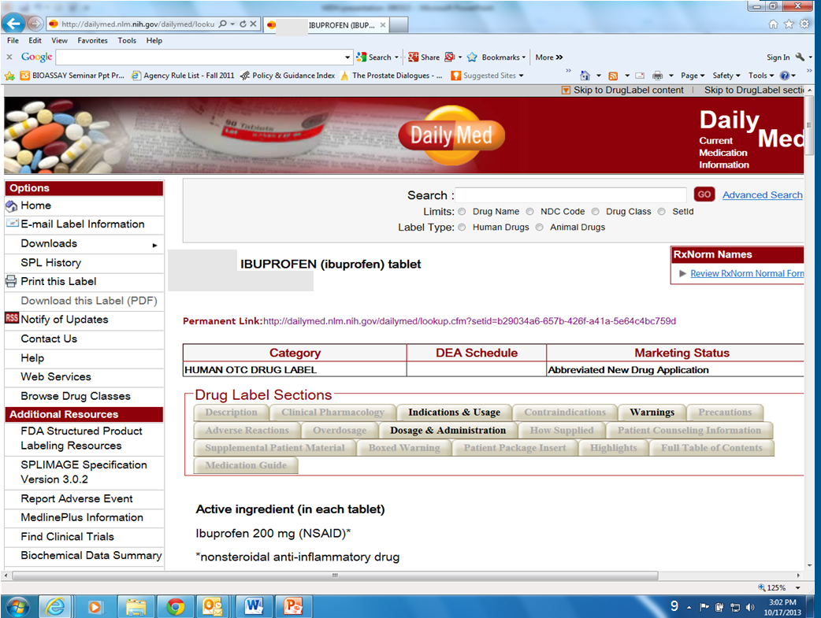
Suggestions to Enhance DailyMed Site (3/5)

Slide 10
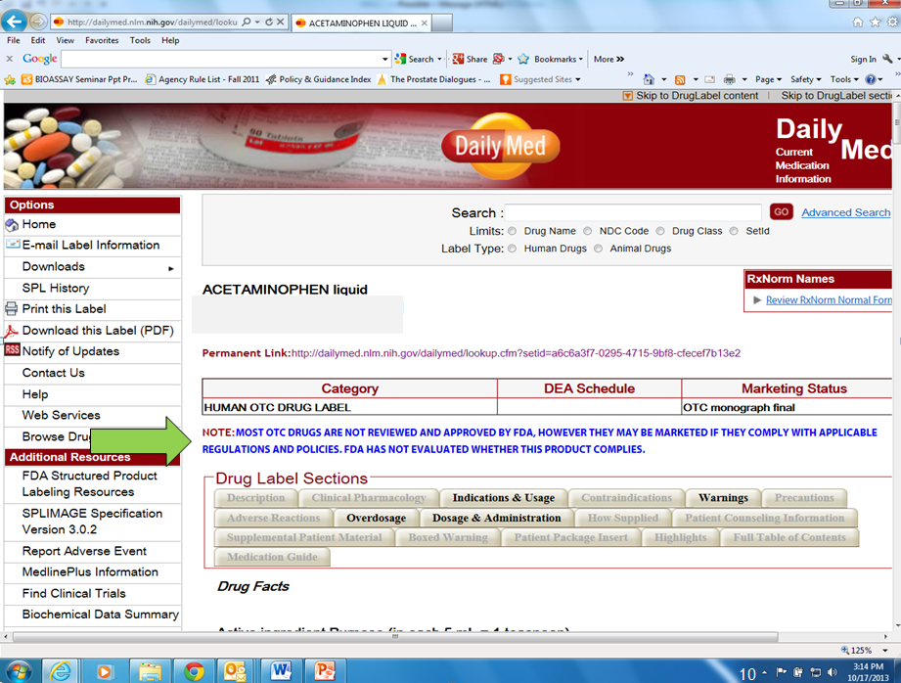
Suggestions to Enhance DailyMed Site (4/5)

Slide 11
Suggestions to Enhance DailyMed Site (5/5)
Product Identification System
Tool to assist healthcare professionals, consumers, others with identifying solid oral dosage forms from a trusted source
Product identification attributes (imprints, color, shape, etc.)
Encourage submissions from OTC companies for SPLIMAGE
Site references “...approved prescription drugs...” which implies OTCs are not included in the program
Opportunity to expand system to include OTCs or to promote inclusion of nonprescription medicines

Slide 12
Many thanks!!
Contact Information:
Marcia D. Howard, Ph.D.
Senior Director, Regulatory & Scientific Affairs
CHPA
mhoward@chpa.org
http://www.chpa.org/
http://www.otcsafety.org/

