Slide 1
Overview of DailyMed
John Kilbourne MD
National Library of Medicine
kilbourj@mail.nlm.nih.gov

Slide 2
Structured Product Label (SPL)
Significant and authoritative source of data
Practical demonstration of FDA-NLM workflow cooperation
Primary data source for RxNorm

Slide 3
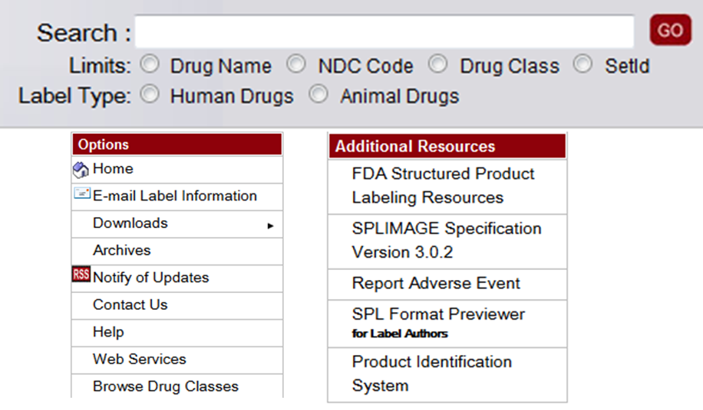
http://dailymed.nlm.nih.gov/

Slide 4
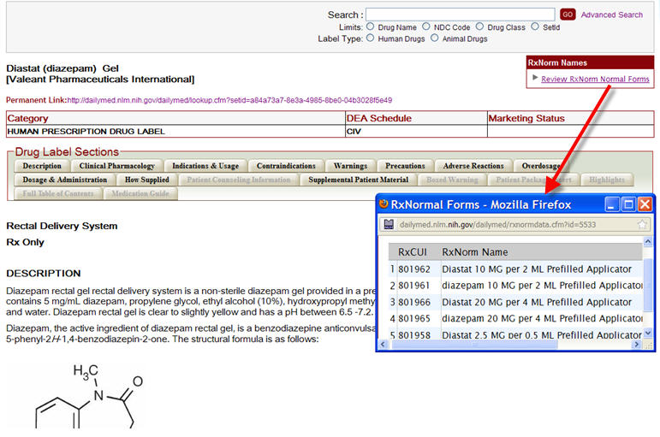
Diazepam Label on DailyMed

Slide 5
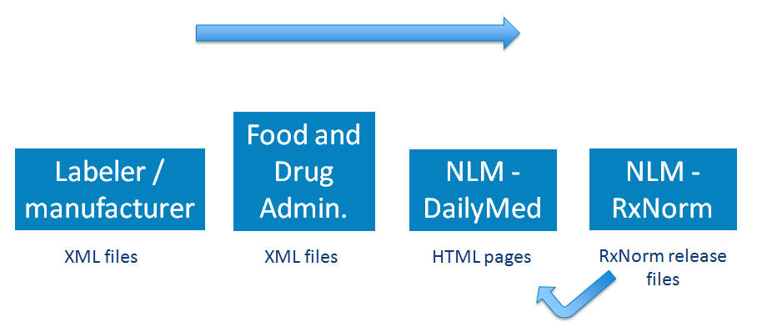
Data Flow: Path of data for SPL

Slide 6
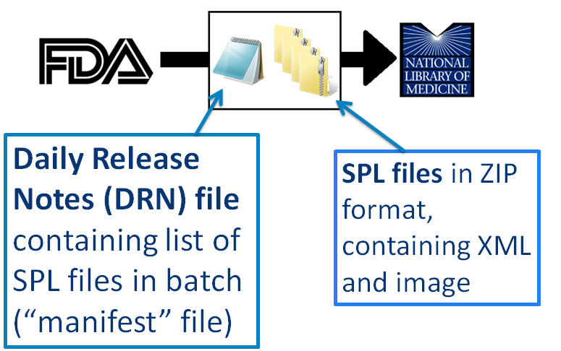
DailyMed File Processing

Slide 7
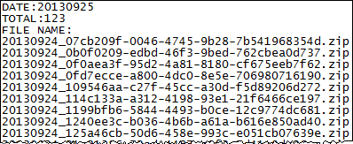
DRN File

Slide 8
DRN Validation Checks
ZIP file exists
ZIP file name follows correct format
ZIP file contains only one XML file
XML file passes SPL schema validation
SPL has valid version number
All images referenced by SPL exist

Slide 9
Files Published Online
HTML
PDF
XML
ZIP

Slide 10
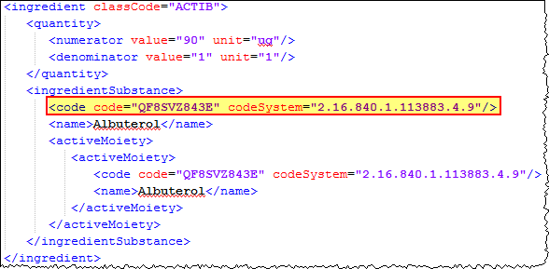
Unique Ingredient Identifier (UNII)

Slide 11
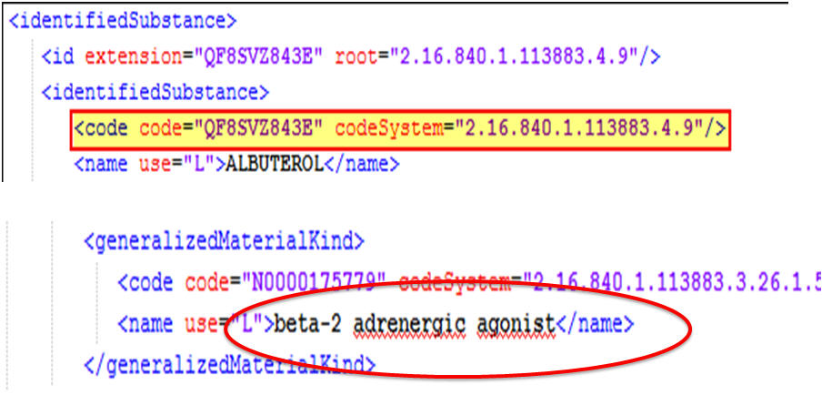
Drug Class Indexing

Slide 12
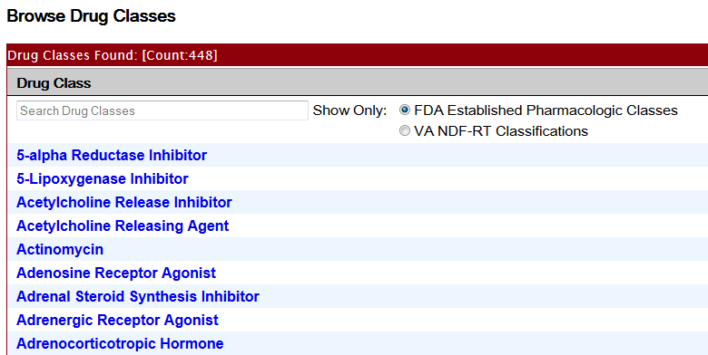
Drug Classes Displayed

Slide 13
Current Web Services
Returns a list of all SPLs with the given NDC.
Returns imprint data associated with the given NDC.
Returns a list of all SPLs with the given drug name.
Much broader set of web services planned for late 2013 / early 2014.

Slide 14
Other Facts
Drug data published ‘as is’
Archived labels, billing unit data
Medwatch data being incorporated
Substance indexing files (mol files)
Patient level information may be forthcoming

Slide 15
Thank you
John Kilbourne MD
kilbourj@mail.nlm.nih.gov

