Slide 1
SPL/DailyMed Jamboree October 28, 2013 Bethesda, MD

Slide 2

SPL and DailyMed
Why not just use PDF?
Where is this going?

Slide 3
Downstream use of SPL
Electronic submission of data established in 2005
All marketed drugs and biologics must be submitted to FDA for posting on DailyMed
NLM originally asked to provide download access to the files.
Today’s meeting to focus on what happens to the data after it is submitted to FDA

Slide 4
Why the big deal?
Authoritative
Freely available
Structured
XML text (plus images)

Slide 5
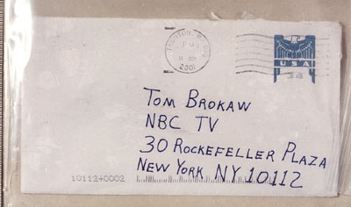
Structured data - front of an envelope

Slide 6
PDF drug labels also have structure…
Why not just use PDF?
Adobe PDF format designed for viewing and printing
Not designed for data extraction and re-use
XML: parseable, digestable, process-able by computers
Can use, re-use, re-arrange, sort, count, search and manipulate XML text data

Slide 7
What does the NLM have to do with all this?
Largest repository of biomedical information in the world
RxNorm also from NLM
Researchers in biomedical text processing and information retrieval
Kin Wah Fung, Olivier Bodenrieder, and many others

Slide 8
How today will work
Speakers will introduce themselves and their work
Please hold questions till the end
People online can send questions to Chris Hui: huic@mail.nlm.nih.gov Please identify who the question is for, if possible.
Two separate question panels; industry/non-government and government

Slide 9

Where is this going?

Slide 10
Thank you
John Kilbourne MD
kilbourj@mail.nlm.nih.gov

