Slide 1
Structured Product Labeling Overview
SPL/DailyMed Jamboree - October 2013
Lonnie Smith
U.S. Food and Drug Administration

Slide 2
Overview
Structured Product Labeling (SPL) Overview
Exchange of SPL Data
Indexing SPL Overview
Other SPL-related topics

Slide 3
SPL Overview

Slide 4
SPL Standard
HL7 health and regulatory data international standard
Adopted by FDA
Exchange of product and facility information
FDA initiative to improve patient safety through better access to product information

Slide 5
Components of Product SPL
Content of Labeling
Product Data Elements
Product Name
Dosage Form
Route of Administration
Ingredient (active/inactive/adjuvant)
DEA Schedule
Product characteristics (color, shape, size, etc…)
Packaging
Marketing Information (category, status, start and end dates)
Representative samples of carton/container labels
Identity of distributor and manufacturer (may not be disclosed) of product
SPLIMAGE

Slide 6
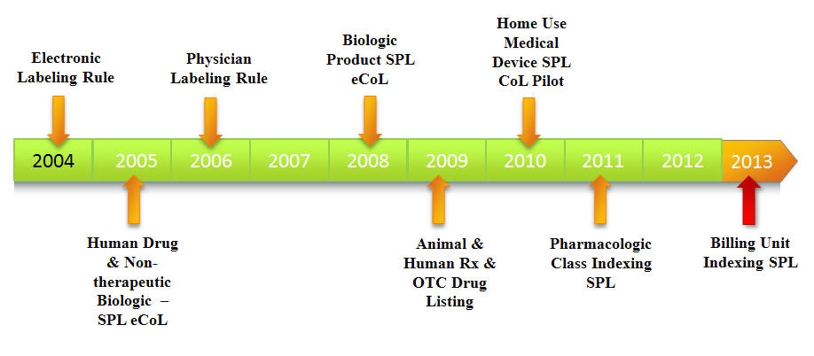
SPL Implementation Highlights

Slide 7
Exchange of SPL Data

Slide 8

SPL Data Received for Entities Located in Over 80 Countries
Owners/operators of drug establishments around the globe which commercially market drug products in the US register sites in SPL format.
SPL files are submitted for drug products manufactured at these facilities.

Slide 9
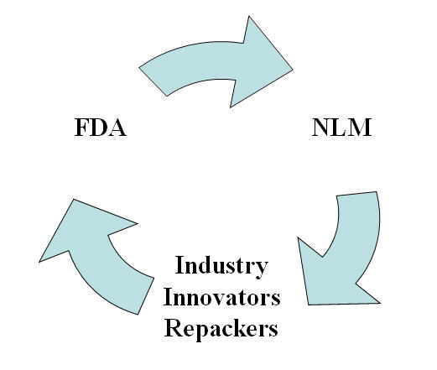
Exchanging SPL Data

Slide 10
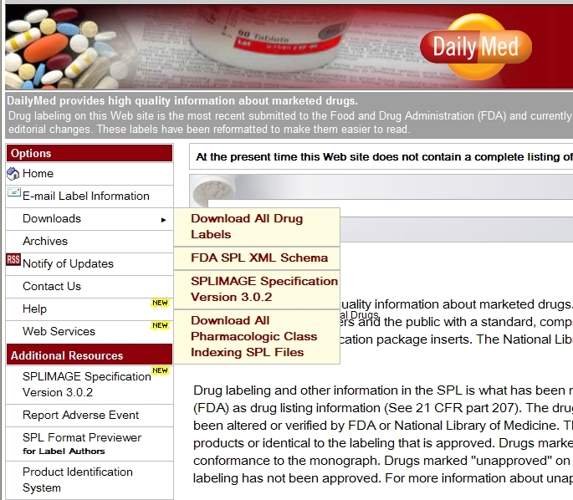
DailyMed
FDA-to-NLM - Daily transmissions of up-to-date product information received from drug companies
MOU (FDA/NLM)
NLM makes all SPL files available via download

Slide 11
Types of SPL Product Data Currently Exchanged
Drug Products
Human Rx Drugs
Approved & Unapproved Rx drugs
Unapproved medical gases
Unapproved homeopathic
Human OTC Drugs
OTC monograph final
OTC monograph not final
OTC homeopathic
Animal Rx drugs
Approved Rx
Unapproved Rx
Animal OTC Drugs
Other
Indexing (pharmacologic class & billing unit)
Medical device (content of labeling) (Voluntary submissions only)

Slide 12
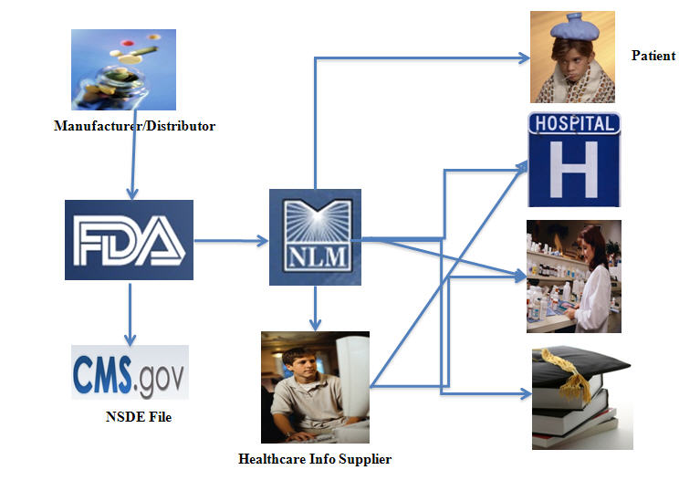
SPL Data Flow

Slide 13

Consumer Access to Up-to-Date Product Information
Access to same package insert info available to healthcare professionals
Can review SPL data while awaiting filling of prescription.
Updated medication guides, patient package inserts, etc…
Access to updated drug facts labels for OTC drug products

Slide 14
Indexing SPL Overview

Slide 15
Indexing SPL
Indexed clinical data (e.g. pharmacologic class, indications)
Indexing SPL files - generated by FDA (No need to alter companies’ product SPL files to index them.)
Inserted machine readable tags not in printed content of labeling
Allows users to rapidly search and sort information
Supports
automated health information systems
electronic health records, electronic prescribing, clinical decision support systems

Slide 16
Pharmacologic Class Indexing SPL
Pharm Class Indexing SPL
Active moiety UNII
Active moiety Name
Physiologic Effect & NUI
Mechnism of Action & NUI
Chemical Structure & NUI
Established Pharmacologic Class & NUI
Product SPL
Active moiety UNII
Product Names
Product Type
Dosage Form
Active Ingredient Name
Strength of Active Ingredient
Basis of Strength
DEA Schedule
Route of Adminstration
Marketing Category
Content of labeling text sections (e.g. 12.1 Mechanism of Action)
Application Number
Distributor's Name

Slide 17
Billing Unit Indexing SPL
Billing Unit Indexing SPL
NDC Package Code
Billing Unit (e.g. mL)
Product SPL
NDC Package Code
Product Names
Product Type
Dosage Form
Active Ingredient Name
Strength of Active Ingredient
Basis of Strength
DEA Schedule
Route of Adminstration
Marketing Category
Application Number (if applicable)
Distributor's Name

Slide 18
Other SPL-related Topics

Slide 19
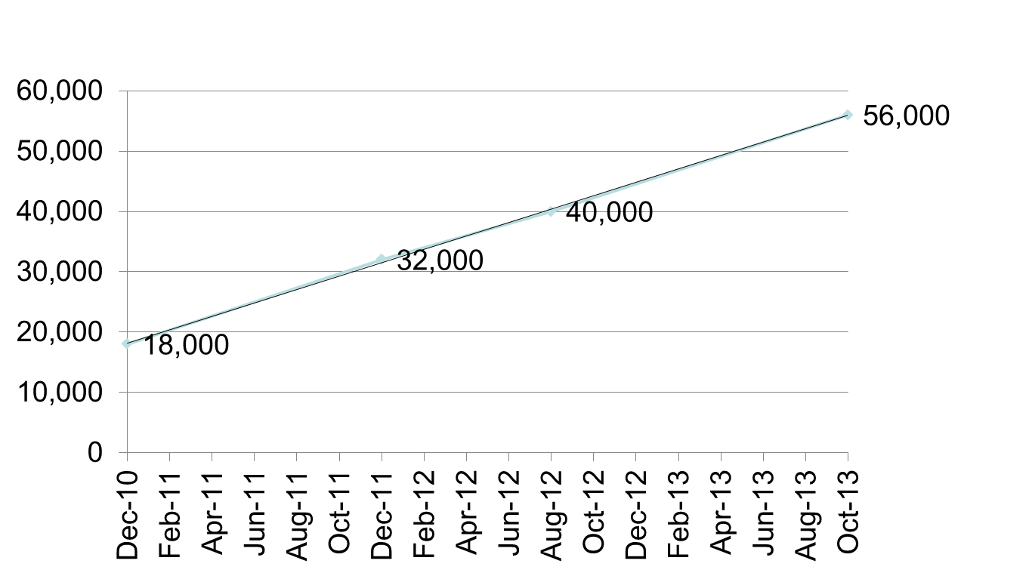
Amount of Product SPL Files on DailyMed Dec. 2010 – Oct. 2013

Slide 20

Let’s Not Forget About the Animals
In 2013, significant increase in Animal Drugs Product SPL Data
October 2012: 2,505 NDC Package Codes
October 2013: 4,253 NDC Package Codes

Slide 21
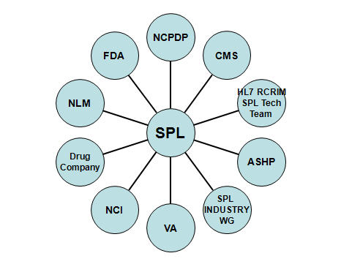
Collaboration = SPL Success

Slide 22
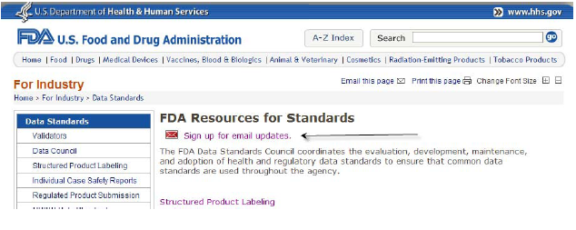
Stay Informed
FDA Data Standards Council website listserv
http://www.fda.gov/ForIndustry/DataStandards/default.htm

Slide 23
SPL-related Questions
SPL e-mail account (spl@fda.hhs.gov)

Slide 24
Thank You

