Slide 1
Daily Med Jamboree
SPL/DailyMed Jamboree Workshop
October 28, 2013
Stephen A. Weitzman, J.D., LL.M.

Slide 2

Celebrating 10 Years

Slide 3

What Is The DailyMed?
It’s the DailyNews of
New and Changed Drug Labeling
It’s the Encyclopedia of Drug Labeling

Slide 4
The Vision – DailyMed (1/2)
Establish one continuously updated resource that provides “real time” accurate, comprehensive and usable drug data to all audiences, free of charge on the Web, and distributes that information further throughout healthcare through publishers, e-health, and provider systems to prescribers, dispensers, and the public.

Slide 5
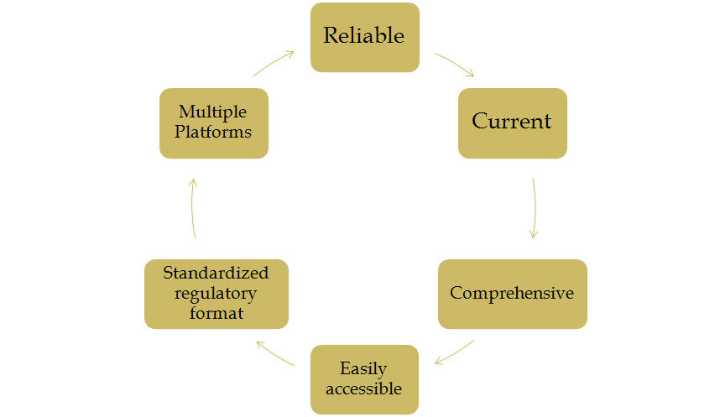
The Vision – DailyMed (2/2)

Slide 6
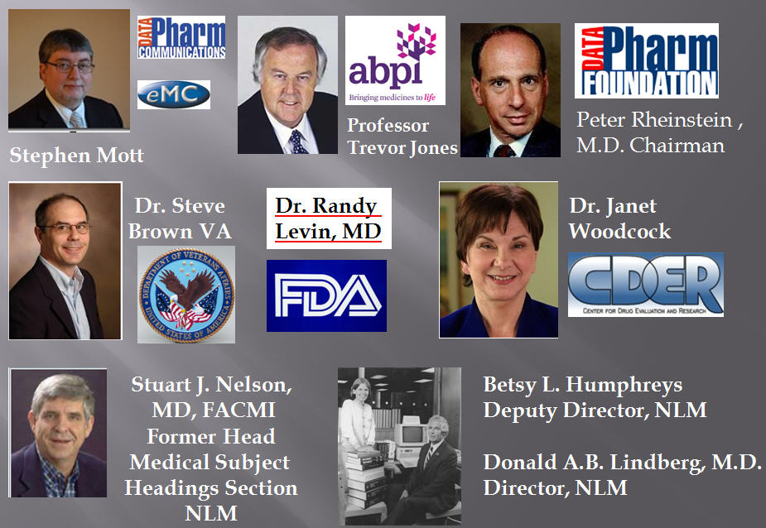
IT TAKES A TEAM

Slide 7
THE PRODUCT “LABEL”
THE LAW
1939 STAUTORY MANDATE
“Adequate Directions for Use” [For a lay person.]
Durham-Humphrey – 1952
Exemption: If the label of such drug or device bears the statement “Caution: To be used only by or on the prescription of a _______..."
PPI – Physician Package Insert Contents are governed by the misbranding provision that labeling not be “False and Misleading.”

Slide 8
Steps for Dissemination of Product Information on Paper [$]
  Shrink font size to 6 point
  Print on tissue thin paper
  Fold multiple times
  Place folded paper in to a box
  Seal box
  Place box into shipping carton
  Send to Warehouse
  Sell Product and ship to wholesaler
  Wholesaler opens shipping carton, sells and ships packages to pharmacy
  Pharmacy puts on shelf
  Package insert goes into trash pail for recycling

Slide 9
CHALLENGES IN 2000
Modernize FDA’s labeling review process
OLD-Processing and Review of Labeling Changes
  Word for word comparison with previous examples of labeling
  Identify all changes
  Review changes
  Negotiate changes with applicant
  Distribute new labeling internally
OLD-Steps for Preparation of Labeling for review and Comparison
  Photocopy parts of package insert
  Cut copy of package insert into parts
  Photocopy again to enlarge each part
  Tape each part together so it will fit on a single sheet of paper
  Photocopy taped paper
  Repeat for each example used in the comparison and review

Slide 10
FDA DataPHARM CRADA
Purpose:
  1. Enhance patient safety and reduce medical error by making all drug labeling information used by professionals and consumers accessible in a more timely fashion
  2. Improve the Food and Drug Administration (FDA) labeling review process.
  3. Provide medication information in a form that can easily be used by health care information and decision making systems.
This project is part of a joint FDA, National Library of Medicine (NLM) and Veterans Health Administration (VHA) initiative to disseminate medication information in electronic form called the DailyMed.
The project was built on structuring the label components into XML. [HL7]

Slide 11
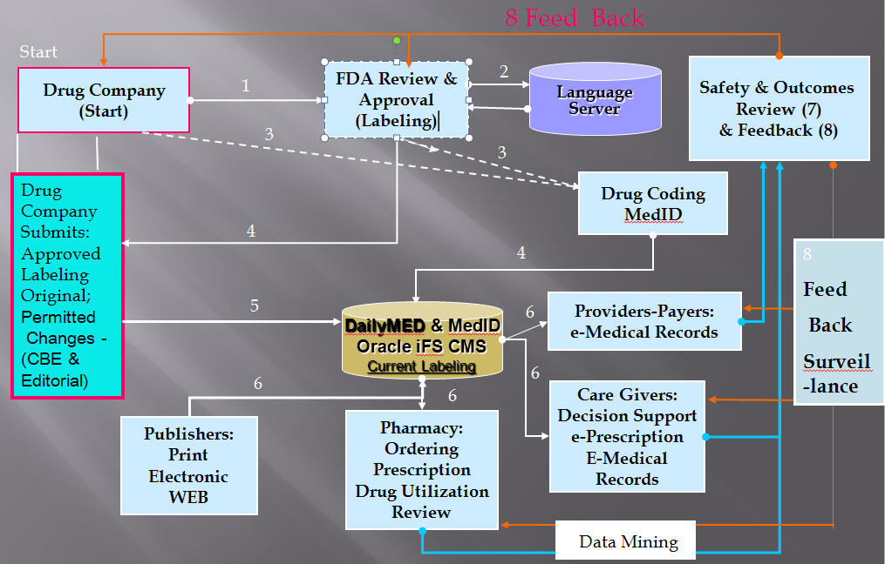
Drug Information Path: 2002 Concept
Notes:
E3 application server used to store the mined information and distribute the information to healthcare stakeholders. Distribution can be coordinated and automated via the implementation of workflow tools and/or a business rules engine.

Slide 12
MY HISTORY
1999 PhRMA Established the Paperless Labeling Task Force – Dr. Alan Goldhammer
Objective: Get rid of the Paper PPI which is out of date by the time the product reaches the pharmacy shelf
2000 Committee member says the U.K. has something called the eMC.
2000-2001 Participated in HL7 discussions relating to RxNorm and Structure. [San Diego.]

Slide 13


Learned From Our Sister Organization

Slide 14

WHAT DO WE DISCOVER
Started in 1997 and Up and Running in 2000

Slide 15
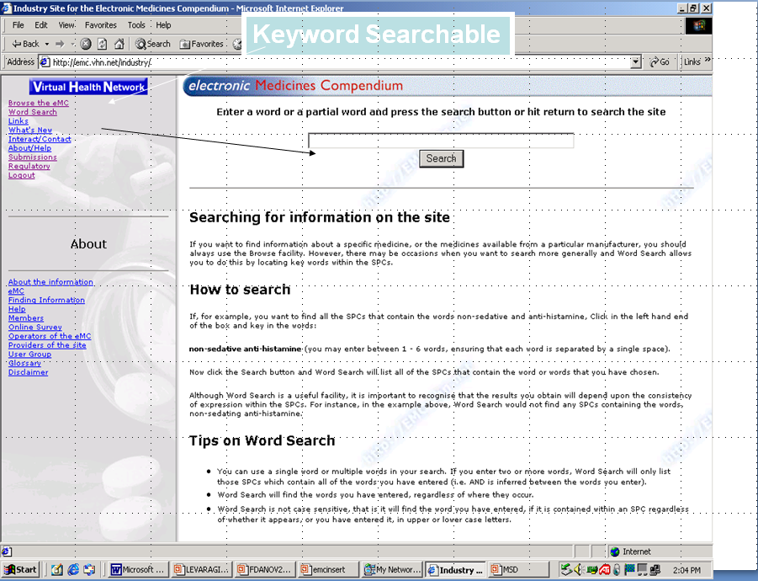
http://emc.vhn.net

Slide 16
ACCOMPLISHMENTS TO DATE
Automated FDA’s Labeling Review Process [√]
Improved labeling organization and structure [√]
Established standard nomenclature– RxNorm [√]
Provided the public with a definitive up-to-date medicines reference source – DAILYMED online[√]
Sped the flow of this information to prescribers & patients through NLM distribution methods - Secure ftp Transfer Once Daily [√]
Downloadable for reuse [√]
First Label November 2005
2013 – Still have paper [F]

Slide 17
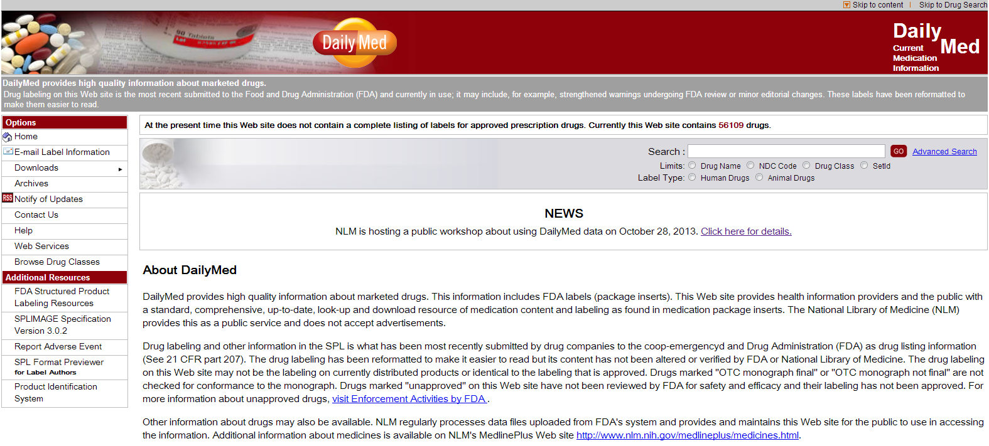
Use of DailyMed
Page View Counts Growing
Roughly 11 Million in March, 2011
8 Minutes Per Page View

Slide 18
CHALLENGES GOING FORWARD (1/2)
Does the PPI (Physician Package Insert ) provide "Full prescribing information?“
Is current labeling ADEQUATE?
In the age of personalized medicine are blanket warnings or precautions adequate now that we know individual patients, because of "omics,” respond differently in terms of adverse events (in degree) and effectiveness (degree)?
In that case is there sufficient information about the patients who participated in the clinical studies for the prescriber to make the "risk benefit decision" for their patients?
[Sharing Clinical Trial Data At What Level?]

Slide 19
CHALLENGES GOING FORWARD (2/2)
Are we taking advantage of the structure labeling of the PPI adequately in patient engagement and product utilization?
Do we need a PPI for physicians for OTC drugs. While these drugs are sufficiently safe to be bought without prescriptions some were once prescription drugs?
Is the current DailyMed website structure improvable?
Who will prescribe, counsel, and monitor medication therapy? Doctors, Nurses, Pharmacists, Dentists – in the age of Accountable Care & Universal Health Insurance?

Slide 20
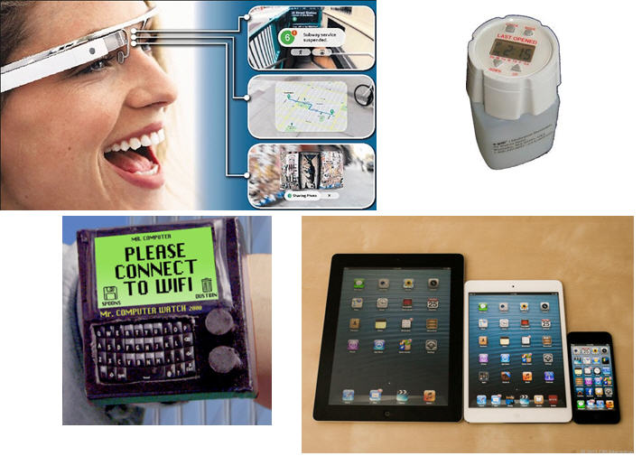
NEW CHALLENGES
Methods of Information Distribution

Slide 21
Next Device Label Website
Separate Website [Link between Rx and Dx?]
"Generic" or Common Names
Adherence to LOINC Codes for Structure of SPL
Catchy Name
Uniform Device Identifier

Slide 22

FUNDING
DailyMed – Get rid of paper and fund DailyMed!
Integration with ClinicalTrials.gov
The Medical Device Labeling Website

Slide 23
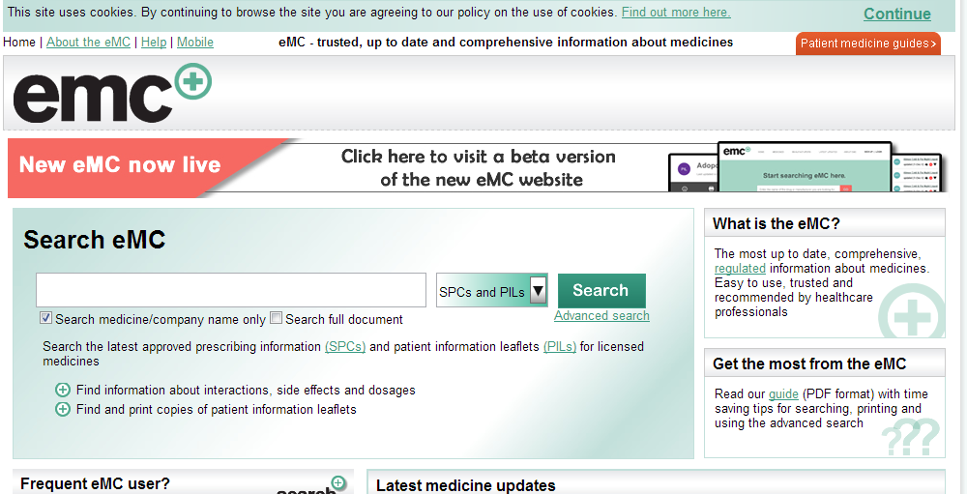
Alternative Views

Slide 24
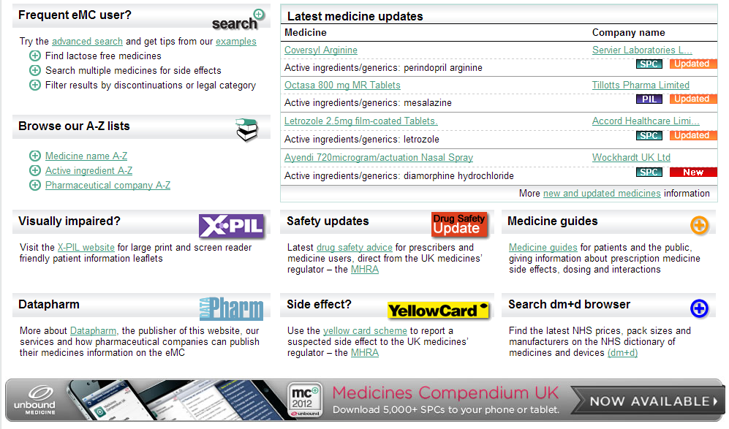
SCREEN BOTTOM

Slide 25
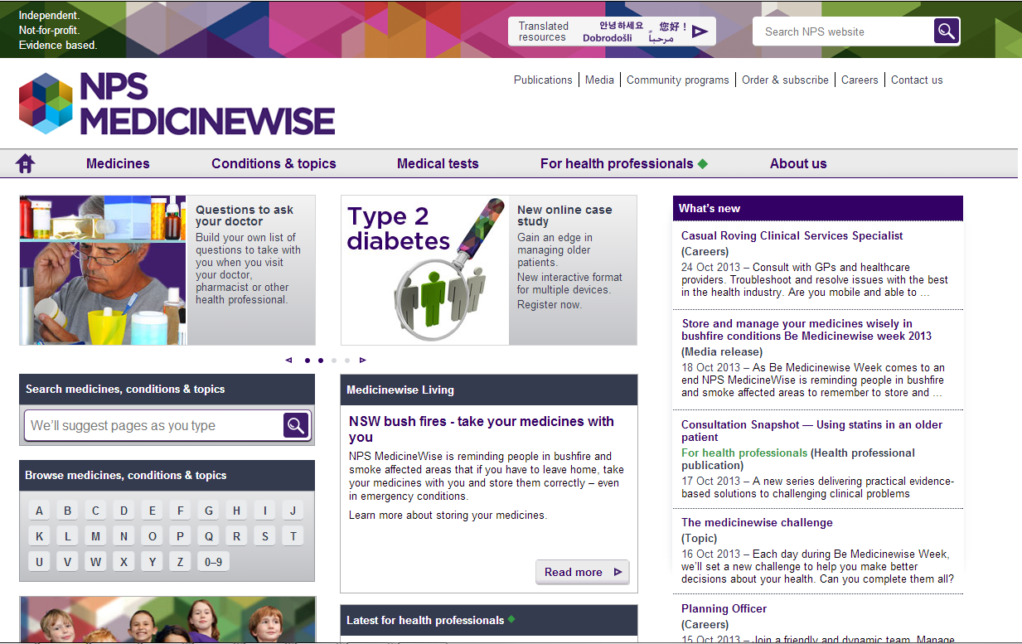
AUSTRALIA

Slide 26
QUSTION FROM
DR. BEN GOLDACRE
Does DataPHARM or a similar outfit have a list, nicely structured data with consistent terms, of all drugs currently on the market (including old ones) and their approval date?

Slide 27
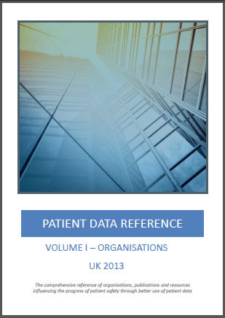
Next for NLM: Clinical Trial Data?
Patient Data Reference – UK 2013
Keeping track of the organisations and policies that are shaping the use of patient data by the healthcare and life sciences industries.
Electronic Medical Records
Life Science Strategies
Health Research
Outcomes
Standards
Governance
Stratified Medicine
Genomics
http://www.medstream.co.uk/

Slide 28

THE END ?

