Slide 1
How BLAST Works & Using Web BLAST Effectively Wayne Matten, PhD mattenw@nih.gov
blast-help@ncbi.nlm.nih.gov

Slide 2
Agenda
How BLAST works
BLAST exercises
Identify a sequence; review BLAST results page
See BLAST results in a gene or genomic context
Why do I get no hits?
Use the new Clustered nr, protein database

Slide 3
I Use BLAST To:
Identify a sequence
Find related proteins
Design or check primers
Locate my sequence in the genome
Annotate genomic sequence
Other
I’ve never used BLAST

Slide 4
Local versus Global Alignment
Query: WHEREISWALTERNOW (16aa)
Subj: HEWASHEREBUTNOWISHERE (21aa)
Global
Query: 1 W--HEREISWALTERNOW 16
W HERE
Subj: 1 HEWASHEREBUTNOWISHERE 21
Local
Query: 1 W--HERE 5 Query: 1 W--HERE 5
W HERE W HERE
Subj: 3 WASHERE 9 Subj: 15 WISHERE 21
Query
Subj

Slide 5
Summary of How BLAST Works
Setup
read in the query, database, and search parameters
apply query filters, e.g., low complexity and repeats
make a lookup table of query “words”
Preliminary search
scan database for word matches
gap-free extensions
gapped extensions, minus deletions/insertions
Traceback
gapped extensions, calculate the deletions/insertions
https://www.ncbi.nlm.nih.gov/books/NBK279684/#appendices.Outline_of_the_BLAST_process
Notes:
High level review of “how BLAST works”:
https://www.ncbi.nlm.nih.gov/books/NBK153387/
More detailed review: Outline of the BLAST Process”:
https://www.ncbi.nlm.nih.gov/books/NBK279684/#appendices.Outline_of_the_BLAST_process

Slide 6
Words (Nucleotide)
Setup
Query:
GTACTGGACATGGACCCTACAGGAA
11-mer
GTACTGGACAT
TACTGGACATG
ACTGGACATGG
CTGGACATGGA
TGGACATGGAC
GGACATGGACC
GACATGGACCC
ACATGGACCCT
Lookup table
. . .

Slide 7
BLASTN Summary
Preliminary search
Database sequence:
ATCGCCATGCTTAATTGGGCTT
CATGCTTAATT
Query, from lookup table:
one exact match
Extension phases
Traceback
Final alignment

Slide 8
Words (Protein)
Setup
Query:
GTQITVEDLFYNIATRRKALKN
GTQ
TQI
QIT
ITV
TVE
VED
EDL
DLF
...
Neighborhood Words
LTV,MTV,ISV,LSV, etc.

Slide 9
Minimum Requirements for a Match - Protein
Preliminary search
Database sequence:
GTQITVEDLFYNI
SEI YYN
Neighborhood words:
two matches - within 40 residues

Slide 10
BLASTP Summary – Neighborhood Words
Setup
example query words
Query: IETVYAAYLPKNTHPFLYLSLEISPQNVDVNVHPTKHEVHFLHEESILEV…
YLS 15
YLT 12
YVS 12
YIT 10
...
HFL 18
HFV 15
HFS 14
HWL 13
NFL 13
DFL 12
HWV 10
...
Neighborhood words
Neighborhood score threshold = 11

Slide 11
BLASTP Summary
Preliminary search: gap-free extentions
Query 1 IETVYAAYLPKNTHPFLYLSLEISPQNVDVNVHPTKHEVHFLHEESI
47
+E YA YL K F+ L +SP+ +DVNVHP+K V +++ I
YLS HFL
Sbjct 287 LEETYAKYLHKGASYFVYLSLNMSPEQLDVNVHPSKRIVHFLYDQEI
333
gapped extentions
Traceback
Final alignment
Query 1 IETVYAAYLPKNTHPFLYLSLEISPQNVDVNVHPTKHEVHFLHEESI-LEV 50
+E YA YL K F+YLSL +SP+ +DVNVHP+K VHFL+++ I + +
Sbjct 287 LEETYAKYLHKGASYFVYLSLNMSPEQLDVNVHPSKRIVHFLYDQEIATSI 337

Slide 12
BLAST Expect Value (Definition)
E = number of database hits you expect to find by chance, ≥ S
Background
1)
From the Help link on the BLAST home page:
The Statistics of Sequence Similarity Scores
2)
Playlist of 4 videos on Expect values/statistics:
https://youtube.com/playlist?list=PL7dF9e2qSW0Zgw8AxCg7hANshivtJGLXf
3)
Playlist of all NCBI BLAST videos
https://youtube.com/playlist?list=PL7dF9e2qSW0azL2xOKAtxDW7QI8UU4XZ6
Notes:
YouTube videos on Expect values:
Simplified reviews, Parts 1 & 2: https://youtu.be/ZN3RrXAe0uM & https://youtu.be/dzRq-5BrGD4
Stephen Altschul’s in-depth webinars, Parts 1 & 2: https://youtu.be/fkRteePMdz8 & https://youtu.be/tXUA20213TM
BLAST Help document (an oldy but goody): The Statistics of Sequence Similarity Scores
https://www.ncbi.nlm.nih.gov/BLAST/tutorial/Altschul-1.html

Slide 13
BLAST Expect Value (Due to Chance)
Expect to find this alignment 48 thousand times by chance

Slide 14
BLAST Expect Value (Not Due to Chance)
7x10⁻¹⁸ - not chance

Slide 15
BLAST Expect Value (In a Nutshell)
E = number of database hits you expect to find by chance, ≥ S
Database size E
Score E

Slide 16
Exercises
But first . . .
Web BLAST: search limits
errors
warnings

Slide 17
Web BLAST Search Limits
5,000 - maximum number of target sequences
1,000,000 - maximum query length for nucleotide queries
100,000 - maximum query length for protein queries
BLAST News:
https://blast.ncbi.nlm.nih.gov/Blast.cgi?CMD=Web&PAGE_TYPE=BlastNews
NCBI Insights Blog:
https://ncbiinsights.ncbi.nlm.nih.gov/2020/06/18/new-blast-settings/

Slide 18
Error Messages
CPU Usage limit exceeded
Process size limit exceeded

Slide 19
Warning Message
IP address... consumed a large amount of server CPU time
Warning: Searches from this IP address have consumed a large amount of server CPU time. Future searches may be penalized in fairness to other users. Please consider the BLAST+ binaries: https://www.ncbi.nlm.nih.gov/books/NBK279690/
may be penalized

Slide 20
I Adjust Default Search Parameters:
Never
Sometimes
Often

Slide 21
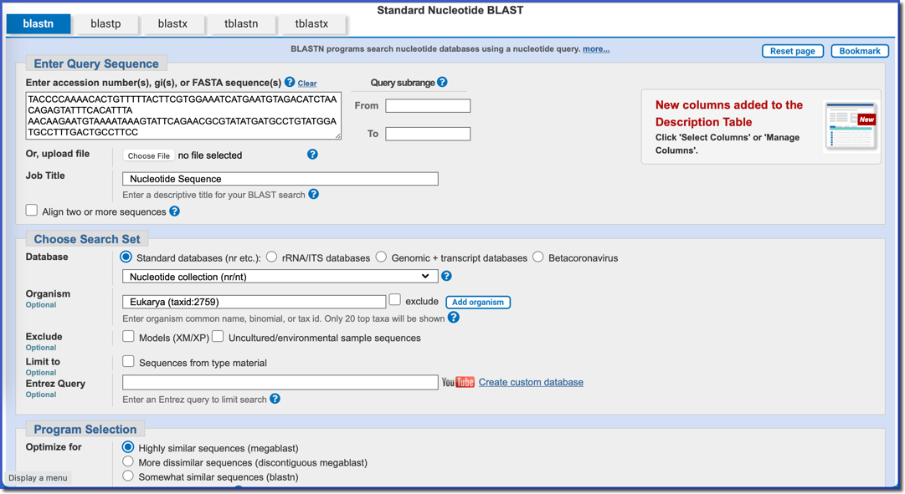
Exercise #1 - Goals
Goals:
Identify a 140 bp nucleotide sequence
Review BLAST results

Slide 22
Exercise #1 – Query
140 bp query
for
Nucleotide BLAST
TACCCCAAAACACTGTTTTTACTTCGTGGAAATCATGAATGTAGACATCTAACAGAGTATTTCACATTTA
AACAAGAATGTAAAATAAAGTATTCAGAACGCGTATATGATGCCTGTATGGATGCCTTTGACTGCCTTCC
RID: KNWN00VF016
Notes:
RID: KDKJ8CGW013

Slide 23
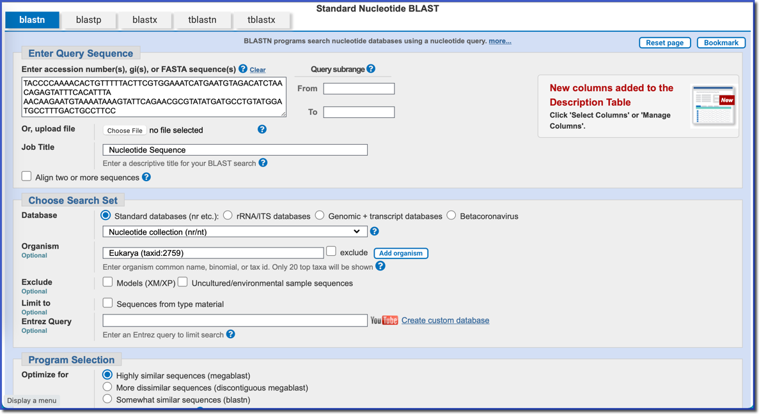
Exercise #1 – Set Up
140 bp query
Default settings
except
Organism

Slide 24
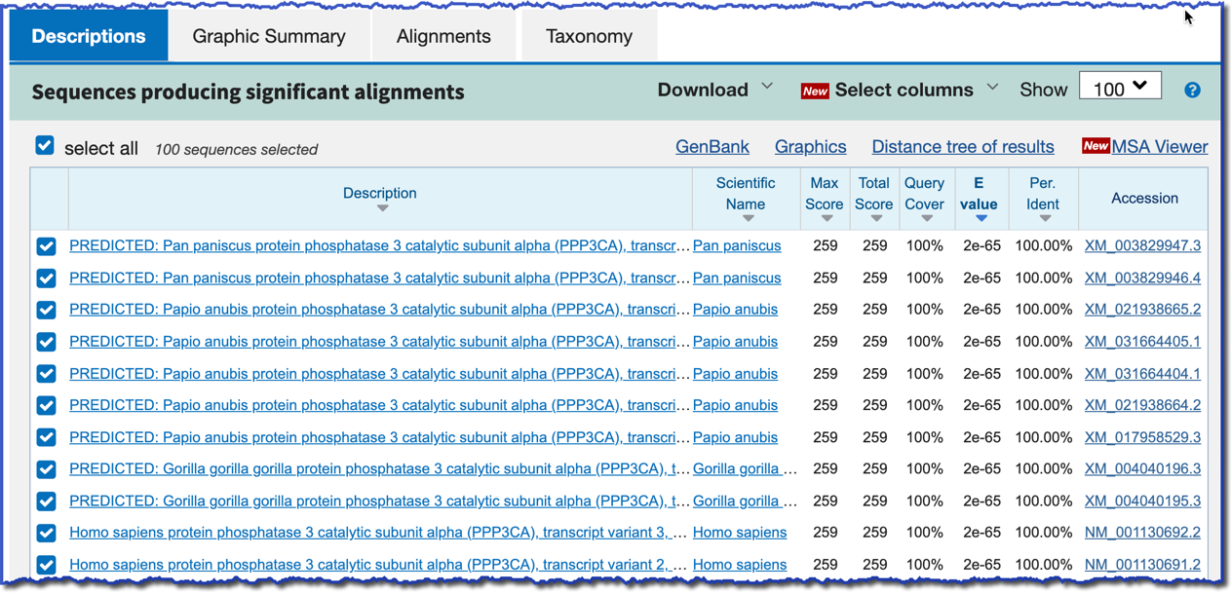
Exercise #1 – Results, RID: KNWN00VF016
Did we achieve our goal?
Query coverage = 100%
Percent identity = 100%
Notes:
RID: KNWN00VF016

Slide 25
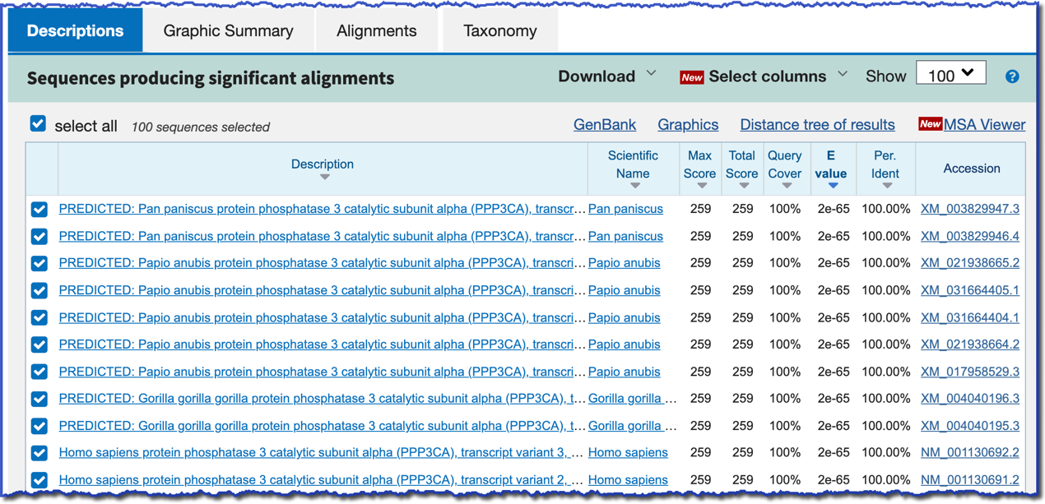
Exercise #1 – Results, Sorting
Sorting is random
when scores are equal

Slide 26
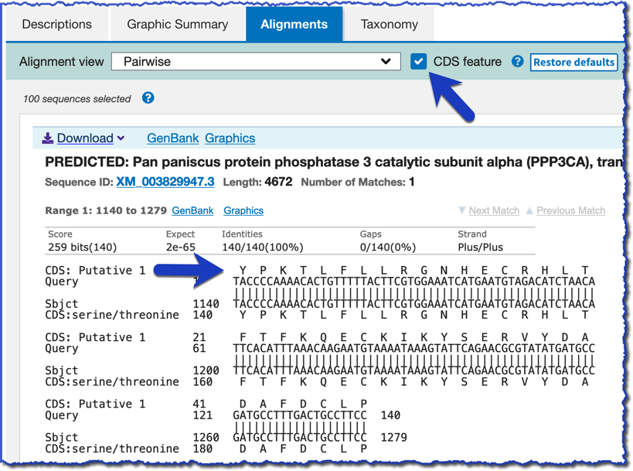
Exercise #1 – Results, Coding Sequence?
CDS feature

Slide 27
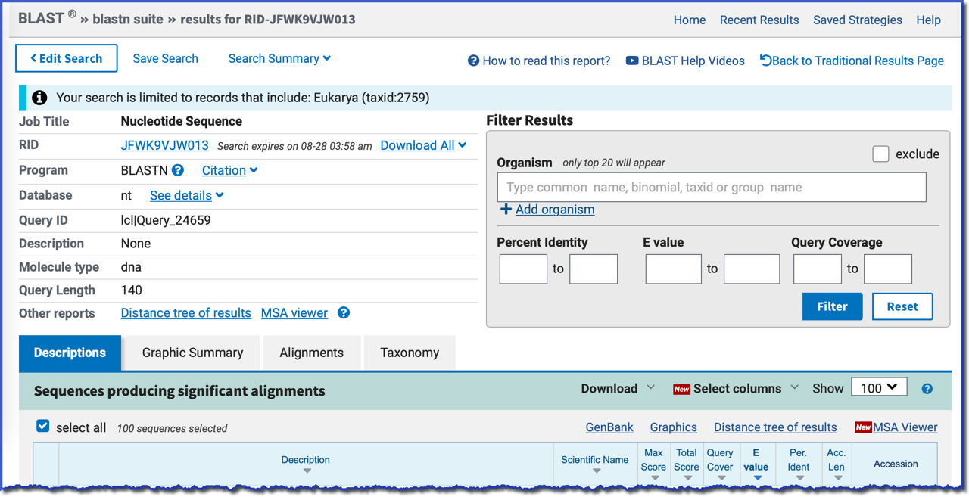
Exercise #1 – Results, Overview 1
See details
RID
Download All

Slide 28
Exercise #1 – Results, Overview 2
Filter your results
Other reports – for all seqs
Selected seqs

Slide 29
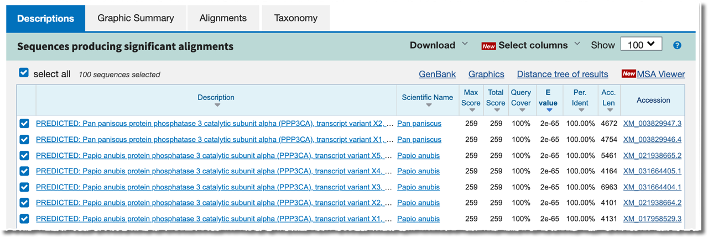
Exercise #1 – Results, Overview 3
Taxonomy
Distance tree
MSA Viewer

Slide 30
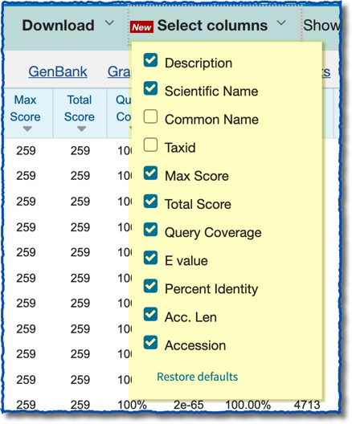
Exercise #1 – Results Overview, Select Columns

Slide 31
What Did We Learn About Our Query?
Exact match in numerous primates
All CDS
Part of the PPP3CA gene

Slide 32
I have used these BLAST results display options:
Distance tree of results
MSA viewer
Multiple alignment (for protein results)

Slide 33
Exercise #2
Using the same query, run a blast search that provides the genomic context of the results.
1) See what part of the gene the query represents
2) Compare this region to other NCBI data
Why?
Search a database containing chromosome-level sequences
How?
Query:
TACCCCAAAACACTGTTTTTACTTCGTGGAAATCATGAATGTAGACATCTAACAGAGTATTTCACATTTA
AACAAGAATGTAAAATAAAGTATTCAGAACGCGTATATGATGCCTGTATGGATGCCTTTGACTGCCTTCC

Slide 34
Exercise #2 - Three Options
Option #1:
refseq_representative_genomes, human
Different
databases
Genome BLAST, human
Option #2:
Search Genome BLAST, human, blastn
Smaller
word size
Option #3:

Slide 35
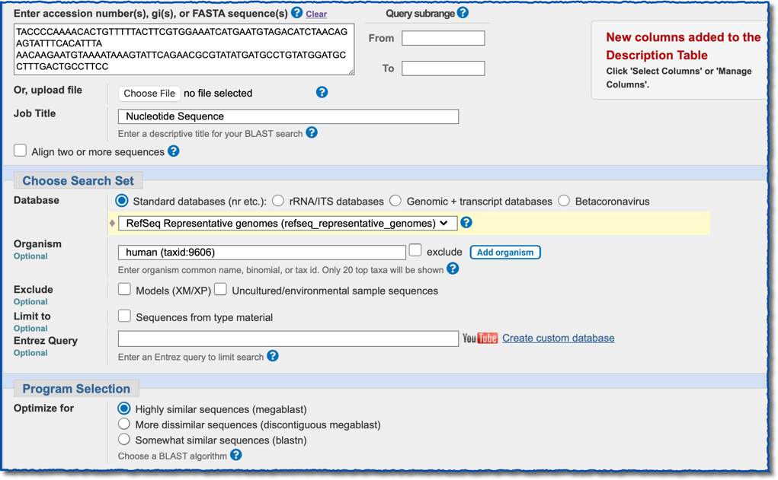
Exercise #2, Option 1 – Setup, RefSeq Rep. Genomes
RefSeq rep.
genomes
(taxid:9606)
megablast

Slide 36
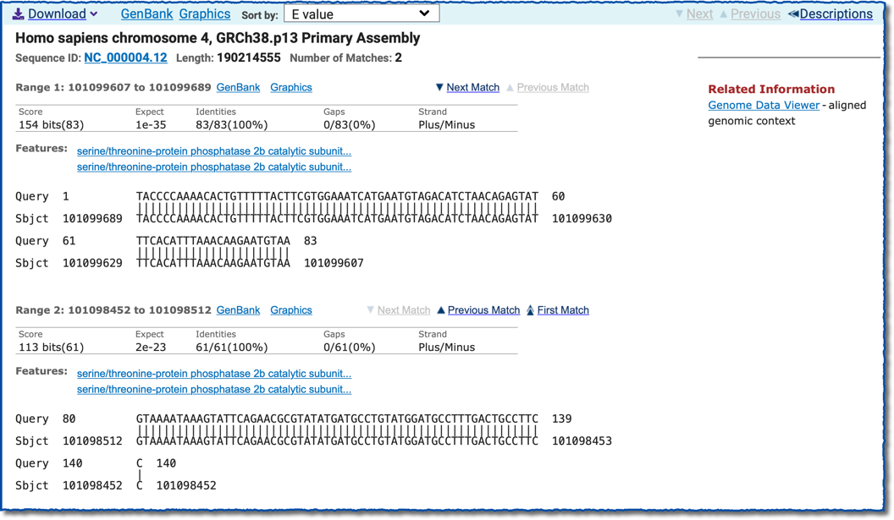
Exercise #2, Option 1 – Results, Alignments
RID: M3T18F9J013
Link to GDV
Note strand
Note strand
Notes:
RID: KDZFCU19013

Slide 37
Exercise #2, Option 1 – Results, Genome Data Viewer (GDV)
BLAST alignments
BLAST alignments
Exon 5
Exon 4
PPP3CA gene,
subunit alpha

Slide 38
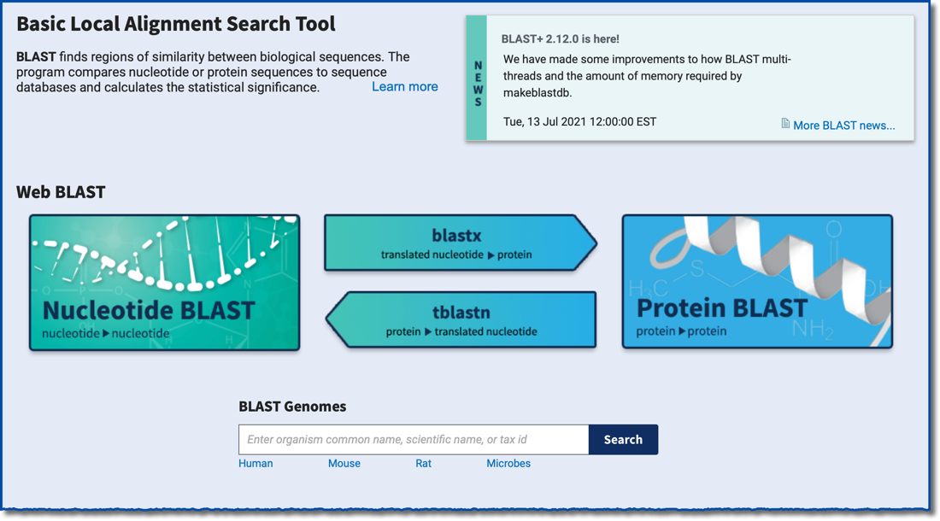
Exercise #2, Option 2 – Setup, “BLAST Genomes”
BLAST home page
BLAST Genomes
Notes:
KEEXM4TW013

Slide 39
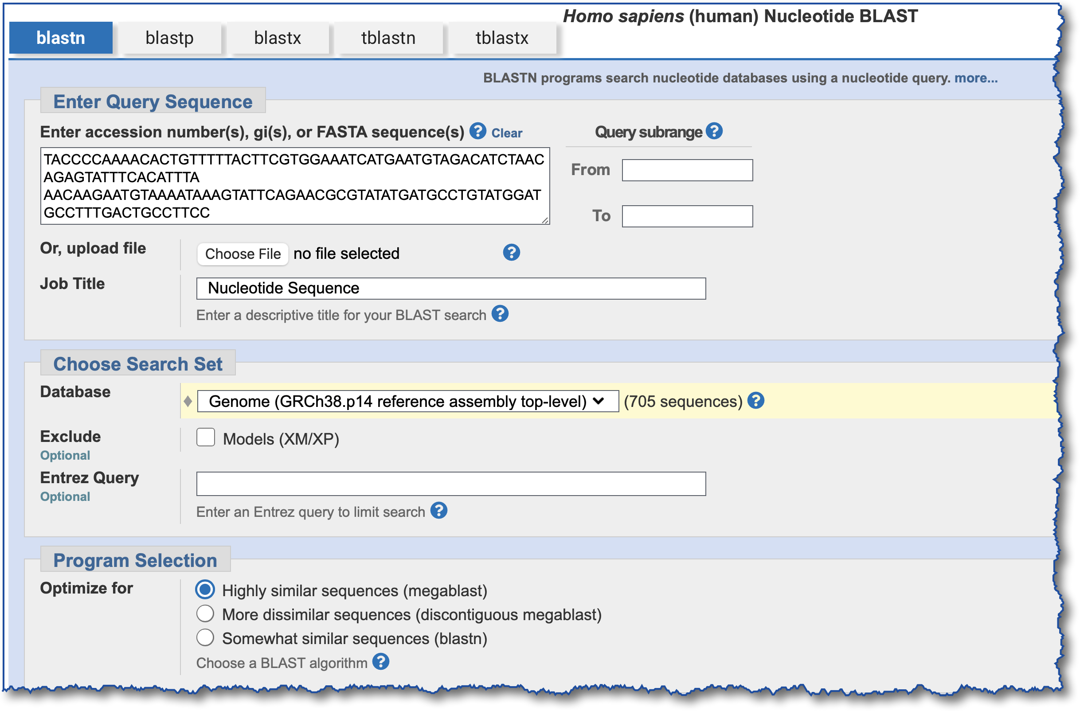
Exercise #2, Option 2 – Results, Alignments
Homo sapiens Nucleotide BLAST
Use blastn instead
Notes:
KDZFCU19013

Slide 40
Exercise #2, Option 2 – Results, Alignments
RID: KVCHCGGS013
Same result as Option 1
Link to GDV
Notes:
KDZFCU19013

Slide 41
Exercise #2, Option 3 – Setup, blastn
Homo sapiens Nucleotide BLAST
Use blastn instead

Slide 42
Exercise #2, Option 3 – Results
Two additional hits with blastn
RID: KVAAC90V013
Notes:
RID: KP0CKH3J016

Slide 43
Exercise #3 - “Why Did I Get No Hits?”

Slide 44
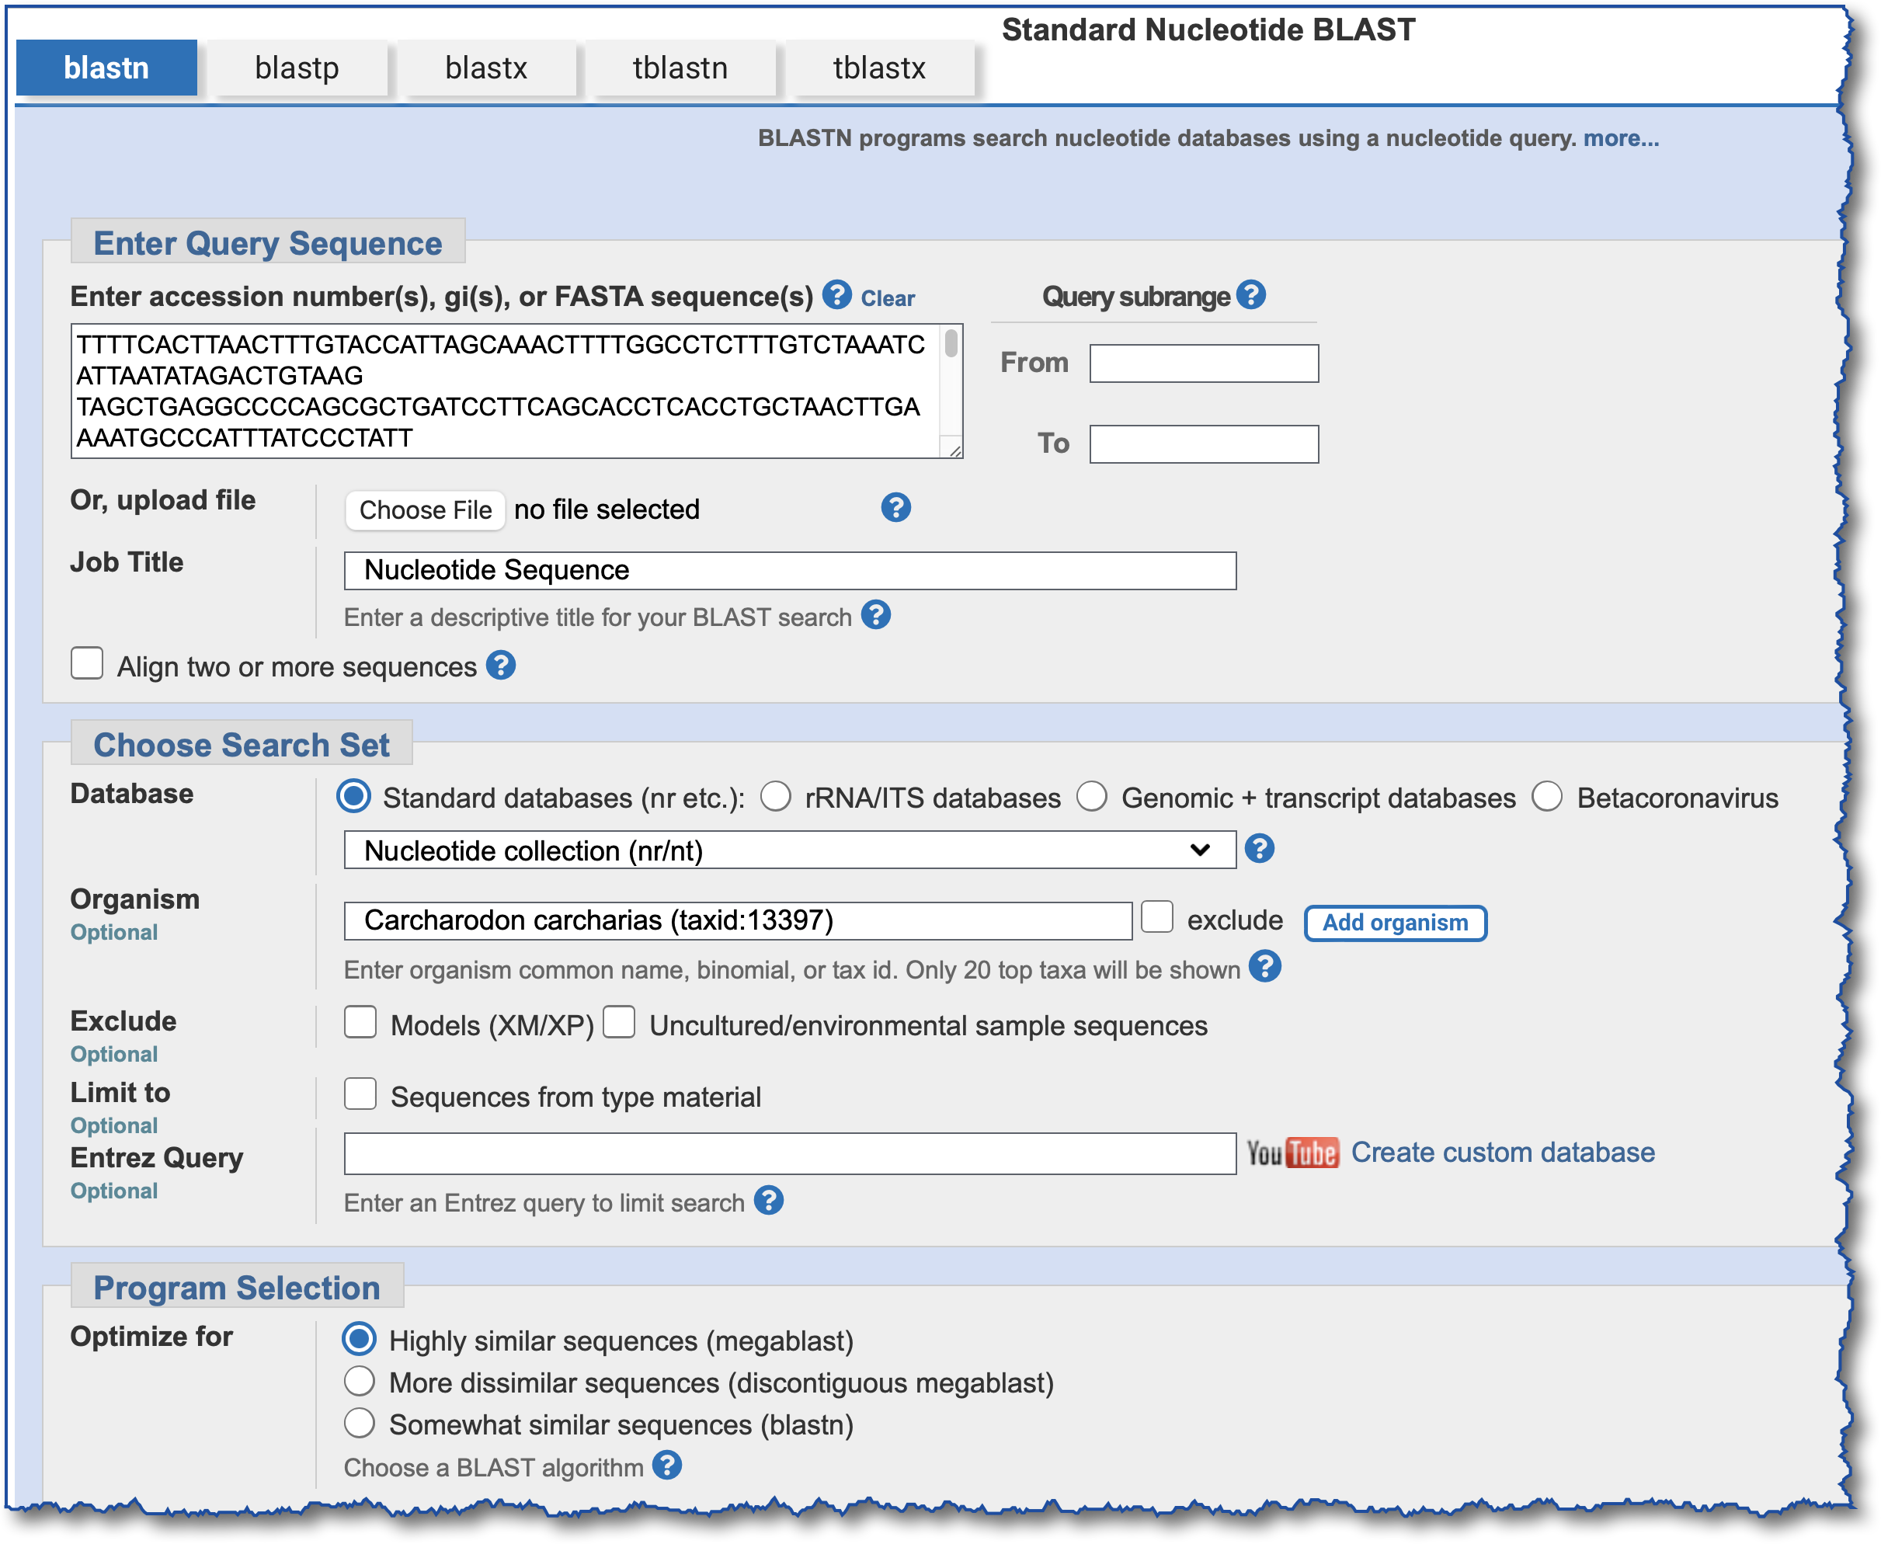
Exercise #3 - “Why Did I Get No Hits?” - SetUp
~1kb query
Great white shark (Carcharodon carcharias)
nt,
Taxonomy limit

Slide 45
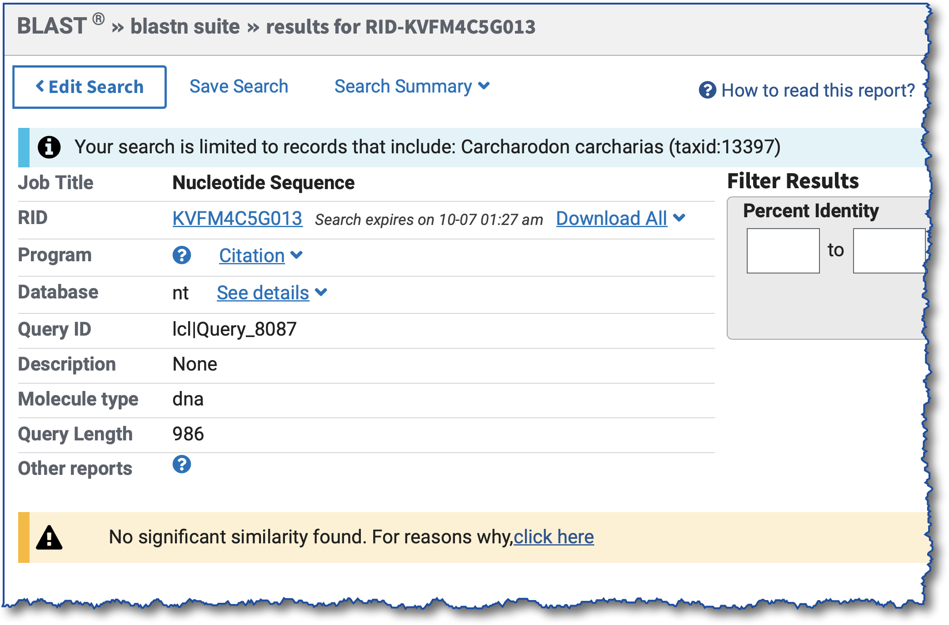
Exercise #3 - “Why Did I Get No Hits?”
RID: KVFM4C5G013
Notes:
Query: great white shark (Carcharodon carcharias (taxid:13397)); KVFM4C5G013

Slide 46
Why does my search return no hits?
Expect value threshold is to low
Word size is too big
Wrong database
Other

Slide 47
Exercise #3, Option 1 – Search WGS Database, Carcharodon carcharias
Start with RID KVFM4C5G013,
change the database

Slide 48
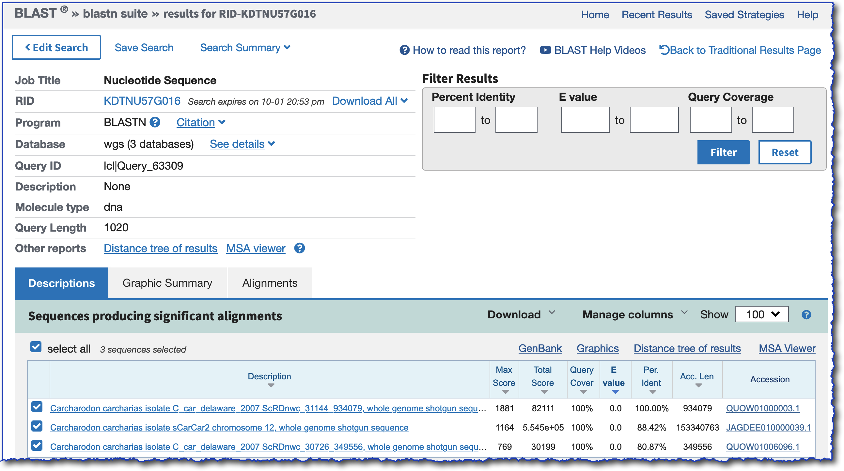
Exercise #3, Option 1 – Search WGS Database - Results
RID: KH01AEZ2016
WGS accessions
Notes:
RID: KH01AEZ2016

Slide 49
Exercise #3, Option 2 – Search BLAST Genomes, Carcharodon carcharias
Use query from RID KVFM4C5G013,
go to BLAST Genomes for
Carcharodon carcharias

Slide 50
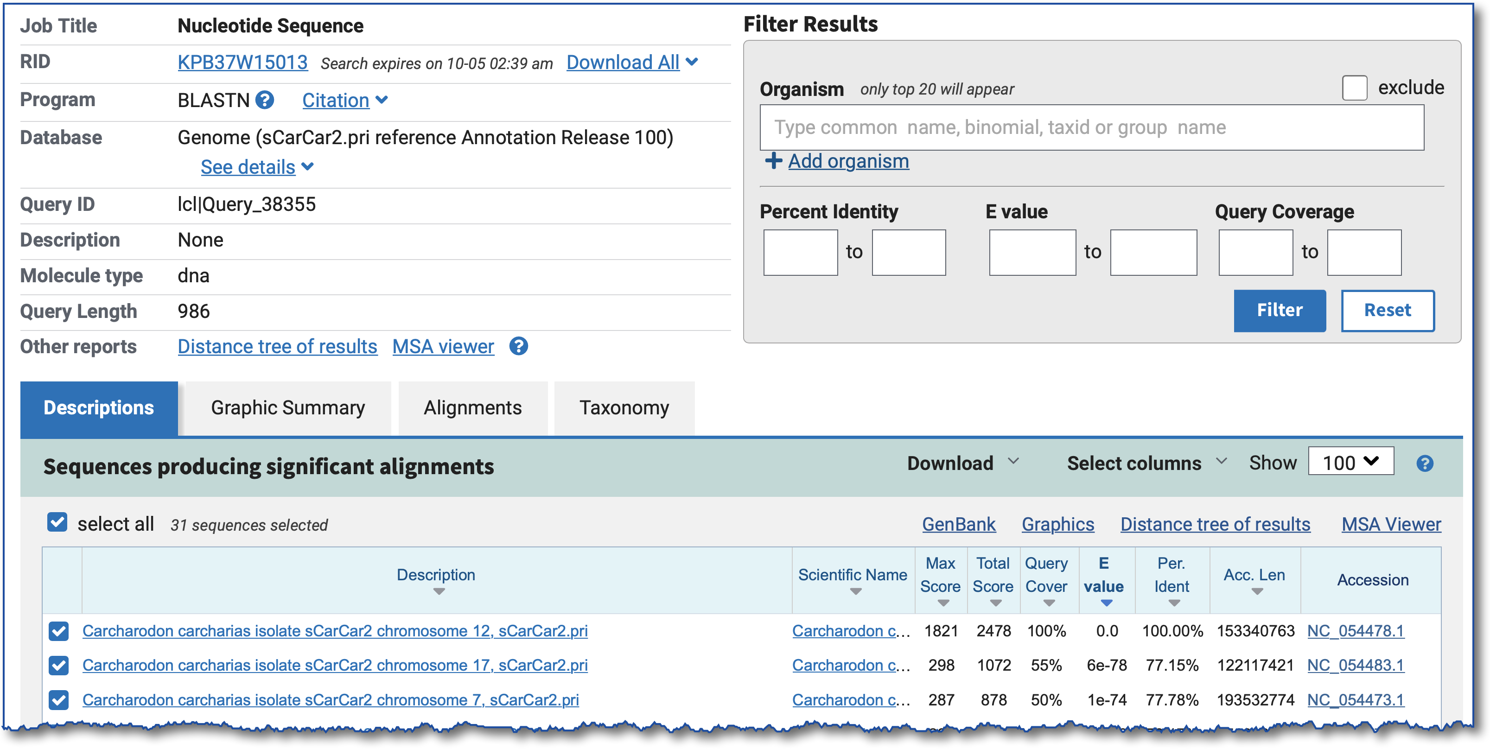
Exercise #3, Option 2 – Results
RID: KPB37W15013
Genome: sCarCar2.pri
RefSeq accessions
Notes:
RID: KPB37W15013

Slide 51
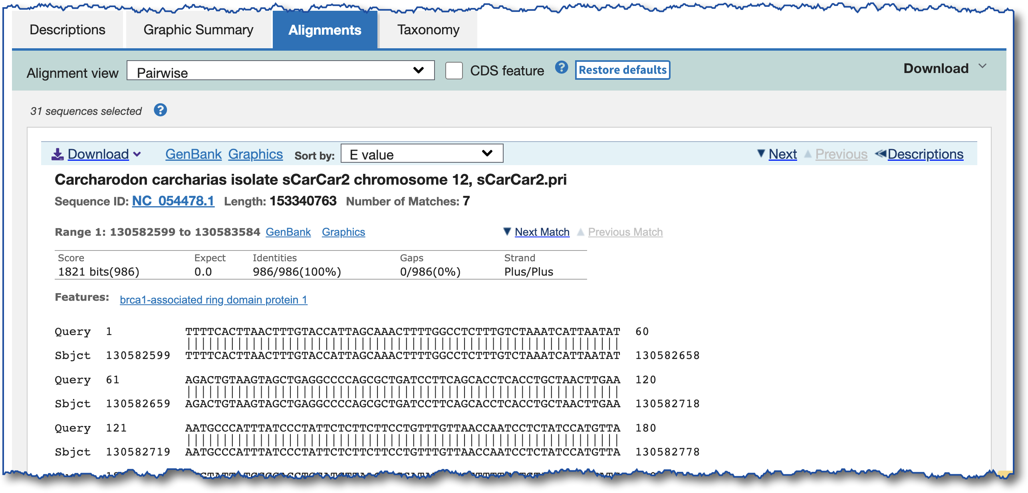
Exercise #3, Option 2 – Results, Alignments
No link to Genome Data Viewer ??
Solutions: 1) Use the “Graphics” link
2) Add the RID in the GDV

Slide 52
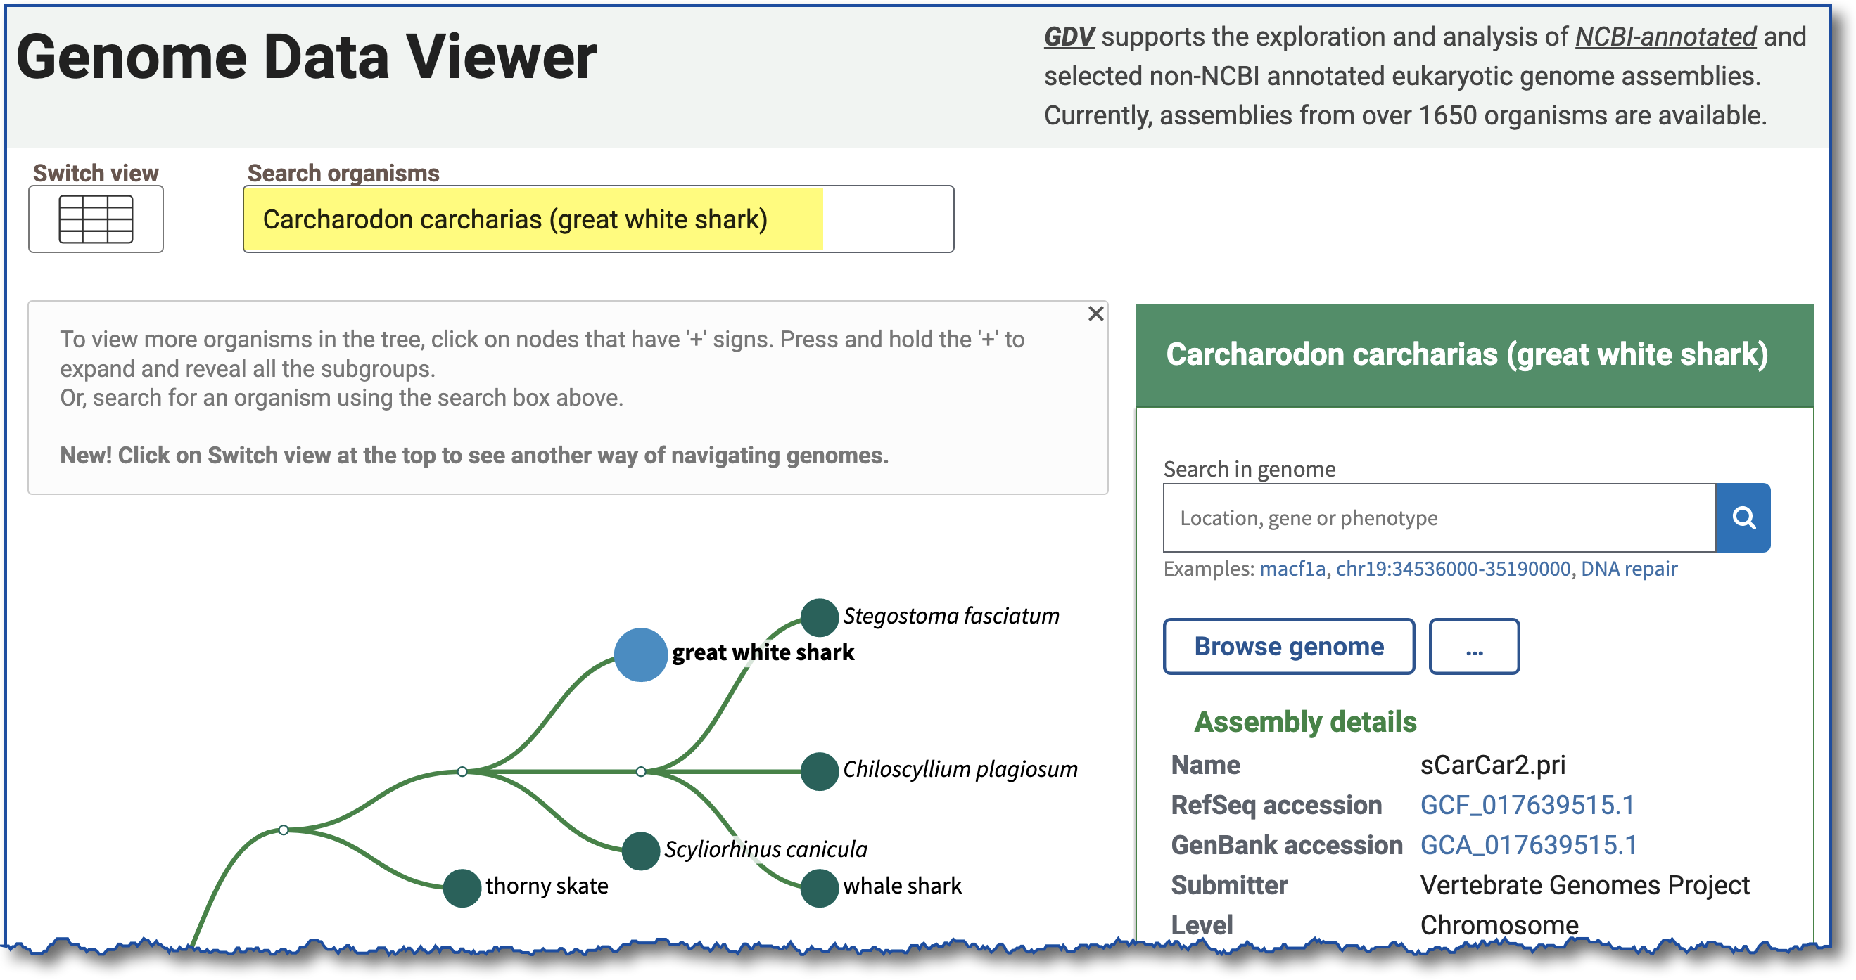
Exercise #3 – View BLAST Results in GDV, Browse Genome

Slide 53
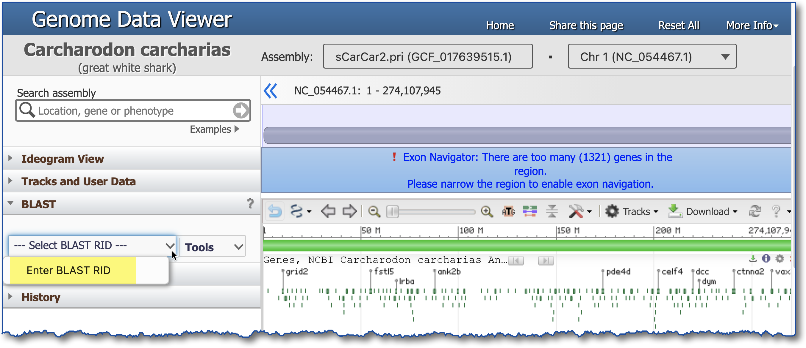
Exercise #3 – Add BLAST RID
KPB37W15013
Notes:
RID: KPB37W15013

Slide 54
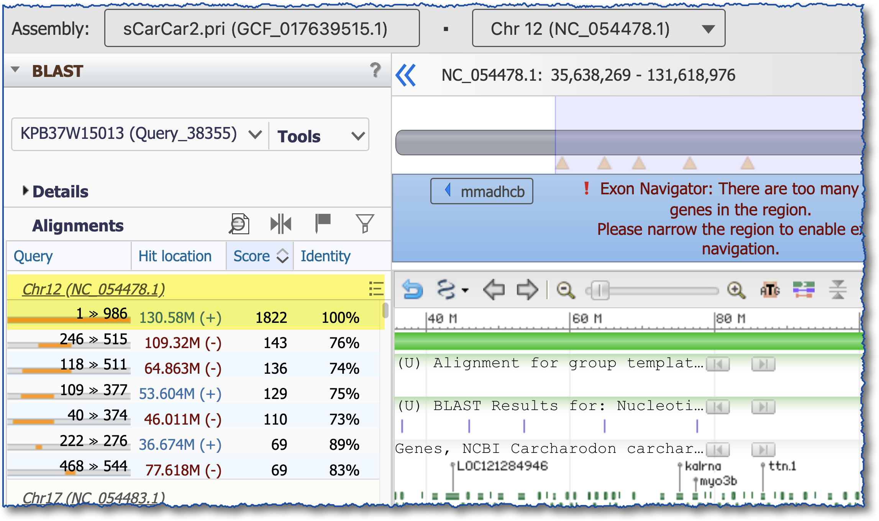
Exercise #3 – View BLAST Alignment
double-click on top hit
Notes:
RID: KPB37W15013

Slide 55
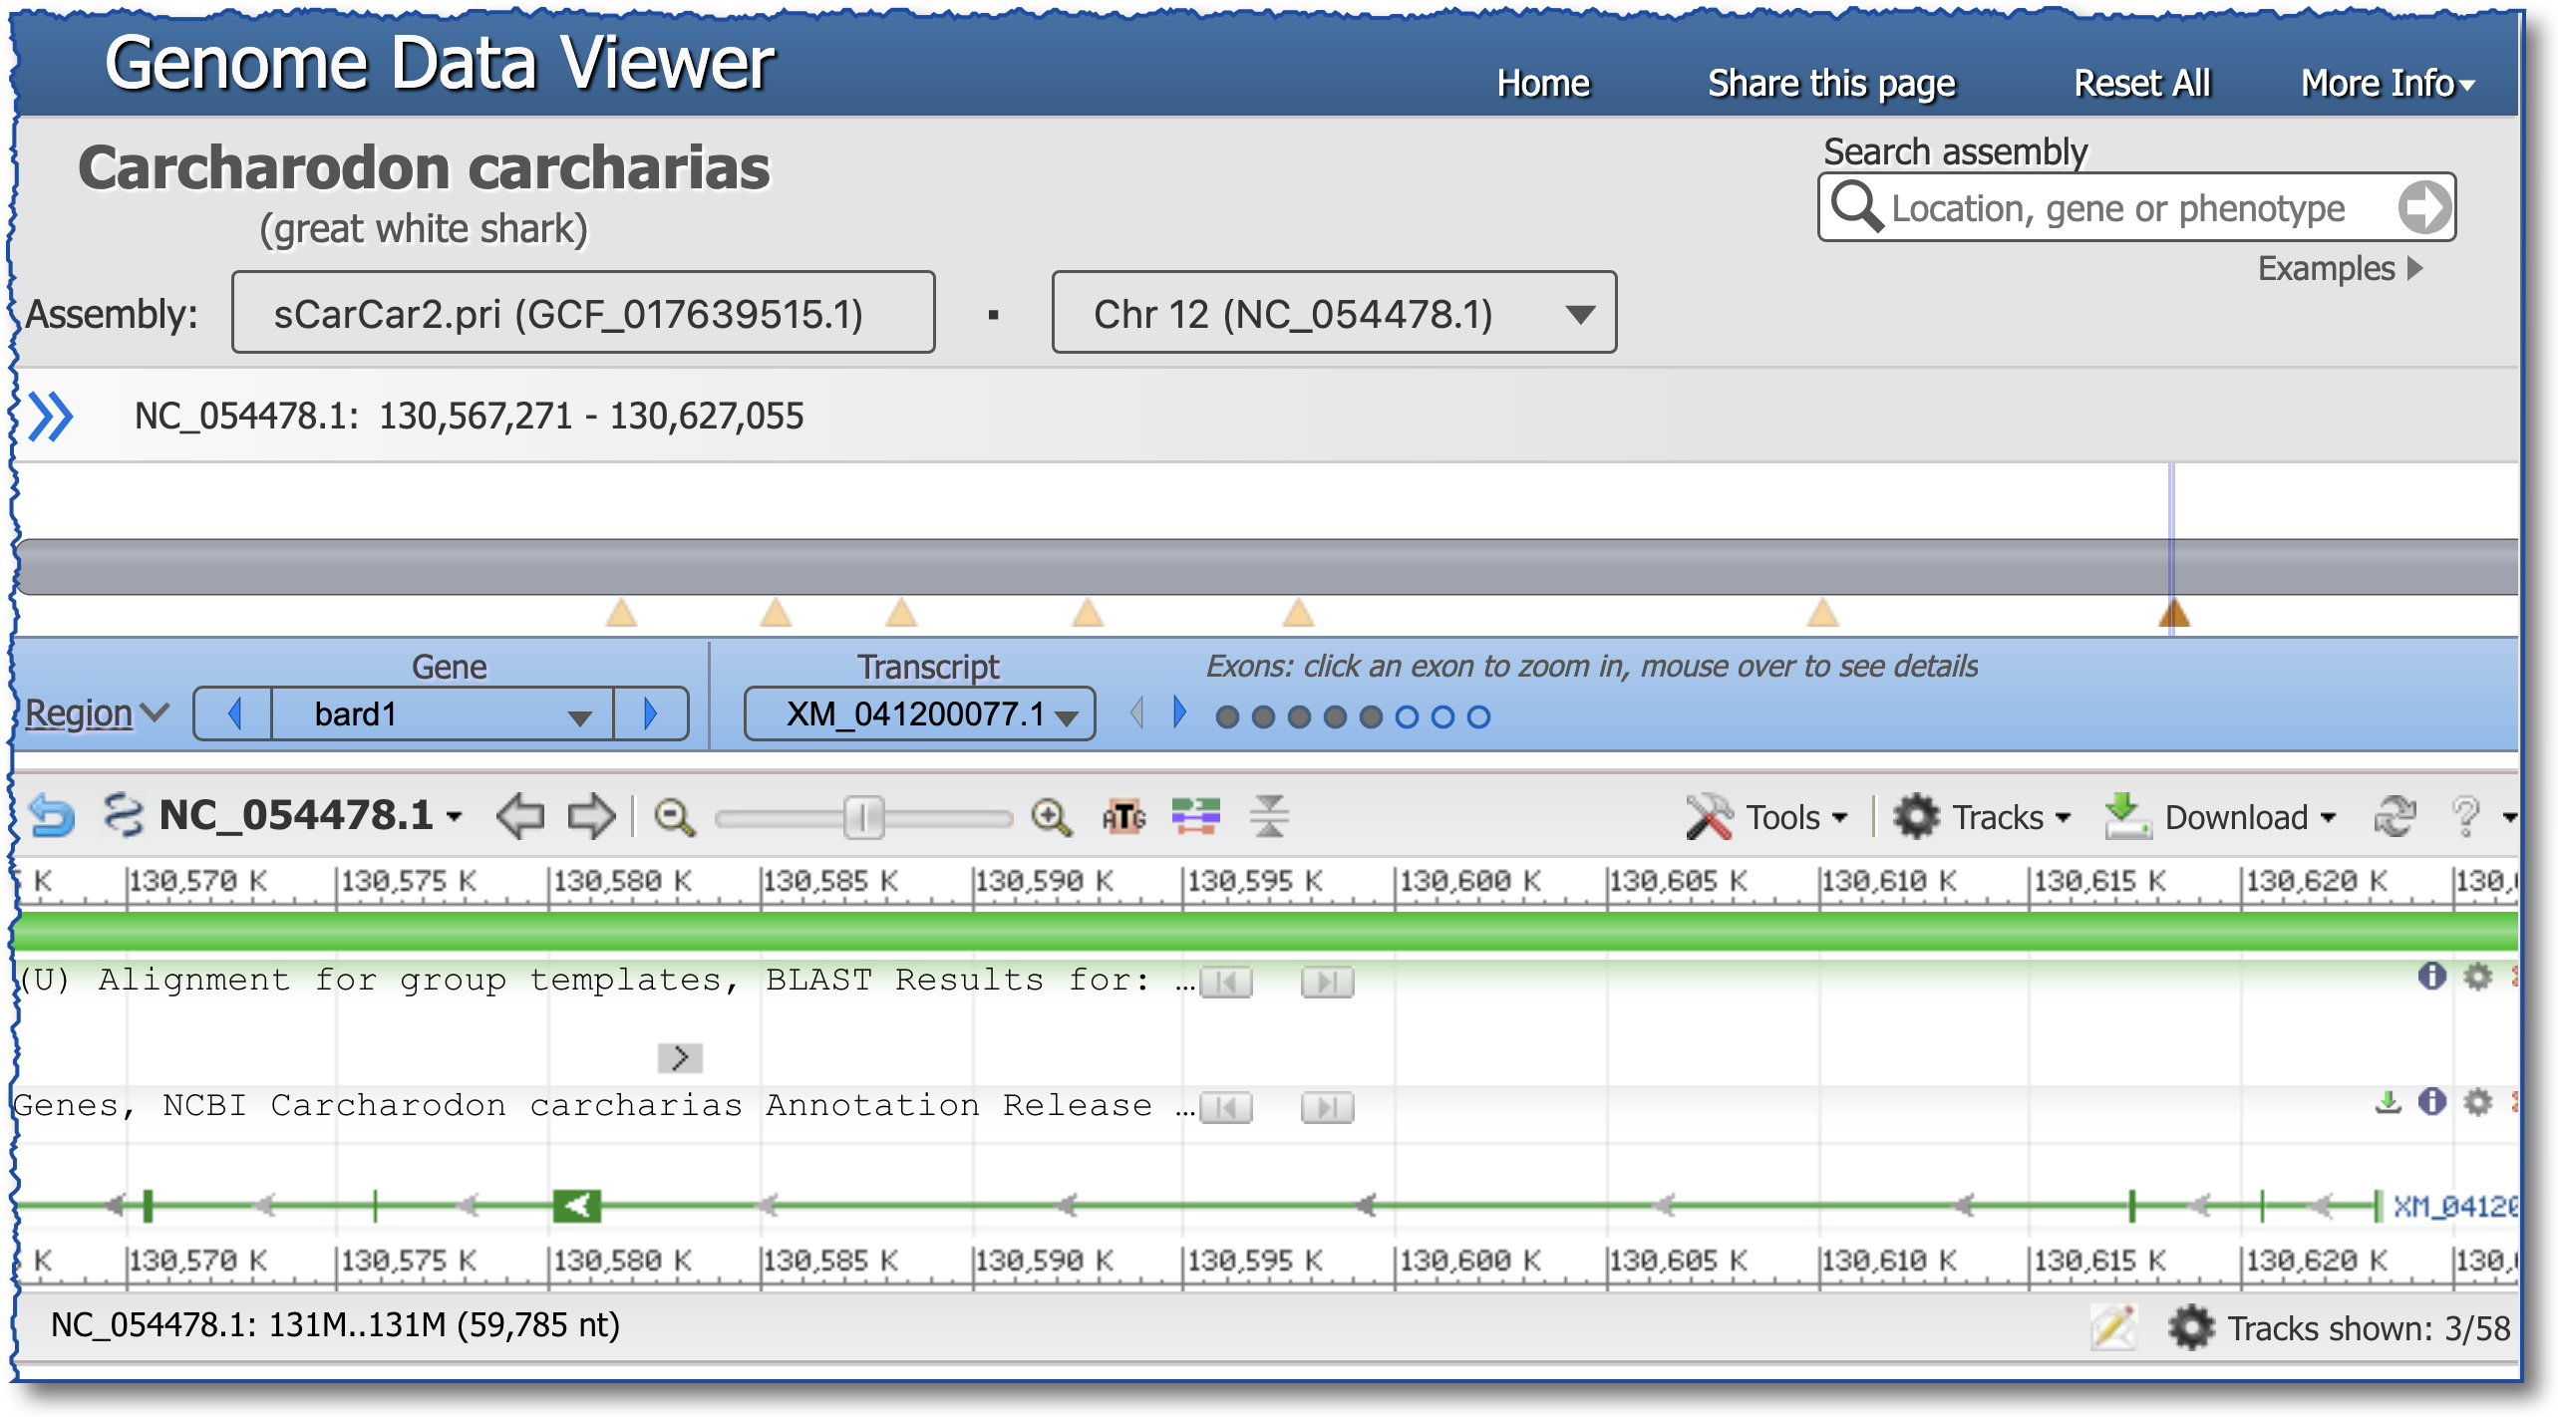
Exercise #3 – See Aligned Region in Gene Context
BLAST alignment
exon #4, bard1 gene
Notes:
RID: KPB37W15013

Slide 56
What Did We Learn About “Why Did I Get No Hits?”
You might need to:
change the database
change the program (word size)
increase the Expect threshold

Slide 57
Exercise #4 – Use the Clustered nr Database
See the blog post about clustered nr

Slide 58
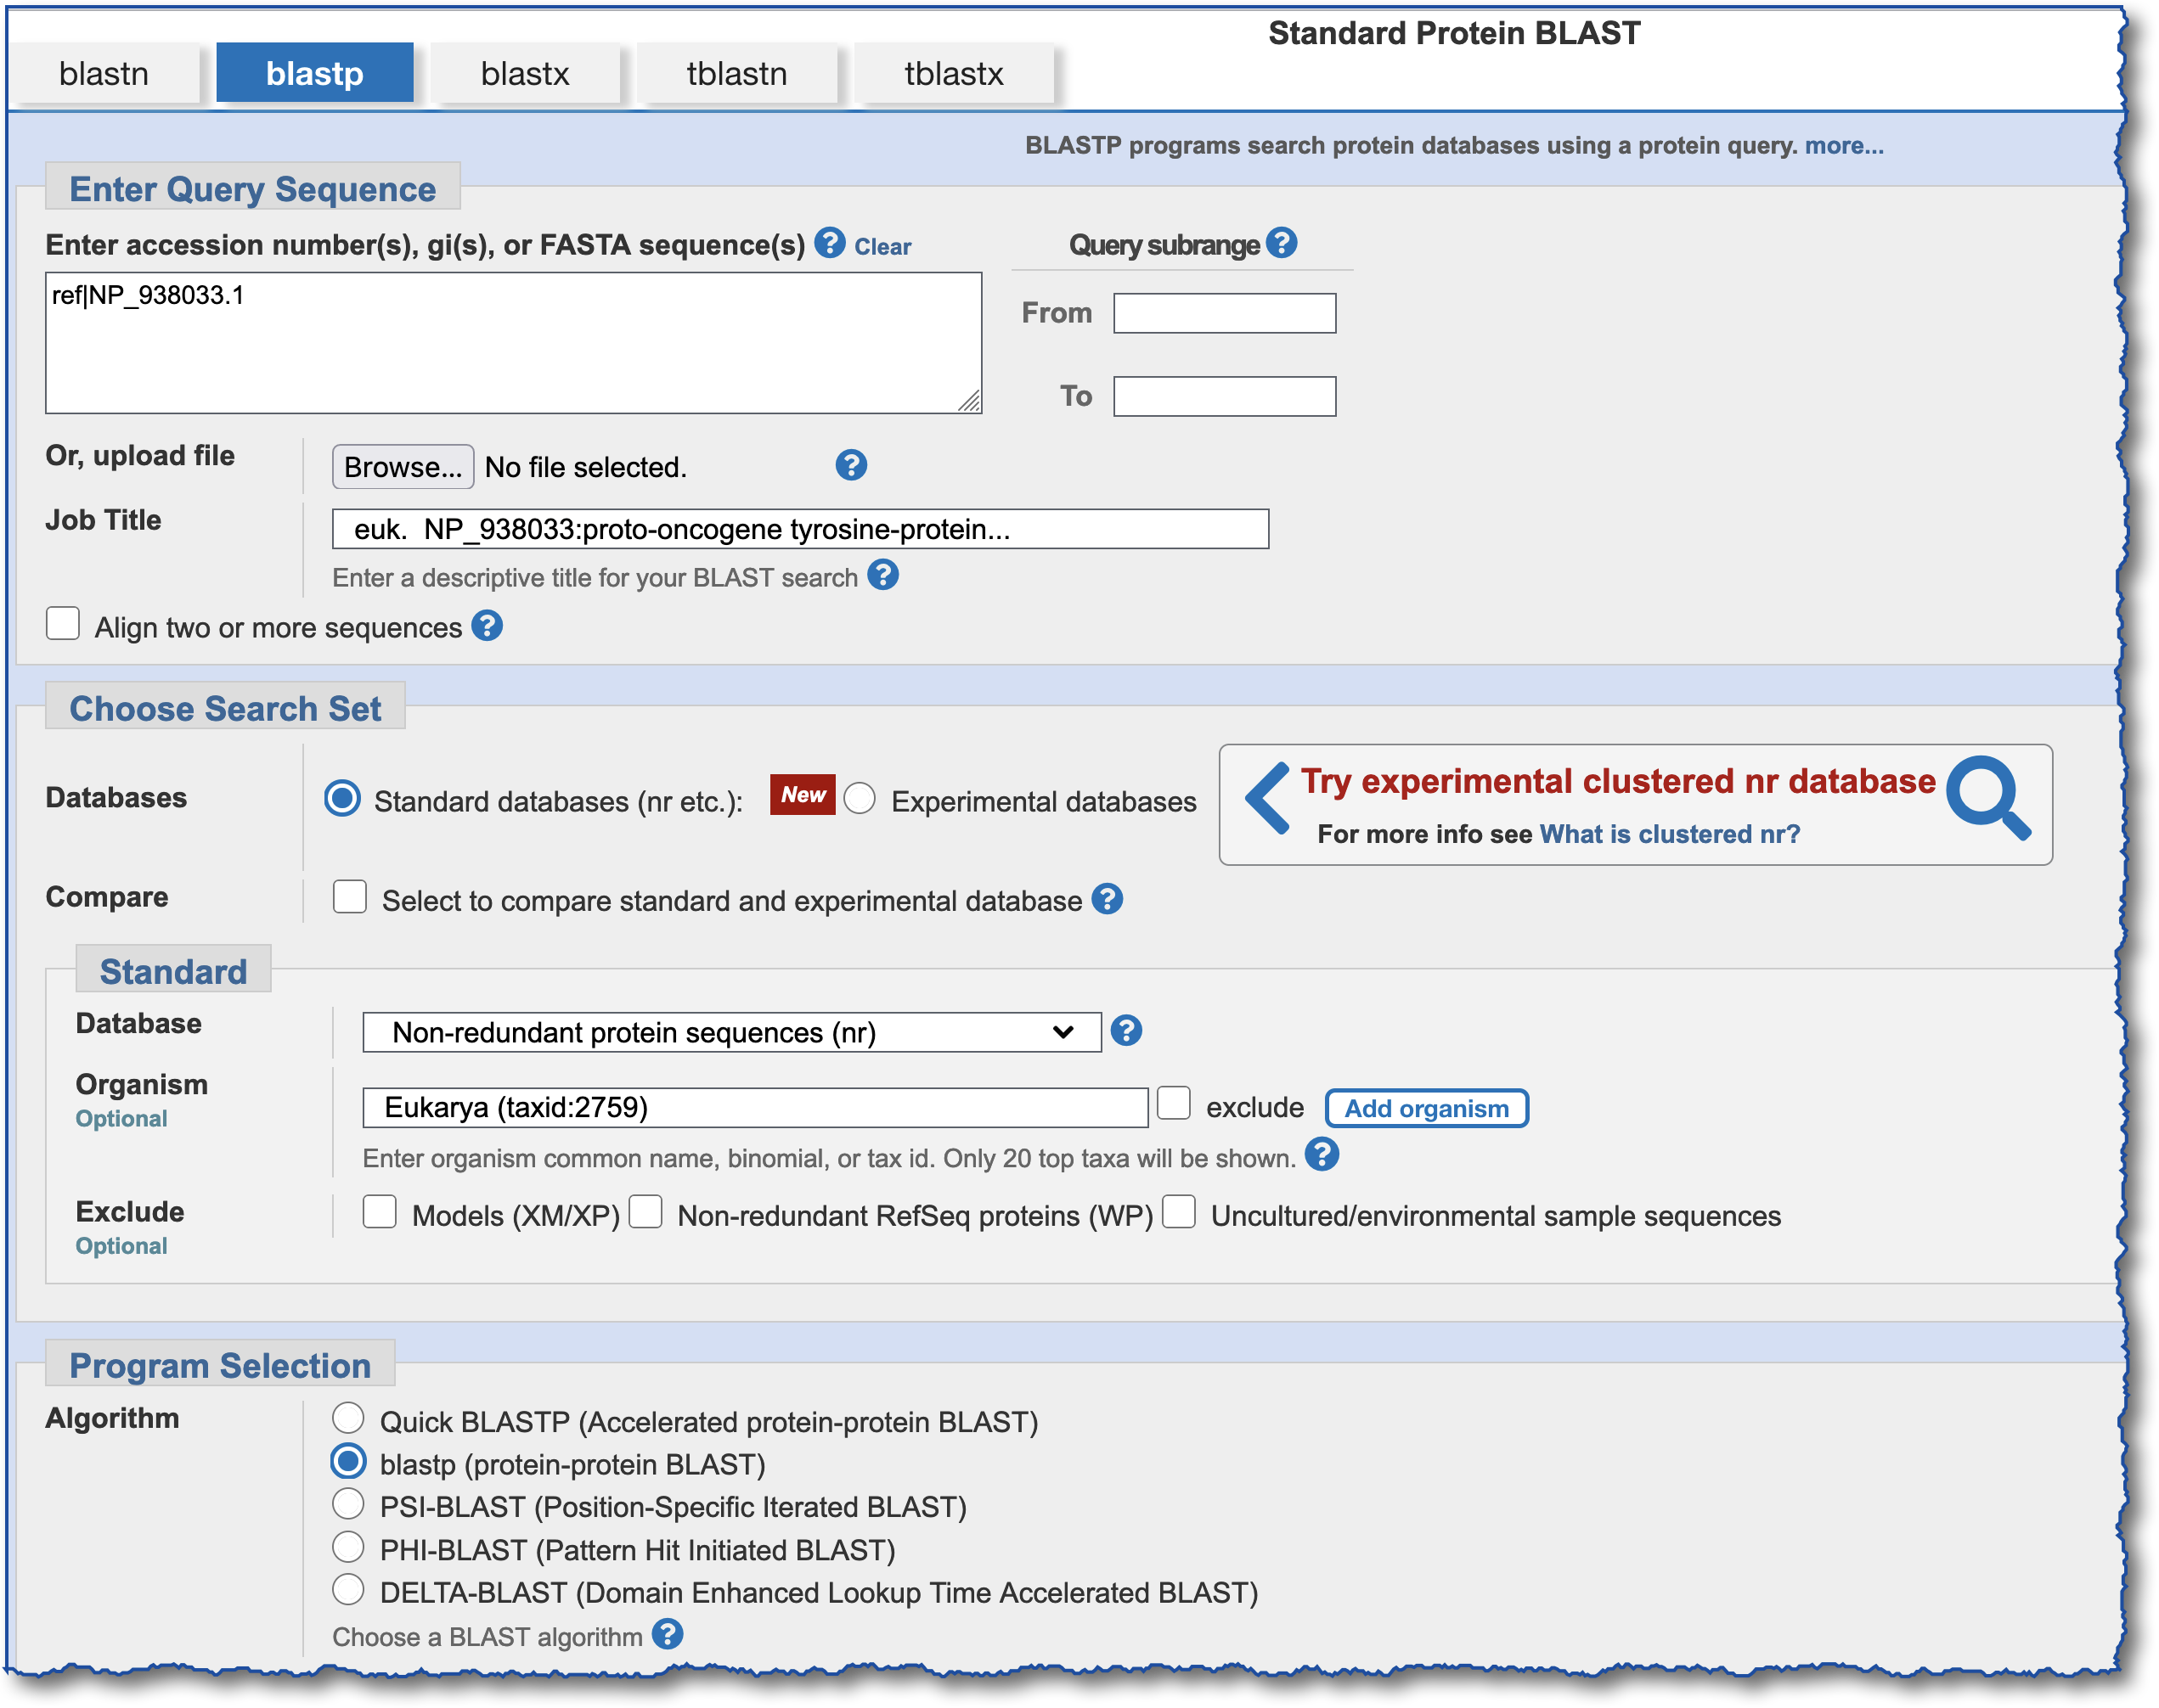
Exercise #5 – Standard nr Database – Setup
NP_938033
nr
Eukaryotes (taxid:2759)
Notes:
NP_938033.1 = proto-oncogene tyrosine-protein kinase Src

Slide 59
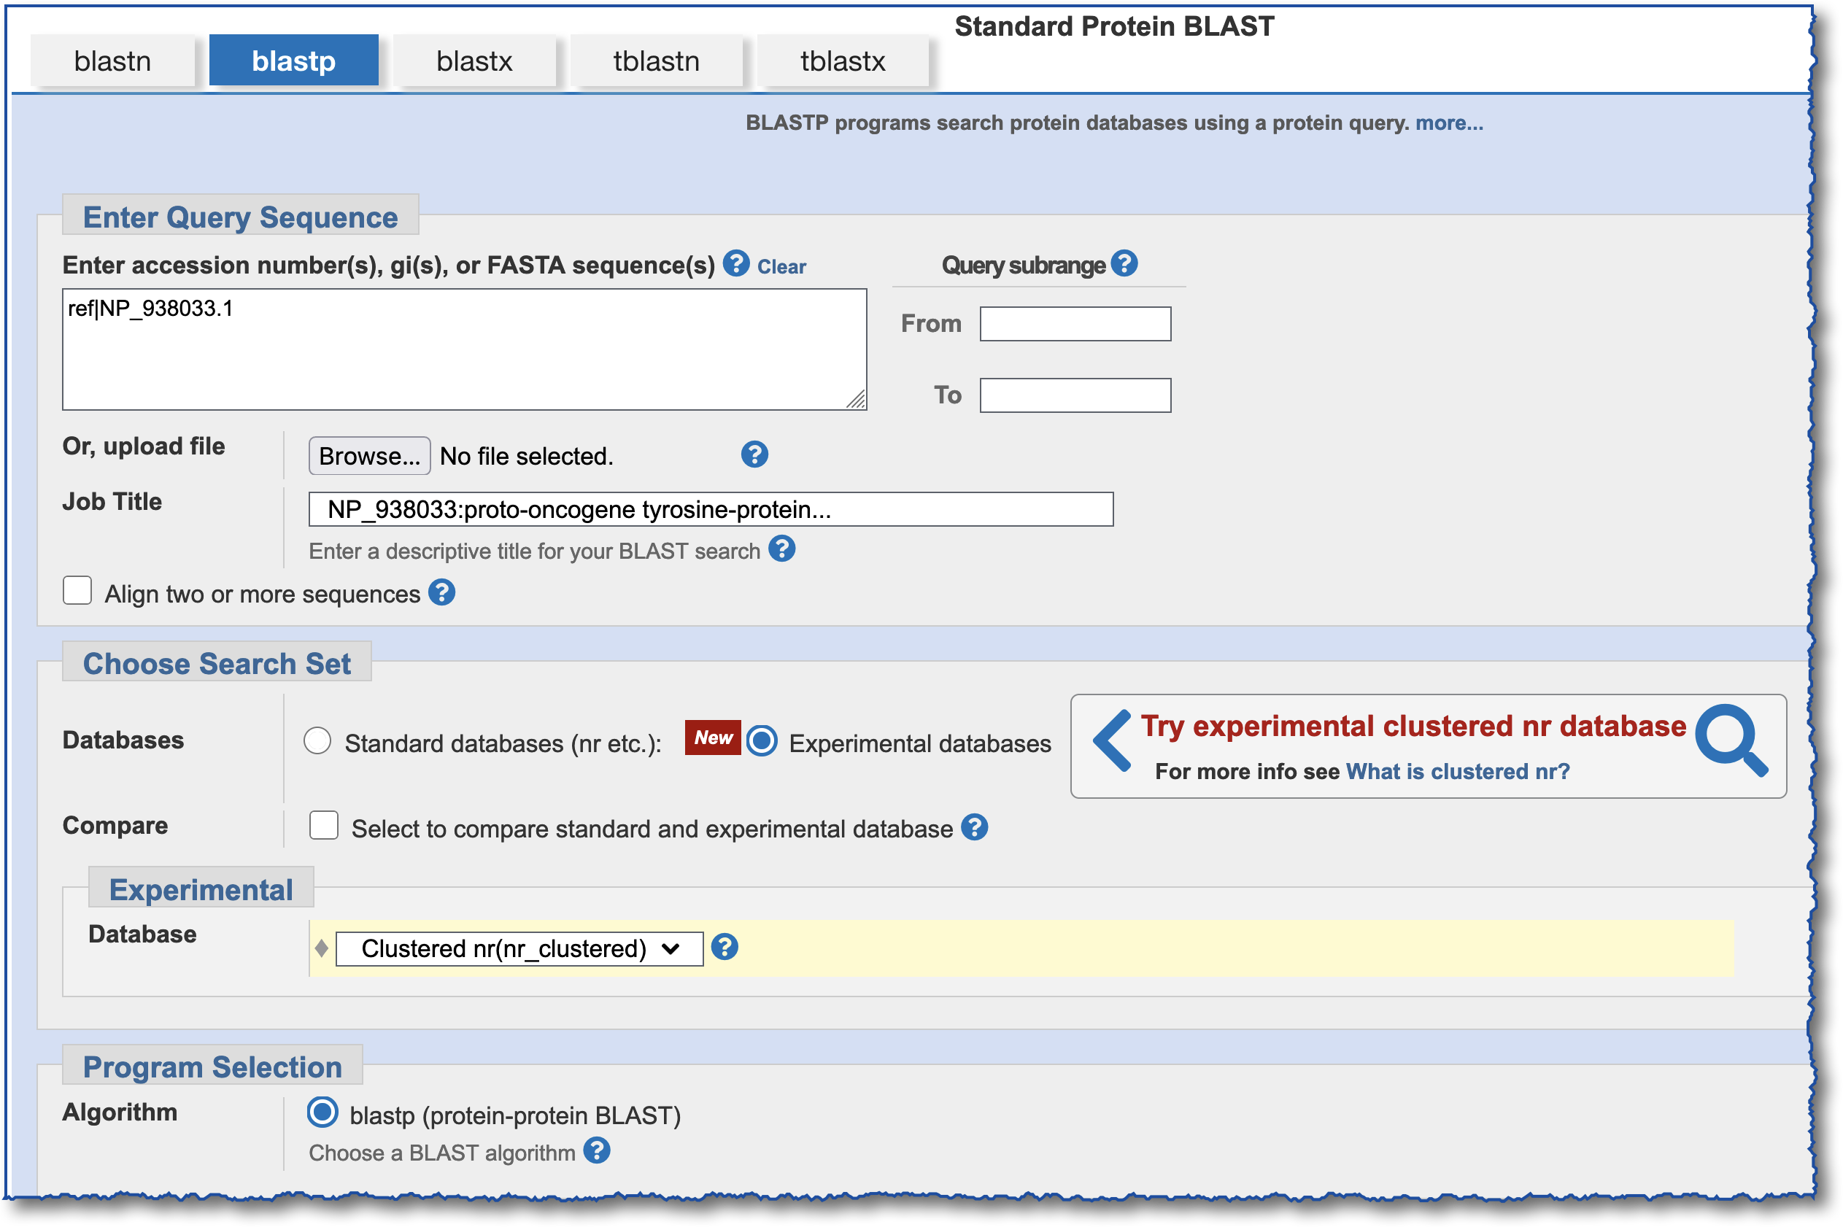
Exercise #5 – Clustered nr, Setup

Slide 60
Exercise #5 – Or Run Both at the Same Time – Setup, Compare
Checkbox to run both searches
Notes:
NP_938033.1 = proto-oncogene tyrosine-protein kinase Src

Slide 61
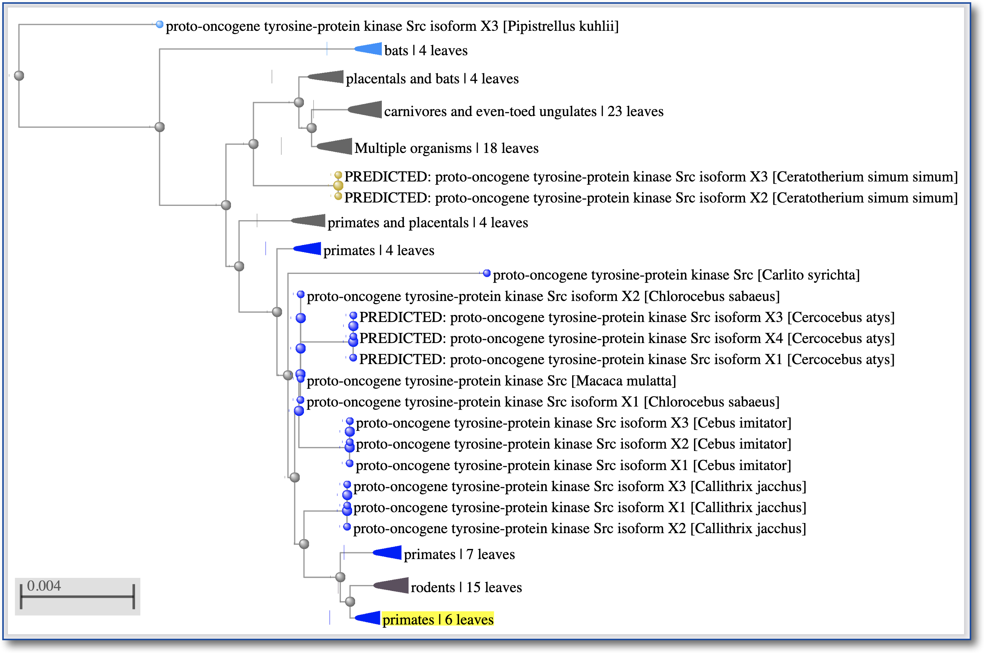
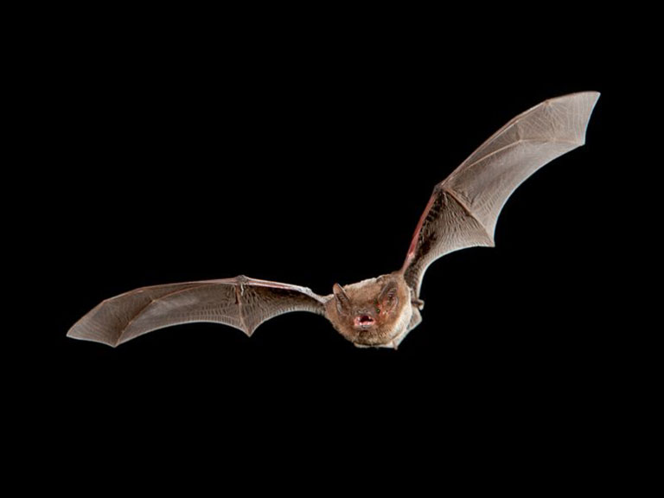
Exercise #5 – Standard nr – Results, Distance Tree
bats
RID: M8NWX25K016

Slide 62
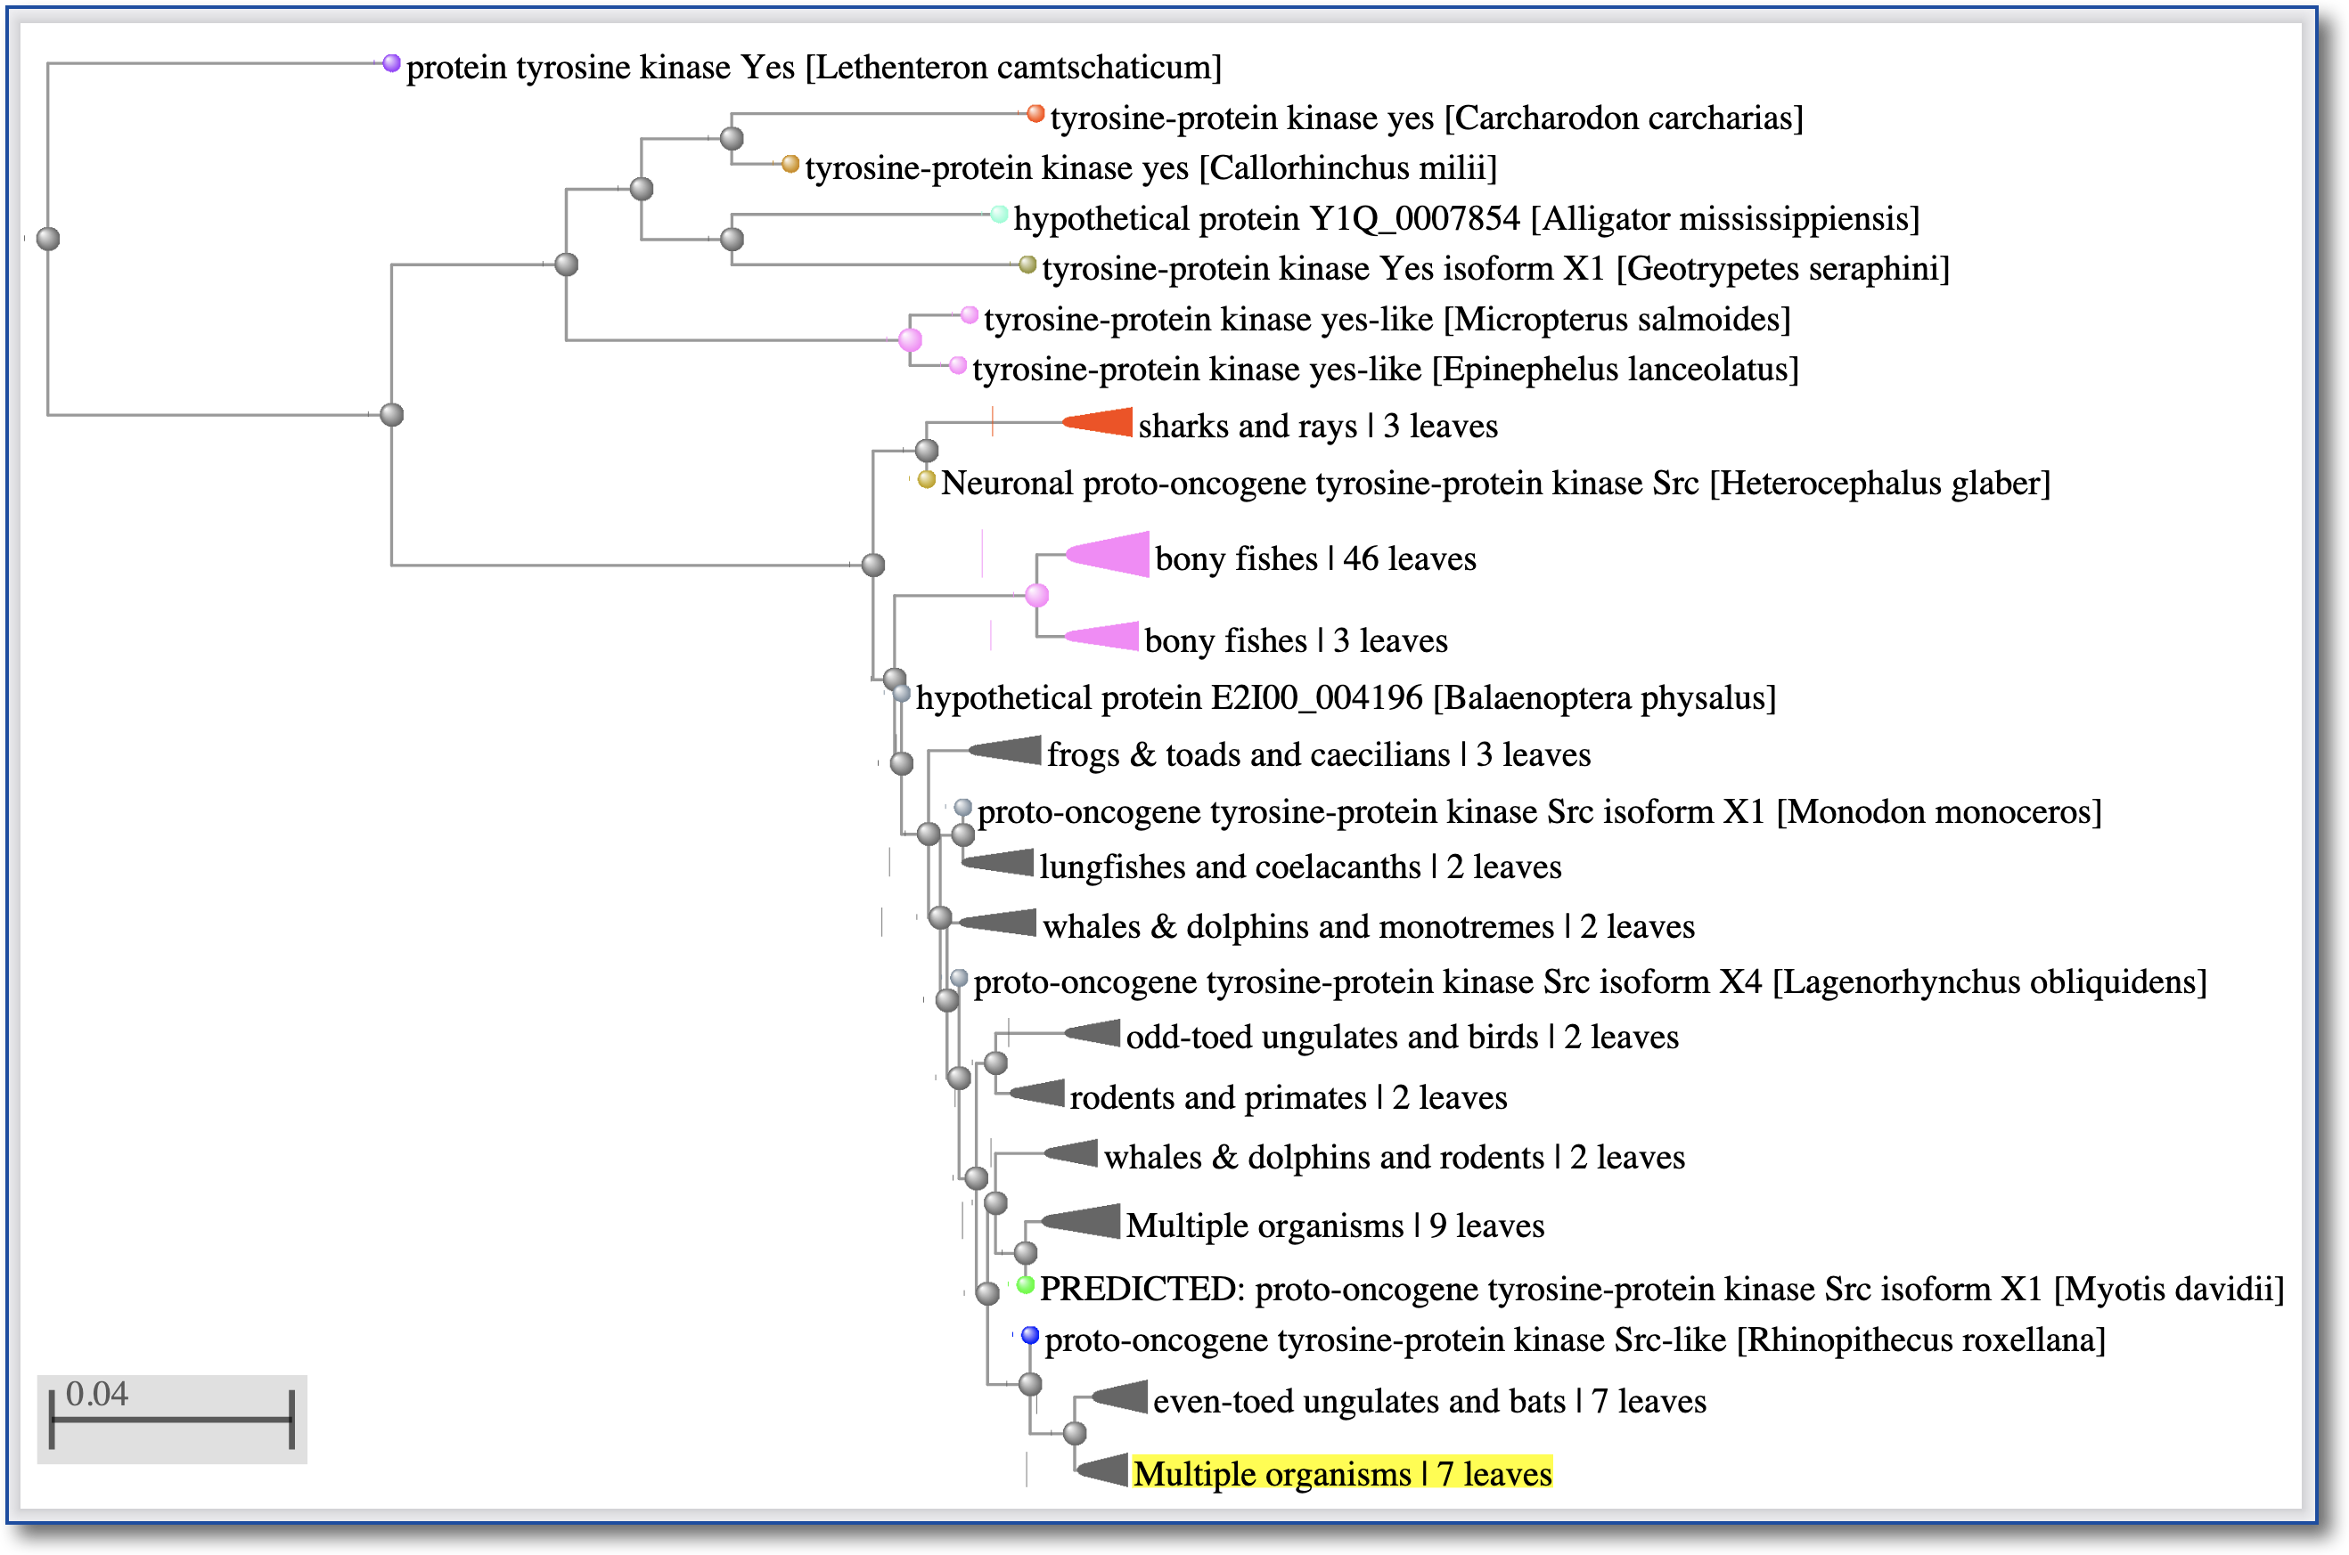
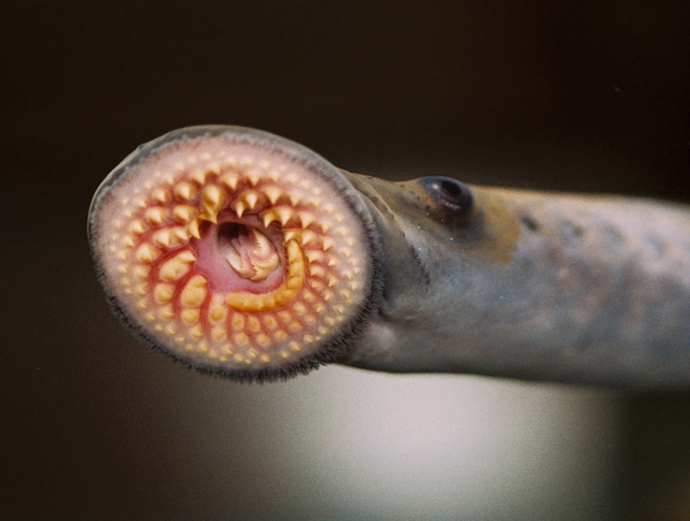
Exercise #5 – Clustered nr – Results, Distance Tree
lamprey
RID: M8NWXVSD016

Slide 63
What Did We Learn About Clustered nr Searches?
Faster searches
Greater taxonomic range
The same result display options

Slide 64
Acknowledgements
BLAST-help group BLAST developers
Scott McGinnis Tom Madden, et al.
Peter Cooper
Tao Tao BLAST Program Mgr.
Wayne Matten Preye Akuiyibo
blast-help@ncbi.nlm.nih.gov

Slide 65
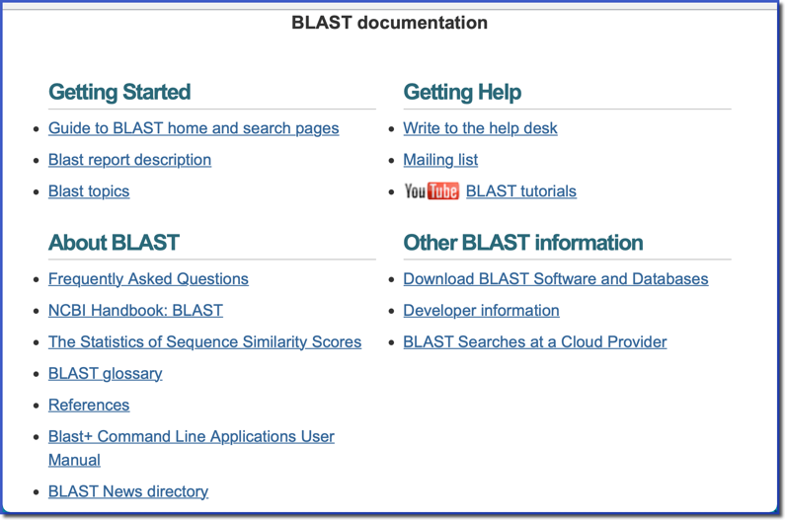
BLAST Help & References
“Help” link on BLAST home page
https://blast.ncbi.nlm.nih.gov/Blast.cgi?CMD=Web&PAGE_TYPE=BlastDocs

Slide 66
Places to Learn More
BLAST News – see the BLAST home page
NCBI Insights Blog: https://ncbiinsights.ncbi.nlm.nih.gov/
Channel: https://www.youtube.com/user/NLMNIH
- BLAST Playlist: https://bit.ly/2MFzsR6
Factsheets: ftp.ncbi.nih.gov/pub/factsheets/
blast-help@ncbi.nlm.nih.gov
info@ncbi.nlm.nih.gov
Email Help

Slide 67
Miscellaneous Slides

Slide 68
Nucleotide Databases (not drawn to scale)
NT
Refseq genomes
RefSeq
representative genomes
RefSeq RNA
EST
HTGS 0,1,2
Patent
TSA
WGS
SRA
TSA
VDB files

Slide 69
Protein Databases (not drawn to scale)
NR
Metagenome
(environmental)
PDB
Swissprot
TSA proteins
Landmark
RefSeq protein
Patent

