Slide 1
Welcome to FDN Session 164 “Discovering Molecular Mechanisms of Genetic Disorders with NCBI Resources"
Today's materials: https://bit.ly/2024foundations-molecularpathology

Slide 2
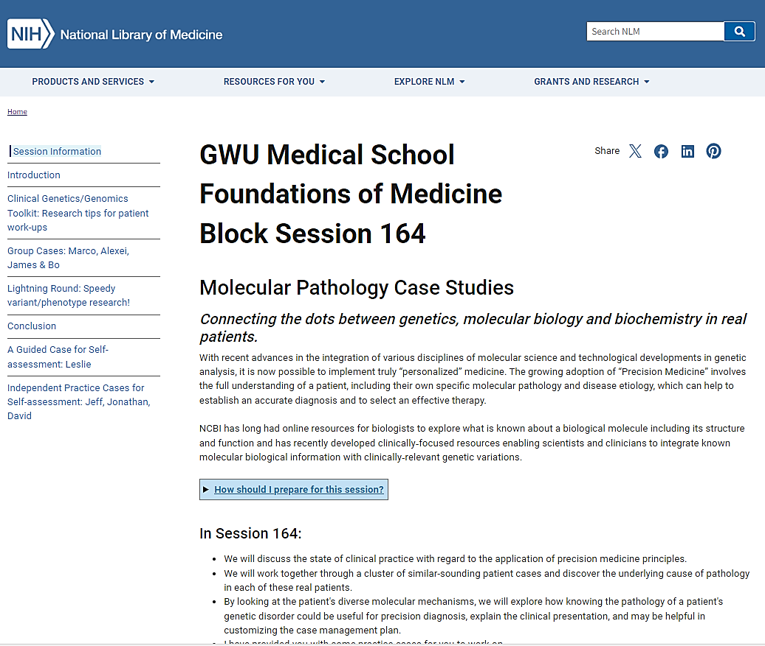
Workshop Materials https://bit.ly/2024foundations-molecularpathology
A website with ALL of the information for today
and for you to refer to throughout med school.

Slide 3
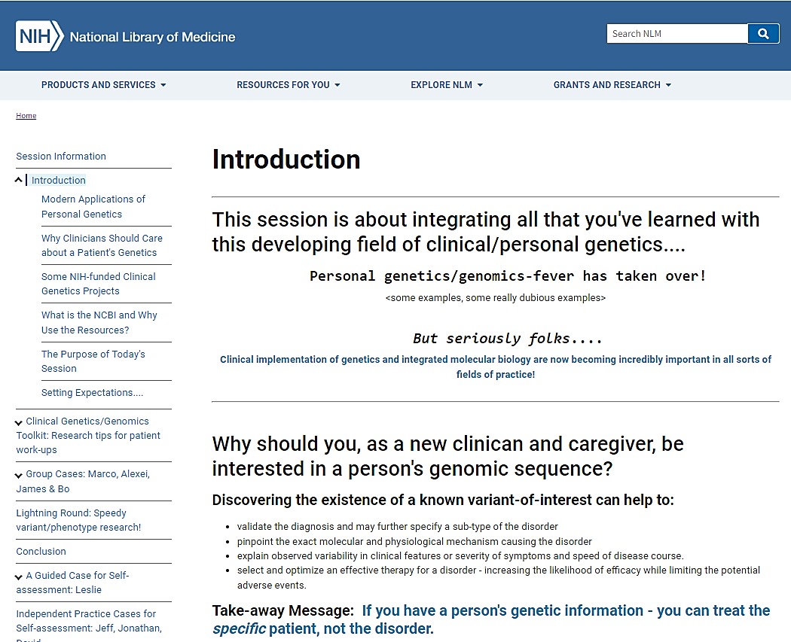
Introduction
Some background information &
setting up today’s activity!

Slide 4
Wait! What?
Personal Genetics/Genomics fever has taken over!

Slide 5
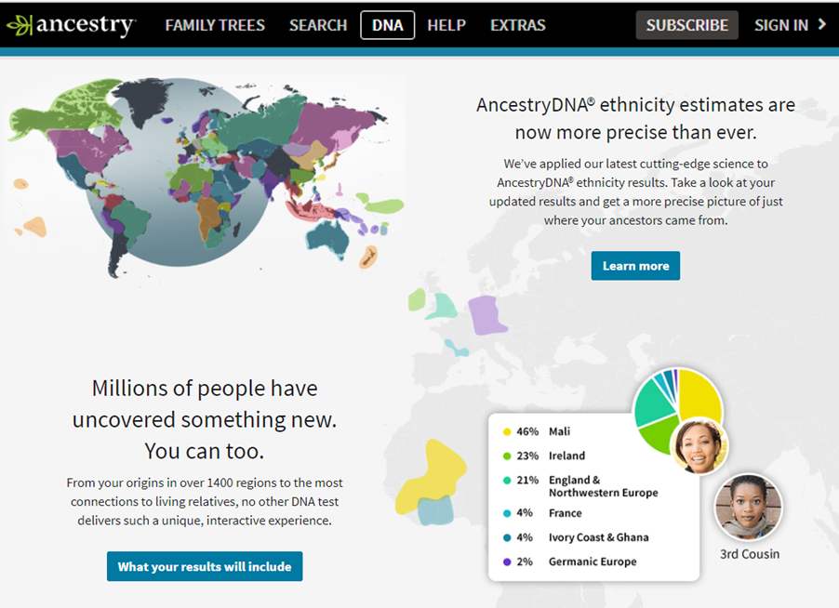
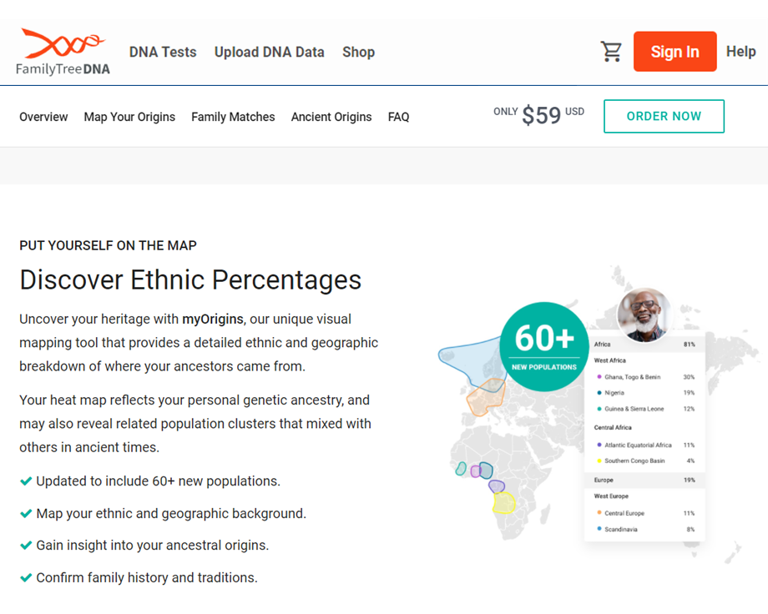
Wide-spread application of genetic/genomic information started out with human migration & ancestry,

Slide 6
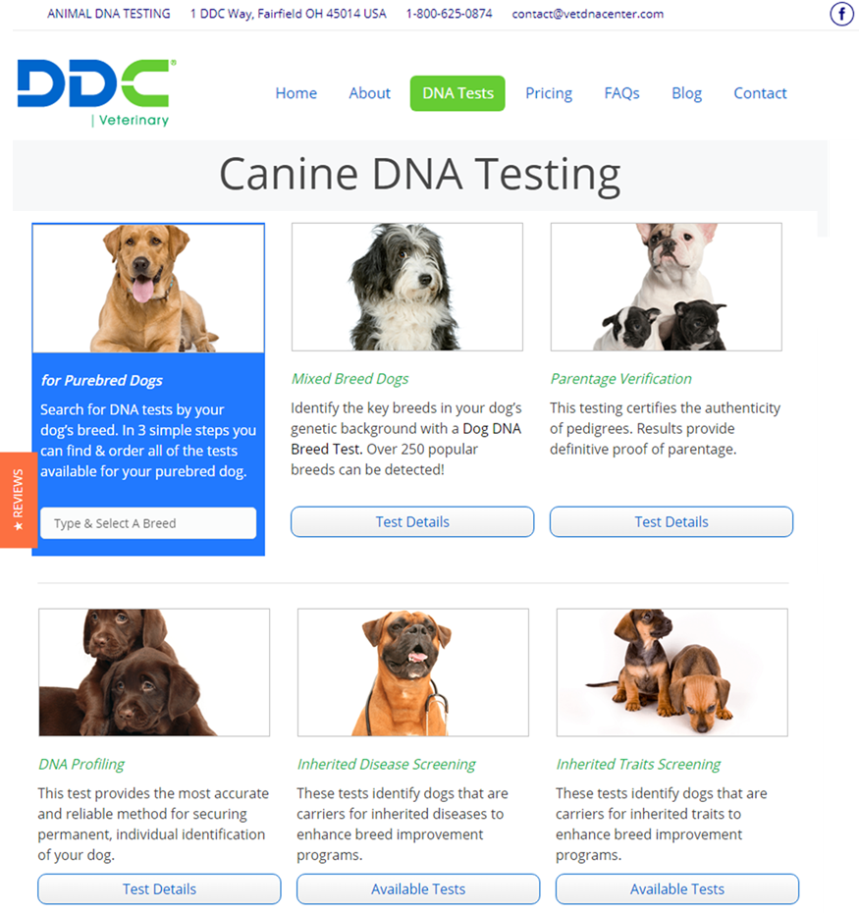
and from there, family history & phenotypes,

Slide 7
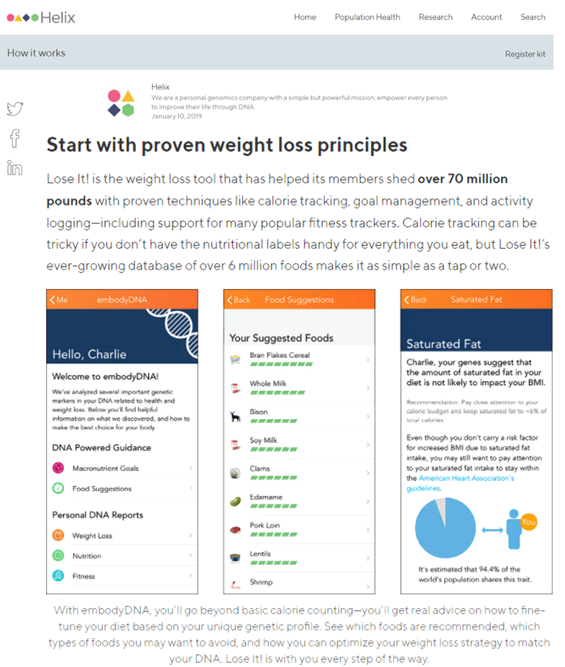
what type of diet and/or what you should eat,

Slide 8
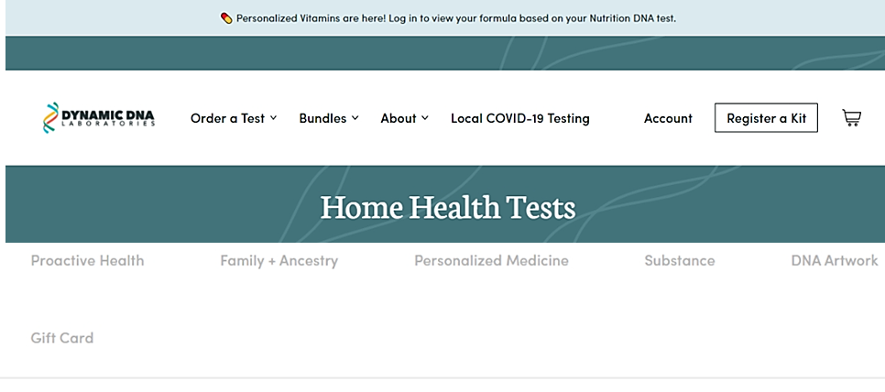
and from there health, nutrition, personality, family relationships, response to cannabis & DNA Artwork!

Slide 9
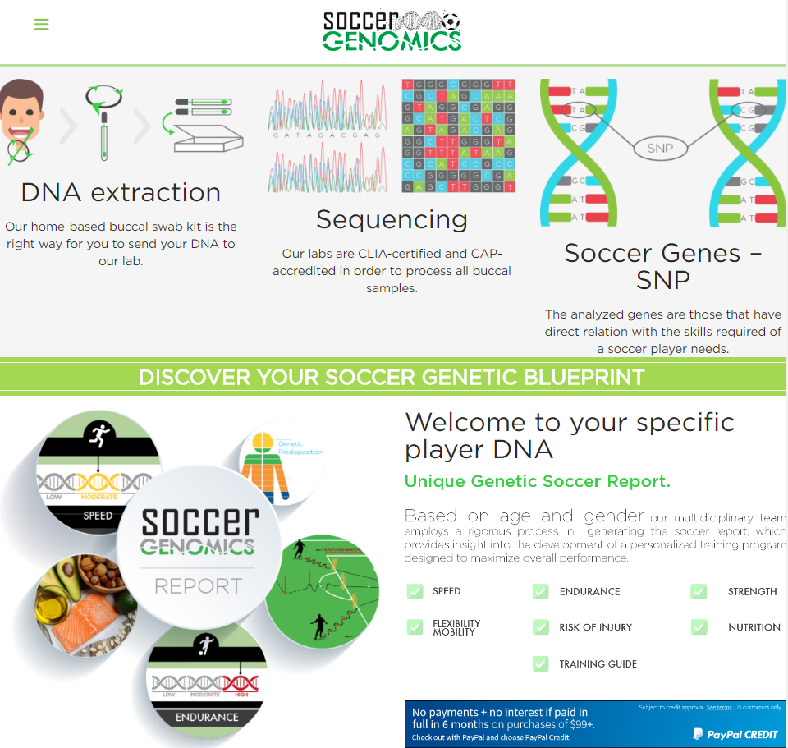
what sport/position you should play,

Slide 10
what wine you should buy....

Slide 11
Have you.....
Thought about taking a genetic test, but have not
Taken a direct-to-consumer genealogical/ancestry DNA test
Taken a direct-to-consumer genetic test with health-related information
Seen a genetic test for a patient
Seen a case management plan changed based on a genetic test result
Given your dog a genetic test

Slide 12
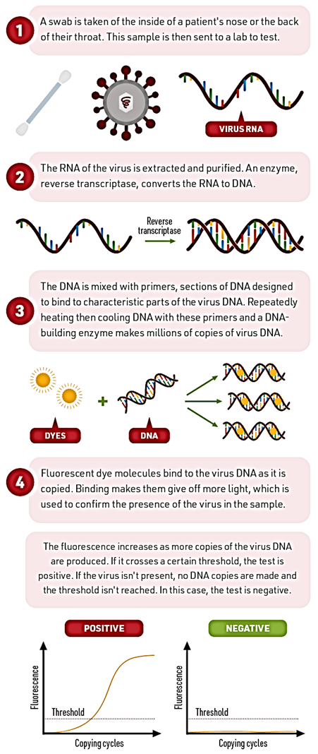
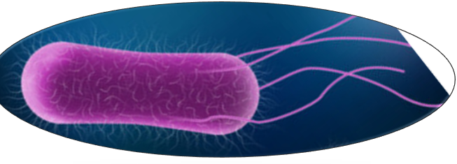
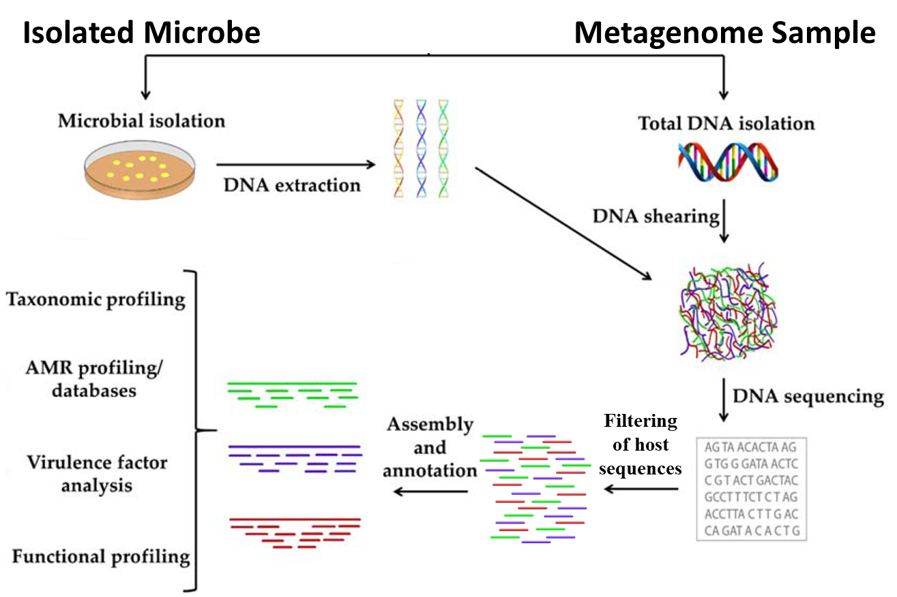
RT-PCR or Genome Sequencing for Diagnosis of Infection Pathogen

Slide 13
But seriously, folks….
Using Genetic/Genomics to assist in
High-Definition Diagnosis &
Precision Treatment Selection
High Definition & Precision?

Slide 14
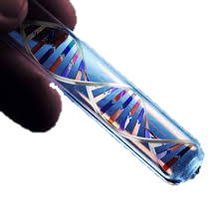
An outline of a history of medical practice
The Art of Medicine
The Science of Medicine
Evidence-based Clinical Practice
"Evidence-based medicine is the integration of best research evidence with clinical expertise and patient values.“
“Personalized” Medicine
[AMA – all patient-care should be “personalized”]
“Precision” Medicine
“Precision medicine is an emerging approach for disease diagnosis treatment and prevention that takes into account individual variability in genes, environment, and lifestyle for each person.”
and now?
…..Molecular Medicine, Genomic Medicine, High-Definition Medicine….

Slide 15
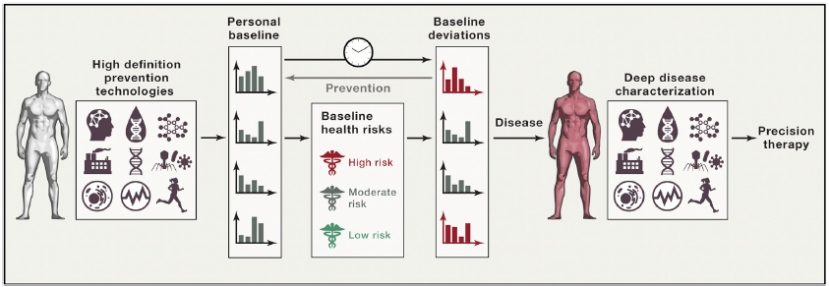
High-definition Medicine?
Establish an Individual’s Baseline of Health
Create a Personalized “Prevention” Strategy
Perform High-Definition Diagnosis & Select High-Precision Treatment
“High-Definition Medicine.” Torkamani A, Andersen KG, Steinhubl SR, and EJ Topol. Cell. 24 August 2017 170(5), 828–843.

Slide 16
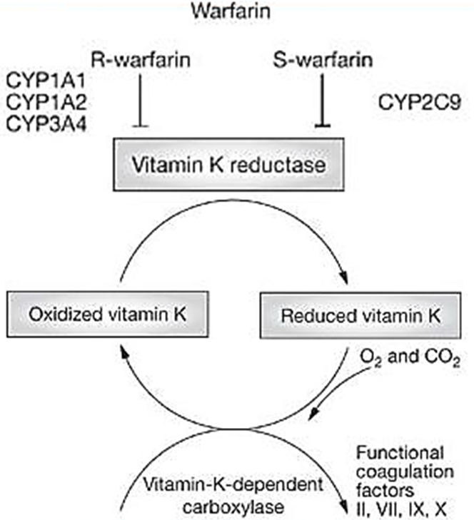
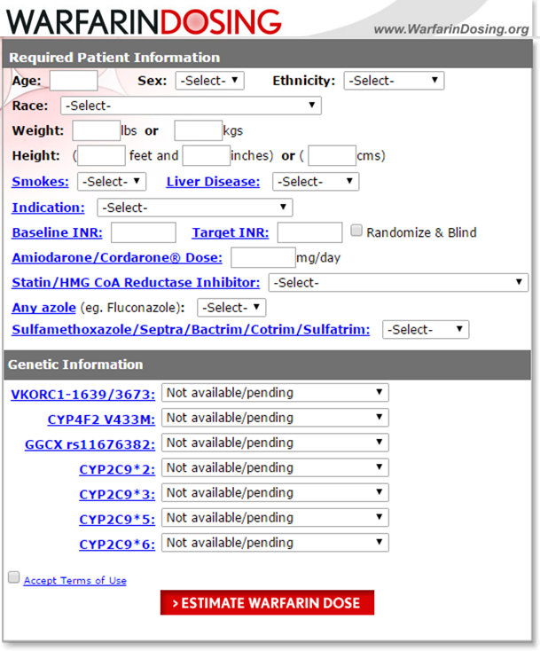
Pharmacogenetics Testing - Dosage Prediction: Maximizing Effectiveness & Minimizing Adverse Events
Inclusion of Pharmacogenomics in a Dosing Algorithm
Dosing for warfarin/Coumadin
can be complicated….
Example:
Young, african american,
thin, smoking male
high dose….120 mg
Older, caucasian,
slightly heavy female
low dose….2 mg

Slide 17
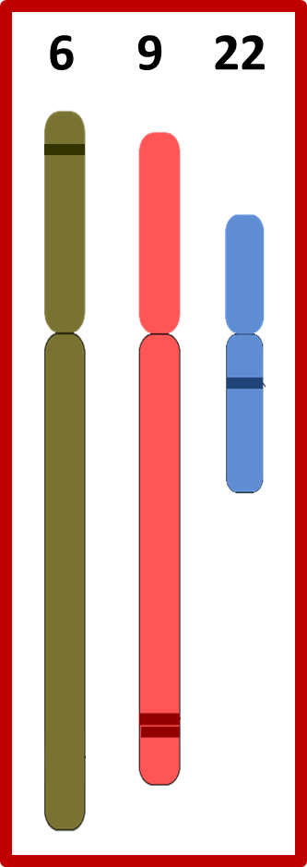
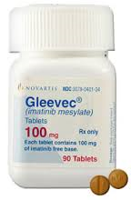
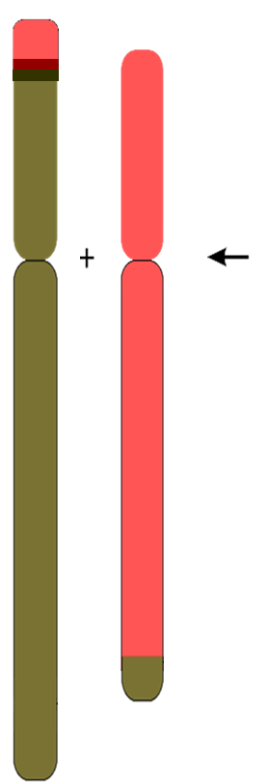
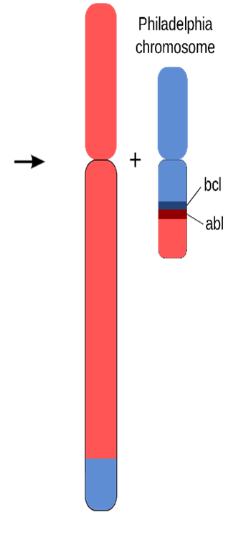
Genetic Testing for Diagnosis & Targeted Therapy
Acute Myeloid Leukemia (AML)
M2 subtype (a.k.a. “with maturation”)
t(6;9)(p23;q34)
Chronic Myelogenous Leukemia (CML)
t(9;22)(q34;q11.2)
DEK
DEK-NUP214
Survival Rate
1970s <20%
2020s <20%
Survival Rate
1970s <15%
2020s >94%
BCR
BCR-ABL1
ABL1
NUP214
Notes:
Chronic myelogenous (or myeloid or myelocytic) leukemia (CML)
Philadelphia Chromosome [t(9;22)(q34;q11.2)]/BCR-ABL fusion protein -> Drug target: Gleevec, et al. (http://atlasgeneticsoncology.org/Anomalies/CMLID1117.html)
BCR and ABL are genes that encode a proteins involved in signal transduction of cell-cycle regulatory as well as regulation of cell differentiation, cell adhesion, and stress response
CML Gleevec-family Drug resistance caused by T315I mutation in BCR-ABL
Survival rate went from <15% (early 1970s) to >94% (now)!
Acute myeloid leukemia t(6;9)(p23;q34) M2-subtype
DEK-NUP214 fusion protein (http://atlasgeneticsoncology.org/Anomalies/t0609ID1014.html)
DEK oncogene (DEK) is a gene that encodes a protein involved in chromatin organization, DNA damage response signaling, and DNA repair
Nucleoporin 214kDa (NUP214) is a gene that encodes a component of the nuclear core complex, a structure that regulates flow of material between the nucleus and cytoplasm
Approximately 1% of newly diagnosed AML patients have the DEK-NUP214 fusion gene and it is a very poor prognostic indicator (<20%)

Slide 18
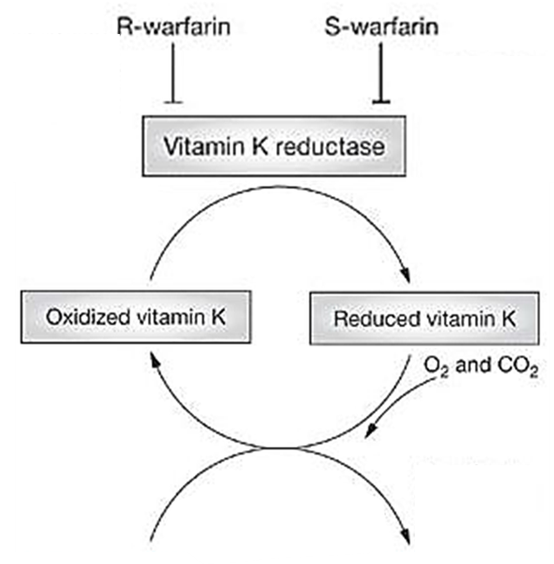
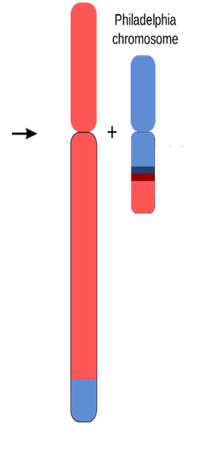
Companion Diagnostics & Targeted Therapies | Pharmacogenomics (tailored dosage)
Deep Vein Thrombosis, Pulmonary Embolism, Prevention of Stroke or recurrent Myocardial Infarction due to excessive clotting
Chronic Myelogenous Leukemia (CML)
t(9;22)(q34;q11.2)
CYP1A1
CYP1A2
CYP3A4
CYP2C9
VKORC1
BCR
BCR-ABL1
Survival rate:
early 1970s = <15%
now >94%!
GGCX
ABL1
Functional coagulation factors
II, VI, IX, X
Notes:
Chronic myelogenous (or myeloid or myelocytic) leukemia (CML)
Philadelphia Chromosome [t(9;22)(q34;q11.2)]/BCR-ABL fusion protein -> Drug target: Gleevec, et al. (http://atlasgeneticsoncology.org/Anomalies/CMLID1117.html)
BCR and ABL are genes that encode a proteins involved in signal transduction of cell-cycle regulatory as well as regulation of cell differentiation, cell adhesion, and stress response
CML Gleevec-family Drug resistance caused by T315I mutation in BCR-ABL
Survival rate went from <15% (early 1970s) to >90% (now)!
Acute myeloid leukemia t(6;9)(p23;q34) M2-subtype
DEK-NUP214 fusion protein (http://atlasgeneticsoncology.org/Anomalies/t0609ID1014.html)
DEK oncogene (DEK) is a gene that encodes a protein involved in chromatin organization, DNA damage response signaling, and DNA repair
Nucleoporin 214kDa (NUP214) is a gene that encodes a component of the nuclear core complex, a structure that regulates flow of material between the nucleus and cytoplasm
Approximately 1% of newly diagnosed AML patients have the DEK-NUP214 fusion gene and it is a very poor prognostic indicator (<20%)

Slide 19
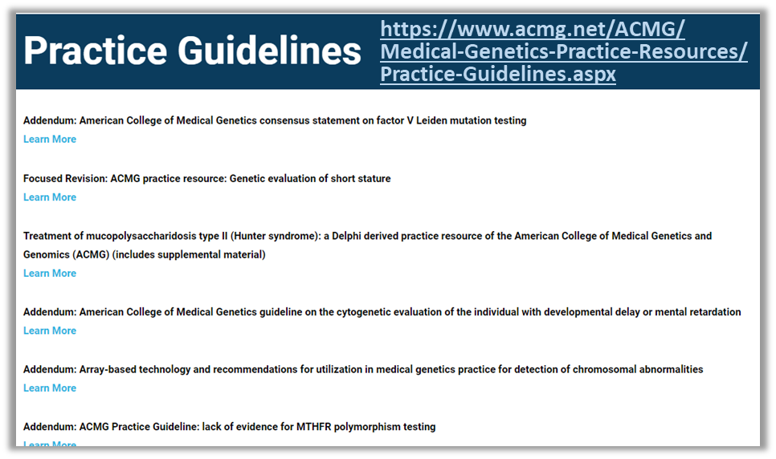
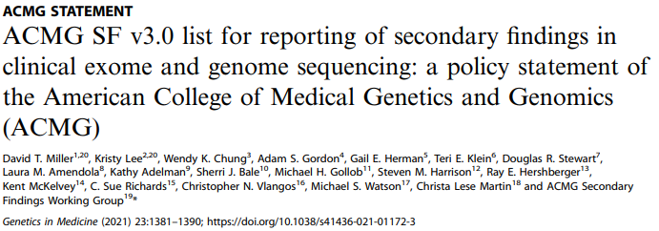
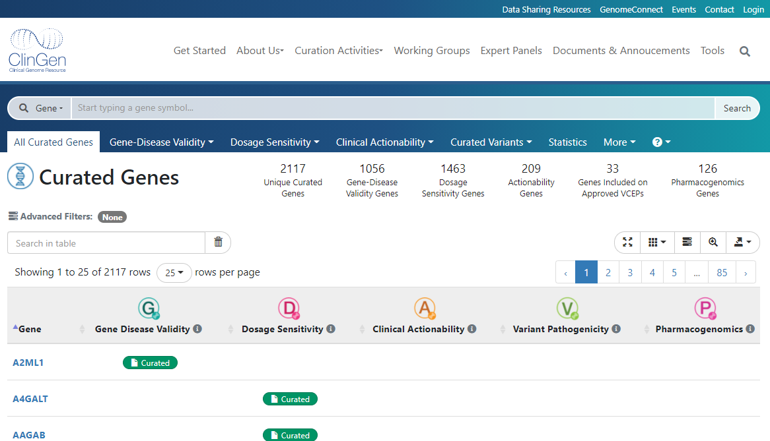
Recommendations for Disorder Genetic Testing Genetic Variant Assertion, Evidence & Actionability
http://www.acmg.net
https://www.clinicalgenome.org/

Slide 20
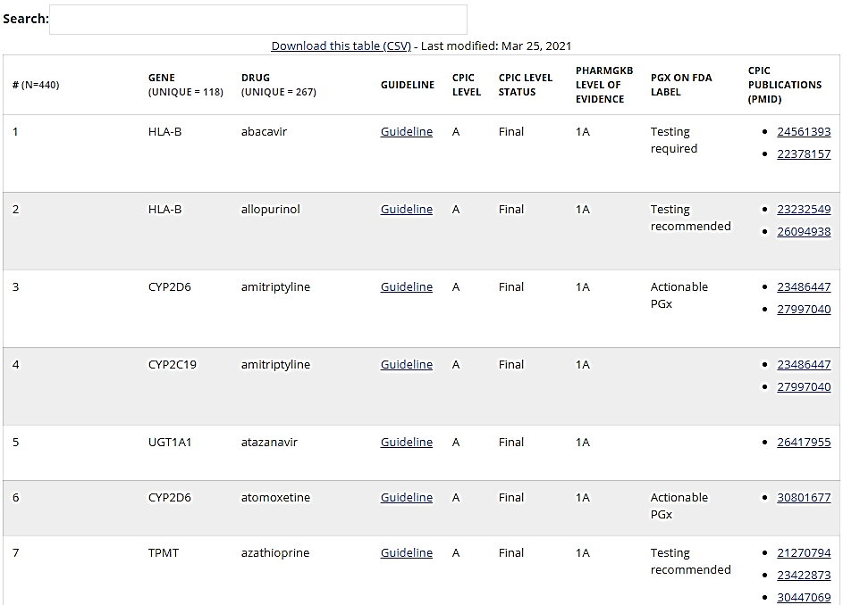
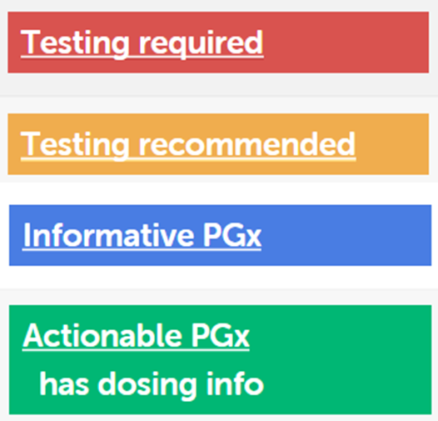
Recommendations for Pharmacogenetic Testing
440 Gene-Drug combinations
131 Actionable PGx
8 Testing recommended
15 Testing required
130 Sufficient evidence for at least one prescribing action to be recommended
124 Guidelines available
https://cpicpgx.org/
https://www.pharmgkb.org/

Slide 21
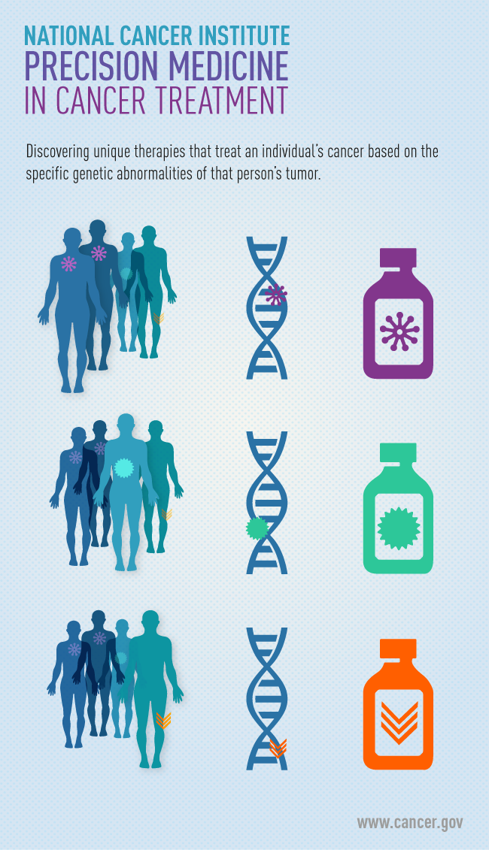
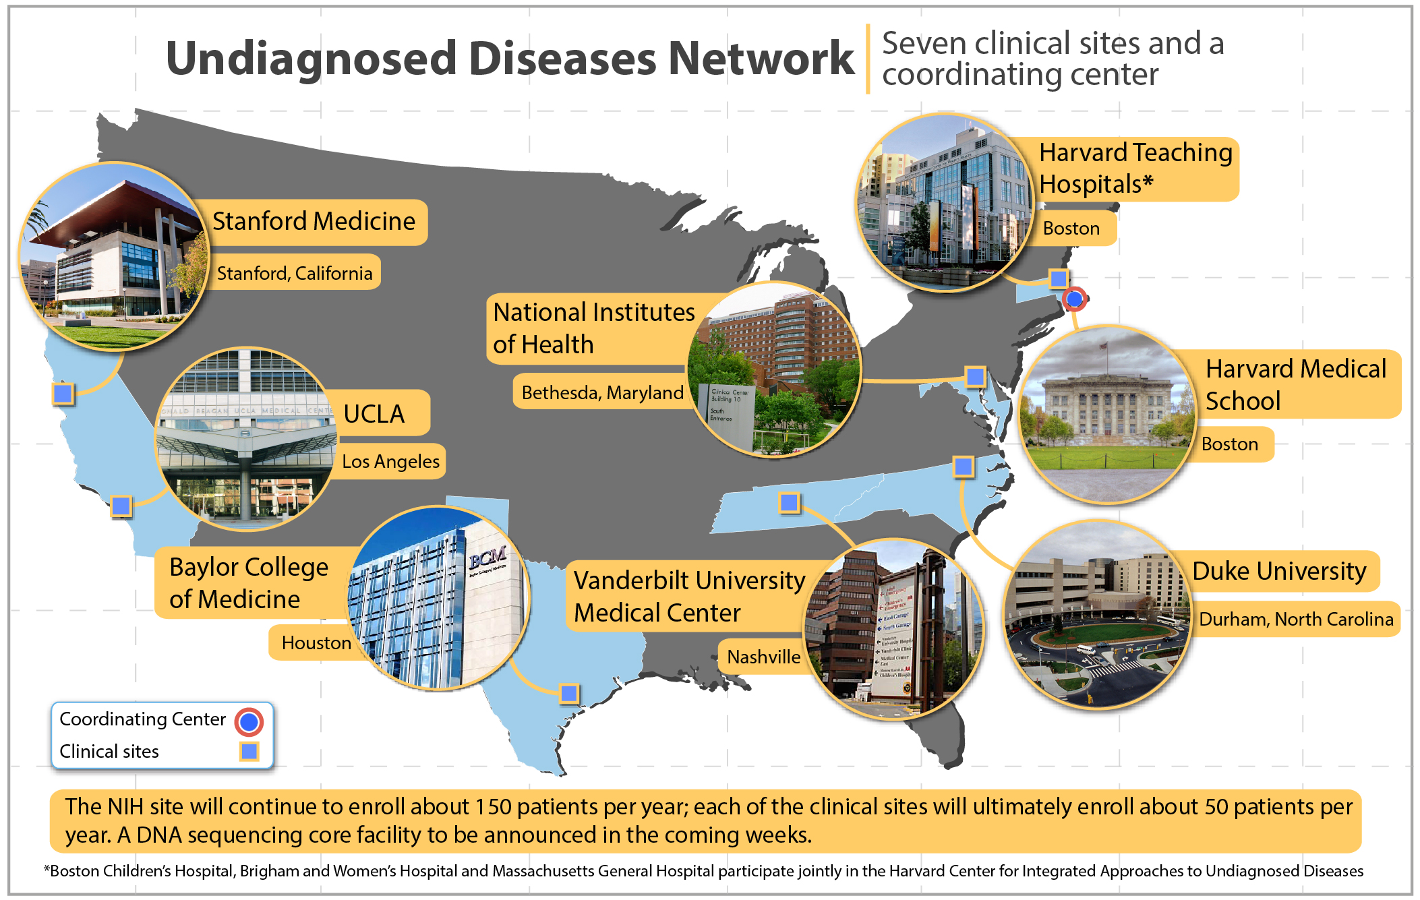
“Precision” Medicine – NIH funded research projects for disease characterization and to improve diagnoses & treatments
Solving medical mysteries through team science.

Slide 22
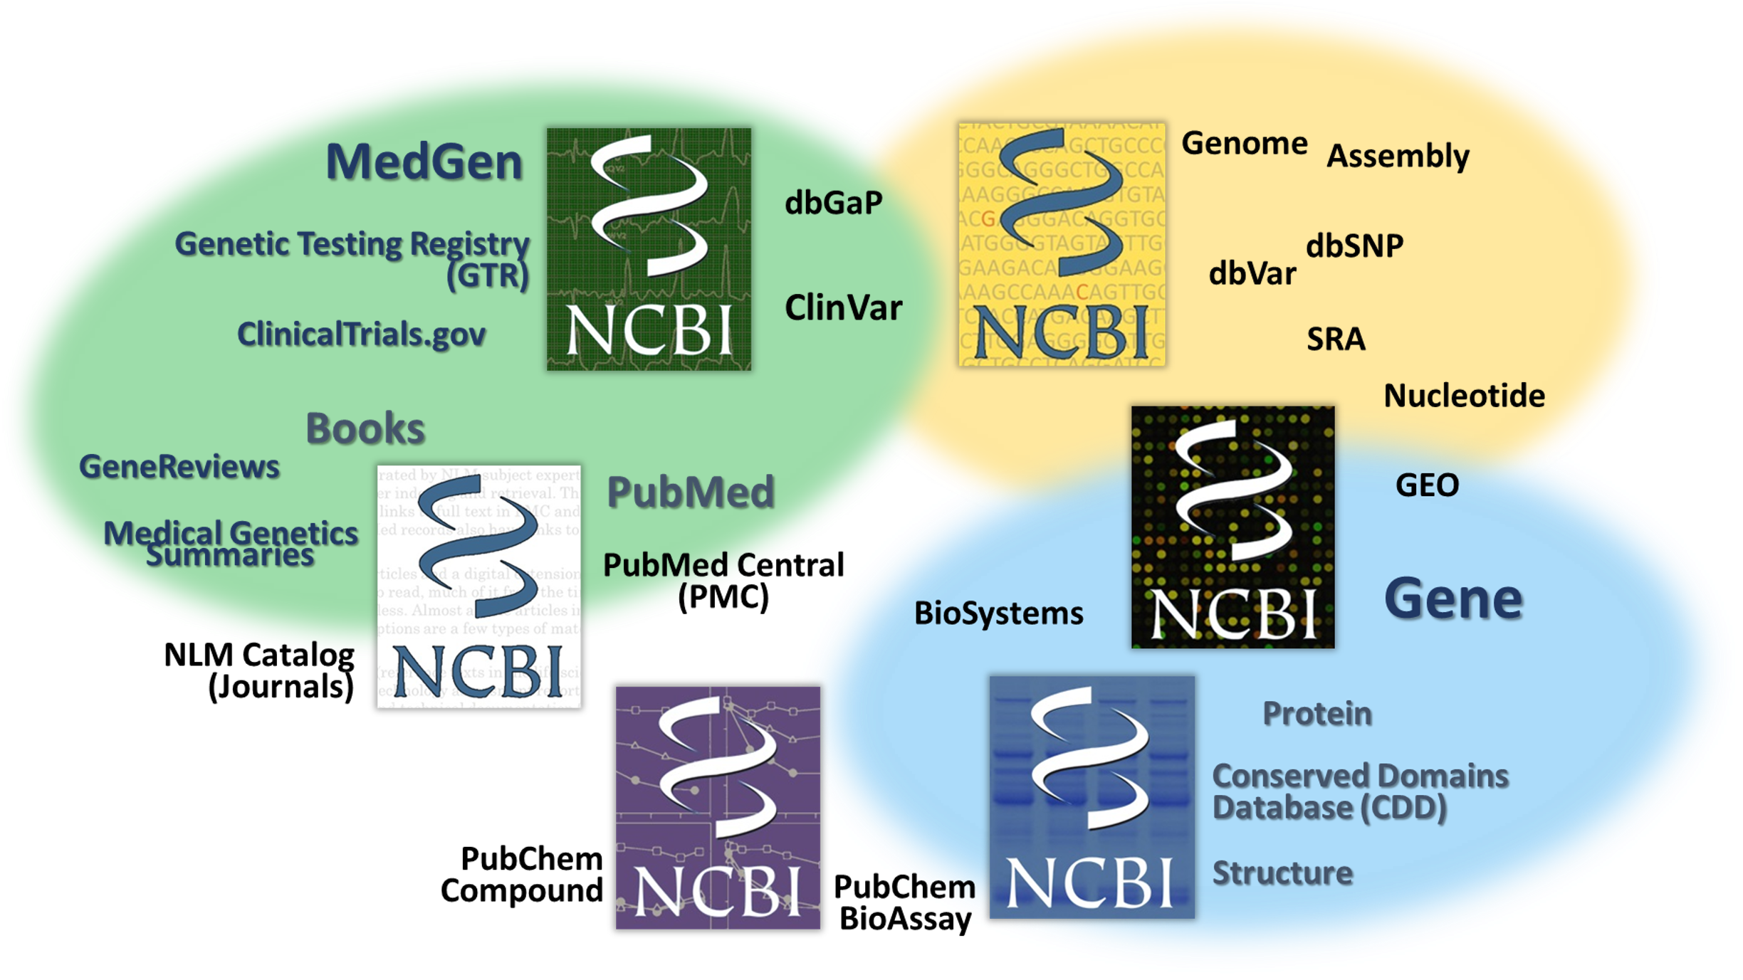
Why “NCBI”?
We are a “center” within the NLM responsible
for creation, curation and maintenance of
medical and scientific databases
and other things…
We receive, create, archive &
make available biomedical information,
as well as perform computational biology
& IT systems research….
we aspire to help make sense of all that information!

Slide 23
Foundations Session 164
With recent advances in the integration of various disciplines of molecular science and technological developments in genetic analysis, it is now possible to implement truly “personalized” medicine. The growing adoption of “Precision Medicine” involves the full understanding of a patient, including their own specific molecular pathology and disease etiology, which can help to establish an accurate diagnosis and to select an effective therapy.
NCBI has long had online resources for biologists to explore what is known about a biological molecule including its structure and function and has recently developed clinically‐focused resources enabling scientists and clinicians to integrate known molecular biological information with clinically‐relevant genetic variations.
Today:
We will discuss the application of precision medicine principles in the clinic.
We will work together through a cluster of similar-sounding patient cases and discover the underlying cause of pathology in each of these real patients.
By looking at the diverse molecular mechanisms seen in these patients, we will:
explore how knowing the pathology of a patient's genetic disorder can facilitate a “precision diagnosis”
explain the clinical presentation
and can be helpful in customizing the case management plan.
There are some additional cases for you to work on for practice & self-assessment.
This session was designed to help you
review the major concepts you've been learning
& to give you experience in integrating all of them in real-world patient case studies!
Molecular Pathology Case Studies:
Connecting the dots between
Genetics
Molecular biology
Biochemistry
in real patients!

Slide 24
SETTING EXPECTATIONS
What we will cover
NCBI's web-based resources that may be helpful to learn about human genetic disorders/conditions, genetic variations, genes and gene products.
Examples of how you can use these resources from real clinical cases to explore and understand the underlying molecular pathology.
What we will not cover
basic genetics or genetic principles - although we will use your knowledge about these in our discussions.
high-throughput variant analysis - but you may find some helpful resources in the provided reference materials.
resources for all human disorders, today we are focusing on simple genetic disorders. (for example, we will not discuss polygenic disorders such as most cancers or variants in disease-causing pathogens)
Today's workshop is about finding helpful information you can use in your research.
We will not discuss best practices for implementation of genetic information in the clinic or production of diagnostic or therapeutic products.
Disclaimer
⇒ We cannot make recommendations on what you should do.
We provide resources, data and information that you can use as part of your work.

Slide 25
Let’s get this out of the way – “How am I going to be tested on this?”
You are going to be tested on this in several ways:
Next week’s exam
You will not have to run through a whole case study.
You will not be tested on the specifics of each of these cases.
You will need to be able to answer questions based on application of genetics/molbiol/biochem in patient cases:
When is genetic testing something to consider and how does it fit within clinical cases?
Why is it helpful to integrate molecular sciences for decisions about patient care & case management?
How are problems at the molecular level (integrated molecular pathology) related to health?
Where can you find high-quality biological information when you need it?
USMLE Step 1
Integration of molecular sciences information will help you answer case study-driven questions.
Your CAREER!
Keep up with science, technology with an increasingly-specific focus on individual patient’s cases
Resident Preceptors, Attending Physicians, etc. – will all be asking you questions…..
Patients & Parents increasingly wanting to know “why?” Be able to fully explain things!

Slide 26
Clinical Genetics Tooklit - a reference source -
A reference for you with information about clinical variations for now & later when you need it!

Slide 27
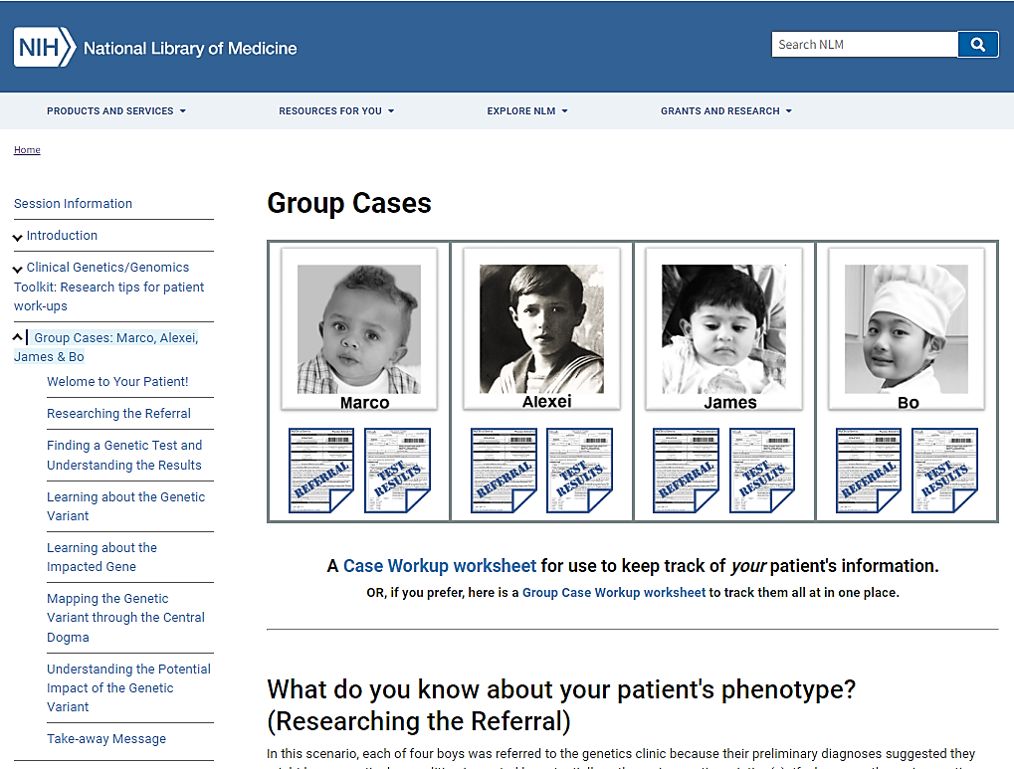
The Workflow - a guided workflow -
Time to practice a patient case workup with some guidance!
And we’ll compare case workup information for four boys with similar-sounding issues.

Slide 28
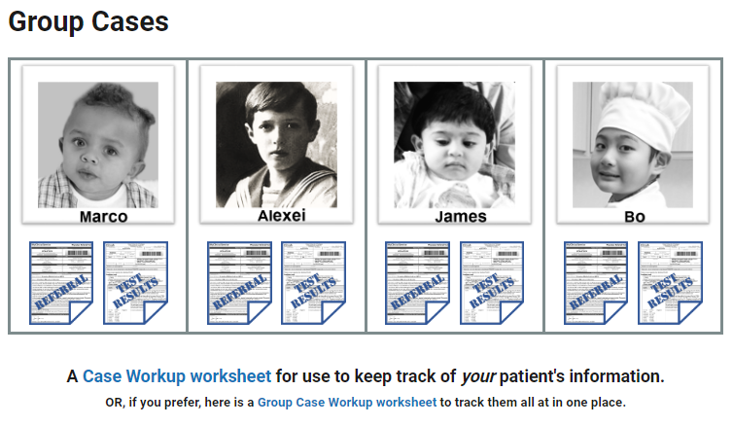
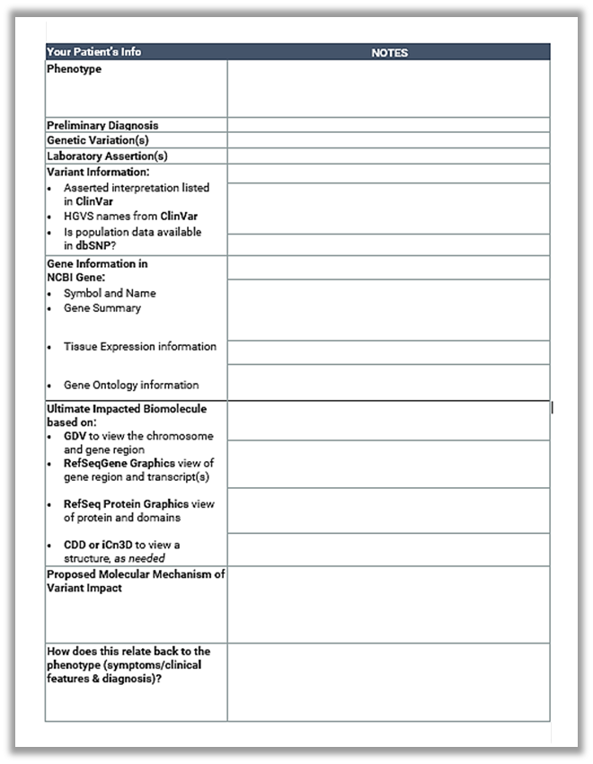
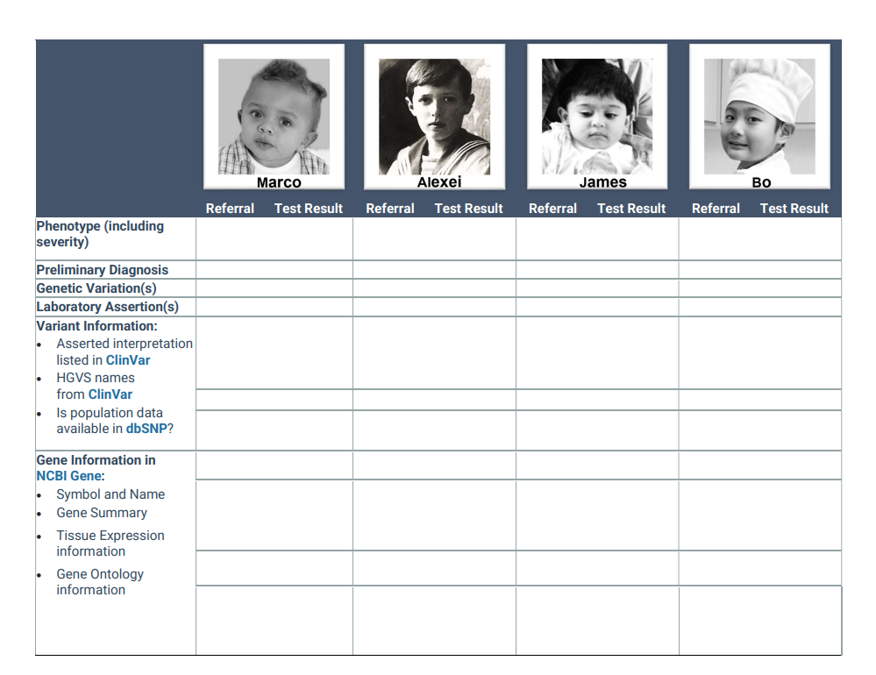
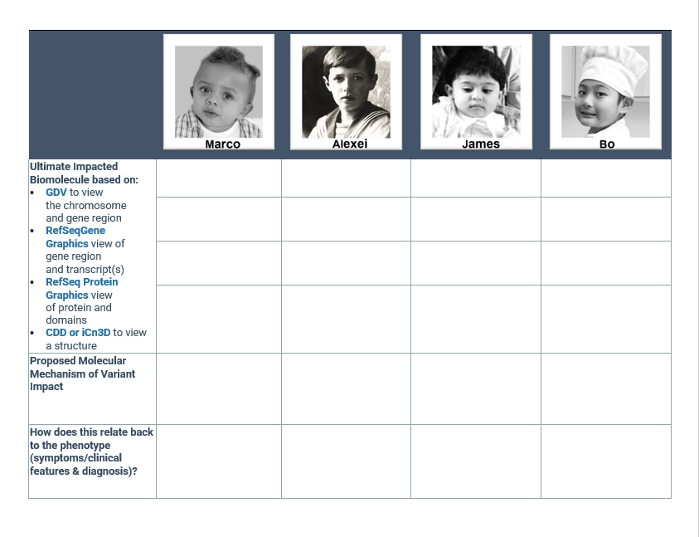
Optional Worksheet: a WordDoc to fill out
Today, you are going to work with
one of these boys!

Slide 29
Researching the Referral

Slide 30
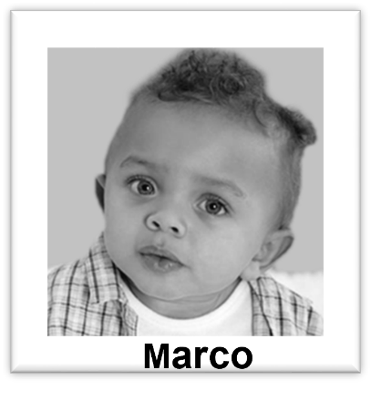
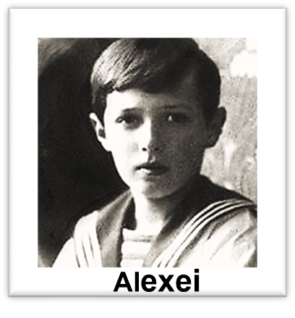
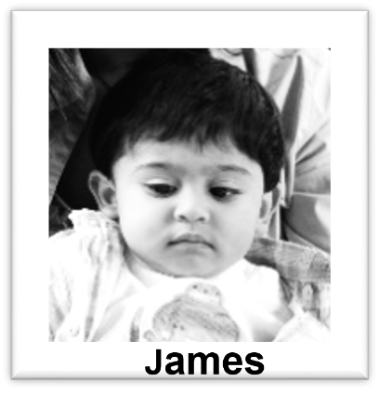
Read the Referral – and take notes!
Phenotype (including severity)
Preliminary Diagnosis
If you want to learn more about this disorder…..Search in MedGen!

Slide 31
Read the Referral – and take notes!
Phenotype (including severity) | significant bruising and severe pain after his first soccer practice previous episodes of scratches causing prolonged bleeding family history: a male cousin was known to have hemophilia. | severe hematoma on thigh after bumping into a boat’s oarlock. long history of recurrent episodes of illness (bruises, bleeding episodes, and long painful recoveries) since shortly after birth Family history: rumors of bleeding issues in many cousins of the maternal family. | relentless nosebleed caused by “bumping into a coffee table” visible bruising on his knees and palms since he began crawling at 6 months Family history: Mother required a blood transfusion after natural childbirth Maternal uncle died at the age of 6 years old from a “brain bleed” after a fall. | profuse bleeding laceration on left index finger previous episodes of prolonged bleeding which hadn’t “risen to the level of an ER visit but were concerning.” Family history: No “genetic” family history is available as Bo was adopted from China at the age of 3 years old
Preliminary Diagnosis | Hemophilia (sub-type not determined yet) | Hemophilia (sub-type not determined yet) | Hemophilia (sub-type not determined yet) | Hemophilia (sub-type not determined yet)
To learn more about this disorder…..Search in MedGen!

Slide 32
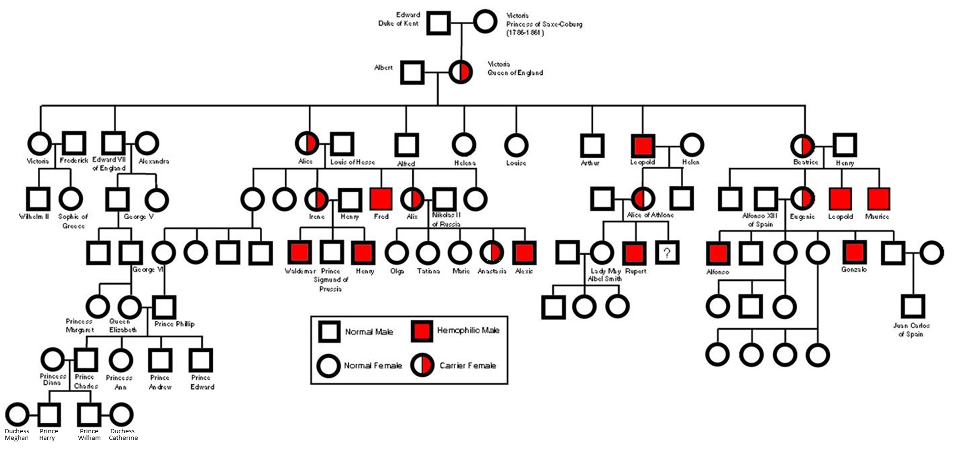
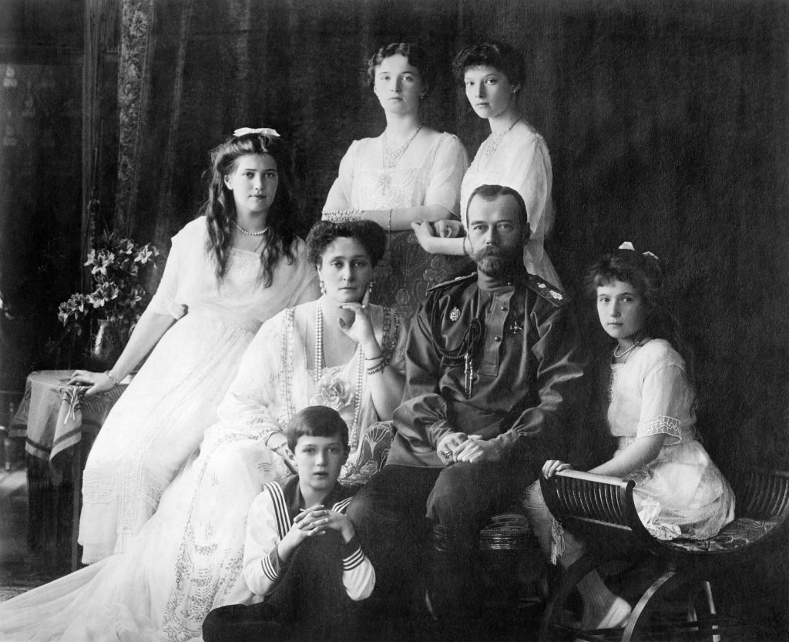
Princess

Slide 33
Understanding the Genetic Test Results

Slide 34
Open your Genetic Test Report
Genetic Variation(s)
Laboratory Assertion(s)

Slide 35
Open your Genetic Test Report
Genetic Variation(s) | NG_011403.1: g.4980_5005del | F9 c.278-3A>G | F8 p.Arg15Ter | F9 p.Asp110Gly
Laboratory Assertion(s) | variant of uncertain significance (VUS) | pathogenic | pathogenic | pathogenic

Slide 36
Learning about the identified variant

Slide 37
Search ClinVar with the Genetic Test Reported Variant
Genetic Variation(s) | NG_011403.1: g.4980_5005del | F9 c.278-3A>G | F8 p.Arg15Ter | F9 p.Asp110Gly
Variant Information: Asserted interpretation in ClinVar HGVS names from ClinVar Is population data available in dbSNP?

Slide 38
Marco’s genetic variant isn’t showing up in ClinVar. Why?
Because I typed it in wrong.
Because ClinVar’s search isn’t working.
Because no one has ever found that variant before.
Because no one in a clinical or research lab has submitted information about that particular variant.

Slide 39
Search ClinVar with the Genetic Test Reported Variant
Genetic Variation(s) | NG_011403.1: g.4980_5005del | F9 c.278-3A>G | F8 p.Arg15Ter | F9 p.Asp110Gly
Variant Information: Asserted interpretation in ClinVar HGVS names from ClinVar Is population data available in dbSNP? | not in ClinVar! (assumed VUS) | pathogenic | pathogenic | pathogenic
 | NG_011403.1(F8): g.4980_5005del Note: no protein HGVS | NG_007994.1(F9): g.15338A>G Note: no protein HGVS | NG_011403.2(F8): g.5214C>T NP_000123.1(F8): p.Arg15Ter | NG_007994.1(F9): g.15392A>G NP_000124.1(F9): p.Asp110Gly
 | Not in Clinvar. Searching directly in dbSNP did not find anything. | rs398122990 Yes! And it is really, really rare. | rs387906432 Yes! And it is really, really rare. | rs137852234 Yes! And it is pretty darn rate.

Slide 40
Learning about the implicated gene

Slide 41
Search Gene with the Test Reported Gene Symbol
Gene Symbol | F8 | F9 | F8 | F9
Gene Information in NCBI Gene: Gene Name Gene Summary Tissue Expression information Gene Ontology information

Slide 42
Search Gene with the Test Reported Gene Symbol
Gene Symbol | F8 | F9 | F8 | F9
Gene Information in NCBI Gene: Gene Name Gene Summary Tissue Expression information Gene Ontology information | Coagulation factor VIII | Coagulation factor IX | Coagulation factor VIII | Coagulation factor IX
 | …participates in the intrinsic pathway of blood coagulation; factor VIII is a cofactor for factor IXa which, in the presence of Ca+2 and phospholipids, converts factor X to the activated form Xa. ….Defects in this gene results in hemophilia A, a common recessive X-linked coagulation disorder. [provided by RefSeq, Jul 2008] |  | …participates in the intrinsic pathway of blood coagulation; factor VIII is a cofactor for factor IXa which, in the presence of Ca+2 and phospholipids, converts factor X to the activated form Xa. ….Defects in this gene results in hemophilia A, a common recessive X-linked coagulation disorder. [provided by RefSeq, Jul 2008]
 | Broad expression, especially in Liver, Spleen and others |  | Broad expression, especially in Liver, Spleen and others
 | Extracellular Blood coagulation Protein binding |  | Extracellular Blood coagulation Protein binding

Slide 43
Search Gene with the Test Reported Gene Symbol
Gene Symbol | F8 | F9 | F8 | F9
Gene Information in NCBI Gene: Gene Name Gene Summary Tissue Expression information Gene Ontology information | Coagulation factor VIII | Coagulation factor IX | Coagulation factor VIII | Coagulation factor IX
 |  | …vitamin K-dependent coagulation factor IX that circulates in the blood as an inactive zymogen….converted to an active form by factor XIa, …activates factor X … through interactions with Ca+2 ions, membrane phospholipids, and factor VIII. Alterations of this gene…cause factor IX deficiency, which is a recessive X-linked disorder….[provided by RefSeq, Sep 2015] |  | …vitamin K-dependent coagulation factor IX that circulates in the blood as an inactive zymogen….converted to an active form by factor XIa, …activates factor X … through interactions with Ca+2 ions, membrane phospholipids, and factor VIII. Alterations of this gene…cause factor IX deficiency, which is a recessive X-linked disorder….[provided by RefSeq, Sep 2015]
 |  | Pretty much just expressed in the liver |  | Pretty much just expressed in the liver
 |  | Extracellular Blood coagulation Ca+2-binding & endopeptidase |  | Extracellular Blood coagulation Ca+2-binding & endopeptidase

Slide 44
Search Gene with the Test Reported Gene Symbol
Gene Symbol | F8 | F9 | F8 | F9
Gene Information in NCBI Gene: Gene Name Gene Summary Tissue Expression information Gene Ontology information | Coagulation factor VIII | Coagulation factor IX | Coagulation factor VIII | Coagulation factor IX
 | …participates in the intrinsic pathway of blood coagulation; factor VIII is a cofactor for factor IXa which, in the presence of Ca+2 and phospholipids, converts factor X to the activated form Xa. ….Defects in this gene results in hemophilia A, a common recessive X-linked coagulation disorder. [provided by RefSeq, Jul 2008] | …vitamin K-dependent coagulation factor IX that circulates in the blood as an inactive zymogen….converted to an active form by factor XIa, …activates factor X … through interactions with Ca+2 ions, membrane phospholipids, and factor VIII. Alterations of this gene…cause factor IX deficiency, which is a recessive X-linked disorder….[provided by RefSeq, Sep 2015] | …participates in the intrinsic pathway of blood coagulation; factor VIII is a cofactor for factor IXa which, in the presence of Ca+2 and phospholipids, converts factor X to the activated form Xa. ….Defects in this gene results in hemophilia A, a common recessive X-linked coagulation disorder. [provided by RefSeq, Jul 2008] | …vitamin K-dependent coagulation factor IX that circulates in the blood as an inactive zymogen….converted to an active form by factor XIa, …activates factor X … through interactions with Ca+2 ions, membrane phospholipids, and factor VIII. Alterations of this gene…cause factor IX deficiency, which is a recessive X-linked disorder….[provided by RefSeq, Sep 2015]
 | Broad expression, especially in Liver, Spleen and others | Pretty much just expressed in the liver | Broad expression, especially in Liver, Spleen and others | Pretty much just expressed in the liver
 | Extracellular Blood coagulation Protein binding | Extracellular Blood coagulation Ca+2-binding & endopeptidase | Extracellular Blood coagulation Protein binding | Extracellular Blood coagulation Ca+2-binding & endopeptidase

Slide 45
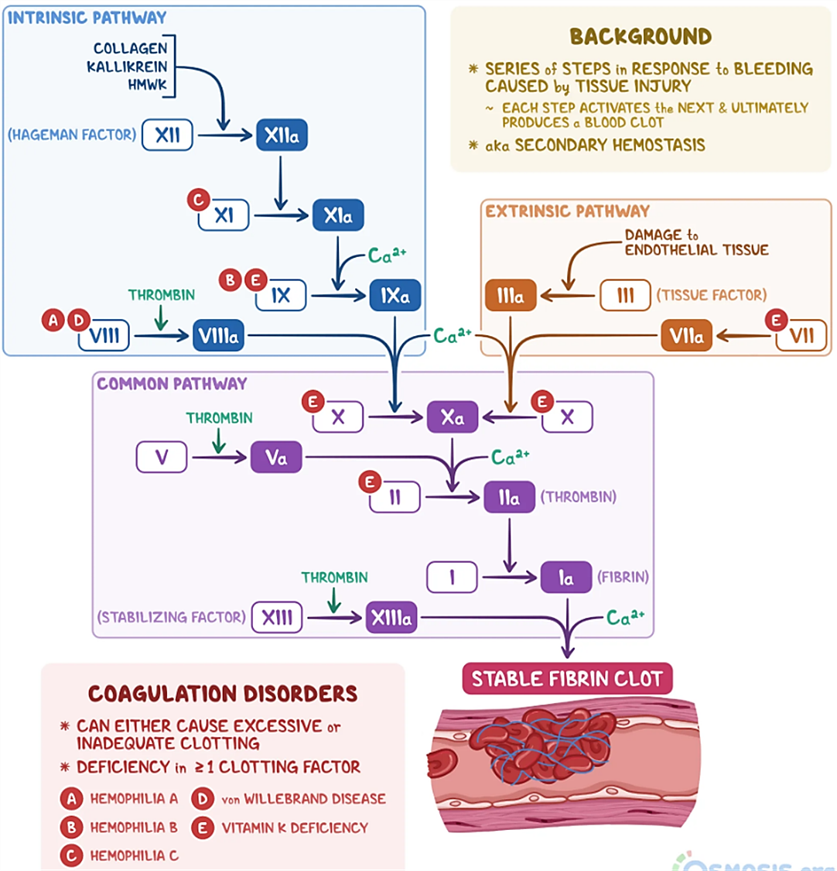
About the clotting cascade
Factor 8 (F8 a.k.a. FVIII)
& Factor 9 (F9 a.k.a. FIX)
are critical regulatory factors for blood coagulation/clotting.
They also both happen to be encoded on the
X-chromosome.
Males only have 1 copy of the gene and therefore are dramatically impacted if there is a pathogenic variant impacting even just one of these two genes.
https://www.osmosis.org/answers/coagulation-cascade

Slide 46
Mapping the variant

Slide 47
Map the Variant with Genome/Sequence Browser Tools
Genetic Variation(s) | NG_011403.1(F8):g.4980_5005del | NG_007994.1(F9):g.15338A>G NP_000124.1(F9):p.Gly94Ter | NG_011403.2(F8):g.5214C>T NP_000123.1(F8):p.Arg15Ter | NG_007994.1(F9):g.15392A>G NP_000124.1(F9):p.Asp110Gly
Ultimate Impacted Biomolecule based on: GDV to view the chromosome and gene region RefSeqGene Graphics view of gene region and transcript(s) RefSeq Protein Graphics view of protein and domains CDD or iCn3D to view a structure

Slide 48
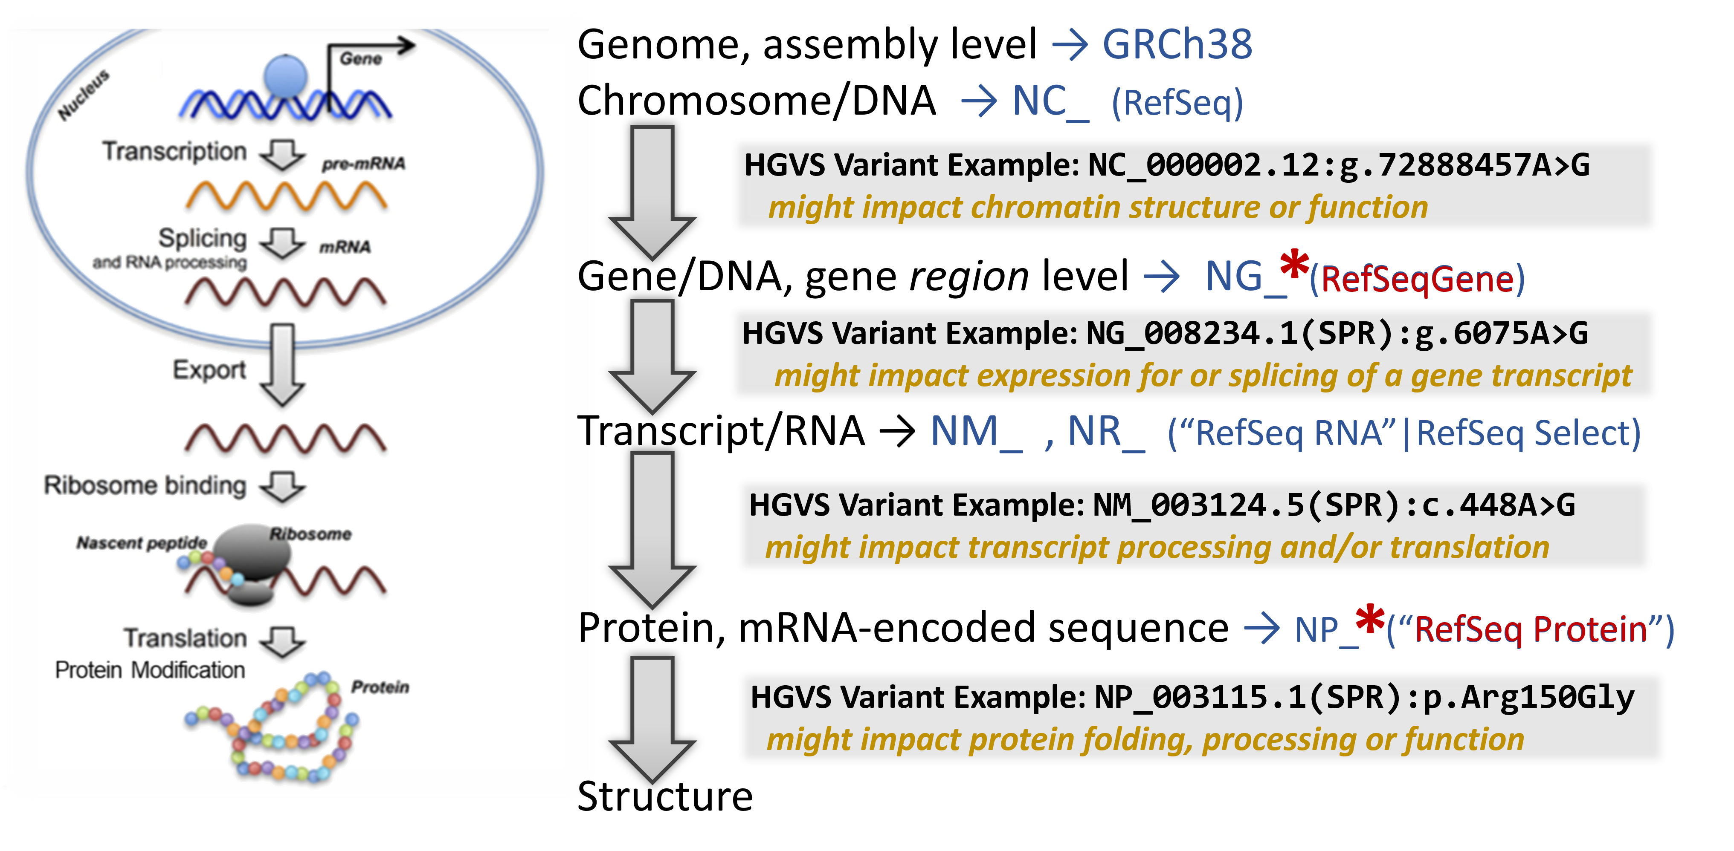
An overview of the central dogma & locating a genetic variation

Slide 49
An overview of the central dogma & locating a genetic variation
Is the variant in the:
✓

Slide 50
Map the Variant with Genome/Sequence Browser Tools
Genetic Variation(s) | NG_011403.1(F8):g.4980_5005del | NG_007994.1(F9):g.15338A>G NP_000124.1(F9):p.Gly94Ter | NG_011403.2(F8):g.5214C>T NP_000123.1(F8):p.Arg15Ter | NG_007994.1(F9):g.15392A>G NP_000124.1(F9):p.Asp110Gly
Ultimate Impacted Biomolecule based on: GDV to view the chromosome and gene region RefSeqGene Graphics view of gene region and transcript(s) RefSeq Protein Graphics view of protein and domains CDD or iCn3D to view a structure

Slide 51
Map the Variant with Genome/Sequence Browser Tools
Genetic Variation(s) | NG_011403.1(F8):g.4980_5005del | NG_007994.1(F9):g.15338A>G NP_000124.1(F9):p.Gly94Ter | NG_011403.2(F8):g.5214C>T NP_000123.1(F8):p.Arg15Ter | NG_007994.1(F9):g.15392A>G NP_000124.1(F9):p.Asp110Gly
Ultimate Impacted Biomolecule based on: GDV to view the chromosome and gene region RefSeqGene Graphics view of gene region and transcript(s) RefSeq Protein Graphics view of protein and domains CDD or iCn3D to view a structure | Deleted region upstream from through the beginning of the transcription start. |  | Located in the coding region within exon 1.
 | Transcripts are not expressed, therefore the variant does not impact biomolecules beyond the gene region in the chromosome. |  | Located within the first coding exon.
 |  |  | The coding sequence quickly terminates after only 14 residues – producing a non-functional peptide destined for degradation.
 |  |  | Most of the protein is never made so it cannot serve as a complex anchor for clotting factor aggregation.

Slide 52
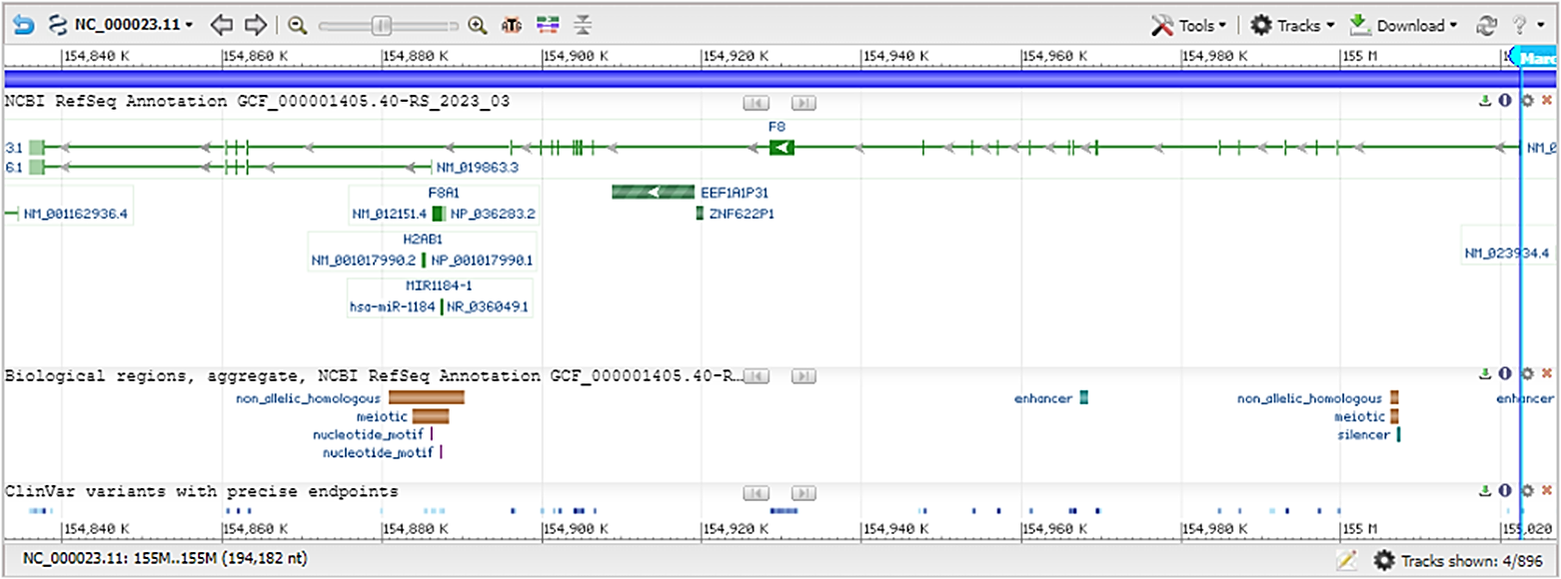
Marco’s variant is a deletion of the region including the transcript start codon – so no transcript is produced.
James’ variant is in the coding region of the transcript – thus directly impacts the protein sequence.

Slide 53
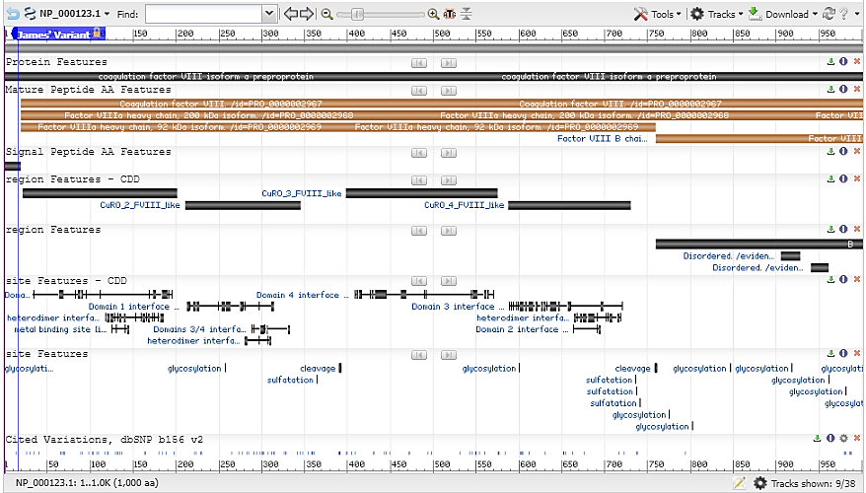
James’ variant in the coding region of the transcript is a termination codon.
Thus, the full-length peptide is never made – actually most of it is gone!….so there is no functional protein made.

Slide 54
Map the Variant with Genome/Sequence Browser Tools
Genetic Variation(s) | NG_011403.1(F8):g.4980_5005del | NG_007994.1(F9):g.15338A>G NP_000124.1(F9):p.Gly94Ter | NG_011403.2(F8):g.5214C>T NP_000123.1(F8):p.Arg15Ter | NG_007994.1(F9):g.15392A>G NP_000124.1(F9):p.Asp110Gly
Ultimate Impacted Biomolecule based on: GDV to view the chromosome and gene region RefSeqGene Graphics view of gene region and transcript(s) RefSeq Protein Graphics view of protein and domains CDD or iCn3D to view a structure |  | Located near a splice site in the gene just before exon 4. |  | Located in the coding region within exon 4.
 |  | Exon 4’s acceptor site is shifted back due to the variation – causing a frameshift of the coding sequence. |  | Located within the coding region within exon 4.
 |  | The coding sequence frameshift encodes an 11-residue peptide and then a stop codon - prematurely terminating the protein. |  | The protein is made, but with a change in amino acid 110 from an acidic Aspartate to a neutral Glycine.
 |  | A large portion of the protein is never made – especially the endopeptidase domain which is critical for activating FX – and propagating the clotting cascade. |  | The variant is one of 3 residues annotated as critical for binding to Ca⁺². The change from acidic Aspartate residue to neutral Glycine impacts its binding to the Ca⁺² & protein folding, thus processing & activation.

Slide 55
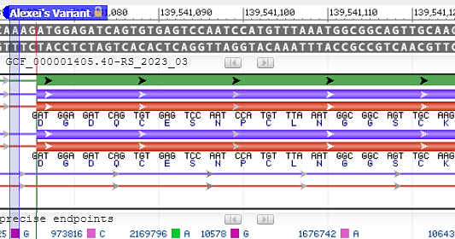
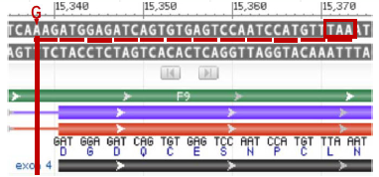
Alexei’s variant is near the end of a coding exon.
Because the variant creates an exon signal mimic, it shifts the exon splice site up two residues causing a frameshift in the protein coding sequence.

Slide 56
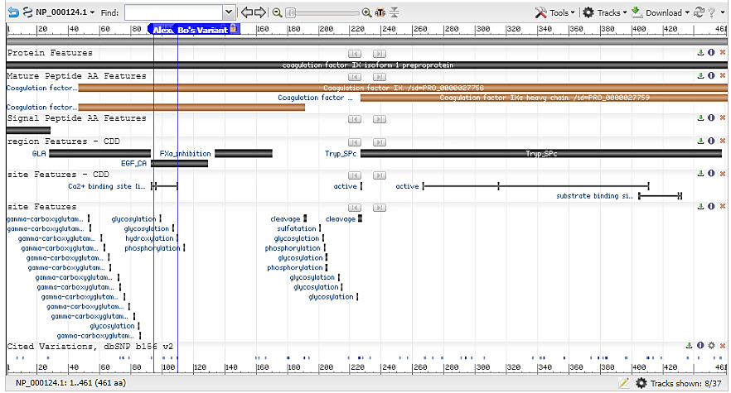
Alexei’s splicing-shift and coding frameshift variant causes a short non-sense peptide with a termination codon.
Thus, only the beginning of the peptide is made….so no functional protein is created.
This is similar to what is seen for James’ F8 protein.

Slide 57
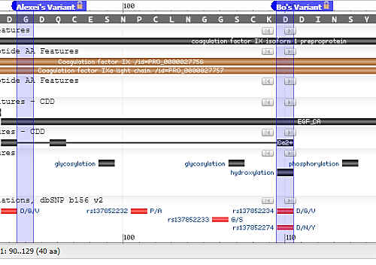
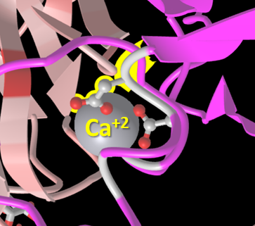
Bo’s variant is in the transcript’s protein coding region and ends up in the protein sequence & structure!
The variant replaces one of the critical binding residues for the Calcium ion binding site – disrupting its ability to maintain a folded structure.
Thus, the protein isn’t processed effectively leading to a smaller amount of active enzyme for the clotting cascade.

Slide 58
Map the Variant with Genome/Sequence Browser Tools
Genetic Variation(s) | NG_011403.1(F8):g.4980_5005del | NG_007994.1(F9):g.15338A>G NP_000124.1(F9):p.Gly94Ter | NG_011403.2(F8):g.5214C>T NP_000123.1(F8):p.Arg15Ter | NG_007994.1(F9):g.15392A>G NP_000124.1(F9):p.Asp110Gly
Ultimate Impacted Biomolecule based on: GDV to view the chromosome and gene region RefSeqGene Graphics view of gene region and transcript(s) RefSeq Protein Graphics view of protein and domains CDD or iCn3D to view a structure | Deleted region upstream from through the beginning of the transcription start. | Located near a splice site in the gene just before exon 4. | Located in the coding region within exon 1. | Located in the coding region within exon 4.
 | Transcripts are not expressed, therefore the variant does not impact biomolecules beyond the gene region in the chromosome. | Exon 4’s acceptor site is shifted back due to the variation – causing a frameshift of the coding sequence. | Located within the first coding exon. | Located within the coding region within exon 4.
 |  | The coding sequence frameshift encodes an 11-residue peptide and then a stop codon - prematurely terminating the protein. | The coding sequence quickly terminates after only 14 residues – producing a non-functional peptide destined for degradation. | The protein is made, but with a change in amino acid 110 from an acidic Aspartate to a neutral Glycine.
 |  | A large portion of the protein is never made – especially the endopeptidase domain which is critical for activating FX – and propagating the clotting cascade. | Most of the protein is never made so it cannot serve as a complex anchor for clotting factor aggregation. | The variant is one of 3 residues annotated as critical for binding to Ca⁺². The change from acidic Aspartate residue to neutral Glycine impacts its binding to the Ca⁺² & protein folding, thus processing & activation.

Slide 59
Putting it all together tell the story….

Slide 60
Put it all together…
Diagnosis
Genetic Variation(s)
Proposed Molecular Mechanism of Variant Impact
How does this relate back to the phenotype (symptoms/ clinical features & diagnosis)?

Slide 61
Put it all together…
Diagnosis | Hemophilia A | Hemophilia B | Hemophilia A | Hemophilia B
Genetic Variation(s) | NG_011403.1(F8): g.4980_5005del | NG_007994.1(F9): g.15338A>Gr | NP_000123.1(F8): p.Arg15Ter | NP_000124.1(F9): p.Asp110Gly
Proposed Molecular Mechanism of Variant Impact | The deletion in the region just upstream and after the transcriptional start site - likely removes promoter elements and does not allow for gene expression. | This is a change in a splice site base – shifting the splicing back two positions, causing a coding frameshift and ending in premature termination. | This changes an amino acid coding codon to a premature termination codon. | This changes an acidic residue which is needed for binding a critical calcium ion which is required for F9 function.
How does this relate back to the phenotype (symptoms/clinical features & diagnosis)? | With a non-expressible F8, the clotting cascade will not be able to progress to create clots. This correlates with a severe phenotype. | With an F9 protein prematurely terminated, the catalytic domain for activating the next clotting factor is not made and the clotting cascade cannot progress to create clots. This correlates with a severe phenotype. | With an F8 protein prematurely terminated, the binding domains for activating the next clotting factor is not made and the clotting cascade cannot progress to create clots. This correlates with a severe phenotype. | With the loss of one of 3 coordinating residues for a critical calcium ion, the F9 protein is not fully functional and may not effectively activate the next clotting factor. This correlates with a less severe phenotype.

Slide 62
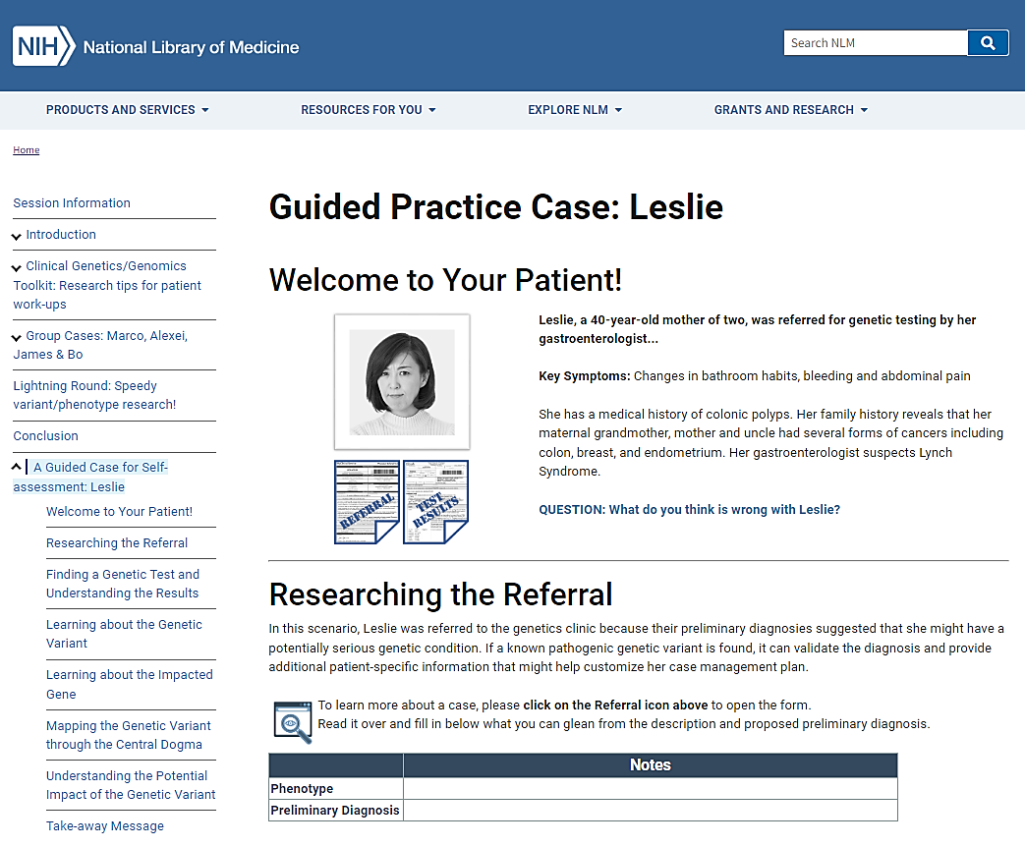
Leslie’s Case - your workflow practice -
A guided case to practice on your own!

Slide 63
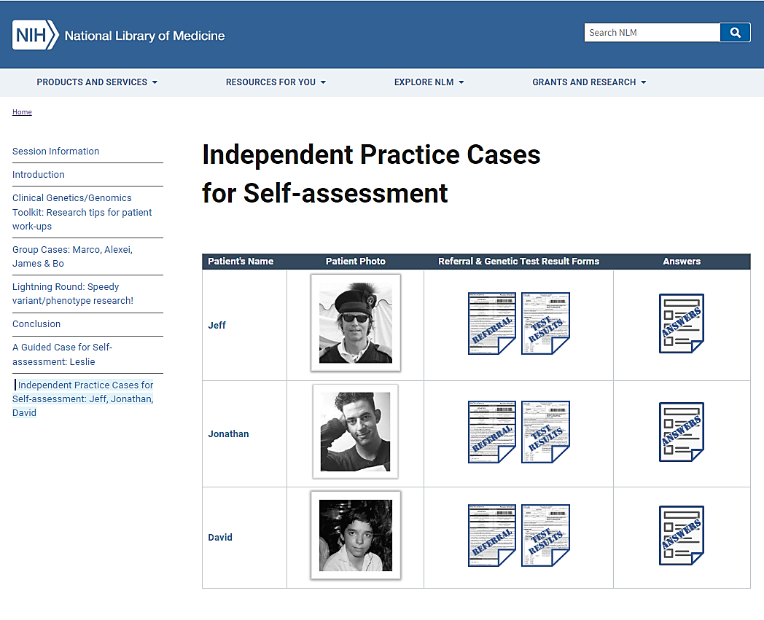
Independent Cases - your workflow practice -
In your career you are going to get a patient history and/or referral information and potentially a genetic test result.
You won’t get guided research steps.
So, here are three practice cases that you can try out!

Slide 64
But what if I’m in the clinic and don’t have time to spend getting critical information?

Slide 65
Lightning Round - your workflow practice -
A quick way to find up-to-date genetic variant/disorder information.

Slide 66
Important Concepts - to know -
Why should I care about molecular science while preparing to be a physician?
knowledge is more power to act & act more effectively!
How could understanding a patient’s specific molecular pathology help you as a doctor?
aiding in precision diagnosis,
implementation of proactive/preventative measures
including optimizing therapeutic selection,
communicating with the patient & patient’s family
What in the patient’s case record could start you thinking about ordering a genetic test?
known genetic disorder with or without family history
(don’t trust commercial tests for your diagnosis!)
Which databases are good places to start to find helpful disease/condition, gene information, and to validate a lab’s call about a pathogenic genetic variation?
NCBI MedGen , NCBI Gene & NCBI ClinVar

Slide 67
Conclusion Thanks for participating today!
In today’s session,
you learned to use some NCBI resources to understand the impact of a genetic variation on a person’s biology!
Here are some ways to learn more about the cool tools you used today!
NCBI has a lot of resources to help the clinical and scientific research community…
…and ways to keep up with news and developments!

