Slide 1
Developing an NIH Strategic Plan for Data Science
Jon R. Lorsch, Ph.D., Director
National Institute of General Medical Sciences

Slide 2
Developing an NIH Strategic Plan for Data Science
Requested by Congress
The plan will focus on:
Modernizing the data resource ecosystem to increase its utility for researchers and other stakeholders and to optimize its efficiency of operation
Enhancing data sharing, access, interoperability
Improving ability to use EHR, clinical, and observational data for research while ensuring data confidentiality
Modernizing infrastructure, increasing capacity

Slide 3
A Couple of Definitions…
A Couple of Definitions…
“Data science is an interdisciplinary field of inquiry in which quantitative and analytical approaches, processes, and systems are developed and used to extract knowledge and insights from increasingly large and/or complex sets of data.”
FINDABLE
ACCESSIBLE
INTEROPERABLE
REUSABLE

Slide 4
Table – 1st Column: Domains of Data Science; 2nd Column: Description
Domains of Data Science | Description
Data Infrastructure | Hardware, architecture, and platforms necessary to capture, organize, store, allow access to, and compute on data
Data Resources | Methods, practices, and associated features needed to increase the value and utility of data beyond its native state
Advanced Management, Analytics, and Visualization Tools | Algorithms, software, models, and tools necessary to extract knowledge and understanding from data
Workforce Development | Policies, practices, and programs to train and develop an outstanding data science workforce
Policy, Stewardship, and Sustainability | The policies and practices necessary for governance, financial management, and sustainable stewardship of the biomedical data science ecosystem

Slide 5
Organization of the Strategic Plan
Organization of the Strategic Plan
Overarching Goals
Strategic Objectives
Implementation Tactics
Milestones and Performance Measures

Slide 6
Overarching Goal 1: Support Highly Efficient and Effective Data Infrastructure for Biomedical Research
Overarching Goal 1: Support Highly Efficient and Effective Data Infrastructure for Biomedical Research
Strategic Objective 1-1: Optimize Data Storage, Access and Security
Rely on private sector where possible
Strategic Objective 1-2: Connect NIH Data Systems
Use NIH Data Commons and NLM/NCBI as hubs
NIH-supported
Datasets
(FAIR)
https://commonfund.nih.gov/bd2k/commons
NIH Data Commons

Slide 7
Overarching Goal 2: Promote the Modernization of the Data Resources Ecosystem
Overarching Goal 2: Promote the Modernization of the Data Resources Ecosystem
Strategic Objective 2-1: Modernize the Data Repository Ecosystem
Implementation Tactics:
Separate the support of databases and knowledgebases

Slide 8
Databases and Knowledgebases
Databases and Knowledgebases
Databases: data repositories that store, organize, validate, and make accessible the core data related to a particular system or systems
For example, the core data for a model organism database might include genome, transcriptome, and protein sequences and functional annotations of gene products
Knowledgebases: accumulate, organize, and link growing bodies of information related to core datasets
For example, information about expression patterns, splicing variants, localization, protein-protein interaction and pathway networks related to an organism or set of organisms; publication information

Slide 9
Overarching Goal 2: Promote the Modernization of the Data Resources Ecosystem
Overarching Goal 2: Promote the Modernization of the Data Resources Ecosystem
Strategic Objective 2-1: Modernize the Data Repository Ecosystem
Implementation Tactics:
Separate the support of databases and knowledgebases
Use appropriate mechanism, review, and management for each type of repository
Dynamically measure data use, utility, and modification
Ensure privacy and security
Create unified, efficient, and secure authorization of access to sensitive data
Employ explicit evaluation, lifecycle, sustainability, and sunsetting expectations for data resources

Slide 10
Overarching Goal 2: Promote the Modernization of the Data Resources Ecosystem
Overarching Goal 2: Promote the Modernization of the Data Resources Ecosystem
Strategic Objective 2-2: Support the Storage and Sharing of Individual Datasets
Implementation Tactics:
Link datasets to publications via PubMed Central and NLM/NCBI
Longer-term: Expand NIH Data Commons to allow submission, open sharing, and indexing of individual, FAIR datasets

Slide 11
Overarching Goal 2: Promote the Modernization of the Data Resources Ecosystem
Overarching Goal 2: Promote the Modernization of the Data Resources Ecosystem
Strategic Objective 2-3: Leverage Ongoing Initiatives to Better Integrate Clinical and Observational Data into Biomedical Data Science
Implementation Tactics:
Create efficient linkages among NIH data resources that contain clinical and observational information
Facilitate the creation and widespread adoption of consensus Common Data Elements (CDEs) for clinical studies
Develop and implement universal credentialing protocols and user authorization systems that work across NIH data resources and platforms
TOPMed

Slide 12
Overarching Goal 3: Support the Development and Dissemination of Advanced Data Management, Analytics, and Visualization Tools
Overarching Goal 3: Support the Development and Dissemination of Advanced Data Management, Analytics, and Visualization Tools
Strategic Objective 3-1: Support Useful, Generalizable, and Accessible Tools and Workflows
Implementation Tactics:
Separate support for tools from support for databases and knowledgebases
Use appropriate mechanism, review, and management for tool development
Leverage commercial tools, software, workflows, and expertise
Promote development of open source, openly shared and reusable tools, software, and workflows
Strategic Objective 3-2: Broaden Use of Specialized Tools
Example: Algorithms from astronomy adapted for use in cellular imaging
Support research for improving methods for using EHRs and other clinical data
Strategic Objective 3-3: Improve Discovery and Cataloging Resources
Development and adoption of community standards for data indexing, citation and provenance will be key

Slide 13
Why Separate Support of Databases, Knowledgebases and Tool Development?
Why Separate Support of Databases, Knowledgebases and Tool Development?
Strategic Objective 2-1: Modernize the Data Repository Ecosystem
Implementation Tactics:
Separate the support of databases and knowledgebases
Use appropriate mechanism, review, and management for each type of repository
Strategic Objective 3-1: Support Useful, Generalizable, and Accessible Tools and Workflows
Implementation Tactics:
Separate support for tools from support for databases and knowledgebases
Use appropriate mechanism, review, and management for tool development

Slide 14
Why Separate Support of Databases, Knowledgebases and Tool Development?
Why Separate Support of Databases, Knowledgebases and Tool Development?
NIH-funded data resources historically have been evaluated and funded as research grants
Misalignment of goals and review expectations: innovation, hypothesis generation/testing, etc. rather than user service, utility, efficiency of operation, usage
Has led to entanglement of tool development and resource management
Tool development and dissemination should be evaluated on their own merits rather than linked to the existence of important data resources
Database and knowledgebase functions, needs and uses are not the same
Core data may be essential to the research community but (in some cases) the associated knowledgebase information less so
Cost of human curation is high and its utility and impact must be carefully evaluated, independent of the need for access to core data
Need for usage, utility, impact and efficiency metrics for each kind of resource and for tools

Slide 15
Creating a More Modern and Coherent Data Resource Ecosystem
Creating a More Modern and Coherent Data Resource Ecosystem
Knowledgebase
Tools
Database
“Tool Depot”

Slide 16
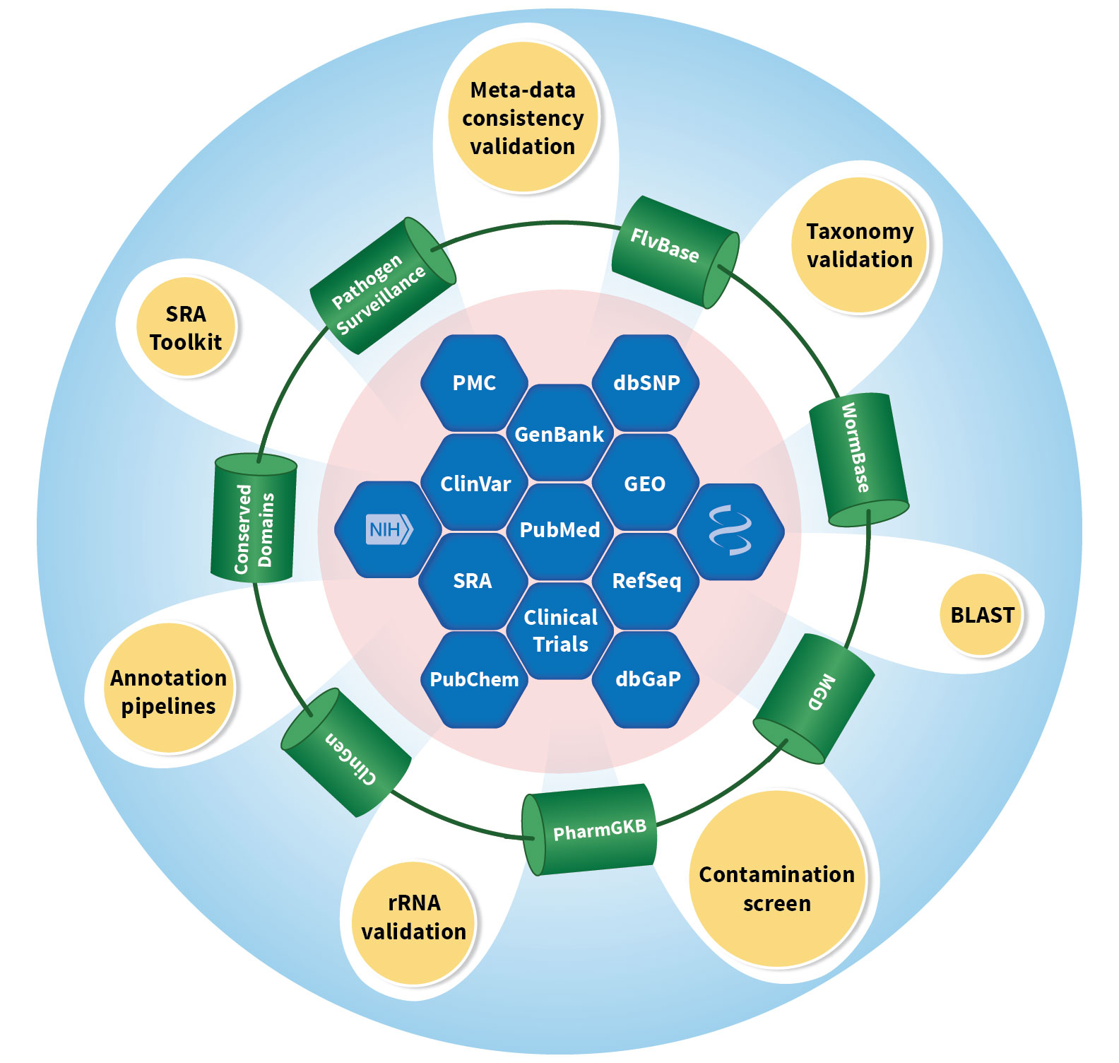
Figure

Slide 17
Overarching Goal 4: Enhance Workforce Development for Biomedical Data Science
Overarching Goal 4: Enhance Workforce Development for Biomedical Data Science
Strategic Objective 4-1: Enhance the NIH Workforce
E.g., Data science training and education for NIH staff
Strategic Objective 4-2: Expand the National Research Workforce
Enhance quantitative and computational training for graduate students and postdocs
Strategic Objective 4-3: Engage a Broader Community
E.g., Citizen science

Slide 18
Overarching Goal 5: Enact Appropriate Policies to Promote Stewardship and Sustainability
Overarching Goal 5: Enact Appropriate Policies to Promote Stewardship and Sustainability
Strategic Objective 5-1: Develop Policies for a FAIR Data Ecosystem
Policies must be achievable and minimize administrative burden
Strategic Objective 5-2: Enhance Stewardship
Implementation Tactics:
Develop standard use and utility metrics and review expectations for data resources and tools
Establish sustainability models for data resources

Slide 19
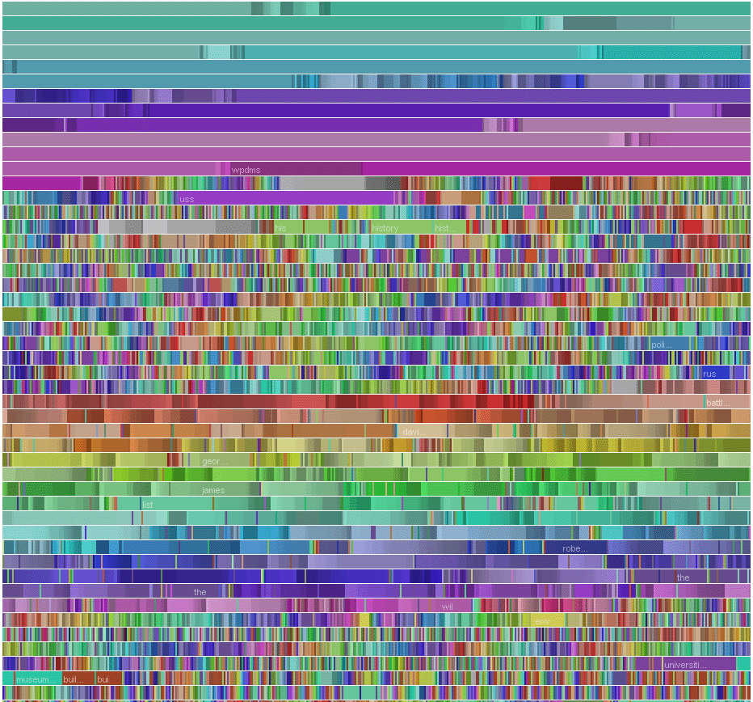
Next Steps
Next Steps
Obtain stakeholder feedback (RFI, Council presentations)
Set short, medium, and long-term priorities
Establish performance measures and milestones
Deliver final strategic plan to Congress in May

Slide 20
Questions & Comments

