Slide 1
National Information Center on Health Services Research & Health Care Technology
National Library of Medicine
Webinar Part I
HTA 101: Introduction to Health Technology Assessment
August 31, 2011
Clifford Goodman, PhD
The Lewin Group
Falls Church, Virginia USA
clifford.goodman@lewin.com
1

Slide 2
HTA 101: Outline
Origins
Health technology
Definition and categories
Inappropriate use
HTA and its role in health care
Definitions
Applications
Properties and impacts assessed
HTA methods
Primary methods
Secondary/integrative methods
Economic analyses
Priority setting and timing of HTA
Bibliographic sources for HTA
Current HTA trends
2

Slide 3
Origins of Technology Assessment
Technology assessment (TA) arose in the mid-1960s from an appreciation of the critical role of technology in modern society and its potential for unintended, and sometimes harmful, consequences.
The term “technology assessment” was introduced in 1965 in the US House of Representatives, with the primary purpose of serving policymaking.
Examples of early assessment topics were offshore oil drilling, pesticides, automobile pollution, nuclear power plants, supersonic airplanes, and the artificial heart.
See, e.g.: Brooks H, Bowers R. The assessment of technology. Science 1970;222(2):13-20; and US Congress, House of Representatives. Committee on Science and Astronautics. Technology Assessment. Statement of Emilio Q. Daddario, Chairman, Subcommittee on Science Research and Development. 90th Cong., 1st sess., Washington, DC; 1967.
3

Slide 4
Early Health Technology Assessments
Development of TA in 1960s and 1970s coincided with the introduction of health technologies that prompted widespread interest in matters that transcended their intended health effects. Examples of early HTAs:
Multiphasic health screening (NAE* 1969)
In vitro fertilization (NRC* 1975)
Predetermination of the sex of children (NRC 1975)
Retardation of aging (NRC 1975)
Modifying human behavior by neurosurgical, electrical or pharmaceutical means (NRC 1975)
Drug bioequivalence (OTA* 1974)
*NAE: National Academy of Engineering; NRC: National Research Council; OTA: US Congressional
Office of Technology Assessment
4

Slide 5
What is Health Care Technology?
Technology is the practical application of knowledge.
Three ways to describe health technology include its:
Physical nature
Clinical purpose
Stage of diffusion
5

Slide 6
Health Care Technology: Physical Nature
Drugs: e.g., aspirin, antibiotics, cancer chemotherapy
Biologics: e.g., vaccines, blood products, biotechnology-derived substances
Devices, equipment, supplies: e.g., cardiac pacemaker, MRI scanner, mosquito netting
Medical and surgical procedures: e.g., acupuncture, bariatric surgery, cesarean section
Support systems: e.g., clinical laboratory, drug formulary, electronic health record system
Organizational, delivery, managerial systems: e.g., vaccination program, health care payment system
6

Slide 7
Health Care Technology: Purpose
Prevention
Screening
Diagnosis
Treatment
Rehabilitation
Palliation
Other
7

Slide 8
Health Care Technology: Stage of Diffusion
Future
Experimental (laboratory or animal testing)
Investigational (clinical studies)
Established (standard approach)
Obsolete
8

Slide 9
Technologies Determined to be Ineffective or Harmful After Diffusion (all/most uses)
Ten examples:
Thalidomide for sedation in pregnant women
Oxygen supplementation for premature infants
Prefrontal lobotomy for mental disturbances
Gastric freezing for peptic ulcer disease
Episiotomy (routine or liberal) for birth
ABMT-HDC for breast cancer
Hormone replacement therapy for healthy menopausal women
COX-2 inhibitors
Prostate specific antigen (PSA) screening for prostate cancer
Bevacizumab for breast cancer
9

Slide 10
Underused Cost-Effective Technologies
Ten examples:
ACE inhibitors for treatment of heart failure
Cochlear implants for severe-to-profound deafness
Colorectal cancer screening
HbA1c testing every 6 months in diabetic patients
Hypertension management
Mammography (esp. age 50+)
Organ transplantation
Pap smears
Warfarin to prevent strokes due to atrial fibrillation
Immunizations: childhood, influenza, pneumococcal for high-risk patients
10

Slide 11
What Is Health Technology Assessment?
HTA is the systematic evaluation of properties, effects, or other impacts of health care technology.
The main purpose of HTA is to inform policy making for technology in health care.
HTA may address the direct and intended consequences of technologies, as well as the indirect and unintended consequences of technologies.
HTA is conducted by interdisciplinary groups.
HTA uses explicit analytical frameworks and a variety of methods.
11

Slide 12
HTA Performed by Different Organizations to Inform Health Care Policies or Decisions
Advise a regulatory agency about allowing the marketing / use of a technology
Advise payers (health authorities, health plans, etc.) about technology reimbursement: coverage (whether or not to pay), coding, and payment amount
Advise clinicians and patients about appropriate use of a technology
Help managers of hospitals and other health care organizations make decisions about acquiring a technology
Support decisions by health technology companies about technology development and marketing
Support decisions by financial groups about investing in new technology companies
12

Slide 13
Properties and Impacts Assessed
Main categories:
Technical properties
Safety
Efficacy and effectiveness
Cost and other economic attributes
Social, legal, ethical, or political impacts
13

Slide 14
Efficacy vs. Effectiveness
Efficacy
Benefit of using a technology for a particular health problem in ideal conditions of use, for example, in a strict protocol of a randomized controlled trial or at a “center of excellence.”
Effectiveness
Benefit of using a technology for a particular health problem in general or routine conditions of use, for example, in a community hospital.
14

Slide 15
Measuring Efficacy/Effectiveness
Health outcomes/endpoints (“benefits” and “harms”)
mortality
morbidity
adverse events
Quality of life, also:
functional status
patient satisfaction
Intermediate (including surrogate*) endpoints
e.g., blood pressure, lab values, EKG (“biomarkers”)
Accuracy of tests (screening, diagnosis, monitoring)
sensitivity
specificity
predictive value positive, negative
* True surrogate: highly, reliably predictive of health outcomes

Slide 16
Quality-Adjusted Life Year (QALY)
It is widely accepted that one year of life spent in a good state of health (or function of quality of life) is preferred to one year spent in a poor state of health.
“Utility” refers to the relative preference (value) that an individual (or society) has for a particular state of health.
Utility weights are determined using direct methods, e.g., time trade-off or standard gamble, or indirect methods, e.g., SF-36, EQ-5D/EuroQoL, Health Utility Index, Quality of Well-Being Scale.
The QALY is a unit for measuring outcomes of health care (or other interventions). QALYs combine length of life with quality of life. That is, years of life are adjusted (weighted) by patient/user utility for the quality of life experienced during those years.
The QALY may be used as the unit of patient/user outcomes in a cost-utility analysis. (We will return to this later …)
16

Slide 17
QALY = Length of Life X Quality Weight Survival and QoL with Current/Standard Treatment
Using QALYs to capture changes in length of life (mortality) and quality of life (e.g., utility for state of health)

Slide 18
QALY = Length of Life X Quality Weight Survival and QoL with New or Additional Treatment
Using QALYs to capture changes in length of life (mortality) and quality of life (e.g., utility for state of health)

Slide 19
Three Main Groups Of Methods
Primary data collection
Collect original data, for example, using clinical trials or observational studies (prospective or retrospective)
Secondary / integrative analyses
Combine (synthesize or integrate) data from existing sources
Economic analyses
Weighing costs and benefits (outcomes or other results)
19

Slide 20
Primary Data Methods: Attributes of Stronger Evidence for Causal Effect of a Technology
In General:
Prospective studies are stronger than retrospective ones.
Controlled studies are stronger than uncontrolled ones.
Studies with contemporaneous control groups are stronger than studies with historical control groups.
Randomized studies are stronger than non-randomized ones.
Large studies (with enough patients to detect true treatment effects) are stronger than small ones.
Blinded studies (patients, providers do not know which intervention is being used) are stronger than unblinded ones.
Studies that clearly define study populations, interventions, and outcome measures are stronger than those that do not.
20

Slide 21
A Basic Evidence Hierarchy
Systematic reviews and meta-analyses of RCTs
RCTs
Non-randomized trials
Observational studies
Non-experimental studies
Expert opinion
21

Slide 22
Grade Evidence Framework
Study Design | Quality of Evidence | Lower if | Higher if
Randomized trial → | High | Risk of bias -1 Serious -2 Very serious Inconsistency -1 Serious -2 Very serious Indirectness -1 Serious -2 Very serious Imprecision -1 Serious -2 Very serious Publication bias -1 Likely -2 Very likely | Large effect +1 Large +2 Very large Dose response +1 Evidence of a gradient All plausible confounding +1 Would reduce a demonstrated effect or +1 Would suggest a spurious effect when results show no effect
 | Moderate
Observational study | Low
 | Very low
Source: Grading of Recommendation Assessment, Development, and Evaluation (GRADE) Working Group. Guyatt G, et al. J Clin Epidemiol 2011; 64:383-94.

Slide 23
Secondary Data Analyses
Expert opinion
Group judgment (“consensus development”)
Unstructured literature review
Systematic literature review
Meta-analysis
Modeling (e.g., decision trees, Markov models)
23

Slide 24
Systematic Review
A form of structured literature review that addresses one or more key questions that are formulated to be answered by analysis of evidence
Involves:
objective means of searching the literature
applying predetermined inclusion and exclusion criteria to this literature
critically appraising the relevant literature
extraction and synthesis of data from evidence base to formulate answers to key questions
May include meta-analysis
24

Slide 25
Meta-Analysis
Refers to statistical procedures for combining results from different studies. This combination may produce a stronger conclusion than can be provided by any single study. It is generally most appropriate when there are not definitive studies on a topic and non-definitive studies are in some disagreement.
25

Slide 26
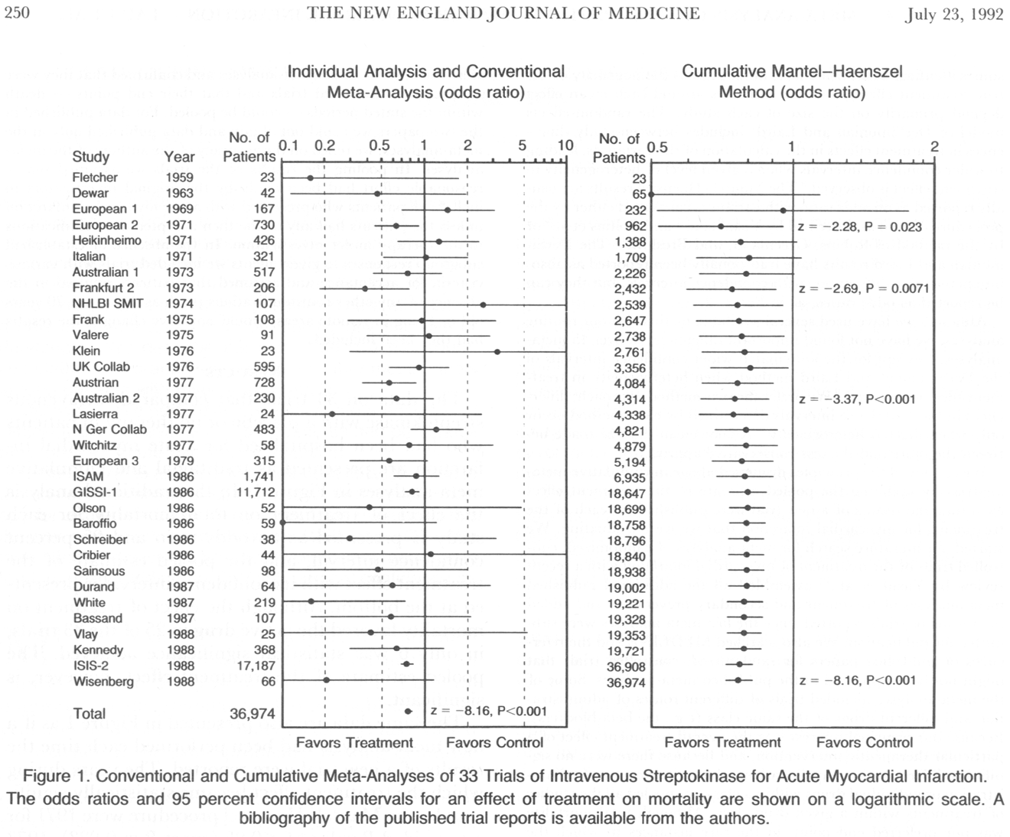
Source: Lau J, Antman EM, Jimenez-Silva J, et al. Cumulative meta-analysis of therapeutic trials for myocardial infarction. N Engl J Med 1992;327(4):248-54.
26

Slide 27
Modeling
Analytical techniques for simulating (representing) real processes involving decisions and their outcomes
For choosing among alternative health care interventions in a particular patient population, modeling accounts for the uncertainties (probabilities) that each decision will result in particular outcomes (e.g., health states), and/or the value (e.g., patient utility, costs) associated with each outcome.
Types, e.g., Markov chain process; decision analysis/tree; Monte Carlo simulation; simulations of disease processes, health care interventions, and health care systems
27

Slide 28
Outcome
Expected Value
Probability X Value = 0.60 X 0.80 = 0.48 0.34 X 0.20 = 0.07 0.06 X 0.00 = 0.00 1.00 0.55
Improved Deteriorated Death Sum @ medical node
Medical
Recurrent angina after CABG
Improved, no restenosis Improved after 1 restenosis Failed after 1 restenosis Initial failure MI/CABG/Death Sum @ PTCA node
0.55 X 0.95 = 0.52 0.15 X 0.50 = 0.08 0.15 X 0.10 = 0.01 0.10 X 0.10 = 0.01 0.05 X 0.00 = 0.00 1.00 0.62
PTCA
CABG #2
Improved Unimproved after Death Sum @ CABG #2 node
0.60 X 0.70 = 0.42 0.35 X 0.00 = 0.00 0.05 X 0.00 = 0.00 1.00 0.42
Decision tree for management of angina after coronary artery bypass surgery.
Source: Mills RM Jr, Kalan JM. Developing a rational management strategy for angina pectoris after coronary bypass surgery: a clinical decision analysis. Clin Cardiol 1991;14:191-7.
28

Slide 29
Economic Evaluation
Δ Costs
Δ Consequences
(Outcomes)
29

Slide 30
Types of Economic Studies
Cost of illness analysis (COI): economic impact of illness or condition, including treatment costs
Cost minimization analysis (CMA): least costly among alternatives that produce equivalent outcomes
Cost effectiveness analysis (CEA): costs weighed against outcomes focused on a single natural unit, e.g., deaths, heart attacks, lung cancer cases
Cost consequence analysis (CCA): form of CEA, but without aggregating across costs or outcomes
Cost utility analysis (CUA): form of CEA, outcomes aggregated into a unit of utility, e.g., quality-adjusted life-years (QALYs)
Cost benefit analysis (CBA): costs weighed against outcomes aggregated into monetary units
Budget impact analysis (BIA): impact of new intervention or program on a health system budget, formulary budget, etc.

Slide 31
Cost-Effectiveness Ratio*
$Cost_{Int} – $Cost_{Comp}
CE Ratio = ──────────────
Effect_{Int} – Effect_{Comp}
Int: Intervention
Comp: Comparator
A result would be, e.g.:
“$45,000 per life-year saved”
“$10,000 per lung cancer case averted”
*Also known as incremental cost-effectiveness ratio (ICER)

Slide 32
Cost-Effectiveness Plane: Four Quadrants
+
COST
-
+
EFFECTIVENESS

Slide 33
CEA Needed in Two Quadrants
+
REJECT
(Dominated)
CEA
COST
CEA
ADOPT
(Dominant or
Cost-Saving)
-
+
EFFECTIVENESS

Slide 34
Within CEA Quadrants – Where to Adopt or Reject?
+
REJECT?
REJECT
CEA
ADOPT?
COST
REJECT?
CEA
ADOPT
ADOPT?
-
+
EFFECTIVENESS

Slide 35
Cost Study Attributes: Look for These
Comparator
Perspective
Outcomes/effects selected
Efficacy vs. effectiveness
Data capture method
Direct costs (health care and non-health care)
Indirect costs (e.g., loss of productivity)
Actual costs vs. charges/prices
Marginal costs vs. average costs
Time horizon of analysis
Discounting
Correction for inflation
Modeling use
Sensitivity analysis
Reporting results
Funding source

Slide 36
Perspective
Costs and outcomes accrue differently to:
Patient
Family
Clinician
Hospital, nursing home, other provider institutions
Payer (national or regional health authority, insurance company, etc.)
Society at large
Is there a “right” economic perspective?

Slide 37
Time Horizon
Here, health improvement lags investment
$B
Cost (Cumulative)
Health
0
0
10 yrs
20 yrs

Slide 38
Time Horizon
Determination of cost effectiveness can depend on relative accruals of costs and health benefits at selected time horizon of analysis …
?
?
?
$B
Cost
(Cumulative)
Health
0
0
10 yrs
20 yrs

Slide 39
… Back to Cost-Utility Analysis
Recall the following slide about QALYs …
How much should a health authority be willing to pay per additional QALY?
39

Slide 40
QALY = Length of Life X Quality Weight Survival and QoL with New or Additional Treatment
Using QALYs to capture changes in length of life (mortality) and quality of life (e.g., utility for state of health)

Slide 41
Estimated Cost per QALY Gained by Investing in Different Treatments
41

Slide 42
Example of CUA
Aspirin, clopidogrel, or both for secondary prevention of coronary heart disease (CHD)
Aspirin and clopidogrel are antiplatelet therapies that reduce the rate of cardiovascular events in patients with coronary heart disease.
RCTs have shown certain advantages of clopidogrel over aspirin:
Clopidogrel reduced the relative risk of ischemic stroke, myocardial infarction, or death from vascular causes in patients with prior cardiovascular disease by 8.7% compared to aspirin.
Adding clopidogrel to aspirin for patients with acute coronary syndromes reduced the risk of cardiovascular death by 20% vs. aspirin alone.
Aspirin: $0.04 for 325mg/day; clopidogrel: $3.22 for 75mg/day
The Coronary Heart Disease Policy Model, a computer simulation of the U.S. population, estimated cost per QALY gained of increased use of aspirin, clopidogrel, or both for secondary prevention of coronary heart disease in patients age 35-84 for the 25-year period 2003-27.
Source: Gaspoz JM, et al. Cost effectiveness of aspirin, clopidogrel, or both for secondary prevention of coronary heart disease. N Engl J Med 2002;346(23):1800-6.
42

Slide 43
Example of CUA
Aspirin, clopidogrel, or both for secondary prevention of CHD
Cost/QALY
gained*
Current use of aspirin VS. No aspirin $14,000
Aspirin for all eligible pts. VS. Current use of aspirin $14,000
Aspirin for all eligible pts.** and clopidogrel for the remaining $39,000
5.7% VS. Aspirin for all eligible pts.
Clopidogrel for all pts. VS. Aspirin for all eligible pts. and clopidogrel $320,000
for remaining 5.7%
Combination of clopidogrel for all pts. plus aspirin for eligible pts. $160,000
VS. Aspirin for all eligible pts. and clopidogrel for remaining 5.7%
* Standardized to 2008 US$.
** 5.7% of patients assumed not eligible for aspirin due to allergies or intolerance.
Authors’ conclusions: Increased prescription of aspirin for secondary prevention of coronary heart disease is attractive from a cost-effectiveness perspective. Because clopidogrel is more costly, its incremental cost effectiveness is currently unattractive, unless its use is restricted to patients who are ineligible for aspirin.
Sources: Gaspoz JM et al. 2002. The Cost-Effectiveness Analysis Registry. Tufts Medical Center. Available from: www.cearegistry.org. Accessed August 2011.
43

Slide 44
HTA Priorities: What Gets Attention?
High individual burden of morbidity/mortality
Large number of patients affected
High individual or population cost of disease
High unit or aggregate cost of technology
Substantial variations in practice
Unexpected adverse event reports
Evidence that available findings not well disseminated or adopted by practitioners
Sufficient research findings available upon which to base assessment
HTA findings likely to have impact on practice
Political pressure
44

Slide 45
Timing of Assessment
“It is always too early to assess a technology,
until suddenly it is too late.”
Martin Buxton 1987
Source: Buxton MJ. Problems in the appraisal of new health technology: the evaluation of heart transplants in the UK. In: Drummond MF, ed. Economic appraisal of health technology in the European Community. Oxford: Oxford Medical Publications, 1987.
45

Slide 46
Timing of Assessment
No single correct time to conduct an HTA
HTA is conducted to meet needs of various policy makers throughout the life of a technology
Stakeholders desire transparency, predictability
Trade-offs in when to assess:
The earlier a technology is assessed, the more likely we can limit its use if it is harmful or ineffective; but …
The findings of an early HTA may be misleading, because there is not enough experience or information to assess
“Moving target” problem
46

Slide 47
Bibliographic Databases Commonly Used for HTA
PubMed (including MEDLINE)
Embase
Cochrane Library
Cochrane Database of Systematic Reviews
Cochrane Central Register of Controlled Trials
Database of Abstracts of Reviews of Effects (DARE)
NHS Economic Evaluation Database (NHS EED)
Health Technology Assessment Database
Health Economic Evaluations Database (HEED)
CEA Registry
CINAHL
PsycINFO
47

Slide 48
Current Trends in HTA
Greater demand for HTA to support health service policies, practice guidelines, patient care decisions, payment, purchasing
More transparent, systematic, consultative HTA processes
Higher standards of evidence and use of evidence appraisal hierarchies
More interest in evidence from real-world practice (registries, surveillance, practical clinical trials) and comparative effectiveness research (especially “head-to-head” trials), not just RCTs for efficacy
More specificity in HTA findings, e.g., by patient subgroup, practice setting, provider experience
48

Slide 49
Current Trends in HTA (2)
Greater emphasis on cost-effectiveness and related economic impacts, and on improving and standardizing the methods
Greater use of systematic reviews, meta-analysis, decision analysis, and other synthesis methods
Instant, international, low-cost access to published evidence, most completed HTA reports, awareness of ongoing HTAs
Greater international collaboration in HTA methods, expertise, reports
Greater attention to need to coordinate/align HTA to support market approval and payment functions
49

Slide 50
National Information Center on Health Services Research & Health Care Technology
National Library of Medicine
Webinar Part I
HTA 101: Introduction to Health Technology Assessment
August 31, 2011
Clifford Goodman, PhD
The Lewin Group
Falls Church, Virginia USA
clifford.goodman@lewin.com
50

