Slide 1
Unified Medical Language System (UMLS) Metathesaurus Data
David Anderson, MLS
david.anderson@nih.gov
National Library of Medicine
National Institutes of Health
U.S. Department of Health & Human Services

Slide 2
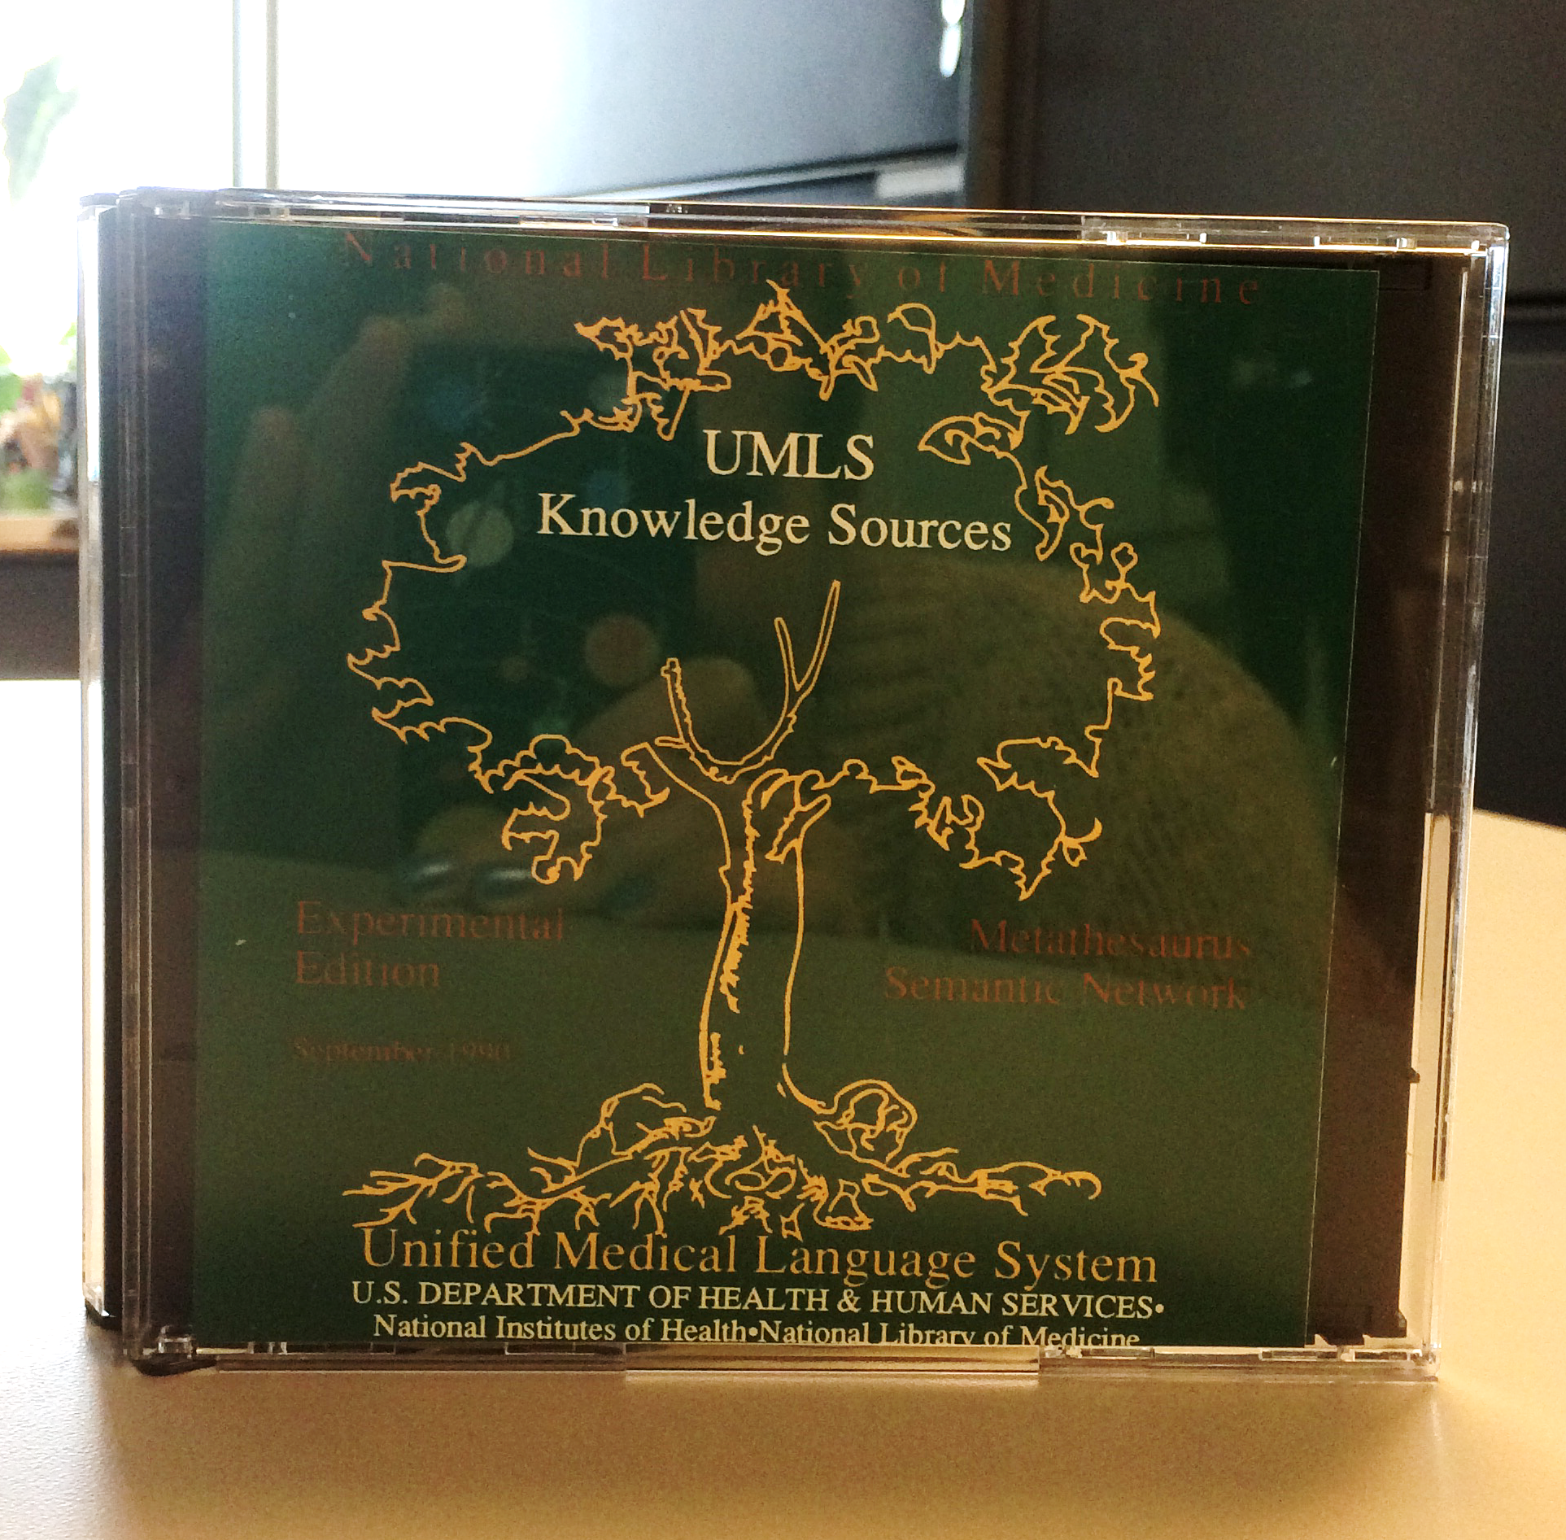
What is the UMLS Metathesaurus?
The UMLS Metathesaurus is a set of files that brings together many biomedical terminologies and standards to enable interoperability between computer systems.

Slide 3
UMLS Metathesaurus Terminologies

Slide 4
Who Uses the UMLS?
Researchers
Health Application Developers
Health Service Providers
Educators

Slide 5
UMLS Metathesaurus Data
28 GB
16 Million Names
187 Terminologies
27 Languages
3.3 Million Concepts
60 Million Relationships

Slide 6
Learning UMLS
Sign up for a free UMLS license / account
Explore the UMLS Metathesaurus Browser
Download and explore the data
Try the UMLS API

Slide 7
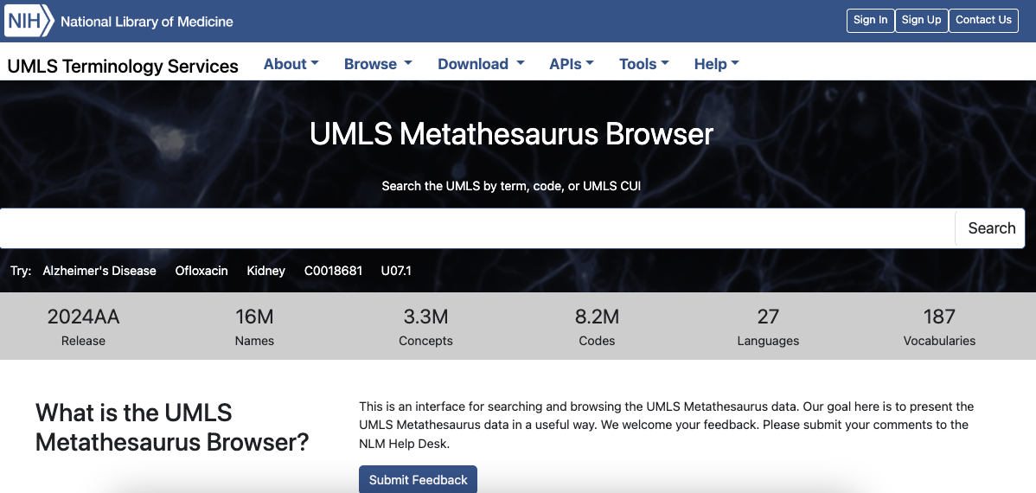
UMLS Metathesaurus Browser

Slide 8
UMLS Metathesaurus File Facts
All files are pipe-delimited (|) tables
Files are often too large to load into Excel
Can be loaded into relational databases (MYSQL, Oracle, sqlite3, etc)
Explore files in the command line using various tools like the python

Slide 9
UMLS Metathesaurus Data Files
AMBIGLUI.RRF
AMBIGSUI.RRF
CHANGE
MRAUI.RRF
MRCOLS.RRF
MRCONSO.RRF
MRCUI.RRF
MRDEF.RRF
MRDOC.RRF
MRFILES.RRF
MRHIER.RRF
MRHIST.RRF
MRMAP.RRF
MRRANK.RRF
MRREL.RRF
MRSAB.RRF
MRSAT.RRF
MRSMAP.RRF
MRSTY.RRF
MRXNS_ENG.RRF
MRXNW_ENG.RRF
MRXW_ARA.RRF
MRXW_BAQ.RRF
MRXW_CHI.RRF
MRXW_CZE.RRF
MRXW_DAN.RRF
MRXW_DUT.RRF
MRXW_ENG.RRF
MRXW_EST.RRF
MRXW_FIN.RRF
MRXW_FRE.RRF
MRXW_GER.RRF
MRXW_GRE.RRF
MRXW_HEB.RRF
MRXW_HUN.RRF
MRXW_ITA.RRF
MRXW_JPN.RRF
MRXW_KOR.RRF
MRXW_LAV.RRF
MRXW_NOR.RRF
MRXW_POL.RRF
MRXW_POR.RRF
MRXW_RUS.RRF
MRXW_SCR.RRF
MRXW_SPA.RRF
MRXW_SWE.RRF
MRXW_TUR.RRF
MRXW_UKR.RRF
indexes

Slide 10
Commonly Used UMLS Metathesaurus Data Files
File Name | Content
MRCONSO | Concept Unique Identifiers (CUIs), Names, Codes, Sources
MRREL | Relationships

Slide 11
MRCONSO (Concepts, Names, Codes, Sources)
Name
Addison Disease
Addison’s disease
Addison’s Disease
Primary adrenal insufficiency
Primary adrenocortical insufficiency
Insufficiency, Primary Adrenocortical
Primary adrenocortical insufficiency (disorder)
Primary hypoadrenalism
Primary hypoadrenalism
Enfermedad de Addison
Source Terminology
MeSH
ICD-10-CM
MeSH
MedDRA
ICD-10-CM
MeSH
SNOMED CT
MedDRA
SNOMED CT
MeSH Spanish
Code
D000224
E27.1
D000224
S2164152
E27.1
D000224
373662000
S0718109
373662000
D000224
Atom Identifier
A6954527
A17799651
A26597849
A2018590
A17786892
A6970512
A3644299
A25720215
A3060485
A9175691
Concept Unique Identifier (CUI)
C0001403
C0001403
C0001403
C0001403
C0001403
C0001403
C0001403
C0001403
C0001403
C0001403

Slide 12
What can MRCONSO be used for?
Linking names, concepts, and codes
Crosswalking from one terminology to another
Searching for a string and returning a set of concepts or codes
Identifying synonyms for a particular string
Identifying meaning in text
Annotate clinical notes and other documents with standard identifiers
Find co-occurrences of concepts

Slide 13
Commonly Used UMLS Metathesaurus Data Files-1
File Name | Content
MRCONSO | Concept Unique Identifiers (CUIs), Names, Codes, Sources
MRREL | Relationships

Slide 14
MRREL (Relationships)
MRREL aggregates all of the relationships asserted in the UMLS source terminologies into one file
Some relationships are hierarchical (broader/narrower or parent/child)
Some relationships are non-hierarchical. Examples
has_finding_site
may_treat
is_finding_of_disease

Slide 15
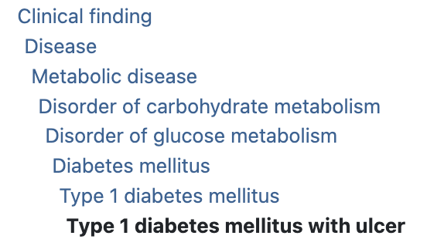
Hierarchical Relationships (MRREL)

Slide 16
Broader Concepts (MRREL)
Hyperglycemia
(C0020456)
Concept | Source
Abnormal Blood Chemistry and Hematology Test Result | NCI
Abnormal blood glucose concentration | HPO
Disorder of endocrine pancreas | SNOMEDCT_US
Disorder of endocrine system | SNOMEDCT_US
Disorder of glucose metabolism | SNOMEDCT_US
Disorder of glucose regulation | SNOMEDCT_US
Elevated blood glucose level | ICD10
ENDOCRINE FEATURES | OMIM
Endocrine System | MEDLINEPLUS
Glucose Metabolism Disorders | MSH
Glycemic Measurement Finding | NCI
Hyperglycaemic conditions NEC | MDR
Hyperglycemic disorder | SNOMEDCT_US
LABORATORY ABNORMALITIES | OMIM
METABOLIC FEATURES | OMIM
Metabolic Problems | MEDLINEPLUS

Slide 17
Narrower Concepts (MRREL)
Hyperglycemia
(C0020456)
Concept | Source
Acute hyperglycemia | SNOMEDCT_US
Chronic hyperglycemia | SNOMEDCT_US
Drug-induced hyperglycemia | SNOMEDCT_US
Glucose Intolerance | MSH
Hyperglycemia, Postprandial | MSH
Hyperglycemic disorder in pregnancy | SNOMEDCT_US
Hypoinsulinism | SNOMEDCT_US
Impaired fasting glucose | HPO
Impaired fasting glycemia | SNOMEDCT_US
Metabolic stress hyperglycemia | SNOMEDCT_US
Neonatal Hyperglycemia | NCI
Postpancreatectomy hyperglycemia | SNOMEDCT_US
Postprandial hyperglycemia | HPO
Severe hyperglycemia due to diabetes mellitus | SNOMEDCT_US

Slide 18
Non-Hierarchical Relationships (MRREL)
Subject (CUI2) | Relationship (RELA) | Object (CUI1) | Source (SAB)
Intermuscular hernia | has_finding_site | Abdomen | SNOMED CT
Megakaryocytes Increased in Bone Marrow | is_finding_of_disease | Primary Myelofibrosis | NCI Thesaurus
albuterol | may_treat | Asthma | MED-RT
INTERSTITIAL LUNG AND LIVER DISEASE | has_manifestation | anemia | OMIM
Gluten Sensitivity | related_to | Celiac Disease | MEDLINEPLUS

Slide 19
Commonly Used UMLS Metathesaurus Data Files-2
File Name | Content
MRCONSO | Concept Unique Identifiers (CUIs), Names, Codes, Sources
MRREL | Relationships

Slide 20
Links
UMLS Reference Manual
https://www.ncbi.nlm.nih.gov/books/NBK9676/
Sign up for a free UMLS Metathesaurus License / Account:
https://uts.nlm.nih.gov/uts/signup-login
Explore the UMLS Metathesaurus Browser:
https://uts.nlm.nih.gov/uts/umls/home
Explore the UMLS API:
https://documentation.uts.nlm.nih.gov/rest/home.html
Download the UMLS Metathesaurus Full Subset or the MRCONSO.RRF file:
https://www.nlm.nih.gov/research/umls/licensedcontent/umlsknowledgesources.html

Slide 21
Thank you!
David Anderson, MLS
david.anderson@nih.gov
National Library of Medicine
National Institutes of Health
U.S. Department of Health & Human Services

