Slide 1
Introduction to UMLS Editing
Miranda Jarnot, Ph.D.
U.S. National Library of Medicine
National Institutes of Health
jarnotm@mail.nlm.nih.gov

Slide 2
What is the UMLS?

Slide 3
Concept-centered Approach
Scope of the UMLS is determined by the combined scope of its source vocabularies --
There is no overall "scope" of the UMLS itself
UMLS is concept-centric
Goal = Establish synonymy between source vocabularies

Slide 4
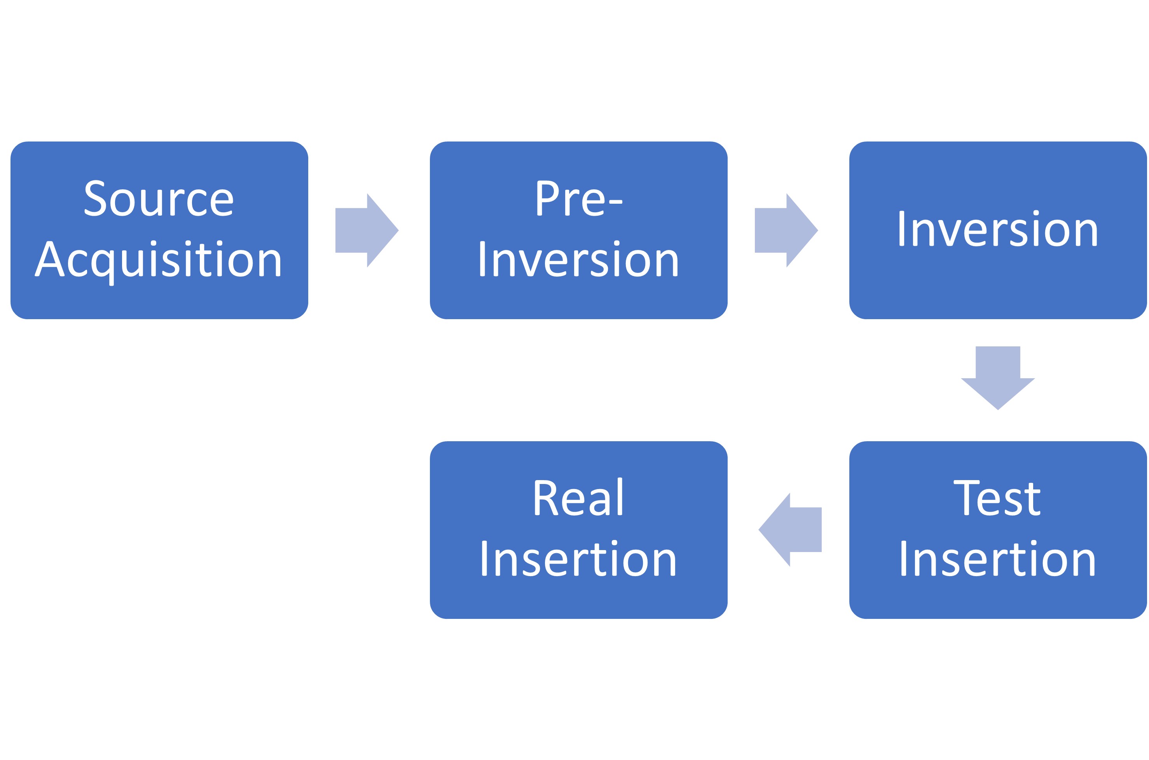
How does source data get into the UMLS?

Slide 5
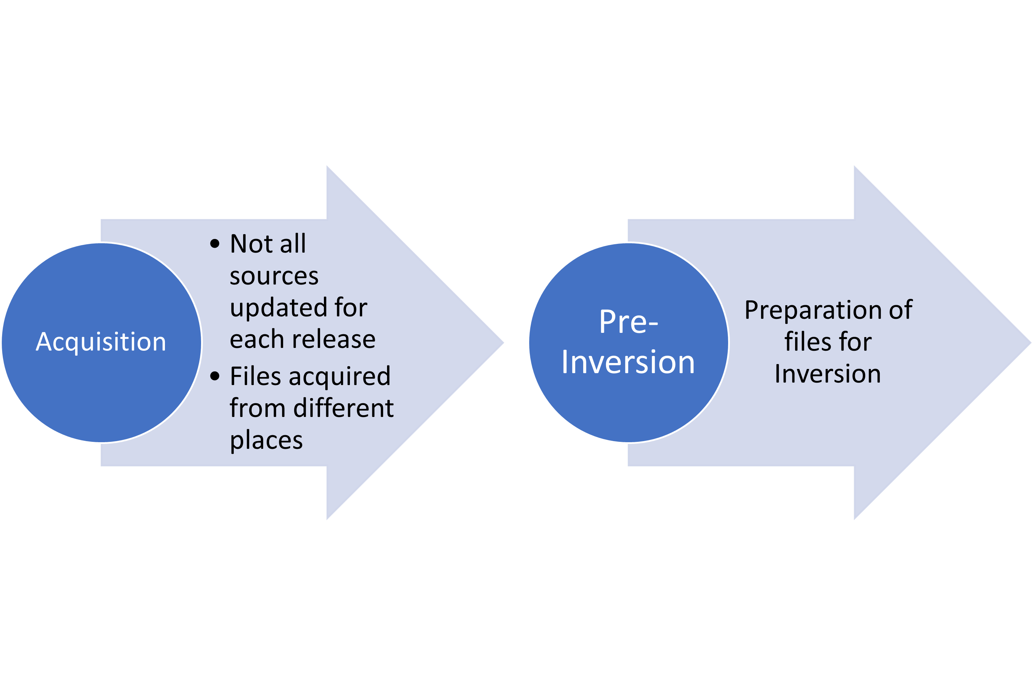
Source Acquisition and Pre-Inversion

Slide 6
Inversion
Source data is processed into a common data load representation
No two sources have the same format
XML
Fixed-length field
.pdf
Excel
Flat file (OBO)

Slide 7
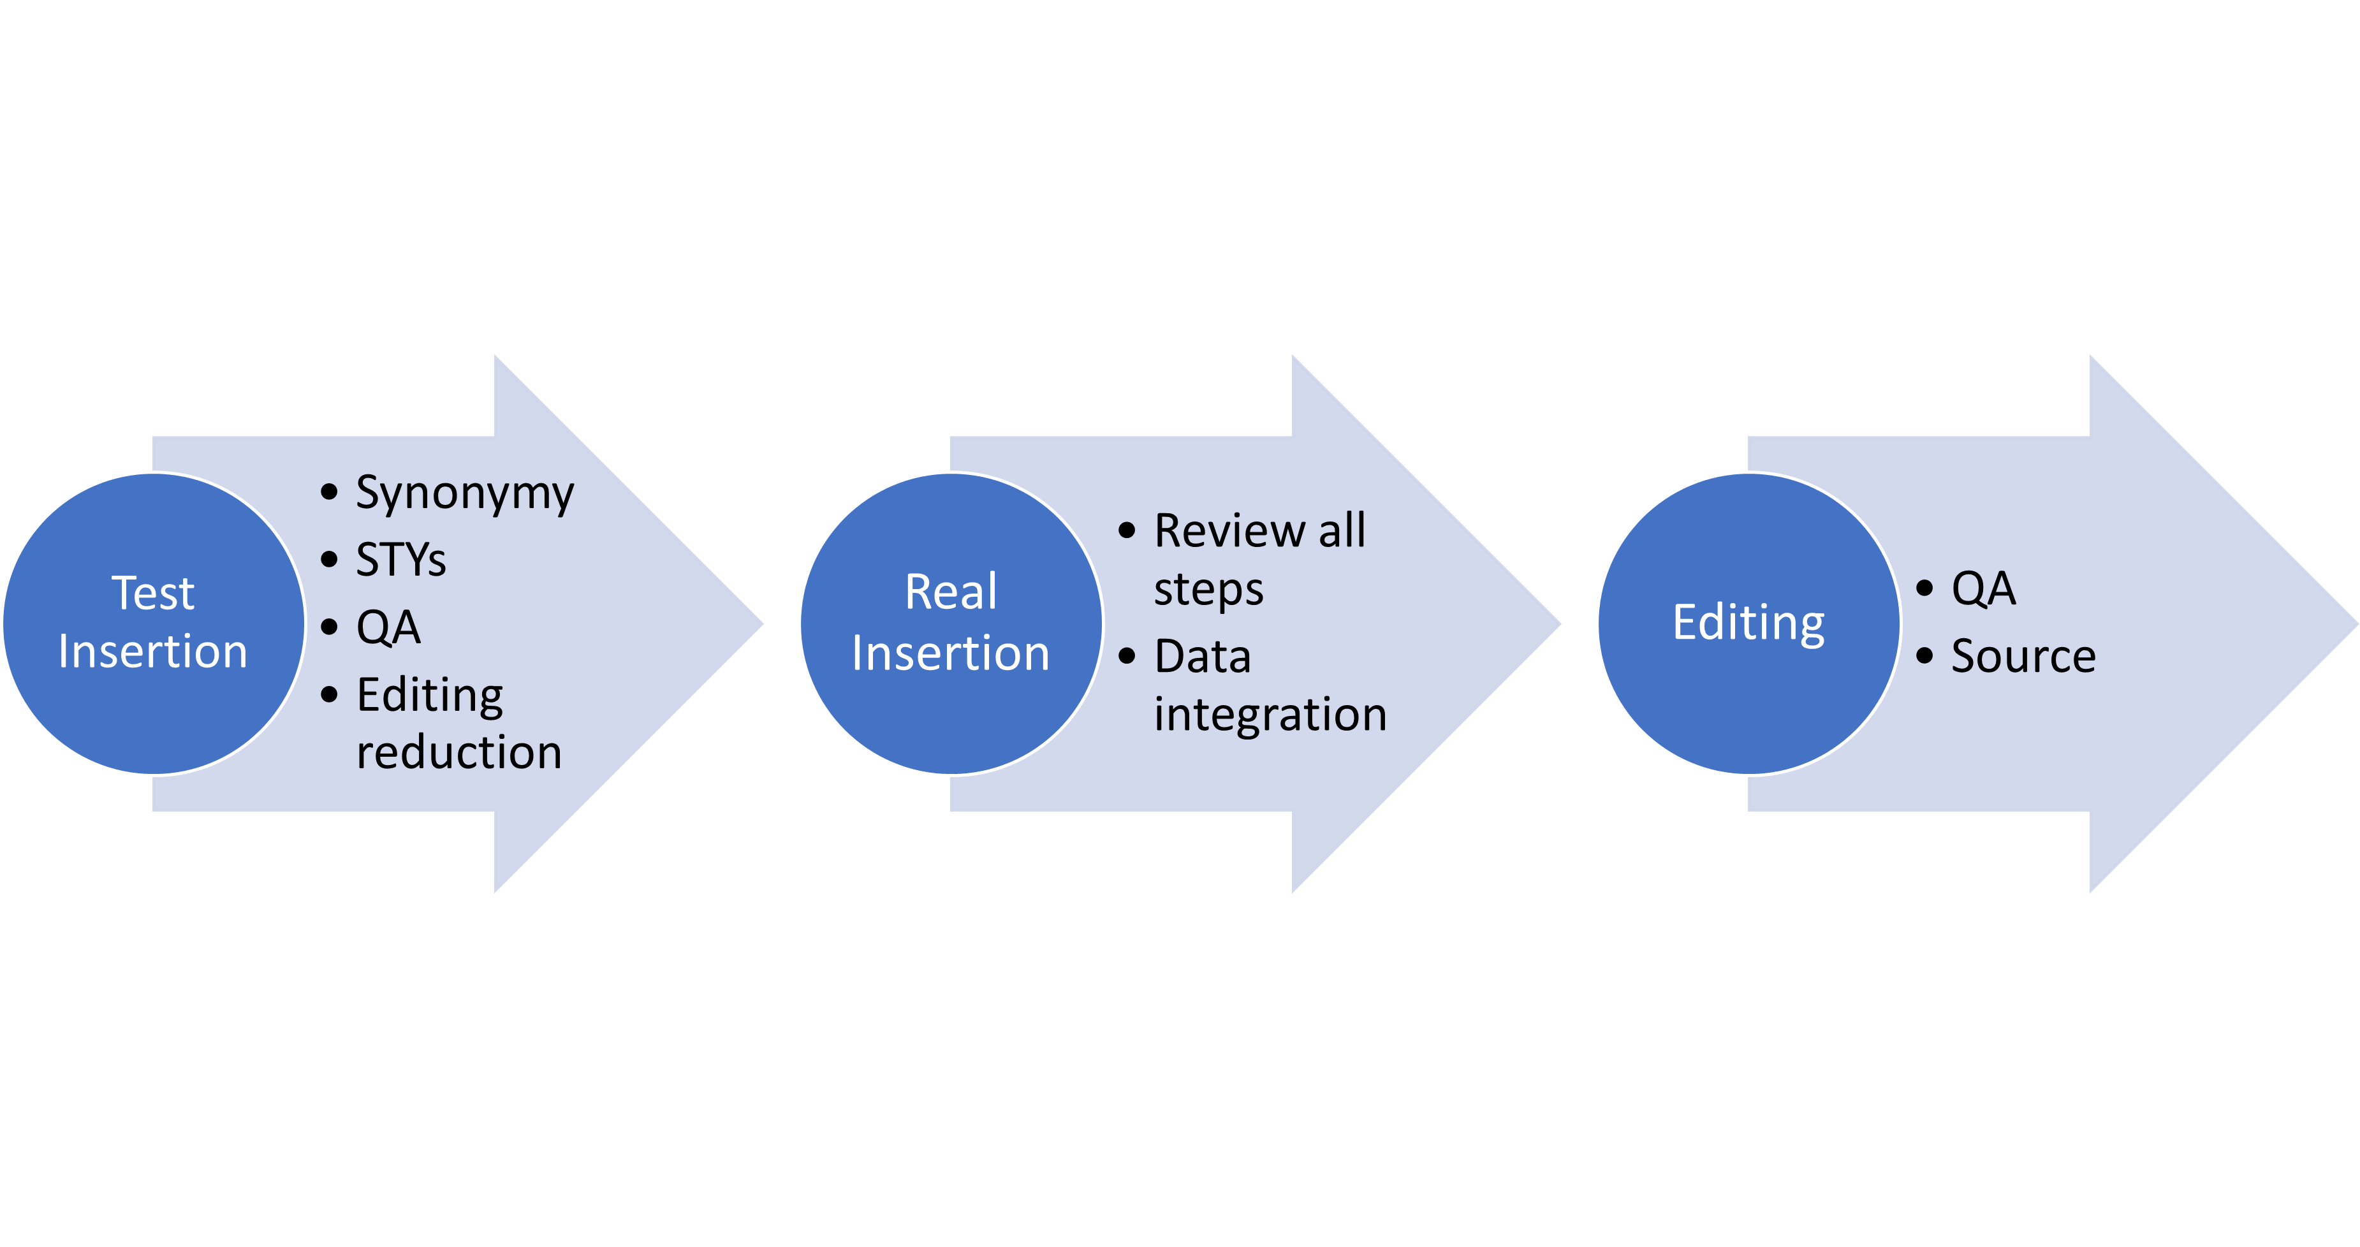
Test Insertion and Real Insertion

Slide 8
Editing the Metathesaurus
Primary Rule of Editing =
Respect the Source

Slide 9
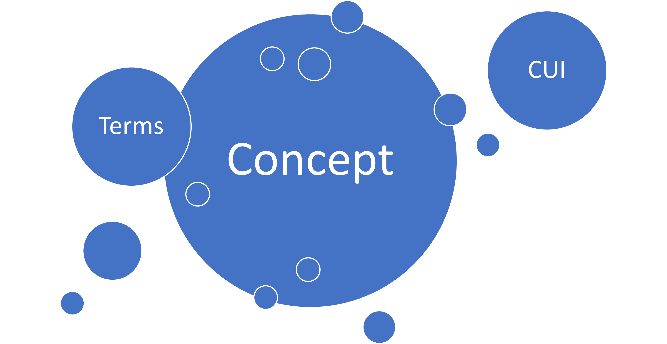
Concepts in the Metathesaurus

Slide 10
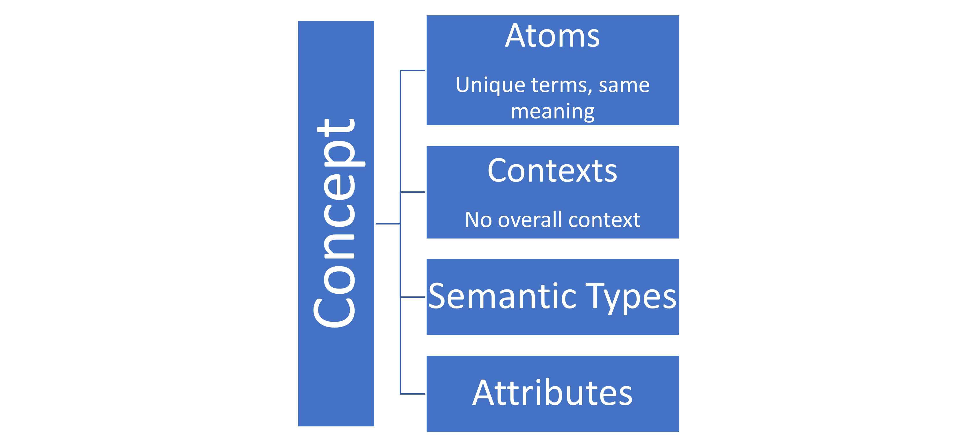
Concepts in the UMLS (cont.)

Slide 11
Concepts in the Metathesaurus (cont.)
Relationships (RELs)
Source Level
Concept level
Types of RELs
Related to (RT) – Chocolate Ingestion is RT Chocolate
Broader than (BT) – Mammal is BT Dog
Narrower than (NT) – Apple Pie is NT Pie
Not Related (XR) – Indiana is XR to India

Slide 12
Synonymy
Synonymy is first determined by the data given from a source
Source codes
Algorithms / merge functions
Editor review
Editors follow the “Prime Directive” of respecting synonymy asserted by a source
UMLS treats lexical variants as synonyms…
Singular/plural: feet and foot; apple and apples
Direct/indirect: Neoplasms, Breast and Breast Neoplasms
Punctuation: Insulin-like receptor and insulin like receptor

Slide 13
Synonymy (continued)
But sometimes lexical variants are NOT synonymous!
Home Nursing and Nursing Home
Mushroom Poison and Poison Mushrooms
Clues from the source
Editor’s own knowledge/background
Research
There are no foolproof rules to apply in determining synonymy

Slide 14
Editing Freeze and File Release
At the end of March (AA release) and September (AB release), the production database is locked for editing, or “frozen”
Editing leads perform QA editing
Production DB is closed for production of release files
Editing remains down for 2-3 days while files are prepared
Editing begins for the next release
UMLS is released
And then the cycle starts again…

