Slide 1
ClinicalTrials.gov Updates

Slide 2
BETA API
ClinicalTrials.gov launched a new BETA application programming interface (API) in July 2019
Over 300 Search fields available
Formats: XML, JSON, SVI, tree
Interactive training demos
Please try it out and send feedback to: register@clinicaltrials.gov

Slide 3
Website Highlights
Notes:
General Updates
Additional search options for recruitment status and location improve precision of search results
New research participation resources and disclaimer
COVID Updates
Links to CDC and NIH informational websites have been added to the ClinicalTrials.gov home page
From the home page, users can also access a list of records related to COVID-19 that have been posted to ClinicalTrials.gov (shown on next slide)

Slide 4
COVID-19 Resources
Notes:
Results can be filtered to show federally-funded clinical studies related to COVID-19
Provide ongoing and completed COVID-19 studies listed on the World Health Organization's International Clinical Trials Registry Platform (WHO ICTRP) on the ClinicalTrials.gov web site

Slide 5
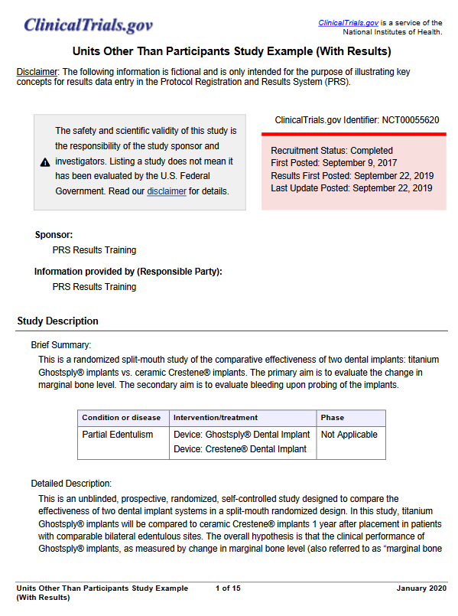
Resources and Training for Data Providers
https://clinicaltrials.gov/ct2/manage-recs/present#ResultsExamplStudies
Notes:
ClinicalTrials.gov offers sample study records and fictional manuscripts for a variety of study designs such as parallel and cross-over, and dose escalation
The most recent samples were created to address “Units other than Participants”
Additional records and manuscripts are in development
Cluster Randomized
Fractional Factorial
Sequential, Multiple Assignment, Randomized Trial (SMART)
Micro-randomized

Slide 6
Resources and Training for Data Providers
Tutorials launched over the last year provide step-by-step instructions for data entry and updates.
Notes:
PRS Guided Tutorials provided step-by-step instructions for data entry
Results tutorials launched in August 2019
Registration tutorials were added in March 2020
They can be accessed on ClinicalTrials.gov or from within the Protocol Registration and Results System (PRS)
Content updates, based on user feedback, are in progress

Slide 7
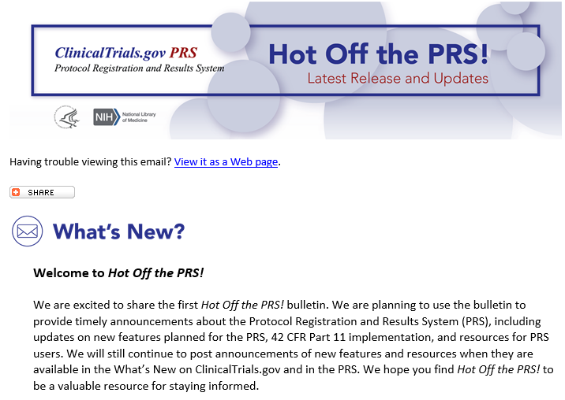
Email Bulletin: Hot Off the PRS!
Launched in 2019 to provide timely updates for PRS users
Sign up: https://bit.ly/33qcZBb
Notes:
ClinicalTrials.gov launched Hot Off the PRS! in August of 2019.
It provides:
Timely updates for PRS users, and
Proactive communication

Slide 8
ClinicalTrials.gov Launched a Multi-year Modernization Effort
Ensure ClinicalTrials.gov continues to be a trusted and valued premier public health resource that provides maximum value to the public and serves its mission well into the future.
Notes:
ClinicalTrials.gov is one year into a five-year modernization effort.
In the past year, ClinicalTrials.gov has:
Met with 21 of 27 institutes and centers across NIH for input
Collected public comments, and
Held a public meeting to discuss the RFI comments

Slide 9
ClinicalTrials.gov Modernization Overview
Current year: Engagement
Engage with stakeholders to determine and validate approach and specifications
Request for Information (RFI) and Public Meeting
NLM Board of Regents Working Group
Develop modernization roadmap
Enhance internal business processes
Future (years 2 – 5): Implementation of Roadmap
Conduct user evaluation and continue engagement
Make improvements to support compatibility across trial lifecycle (seamless end-to-end process)
Upgrade system infrastructure components
9

