Slide 1
PubMed Update MLA 2020
July 17, 2020
Marie Collins

Slide 2
Agenda
PubMed by the Numbers
A New PubMed
Improving the Mobile Experience
Best Match – New Relevance Sort Order
New to the PubMed Interface
Future Updates
Where to go for Support and Training
2

Slide 3
PubMed by the numbers
31 million citations
More than 1.2 million citations added in 2019
3.4 million users on a typical weekday
40% of traffic from mobile devices
99.8% using the new PubMed
3

Slide 4
New PubMed
We are transforming PubMed into a modern hub with a fast, reliable, and intuitive search that connects people to the world's leading sources of biomedical information.

Slide 5
Agile Development Model
Release minimum viable product – enough features for early users and environment to capture feedback for future development
Release new features frequently
Pay continuous attention to technical excellence and good design
5

Slide 6
The features you rely on…
More than 31 million citations
Automatic Term Mapping (ATM)
Boolean search syntax
Ability to tag terms in a specific search field
Phrase searching
6

Slide 7
The features you rely on…
Advanced search
Search details
Downloadable search history
Outside Tool icons
My NCBI custom filters
Links from the MeSH terms
Send to citation manager
Save/Email/Send/Share results
7

Slide 8
…plus new features for a better experience
Preview snippets from the abstracts on the results page
Page from abstract to abstract
Navigate around a record using the sidebar
Cite in your preferred format
Share via social media or permalink
Display up to 5 Outside Tool icons
Access everything from your mobile device
8

Slide 9
…plus enhanced retrieval
Better sensors
Added synonymy, including plural forms
Improved British/American mapping
Unlimited truncation
Improved Best Match brings the best results to the top!
9

Slide 10
PubMed best practices have not changed
Looking for some good articles about a topic?
Enter your search terms into the search box
Be specific – this is the best way to narrow your results
No search tags or ANDs needed
Avoid quotation marks
Avoid truncation (*)
Looking for a specific, known article?
Let the citation sensor work for you
10

Slide 11
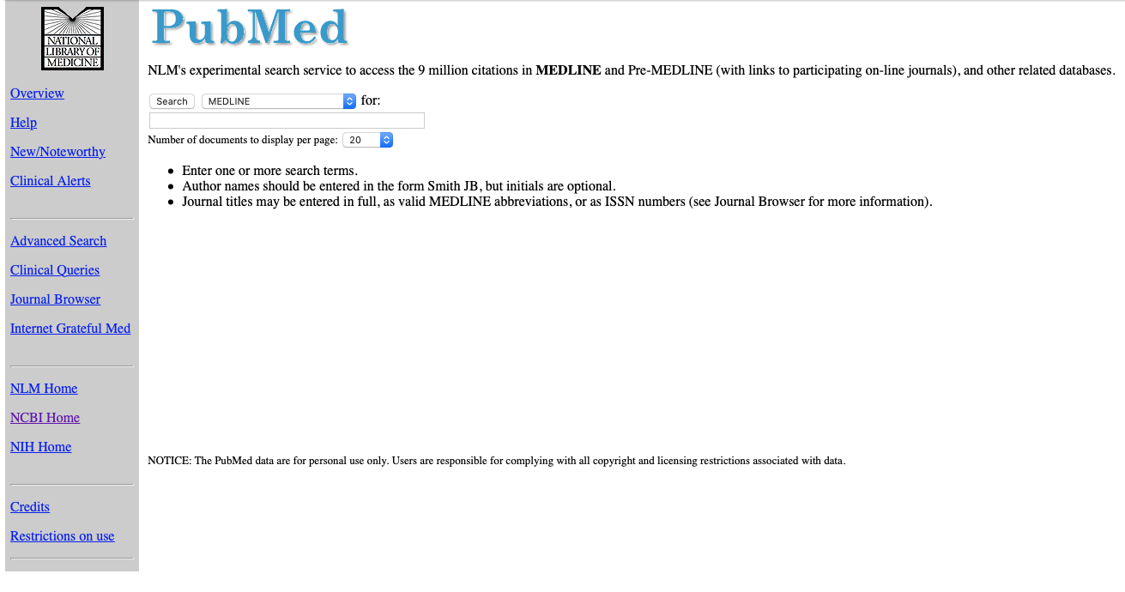
The evolution of PubMed - 1997
11

Slide 12
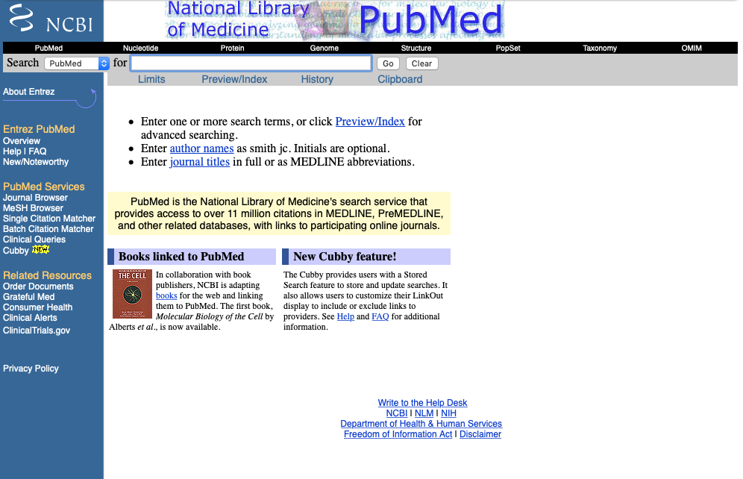
The evolution of PubMed - 2000
12

Slide 13
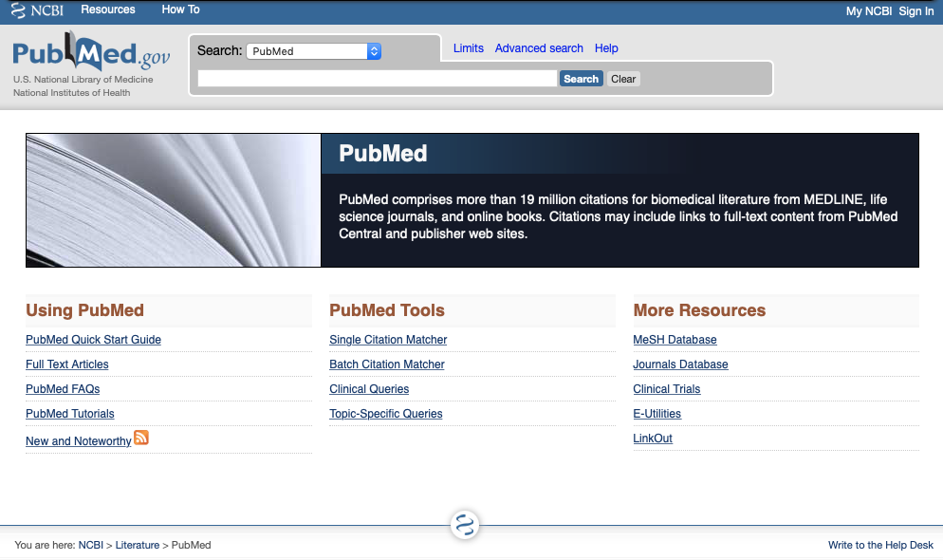
The evolution of PubMed - 2010
13

Slide 14
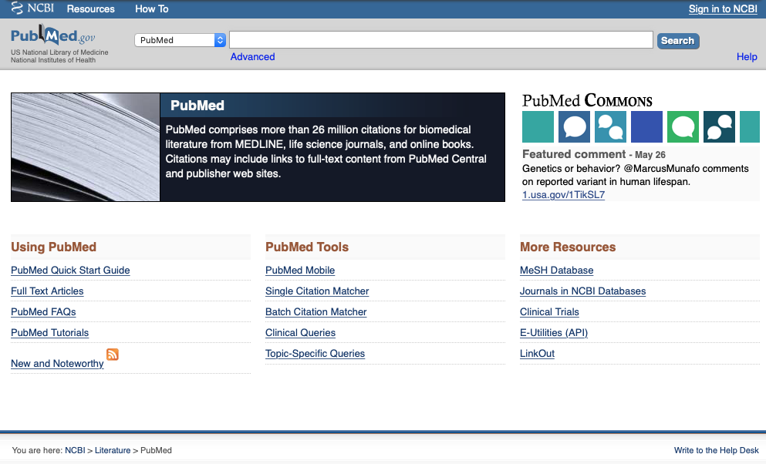
The evolution of PubMed - 2016
14

Slide 15
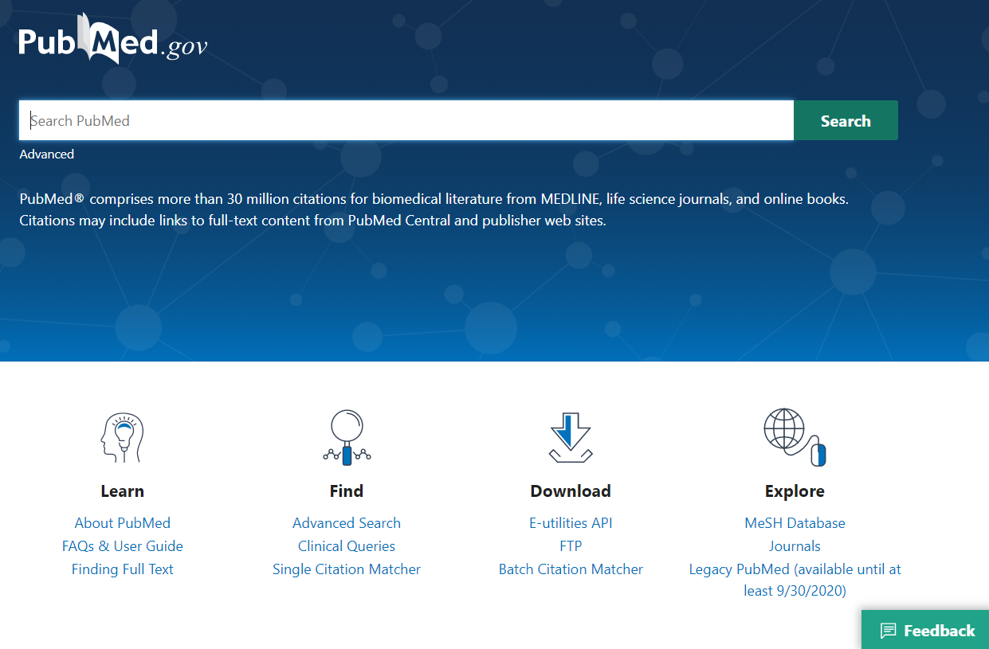
The evolution of PubMed - 2020
15

Slide 16
Commercial cloud for PubMed
High performance, high availability, high security
Scalable short term and long term
Enforces separation of development and operations
Enables hardware migration as needed
Platform services improve security, documentation, and maintenance
16

Slide 17
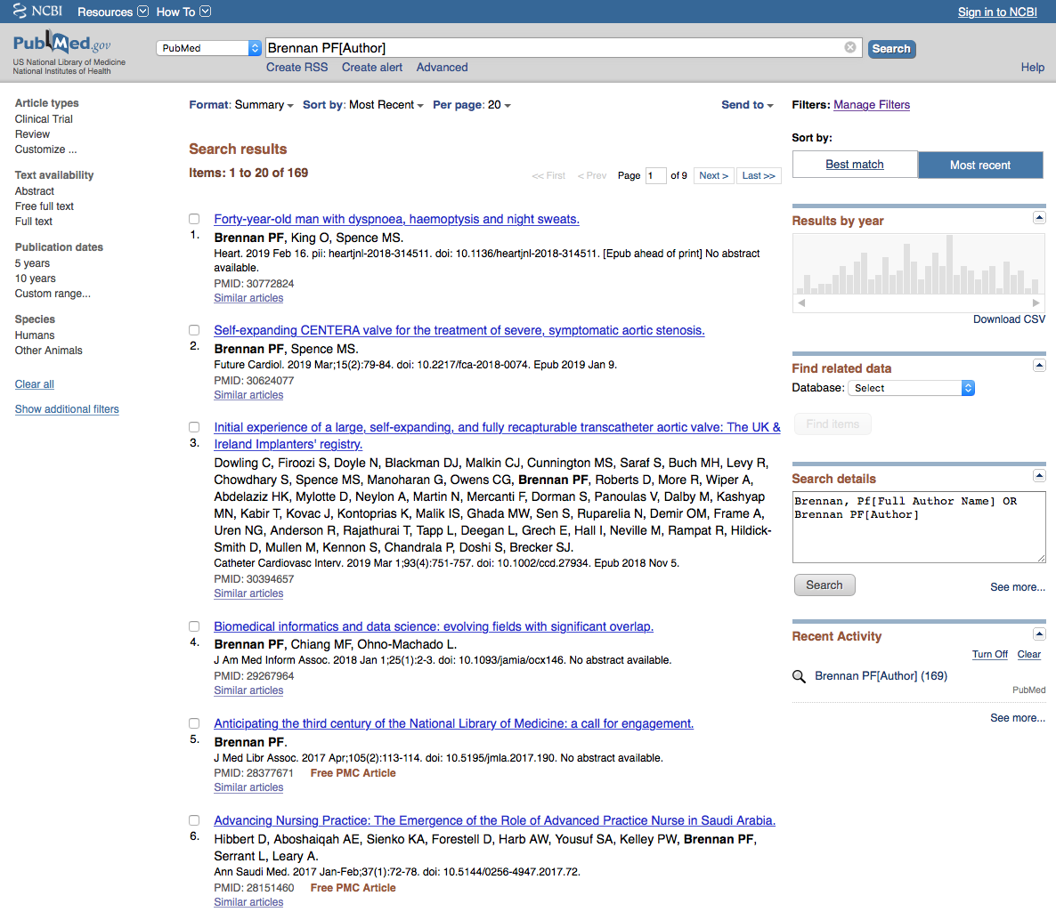
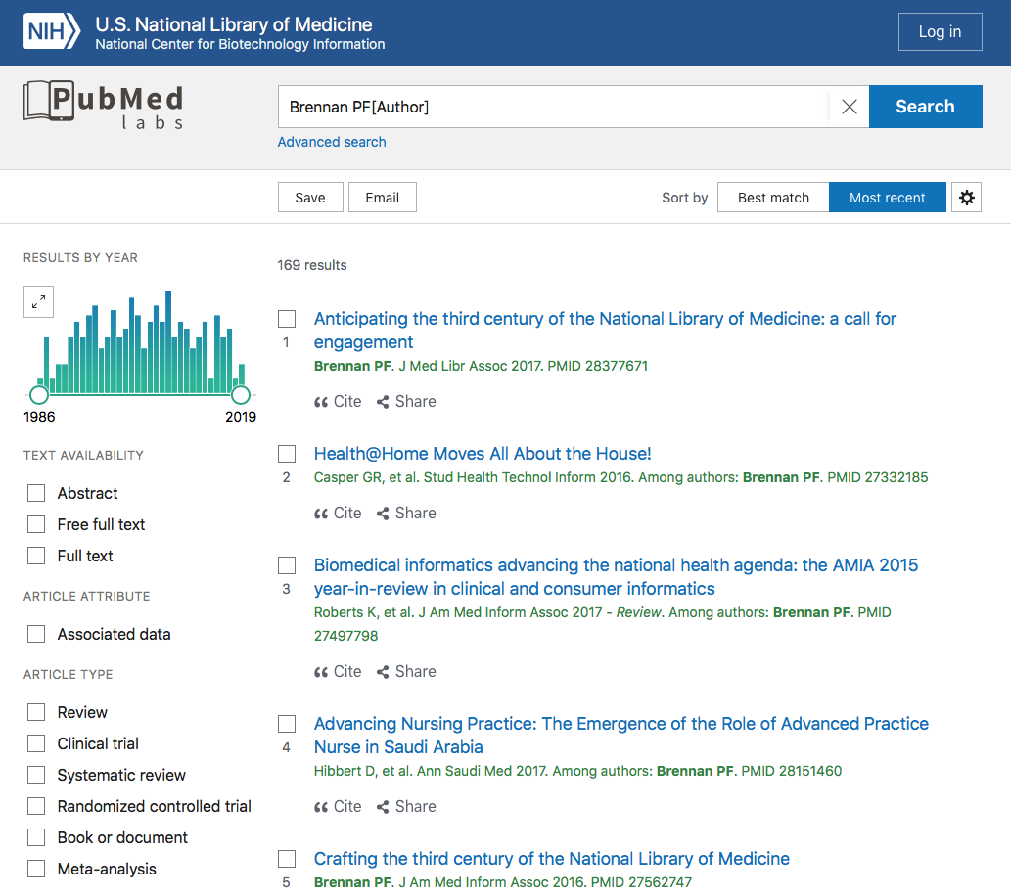
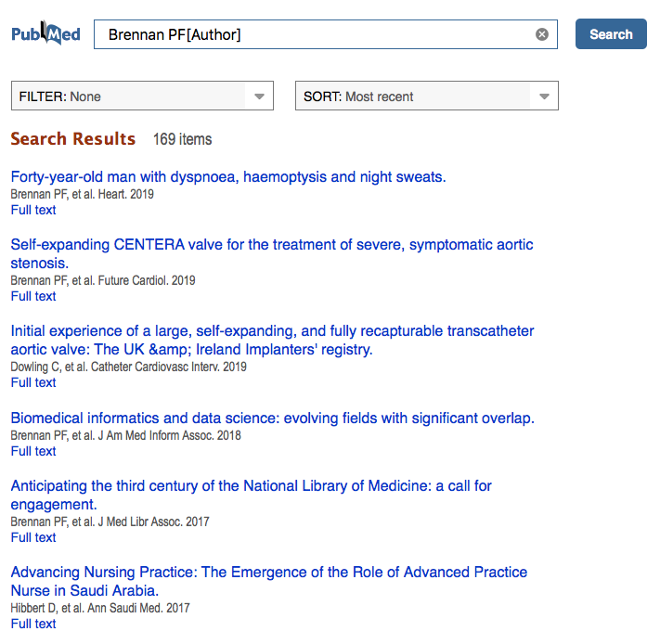
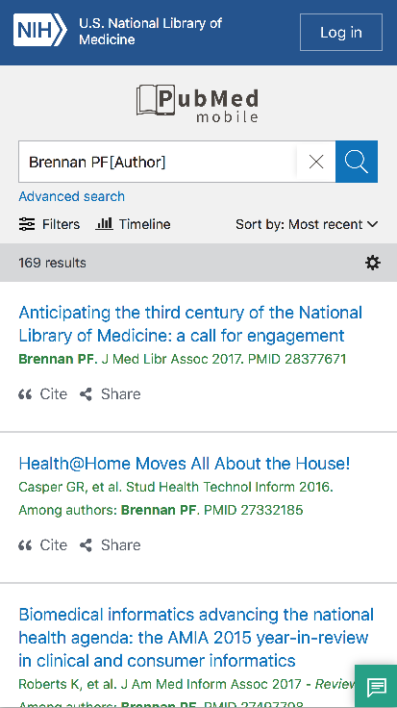
Legacy PubMed
Improving the mobile experience
New PubMed
Desktop access
Desktop
2 separate websites
Single, responsive website
Cloud-based
Mobile access
Mobile
17

Slide 18
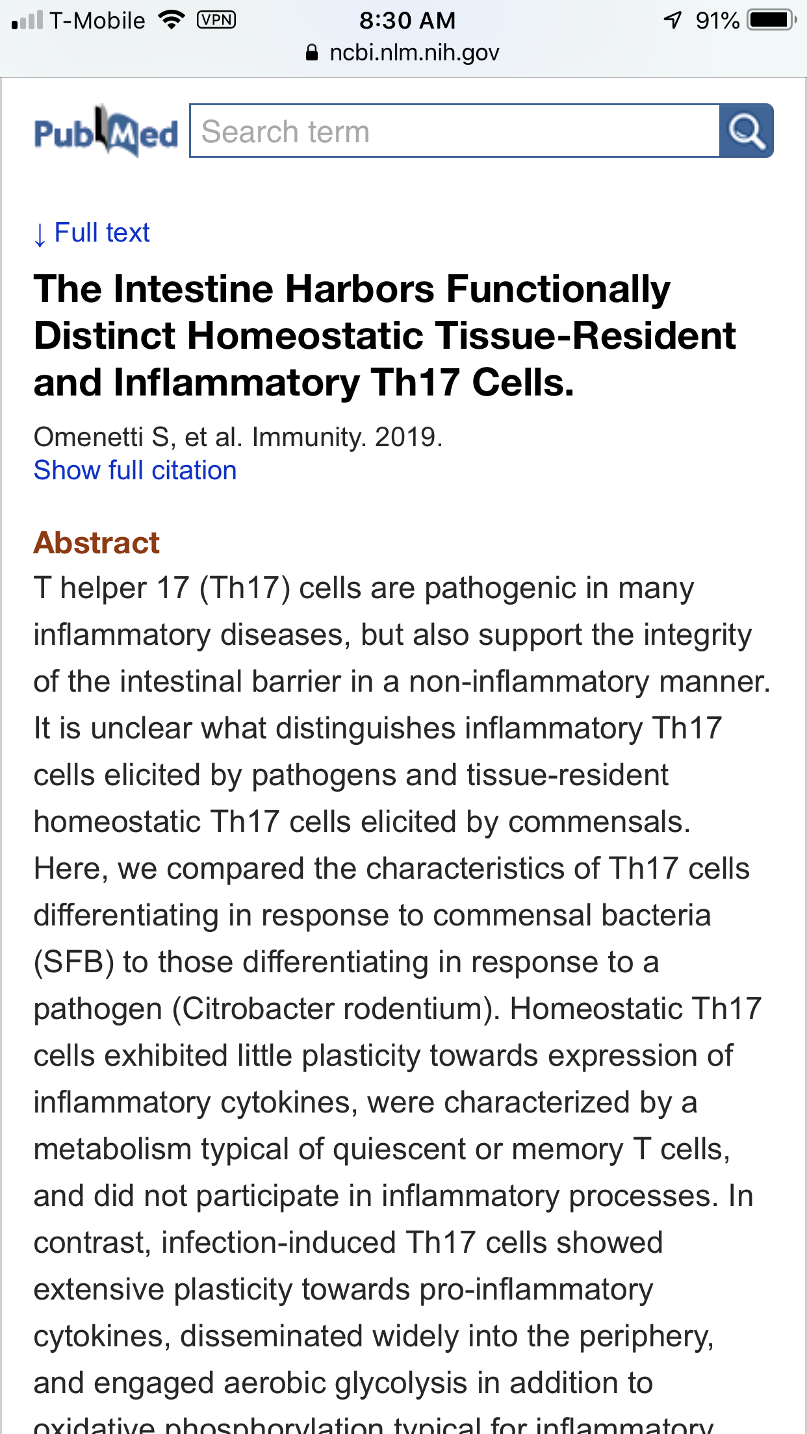
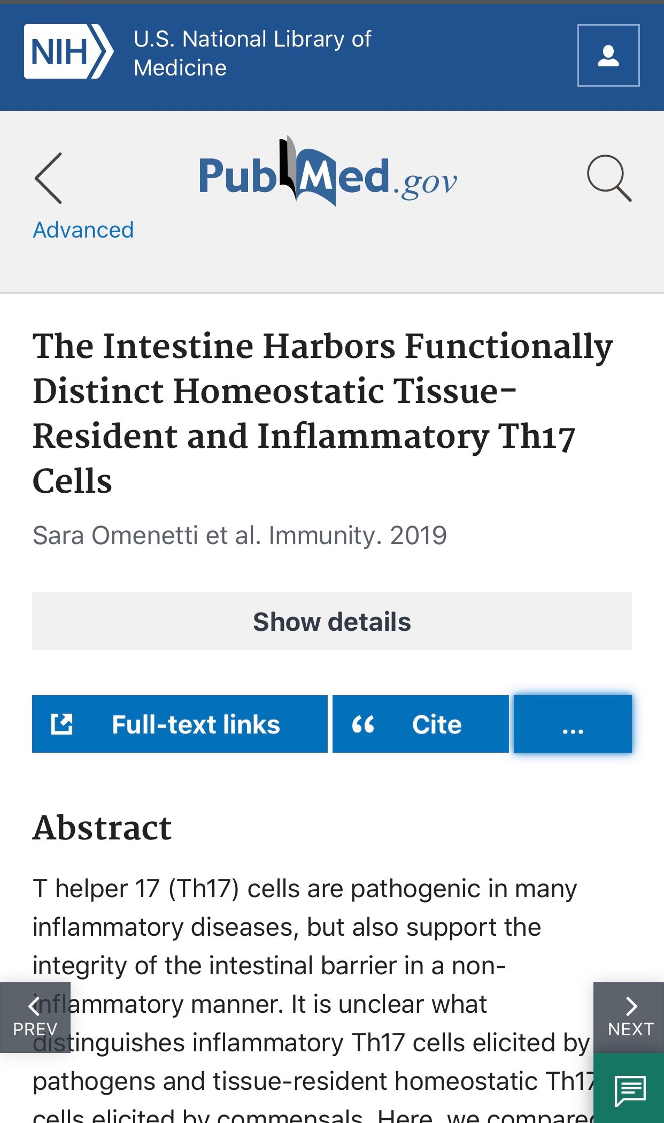
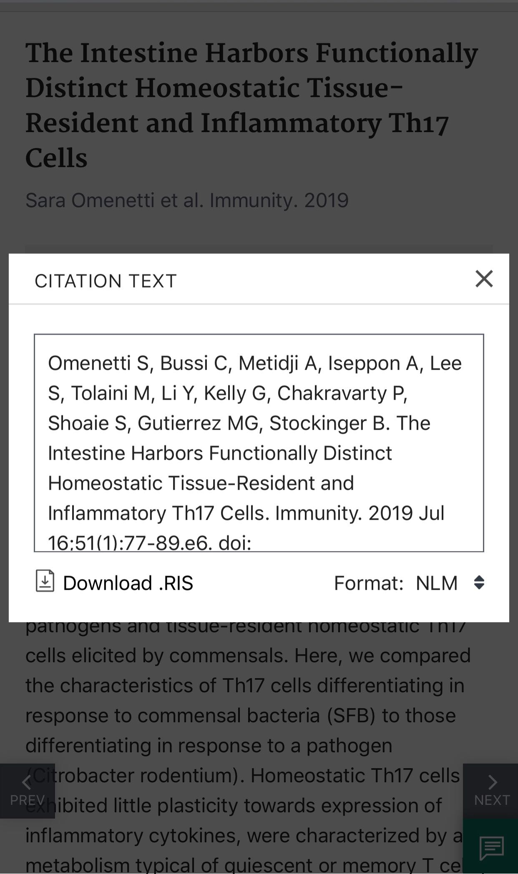
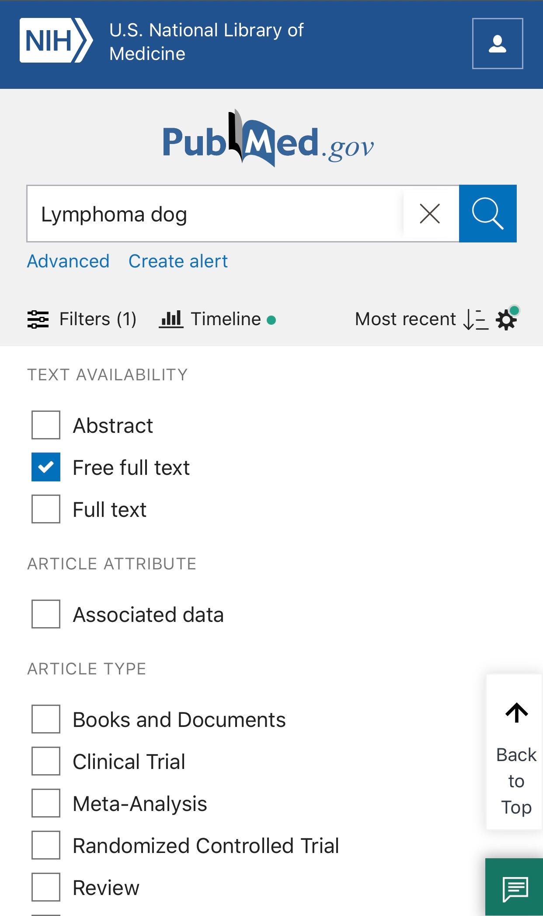
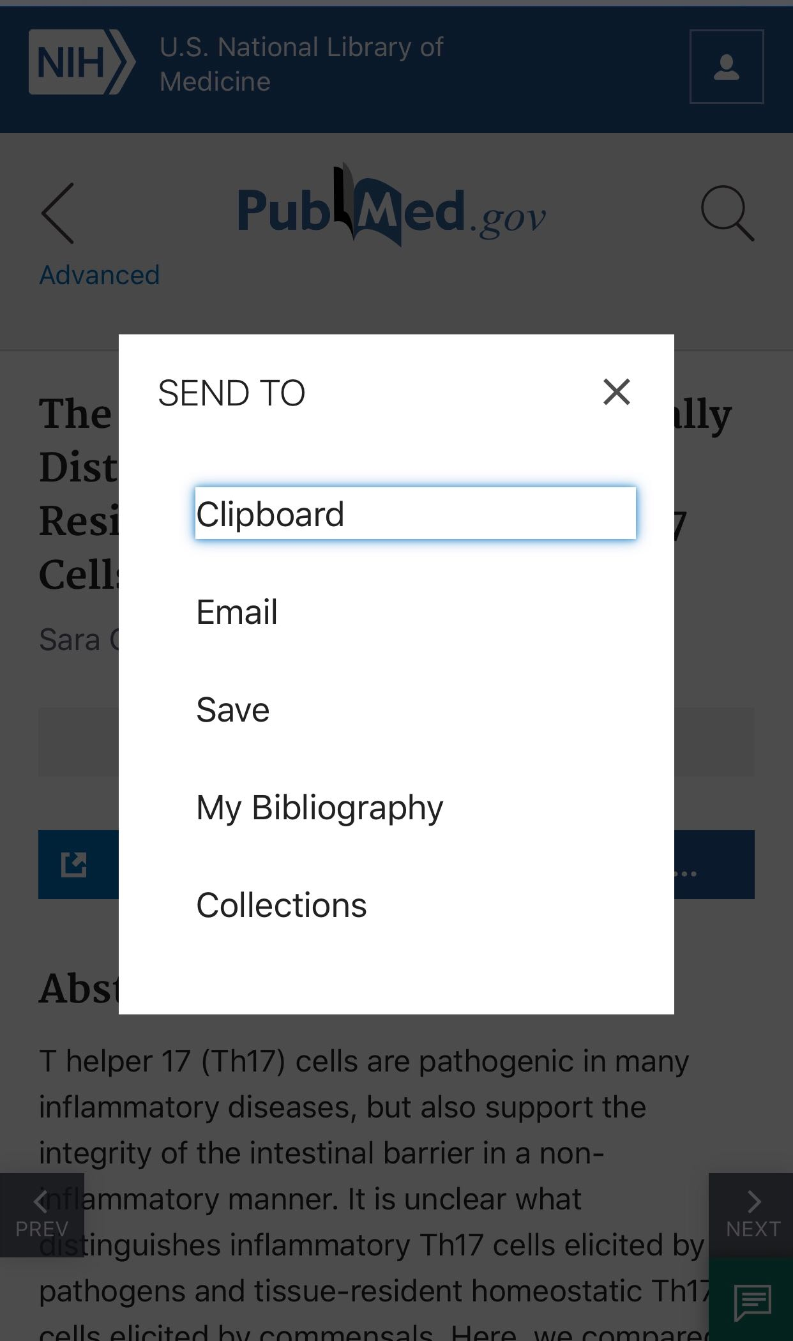
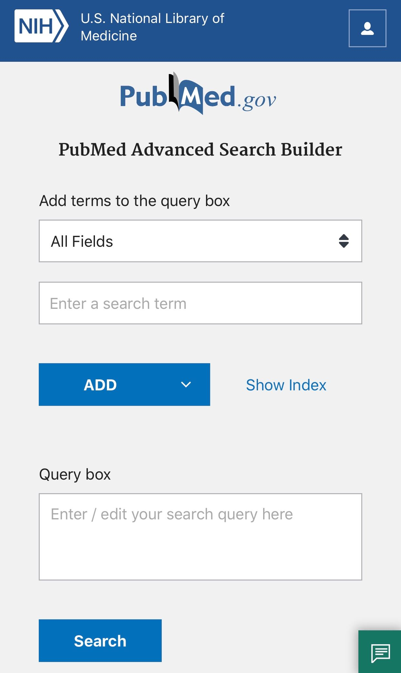
Improving the mobile experience
Legacy:
New:
18

Slide 19
Best Match: New relevance sort for PubMed
All PubMed searches use the same automatic term mapping and enhanced synonymy. You retrieve the same citations regardless of sort order.
By default the results are returned in Best Match sort order.
An enhanced relevance search is important because most users—more than 80 percent—click on the results that are presented on the first page.
You can use the “Display options” button to choose a different sort order.
19

Slide 20
Best Match: New relevance sort for PubMed
Search: caregiver burden als Sort order: Most recent
Psychometric properties of the Korean version of the positive aspects of caregiving scale for family caregivers of people with amyotrophic lateral sclerosis.
Costs of illness in amyotrophic lateral sclerosis (ALS): a cross-sectional survey in Germany.
Understanding the needs of people with ALS: a national survey of patients and caregivers.
Blended psychosocial support for partners of patients with ALS and PMA: results of a randomized controlled trial.
The Use of Telehealth to Enhance Care in ALS and other Neuromuscular Disorders.
Healthcare provision in amyotrophic lateral sclerosis: procedures, queries and pitfalls in Germany and Poland.
US data on children and youth caregivers in amyotrophic lateral sclerosis.
Everyday life experiences of close relatives of people with amyotrophic lateral sclerosis receiving home mechanical ventilation-A qualitative study.
An overview of screening instruments for cognition and behavior in patients with ALS: selecting the appropriate tool for clinical practice.
Prediction of caregiver burden in amyotrophic lateral sclerosis: a machine learning approach.
20

Slide 21
Best Match: New relevance sort for PubMed
Search: caregiver burden als Sort order: Best Match
Caregiver burden in amyotrophic lateral sclerosis: a cross-sectional investigation of predictors.
The Evolution of Caregiver Burden in Frontotemporal Dementia with and without Amyotrophic Lateral Sclerosis.
Longitudinal predictors of caregiver burden in amyotrophic lateral sclerosis: a population-based cohort of patient-caregiver dyads.
Caregiving in ALS - a mixed methods approach to the study of Burden.
Caregiver burden and quality of life of patients with amyotrophic lateral sclerosis in India.
End-of-life management in patients with amyotrophic lateral sclerosis.
Behavioural But Not Cognitive Impairment Is a Determinant of Caregiver Burden in Amyotrophic Lateral Sclerosis.
Caregiver burden and patients' perception of being a burden in ALS.
Caregiver burden and family functioning in different neurological diseases.
Ethical considerations and palliative care in patients with amyotrophic lateral sclerosis: A review.
21

Slide 22
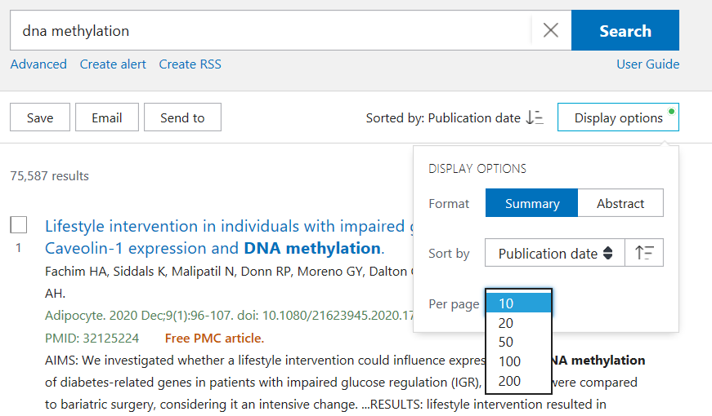
January 2020: Display options
Publication date sort order, and reverse sorting
Items per page selections
These selections are applied to searches until cookies are cleared
The New PubMed Updated: Items Per Page, Sort Options, See All Similar Articles, and More
22

Slide 23
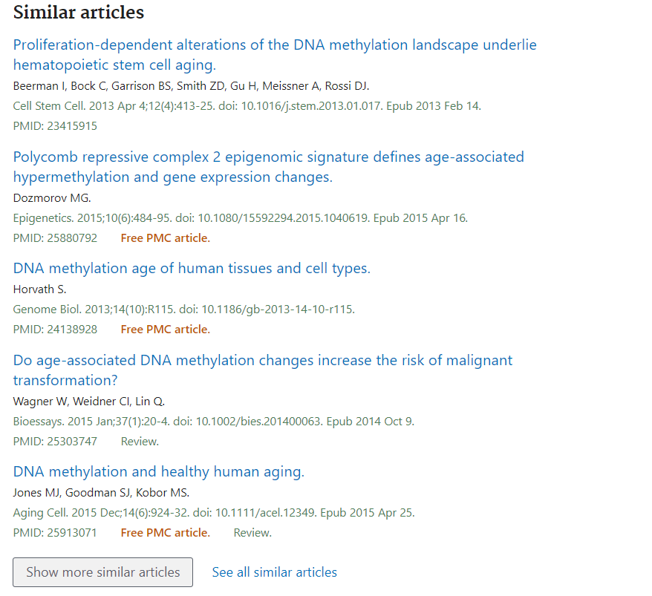
January 2020: Similar articles
View full Similar articles list as separate results set
23

Slide 24
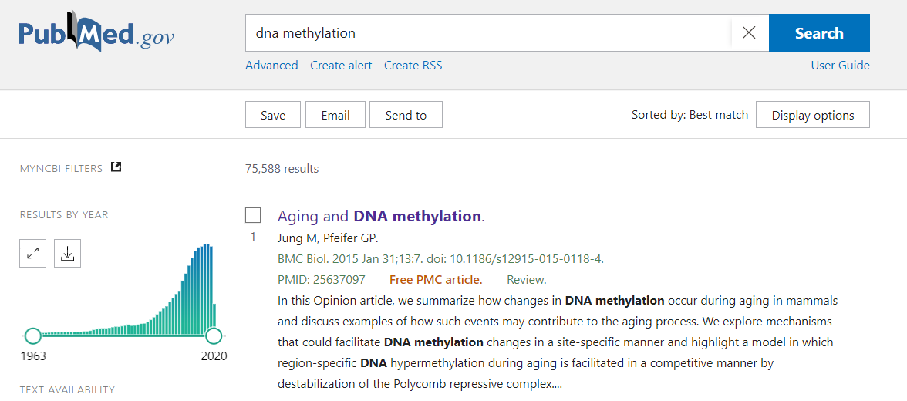
January 2020: Download Results by Year
24

Slide 25
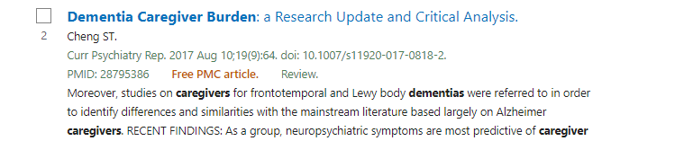
March 2020: Improved summary display
Summary display includes the full author list and other citation details
The New PubMed Updated: Summary Display with Full Author List, Send to: Citation manager, PubMed Format, and More
25

Slide 26
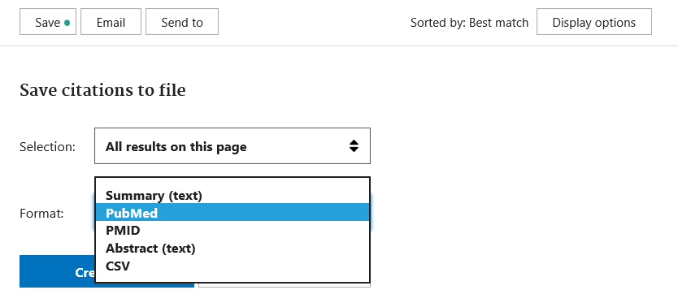
March 2020: PubMed format
PubMed format has all of the fields and field tags of MEDLINE format in legacy PubMed
The New PubMed Updated: Summary Display with Full Author List, Send to: Citation manager, PubMed Format, and More
26

Slide 27
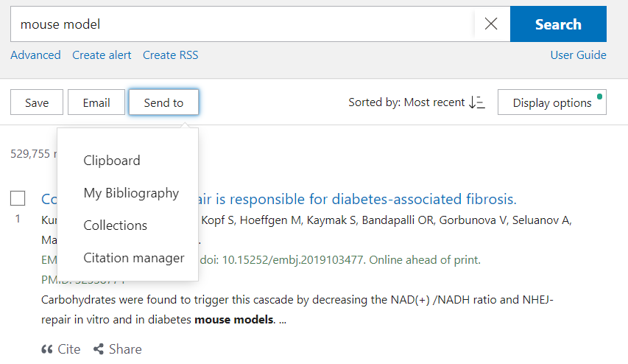
March 2020: Send to Citation manager
Send to Citation manager is available
Same fields as PubMed format, with .nbib extension
27

Slide 28
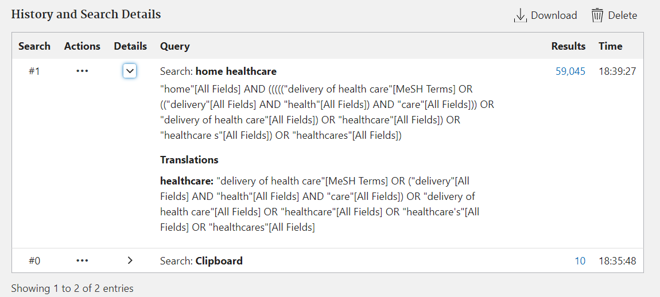
March 2020: Advanced search improvements
Search details include individual term translations
Citations in the Clipboard have been added to History as search number #0.
28

Slide 29
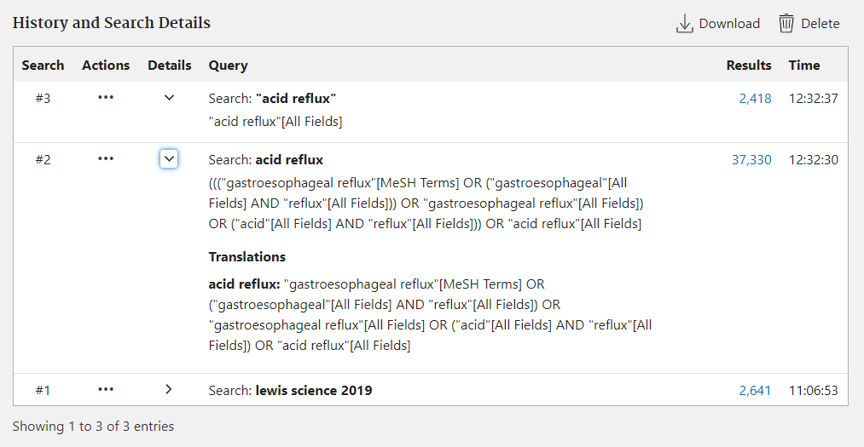
Search History and Details
29

Slide 30
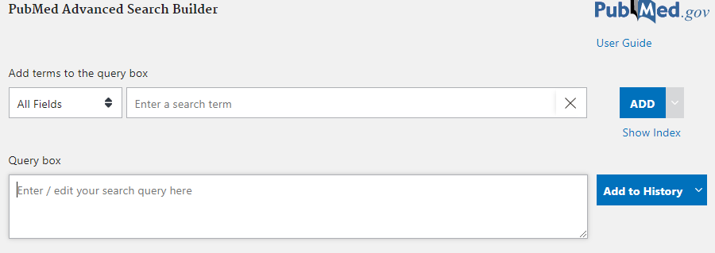
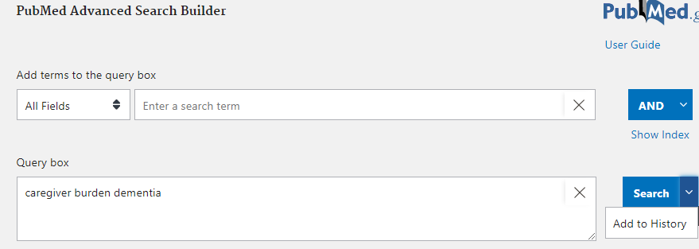
Search/Add to History Split Button
30

Slide 31
Also in March/April 2020
“PubMed Essentials” quick tours announced
“How PubMed Works” series
Create RSS feature added
31

Slide 32
Future updates
Redesigned Clinical Queries page
Custom date range filter
Sort by first author, sort by journal
Summary display without snippets
Display formats for PMID list and PubMed format
Abstract Related Information feature
My NCBI preferences:
Highlighting
Multiple Outside Tool selections
32
24

Slide 33
Where to go for support and training
User Guide
PubMed Online Training Page
NNLM courses and recordings
Feedback button
Support Center link
33

