Slide 1
ClinicalTrials.gov Updates

Slide 2
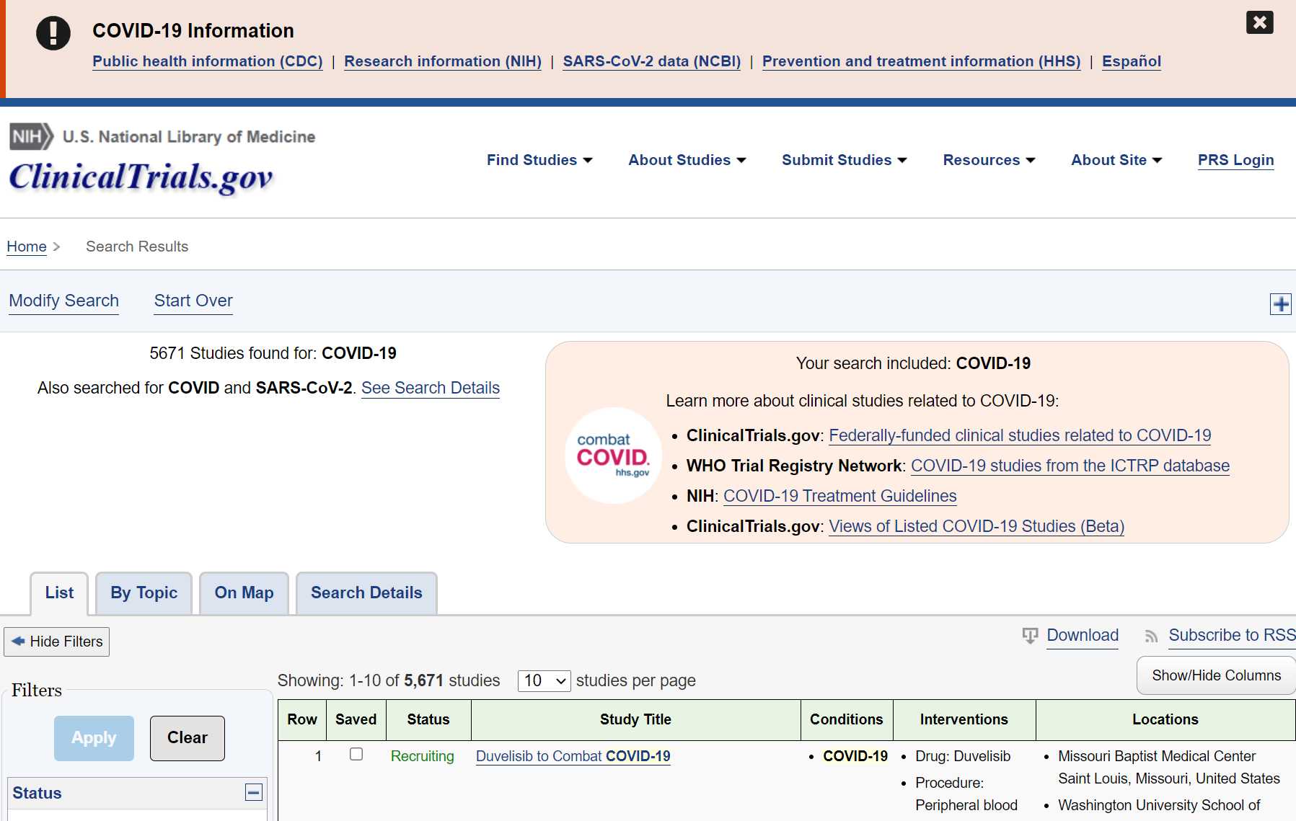
COVID-19 Resources
Notes:
Results can be filtered to show federally-funded clinical studies related to COVID-19
Provide ongoing and completed COVID-19 studies listed on the World Health Organization's International Clinical Trials Registry Platform (WHO ICTRP) on the ClinicalTrials.gov web site

Slide 3
ClinicalTrials.gov and COVID-19 Information
Serves as centralized resource for COVID-19 clinical research
Over 5,670 COVID-19–related study records on ClinicalTrials.gov as of May 13, 2021
Plus 4,160 COVID-19–related studies from World Health Organization (WHO) portal
Provides rapid dissemination of COVID-19 studies and results information
Registration information processed within 2 business days
Expedited results review, within 7 days, and one-on-one assistance available
Added COVID-19 research “views” by location, funder, and vaccine/drug
Beta: https://clinicaltrials.gov/ct2/covid_view
Posted “Responses to Top Questions from Responsible Parties Related to Coronavirus (COVID-19)” last updated May 2021
See: https://prsinfo.clinicaltrials.gov/TopQuestionsFromResponsibleParties-Covid19.pdf

Slide 4
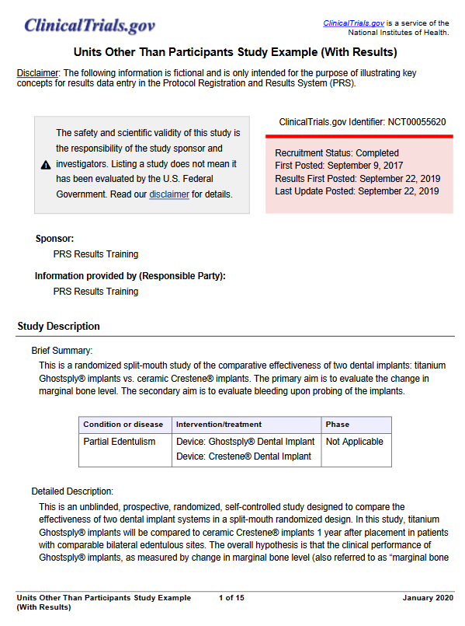
Resources and Training for Data Providers
https://clinicaltrials.gov/ct2/manage-recs/present#ResultsExamplStudies
Notes:
ClinicalTrials.gov offers sample study records and fictional manuscripts for a variety of study designs such as parallel and cross-over, and dose escalation
The Training Materials page has two new study design examples for results data entry, Micro-Randomized and Sequential, Multiple Assignment, Randomized Trial (SMART).
The following example study records and study papers are fictional and were created to illustrate key concepts for results data entry in PRS. Each are available as a PDF file.
Parallel Study Design
Cross-over Study Design
Dose Escalation Study Design
Factorial Study Design
Multiple Period Study Design
Units Other Than Participants
Cluster Randomized Design
Fractional Factorial Design
Micro-Randomized Design
SMART Design

Slide 5
Resources and Training for Data Providers
Tutorials providing step-by-step instructions for data entry and updates have been updated with two new sections:
Quick Overview Guides
PDF Library
Notes:
March 2021: Quick Overview Guides are designed to help users get the most from the tutorials, and the PDF Library has all of the tutorial content in a single place
PRS Guided Tutorials provided step-by-step instructions for data entry
Results tutorials launched in August 2019
Registration tutorials were added in March 2020
They can be accessed on ClinicalTrials.gov or from within the Protocol Registration and Results System (PRS)
Content updates, based on user feedback, are in progress

Slide 6
ClinicalTrials.gov Launched a Multi-year Modernization Effort
Ensure ClinicalTrials.gov continues to be a trusted and valued premier public health resource that provides maximum value to the public and serves its mission well into the future.
Notes:
ClinicalTrials.gov is one year into a five-year modernization effort.
In the past year, ClinicalTrials.gov has:
Met with 21 of 27 institutes and centers across NIH for input
Collected public comments, and
Held a public meeting to discuss the RFI comments

Slide 7
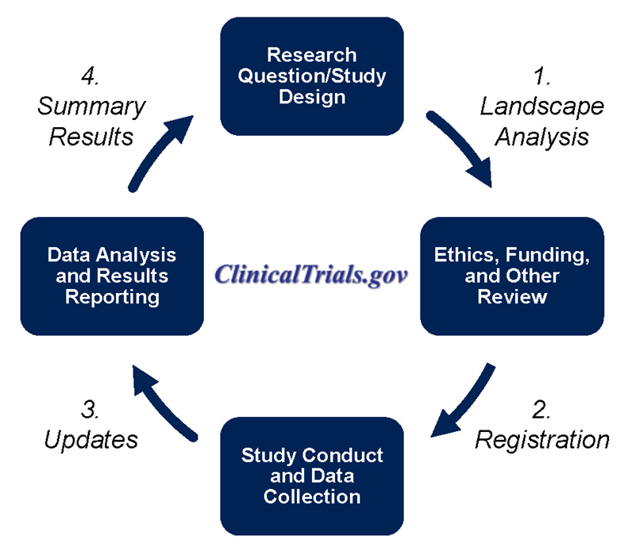
ClinicalTrials.gov Modernization Overview
Year 1: Engagement
Engage stakeholders to determine and validate approach and specifications
Enhance internal business processes
Develop modernization roadmap
Years 2 – 5: Implementation
Implement modernization roadmap
Conduct user testing/evaluation
Continue engaging stakeholders
Improve support for compatibility across clinical trial lifecycle
Upgrade system infrastructure
7

Slide 8
User Feedback and Modernization
Why We Are Engaging Users
People with different backgrounds and experience levels use the site for a variety of reasons.
Designing and developing with real users is critical for better addressing user needs.
How We Are Engaging Users
Modernization teams are designing and developing content in increments, or sprints.
Teams will seek feedback from people from specific user groups to try out new features and prototypes during a sprint.
Teams will use this feedback immediately to build better prototypes.

Slide 9
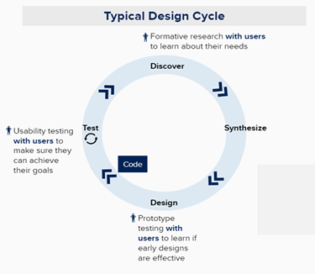
Users Are Central to Approach
Defined User Needs
Over 250 RFI responses about PRS information submission, website functionality, and data standards
Identified Design Opportunities
Over 70 individual interviews with people representing 10 user groups
Evaluating Design with Users
Multiple rounds of individual users providing feedback on wireframes and prototypes
Notes:
External users – patients, data providers, data consumers
Internal users – reviewers, info specialists, developers, management/oversight

Slide 10
Technology Supports Users
ClinicalTrials.gov Website
New Front End and Back End built in parallel to current with staged ‘switch’
PRS
New Front End and JSON API built in parallel to current with staged ‘switch’
Back End replaced in phases (invisible to users)
Key Features and Benefits
Cloud infrastructure approach enhances reliability, sustainability
Synergies for development team in using same technologies for website and PRS development
Deliver new features and functionalities to users in useful and regular increments
Improve user experience and workflow without disrupting it

Slide 11
Meetings with NLM’s Board of Regents Public Service Working Group on ClinicalTrials.gov Modernization
Modernization RoadMap
Public meeting
Public webinar
Public meeting
Public webinar
2019 2020 2021 2022 2023+
Request for information (RFI) for external input
Public webinar
Consultation with NIH internal stakeholders
Stakeholder Engagement
New test version of website to launch Fall 2021.
ClinicalTrials.gov Website
Patients & Advocates
Data Researchers
Improved features for finding, understanding, sharing, and analyzing clinical trial information
Product
Development
Protocol Registration and Results System (PRS)
Automation approaches
Modernization effort launched by NLM
Data Providers
Improved features for submitting and managing clinical trial information
Technical
Infrastructure
Agile teams and processes established
Moved platform to NCBI infrastructure
Enhance Cloud-based Infrastructure and Development Processes
Updated platform to improve reliability, sustainability, and support growth

Slide 12
API
The Beta API introduced in July 2019 is now the operational API.
Links to the current XML schema and crosswalk linking data elements to corresponding API fields are available.
Beginning on January 1, 2022, the previous API will no longer be supported.

Slide 13
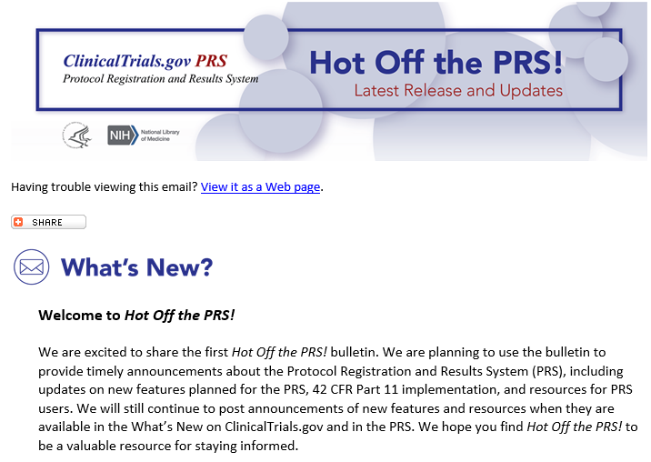
Email Bulletin: Hot Off the PRS!
Provides timely updates for PRS users
Sign up: https://bit.ly/33qcZBb
Notes:
ClinicalTrials.gov launched Hot Off the PRS! in August of 2019.
It provides:
Timely updates for PRS users, and
Proactive communication

