Slide 1
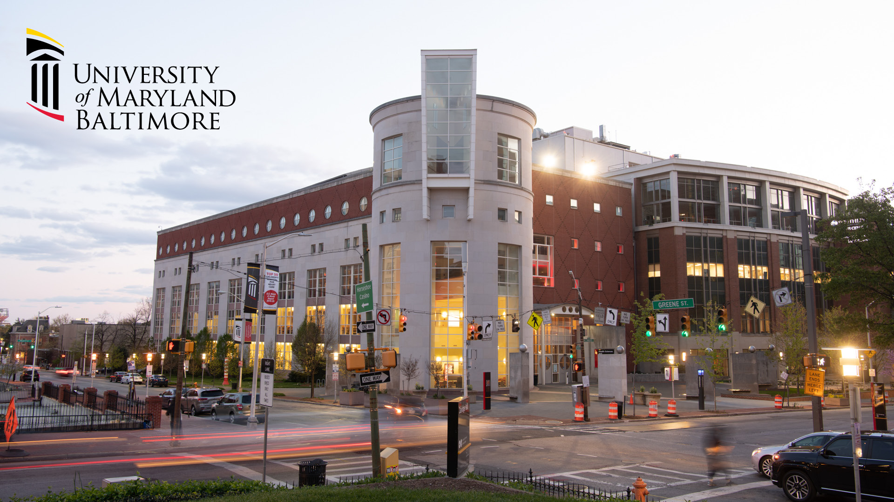
Welcome to NNLM Region 1!
Tony Nguyen
Executive Director
ttnguyen@hshsl.umaryland.edu
https://calendly.com/ttnguyen-1

Slide 2
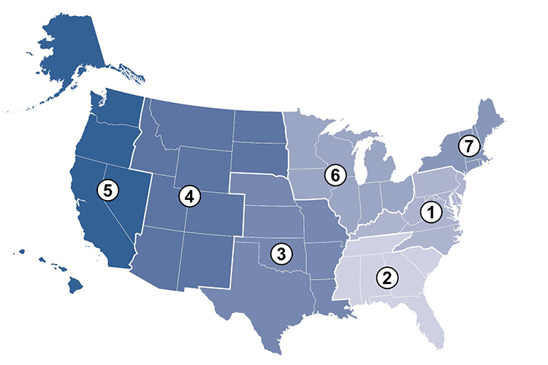
NNLM
Regional
Medical Libraries

Slide 3
NNLM Offices and Centers
Training Office (NTO), Salt Lake City, Utah
Web Services Office (NWSO), Baltimore, Maryland
Public Health Coordination Office (NPHCO), Worcester, Massachusetts
NLM Office of Engagement and Training (OET), Bethesda, Maryland
All of Us Community Engagement Center (CEC), Iowa City, Iowa
All of Us Training and Education Center (TEC), Pittsburgh, Pennsylvania
Center for Data Services (NCDS), New York, New York
Evaluation Center (NEC), Chicago, Illinois

Slide 4
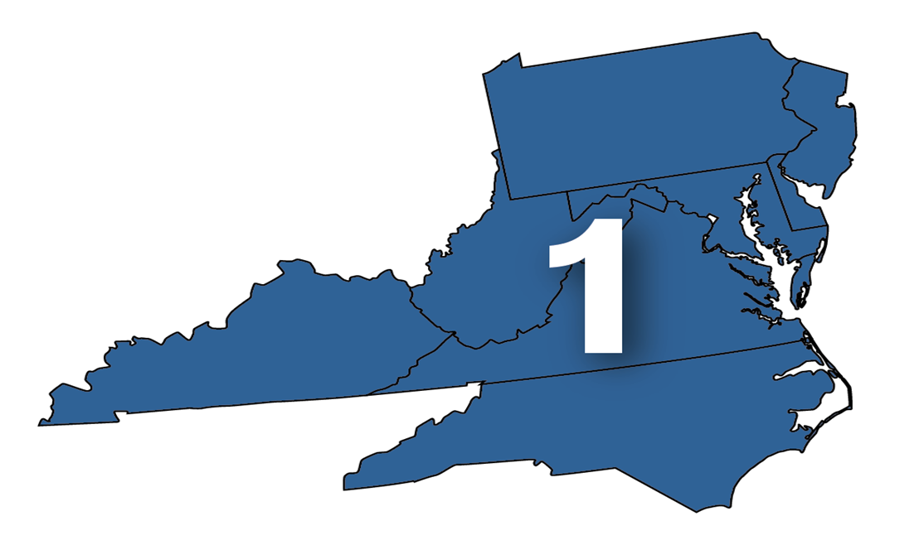
NNLM Region 1
Delaware
Kentucky
Maryland
New Jersey
North Carolina
Pennsylvania
Virginia
Washington, D.C.
West Virginia

Slide 5
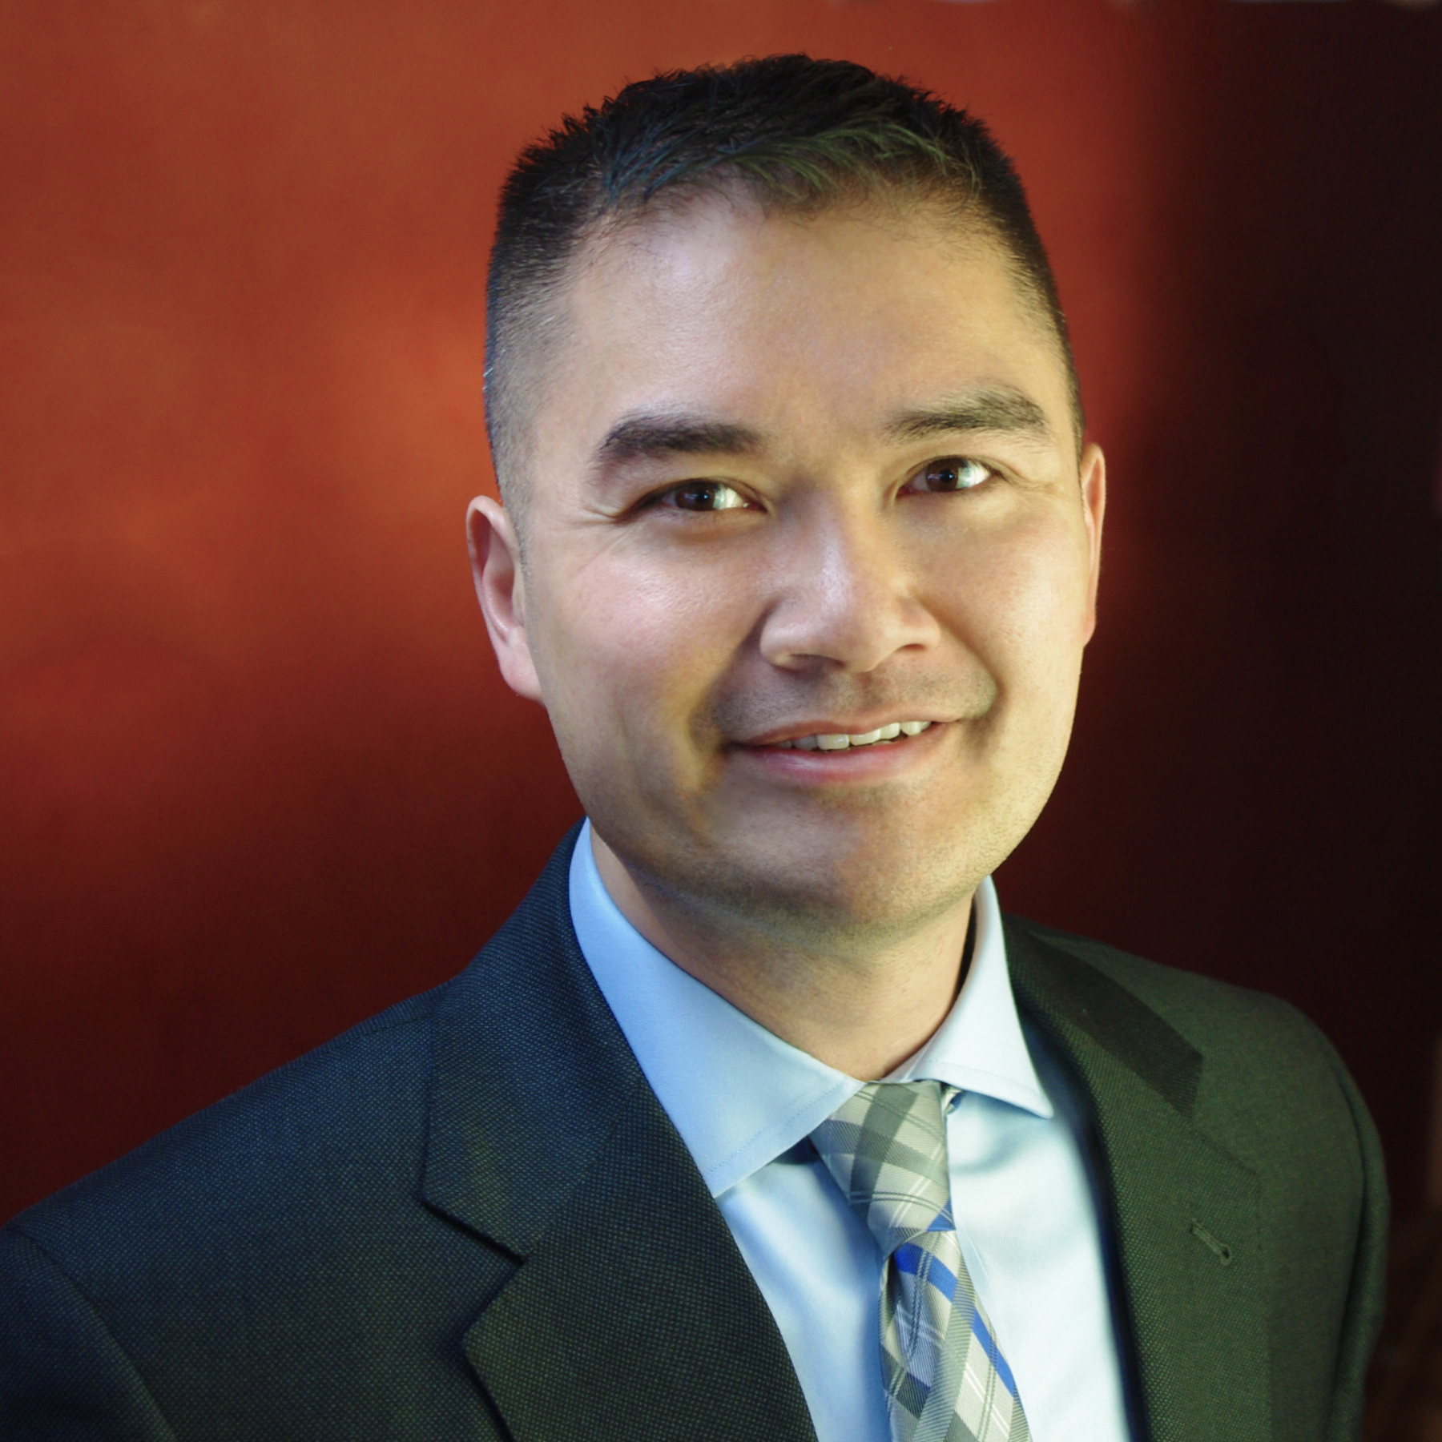
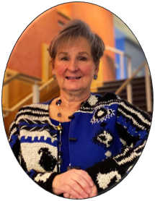
Region 1 Team Leads
Tony Nguyen
Executive Director
M.J. Tooey
Associate Vice Provost
Dean, HSHSL
Director, NNLM R1

Slide 6
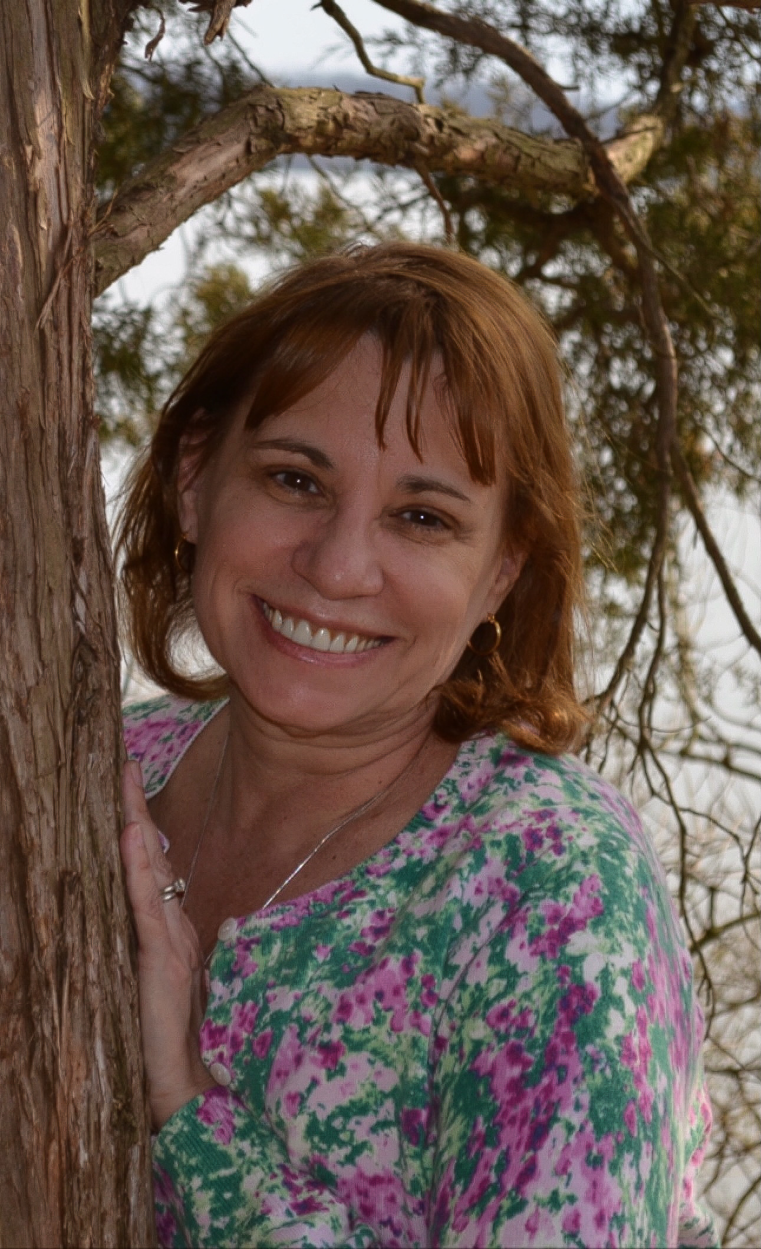
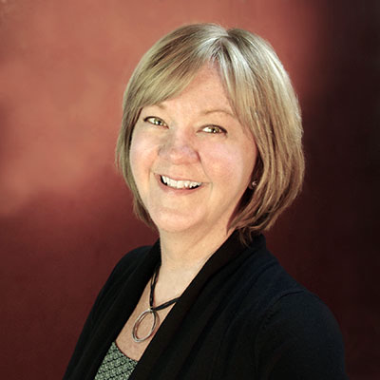
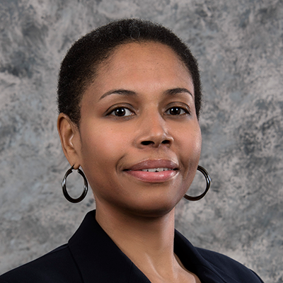
Region 1 Staff
Colette Beaulieu
Office Manager
Nancy Patterson
Outreach Librarian
April Wright
Outreach Librarian

Slide 7
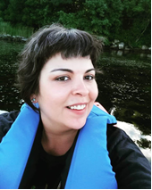
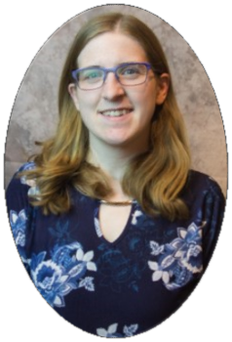
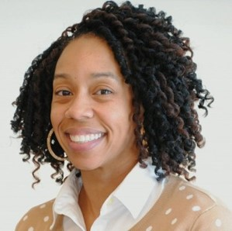
Welcome to Region 1!
Faith Steele
Outreach and Education
Librarian
Tiffany Chavis
Health Literacy Librarian
Christine Nieman
Data Management Librarian

Slide 8
NNLM Initiatives 2021-2026
Confronting Health Misinformation
Bridging the Digital Divide
Environmental Determinants of Health

Slide 9
NLM Priority Areas
All of Us Research Program: https://joinallofus.org/nlm
Librarian’s Roles in Data Sharing and Research Literacy
Community Participatory Research

Slide 10
If you were presented these Initiatives and Priority areas, what would you do?
Confronting Health Misinformation
Bridging the Digital Divide
Environmental Determinants of Health
All of Us Research Program
Librarian’s Roles in Data Sharing and Research Literacy
Community Participatory Research

Slide 11
Year 1 Highlights
Funded 19 projects, awarded $248,411
Offered 20 training opportunities
  Library Carpentry
  Social Justice Webinars
  Evidence-Based Practice Series
  Advancing Engagement through Research: New Trends and Opportunities
Collaborated to Support MLA Specialization Certifications
Sponsored 7 LIS student interns UKy Alt Spring Break

Slide 12
Region 1 Governance Program
Executive Committee
Ambassadors
Library Advisory Board
Communities of Interest Leaders
Region 1 Governance Program Guide: https://nnlm.gov/guides/region-1-governance-program.

Slide 13
Looking Ahead to Year 2
Library Carpentry Workshops in June & November 2022
New NNLM Resource Guides:
  Environmental Health/Environmental Justice
  Outreach and Engagement
Introduction to Environmental Health & Justice Tools Class

Slide 14
More in Year 2…
Disaster Response & Emergency Preparedness Webinars
Environmental Justice, Social Justice and Health Equity Webinars
New Communications Program
National Symposia, Spring 2023

Slide 15
Question for Audience 2
What Other
Activities and Projects
Would You Like to See
in the Coming Year?

Slide 16
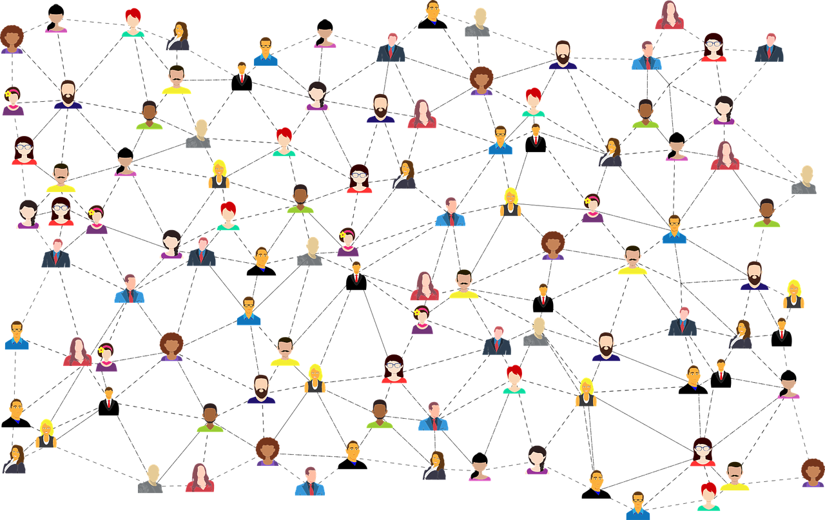
Free Network Membership for Organizations
Free Membership: https://nnlm.gov/membership/join

Slide 17
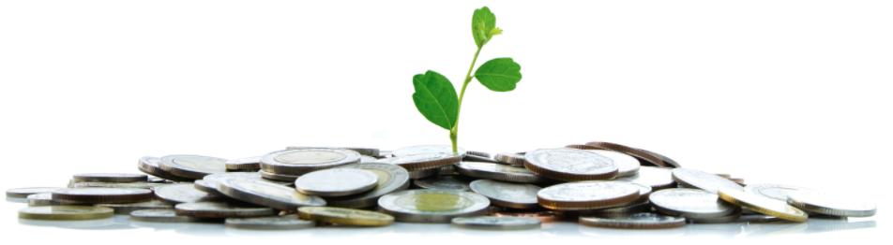
Changes to Region 1 Awards Program
NNLM Funding Opportunities: https://nnlm.gov/funding/rfa

Slide 18
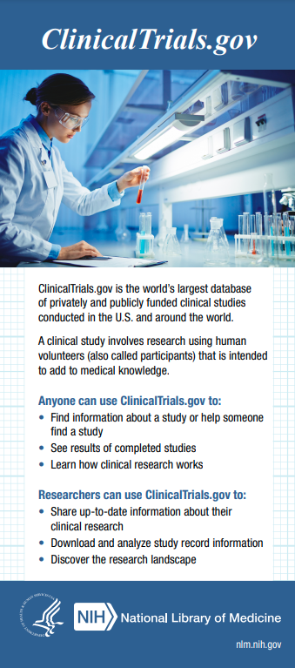
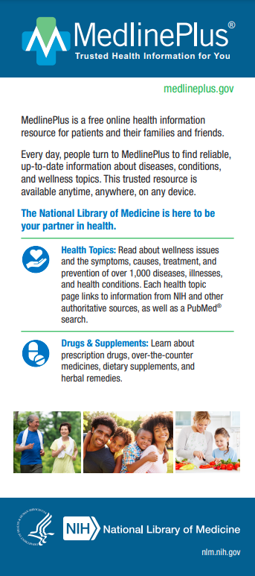
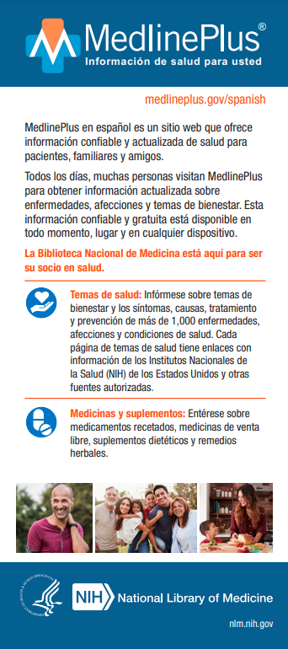
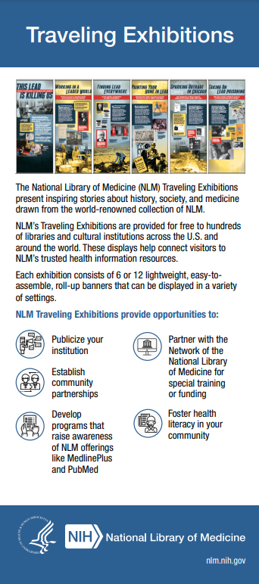
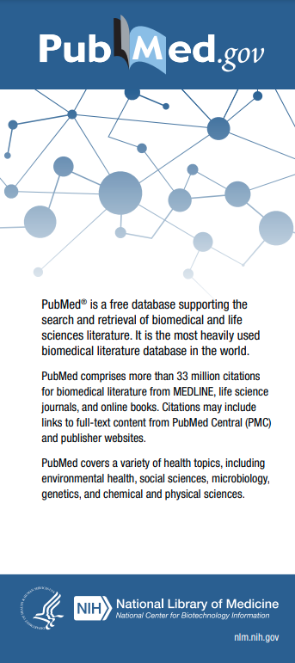
Free Informational Resources
Order Free Handouts: https://nnlm.gov/guides/order

Slide 19

Create a Free Account
Free NNLM Account Creation: https://nnlm.gov/user/join

Slide 20

Free Training & Education Opportunities
Training Opportunities: https://nnlm.gov/training/schedule

Slide 21
Upcoming Classes
NNLM Book Discussion: Doing Harm: The Truth About How Bad Medicine and Lazy Science Leave Women Dismissed, Misdiagnosed, and Sick, May 2 - July 31
Beyond an Apple a Day: Providing Consumer Health Information at Your Library, May 9 - June 6
Wellness in the Workplace, May 9 – May 22
Tackling Inclusivity and the Future of Oral Health, May 10

Slide 22



MLA Certifications
Earn a Specialization for Free: https://nnlm.gov/guides/specialization

Slide 23

NNLM Reading Club
Reading Club: https://nnlm.gov/nnlm-reading-club

Slide 24
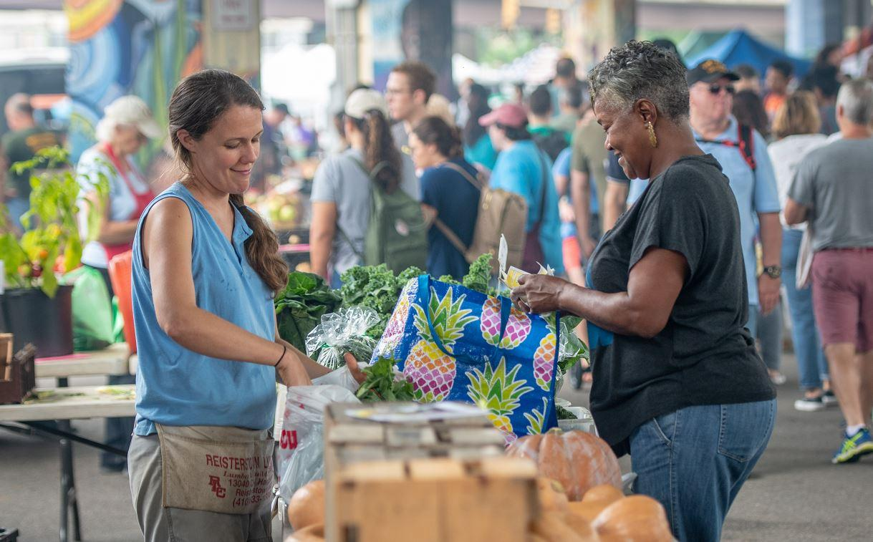
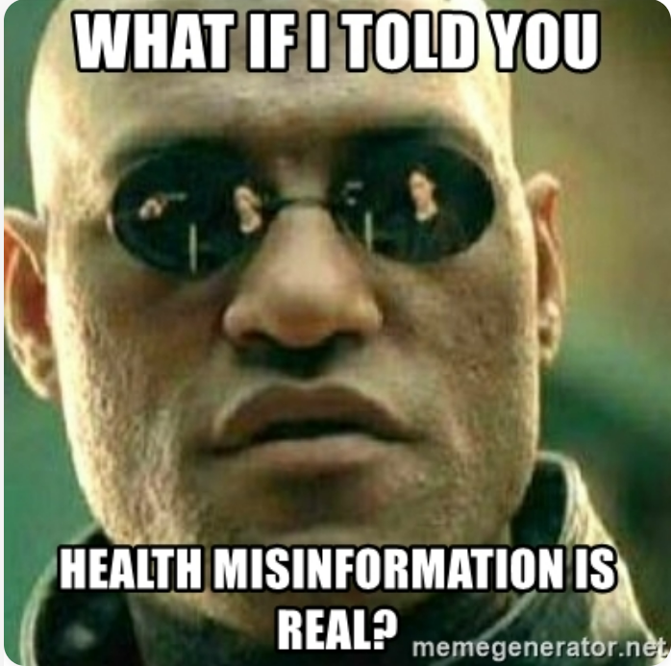

Social Media Engagement
Environmental Determinants of Health
#WhereyouatWednesday
Health Misinformation
#HealthMisinfo
Bridging the
Digital Divide
#FYIFriday

Slide 25







Connect with Region 1
NNLM.gov
Join our Digest News
nnlm@hshsl.umaryland.edu
Region 1 Insights Blog
@nnlmregion1
@nnlmregion1
LinkedIn

Slide 26

Region 1 Office Hours
Attend NNLM Region 1 Office Hours
Every other Wednesday, 1 PM ET.
Schedule Individual Consults
Email: nnlm@hshsl.umaryland.edu

Slide 27
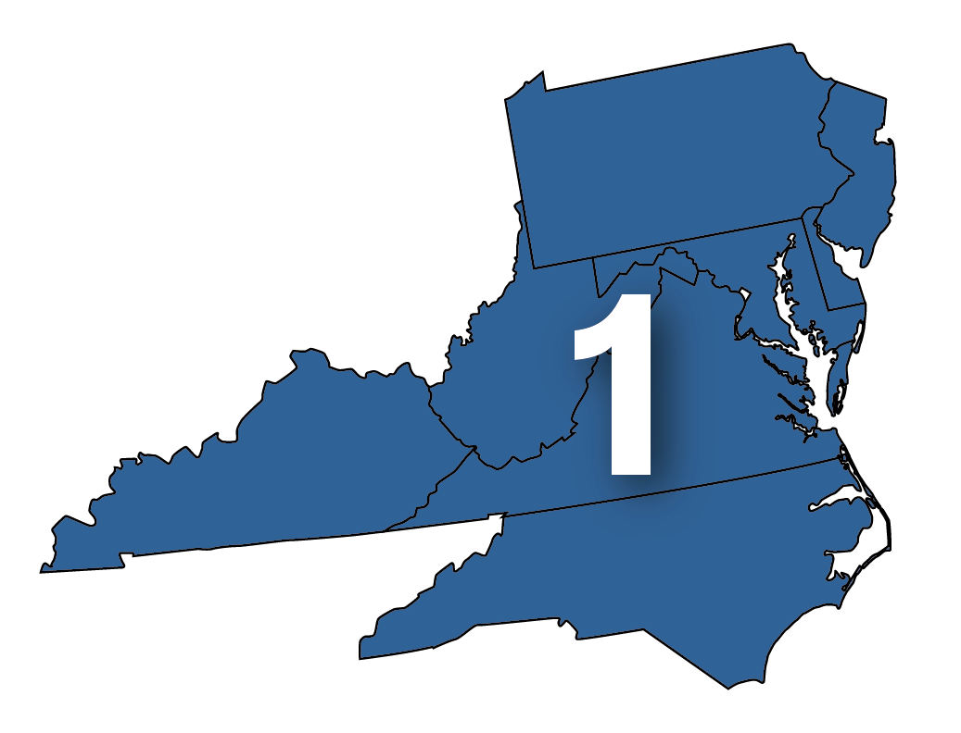
How Can NNLM Region 1 Support You and Your Organization?

Slide 28
Thanks
Tony Nguyen
ttnguyen@hshsl.umaryland.edu
https://calendly.com/ttnguyen-1

