Slide 1
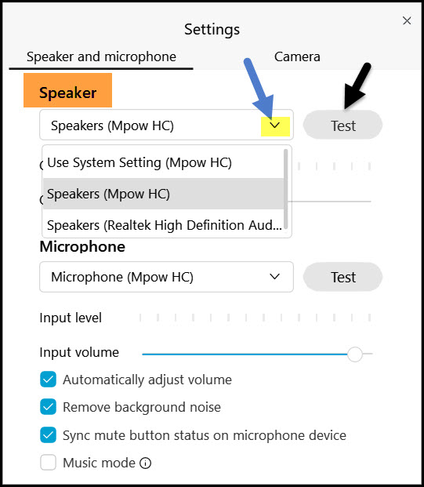
Welcome!
If you are unable to hear:
Locate the Unmute or Connect Audio button.
Next, click Settings to confirm WebEx is using the correct audio device.
Then, use the drop-down menu to choose a different device, if need be.
Notes:
Hello, and welcome. While we are waiting to get started on the screen are audio instructions for WebEx.
[Read slide]

Slide 2
Region 5 NNLM Day @ MLA April 28, 2021
Notes:
Hello, everyone! Welcome to the Network of the National Library of Medicine Day at MLA with Region 5, located at the University of Washington Health Science Library. Thank you so much for joining us today.
I am Daina Dickman, Assistant Director, for Region 5. My colleague Maddie Romansic, Program Analyst and Communication Specialist, will be helping with tech. Carolyn Martin, Outreach and Education Coordinator, will be joining us later in the presentation with some fun Trivia question.
Today, I am here to tell you about our Year 1 accomplishments i and look forward to what Region 5 will offer for funding and programs in Year 2.

Slide 3
Session overview
You are automatically muted upon entry. Please stay on mute during the presentation, but you can unmute yourself to ask questions during Q&A
Please note, we are providing live captions, and you can access by captions by clicking the CC button and the menu option ‘show subtitle’.
Please fill out our short survey so we can keep track of participant information. (Link in chat box)
Notes:
As we settle in, there are a few things to be aware of:
You were automatically muted on entry to WebEx room. Please keep your microphone muted during the presentation. We encourage you to unmute yourselves during the Q&A at the end of the session.
Please post questions or comments in the chat during the presentation. Questions will be collected and addressed at the end of the session.
This session is being live captioned. You can access the captions by clicking the “CC” button, then navigating to “show subtitles”

Slide 4
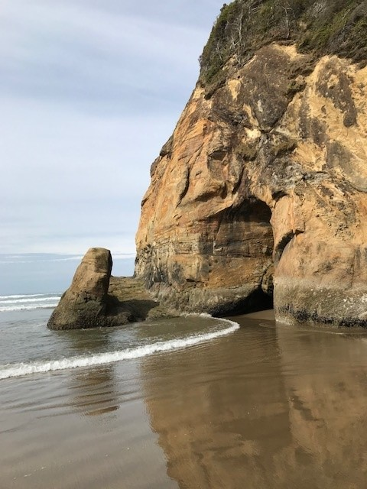
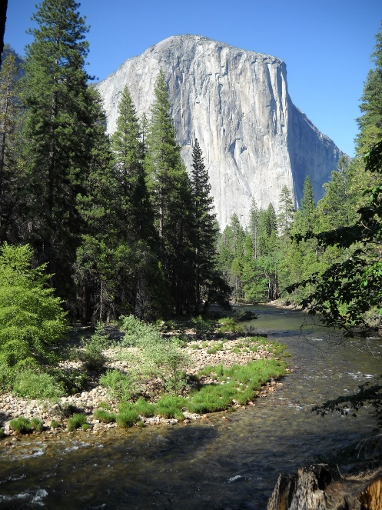
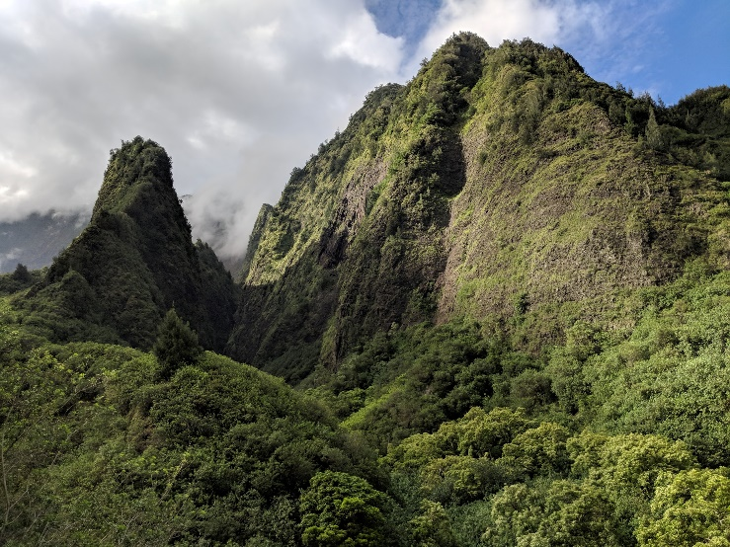
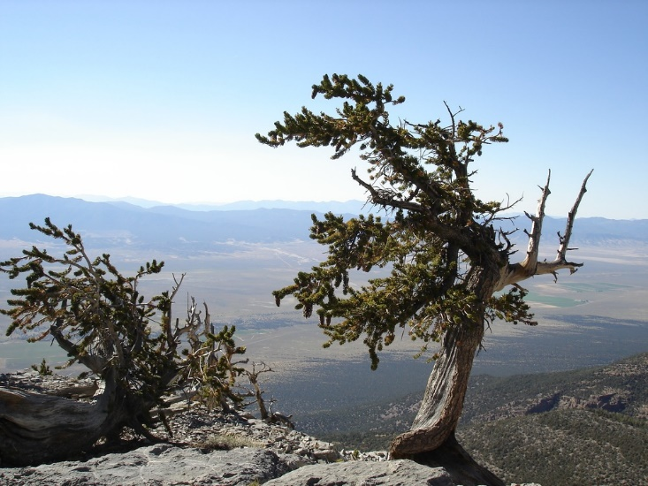
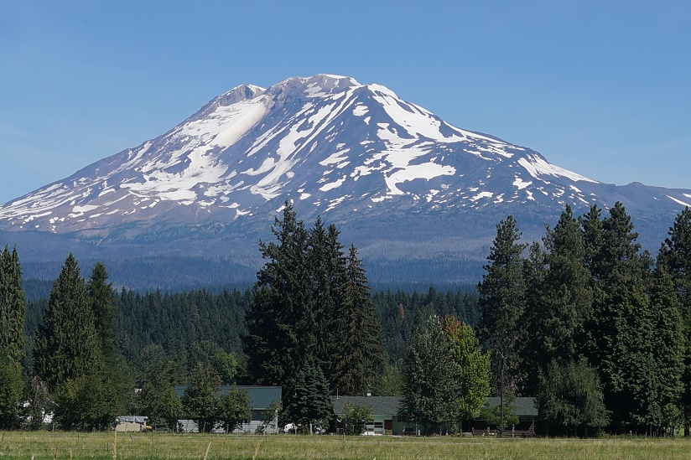
Hello!
Notes:
I’ve included some photos from the diverse natural beauty in our region’s states.
For our agenda today I will cover what happened at Region 5 in Year 1 of our grant (2020-2021) and talk about what to look forward to in Year 2 (2022-2023). I will talk about membership, DOCLINE, Year 1 funding awards, data programming,, equity, diversity and inclusion efforts at NNLM, and training opportunities and new Year 2 funding opportunities.

Slide 5
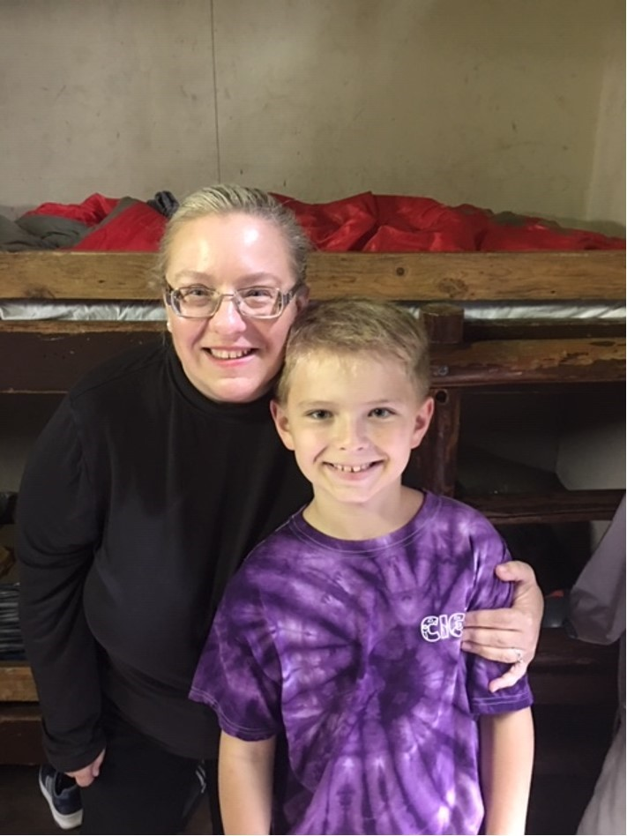
Tania Bardyn (she/her/hers)
Associate Dean for Health Sciences
University of Washington Libraries
NNLM Region 5 Director and Principal Investigator (PI)
bardyn@uw.edu
Focus: 20+ years’ experience forging strategic partnerships with public, private, and non-profit sectors to build innovative health information management systems and outreach services to advance evidence based practice and equitable healthcare access and training resources in urban and rural communities.
Tania with her son Stefan, pictured at summer camp pick up day, Mt. Rainier, WA
Notes:
We are joined today for a welcome to our session by Tania Bardyn, the NNLM Region 5 Director and Principal Investigator. Tania is the Associate Dean for Health Sciences at the University of Washington Libraries.
Tania has 25 years of experience in medical librarianship. She has worked at 3 regional medical libraries, or RMLs, and has been the PI for NNLM at the University of Washington for 10 years.
Thank you, Tania—I’ll hand it over to you now.
Tania:

Slide 6
Getting to Know You: #1 of 2 Poll Questions
Is your organization a member of the Network of the National Library of Medicine (NNLM)?
(Single Choice)
Answer 1: Yes
Answer 2: No
Answer 3: Don't Know
Notes:
Thank you so much for that welcome Tania.
We would love to know more about who has joined us today with two quick poll questions. You will find the poll panel on the right hand side of your screen.
[Read slide]
[Read results]

Slide 7
Getting to Know You: #2 of 2 Poll Questions
Where are you joining us from?
(Multiple Choice)
Answer 1: Alaska
Answer 2: Oregon
Answer 3: Washington
Answer 4: California
Answer 5: Nevada
Answer 6: Hawai’i
Answer 7: Pacific Territory or Freely Associated State
Answer 8: Outside Region 5
Notes:
[Read slide]
[Read results]

Slide 8
NNLM REGION 5: Reaching More People in More Ways!
Notes:
A quick overview of region
The Regional Medical Library, or RML, at the University of Washington serves members in Alaska, California, Hawaii, Nevada, Oregon, Washington, and U.S. Territories and Freely Associated States from 2021-2026.
Prior to a 2021 rearrangement of NNLM regions California, Hawai’i and the Pacific Territories and Freely Associated States was served by the former NNLM RML at UCLA.
We are excited to build partnerships with our new California, Hawaii, and Pacific Island members.

Slide 9
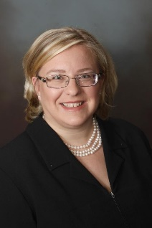
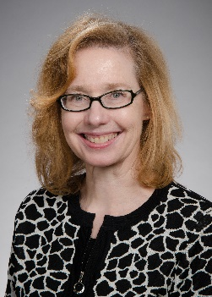
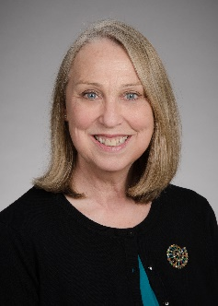
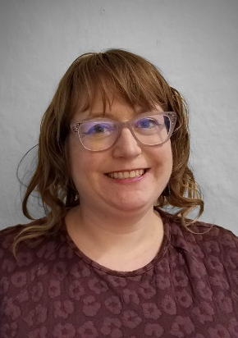
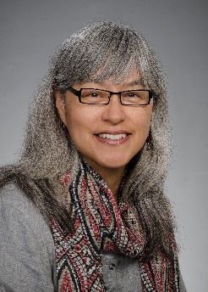
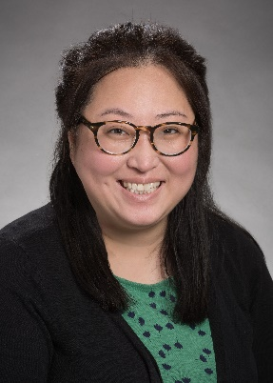
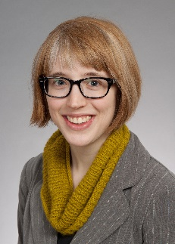
NNLM Region 5 Staff
Tania Bardyn, MLIS, AHIP
Director & Principal Investigator
Cathy Burroughs, MLS
Executive Director
Michele Spatz, MLS
Outreach & Engagement
Daina Dickman, MLIS, AHIP
Assistant Director
Emily Hamstra MSI
Outreach & Access
Carolyn Martin, MLS, AHIP
Outreach & Education
Nancy Shin, MLIS
Outreach & Data
Maddie Romansic
Prog. Analyst & Comm. Spec.
Lisa Guerrero
Grants Manager
Notes:
First, before we talk about all the exciting things happening in Region 5, I want to acknowledge the fabulous staff in the UW’s Regional Medical Library who are serving Region 5.
You have already met Tania Bardyn, our PI and Associate Dean for Health Sciences at the University of Washington Libraries.
Cathy Burroughs is the Region 5 Exec Director of the program.
Michele Spatz is our Outreach & Engagement Coordinator. Focus is on the funding program and with increasing outreach and engagement to underrepresented populations through existing and new partnerships with libraries and community organizations; She chairs the Region 5 Community Engagement Subcommittee; and manages our funding awards program.
I am Daina Dickman, Assistant Director, although this is actually my last week with NNLM and it has been lovely to work with Region 5
Emily Hamstra, is Outreach and Access Coordinator. Her focus is outreach to health professions, public health, and hospital, health sciences, and academic libraries. She provides education and training for NLM resources, NNLM membership, and DOCLINE support and is Chair of the Region 5 Subcommittee on Access and Outreach
Carolyn Martin is Outreach & Education Coordinator. Her focus is working with public librarians and community organizations primarily. She provides leadership for assessing and understanding educational needs of the region and developing programs focused on culturally responsive consumer health programs or trainings . She is the cochair of NNLM’s Cultural Humility & Diversity Interest Group, is our lead coordinator for Region 5’s blog, Instagram, and Weekly Digest, serves as the R5 contact for NLM Travelling Exhibitions, and will develop opportunities for iSchool practicums and intern projects.
Nancy Shin is Outreach and Data Coordinator. Her focus: is training the future workforce in biomedical informatics and data science, including offering training for medical, academic, and health sciences librarians, and supporting pipeline programs for scientific and data careers of the future.
Maddie Romansic is Program Analyst & Communications Specialist. Her responsibilities cover general communications & social media; project reporting support for Region 5 network members, and web conferencing, and digital accessibility support for Region 5 staff
Lisa Guerrero is our Grants Manager/Budget Analyst, and she handles all things fiscal as well as proposal development and grants compliance for our primary grant and subawards.

Slide 10
y1 Funding Awards
Notes:
So, as we jump into a recap of what we accomplished in Year 1 of our 5 Year grant, we will start with our Year 1 Funding Awards. A major aim of our grant is to administer funding awards to support Network members work in our region. Our goal for these awards is to encourage network member participation and to benefit under-resourced communities by improving access to information.

Slide 11
Collection Equity Awards
Collection Equity Awards
27 awards of $1500 each
Fund collection development that amplifies diverse voices writing on health/medical topics
Awards to: 11 academic libraries; 2 community-based organizations; 1 hospital library and 13 public libraries
Notes:
[READ SLIDE]
We intentionally made the final report a bibliography of the materials awardees purchased. With the submitted bibliographies, our aim is to create a
unique downloadable collection development tool focused on diverse voices writing on health thus enabling us to amplify the reach of this award.

Slide 12
Technology Equity Awards
Technology Equity Awards
3 awards of $5000 each
Designed to support infrastructure that improves equitable access to biomedical and health information
Awards to: 1 public library, 1 academic health sciences library and 1 community-based organization
Notes:
[READ SLIDE]
We funded 3 projects that focused on:
The public library program was for creating a highly accessible computer station to meet community needs in partnership with community organizations
The academic HSL award was for purchasing two 3-D scanners: one high-quality scanner for community demonstrations and scanning historical objects, and one hand-held scanner, which is more portable and allows learners to engage with a technology increasingly used in clinical settings
And the community-based organization was for implementing a new system of digital data collection, management, and dissemination for a syringe exchange program serving seven Oregon Counties

Slide 13
Environmental Health Outreach Award
Environmental Health Outreach Award
1 award of $5000
Award to: academic health sciences library planning outreach/education to high school students on the harmful health effects of bad air quality.
Notes:
Next is the Environmental Health Outreach Award. This $5000 award funded a collaboration between a health sciences university and a public university focused on outreach to high school students in the San Joaquin Valley to teach about the impacts of air pollutants on the respiratory system; the health effects of poor air quality; how to search NLM resources for health information; and community resources to improve air quality and reduce the impact of poor air quality on their health.

Slide 14
Professional Development Awards
Professional development opportunities such as classes, conferences, or workshops for individual NNLM members
Costs associated with hosting an expert speaker to give a talk, workshop, class or lecture.
Educational activities on Diversity, Equity, and Inclusion that aim to improve service to underserved, minority and underrepresented communities.
Notes:
Our professional development awards are up to $1500 each and are designed to support a highly trained workforce for biomedical and health information with an emphasis on supporting the skill development of people from underrepresented groups.
[Read slide]
In Year 1, we funded the Oregon Post Adoption Resource Center with a professional development award to host their guest speaker, Amerika Haynes-Lewis, talking about her years in foster care and the importance of diverse books in helping her cope and see herself as someone who matters. ​

Slide 15
Data Programming

Slide 16
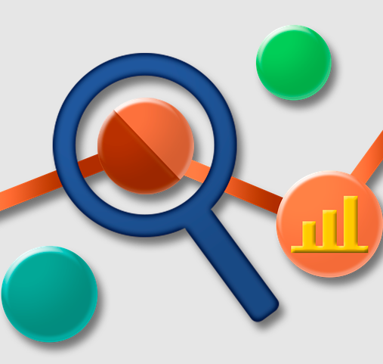
Y1 Data Programming Highlights
Genetics 101 (December 2021)
Data Literacy for the Busy Librarian (February 2022)
NNLM-R5/PNC-MLA Health Equity and Diversity Speaker Series: Do No Harm with Data Viz (February 2022)
Notes:
Year 1 was a very busy year for data in Region 5!
Some key projects that I wanted to highlight include the online class Genetics 101 which reached maximum registration capacity at 100 registrants. We received a lot of positive and enthusiastic comments about it with 44 students completing the course! Another popular and successful online class was Data Literacy for the Busy Librarian. Like Genetics 101, Data Literacy for the Busy Librarian reached maximum registration capacity. The last key project that I wanted to highlight is a collaboration with the PNC/MLA group on a Health Equity and Diversity Speaker series. The second speaker in this speaker series, was Alice Feng, Data Visualization Analyst at the United Nations Development Programme, who gave an amazing talk to over 160 attendees on the topic of Do No Harm with Data Viz.

Slide 17
Library Carpentry
Popular workshops on software and data skills
Modules on R, R-Studio, and OpenRefine
Notes:
Region 5 hosted a well attended spring session of Library Carpentry workshops, with preference given to Region 5 members for enrolling. Library Carpentry focuses on building software and data skills within library and information-related communities. Our spring session included modules on R, R-Studio, and OpenRefine over 3 half-days. Their hands-on, approachable workshops empower people in a variety of roles to use software and data in their own work and support effective, efficient, reproducible practices.
We had a winter session scheduled, but due to unforeseen circumstances have moved this to year 2. You can check our communication channels for when this is rescheduled, but we are aiming for Fall 2022.

Slide 18
Membership & docline
Notes:
Next, let’s look at Membership and DOCLINE accomplishments

Slide 19
Membership
NNLM Region 5 | Member Organizations
Alaska | 28
Am Samoa | 1
California | 401
Guam | 9
Hawai’i | 21
Nevada | 26
N. Mar Isles | 3
Oregon | 112
Washington | 190
Welcomed 27 new members
Behind the scenes work; updating to a new membership management system
Notes:
In Year 1 we welcomed 27 new members. We have representation from across our region.
[READ CHART]
We are always looking to expand out membership, so please let your contacts know about the benefits of being an NNLM member. ​
​
You can also email us with suggestions of potential members.​
​
The NNLM has a new member management system. Region 5 staff have been busy behind the scenes doing membership records clean up and learning the new membership management system. We're confident the new system will help us improve communication with members. And, to help with communication we will be contacting members in the coming year about updating their membership records. ​

Slide 20
DOCLINE Support
Established workflow for responding to support requests
Email Region 5 DOCLINE Support: DOCLINE@uw.edu
Welcomed 3 new DOCLINE Libraries
George Fox University (OR)
Queen's Medical Center (HI)
Institute for Functional Medicine (WA)
Reviewed and updated Library Groups
Notes:
DOCLINE remains one of the most popular services offered by NNLM. If you aren’t familiar with this service, DOCLINE is the National Library of Medicine’s interlibrary loan (ILL) request routing system. The purpose of the system is to improve access to biomedical literature for library members of NNLM and beyond.​
​
In 2021 administration of DOCLINE moved to the Regional Medical Libraries and we are continuing to improve our workflows and response to member requests for technical support. In 2021 we welcomed three new DOCLINE Libraries, including Queen’s Medical Center in Hawaii, George Fox University in Oregon, and the Institute for Functional Medicine in Washington. We're in the process of working with these libraries to set up their DOCLINE profiles, and all will be ready to lend soon.​
​
This year we contacted libraries involved in DOCLINE Library lending Groups to review their group's members and lending agreements. Through this process we identified and removed libraries who no longer participate in DOCLINE, ensuring that requests are not routed to non-participating libraries. ​

Slide 21
EDI & training
Notes:
Our next area is Equity, Diversity, and Inclusion and Training efforts at Region 5

Slide 22
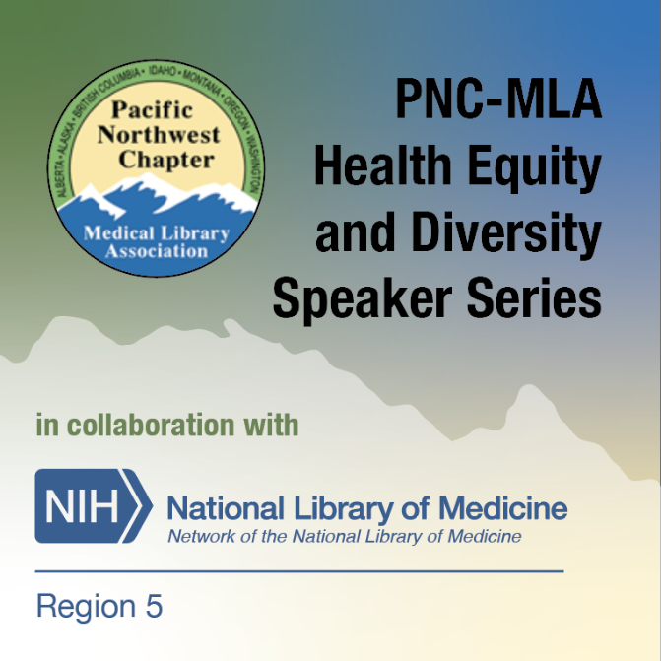
Equity, Diversity, Inclusion
Inclusive Language resource list for NNLM staff
PNC-MLA Health Equity and Diversity Speaker Series (collaboration)
Increasing Environmental Health Literacy in a Native American Community (or "Guardians of the Living Water")
Do No Harm with Data Viz
Notes:
NNLM has been working to address EDI in our work. Several NNLM staff form a cultural humility and diversity group to assist in guidance and providing resources and learning opportunities.
One accomplishment was to create an inclusive language resource list relevant to the work we do whether for class content, presentations, communications, etc. We encourage the staff at NNLM to utilize these resources in the reviewing and creatin their work. We’ve also identified learning opportunities available at our own institutions and elsewhere.
As mentioned, Region 5 has collaborated with the Pacific Northwest Chapter of MLA to create the PNC-MLA Health Equity and Diversity Speaker Series. We provide the webinar platform, live captioning, and MLA CE while PNC’s Diversity Committee invites presenters.
Chat box link: PNC-MLA Health Equity and Diversity Speaker Series https://nnlm.gov/training/class-catalog/pnc-mla-health-equity-and-diversity-speaker-series
So far we have had 2 sessions and hope to schedule an upcoming one this summer. The plan it to have about 4 sessions a year. If you have anyone or a topic you’d like covered, please let us know and I’ll pass that info on to the PNC Diversity Committee.

Slide 23
NNLM Training
National classes
Collaborative
Quality Design and Content
Support MLA's specializations
Notes:
The NNLM National Training Office coordinates the national education program. The classes and webinars are a collaborative effort by various Regional Medical Library staff for quality, relevance, cultural humility, etc.
NNLM works closely with the Medical Library Association to provide classes eligible for their specializations. The Consumer Health Information Specialization, or CHIS, is one you may have heard especially if you work with the public. There is also the Disaster Information and the Data Services specializations. Currently being developed is the Systematic Review Services specialization. We take care of the application fees for these though not yet for the Systematic Review. If you have questions about this, you can either contact us or MLA.
Chat box links: Medical Library Association specializations https://nnlm.gov/guides/specialization

Slide 24
Customized Training
Training for R5 Members in Y1 include:
Hawaii Pacific Chapter of MLA conferences- 4 CE classes
Sacramento Public Library, "Finding Health Information You Can Trust"
"Health and medicine resources from the National Library of Medicine", College Libraries Across Washington (CLAWS) of the Washington Library Association Monthly Round Table
"Health Communication", Public Health 701, University of Hawai’i at Manoa
Notes:
In addition to providing classes nationally for NNLM, Region 5 has done some training specifically for the region. Here is a list of Year 1 sessions which includes continuing education sessions at conferences, public library inservice, and library organization events.
As you can see, Region 5 offered 4 CE classes for Hawaii Pacific Chapter of MLA, a session for Sacramento Public Library, a session for a Washington Library Association Monthly Roundtable, and a presentation ln Health Communication for Public Health 701 at University of HawaiiI!
We are always delighted to provide presentations or training for your staff or organizational event.
If your organization is seeking an in-service or training please reach out. Carolyn Martin, our Outreach & Education Coordinator, will be happy to connect you with our staff to provide what meets your organization’s needs.
If you have questions about classes and webinars, or wish to have us provide a regional or local CE or professional development opportunity, you can also reach out to Carolyn.
Chat box link: Carolyn Martin’s email, martinc4@uw.edu

Slide 25
Outreach & Networking
Notes:
Next I will share some of our Outreach and Networking opportunities from Year 1

Slide 26
Regional & National Conferences
Spatz, M, (2021, December 2). Real World Consequences: Mitigating Health Misinformation [Presentation]. Hawaii Library Association Conference.
Spatz, M, Acosta-Ramirez, S. (2022, February 14-16) Health at Your Fingertips Salud Al Alcance De Su Mano. [Presentation] 2022 Western Forum for Migrant and Community Health.
Hamstra, E. (2022, March 8-10). Introduction to Health Reference [Presentation] Virtual RUSA Forum.
Shin, N., and Beard, L. (2022, March 15-17). A Guide to Responsible and Inclusive Data Ethics [Poster]. Virtual RDAP Conference.
Dickman, D., Churchill, V., McClung, S., Rau, R., and Wilson, A. (2022, March 31-April 1). Promoting DEI in Health Collections at California Academic Libraries [Presentation]. CARL Conference.
Regional & National Conferences
Notes:
In addition to training, Region 5 librarians have been presenting at various librarian and health professional conferences.
Here is a small selection of our conference presentations, including a partial list of the presentations done at these conferences:
Hawaii Library Association
Western Forum for Migrant and Community Health
ALA’s RUSA Forum
RDAP, The Research Data Access and Preservation Conference
Public Library Association
and CARL, the California Academic and Research Libraries conference

Slide 27
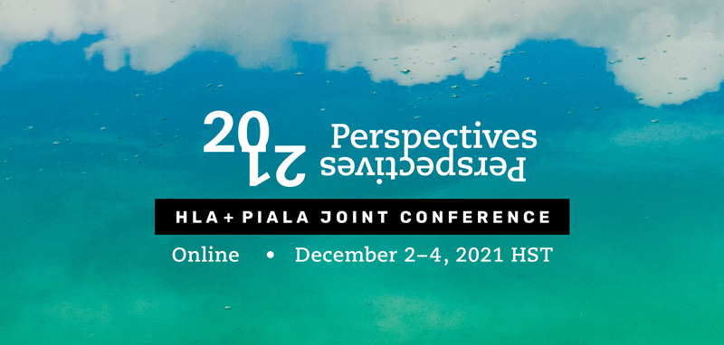
MLA Chapter meetings
Region 5
Notes:
NNLM Region 5 is always happy to present at your regional MLA chapter meetings or other organizational conferences. We can also offer CE classes. Chapters in our region include PNC, NCNMLG, MLGSCA, and HPCMLA
I just want to particularly highlight that our participation at the virtual Hawaii Library Association and Pacific Islands Association of Libraries, Archives, and Museums joint conference was very important, to introduce staff from the new RML to Hawaii and the Pacific Islands. We had 2 presentations on the program, and a virtual exhibit.
Both Nancy Shin and Michele Spatz were on the program with presentations about inclusive data ethics and addressing health misinformation.

Slide 28
Upcoming for Year 2
Notes:
OK, so that was a selection of what happened in Year 1. We are excited to look forward to Year 2. I am going to give you a preview on what's on the horizon including funding opportunities and partnerships.

Slide 29
Year 2 Funding Opportunities Applications due: June 28, 2022
Region 5
Outreach & Engagement Awards
minimum of 3 awards up to
$25,000 each
Region 5
Data Engagement Awards
minimum of 3 awards up to
$25,000 each
Notes:
We recently closed applications for this first round of Funding Opportunities in Year 2. These included the Health Information Outreach Subaward, and three “express outreach awards” for Environmental Health Justice, Health Misinformation, and Technology Equity. Our reviewers just finished looking at the applications and we expect to make an announcement soon of awarded funds.
We didn’t get as many applications as we hoped for in the first round of Year 2 award funding. So, we are also intending to announce these new funding opportunities in Year 2.
In Year 2, we are poised to give out more funding to support the work of the region since Network member participation in the NNLM mission is key.
This year, we are offering larger award opportunities. These 2 new awards –Outreach & Engagement; and Data Engagement, will be announced soon and applications will be due June 28.

Slide 30
Region 5
Outreach & Engagement Awards
Award and Amount Available | Purpose | Examples of Activities
Outreach and Engagement Award Up to $25,000 | Support projects to increase access and use of quality online health information, improve health literacy and increase health equity through engagement and training for health information. | Collaborate with a public library, public health department or community clinic to promote vaccination drives or health fairs Co-host a program with a community health educator about resources relevant to community health needs Upgrade tech equipment to facilitate health-focused virtual reality instruction
Region 5
Outreach & Engagement Awards
minimum of 3 awards up to
$25,000 each
Notes:
The Outreach & Engagement Award is up to $25,000 and will support projects to increase access and use of quality online health information, improve health literacy, and increase health equity through engagement and training for health information.
Some ideas for activities include:
Collaborate with a public library, public health department or community clinic to promote vaccination drives or health fairs
Co-host a program with a community health educator about resources relevant to community health needs
Upgrade tech equipment to facilitate health-focused virtual reality instruction

Slide 31
Region 5
Data Engagement Awards
Award and Amount Available | Purpose | Examples of Activities
Data Engagement Award Up to $25,000 | Support engagement in data literacy, data science or data management. | Researching data for social, economic, or racial health equity Projects addressing research reproducibility, data access, and discovery Teaching a class or hosting a symposium on public health or medical data Designing an open science project
Region 5
Data Engagement Awards
minimum of 3 awards up to
$25,000 each
Notes:
The Data Engagement Award is also up to $25,000 and will support engagement in data literacy, data science, or data management.
Some ideas for activities include:
Researching data for social, economic, or racial health equity
Projects addressing research reproducibility, data access, and discovery
Teaching a class or hosting a symposium on public health or medical data
Designing an open science project
Do keep in mind---We can make awards for projects up to $25,000 each on both of these awards -- OR – we can make smaller awards if proposals come in with budgets at any amount less than $25,000.
So, we have plenty of funding available!

Slide 32
Y2 Funding Award Applications
Awards support projects planned for between 7/1/22 to 4/30/23
Intend to apply? Email by June 7 nnlm@uw.edu
Proposal deadline:
June 28, 2022
Notes:
With funding from these awards, the programs or events you conduct should occur between July 1, 2022 to April 30, 2023.
To be considered, your application will be due June 28, and we request an email to nnlm@uw.edu stating your intent to apply, by June 7.
When these new awards are posted, they will appear on Region 5’s website in the funding tab
Chat box link: https://nnlm.gov/funding/
We will make the announcements on our Region 5 listserv and through the MLA Chapter listservs.
And, if you wanted to be inspired, look at NNLM’s previously funded projects by browsing the “Funded Projects” feature.
Chat box link: https://nnlm.gov/funding/funded
If you have any questions about applying for funding, our staff are happy to answer questions and assist you with your application.

Slide 33
Year 2 Professional Development Awards
Professional Development
Support a highly trained workforce for biomedical and health information resources and data, improve health literacy, and increase health equity through information.
Notes:
We will also be continuing our popular professional development awards, so you can look for more information when these are announced.
These awards are designed to support a highly trained workforce for biomedical and health information resources and data, improve health literacy, and increase health equity through information.

Slide 34
Year 2 External Partnerships
Continue a multi-year agreement with the Alaska Medical Library that addresses distinct health information needs of a healthcare workforce serving rural and underrepresented populations.
Partnerships with Seattle-based Northwest Regional Primary Care Association and a rural Oregon community partner, The Next Door, to co-create and disseminate a series of microlearning tutorials on health topics for community health workers.
Notes:
[Read Slide]

Slide 35
Year 2 Internal Partnerships
Collaborate with the National Training Office (NTO) on multiple data literacy and bioinformatics training initiatives, including teaching RDM On-Demand – Data Curation and Documentation; Data Literacy for the Busy Librarian; Bioinformatics and Biology Essentials for the Librarian; and converting Genetics 101 into an On-Demand course.
Assist the NNLM National Public Health Collaborative to support the expansion of the Public Health Digital Library (PHDL) to Washington local health departments, and the Nevada state and Guam territory departments of health.
Notes:
[Read slide]

Slide 36
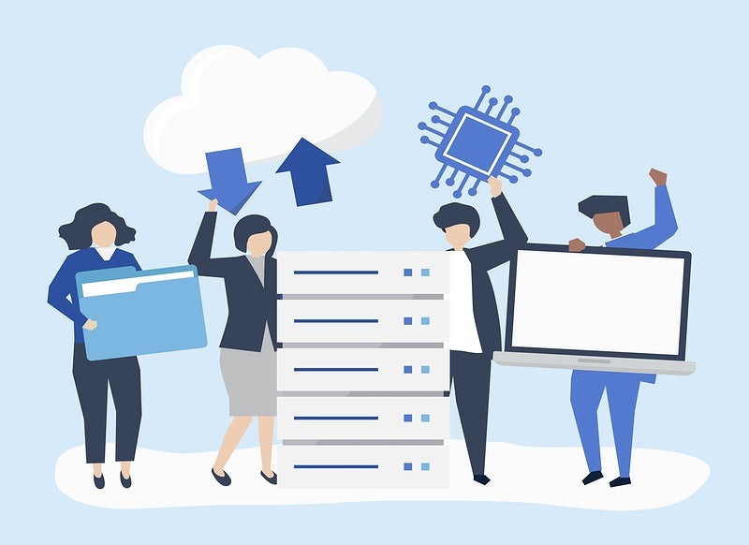
Y2 Future Data Programming
Inclusive Data Ethics Training for R5 CTSA Researchers (January/February 2023)
Library Carpentry workshop
Notes:
Looking ahead for data programming in Region 5, we have a lot of exciting things in store!
In Winter 2023 we anticipate launching Inclusive Data Ethics Training for Researchers. We are first piloting an inclusive data ethics training at University of Washington for researchers in the Institute for Translational Health Sciences, which is one of the NIH Clinical and Translational Science Awards.
This is an exciting and big endeavor that we hope to extend to all organizations in Region 5 with Clinical and Translational Science Awards.
We are also teaming up with Library Carpentry to offer more workshops in Year 2. The dates are not set yet, but we are aiming for late September and will announce widely when registration is open.

Slide 37
MeSH Project: Ethnic Minority Terms
NIH project to expand MeSH terms and concepts related to U.S. racial and ethnic populations.
Volunteers from Region 5 to serve as subject matter experts (SMEs)
Review 3 coding sheets and provide expert opinions
Notes:
Region 5 is also involved with an NIH project on MeSH to expand the terms and concepts related to US racial and ethnic populations.
MeSH, or medical subject headings, is the underlying thesaurus, which is used to index, catalog, and search biomedical and health-related information in MEDLINE and PubMed. A more complete representation of terms will enhance the indexing which will then enhance searching and retrieval for knowledge extraction and reuse. Their ultimate aim is to improve the ability to identify research publications in these scientific areas.
Region 5 reached out to our members for volunteers to serve as subject matter experts on this project. We had an enthusiastic response and have volunteers from Region 5 member institutions including:
South Central Foundation in Alaska
University of California, San Diego
University of Washington
Washington State University
University of Hawai’i
And University of California, San Francisco
The subject matter experts will be reviewing 3 coding sheets and provide expert opinions. The 3 coding sheets cover ethnic group terms, Bureau of Indian Affairs terms, and geographic population groups to which ethnic groups will be mapped.

Slide 38
And more in Year 2!
Continue recruiting new members with a focus on MSIs
Present “Introduction to Health Reference: Ethics and Best Practices” to librarians in San Diego County in response to a county-wide declaration of health misinformation as a public health issue.
Continue facilitating and promoting the NNLM Reading Club
Coordinating webinars on topics of interest to our members, with a return to a regional focus for webinars
Notes:
[Read slide]

Slide 39
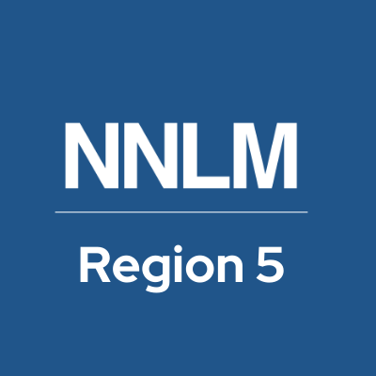
Your Questions for Us We Want to Hear From You!
Feel free to chime in!
Use the Chat Box to type your comments or
questions
Please introduce yourself when submitting a question so we can get to know each other!
Notes:
That brings us to the end of our presentation. After our question time we have a fun NNLM trivia game hosted by Carolyn, so please stick around for that. But now, it is time for questions
[Read Slide]

Slide 40
Thank You!
Questions or followup:
Please email us at nnlm@uw.edu
Join the NNLM Region 5 News Listserv: http://mailman11.u.washington.edu/mailman/listinfo/nnlm-region5

Slide 41
trivia

Slide 42
Trivia Question 1
Region 5 geographical region does not include which state or island:
Alaska
Guam
Idaho
Nevada
California

Slide 43
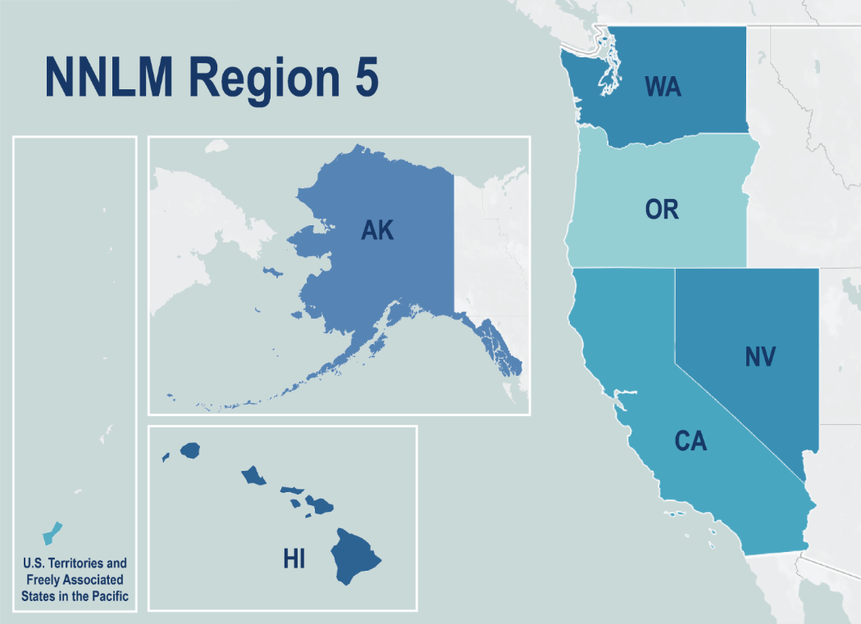
Answer for question 1
Region 5 geographical region does not include which state or island:
Alaska
Guam
Idaho
Nevada
California
Notes:
Answer: Idaho was in the previous Pacific Northwest Region that was also served by University of Washington’s RML, until the regions were adjusted beginning in 2021.
And with that I will hand it over to Michele to talk about TOPIC

Slide 44
Trivia Question 2
NNLM originally began with how many RMLs (Regional Medical Libraries)?
7
8
9
11

Slide 45
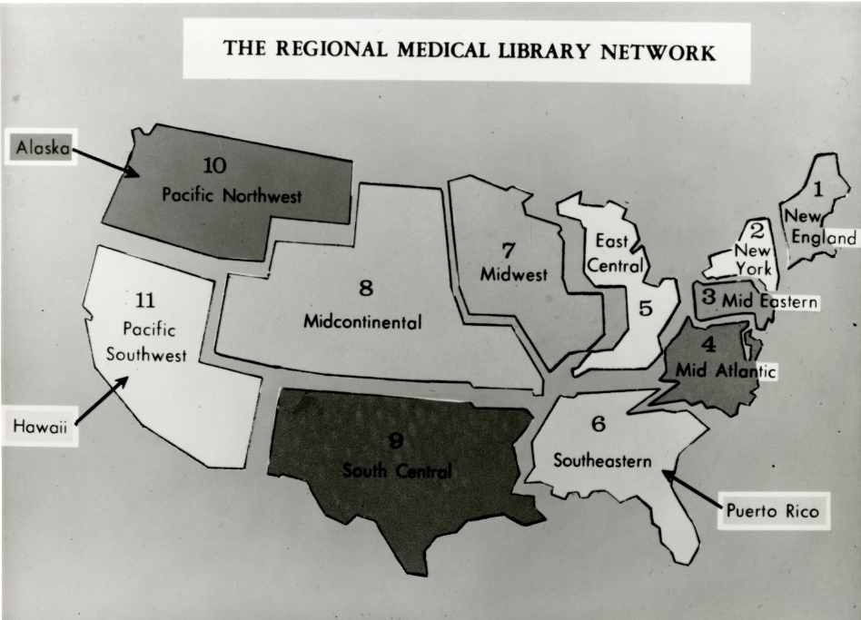
Answer to question 2
NNLM originally began with how many RMLs (Regional Medical Libraries)?
7
8
9
11
original RML map from the NLM Digital Collections
Notes:
Answer: Back in 1968, when the Regional Medical Library Network was first formed, it consisted of 11 regions which is shown in the image on this slide.
Chat box link: The Nation's Health Information Network: History of the Regional Medical Library Program, 1965-1985 https://www.ncbi.nlm.nih.gov/pmc/articles/PMC280609/

Slide 46
Trivia Question 3
MedlinePlus, the National Library of Medicine’s comprehensive consumer health resource, began in:
1995
1998
1999
2001

Slide 47
Answer for question 3
MedlinePlus, the National Library of Medicine’s comprehensive consumer health resource, began in:
1995
1998
1999
2001
Notes:
Answer: MedlinePlus was launched in October 1998 in conjunction with the National Library of Medicine’s first major initiative to increase the public's awareness of and access to health information on the Internet through a consumer health pilot project with public libraries.
Chat box link: MEDLINEplus: building and maintaining the National Library of Medicine's consumer health Web service https://www.ncbi.nlm.nih.gov/pmc/articles/PMC35193/

Slide 48
Trivia Question 4
Who is the current Director of the National Library of Medicine?
Betsy Humphries
Donald Lindberg
Patricia Brennan
Francis Collins

Slide 49
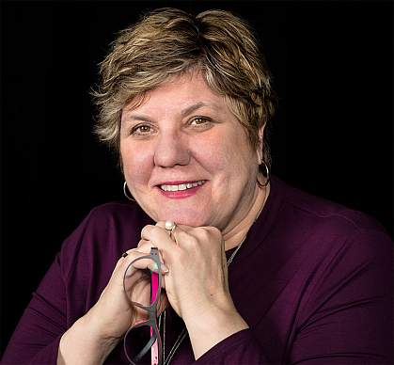
Answer to question 4
Who is the current Director of the National Library of Medicine?
Betsy Humphries
Donald Lindberg
Patricia Brennan
Francis Collins
photo of Dr. Patricia Brennan from NLM website
Notes:
Answer: Dr. Patricia Brennan is the first woman and first nurse to become the Director of the National Library of Medicine in 2016 succeeding Dr. Lindberg. Betsy Humphries was interim director after Dr. Lindberg retired and Dr. Collins recently retired as director of the National Institutes of Health.

Slide 50
Trivia Question 5
What year was the first volume of Index Medicus published?
1836
1866
1879
1922

Slide 51
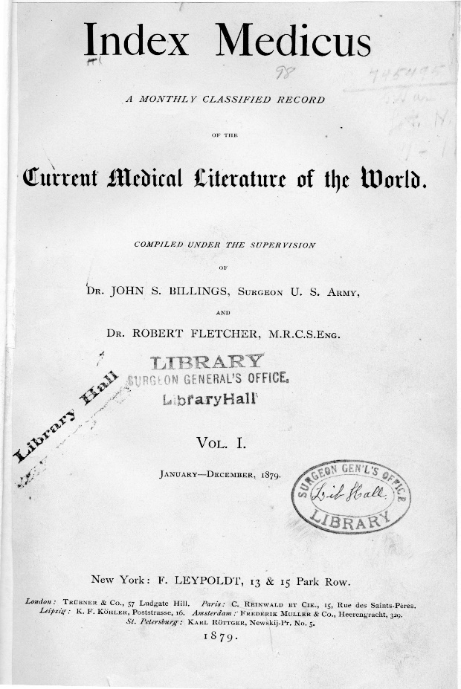
Answer to question 5
What year was the first volume of Index Medicus published?
1836
1866
1879
1922
image of Index Medicus from NLM Digital Collections
Notes:
Answer: The first volume of Index Medicus was published in 1879 and was the first attempt to identify and code the medical literature
Chat box link: The great contribution: Index Medicus, Index-Catalogue, and IndexCat https://www.ncbi.nlm.nih.gov/pmc/articles/PMC2670211/

Slide 52
Trivia Question 6
Which of these was not an NLM Traveling Exhibit?
Pictures of Nursing
From DNA to Beer
The Once and Future Web
The Yellow Wallpaper
From Snake Oil to Penicillin

Slide 53
Answer to question 6
Which of these was not an NLM Traveling Exhibit?
Pictures of Nursing
From DNA to Beer
The Once and Future Web
The Yellow Wallpaper
From Snake Oil to Penicillin
Notes:
Answer: From Snake Oil to Penicillin was a popular NNLM class that focused on evaluating health information

Slide 54
Trivia Question 7
LactMed can be found at:
LactMed.nih.gov
TOXLINE
NCBI Bookshelf
TOXNET

Slide 55
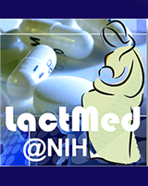
Answer to question 7
LactMed can be found at:
LactMed.nih.gov
TOXLINE
NCBI Bookshelf
TOXNET
Notes:
Answer: LactMed can be found on the NCBI Bookshelf. Previously it was part of the collection in TOXNET which was retired in late 2019.

Slide 56
Trivia Question 8
The first RML (Regional Medical Library) was established in 1967 at:
Yale University’s Medical Library
Harvard’s Francis A. Countway Library of Medicine
National Institutes of Health Library
Johns Hopkins Medicine Welch Medical Library

Slide 57
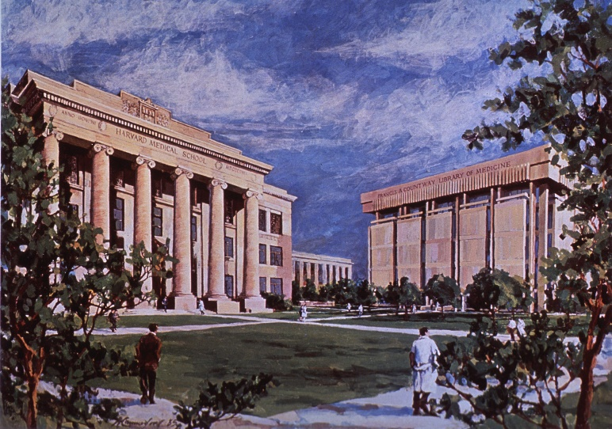
Answer to question 8
The first RML (Regional Medical Library) was established in 1967 at:
Yale University’s Medical Library
Harvard’s Francis A. Countway Library of Medicine
National Institutes of Health Library
Johns Hopkins Medicine Welch Medical Library
image of the Francis A. Countway Library of Medicine
Notes:
Answer: The New England Regional Medical Library Service, the first RML to be designated, was located at Harvard’s Francis A. Countway Library of Medicine

Slide 58
Trivia Question 9
What Region 5 resource provides you a weekly email with information about upcoming NNLM classes, news from NLM and NIH, and highlights resources?
News from NNLM
Weekly Digest
HLIB-L
RML Roundup

Slide 59
Answer to question 9
What Region 5 resource provides you a weekly email with information about upcoming NNLM classes, news from NLM and NIH, and highlights resources?
News from NNLM
Weekly Digest
HLIB-L
RML Roundup
Notes:
Answer: NNLM Region 5 Weekly Digest. This is sent out once a week through our Region 5 News listserv and so if you haven’t signed up, please do so you can be aware of our funding opportunities and news announcements from us and NLM. And don’t worry, we won’t overfill your email in-box.
Chat box link: Join the Region 5 News listserv http://mailman11.u.washington.edu/mailman/listinfo/nnlm-region5

Slide 60
Trivia Question 10
A new refreshed PubMed Central was launched in the year:
2000
2008
2016
2022

Slide 61
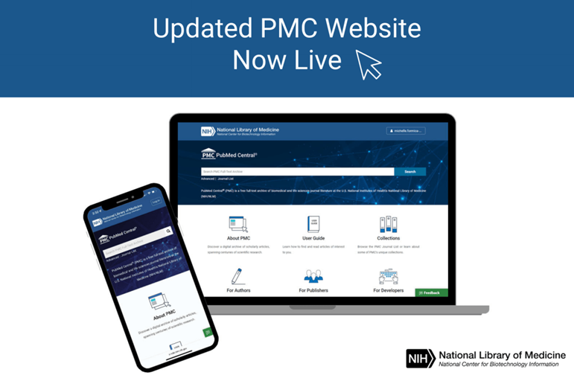
Answer to question 10
A new refreshed PubMed Central was launched in the year:
2000
2008
2016
2022
Notes:
Answer: You may have seen this in the NLM Technical Bulletin or attended the recent NLM Office Hours. Just last month a refreshed PubMed Central was made available.

Slide 62
Thank You!
Questions or followup:
Please email us at nnlm@uw.edu
Join the NNLM Region 5 News Listserv: http://mailman11.u.washington.edu/mailman/listinfo/nnlm-region5
Notes:
Daina:

