Slide 1
NLM Update
Sheldon Kotzin
Associate Director for Library Operations, NLM
kotzin@nlm.nih.gov
May 25, 2010
Notes:
NLM Update
Sheldon Kotzin
Associate Director for Library Operations, NLM
kotzin@nlm.nih.gov
May 25, 2010

Slide 2
Medical Librarians on NLM Advisory Committees
Board of Regents
Eileen Stanley
Ginny Tanji
Holly Buchanan, Consultant
Board of Scientific Counselors, Lister Hill Center
Joan Ash
Notes:
Medical Librarians on NLM Advisory Committees
Board of Regents
Eileen Stanley
Ginny Tanji
Holly Buchanan, Consultant
Board of Scientific Counselors, Lister Hill Center
Joan Ash

Slide 3
Medical Librarians on NLM Advisory Committees
PMC National Advisory Committee
Cynthia Henderson
Literature Selection Technical Review Committee (LSTRC)
Cathy Norton
Linda Walton
Lucretia McClure, Consultant
Notes:
Medical Librarians on NLM Advisory Committees
PMC National Advisory Committee
Cynthia Henderson
Literature Selection Technical Review Committee (LSTRC)
Cathy Norton
Linda Walton
Lucretia McClure, Consultant

Slide 4
Medical Librarians on NLM Advisory Committees
Biomedical Library Review Committee
Judy Consales
Beverly Murphy
Michele Tennant
Deborah Ward
Notes:
Medical Librarians on NLM Advisory Committees
Biomedical Library Review Committee
Judy Consales
Beverly Murphy
Michele Tennant
Deborah Ward

Slide 5
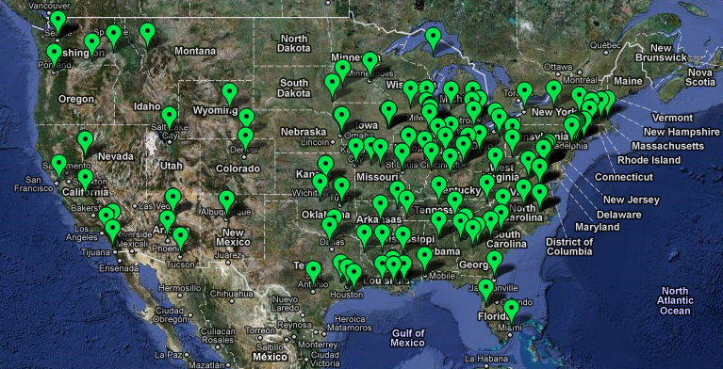
Traveling Exhibits
Notes:
Traveling Exhibits
[IMAGE: Map of the Unites States with locations of the Traveling Exhibition (dated 3_18_2010)]

Slide 6
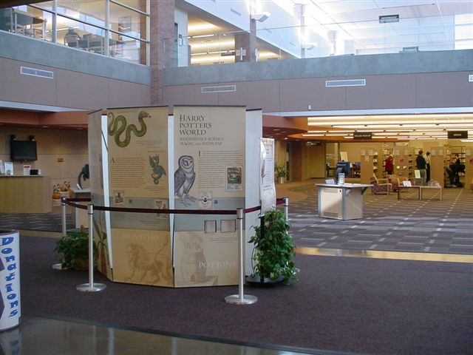
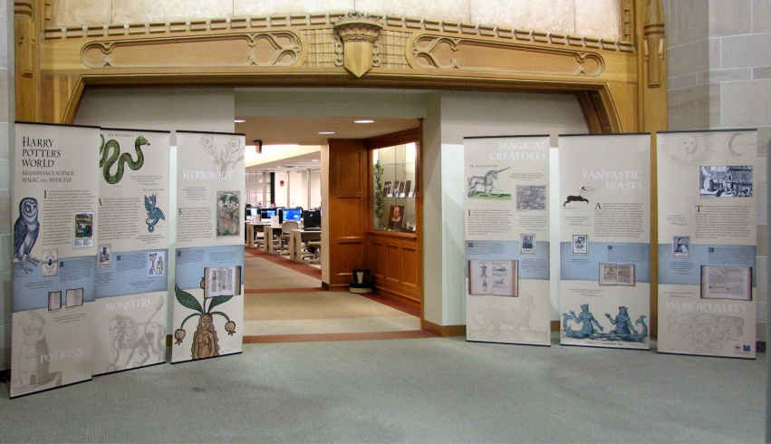
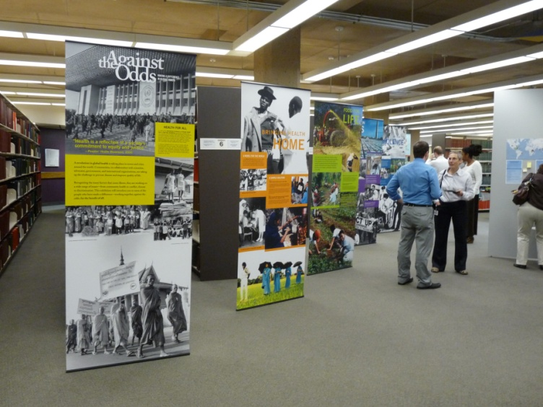
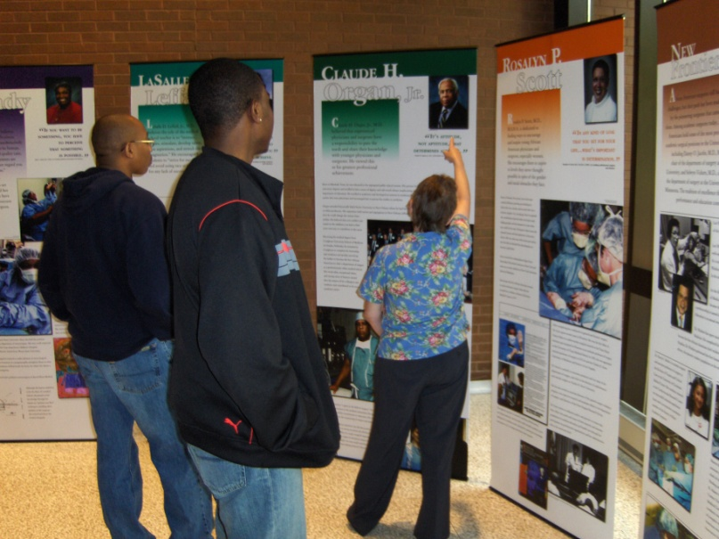
Traveling Exhibits
Notes:
Traveling Exhibits
[IMAGES: A group of four photos of traveling exhibits at various locations]

Slide 7
Traveling Exhibits
Frankenstein
Opening Doors
African American Surgeons
Against the Odds
Harry Potter’s World
Charlotte Perkins Gilman
African Americans in Civil War Medicine
Notes:
Traveling Exhibits
Frankenstein
Opening Doors
African American Surgeons
Against the Odds
Harry Potter’s World
Charlotte Perkins Gilman
African Americans in Civil War Medicine

Slide 8
National Network of Libraries of Medicine (NN/LM) – Map of 8 Regions
Notes:
National Network of Libraries of Medicine (NN/LM) – Map of 8 Regions
[IMAGE: United States map with the 8 regions of the National Network of Libraries of Medicine (NN/LM)]

Slide 9
New Areas in RML Statement of Work
Cross – Regional Initiatives
CTSAs
E-Science
Evidence-Based Health Information
Notes:
New Areas in RML Statement of Work
Cross – Regional Initiatives
CTSAs
E-Science
Evidence-Based Health Information

Slide 10
New Areas in RML Statement of Work
Programs with DHHS Regional Extension Centers
National Emergency Preparedness & Response Plan
Preservation of Print Materials
Outreach to Native Hawaiians & Alaska Natives
Notes:
New Areas in RML Statement of Work
Programs with DHHS Regional Extension Centers
National Emergency Preparedness & Response Plan
Preservation of Print Materials
Outreach to Native Hawaiians & Alaska Natives

Slide 11
Connecting MedlinePlus to EMR & PHRs
Growing Use of Electronic Medical Record Systems & Personal Health Records
Desire to Connect Patients to MedlinePlus Health Information
Leads to Increased Health Literacy & Improved Health Care
Notes:
Connecting MedlinePlus to EMR & PHRs
Growing Use of Electronic Medical Record Systems & Personal Health Records
Desire to Connect Patients to MedlinePlus Health Information
Leads to Increased Health Literacy & Improved Health Care

Slide 12
Connecting MedlinePlus to EMR & PHRs
Health Info Systems use ICD-9-CM or SNOMED-CT Codes to Connect to Health Topic pages
MedlinePlus Supports HL7 Info Button & other technologies
Dec 2009 – used by Institute for Family Health
March 2010 – used by Columbia University Medical Center
Notes:
Connecting MedlinePlus to EMR & PHRs
Health Info Systems use ICD-9-CM or SNOMED-CT Codes to Connect to Health Topic pages
MedlinePlus Supports HL7 Info Button & other technologies
Dec 2009 – used by Institute for Family Health
March 2010 – used by Columbia University Medical Center

Slide 13
Examining Go Local
Since July, NLM staff committed hundreds of hours to work with Go Local site staff to address these goals:
Fill a need & increase use
Reduce labor burden for participants
Have a sustainable site with strong buy-in from partner institutions
Notes:
Examining Go Local
Since July, NLM staff committed hundreds of hours to work with Go Local site staff to address these goals:
Fill a need & increase use
Reduce labor burden for participants
Have a sustainable site with strong buy-in from partner institutions

Slide 14
Brainstorming
Health topic “Centers” to focus on specific issues, but mostly reproduces MedlinePlus
Facilitate cross-border searching, but would require labor to address inconsistencies among sites and results no better than Google, Yahoo, etc.
New emphasis on free or low-cost services, but requires labor and these services can be found using major search engines
Social tools such as reviews, but is not practical for government site and already done elsewhere
Notes:
Brainstorming
Health topic “Centers” to focus on specific issues, but mostly reproduces MedlinePlus
Facilitate cross-border searching, but would require labor to address inconsistencies among sites and results no better than Google, Yahoo, etc.
New emphasis on free or low-cost services, but requires labor and these services can be found using major search engines
Social tools such as reviews, but is not practical for government site and already done elsewhere
[IMAGE: Screenshot of Go Local Web pages and a search screen]

Slide 15
Population Served Increased, Page Views Dropped
Population covered: 127,604,553
Notes:
[CHART SUMMARY: the population served in Q4-2005 was 6%, and increased to 42% in Q1-2010. However the number of page views only increased from 64,094 in Q4-2005 to 190,000 in Q1-2010; so the ratio of page views to population covered dropped significantly. In addition, the number of page views peaked in the third quarter of FY08 and dropped in quarter until the program was ceased.]
[NOTE: Q4-2005 shows 6% of the population was covered (17,536,659 people), and 64,094 total Page Views]
[NOTE: Q1-2010 shows 42% of the population was covered (127,604,553 people), and a total of 190,000 total Page Views]

Slide 16
Discontinue Go Local because:
Use is low and shrinking – very poor return on your time
Maintaining Go Local is highly labor intensive and unsustainable
Good idea in 2001, functionality now equaled by today’s basic Internet resources, and surpassed by others
Notes:
Discontinue Go Local because:
Use is low and shrinking – very poor return on your time
Maintaining Go Local is highly labor intensive and unsustainable
Good idea in 2001, functionality now equaled by today’s basic Internet resources, and surpassed by others

Slide 17
Resumption of NCBI In-Person Training
Two - Day Workshops
Four Modules
Four Courses / Year
Notes:
Resumption of NCBI In-Person Training
Two - Day Workshops
Four Modules
Four Courses / Year

Slide 18
Resumption of NCBI In-Person Training
Sequences, Genomes, & Maps
Proteins, Domains, & Structures
Using NCBI BLAST Services
Human Variation & Disease Genes
Notes:
Resumption of NCBI In-Person Training
Sequences, Genomes, & Maps
Proteins, Domains, & Structures
Using NCBI BLAST Services
Human Variation & Disease Genes

Slide 19
EAI Title Status
Participating Titles
220 journals
69 monographs
Outstanding Titles
101 journals from 62 publishers
Titles ranked by priority by editorial committee
AAP will assist with contacting remaining publishers in priority order
Notes:
EAI Title Status
Participating Titles
220 journals
69 monographs
Outstanding Titles
101 journals from 62 publishers
Titles ranked by priority by editorial committee
AAP will assist with contacting remaining publishers in priority order

Slide 20
Participating Publishers
American Academy of Pediatrics
American Association for the Advancement of Science
American College of Physicians
American Society of Health-Systems Pharmacists
ASM Press
B.C. Decker
BMJ
Elsevier
F.A. Davis
Mary Ann Liebert
Massachusetts Medical Society
McGraw-Hill
Merck Publishing
Oxford University Press
People’s Medical Publishing House
Springer
University of Chicago Press
Wiley
Wolters Kluwer
Notes:
Participating Publishers
American Academy of Pediatrics
American Association for the Advancement of Science
American College of Physicians
American Society of Health-Systems Pharmacists
ASM Press
B.C. Decker
BMJ
Elsevier
F.A. Davis
Mary Ann Liebert
Massachusetts Medical Society
McGraw-Hill
Merck Publishing
Oxford University Press
People’s Medical Publishing House
Springer
University of Chicago Press
Wiley
Wolters Kluwer

Slide 21
Top Journals from LinkOut
Journal of Trauma (48)
Cochrane database of systematic reviews (43)
Lancet (38)
New England Journal of Medicine (27)
Critical care medicine (20)
BMJ (16)
Journal of clinical gastroenterology (16)
Annals of surgery (15)
Notes:
Top Journals from LinkOut
Journal of Trauma (48)
Cochrane database of systematic reviews (43)
Lancet (38)
New England Journal of Medicine (27)
Critical care medicine (20)
BMJ (16)
Journal of clinical gastroenterology (16)
Annals of surgery (15)

Slide 22
Top Books from StatRef
Human Virology (188)
Red Book®: 2009 Report of the Committee on Infectious Diseases (154)
AHFS Drug Information® (106)
Emergency Medicine: A Comprehensive Study Guide (77)
Current Medical Diagnosis & Treatment (61)
Notes:
Top Books from StatRef
Human Virology (188)
Red Book®: 2009 Report of the Committee on Infectious Diseases (154)
AHFS Drug Information® (106)
Emergency Medicine: A Comprehensive Study Guide (77)
Current Medical Diagnosis & Treatment (61)

Slide 23
Remaining Tasks
Contact publishers of remaining titles
Establish regular review of titles
Verify access
Check for title changes, publisher changes
Establish regular testing of communications
Verify contacts
Notes:
Remaining Tasks
Contact publishers of remaining titles
Establish regular review of titles
Verify access
Check for title changes, publisher changes
Establish regular testing of communications
Verify contacts

Slide 24
Medical Heritage Library
Funder: Sloan Foundation
Proposer: Open Knowledge Commons
Total Funding: $1.5 M
NLM’s Funding: $365,000 over 2 yrs.
Level of Effort: 30,000 volumes
Notes:
Medical Heritage Library
Funder: Sloan Foundation
Proposer: Open Knowledge Commons
Total Funding: $1.5 M
NLM’s Funding: $365,000 over 2 yrs.
Level of Effort: 30,000 volumes

Slide 25
Medical Heritage Library
Participants:
NLM
Countway
Cushing / Whitney at Yale
Long Health Sciences at Columbia
NYPL
Notes:
Medical Heritage Library
Participants:
NLM
Countway
Cushing / Whitney at Yale
Long Health Sciences at Columbia
NYPL

Slide 26
Medical Heritage Library
NLM’s Contribution:
5,700 Monographs
Americana 1720-1865
Usable Surrogates of Rare, Unique Items
Notes:
Medical Heritage Library
NLM’s Contribution:
5,700 Monographs
Americana 1720-1865
Usable Surrogates of Rare, Unique Items

Slide 27
Medical Heritage Project
Expanded Public Access
Project Team Approach
HMD – Content
Preservation – Scanning
Tech Services – Repository
Notes:
Medical Heritage Project
Expanded Public Access
Project Team Approach
HMD – Content
Preservation – Scanning
Tech Services – Repository

Slide 28
Some Important 2010 Initiatives
Complete Serials Inventory
Redesign MedlinePlus & MedlinePlus en Español
Improve Mobile MedlinePlus User Experience
Notes:
Some Important 2010 Initiatives
Complete Serials Inventory
Redesign MedlinePlus & MedlinePlus en Español
Improve Mobile MedlinePlus User Experience

Slide 29
Some Important 2010 Initiatives
Optimize Use of E-Journals for ILL
Acquire E-Only Monographs
Determine Future Web Archiving Activities
Notes:
Some Important 2010 Initiatives
Optimize Use of E-Journals for ILL
Acquire E-Only Monographs
Determine Future Web Archiving Activities

Slide 30
Some Important 2010 Initiatives
Work with LC to Increase Publishers Providing ONIX Data
Add Historical Images to FLICKR
New Grants to Reduce Health Disparities
Notes:
Some Important 2010 Initiatives
Work with LC to Increase Publishers Providing ONIX Data
Add Historical Images to FLICKR
New Grants to Reduce Health Disparities

Slide 31
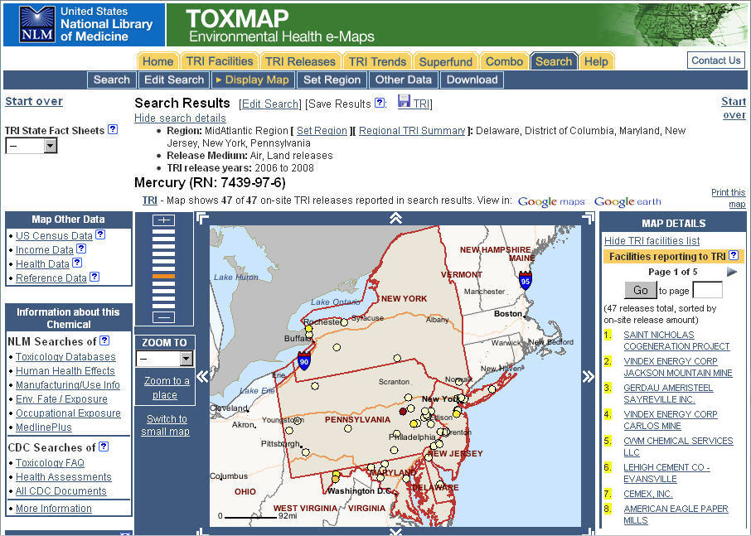
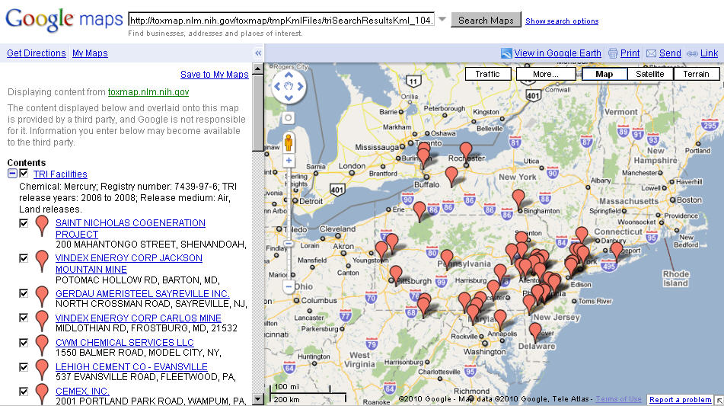
TOXMAP http://toxmap.nlm.nih.gov
Notes:
TOXMAP http://toxmap.nlm.nih.gov
[IMAGE: Grouped screenshots of search results on a TOXMAP Web page and of TOXMAP search results displayed in Google Maps]

Slide 32
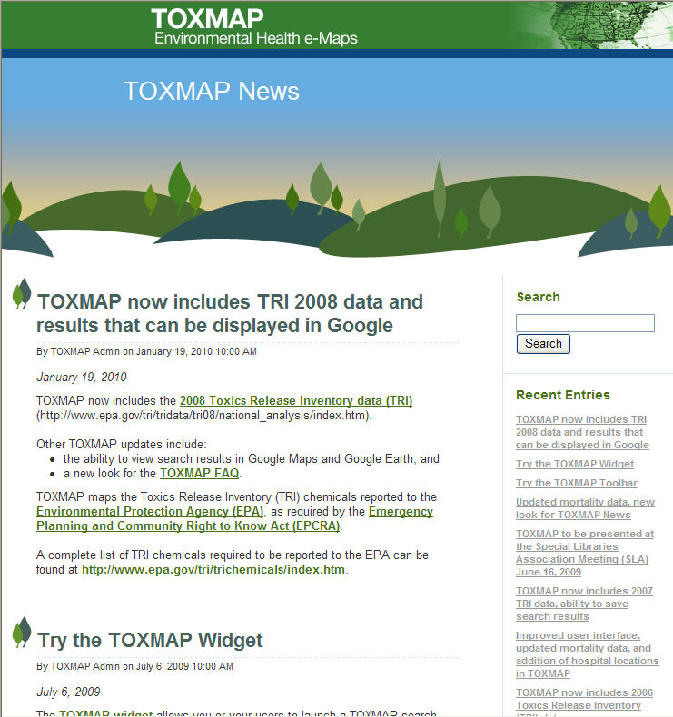
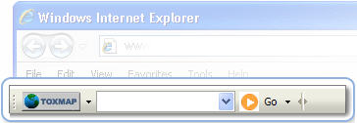
Improved FAQ and News
Toolbar
Widget
Notes:
Improved FAQ and News
[IMAGE: TOXMAP Toolbar and the new Widget are shown next to a screenshot of a TOXMAP Web page]

Slide 33
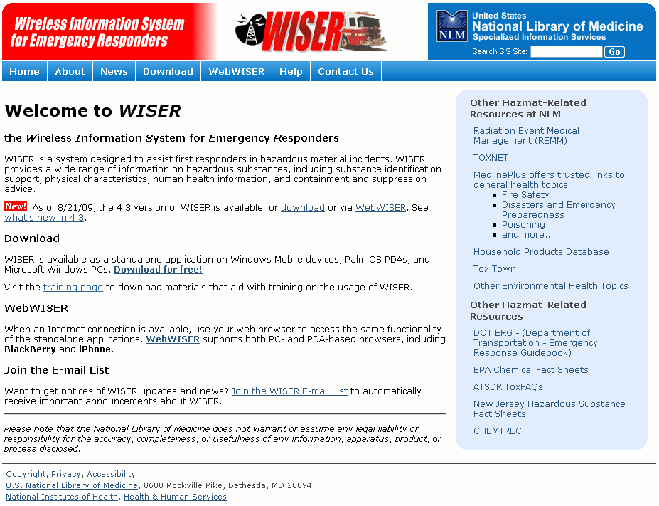
Wireless Information System for Emergency Responders (WISER)
Download the latest version of WISER for your platform
WISER for Windows
WISER for Mobile
Pocket PC
SmartPhone
WISER for Palm OS
Download training materials
Join the WISER email list
Access WebWISER http://webwiser.nlm.nih.gov
http://wiser.nlm.nih.gov
Notes:
Wireless Information System for Emergency Responders (WISER)
Download the latest version of WISER for your platform
WISER for Windows
WISER for Mobile
Pocket PC
SmartPhone
WISER for Palm OS
Download training materials
Join the WISER email list
Access WebWISER http://webwiser.nlm.nih.gov
[IMAGE: Screenshot of the WISER Web page at http://wiser.nlm.nih.gov/]

Slide 34
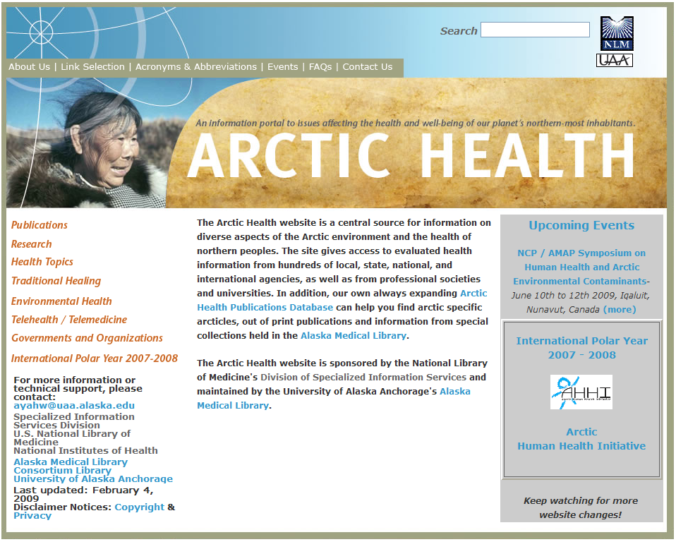
Updates and Expansion of Special Population Websites
Notes:
Updates and Expansion of Special Population Websites
[IMAGE: Screenshot of the Arctic Health Web page]
[IMAGE: Screenshot of the American Indian Health Web page]

Slide 35
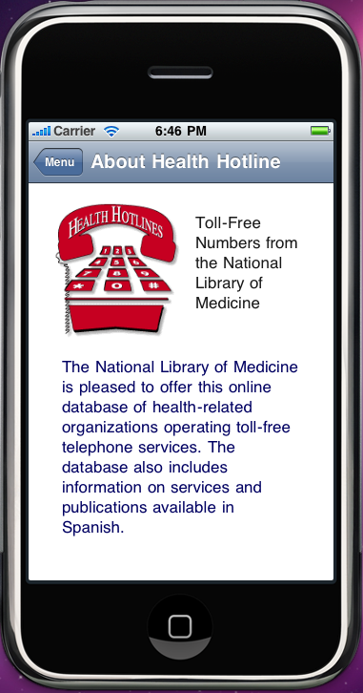
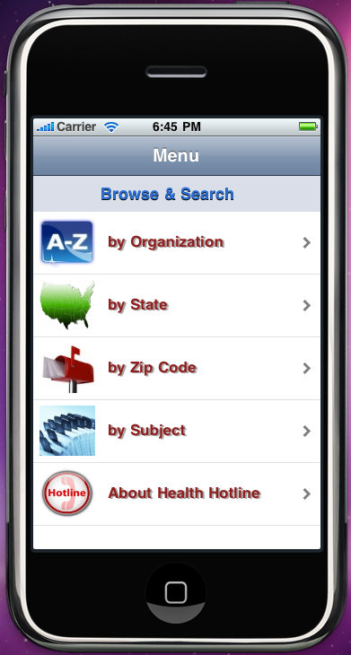
New Health Hotlines App
Notes:
New Health Hotlines App
[IMAGE: Screenshots of iPhone displays: one with the About Health Hotline page, and the other with Browse & Search Menu]

Slide 36
PubMed
Major effort was the PubMed Redesign, launched in the fall of 2009.
3 Preview Webcasts held in the summer.
4 Demonstration Webcasts provided during the introductory period.
Updates to the PubMed tutorial and training workbooks.
Notes:
PubMed
Major effort was the PubMed Redesign, launched in the fall of 2009.
3 Preview Webcasts held in the summer.
4 Demonstration Webcasts provided during the introductory period.
Updates to the PubMed tutorial and training workbooks.

Slide 37
PubMed – Upcoming in late 2010
Introduction of a researcher/author disambiguation identifier.
Focusing initially on grantees and their publications – it’s what we know about.
Expanding to other MyNCBI users.
My NCBI Redesign
Notes:
PubMed – Upcoming in late 2010
Introduction of a researcher/author disambiguation identifier.
Focusing initially on grantees and their publications – it’s what we know about.
Expanding to other MyNCBI users.
My NCBI Redesign

Slide 38
PMC Use – Typical Work Day
 | March 2008 | March 2010
Unique Users | 310,000 | 420,000
Articles Retrieved | 500,000 | 740,000
Articles Available | 1.3 Million | 1.95 Million
Notes:
PMC Use – Typical Work Day
Table Summary: Displays the increased numbers from March 2008 to March 2010.
Column Headers: March 2008, March 2010
Unique Users increased from 310,000 to 420,000
Articles Retrieved increased from 500,000 to 740,000
Articles Available increased from 1.3 Million to 1.95 Million

Slide 39
NLM and Social Media
Directory of social media features from NLM http://www.nlm.nih.gov/socialmedia
Links to NLM entries for:
Twitter
Facebook
RSS, Podcasts, Webcasts
Email lists
Notes:
NLM and Social Media
Directory of social media features from NLM http://www.nlm.nih.gov/socialmedia
Links to NLM entries for:
Twitter
Facebook
RSS, Podcasts, Webcasts
Email lists

Slide 40
2009-2010 NLM/AAHSL Leadership Fellows Program
Heidi M. Nickisch Duggan
Northwestern University
Mentor:
Dorothy A Spencer,
East Carolina University
Irma Quiñones
University of Puerto Rico
Mentor:
Judith S Cohn,
University of Medicine & Dentistry of New Jersey
Notes:
2009-2010 NLM/AAHSL Leadership Fellows Program
Heidi M. Nickisch Duggan
Northwestern University
Mentor:
Dorothy A Spencer,
East Carolina University
Irma Quiñones
University of Puerto Rico
Mentor:
Judith S Cohn,
University of Medicine & Dentistry of New Jersey

Slide 41
2009-2010 NLM/AAHSL Leadership Fellows Program
Fellow | University | Mentor | Affiliation
Bart Ragon | University of Virginia | Elaine Russo Martin | University of CA, Davis
Debra C. Rand | Long Island Jewish Medical Center | Laurie L. Thompson | University of Texas
Keir Reavie | University of CA, Davis | Eric D. Albright | Tufts University
Notes:
2009-2010 NLM/AAHSL Leadership Fellows Program

Slide 42
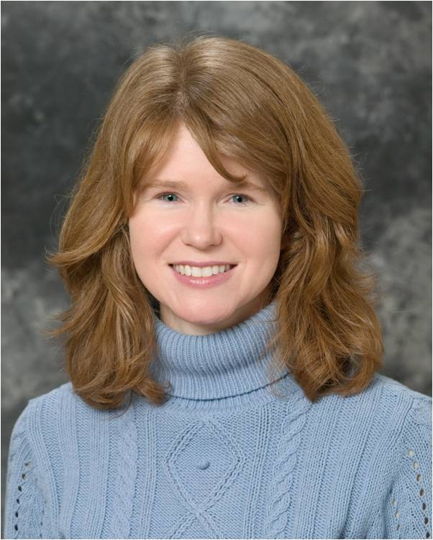
2010 FNLM Michael E. DeBakey Library Services Outreach Award
Rita Smith, MLS
Notes:
2010 FNLM Michael E. DeBakey Library Services Outreach Award
Rita Smith, MLS
[IMAGE: Rita Smith - 2010 Recipient of the Mechael E. DeBakey Library Services Outreach Award]

Slide 43
2008-2009 Associates
Notes:
2008-2009 Associates
[IMAGE: Group photo of the 2008-2009 Associates]

Slide 44
2009-2010 Associates
Notes:
2009-2010 Associates
[IMAGE: Group photo of the 2009-20010 Associates]

Slide 45
Students, Interns, etc. 2009-2010
ARL Career Enhancement Program
Year | Intern | University
2009 | Monica Shin | Simmons
 | Yani Yancy | University of Maryland
2010 | Aime Babcock-Ellis | University of Maryland
 | Harrison Inefuku | University British Columbia
 | Kim Okahara | University of Hawaii
Notes:
Students, Interns, etc. 2009-2010
ARL Career Enhancement Program
[TABLE SUMMARY: ARL Career Enhancement Program's participants in 2009 and 2010. The table has three column headers to list each year, names of interns, and their university]
ARL Career Enhancement Program

Slide 46
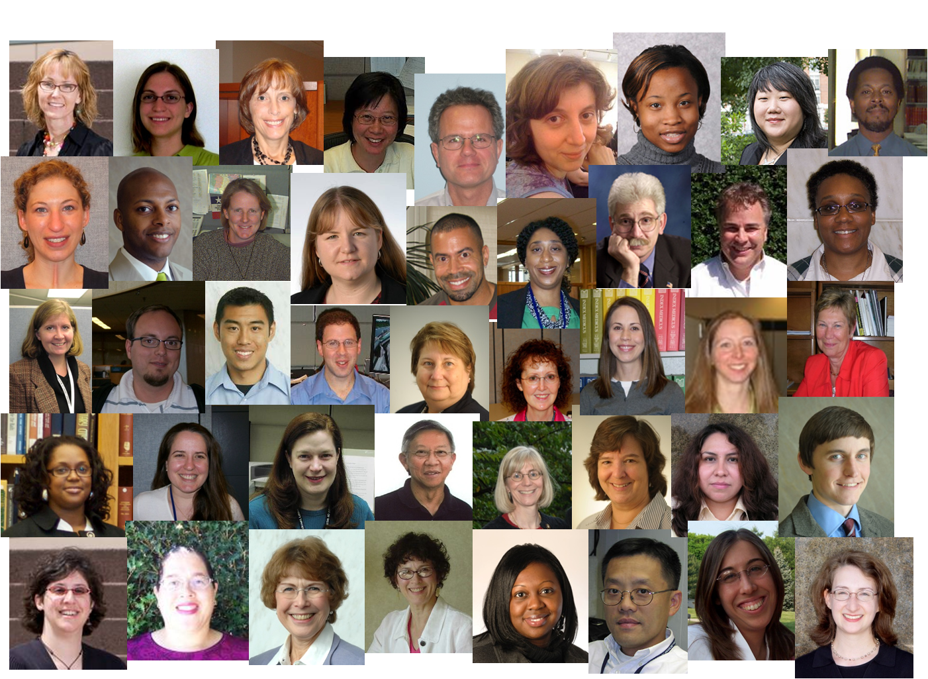
NLM Employees and Succession Planning
Notes:
NLM Employees and Succession Planning
[IMAGE: Collage of over 40 photos of individual NLM employees]

Slide 47
Thank You!
Notes:
NLM Employees and Succession Planning

