Slide 1
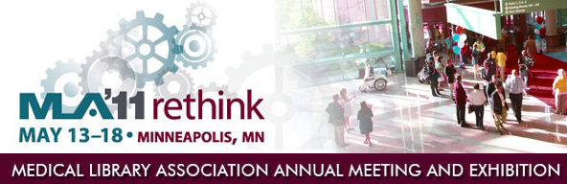
NLM Update, Part 2
Betsy L. Humphreys, MLS, FMLA
Deputy Director, NLM
blh@nlm.nih.gov

Slide 2
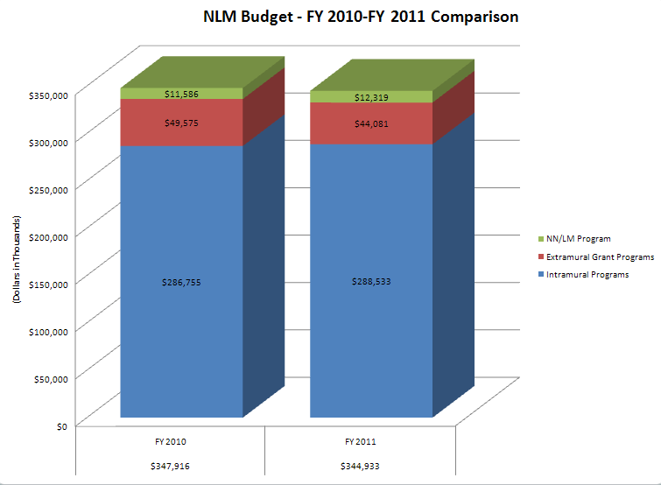
NLM Budget FY-2010 – FY 2011 Comparison
Notes:
The budget for FY 2010 is $347,916,000 and is broken down as:
NN/LM Program = $11,586,000
Extramural Grant Programs = $49,575,000
Intramural Programs = $286,755,000
The Budget for FY2011 is $344,933,000 and is broken down as:
NN/LM Program = $12,319,000
Extramural Grant Programs = $44,081,000
Intramural Programs = $288,533,000

Slide 3
Grants @ NLM
Timeline
  1965 – Medical Library Assistance Act - First awards for research and training in history of medicine
  1972 – First informatics training for MDs
  1982 – First IAIMS planning grants
  1995 – Internet connections grants (from NSF to NLM)
Investments – 1965 through 2010
  Research - $546,244 million
  Training - $224,586 million
  Scholarly works & Resources - $196,468 million

Slide 4
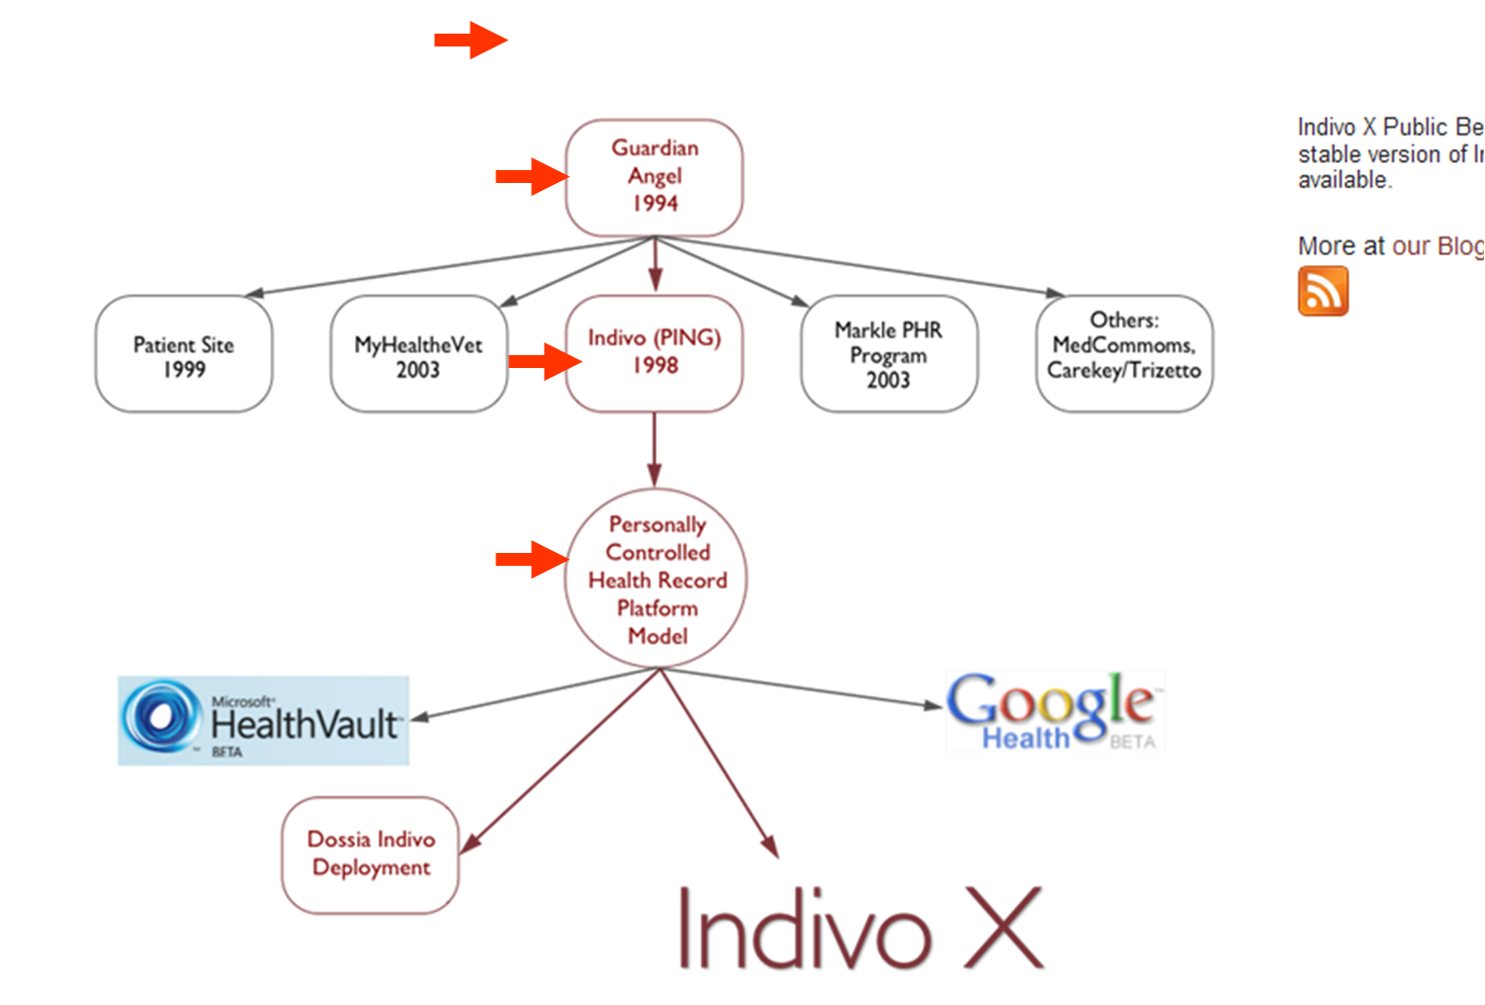
Case Study: Personally Controlled Health Records supported by NLM grants
Notes:
Case Study of Personally Controlled Health Records supported by NLM Grants:
Guardian Health 1994
- Patient Site 1999
My HealtheVet 2003
Indivo (PING) 1998
Markle PHR Program 2003
Others: MedCommoms, Carekey/Trizetto
Personally Controlled Health Record Platform Model
Microsoft Health Vault Beta
Google Health Beta
Dossia Indivo Deployment
Indivo X

Slide 5
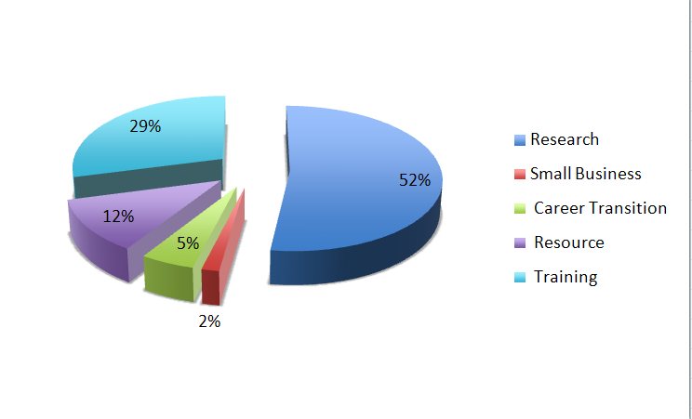
FY 2010 NLM Grants: $49.9 Million
TODAY: 3pm session: Minneapolis Convention Center, Room 101B, Level One
Valerie Florance,Ph.D: Roles for Librarians in the Changing Landscape
of Federal Grants.
Notes:
FY 2010 NLM Grants: $49.9 Million
- Research = 52%
- Small Business = 2%
Career Transition = 5%
- Resource = 12%
Training = 29%
Notes: Today: 3PM session Minneapolis Convention Center, Room 101B, Level One
Valerie Florance, Ph.D: Roles for Librarians in the Changing Landscape of Federal Grants

Slide 6
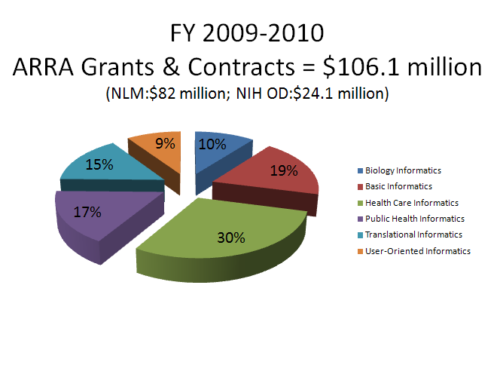
FY 2009-2010 ARRA Grants and Contracts = $106.1 million
Some NLM ARRA Challenge Topics: Information Prescriptions, Clinical
Question Answering, Advanced Decision Support, Genomic Information
in EHRs, Modeling Health Effects of Climate Change
Notes:
FY 2009-2010
ARRA Grants and Contracts = $106.1 million
(NLM: $82 million; NIH OD: $24.1 million)
The chart is divided as:
Biology informatics=10%
Basic informatics = 19%
Health Care informatics = 30%
Public Health informatics = 17%
Transitional informatics = 15%
User-Oriented informatics = 9%
Some NLM ARRA Challenge Topics: Information Prescriptions, Clinical Question Answering, Advanced Decision Support, Genomic Information in EHRs, Modeling Health Effects of Climate Change

Slide 7
ARRA R&D Contracts from NLM:
$11.9 million
Computational Thinking
  13 awards for systems that use computer intelligence to solve biomedical problems
Imaging, Multimedia R & D
  18 awards - revise Insight Image Segmentation and Registration Toolkit (ITK)
    Open Source, current version heavily used
  C3PI Computational Photography for Pill Identification
  Remote Virtual Dialog Software for use on the Internet

Slide 8
2011 is the 25th Anniversary –
Unified Medical Language System (UMLS)
Initial Research Contracts funded in 1986
The objective . . .is to solve what is the most fundamental
barrier to the application of computers in medicine; namely,
the lack of a standard language. . . We will attempt to build
. .a language that will cross between the biomedical literature
and the observations on the patient, as well as the
educational applications in the school, a language which
allows those areas to be interrelated.
--Donald A. B. Lindberg, M.D., March 19, 1985
Hearings before House Committee on Appropriations,
99th Cong., 1st Session, Part 4B (857), 1985.

Slide 9
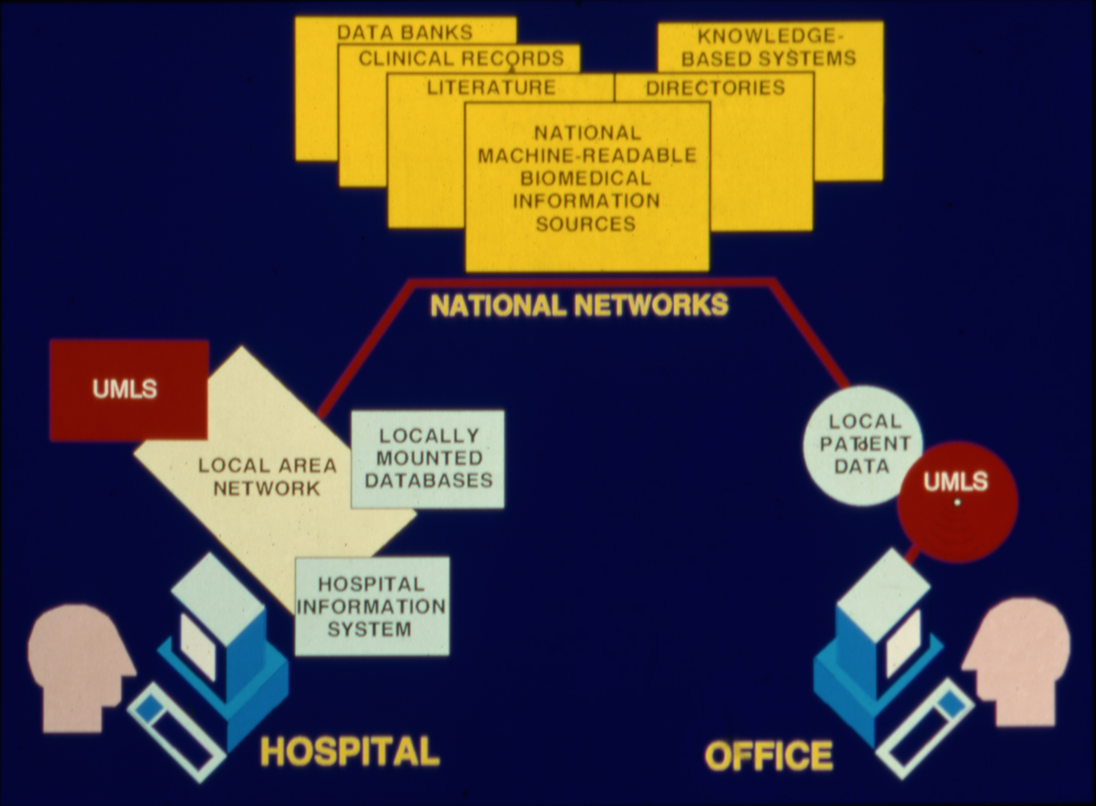
National Networks
1988
Notes:
1988: A user at a hospital would access the UMLS, Locally Mounted Databases, and the Hospital Information System via the Local Area Network.
The National Network included National Machine-Readable Biomedical Information Sources, Data Banks, Clinical Records, Literature, Directories, and Knowledge Based Systems.
A user at an office would would access the local patient data and the UMLS.

Slide 10
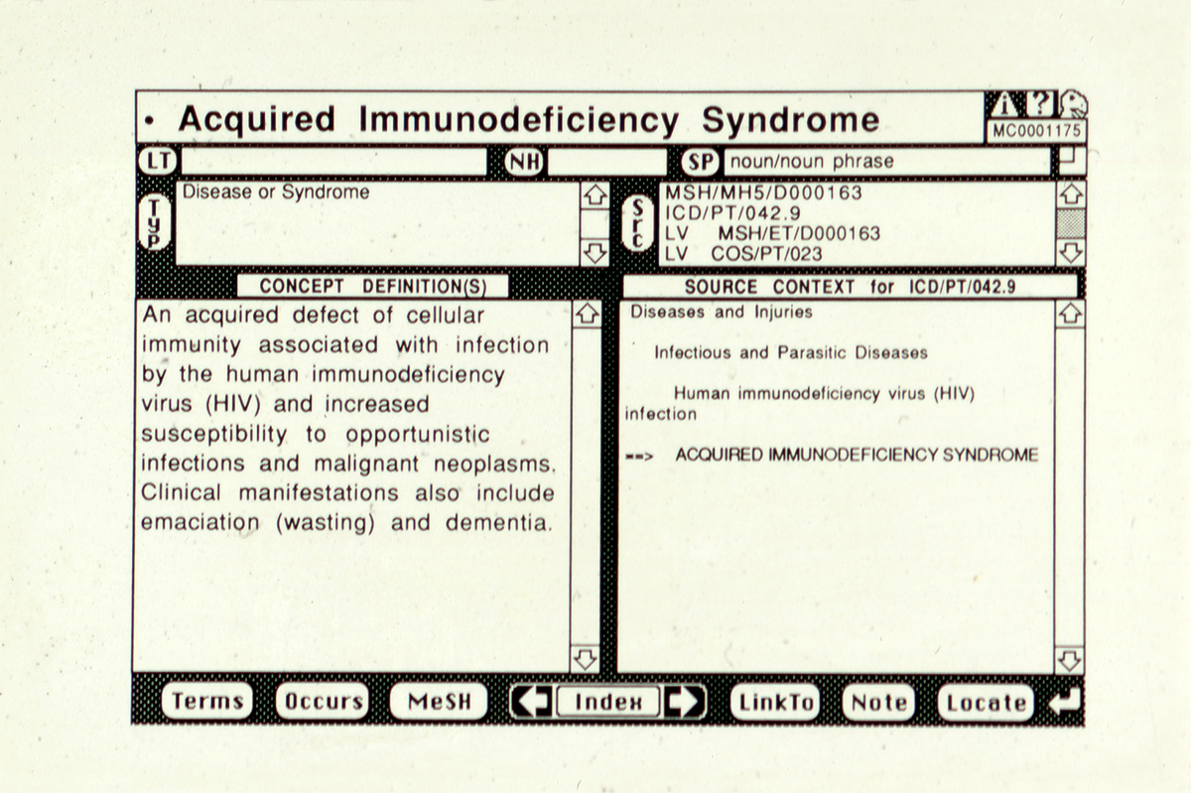
MeSH AIS
1990 – MetaCard – world’s largest Hypercard stack (Lexical Technology, Inc)

Slide 11
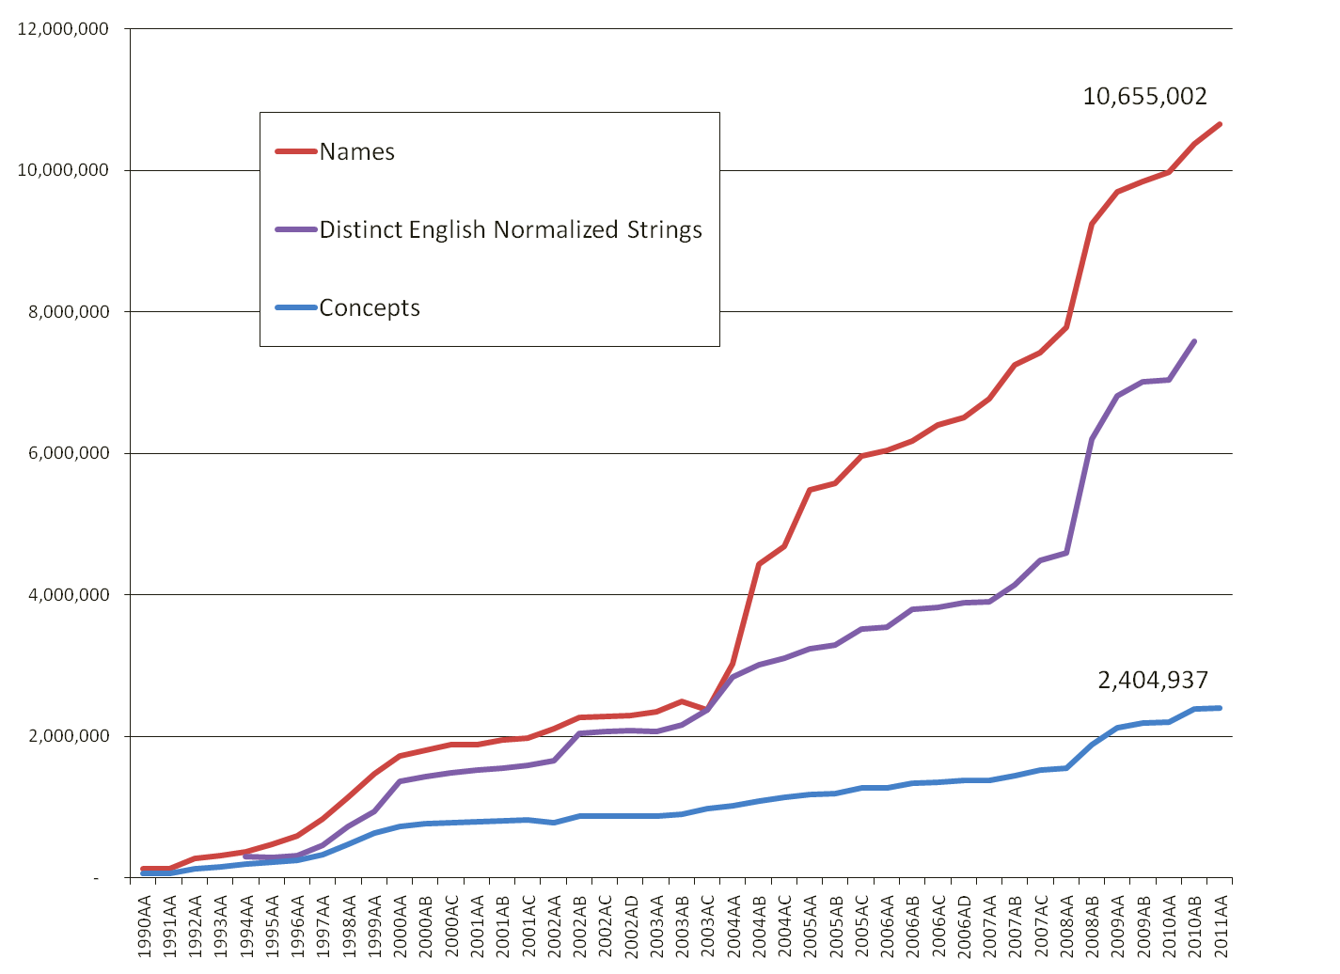
Growth of the UMLS Metathesaurus, 1990--
Notes:
The grown of the UMLS Metathesaurus from 1990 to 2011.
- Names grew from 0 to 10,655,002
Distinct English Normalized Strings grew from 0 to approximately 750,000
Concepts grew from 0 to 2,404,937

Slide 12
2011 UMLS Metathesaurus
2,404,937 concepts
160 source vocabulariesincluding “meaningful use” standards
21 different languages
7,954,432 terms (Eye, Eyes, eye = 1)
8,856,464 unique strings (Eye, Eyes, eye = 3)
10,655,002 atoms or source vocabulary strings
  eye [from MeSH, Eye [from SNOMED CT] = 2

Slide 13
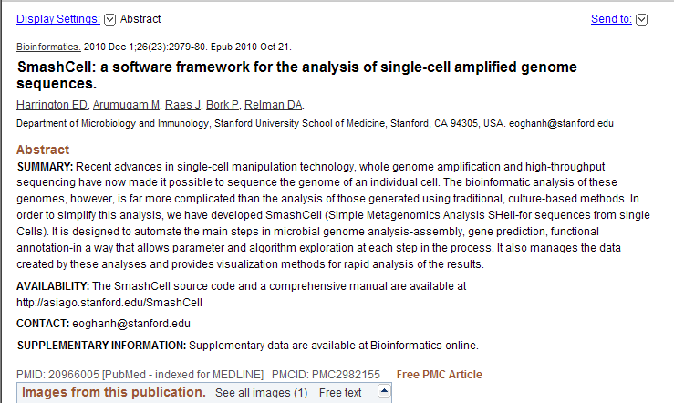
UMLS-enabled: 1st level indexing of selected journals by Medical Text Indexer (MTI) Program

Slide 14
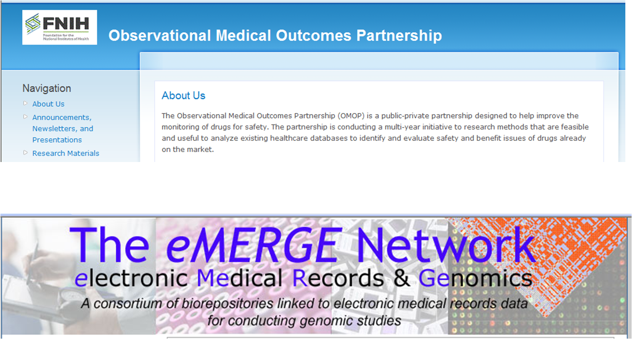
UMLS-enabled: Aggregating data from large EHR systems for clinical and translational research

Slide 15
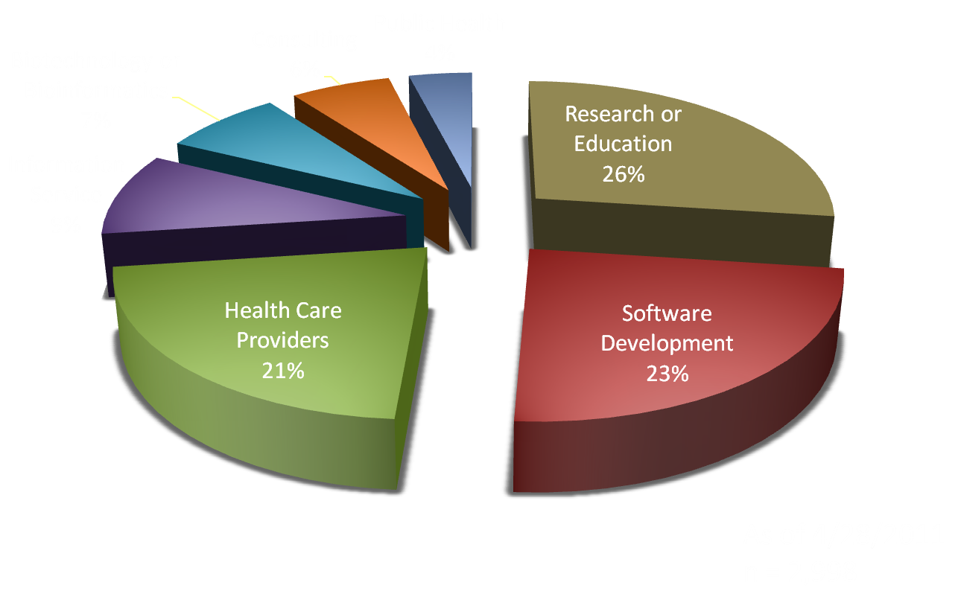
Primary Activity Of US UMLS Licensees
Notes:
Primary Activity Of US UMLS Licensees:
Research or Education = 26%
Software Development = 23%
Health Care Providers = 21%
Information Service = 9%
Biotechnology or Bioinformatics = 7%
Consulting = 6%
Public Health = 4%
As of 4/28/2011
n = 2,998

Slide 16
American Recovery & Revitalization Act (ARRA) (2/09)
Health IT for Economic & Clinical Health(HITECH) establishes/funds (among many other things)
Incentives for Medicare/Medicaid providers to implement and demonstrate “meaningful use” of “certified” electronic health records (EHRs)
  Incentives begin in 2011
  Non-use penalties begin in 2016/17

Slide 17
“Meaningful Use” Key Players
(i.e., all 3 issue relevant regulations, guidance)
Centers for Medicare and Medicaid Services (CMS)
Office of the National Coordinator for Health Information Technology (ONC)
National Institute of Standards and Technology(NIST)

Slide 18
“Meaningful Use” Requirements
Planned to escalate: 2011, 2013, 2015
Cover:
  Patient data capture & Orders for drugs, procedures, etc.
  Exchange of patient data between providers
  Provision of data & educational information to patients
  Reporting quality measures
  Privacy/security protections
Core (Mandatory) & Menu (Up to 5 may be deferred)
More Stringent Proposed Requirements for Phase 2 (2013) to be issued for comment this Fall

Slide 19
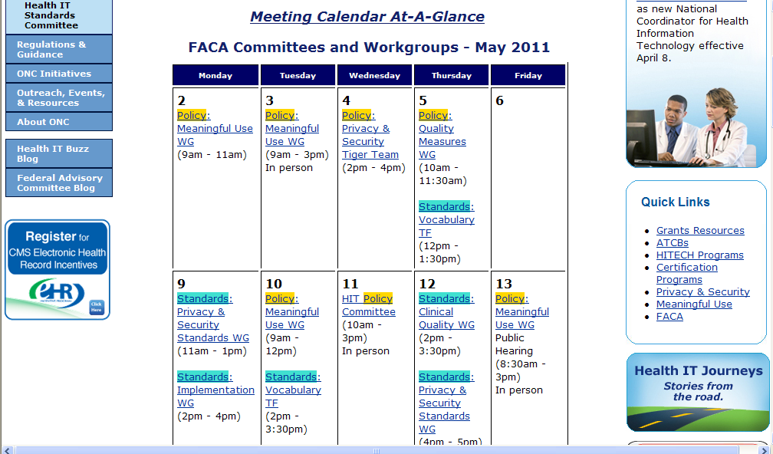
FACA Committees and Workgroups – May 2011

Slide 20
2011 Meaningful Use Menu Criterion (CMS Rule)
Objective: Use certified EHR technology to identify patient-specific education resources and provide these resources to the patient if appropriate.
Measure: More than 10% of all unique patients seen/admitted are provided patient-specific education resources.
2011 EHR certification criterion (ONC Rule)
Enable a user to electronically identify and provide patient
specific education resources to, at a minimum, the data
elements included in the patient’s problem list, medication list, and laboratory test results; as well as provide such resources to the patient.

Slide 21
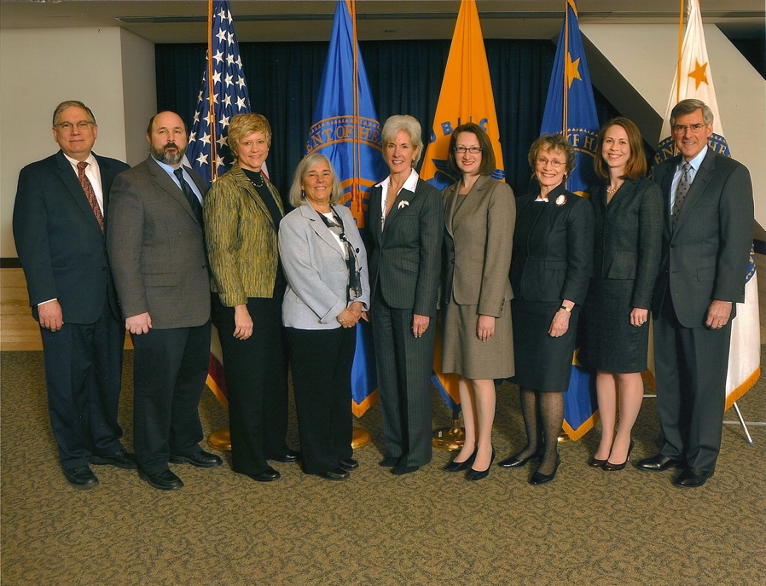
MedlinePlus Connect Receives HHSinnovates Award
MedlinePlus Connect receives HHSinnovates Award
from the Secretary of HHS, March 31, 2011
TODAY: 3pm session: Minneapolis Convention Center, Room 101B, Level One
Joyce Backus: MedlinePlus Connect: Opportunity for Librarians …..
Notes:
Since MedlinePlus Connect helps EHRs identify patient-specific education resources, MedlinePlus Connect can help healthcare organizations meet one of the criteria for Meaningful Use of Electronic Medical Records.
MedlinePlus Connect is already being recognized by the health IT community as an innovative way to link patients and health care providers to quality information.
Health and Human Services Secretary Kathleen Sebelius recently selected MedlinePlus Connect as one of her “Secretary’s Picks” in the latest round of the HHSinnovates competition.

Slide 22
2011 Meaningful Use Core Criterion (CMS Rule)
Objective: Maintain active medication list
Measure: More than 80% of all unique patients seen/admitted
have at least 1 entry (or indication that patient has no currently prescribed medication) recorded as structured data
2011 Vocabulary Standard (ONC Rule)
Medications. Standard. Any source vocabulary that is included in RxNorm, a standardized nomenclature for clinical drugs produced by the United States National Library of Medicine

Slide 23
“Meaningful Use” promotes interest in/use of:
NLM-supported vocabulary standards:
  LOINC – Lab test results
  RxNorm – Medications
  SNOMED CT – Problem list (1 of 2 options)
Related resources/tools – UMLS, subsets, mappings to statistical/billing codes, educational materials
Not only due to 2011 requirements, but more stringent requirements expected in 2013/2015

Slide 24
Convenience Subsets of Standard Terminologies
Available now:
  SNOMED CT – Frequently seen problems
  SNOMED CT -- Nursing problem list
  LOINC – Frequently ordered tests
  LOINC + SNOMED CT - Newborn Screening
Coming soon:
LOINC – Frequent test results
RxNorm – drugs able to be prescribed in US

Slide 25
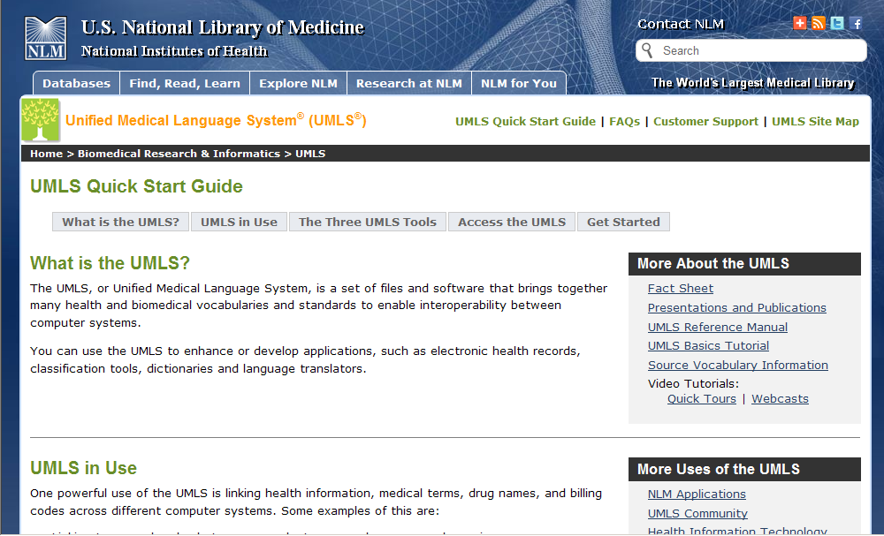
Revised and expanded UMLS pages

Slide 26
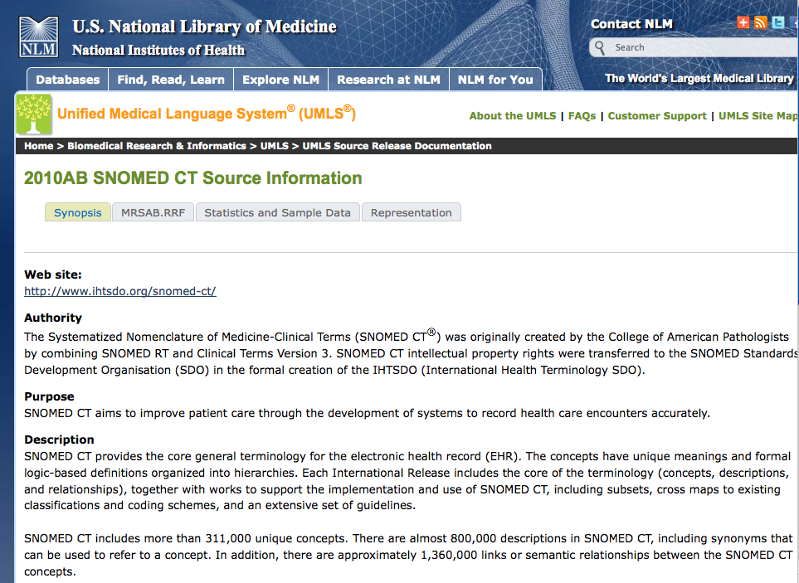
Revised and expanded UMLS pages

Slide 27
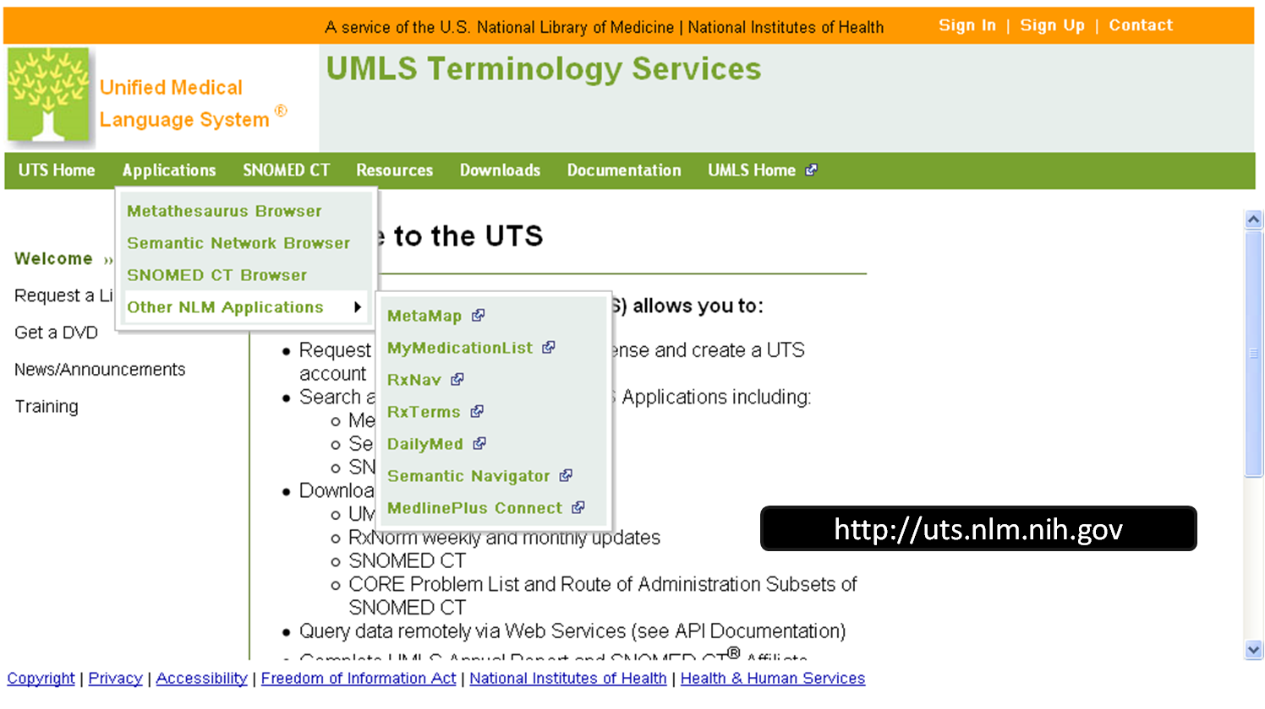
Revised and expanded UMLS pages

Slide 28
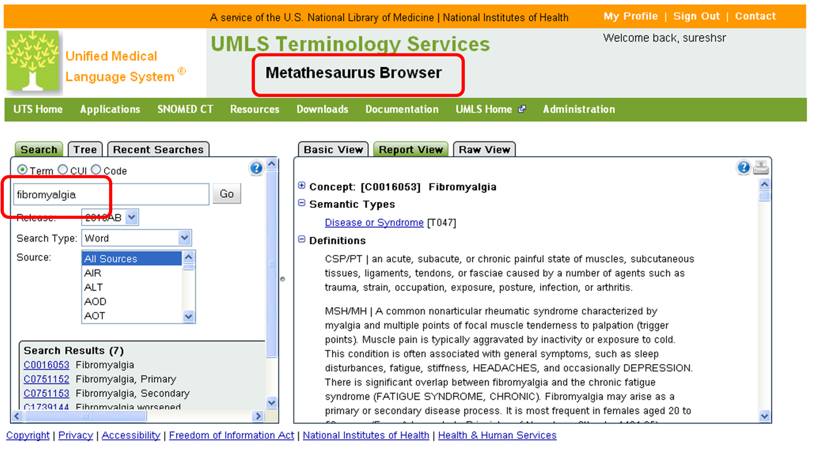
Revised and expanded UMLS pages

Slide 29
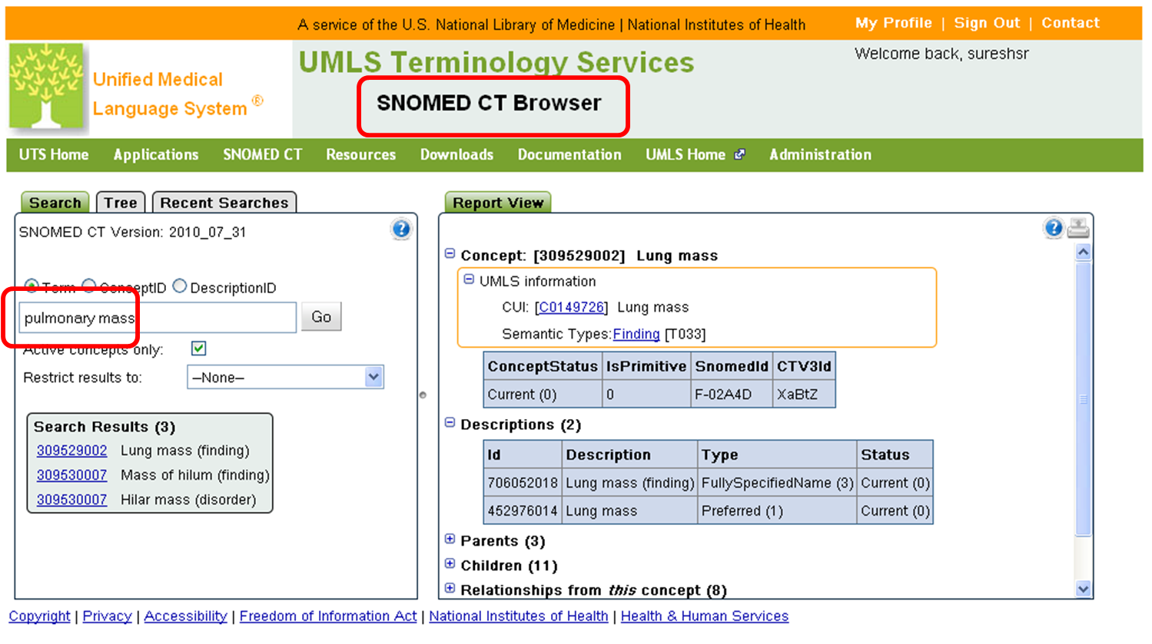
Revised and expanded UMLS pages

Slide 30
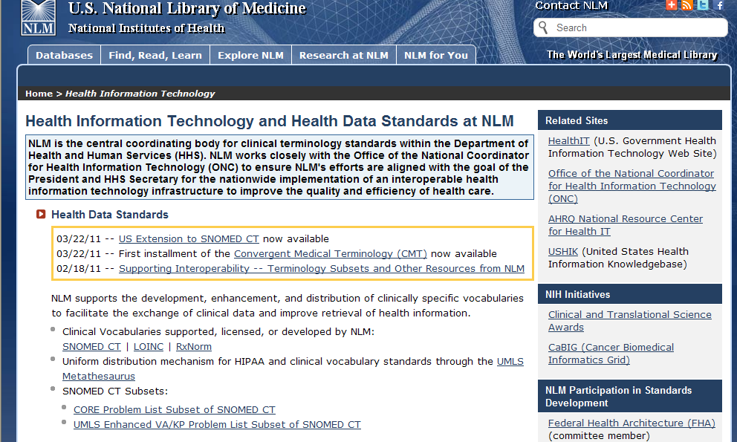
Revised and expanded UMLS pages

Slide 31
PubMed Health
Surprise! early release, courtesy of Google ☺
Evolving: New look/search coming this summer
Emphasis on Comparative Effectiveness content

Slide 32
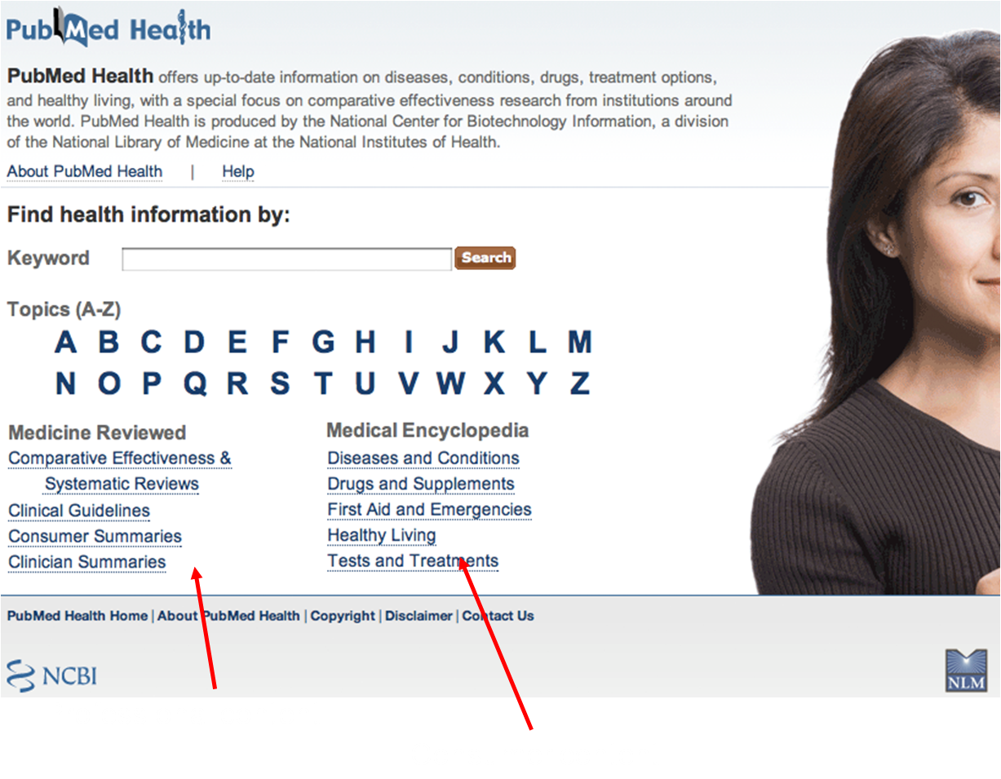
PubMed Health Home

Slide 33
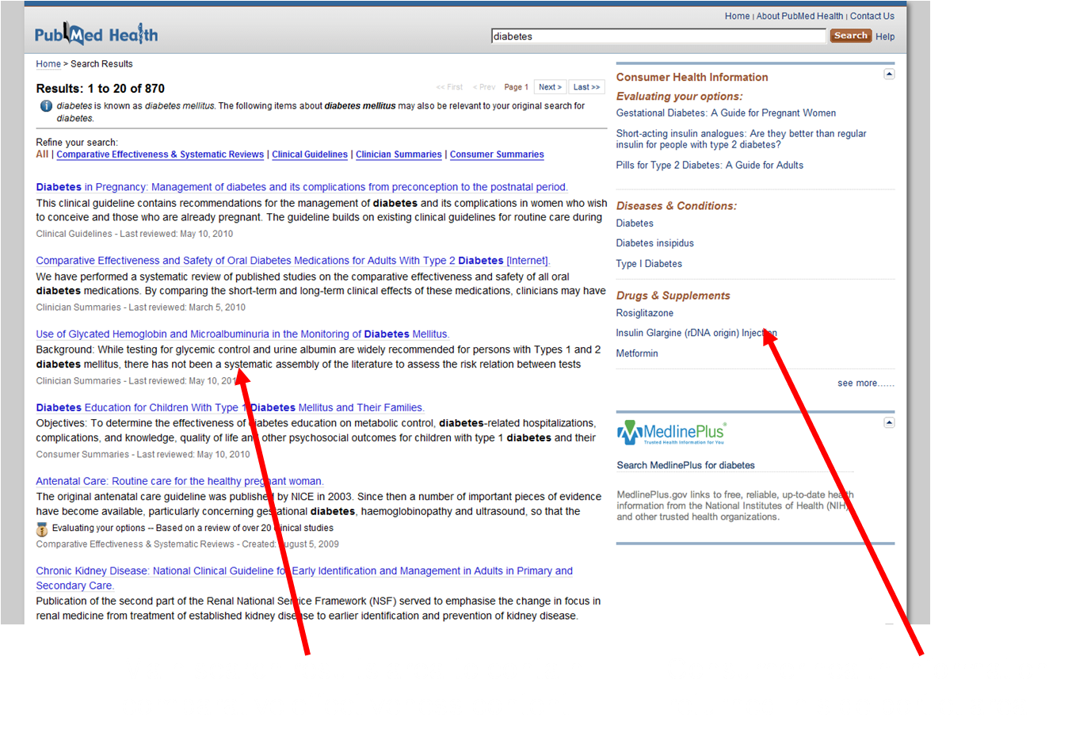
PubMed Health Search

Slide 34
Content sources for PubMed Health
Consumer summaries of Systematic Reviews
PubMed Clinical Q&A
AHRQ: Comparative Effectiveness Review Summary Guides for Consumers
InformedHealthOnline: Fact Sheets and Research Summaries from the German Institute for Quality and Efficiency in Health Care (IQWiG)
Consumer reference information
A.D.A.M.® Medical Encyclopedia
AHFS® Consumer Medication Information.
Information for Health Professionals
AHRQ Evidence Reports
AHRQ Evidence Report Summaries
AHRQ Comparative Effectiveness Reviews, Summaries for Clinicians
NICE Clinical Guidelines
DERP Reports

Slide 35
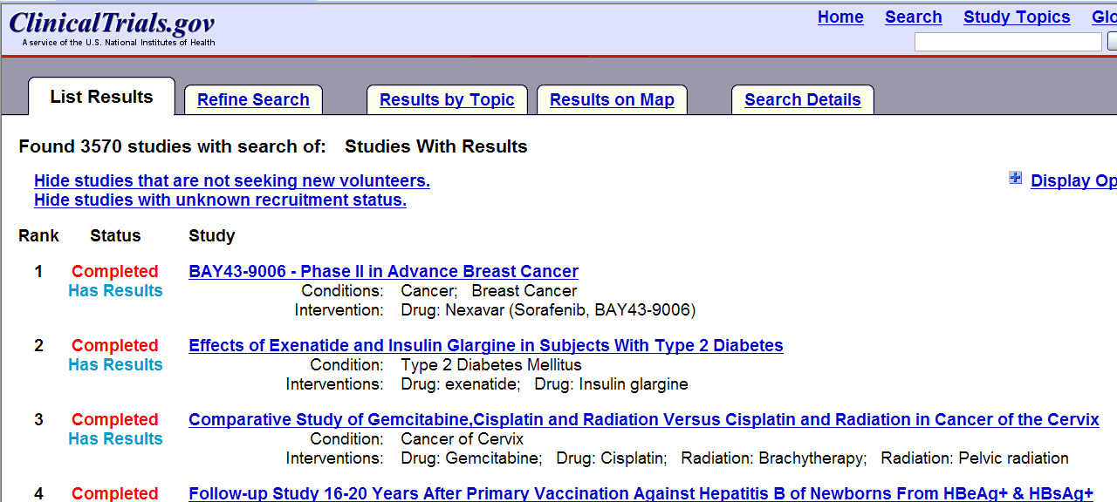
Source of unpublished results for Systematic Reviewers

Slide 36
Community Engagement
An enduring opportunity to help NLM and yourself as a by-product of helping others
  Health information outreach
  Health Literacy – interaction with Health IT, Health insurance reform
  Disaster preparedness (DISASTR-OUTREACH-LIB Listserv )
  Research based on community priorities – assessment, interventions, “measuring the difference”

Slide 37
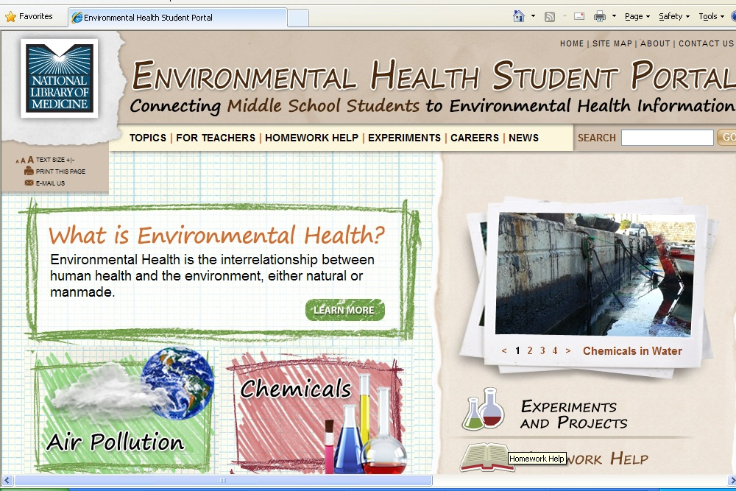
Environmental Health Student Portal

Slide 38
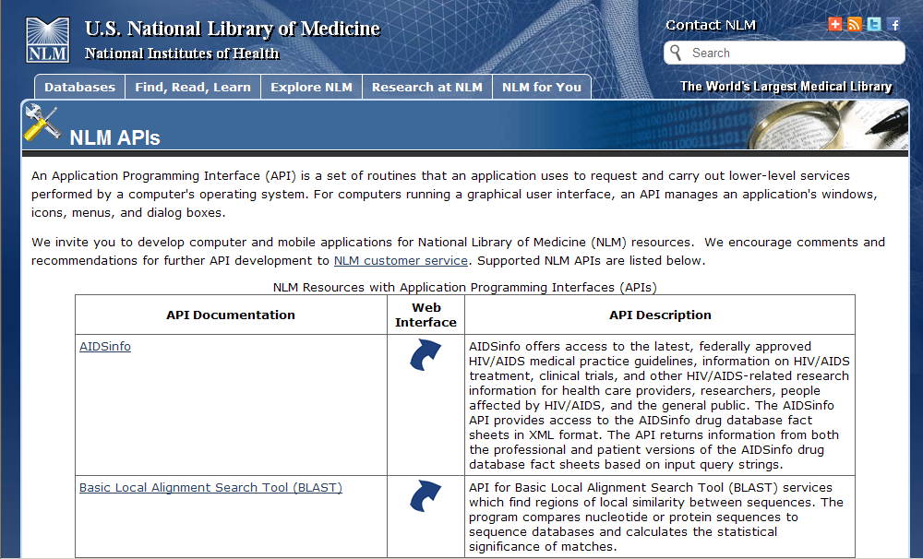
NLM APIs

Slide 39
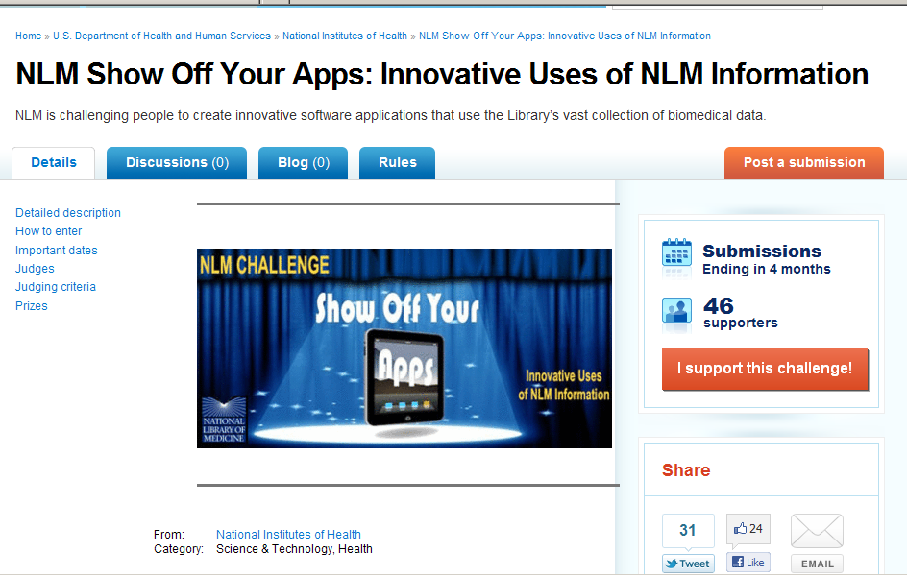
Please participate and help us to publicize....

Slide 40
NLM UPDATE
May 17, 2011
Part 3
Sheldon Kotzin
kotzin@nlm.nih.gov

Slide 41
Medical Librarians on NLM Advisory Committees
Board of Regents
May Ryan, University of Arkansas
Ginny Tanji, University of Hawaii - just elected Chair for 2012
Literature Selection Technical Review Committee
Cathy Norton, Woods Hole, MA
Linda Walton, University of Iowa
Lucretia McClure, Retired
Karen Smith, NIH Library
Catherine Soehner, University of Michigan

Slide 42
Medical Librarians on NLM Advisory Committees
Biomedical Library & Information Review Committee
Judy Consales, UCLA
Julie Kochi, UCSF
Beverly Murphy, Duke University
Michelle Tennant, University of Florida
PMC Advisory Committee
Cynthia Henderson, Howard University
Pat Thibodeau, Duke University

Slide 43
NN/LM Network Members contributing to the new contracts
Nancy Allee
Tom Basler
Donna Berryman
Ysabel Bertolucci
Arpita Bose
Karen Brewer
Michelle Brewer
Kathy Brunjes
Holly Shipp Buchanan
Christine Chastain-Warheit
Ira Combs
Brenda Curry-Wimberly
Rebecca Davis
Gary Freiburger
Rick Forsman
John Frey III
Mark Funk

Slide 44
NN/LM Network Members Continued
Pat Hammond
Reena Karani
Taneya Koonce
Ethel Madden
Sandra Martin
Evelyn Morgen
Barbara Nail-Chiwetalu
Scott Plutchak
Gabriel Rios
Bart Ragon
Mary Ryan
Connie Schardt
Julia Sollenberger
Michele Spatz
Cheryl Suttles
H. Kenneth Walker
Linda Walton
Linda Watson

Slide 45
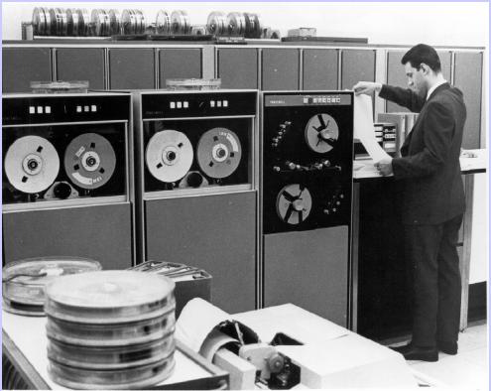
NLM Computer Room – 1970s

Slide 46
MEDLINE 1971
2129 Journals
130,000 Citations
3 Weeks of Training

Slide 47
Quotation from Kent Smith
“Creating a system that will put an icon on each MEDLINE citation that has a link to the publisher of that article. By clicking on that publisher via the www, the publisher will send the article electronically to the user.”
                Kent A. Smith

Slide 48
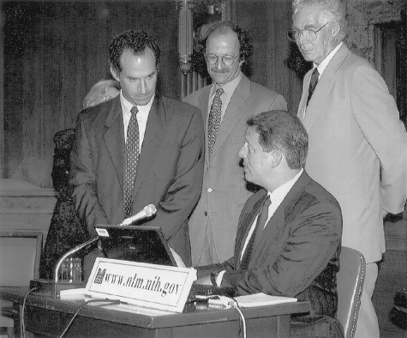
Demo of PubMed -- 1997

Slide 49
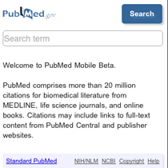
PubMed Mobile
Notes:
Gallery of Mobile Apps and Sites: http://www.nlm.nih.gov/mobile/

Slide 50
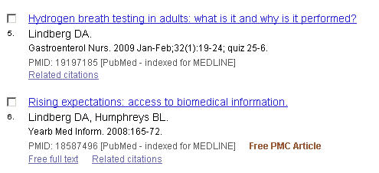
PubMed Search Results

Slide 51
Approaches
Passive
Active
Author name / PMID
Pre-computed clusters
Citations weighted higher
Presented as a view option to users
Identify individuals (as opposed to identifying names or roles)
Self-register & maintenance
Managed via My Bibliography
Extensible & interoperable with other systems

Slide 52
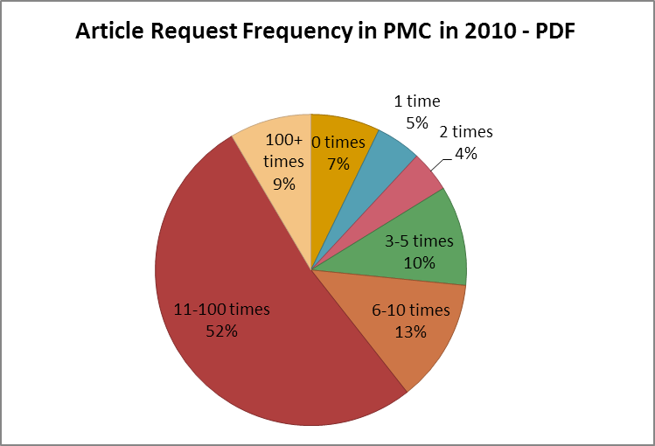
Article Request Frequency in
PMC in 2010 - PDF
2,088,813 articles in this format in PMC; 1,938,409 retrieved at least once in 2010.
Notes:
The chart includes the following data:
1 time = 5%
2 times = 4%
3-5 times =10%
6-10 times = 13%
11-100 times = 52%
100+ times = 9%

Slide 53
NCBI Training Courses
Two – Day In-person Workshops
Four Modules
  Sequences, Genomes, & Maps
  Proteins, Domains, & Structures
  Using NCBI BLAST Services
  Human Variation & Disease Genes
Webinars also being planned.
http://www.ncbi.nlm.nih.gov/Education/webinars.shtml
Notes:
NCBI has reinstated their Biotechnology related training classes. The new classes will be 2-day in person workshops covering 4 modules on:
Sequences, Genomes, & Maps
Proteins, Domains, & Structures
Using NCBI BLAST Services
Human Variation & Disease Genes
NCBI is also planning on providing webinars as well. The one on the west coast is scheduled for June 6-7 at UC Berkeley. Check the website for current information.

Slide 54
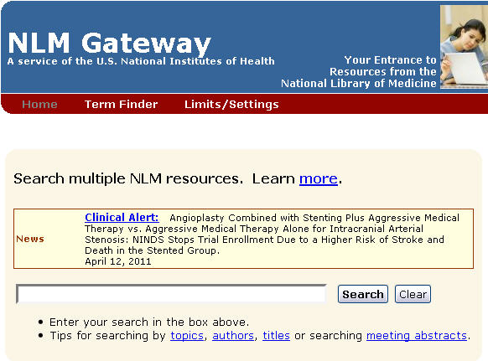
NLM Gateway

Slide 55

Medical Heritage Library
Americana 1720-1865
Usable Surrogates of Rare, Unique Items
Countway
Cushing / Whitney at Yale
  Long Health Sciences at Columbia
  New York Public Library

Slide 56

Books Flying

Slide 57
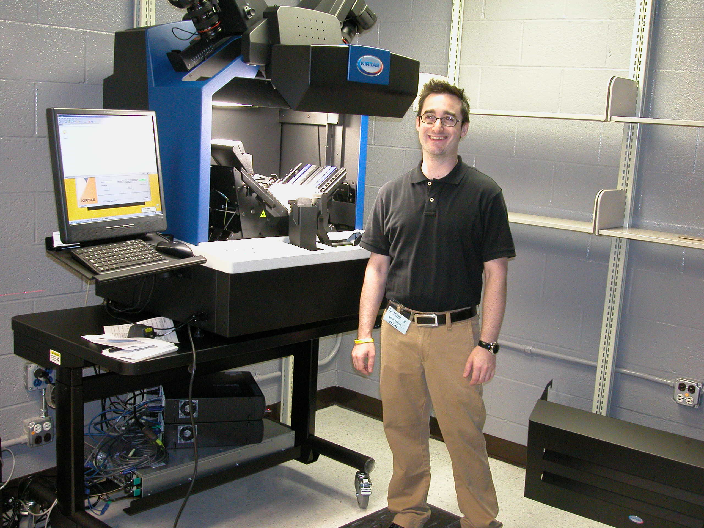
Kirtas Scanner

Slide 58
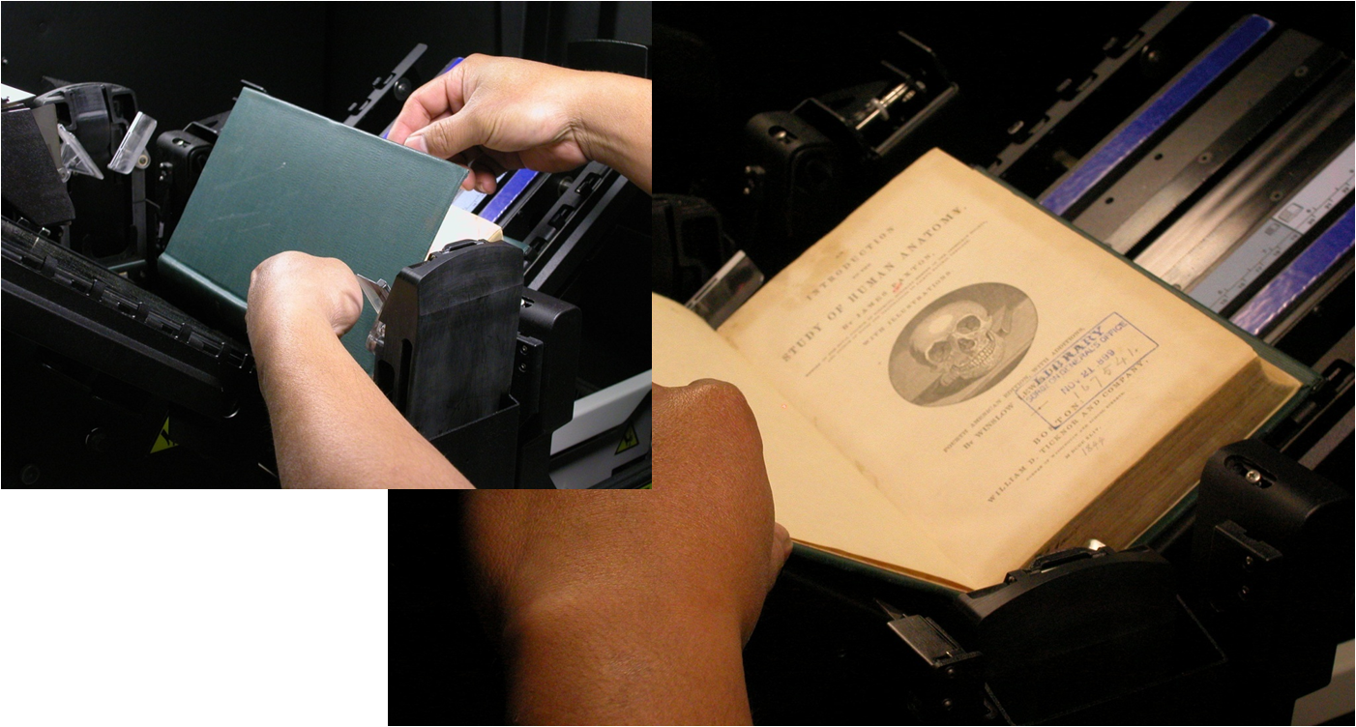
Getting Started: Adjust Scanner Settings and Load Book in Cradle
Notes:
In addition to book width and thickness we check overall condition, page “turnability” and proximity of the text to the binding.

Slide 59
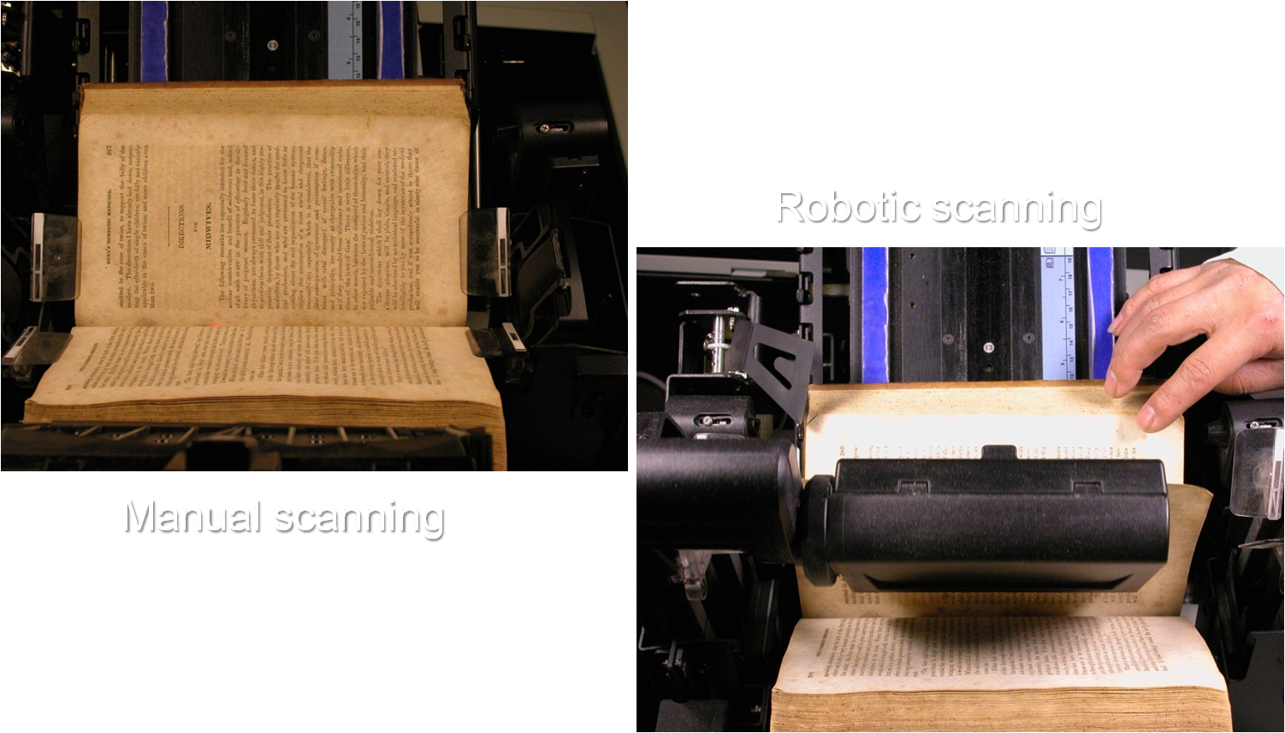
What the Camera Sees

Slide 60
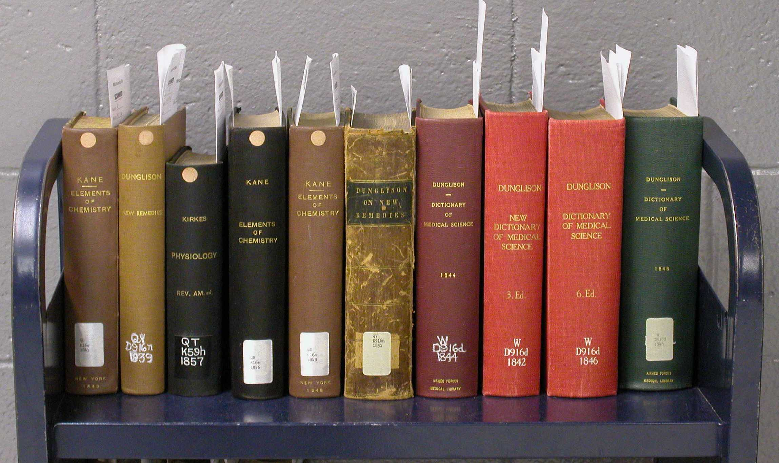
Medical Heritage Library
Progress Through April 30, 2011
Volumes Digitized: 2407
Pages Digitized: 481,000
Estimated Completion: June 2012

Slide 61
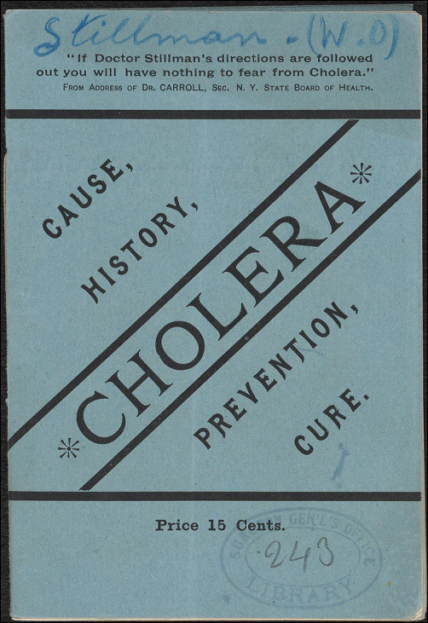
Cholera Book
Title: Cholera: its cause, history, prevention, and cure
Identifier: http://resource.nlm.nih.gov/101218104
Notes:
Title: Cholera: its cause, history, prevention, and cure
Identifier: http://resource.nlm.nih.gov/101218104

Slide 62
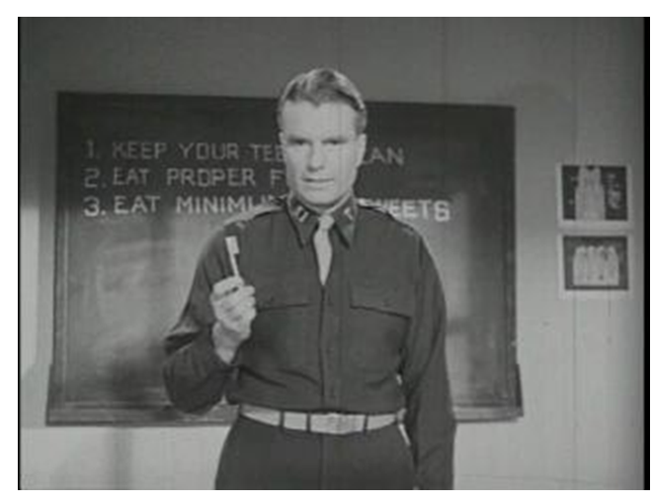
Dental Health Film
Title: Dental health

Slide 63
Upcoming Collections
Medical Heritage Library (MHL) – beginning Spring 2011
NIH Annual Reports (collaboration with NIH Library) – late Spring 2011
Heckler Report on Minority Health – Summer 2011
Additional films from HMD – Fall 2011
Images from the History of Medicine – late 2011
Notes:
The Alfred P. Sloan Foundation is funding the first major collaborative digitization initiative sponsored by Open Knowledge Commons, a digital Medical Heritage Library project.
Health Sciences Library at Columbia University, the National Library of Medicine, the Countway Library of Medicine at Harvard Medical School, Whitney Medical Library at Yale University, and the New York Public Library.
NLM’s Goals and Objectives:
- Enhance access to the NLM collection
- Digitize more of NLM’s collection; Experience and infrastructure to manage additional digitization projects
- Create the Medicine, Health and History Online digital library
Ensure the preservation of endangered print resources in the collection; Identification and conservation treatment of fragile print items in the collection
11 volumes of NIH Clinical Center annual reports to be digitized covering years 1981-1993.
NIH Library plans to eventually digitize the full collection of annual reports.
Approximately 50 NLM historical digitized images selected from the HMD web site, Historical Anatomies on the Web.
- The images on the existing web site are not searchable by subject, artist, or author, and metadata does not exist for the individual images.
Website archiving pilot:
Questions to answer: Selection criteria, Technical facility, Legal issues, Preservation

Slide 64
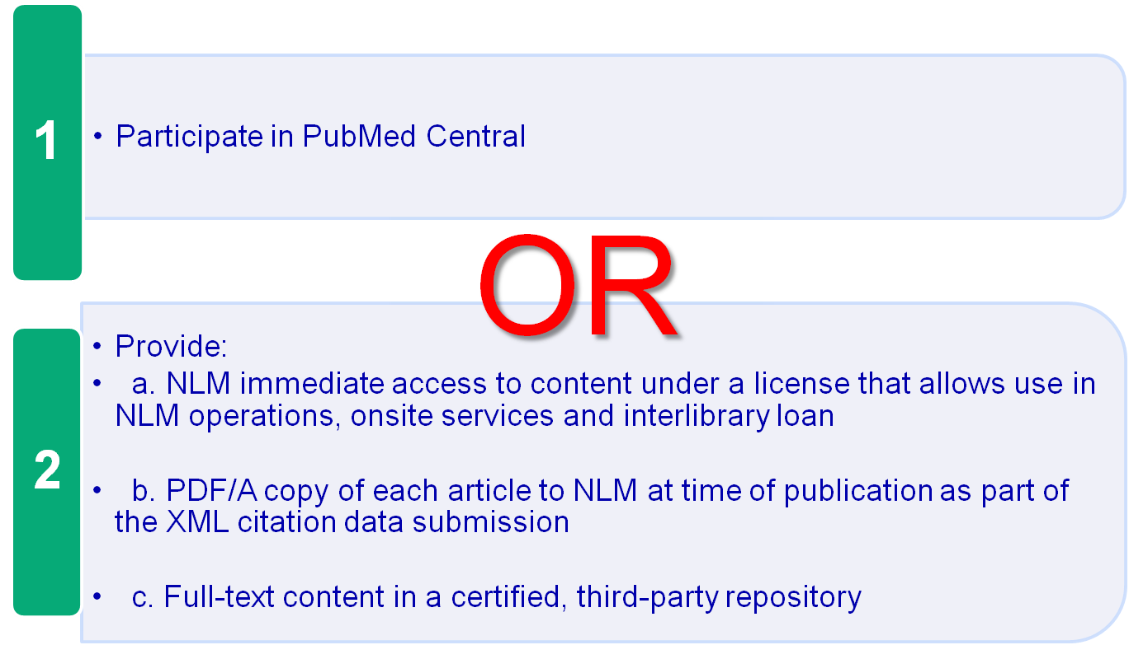
MEDLINE Policy for Indexing E-Journals
Notes:
Medline Policy for Indexing E-Journals
Participate in PubMed Central
- OR -
2. Provide:
NLM immediate access to content under a license that allows use in NLM operations, onsite services and interlibrary loan
b. PDF/A copy of each article to NLM at time of publication as part of the XML citation data submission
c. Full-text content in a certified, third-party repository

Slide 65
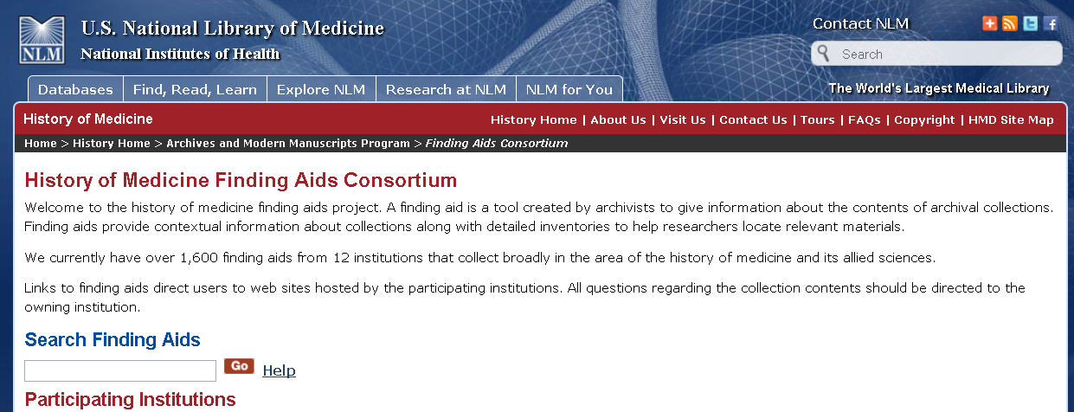
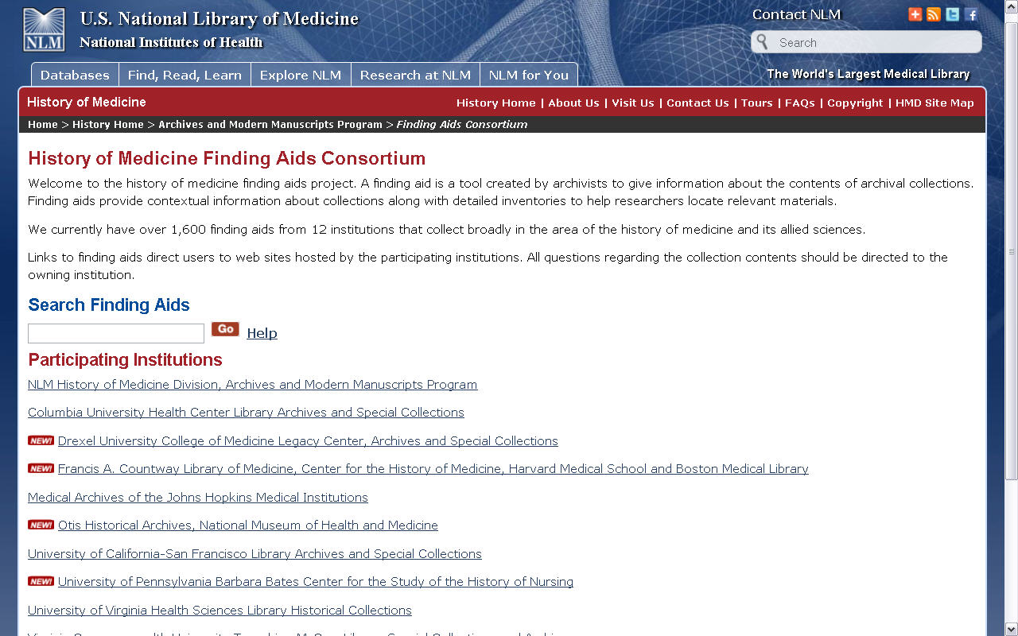
HMD Finding Aids Consortium Home Page

Slide 66
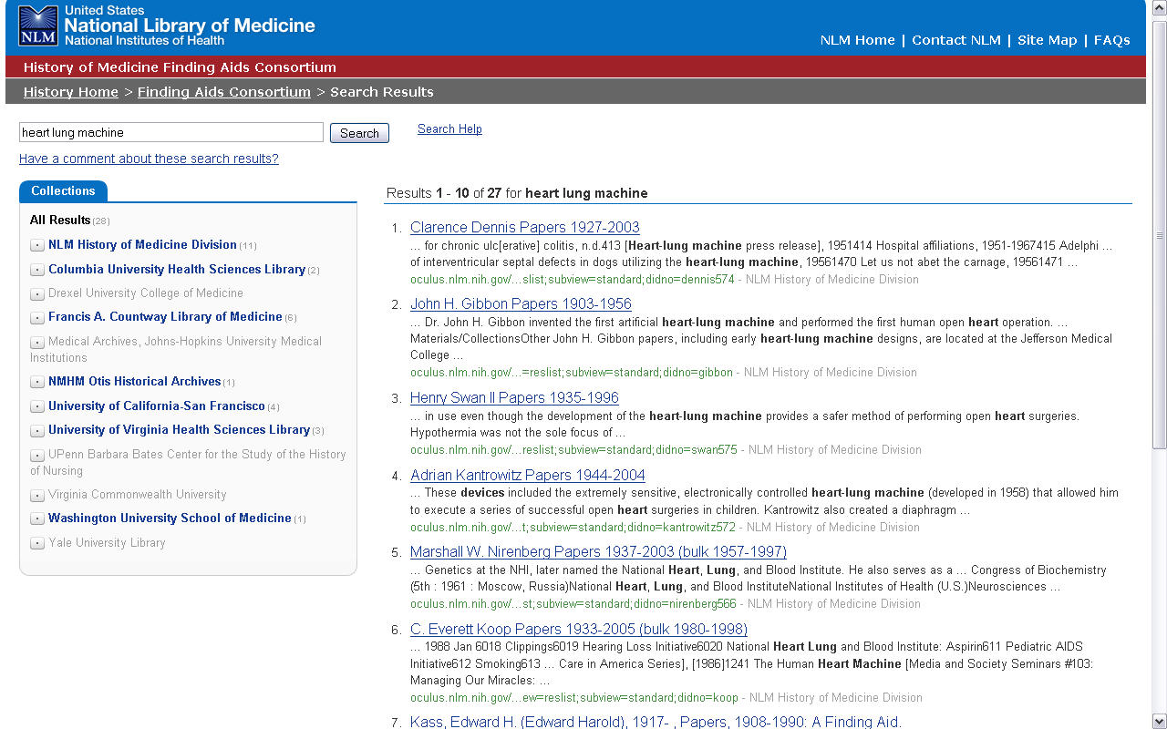
NLM Finding Aids Consortium

Slide 67
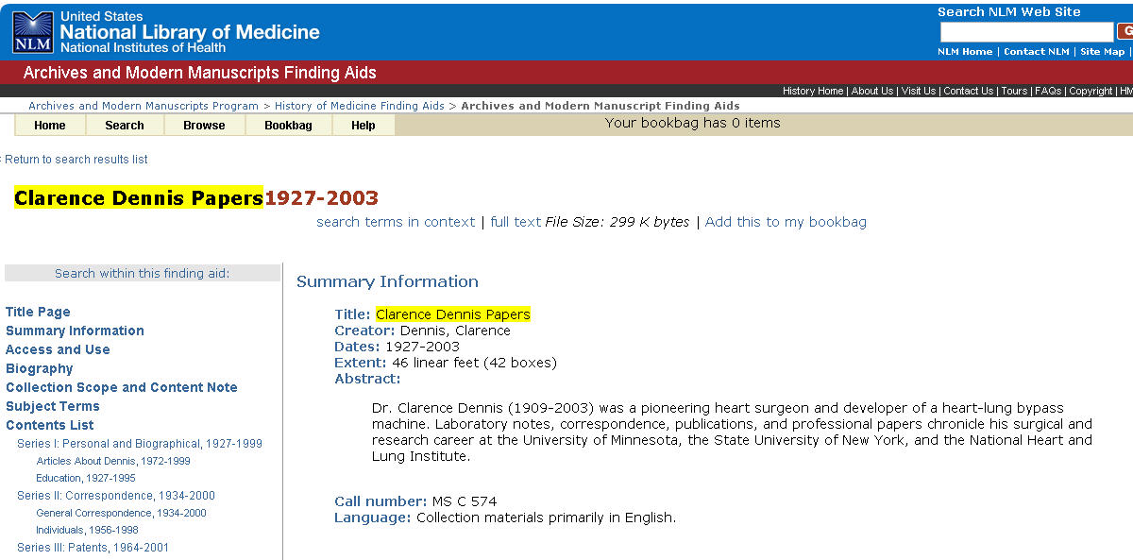
Record for Clarence Dennis Papers

Slide 68
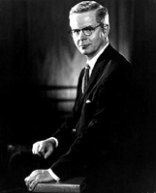
Clarence Dennis

Slide 69
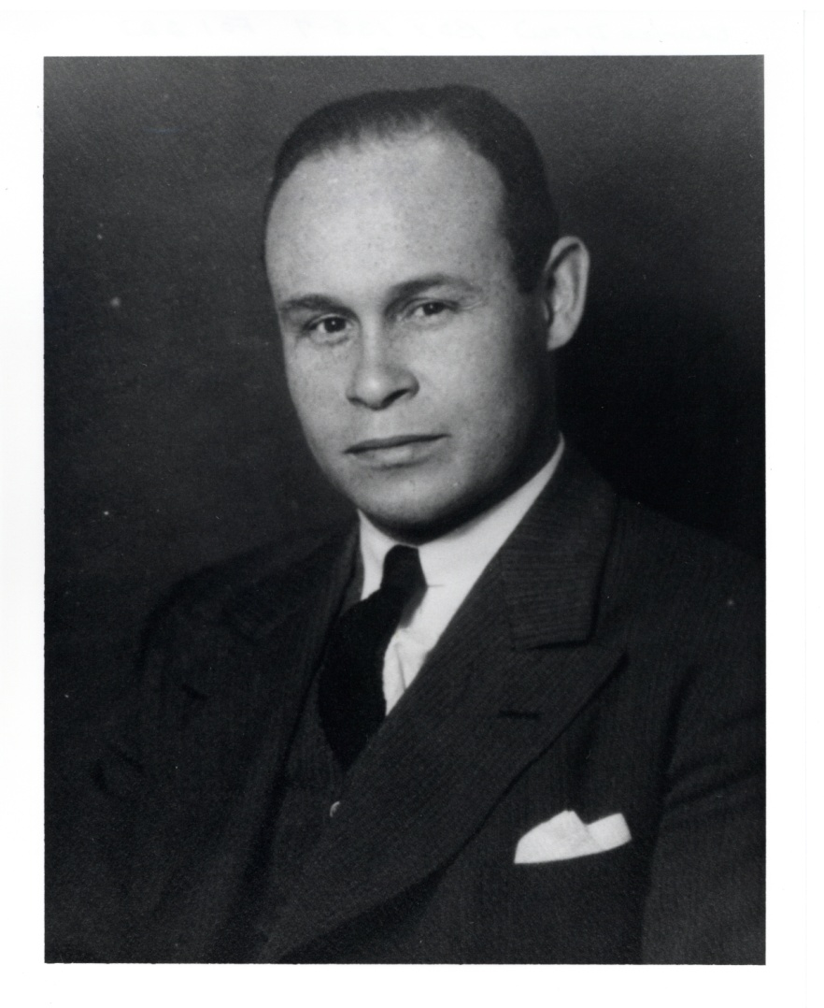
Charles Drew

Slide 70
NLM Project Charter
“The goal of this project is to improve acquisitions and cataloging workflows by re-envisioning technical processing to achieve maximum effective use of staff resources and vendor services.”

Slide 71
NLM is Different
Library of First Resort and Last Resort
Biggest biomedical library in the world
Unequaled subject depth/specialization
User base is diverse, distributed, mediated

Slide 72
But NLM is Similar…
  Rapid transition from print to electronic
  Role as print archive
  Pushing content into user workflows
  Access, rather than collection
  Discovery options are expanding

Slide 73
Five Steps of Workflow Redesign
Understand the current environment
Identify best “possible” practices
Demonstrate the benefits
Enable the organization
Adjust and implement changes

Slide 74

Decision Criteria

Slide 75

Resource Description & Access

Slide 76

Read Me

Slide 77

HMD Exhibitions
Notes:
HMD Exhibitions including Frankenstein, Chaning the Face of Medicine, Opening Doors, and Binding Wounds available at http://www.nlm.nih.gov/hmd/about/exhibition/

Slide 78
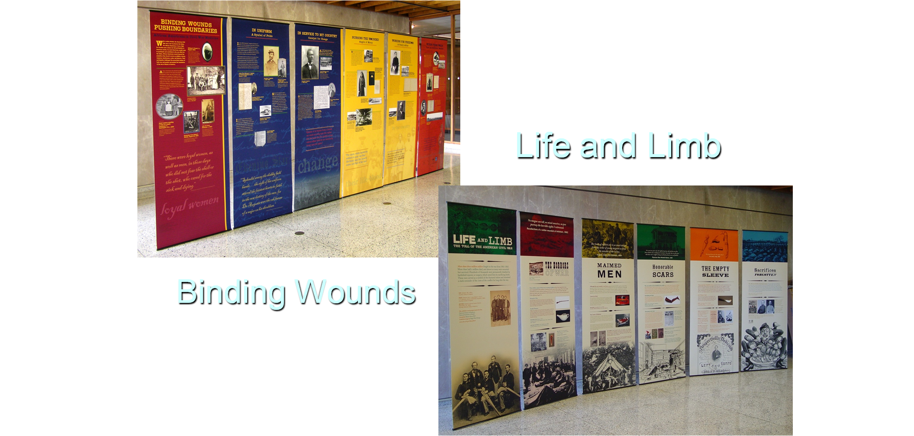
Binding Wounds Exhibition at NLM

Slide 79
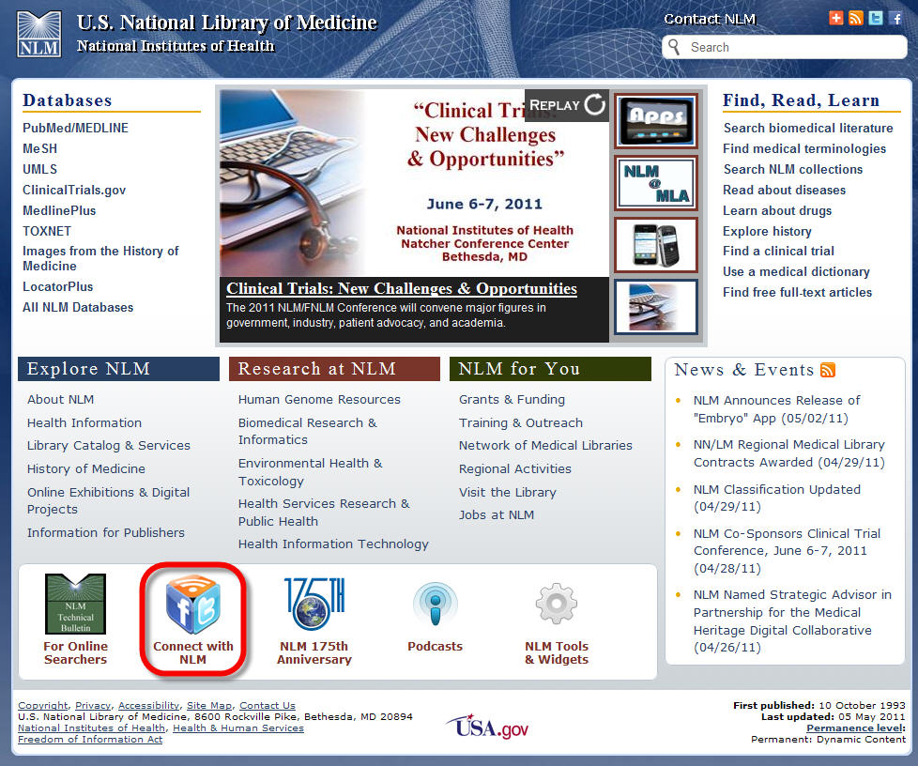
NLM Homepage Refresh

Slide 80
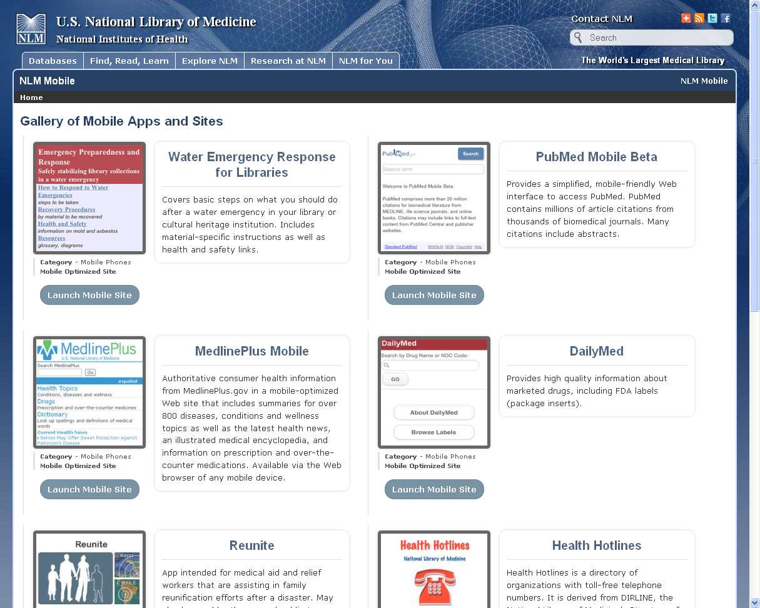
Gallery of Mobile Apps and Sites
Notes:
Gallery of Mobile Apps and Sites: http://www.nlm.nih.gov/mobile/

Slide 81
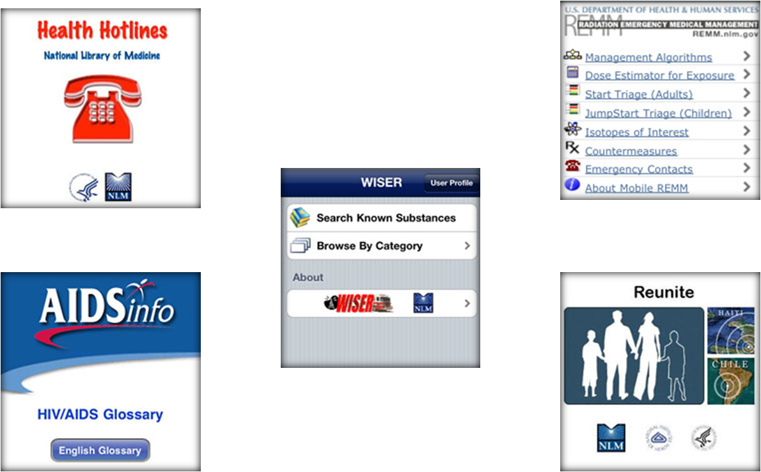
Mobile Apps
Notes:
Download apps. All have versions designed for an iPhone and iPod touch. Some also have versions for Blackberry and Palm OS PDAs.

Slide 82
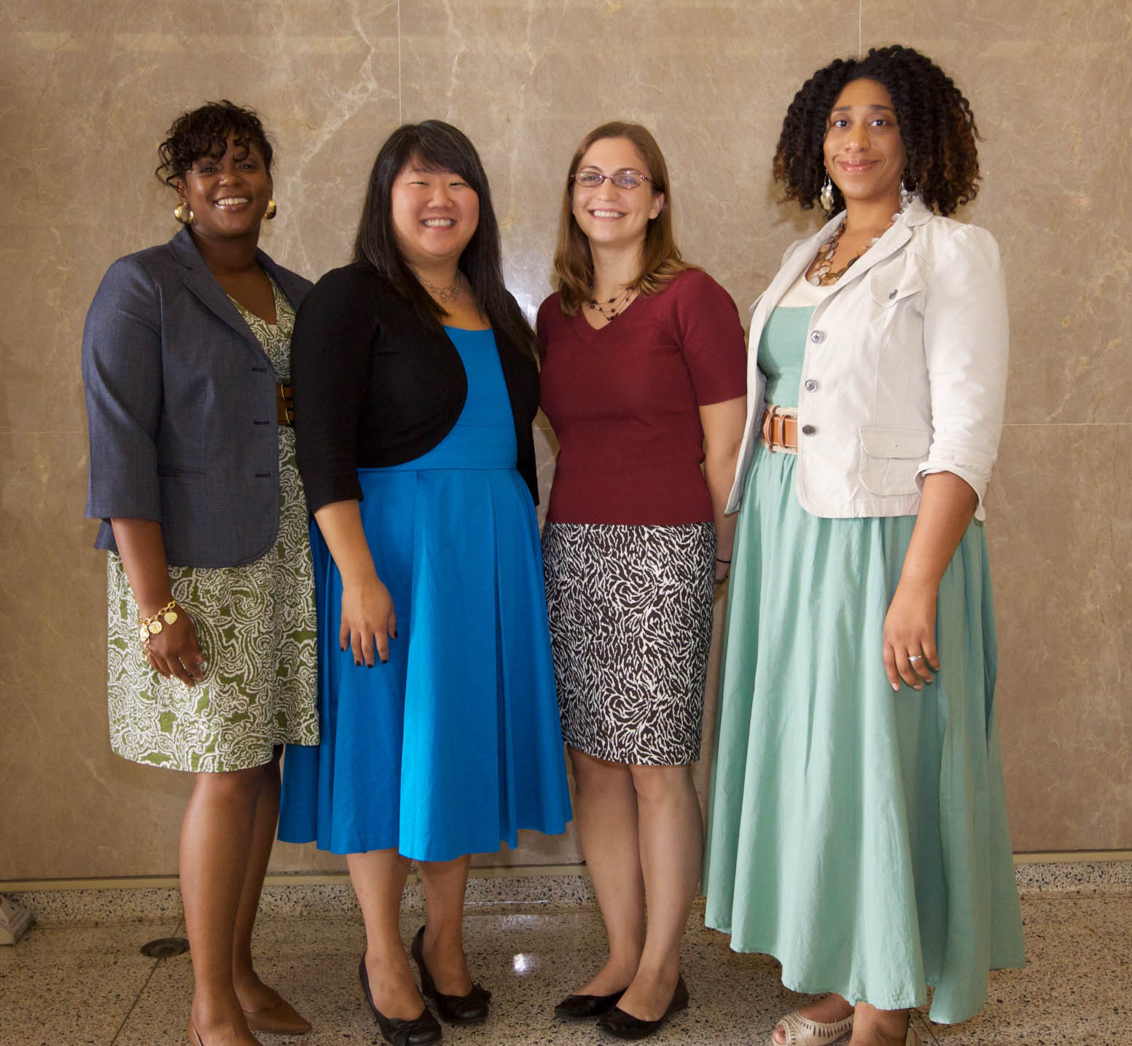
2009-2010 NLM Associates
MaShana Davis, Holly Zerbe, Ada Cornell, Yani Yancey

Slide 83
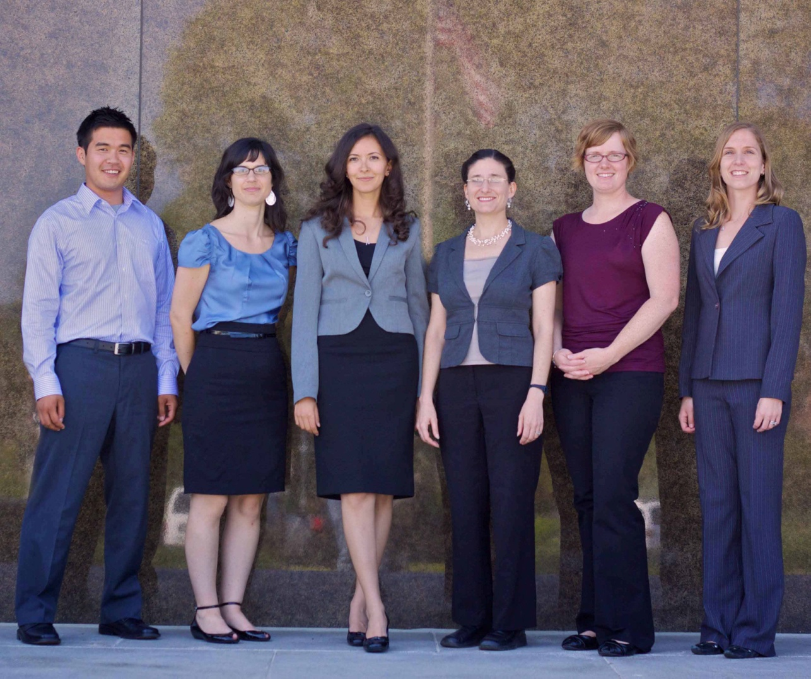
2010-2011 NLM Associates
Stephen Kiyoi, Julie Adamo, Salima M’seffar, Caitlin Sticco, Kristen Greenland, Kristen Burgess

Slide 84
AAHSL Leadership Fellows Data
Total Fellows – 45
Total Mentors – 37
17 Fellows have been named Director or Acting Director
23 Fellows have received promotions to Director or others of higher responsibility

Slide 85

AAHSL Leadership Fellows –
2010-2011

Slide 86

AAHSL Leadership Fellows –
2010-2011

Slide 87

NLM’s 175th Staff Photo
Notes:
The first official event was a panoramic photo of NLM staff on a frigid day in January

