Slide 1
NLM Online Users’ Meeting May 16, 2011
David Gillikin
Chief, Bibliographic Services Division
National Library of Medicine
National Institutes of Health
Department of Health & Human Services
Notes:
NLM Online Users’ Meeting May 16, 2011
David Gillikin
Chief, Bibliographic Services Division
National Library of Medicine
National Institutes of Health
Department of Health & Human Services

Slide 2
Presentations
David Gillikin: Online Update
Loren Frant: MedlinePlus
Questions
Presentations will be posted on the NLM Technical Bulletin: http://www.nlm.nih.gov/pubs/techbull/tb.html
Notes:
Presentations
David Gillikin: Online Update
Loren Frant: MedlinePlus
Questions
Presentations will be posted on the NLM Technical Bulletin: http://www.nlm.nih.gov/pubs/techbull/tb.html

Slide 3
MEDLINE Indexing
FY2010
699,420 citations indexed for MEDLINE.
-1.9% decrease over FY2009.
80,042 gene indexing links created.
FY2011
Anticipating an overall rate of around 723,000 articles indexed.
Special projects underway.
Notes:
Indexing production for FY2010 was actually down by nearly 2%. Though FY2010 did include several government closures due to snow storms, we are watching to see if the contract indexing firms have actually hit a plateau after years of growth. We are hoping to rebound from this in FY2011.

Slide 4
Medical Text Indexer (MTI)
Developed by the Cognitive Science Branch of the Lister Hill Center.
2002 – MeSH suggestions for indexers.
2007 – Subheading suggestions added.
2008 – Catalog Section implementation.
2010 – MTI First Line Indexing tests.
Notes:
One major project has been the Medical Text Indexer or MTI. In place since 2002, the use of MTI has seen steady progress. In the past year we started pursuing the idea of how to further the use of MTI in the first steps of indexing.

Slide 5
MTI First Line Indexing
3 test phases looking at increased possible role of MTI.
Subject areas, efficiencies, and the indexing workflow involving an Indexer & Senior Reviewer.
Results:
Certain subject fields are more applicable.
Minimum gene indexing or chemical indexing.
MTI as first line index source, suggesting MeSH terms.
Senior Reviewer reviews & augments MTI suggestions.
2011 Pilot Production Implementation – MTI First Line Indexing & Senior Reviewer
Notes:
Our tests looked at the standard indexing workflow, involving first an indexer providing the initial indexing process and followed by a senior reviewer who reviews the indexing.
From our work with MTI, 3 different test phases were undertaken to look at applicable subject areas, and indexing efficiencies and costs.
It was identified that for some subject areas, especially those with a minimum amount of gene indexing and chemical indexing, MTI can be used as the first line indexing source, followed by a senior revisor reviewing the indexing. This can lead to a cost savings.
We are now undergoing a pilot production implementation, using
14 journals in the fields of anatomy, medical informatics, and microbiology.

Slide 6
MEDLINE Policy on Indexing Electronic Journals
http://www.nlm.nih.gov/bsd/policy/ejournals.html
Updated in March, implementation in May.
Identifies requirements for electronic-only journals to be indexed.
XML tagged citation data
License to access current content
Preservation component, preferably PMC
Alternative: Certified trusted repository, plus PDF/A deposit to NLM, & license supporting NLM operations, onsite services and interlibrary loan.
Notes:
MEDLINE Policy on Indexing Electronic Journals
http://www.nlm.nih.gov/bsd/policy/ejournals.html
Updated in March, implementation in May.
Identifies requirements for electronic-only journals to be indexed.
XML tagged citation data
License to access current content
Preservation component, preferably PMC
Alternative: Certified trusted repository, plus PDF/A deposit to NLM, & license supporting NLM operations, onsite services and interlibrary loan.

Slide 7
OLDMEDLINE Project
1946 Current List of Medical Literature (CLML) loaded into PubMed in November 2010.
Added over 48,000 citations.
On Hiatus.
Notes:
The OLDMEDLINE project has been an ongoing effort to convert the print indices of the Cumulated Index Medicus and the Current List of Medical Literature. In November we loaded over 48,000 citations from the conversion of the 1946 CLML into PubMed. We are currently working on mapping the subject terms used into MeSH headings. Due to budgetary constraints, the OLDMEDLINE project is now on hiatus, so we’ll have to wait before we can go further back in the conversion process.

Slide 8
PubMed
My NCBI enhancements
Additional PubMed features
PubMed Mobile
Notes:
There is a lot to share with you about PubMed. The major areas to cover are the redesign and enhancements to My NCBI; several new PubMed features; and the introduction of PubMed Mobile.

Slide 9
My NCBI Redesign
Launched April 20, 2011.
Goals:
Streamlined interface
Robust performance
Intuitive navigation
NLM Theater presentations for details
Notes:
My NCBI Redesign
Launched April 20, 2011.
Goals:
Streamlined interface
Robust performance
Intuitive navigation
NLM Theater presentations for details

Slide 10
Screen shot of My NCBI customize and site preferences
Notes:
The upper right hand corner provide links to customize your page and your site prefernces. The Customize this page option lets you decide which options you want to appear on your My NCBI Homepage. But the new design provides an easier option.

Slide 11
Screen shot of My NCBI homepage sections
Notes:
For each of the available sections, you can minimize the section by clicking on the up arrow. Clicking on the X in the right hand corner will remove that feature from you page. You can restore that feature by using the Customize this page link.

Slide 12
Screen shot of My NCBI homepage drag and drop feature
Notes:
You can also drag and drop each feature to rearrange the page to fit your needs and how you work.

Slide 13
Screen shot of My NCBI homepage
Notes:
Screen shot of My NCBI homepage

Slide 14
PubMed: Structured Abstracts
Nearly a quarter of all abstracts currently added to MEDLINE are structured abstracts, containing section labels.
August 2010 - Reformatted for easier display.
Section labels in uppercase, bolded, and each section begins on a new line.
PubMed Abstract display.
No change in searching function currently.
Notes:
Nearly a quarter of all abstracts currently added to MEDLINE are structured abstracts, which are abstracts containing section labels. In August 2010, these abstracts were reformatted to display better. Sections labels are now in uppercase and bolded. Each section begins on a separate line. This new display is only available in the PubMed Abstract display. There is no current change in searching functionality, though in the future we may be able to provide more granular searching within the abstract text based on the section labels.

Slide 15
Structured Abstracts Display
Notes:
Here you can see an example of a structured abstract, the bolding of the section labels and the separation of each section for easier comprehension.

Slide 16
Page Modifier Reintroduced
Notes:
Page Modifier Reintroduced

Slide 17
PubMed Images
Notes:
PubMed abstracts, showing the Image strip. In addition, when you move your cursor over one of the images, an enhanced view of the image is shown.

Slide 18
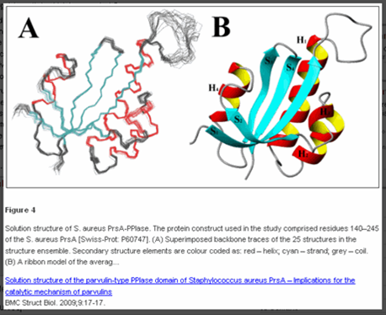
PubMed Abstracts and Images
Notes:
When feasible, an image strip has been added to PubMed abstracts for citations to full text materials in PMC.

Slide 19
PubMed Clinical Queries
Notes:
Here you can see how a search on stroke dementia shows results for each of the 3 clinical research areas. You can select any one of these three results and see the full results for that area by clicking on the See All link at the bottom of each column.

Slide 20
PubMed Mobile
Notes:
Beta version debuted in April
Link on the homepage

Slide 21
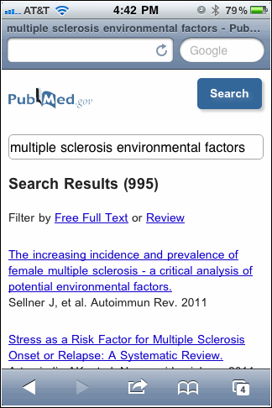
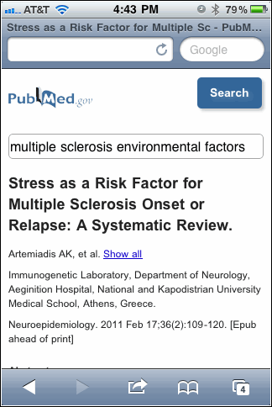
PubMed Mobile screens
Notes:
The inital (Summary) display includes the article title, first author's name, journal title abbreviation, and year of publication.

Slide 22
PubMed Central
PMC statistics as of May 2011.
Over 800 fully participating journals.
265 NIH portfolio journals.
Over 2.17 million articles.
November 2010 – Journal Article Tag Suite Conference held, focusing on the NLM DTDs used in digital publishing and preservation.
2011 Conference already being planned.
Notes:
As of today we have just over 800 full participation titles. That number doesn’t count predecessor titles, i.e., title changes over the course of a journal’s life. So jmla and bmla count as 1 in the 800. We also have 265 NIH portfolio journals.

Slide 23
NCBI Redesigns
Notes:
Several of the NCBI databases are undergoing redesigns to look and behave similar to PubMed. Both the BookShelf and the MeSH Database have been redesigned. The NLM Catalog and the Journals Database have been merged.

Slide 24
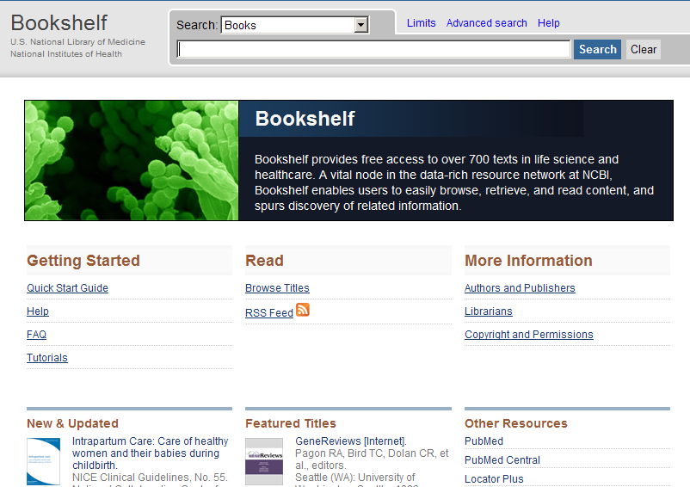
Bookshelf Redesign
Notes:
Here you can see the design change in the BookShelf, going from the old design to the new one.

Slide 25
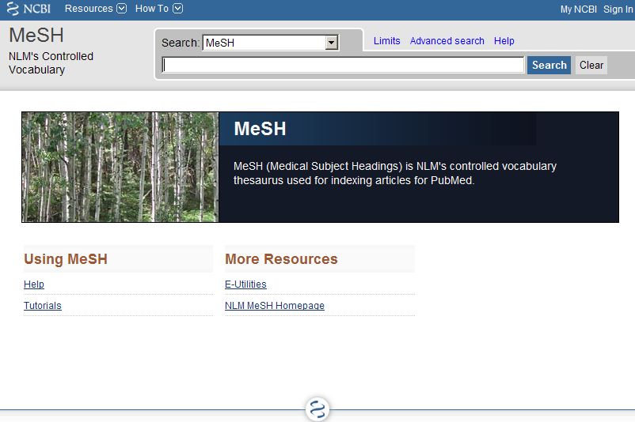
MeSH Database
Notes:
And this shows the shift in the MeSH Database design, from old to new.

Slide 26
NLM Catalog and Journals Database
Notes:
The NLM Catalog and the Journals database were merged into the new NLM Catalog database. This merger was due to the large overlap of data found between the two databases, and as a resource issue. It’s easier to maintain one database than 2 separate by highly similar systems. There is a link on the NLM Catalog homepage to special search feature “Journals in NCBI Databases” that takes you to a special search page, allowing you to search for journals data that had been accessible in the old Journals Database. This “journals in NCBI Databases” link is also available on the PubMed Homepage.

Slide 27
NLM Catalog: Limits and Advance Search
Notes:
The special journals search page. Also contains links to Limits and to an Advance Search page.

Slide 28
Looking for LinkOut?
LinkOut Review
NLM Theater Presentation
Monday, May 16, 3:00
Tuesday, May 17, 1:30
Notes:
LinkOut will not be holding a separate users meeting at MLA this year. But you can attend the LinkOut Review session at the NLM Theater. You can also drop by the NLM booth.

Slide 29
Unified Medical Language System (UMLS)
UMLS Releases:
2010AB release – November 2, 2010
More than 2.3 million concepts and 8.5 million unique concept names from 158 source vocabularies
2011AA release – May 5, 2011
More than 2.4 million concepts and 8.8 million unique concept names from 160 source vocabularies
UMLS Web site reorganization in September.
New UMLS Terminology Services site introduced, replacing the Knowledge Source server.
NLM Theater Presentations.
Notes:
Unified Medical Language System (UMLS)
UMLS Releases:
2010AB release – November 2, 2010
More than 2.3 million concepts and 8.5 million unique concept names from 158 source vocabularies
2011AA release – May 5, 2011
More than 2.4 million concepts and 8.8 million unique concept names from 160 source vocabularies
UMLS Web site reorganization in September.
New UMLS Terminology Services site introduced, replacing the Knowledge Source server.
NLM Theater Presentations.

Slide 30
UMLS Terminology Services (UTS)
Notes:
UMLS Terminology Services (UTS)

Slide 31
NLM Gateway
December 1, 2011 – transition to new pilot search site.
Combination of:
Budget limitations
All databases but one are available from other NLM sources
Most users of those databases search them directly and do not use the Gateway
Notes:
NLM Gateway
December 1, 2011 – transition to new pilot search site.
Combination of:
Budget limitations
All databases but one are available from other NLM sources
Most users of those databases search them directly and do not use the Gateway

Slide 32
NLM Gateway
New pilot search site coming from Lister Hill National Center for Biomedical Communications.
Focus on:
Meeting Abstracts database
Health Services Research Projects in Process (HSRProj).
Details – NLM Technical Bulletin article.
Notes:
NLM Gateway
New pilot search site coming from Lister Hill National Center for Biomedical Communications.
Focus on:
Meeting Abstracts database
Health Services Research Projects in Process (HSRProj).
Details – NLM Technical Bulletin article.

Slide 33
NLM Technical Services Division
NLM Classification 2011 edition released.
60th Anniversary of the NLM Classification.
http://www.nlm.nih.gov/class/
Major areas of focus:
WL (Nervous System)
WM (Psychiatry)
NLM Technical Bulletin article: http://www.nlm.nih.gov/pubs/techbull/ma11/ma11_classification.html
Notes:
The announcement about the cessation of cutter numbers appeared in the NLM Technical Bulletin in December 2009.

Slide 34
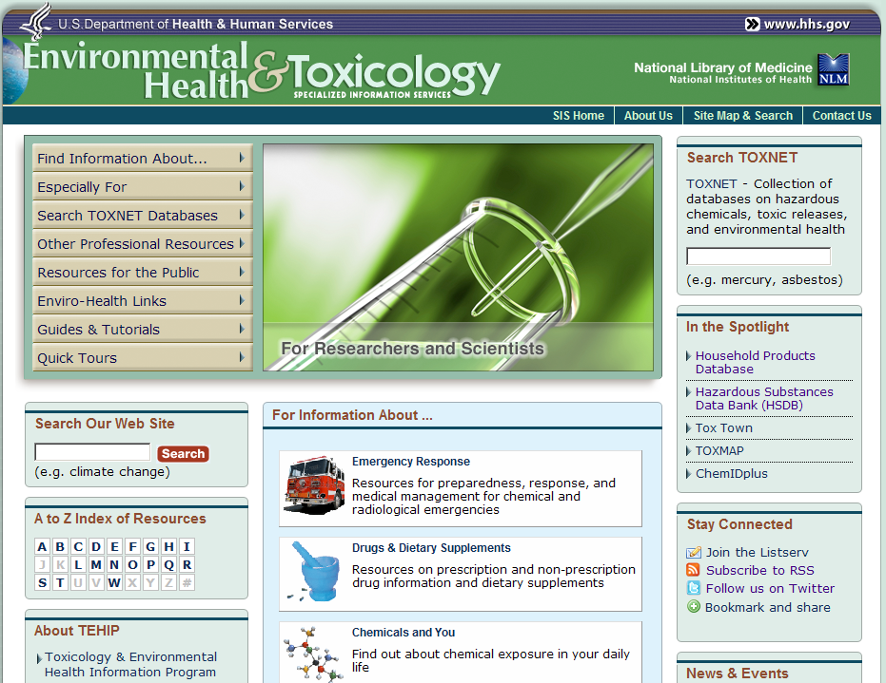
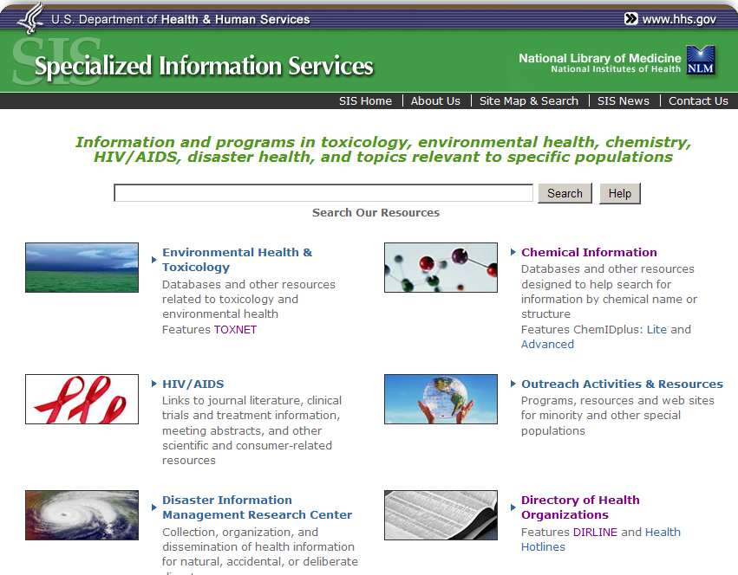
Specialized Information Services (SIS)
Notes:
The SIS homepage was refreshed this October, in an effort to streamline information and to make the Division’s resources easier to access.

Slide 35
Environmental Health Student Portal
Notes:
The environment Health Student portal was launched this fall, introduces middle school students to environmental health science within the context of current middle school science curriculum standards.

Slide 36
AIDSinfo Launched in March
Notes:
AIDSinfo Launched in March

Slide 37
AIDSinfo
Facebook site launched in March.
http://www.facebook.com/AIDSinfo
AIDSinfo Mobile site launched in September.
AIDSinfo HIV Glossary iPhone App.
Notes:
AIDSinfo
Facebook site launched in March.
http://www.facebook.com/AIDSinfo
AIDSinfo Mobile site launched in September.
AIDSinfo HIV Glossary iPhone App.

Slide 38
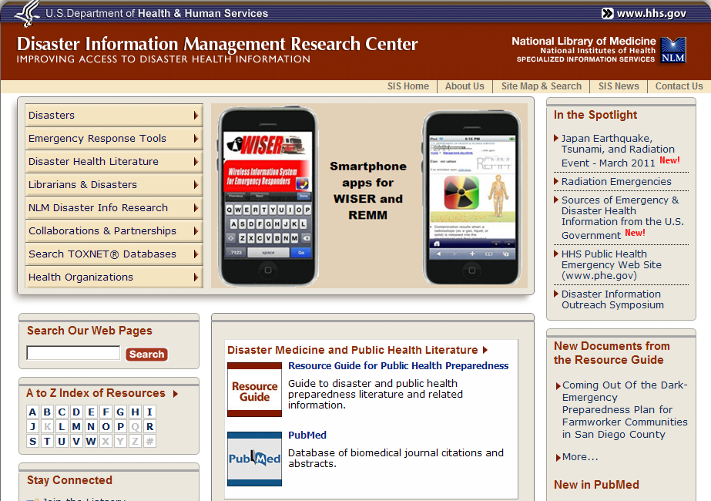
Disaster Information Management Research Center (DIMRC) homepage
Notes:
The DIMRC pages have been redesigned to enhance access to the many and diverse NLM resources useful for disaster and emergency readiness, response, and recovery

Slide 39
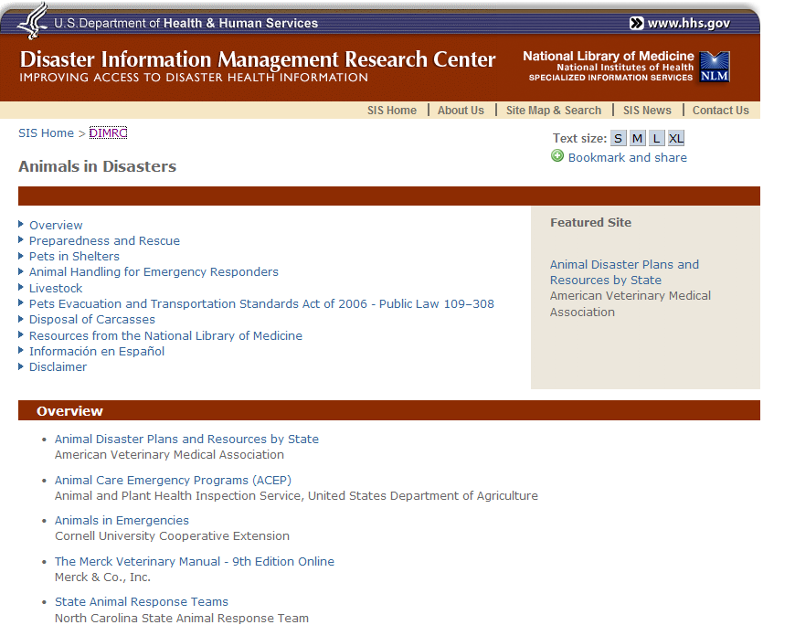
Disaster Information Management Research Animals in Disaster page
Notes:
Disaster Information Management Research Animals in Disaster page

Slide 40
REMM – Radiation Emergency Medical Management
Mobile REMM – New Android support, as well as updated content available though iPhone, Blackberry and Windows Mobile platforms.
New content, including:
Nuclear Reactor Accidents
Personal Protective Equipment
7 new video tutorials about key REMM clinical tools
Notes:
REMM – Radiation Emergency Medical Management
Mobile REMM – New Android support, as well as updated content available though iPhone, Blackberry and Windows Mobile platforms.
New content, including:
Nuclear Reactor Accidents
Personal Protective Equipment
7 new video tutorials about key REMM clinical tools

Slide 41
Wireless Information System for Emergency Responders (WISER)
WISER for iPhone/iPad 1.1 (June 2010).
WISER for Blackberry (July 2010).
WISER 4.4 version released in March
WISER Windows, Pocket PC, and Smart Phone platforms (March 2011).
Interactive Chemical Reactivity capability
19 new substances introduced, including substances in the news such as Crude Oil, Corexit 9500, and Corexit 9527
Notes:
Wireless Information System for Emergency Responders (WISER)
WISER for iPhone/iPad 1.1 (June 2010).
WISER for Blackberry (July 2010).
WISER 4.4 version released in March
WISER Windows, Pocket PC, and Smart Phone platforms (March 2011).
Interactive Chemical Reactivity capability
19 new substances introduced, including substances in the news such as Crude Oil, Corexit 9500, and Corexit 9527

Slide 42
SIS and NLM Exhibit Booth
NLM Theater Presentations:
Disaster Health Information Update
Drug, Toxicology, and Environmental Health Resources Update
NLM K-12 Educational Resources
Notes:
SIS and NLM Exhibit Booth
NLM Theater Presentations:
Disaster Health Information Update
Drug, Toxicology, and Environmental Health Resources Update
NLM K-12 Educational Resources

Slide 43
DailyMed
http://dailymed.nlm.nih.gov/
Contains information on over 23,100 approved prescription drugs.
Usage and Growth:
 | Jan 2011 | Feb 2011 | Mar 2011
Total Hits | 5,357,780 | 8,444,598 | 10,865,718
Average Hits/Day | 172,831 | 301,592 | 350,507
Notes:
DailyMed
http://dailymed.nlm.nih.gov/
Contains information on over 23,100 approved prescription drugs.
Usage and Growth:
DailyMed
http://dailymed.nlm.nih.gov/
Contains information on over 23,100 approved prescription drugs.
Usage and Growth:
Total hits Jan 2011: 5,357,780
Average hits/day Jan 2011: 172,831
Total hits Mar 2011: 10,865,718
Average hits/day Mar 2011: 350,507

Slide 44
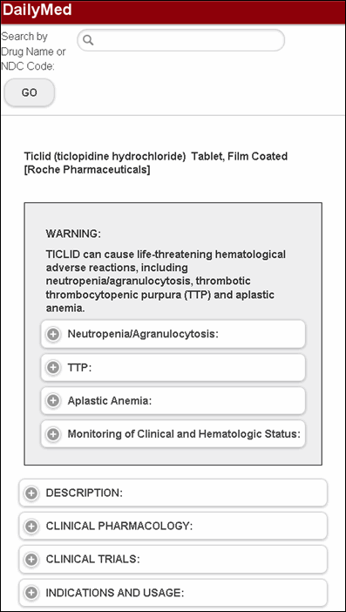
DailyMed
New DailyMed Mobile site - launched in March
http://dailymed.nlm.nih.gov/dailymed/mobile/index.cfm
NLM Theater Presentation on DailyMed and MyMedicationList
Notes:
DailyMed
New DailyMed Mobile site - launched in March
http://dailymed.nlm.nih.gov/dailymed/mobile/index.cfm
NLM Theater Presentation on DailyMed and MyMedicationList

Slide 45
NLM Mobile page http://www.nlm.nih.gov/mobile/
Notes:
NLM Mobile page http://www.nlm.nih.gov/mobile/

Slide 46
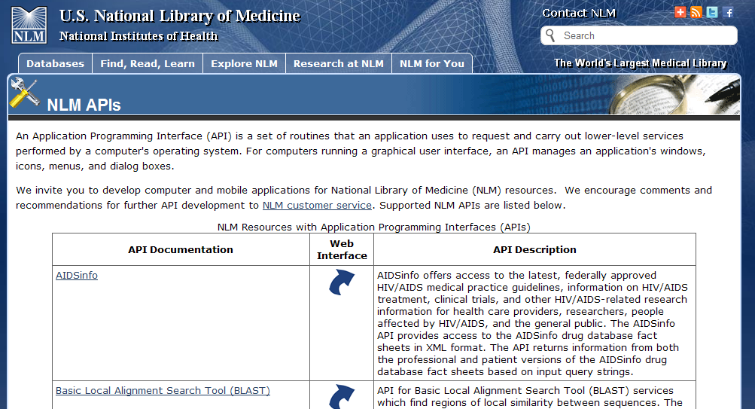
Application Programming Interface (API) Web page
http://www.nlm.nih.gov/api/index.html
Notes:
Application Programming Interface (API) Web page
http://www.nlm.nih.gov/api/index.html

Slide 47
NLM Digital Repository “Digital Collections”
http://collections.nlm.nih.gov/
Public launch – Sept 27, 2010
Four Pilot Projects
600 Cholera Pamphlets – available
10 Historical Audiovisual materials - available
500 Anatomical Images – in process
NIH Institute Annual Reports – in process
NLM Theater Presentation
Notes:
NLM Digital Repository “Digital Collections”
http://collections.nlm.nih.gov/
Public launch – Sept 27, 2010
Four Pilot Projects
600 Cholera Pamphlets – available
10 Historical Audiovisual materials - available
500 Anatomical Images – in process
NIH Institute Annual Reports – in process
NLM Theater Presentation

Slide 48
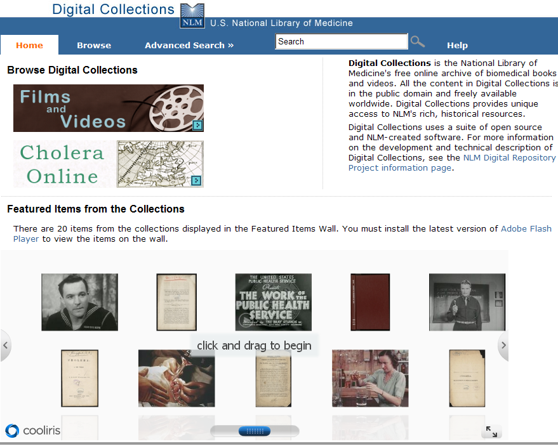
Digital Collections Films and Videos
Notes:
Digital Collections Films and Videos

Slide 49
Educational Clearinghouse Merger
Merger of:
Educational Clearinghouse database at the National Training Center and Clearinghouse (NTCC) & MLA Educational Clearinghouse
Eliminates duplication and redundancies between the 2 databases.
As May 5, the MLA Educational Clearinghouse is open to all and located at: http://cech.mlanet.org/.
Notes:
The Educational Clearinghouse database at the National Training Center and Clearinghouse (NTCC) has been merged with the
MLA Educationl Clearinghouse. This effort was undertaken to eliminate the duplication and redundancies found between the 2 resources. As of May 5, the new MLA Educational Clearinghouse is open to all and located at: http://cech.mlanet.org/.

Slide 50
NLM Update
Tuesday, May 17
10:30 – 11:30 a.m.
Donald Lindberg, MD
Betsy Humphreys
Sheldon Kotzin
Notes:
NLM Update
Tuesday, May 17
10:30 – 11:30 a.m.
Donald Lindberg, MD
Betsy Humphreys
Sheldon Kotzin

Slide 51
DOCLINE User Group Meeting
Tuesday, May 17
2:00 pm – 3:00 pm
Room L100F, Lower Level
Minneapolis Convention
Center
Notes:
DOCLINE User Group Meeting
Tuesday, May 17
2:00 pm – 3:00 pm
Room L100F, Lower Level
Minneapolis Convention
Center

Slide 52
Thank you!
Please stop by the NLM booth
for additional information, the NLM Theater presentations, and to give us your feedback.
Notes:
Please stop by the NLM booth
for additional information, the NLM Theater presentations, and to give us your feedback.

