Slide 1
MedlinePlus,
MedlinePlus Connect
& the
NLM Web Site
Loren Frant
Loren.Frant@nih.gov

Slide 2
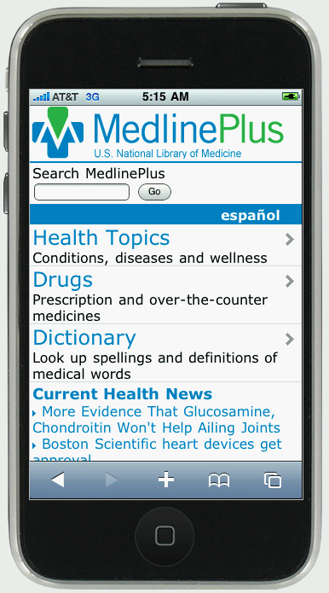
m.medlineplus.gov
2

Slide 3
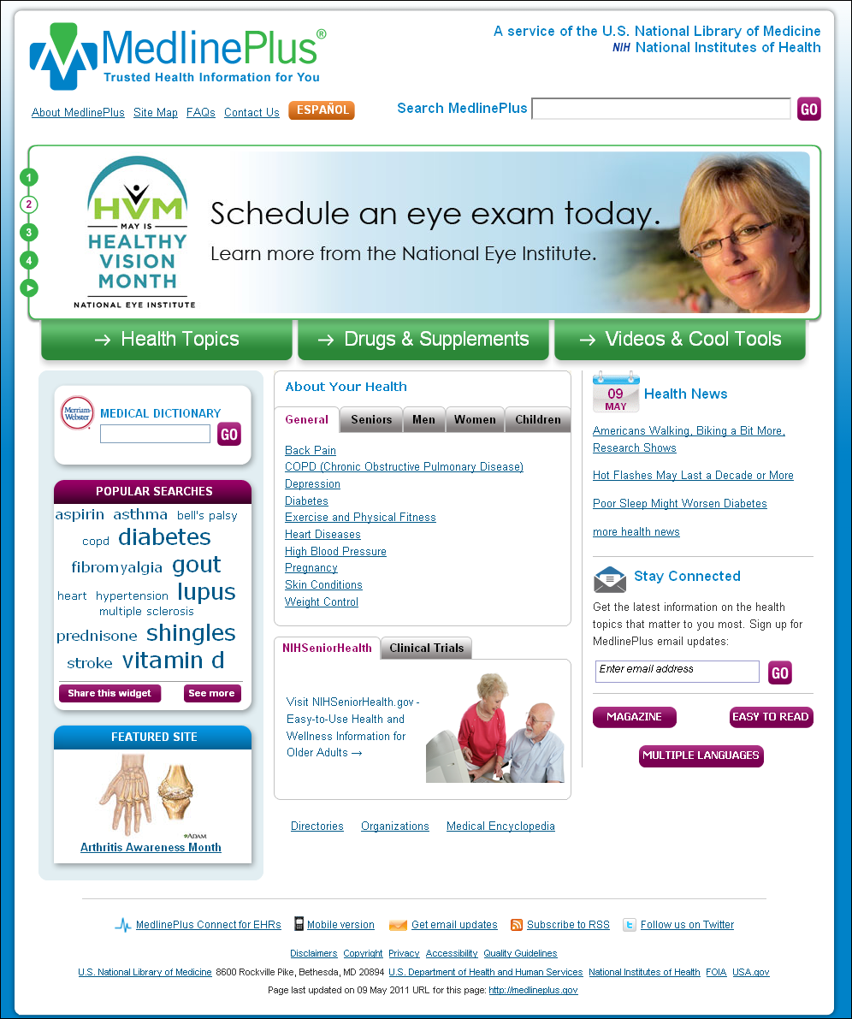
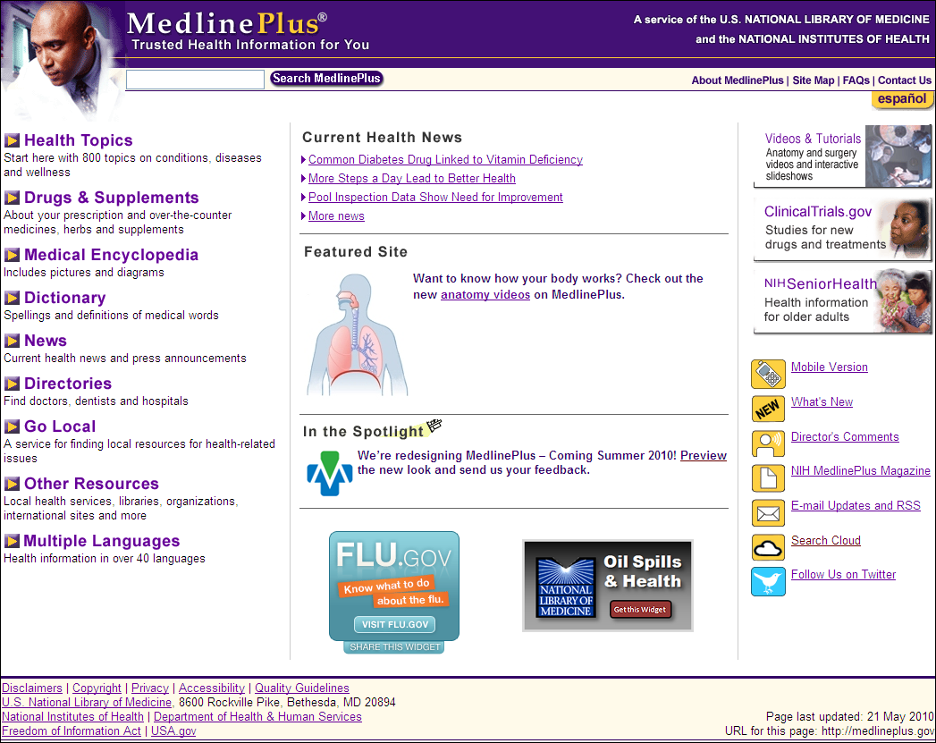
Screen captures of the MedlinePlus English homepages before and after the redesign.
3

Slide 4
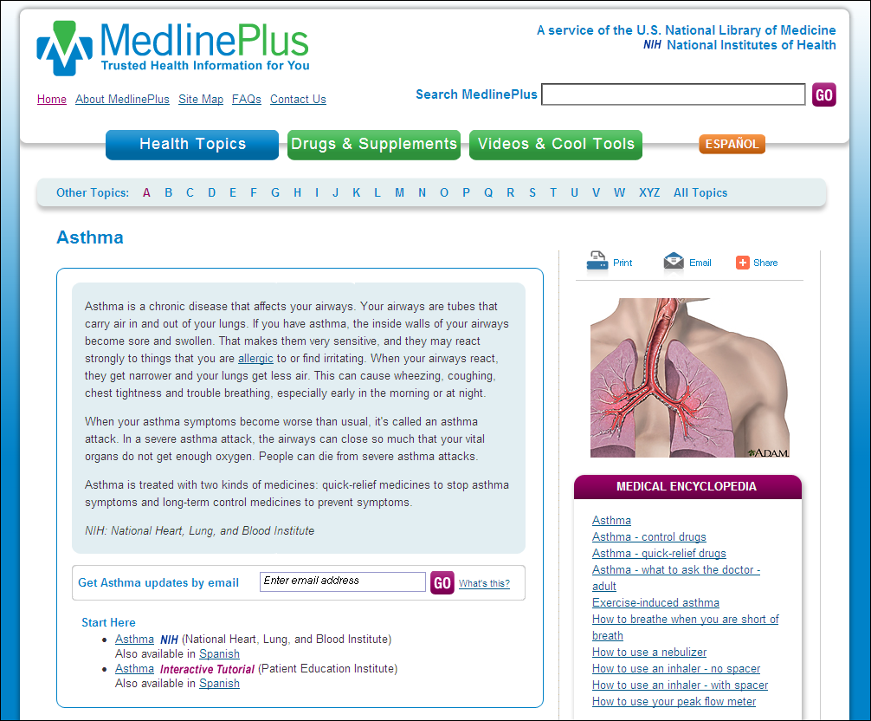
Screen capture of the MedlinePlus English asthma health topic page

Slide 5
Screen capture of the MedlinePlus English asthma health topic page (http://www.nlm.nih.gov/medlineplus/asthma.html) with the email updates sign up box highlighted

Slide 6
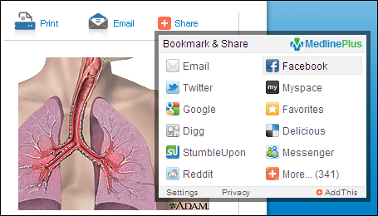
Screen capture of the MedlinePlus English asthma health topic page (http://www.nlm.nih.gov/medlineplus/asthma.html) with the bookmark and share tool highlighted

Slide 7
Screen capture of the MedlinePlus Mobile English homepage on an iPhone (m.medlineplus.gov)
m.medlineplus.gov

Slide 8
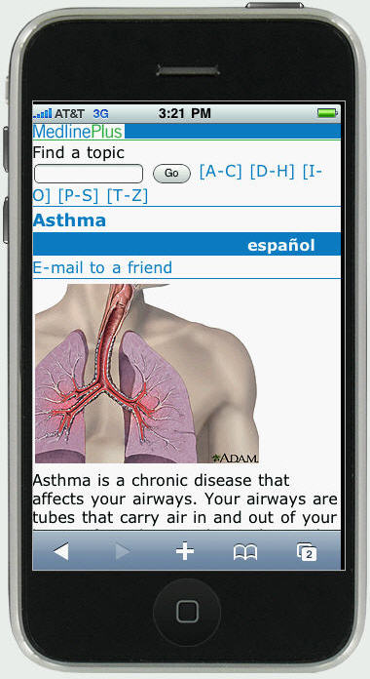
Screen capture of the MedlinePlus Mobile asthma English health topic page on an iPhone
m.medlineplus.gov

Slide 9
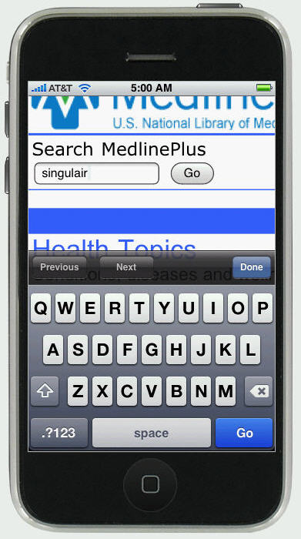
Screen capture of the MedlinePlus Mobile English search box on an iPhone
m.medlineplus.gov

Slide 10
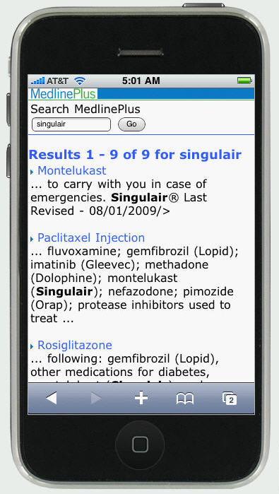
Screen capture of the MedlinePlus Mobile English search results page on an iPhone
m.medlineplus.gov

Slide 11
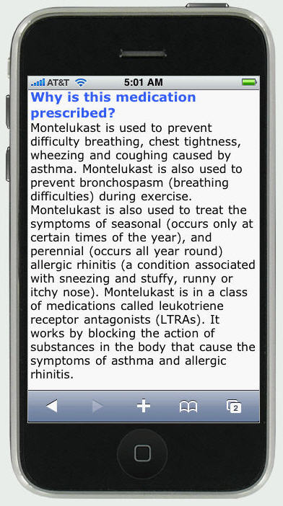
Screen capture of an English drug monograph page on MedlinePlus Mobile on an iPhone
m.medlineplus.gov

Slide 12
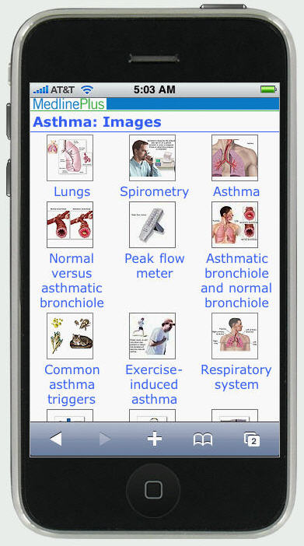
Screen capture of images from the English medical encyclopedia on MedlinePlus Mobile on an iPhone
m.medlineplus.gov

Slide 13
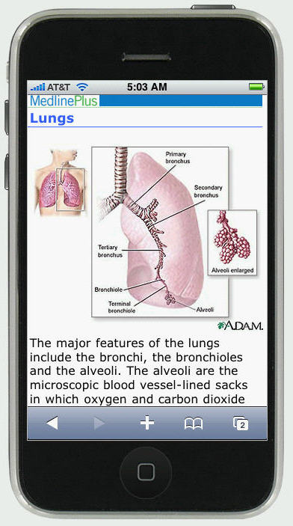
Screen capture of an illustration of the lunch in the English medical encyclopedia on MedlinePlus Mobile on an iPhone
m.medlineplus.gov

Slide 14
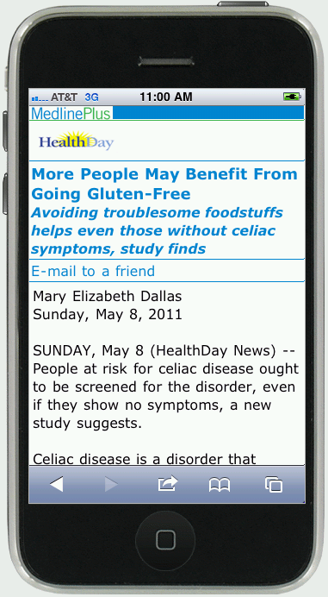
Screen capture of an English HealthDay news article on MedlinePlus Mobile on an iPhone
m.medlineplus.gov

Slide 15
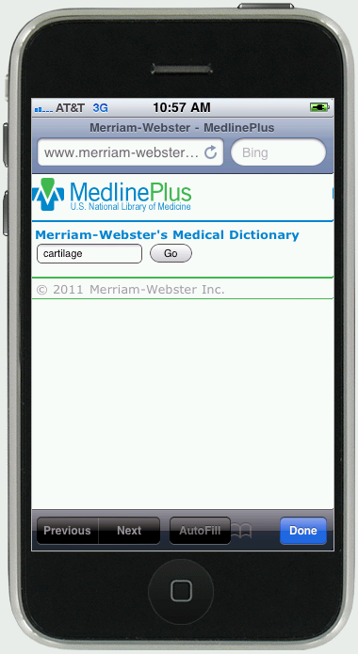
Screen capture of the medical dictionary search page on MedlinePlus Mobile on an iPhone
m.medlineplus.gov

Slide 16
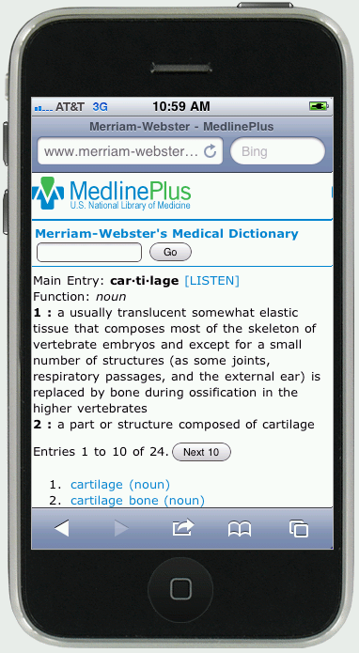
Screen capture of the medical dictionary search result page for "cartilage" on MedlinePlus Mobile on an iPhone
m.medlineplus.gov

Slide 17
Screen capture of the MedlinePlus Mobile English homepage on an iPhone (m.medlineplus.gov)
m.medlineplus.gov

Slide 18
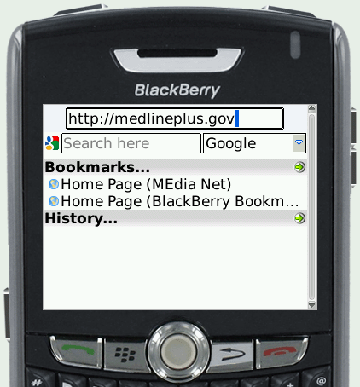
Discovering MedlinePlus Mobile

Slide 19
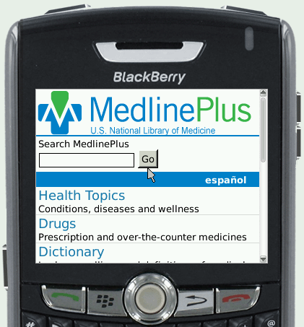
Discovering MedlinePlus Mobile

Slide 20
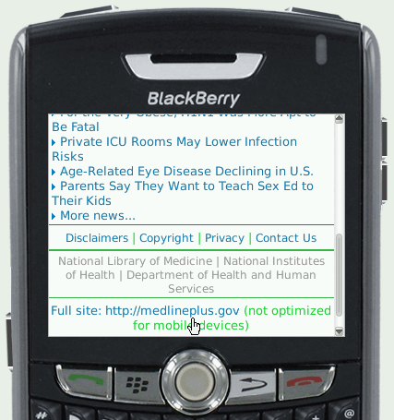

Discovering MedlinePlus Mobile

Slide 21
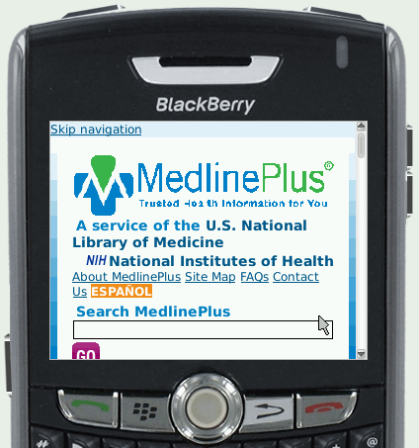
Discovering MedlinePlus Mobile

Slide 22
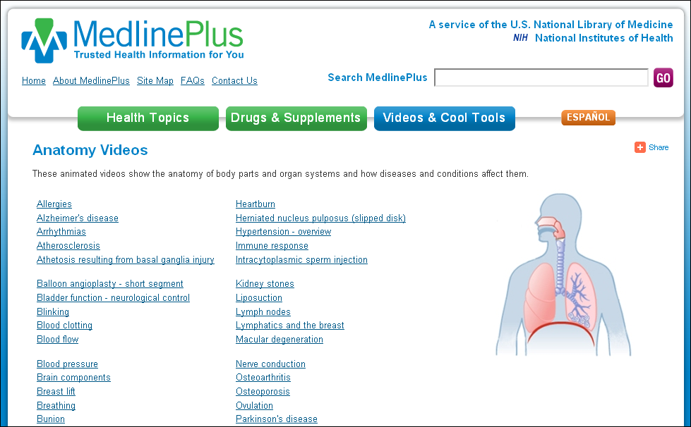
Anatomy Videos

Slide 23
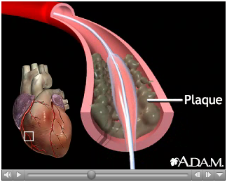
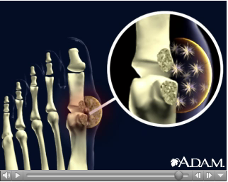
Anatomy Videos

Slide 24

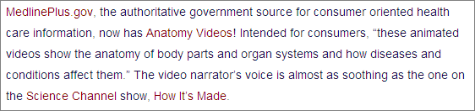
Anatomy Videos
These are a wonderful addition - thanks!

Slide 25
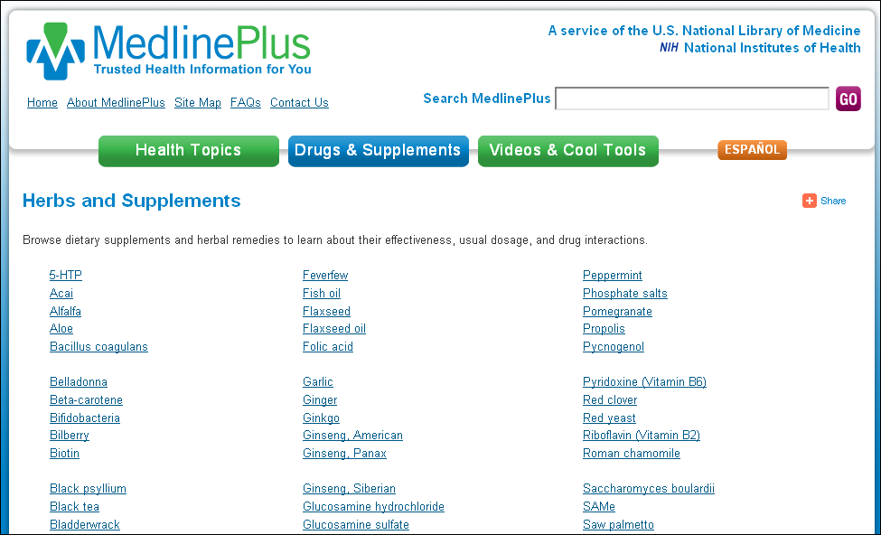

Screen capture of the English Herbs and Supplements page on MedlinePlus with the logo of the content provider highlighted (http://www.nlm.nih.gov/medlineplus/druginfo/herb_All.html)

Slide 26
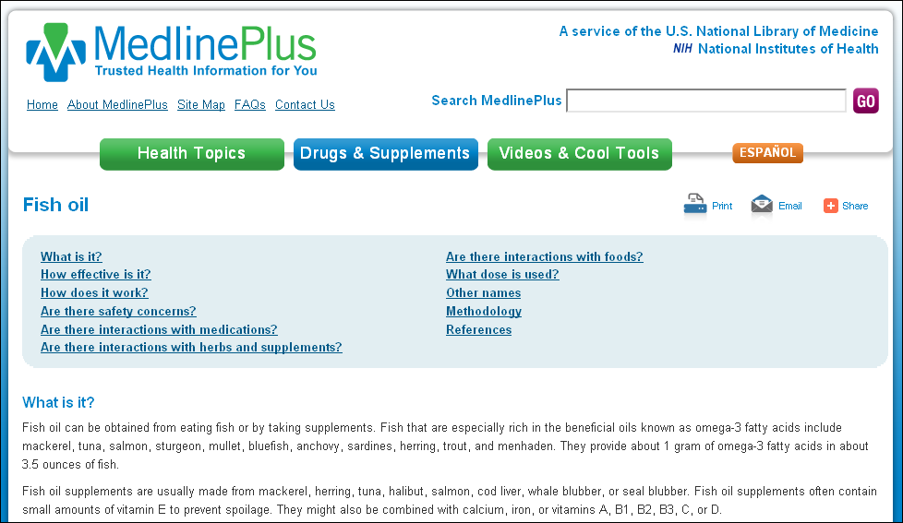
Screen capture of the English Fish Oil page on MedlinePlus (http://www.nlm.nih.gov/medlineplus/druginfo/natural/993.html)

Slide 27
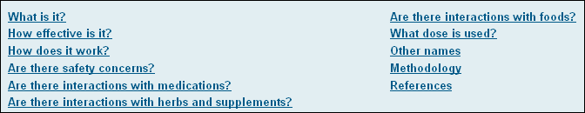
Screen capture of the English Fish Oil page on MedlinePlus with the table of contents highlighted (http://www.nlm.nih.gov/medlineplus/druginfo/natural/993.html)

Slide 28
MedlinePlus Web Service
Accepts keyword query requests and responds with relevant health topics and associated data in XML format
Powered by the Vivisimo search engine
28

Slide 29
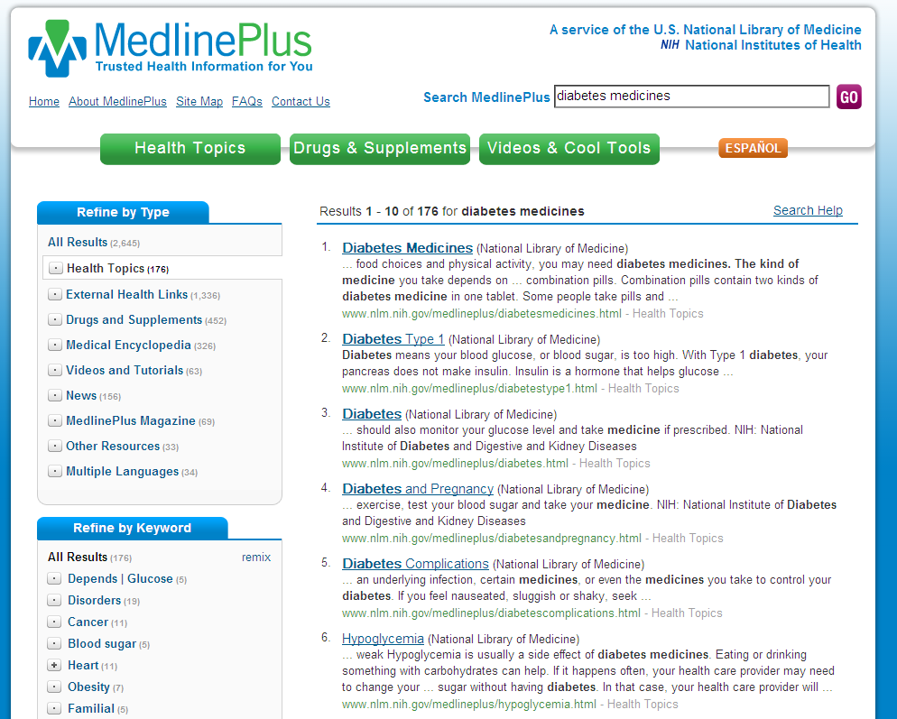
Health Topics Search Collection

Slide 30
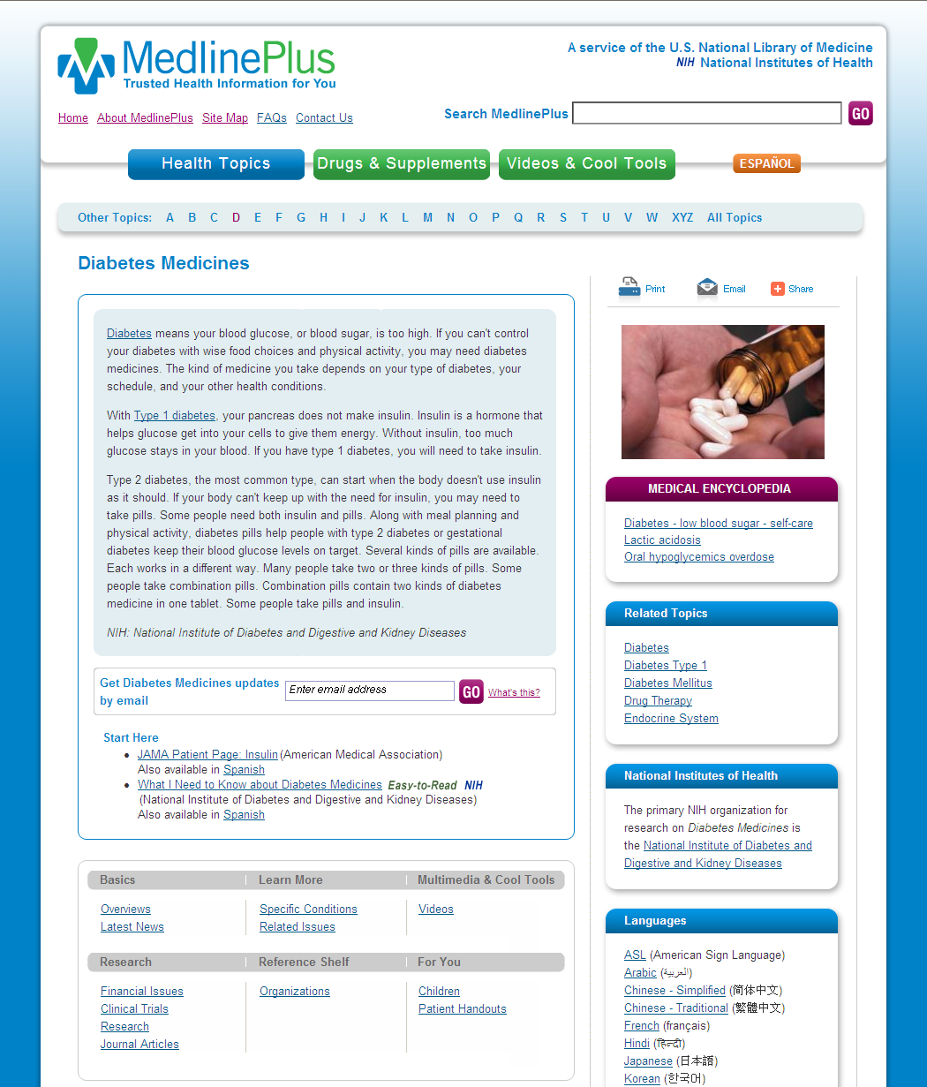
Screen capture of the English Diabetes Medicines health topic page on MedlinePlus (http://www.nlm.nih.gov/medlineplus/diabetesmedicines.html)

Slide 31
Sample Request
Application submits a query to the Web service:
http://wsearch.nlm.nih.gov/ws/query?db=healthTopics&term=diabetes+medicines
31

Slide 32
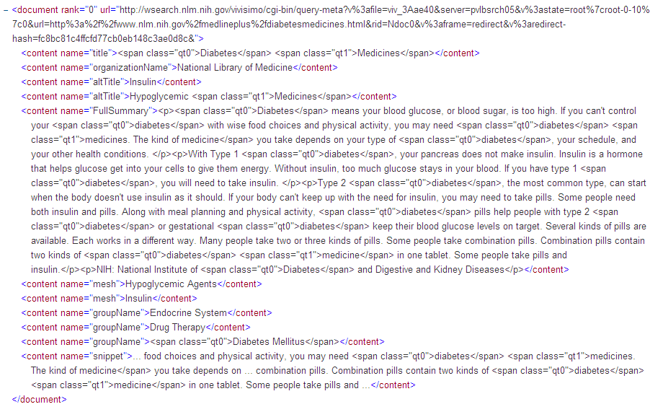
Sample Response

Slide 33
Response Elements
Topic name
URL
Synonyms and see references
Summary
MeSH vocabulary
Group assignments
Snippet
33

Slide 34
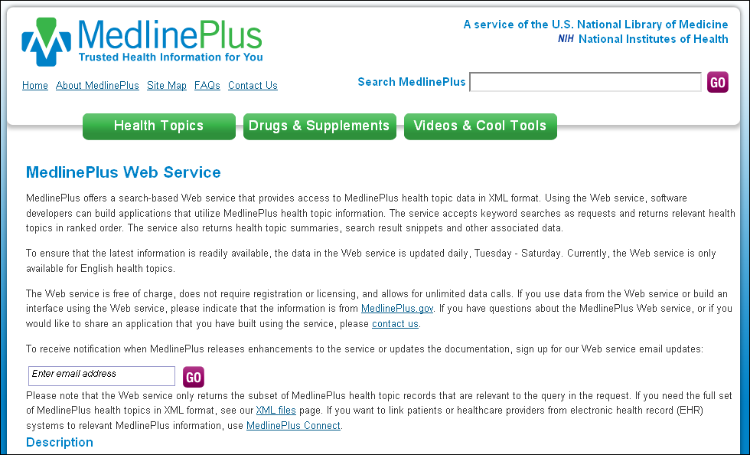
http://www.nlm.nih.gov/medlineplus/webservices.html

Slide 35
MedlinePlus Connect:
Linking EHRs to Consumer Health Information
35

Slide 36


MedlinePlus Connect
Problem, medication, or lab
code-based request
EHR/PHR
MedlinePlus Connect
Consumer health information targeted response
Patient portal
Clinical system
36

Slide 37
Standards
Problem Codes (Diagnoses)
  ICD-9-CM
  SNOMED CT® CORE Problem List Subset
Medication Codes
  RXCUI
  NDC
Lab Test Codes
  LOINC®
HL7 Context-Aware Knowledge Retrieval (Infobutton) Standard
37

Slide 38
Mockup of a patient health record with conditions listed with a link to Asthma highlighted
WMG
Log Out
West Medical Group
Hello, Jane Smith
Health Summary
Your Health Summary – Conditions
Appointments
Issue
Date
Asthma
05/02/2011
Medications
Acute Sinusitis
09/10/2009
Test Results
Depression
04/19/2008
Messages
Insurance

Slide 39
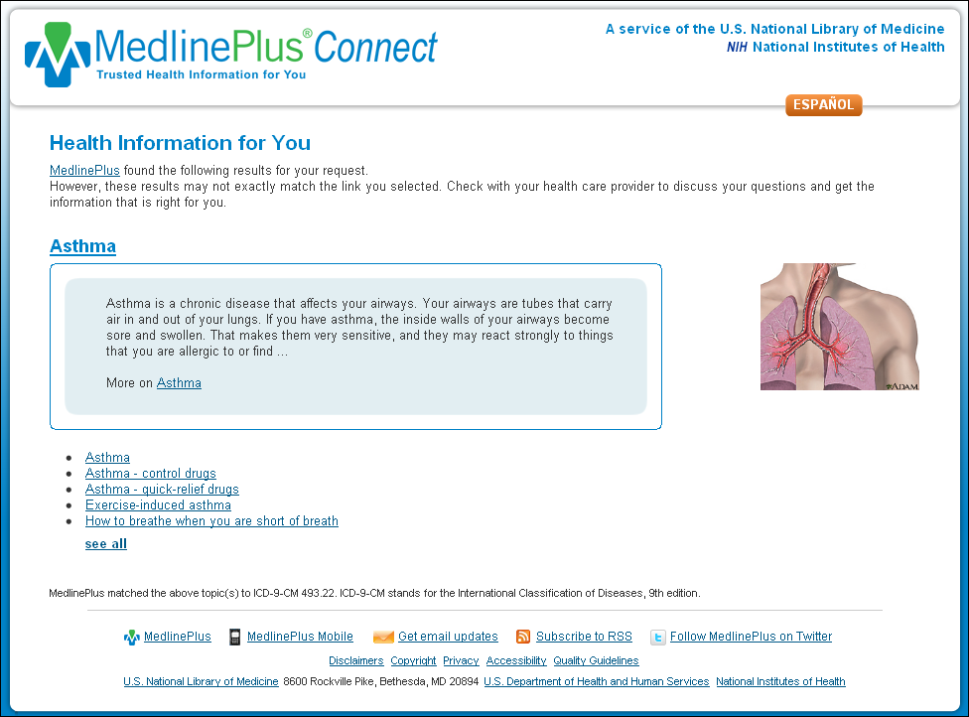
MedlinePlus Connect for Diagnoses

Slide 40
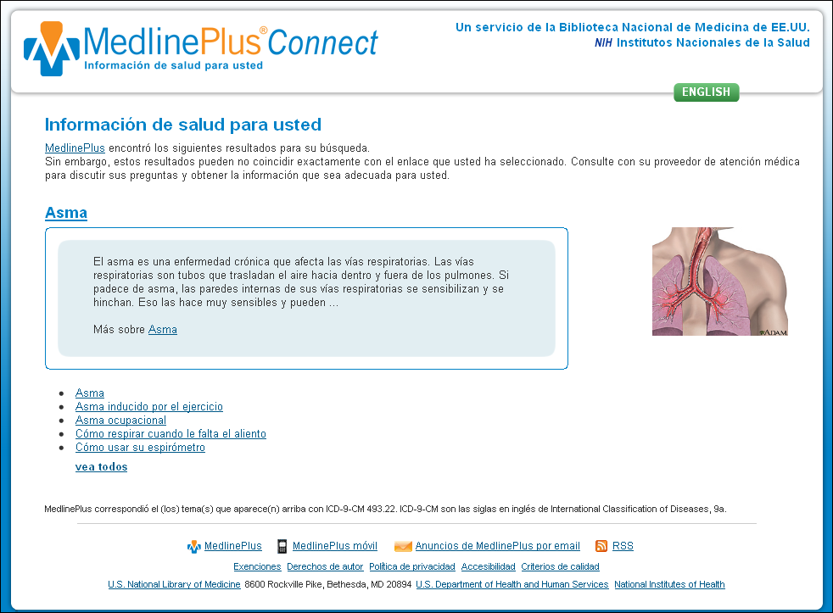
Spanish MedlinePlus Connect for Diagnoses

Slide 41
Mockup of a patient health record listing medications with a link to Paxil highlighted
WMG
Log Out
West Medical Group
Hello, Jane Smith
Health Summary
Your Medications
Appointments
Medication
Date Started
Xyzal
05/02/2011
Medications
Paxil
01/20/2009
Test Results
Messages
Insurance

Slide 42
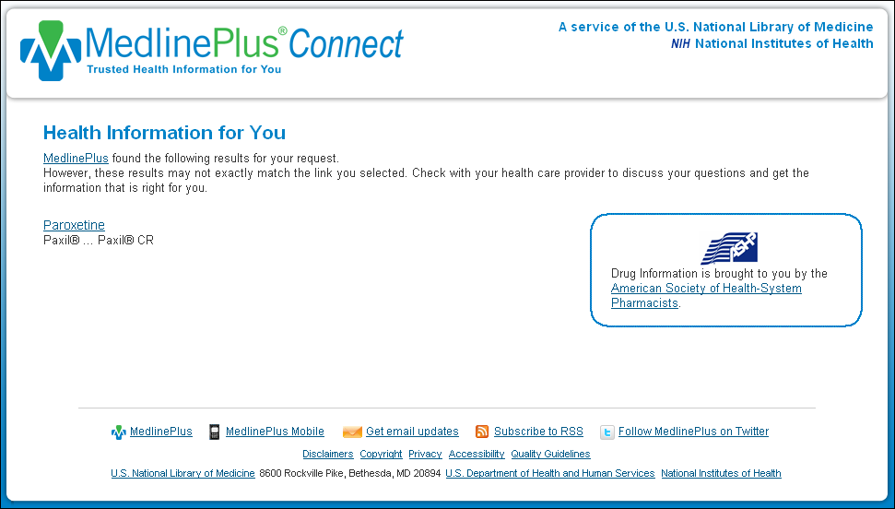
MedlinePlus Connect for Medications

Slide 43








Logos of organizations that have implemented MedlinePlus Connect
Web service
Web application

Slide 44
For More Information
  http://medlineplus.gov/connect
44

Slide 45
Screen capture of the MedlinePlus English homepage

Slide 46
Updating the NLM Web Site with a
User-Driven Design
46

Slide 47
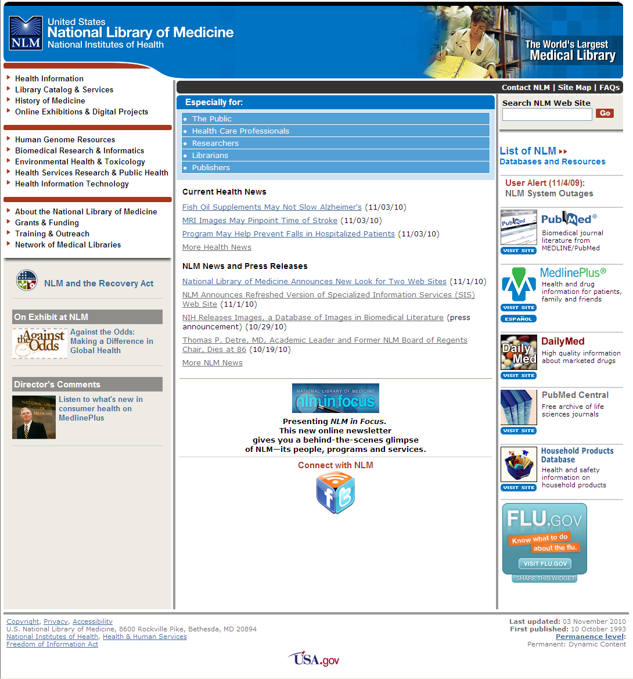
Screen capture of the old NLM homepage

Slide 48
Who are our users?
  Researchers/Scientists (18%)
  Health Care Providers (18%)
  Librarians (15%)
  College/Graduate Students (13%)
  Educators (11%)
  Patients (3%)
48

Slide 49
What are users trying to do?
Find and use NLM Databases (e.g., PubMed, MeSH, UMLS)
Find disease and drug information
Find and use historical resources
49

Slide 50
50
Notes:
Bar chart showing NLM Web site searches – the top 500 terms
99,872 - disease/disorder/symptoms
27,308 - general non-medical topic (e.g., books, jobs, dictionary)
25,135 - nlm product/service by name (e.g., pubmed, mesh, umls)
18,538 - general medical topic (e.g., nutrition, nursing)
17,219 - out of scope/junk
12,114 - drug by name (generic or brand)
6,626 - therapy/prevention (e.g., surgery, CAM, vitamins)
5,406 - anatomical (e.g., heart, foot)

Slide 51
Researchers/Scientists
Why are you visiting the National Library of Medicine Web site today?
(n = 1,201)
Reason for Visit | Percent
One or more of NLM’s databases | 25.3%
General library information and the National Library of Medicine’s resources | 11.2%
For a project or presentation | 10.6%
MeSH Browser (Medical Subject Headings) | 9.3%
History of medicine resources | 8.8%
51
Notes:
Reasons Researchers/Scientists visit the NLM Web site
N = 1,201
25.3 % One or more of NLM’s databases
11.2 % General library information and the National Library of Medicine’s resources
10.6 % For a project or presentation
9.3 % MeSH Browser (Medical Subject Headings)
8.8 % History of medicine resources

Slide 52
Health Care Providers
Why are you visiting the National Library of Medicine Web site today?
(n = 1,195)
Reason for Visit | Percent
One or more of NLM’s databases | 24%
General library information and the National Library of Medicine’s resources | 14.6%
Health information | 9.5%
For a project or presentation | 9.4%
History of medicine resources | 7.4%
52
Notes:
Reasons Health Care Providers visit the NLM Web site
N = 1,195
24 % One or more of NLM’s databases
14.6% General library information and the National Library of Medicine’s resources
9.5 % Health information
9.4 % For a project or presentation
7.4 % History of medicine resources

Slide 53
Librarians
Why are you visiting the National Library of Medicine Web site today?
(n = 1,028)
Reason for Visit | Percent
One or more of NLM’s databases | 22%
General library information and the National Library of Medicine’s resources | 17%
MeSH browser (Medical Subject Headings) | 12%
For a project or presentation | 7%
53
Notes:
Reasons Librarians visit the NLM Web site
N = 1,028
22 % One or more of NLM’s databases
17 % General library information and the National Library of Medicine’s resources
12 % MeSH browser (Medical Subject Headings)
7 % For a project or presentation

Slide 54
Translating User Data into Design
NLM Homepage Advisory Group
  Made up of representatives from all over NLM
  Refined draft designs focused on the top tasks
Conducted informal usability on draft designs
Updated ~8000 pages
54

Slide 55
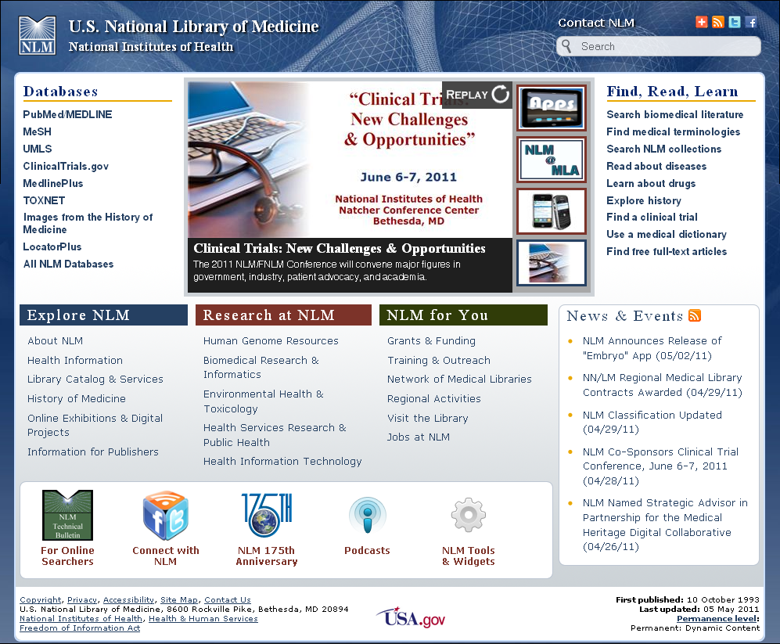

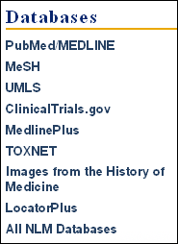

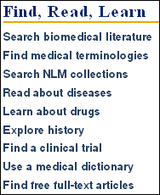
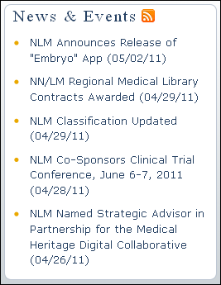
Prominent features on the redesigned NLM homepage

Slide 56

Prominent features on the redesigned NLM homepage

Slide 57
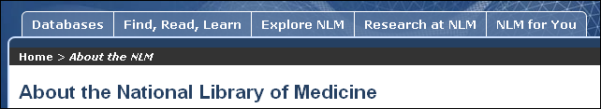
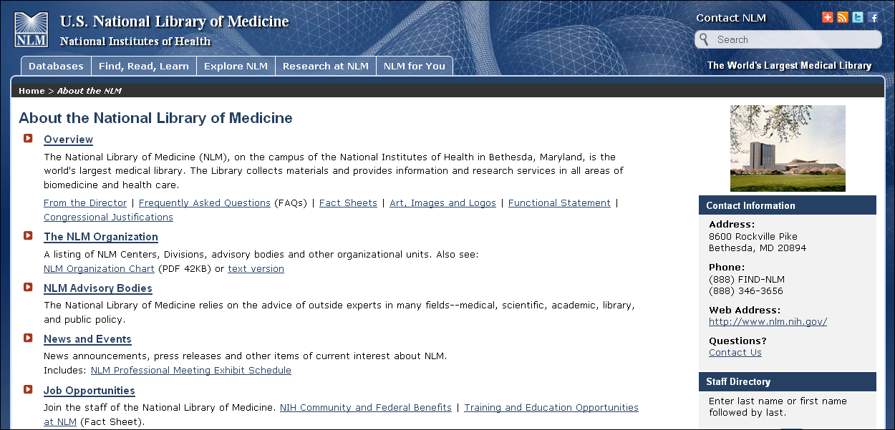
New About NLM page
57

Slide 58
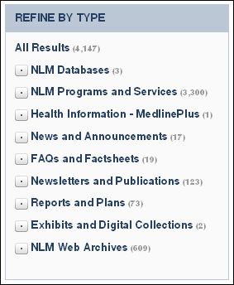
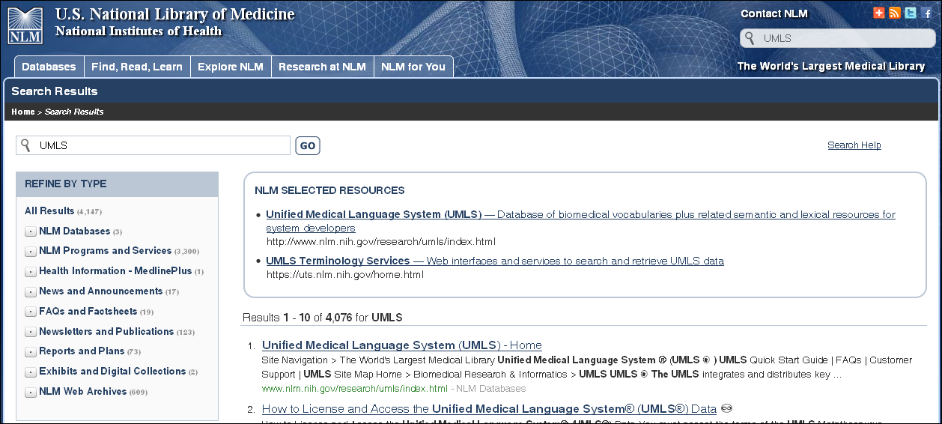
Search Enhancements
58

Slide 59
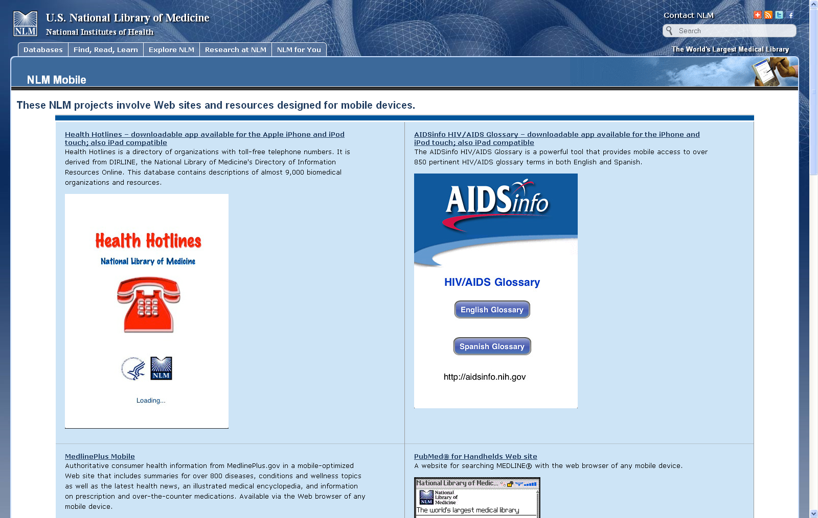
NLM Mobile
59

Slide 60
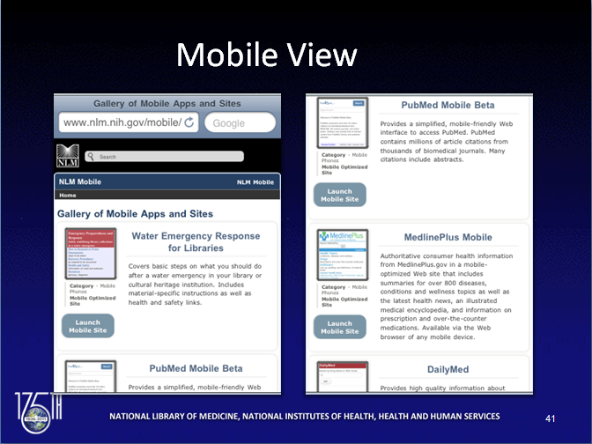
Mobile View
60

Slide 61
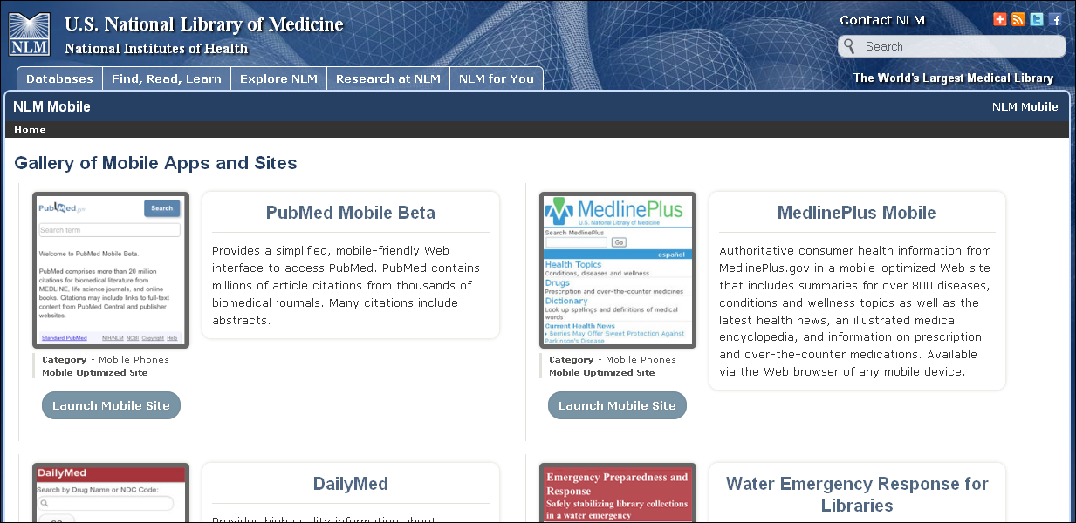
Desktop View

Slide 62
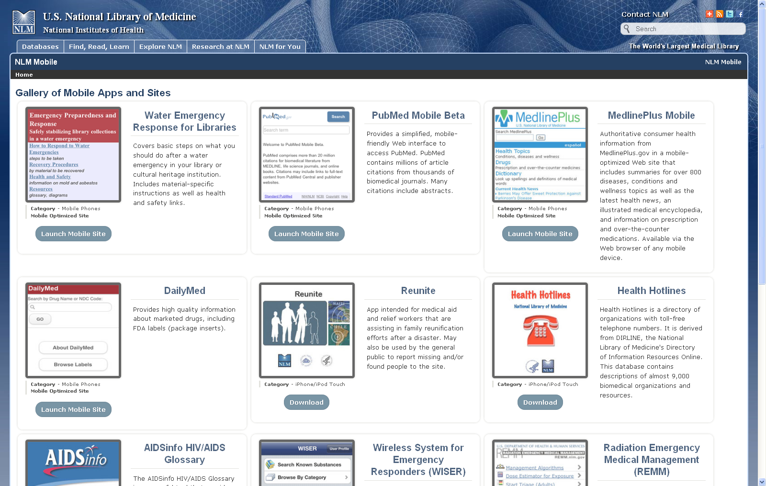
Widescreen View
62

Slide 63
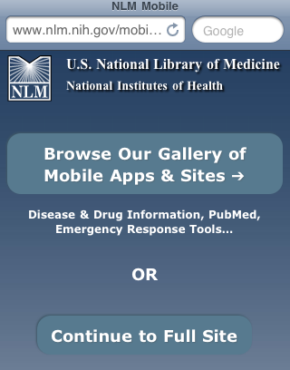
Redirect
63

Slide 64
MedlinePlus homepage, MedlinePlus Connect page and NLM homepage screen captures
64

