Slide 1
NLM Online Users’ Meeting May 21, 2012
David Gillikin
Chief, Bibliographic Services Division
National Library of Medicine
National Institutes of Health
Department of Health & Human Services

Slide 2
Presentations
David Gillikin: Online Update
Janice Kelly: Update from Division of Specialized Information Services
Loren Frant: MedlinePlus
Questions
Presentations will be posted on the NLM Technical Bulletin: NLM Technical Bulletin [http://www.nlm.nih.gov/pubs/techbull/tb.html]

Slide 3
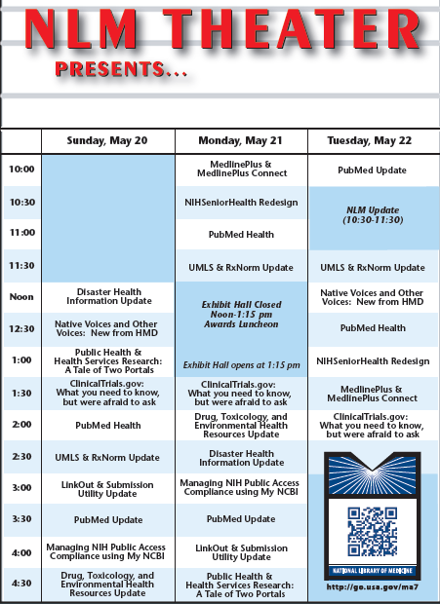
NLM Theater
Notes:
The NLM Exhibit Booth Theater Schedule is available. This year we have a QR Code so you can download the schedule. There is also a short URL for easy use. We will also be sending tweets to the MLA Tweeter feed with reminders and updates about what is happening at the NLM Exhibit booth.

Slide 4
MEDLINE Indexing
FY2011
724,831 citations indexed for MEDLINE
+4% increase over FY2010
80,297 gene indexing links created
FY2012
Anticipating an overall rate of 725,000 articles indexed

Slide 5
Medical Text Indexer First Line Indexing (MTIFL)
2011 Pilot Production Implementation – MTI First Line Indexing & Senior Reviewer
Production
24 journals
7 senior indexing staff
Anticipated to index 5,700 articles annually
Investigating expansion ideas
Notes:
One major project has been the Medical Text Indexer or MTI. In place since 2002, the use of MTI has seen steady progress. In the past year we started pursuing the idea of how to further the use of MTI in the first steps of indexing.

Slide 6
Medical Text Indexer First Line Indexing (MTIFL)
2011 Pilot Production Implementation – MTI First Line Indexing & Senior Reviewer
Production
24 journals
7 senior indexing staff
Anticipated to index 5,700 articles annually
Investigating expansion ideas
Notes:
The indexing process is advancing. Last year I told you about a pilot project involving the Medical Text Indexer software, where this software was being tested as the first indexing source which is then reviewed and modified by a senior indexer. This work has moved into production, called MTI First Line or MTIFL:
24 journals
7 senior indexing staff
Anticipated to index 5,700 articles annually
Investigating expansion ideas

Slide 7
Comment [PT] Indexing
Comment publication type = 33,000 per year.
2011 NLM study.
October 2011 – Transfer major indexing terms from original (parent) article to the comment article.
Comment in and Comment on links maintained.
Author Reply citations treated the same way as of April 2012.
Notes:
We have change how comment citations are indexed. On average, we index about 33,000 comment citations annually. An internal study showed that we could introduce a cost savings without impacting comment retrieval with a change in how comment articles are indexed. We are now transferring the major subject headings used for the parent article to the commenting citation.

Slide 8
PubMed
Advance Search Update
Article Versions
My NCBI Favorites Collection Feature
Citation Manager Send Entry
Change to Limits
Author link search
Notes:
There is a lot to share with you about PubMed. The major areas to cover are the redesign and enhancements to My NCBI; several new PubMed features; and the introduction of PubMed Mobile.

Slide 9
PubMed – Advance Search
Notes:
The Advance Search page was updated in December to provide a less cluttered and more intuitive way to build searches. You can select which field to search and enter a term or phrase.

Slide 10
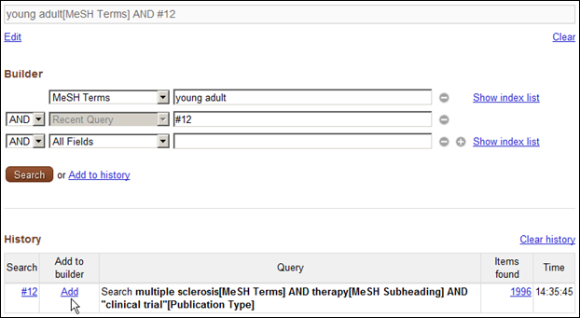
PubMed – Advance Search
Notes:
Search history statements can also easily be added to the search fields to build your search strategy.

Slide 11
Article Versions and MEDLINE/PubMed Citations
New FAQ available in April.
Article Version and MEDLINE/PubMed Citations: [www.nlm.nih.gov/services/article_versions.html]
Version: Subsequent publication of a previously published article that incorporates new data or findings. Links to other versions are provided.
Unique version number.
PubMed = displays only the most current version.
Search PMID and Version to retrieve previous citation versions.
Notes:
A new FAQ was published to explain our Article Versions will be handled in PubMed.
A unique version number is now assigned to a PubMed record.
A regular PubMed search will only display the most current version citation.
Links on the current version will let you access previous versions.
You can also search directly on the version number to retrieve an earlier version.

Slide 12
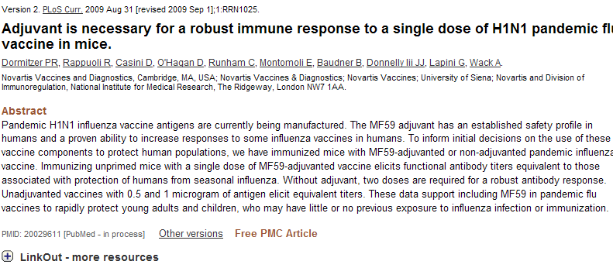
PubMed Versioning Citation

Slide 13
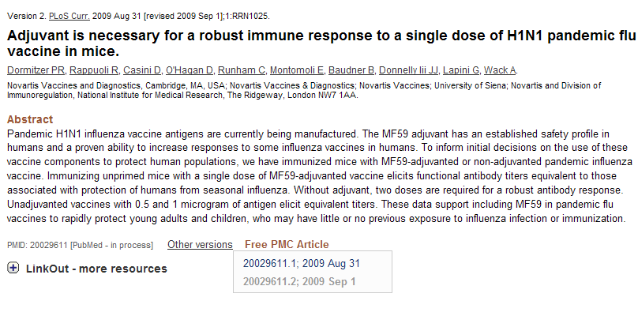
PubMed Citation

Slide 14
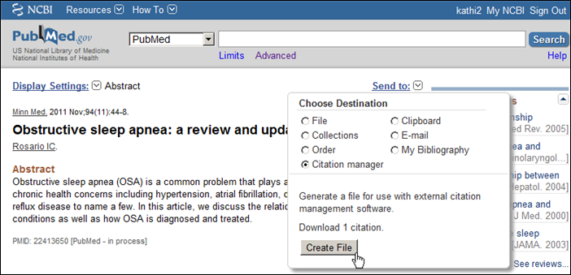
PubMed Results & Citation Manager Software
Notes:
The Send To function now has “Citation Manager” feature, to readily identify how to create and download a file to import into a citation management software.

Slide 15
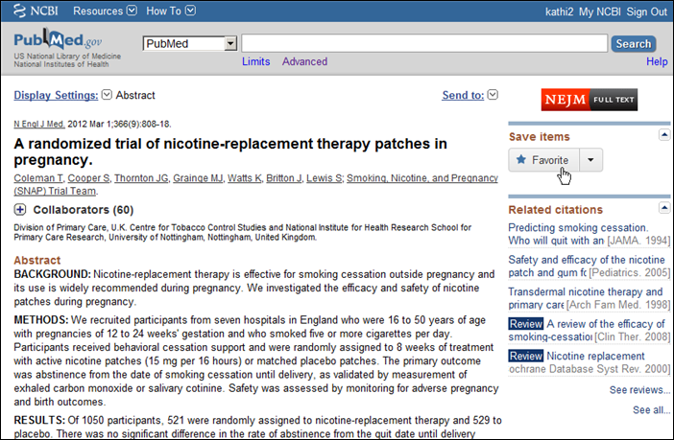
My NCBI Favorites Collection Feature
Notes:
My NCBI users now have an easy mechanism to add a citation to one of their collections. Click on the “Favorite” button under Save Items to get a list of the collections you’ve already created. Or you can create a new collection to use

Slide 16
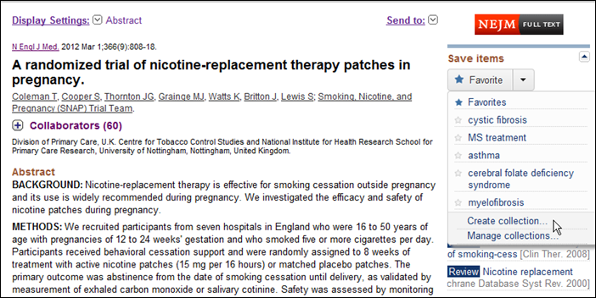
My NCBI Favorites Collection Feature
Notes:
Click on the “Favorite” button under Save Items to get a list of the collections you’ve already created. Or you can create a new collection to use

Slide 17
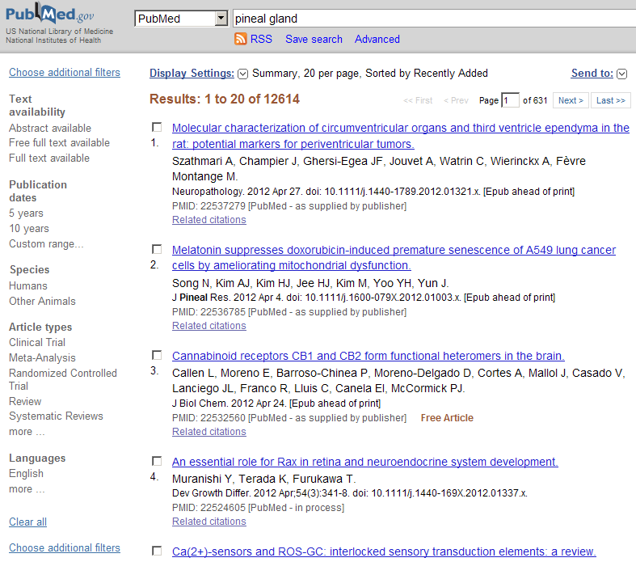
PubMed Filter Bar = Limits
Notes:
Most recently, the LIMITS function was updated to a left hand Filter bar. This was done to try improve the ease of use of LIMITS and to expand their use by end-users. You can modify which Filters you see by clicking on the “Choose additional filters” option.

Slide 18
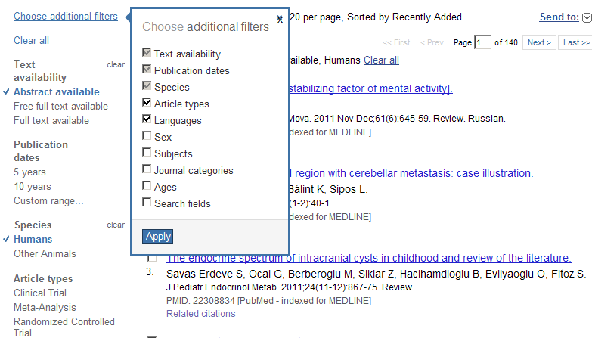
Choose additional filters

Slide 19
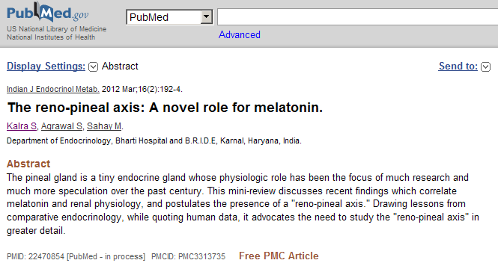
Author Search Link Abstract View
Notes:
The Author search link has been augmented. A computed search is now performed, taking in consideration of the author’s name, article metadata, and other authors involved, providing relevancy ranked result.

Slide 20
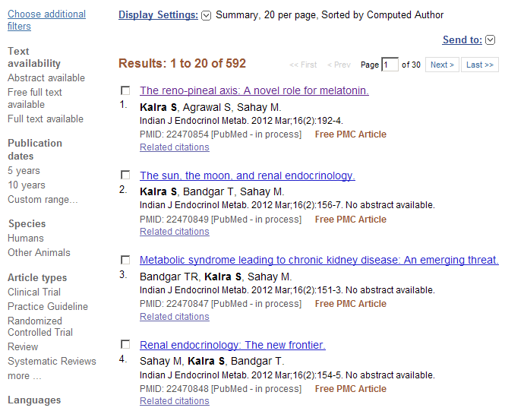
PubMed Citation with Author Rank
Notes:
The similarity for each citation pair is measured by examining the metadata for both citations, such as co-authors, journal, title, affiliation, abstract, MeSH terms, grants, and publication date. Citations that share like author names are divided into different groups by clustering the citations that are highly similar to each other. Citations within each group are then classified as belonging to the same author.

Slide 21
Other MEDLINE/PubMed Additions
Mobile users are now automatically redirected to the PubMed Mobile site.
PubMed Text Version retired in February. Site automatically redirects to PubMed Mobile.
2 new granting organizations added:
Autism Speaks
PEPFAR
Quality Improvement Category Added to Health Services Research (HSR) PubMed Queries

Slide 22
NLM and the National Training Center (NTC) PubMed Training (nnlm.gov/ntc/)
“Train the Trainer” approach, launched fall 2011.
Class composed of 3 online modules and 1 onsite module.
Objectives:
Functional Knowledge of MEDLINE database
Structure and Use of MeSH
Features and functions of PubMed
Techniques & best practices for teaching trainers
NTC & NCBI: developing 5-day in person workshop for librarians on NCBI databases.

Slide 23
PubMed Health
Notes:
PubMed Health continued to expand its focus on Clinical Effectiveness information, and with making Systematic Reviews more accessible and understandable.

Slide 24
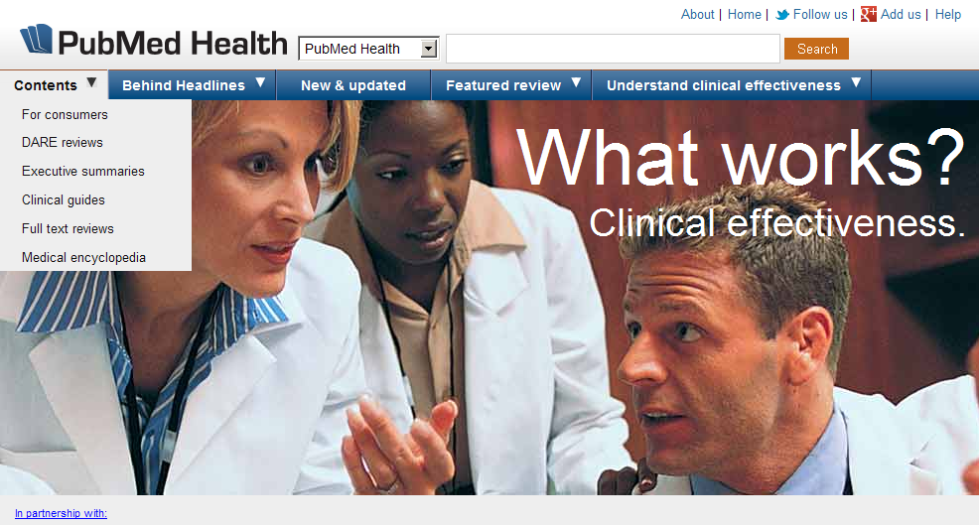
Contents Option on PubMed Health
Contents option on PubMed Health
Notes:
Contents option on PubMed Health

Slide 25
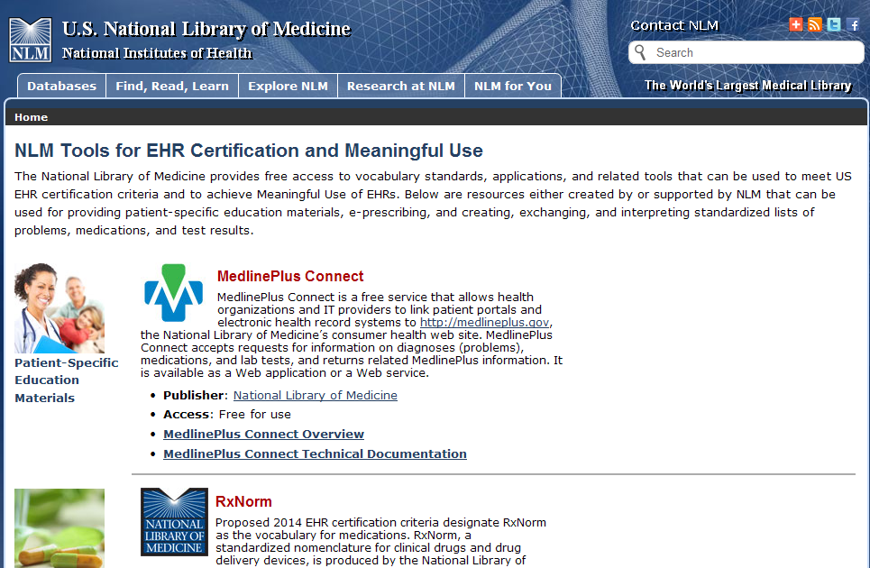
NLM Resources
NLM Tools for HER Certification and Meaningful Use
MedlinePlus Connect
RxNorm
SNOMED CT
LOINC
Notes:
www.nlm.nih.gov/healthit/meaningful_use.html
Covering NLM resources:
MedlinePlus Connect
RxNorm
SNOMED CT: Systematized Nomenclature of Medicine - Clinical Terminology
LOINC : Logical Observation Identifiers Names and Codes

Slide 26
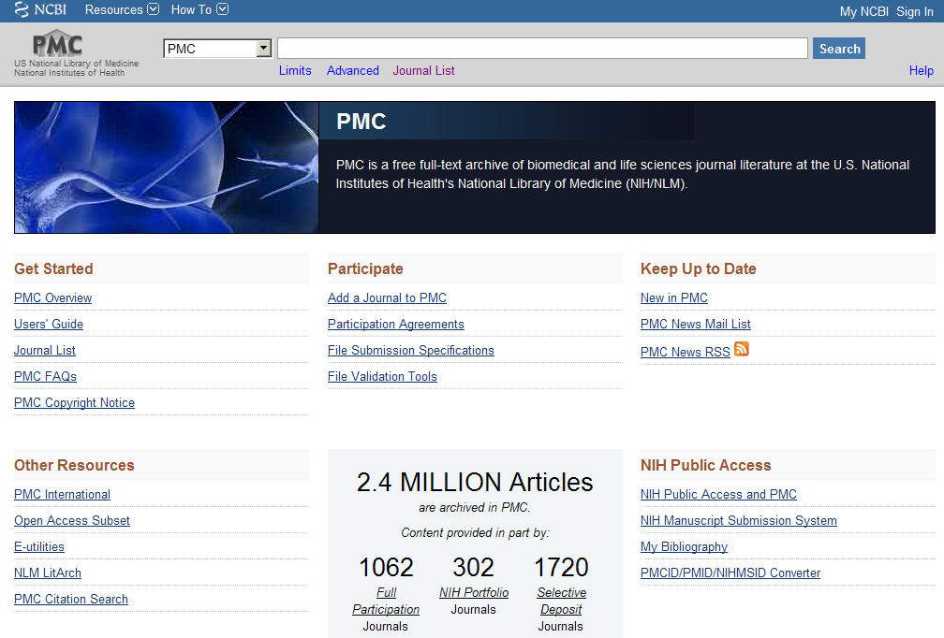
PubMed Central
Notes:
As of today we have just over 1,000 full participation titles. That number doesn’t count predecessor titles, i.e., title changes over the course of a journal’s life. So jmla and bmla count as 1 in the 800. We also have over 300 NIH portfolio journals.

Slide 27
NIH Public Access Policy Status
NIH-funded articles in PMC as of March 2012:
Total for publication dates July 2008 – Dec 2011: approx. 250,000
40% are final, published versions from PMC participating journals
60% are author manuscripts
Estimated compliance rate for the period: 75%

Slide 28
Unified Medical Language System (UMLS)
UMLS Releases:
2011AB release: November 17, 2011
More than 2.63 million concepts and 8.6 million unique concept names from 160 source vocabularies
2012AA release: May 7, 2012
More than 2.7 million concepts and 10.8 million unique concept names from over 160 source vocabularies
US SNOMED CT Content Request System: Beta version in October, production version in February.

Slide 29
Unified Medical Language System (UMLS)
UMLS Video Learning Resources page, consolidating all UMLS-related video tutorials.
Link to UMLA Video Learning Resources page: http://www.nlm.nih.gov/research/umls/user_education/learning_resources.html
Variety of subsets provided; most recent are the SNOMED CT Core Problem list subset & the Route of Administration subset.

Slide 30
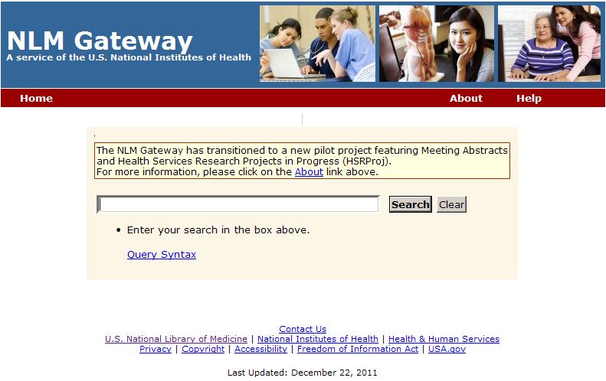
NLM Gateway
New pilot search site
Notes:
New pilot search site launched in December from Lister Hill National Center for Biomedical Communications.
Focus on:
Meeting Abstracts database
Health Services Research Projects in Process (HSRProj)
Addition of the 2010 18th International AIDS Conference abstracts = final data added to Meeting Abstracts.

Slide 31
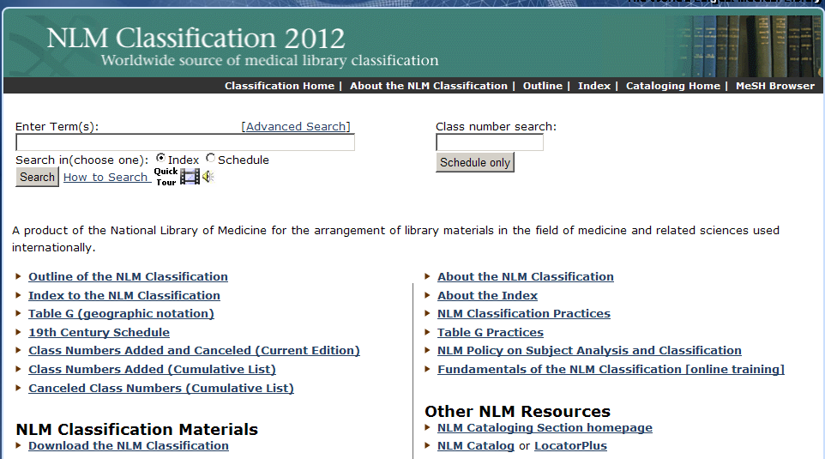
NLM Technical Services Division
Released in April
QV (Pharmacology)
NLM Classification 2012 edition released in April.
Major areas of focus:
QV (Pharmacology)
NLM Technical Bulletin article:
Link to NLM Technical Bulletin article: http://www.nlm.nih.gov/pubs/techbull/mj12/mj12_classification.html
Notes:
NLM Classification 2012 edition released in April.
Major areas of focus:
QV (Pharmacology)
NLM Technical Bulletin article: http://www.nlm.nih.gov/pubs/techbull/mj12/mj12_classification.html

Slide 32
Resource Description and Access (RDA)
New cataloging guidelines replacing AACR2.
NLM to implement by March 31, 2013.
Catalogers who participated in the RDA Test will begin use of RDA in late 2012.
Already using RDA qualifiers for personal names immediately, if this allows NLM to avoid creating an undifferentiated personal name.
Presentation held on Sunday May 20.
Sharon Willis at NLM booth, May 21, 4-5 pm
Notes:
more details on RDA they can attend Sharon Willis’s presentation on Sunday afternoon
Sunday, May 20 (4:30-6:00 PM)
Session: Stepping Up to the Plate with New Concepts of Data: Resource Description and Access, Semantic Web, Linked Data
Topic: Resource Description and Access and the New Bibliographic Framework: Moving Library Data to the Semantic Web
Presenter: Sharon Willis, Cataloging Section, National Library of Medicine, Bethesda, MD
Room : 602/603

Slide 33
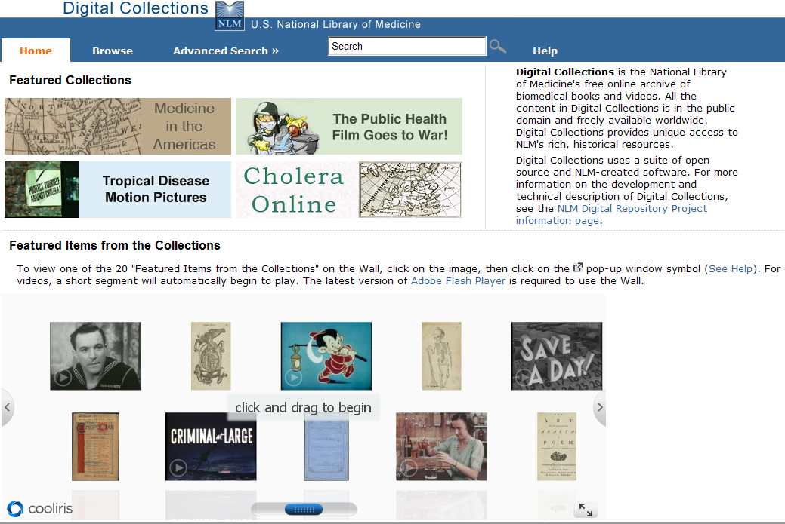
Digital Collections
Featured Collections
Over 6,500 books, including 546 items on Cholera
70 Films:
The Public Health Film Goes to War (18)
Tropical Disease Motion Pictures (46)
Notes:
Digital Collections
Overs 6,500 books, including 546 items on Cholera
70 Films:
The Public Health Film Goes to War (18)
Tropical Disease Motion Pictures (46)

Slide 34
Showcase of NLM APIs Webinar
Covering E-utilities, MedlinePlus Connect, RxNorm, ClinicalTrials.gov, ChemSpell, DIRLINE, Pillbox, Metamap and Medical Text Indexer.
Webinar held on April 10:
Read about the Webinar at: http://www.nlm.nih.gov/pubs/techbull/ma12/ma12_api_webinar.html
Recording at:
Recording of Showcase of NLM APIs: http://www.videocast.nih.gov/Summary.asp?File=17205

Slide 35
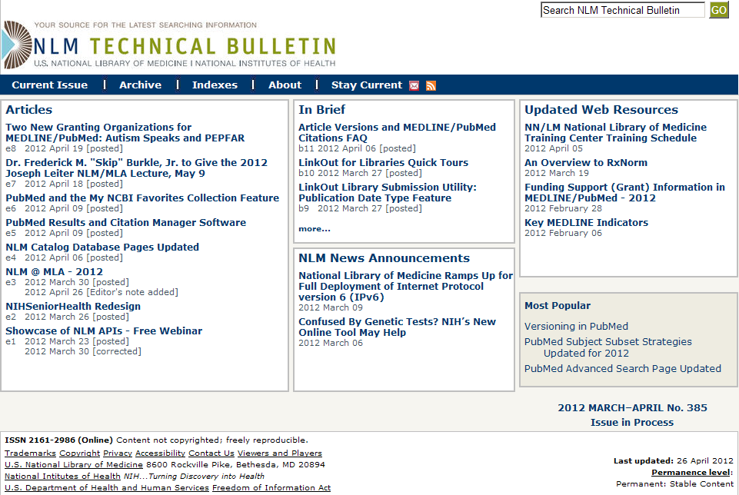
NLM Technical Bulletin
January 2012
Notes:
In January 2012, the NLM Technical Bulletin launched a major redesign. Articles and other items of interests are easily accessed from the body of the page. The top tool bar provides ready access to the archive, indexes and other features like the RSS feed and e-mail update options.

Slide 36
Sheldon Kotzin
Sheldon Kotzin
Retiring after 43 years of service to NLM
NLM Associate
Head, Catalog Maintenance Unit
Head, Collection Access Section
Coordinator, Regional Medical Library Network
Chief, Bibliographic Services Division
Associate Director for Library Operations
Notes:
Sheldon Kotzin, Associate Director for Library Operations, is retiring after 43 years of service to NLM:
NLM Associate
Head, Catalog Maintenance Unit
Head, Collection Access Section
Coordinator, Regional Medical Library Network
Chief, Bibliographic Services Division
Associate Director for Library Operations

Slide 37
Sheldon Kotzin
Sheldon Kotzin
Retiring after 43 years of service to NLM
Executive Editor of MEDLINE
Scientific administrator of the Literature Selection Technical Review Committee
NLM Representative to the National Federation of Indexing and Abstracting Services (NFAIS)
NLM Representative to the International Committee of Medical Journal Editors (ICMJE)
MLA Fellow
Notes:
Sheldon Kotzin, Associate Director for Library Operations, is retiring after 43 years of service to NLM:
NLM Associate
Head, Catalog Maintenance Unit
Head, Collection Access Section
Coordinator, Regional Medical Library Network
Chief, Bibliographic Services Division
Associate Director for Library Operations
Executive Editor of MEDLINE
Scientific administrator of the Literature Selection Technical Review Committee
NLM Representative to the National Federation of Indexing and Abstracting Services (NFAIS)
NLM Representative to the International Committee of Medical Journal Editors (ICMJE)
MLA Fellow

Slide 38
Thank you!
Please stop by the NLM booth
for additional information, the NLM Theater presentations, and to give us your feedback.

