Slide 1
NIHSeniorHealth & MedlinePlus
Loren Frant
Loren.Frant@nih.gov

Slide 2
NIHSeniorHealth Redesign
Transforming a site while keeping its essence…

Slide 3
Why Redesign?
Traffic trending down
User recommendations and comments
Our users have changed since launch
Need search
Dated look and feel

Slide 4
Redesign Process
Research
Best practices for senior-friendly design
Data about how seniors use the Internet
User feedback specific to NIHSeniorHealth
Create designs that are modern while keeping senior-friendly features
Usability testing of page designs and search feature with seniors

Slide 5
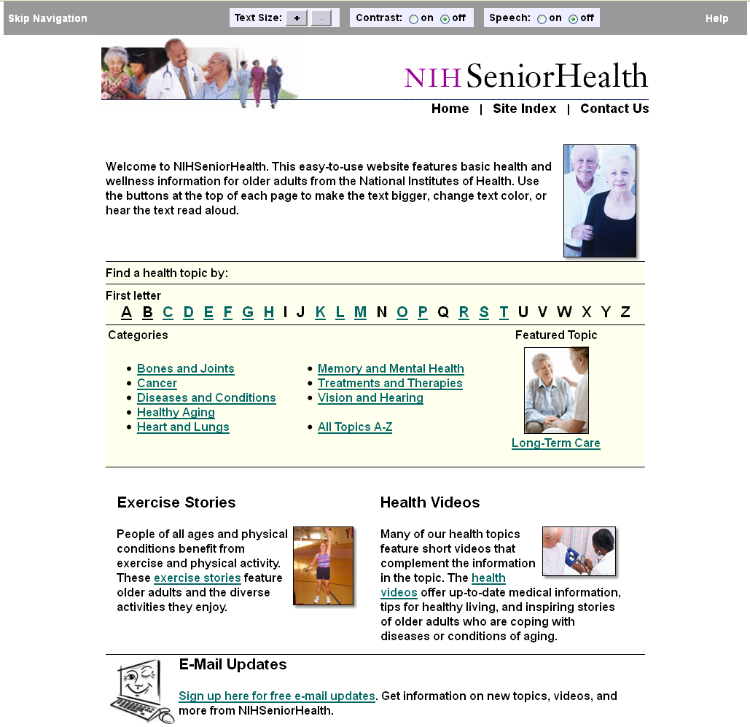
NIHSeniorHealth

Slide 6
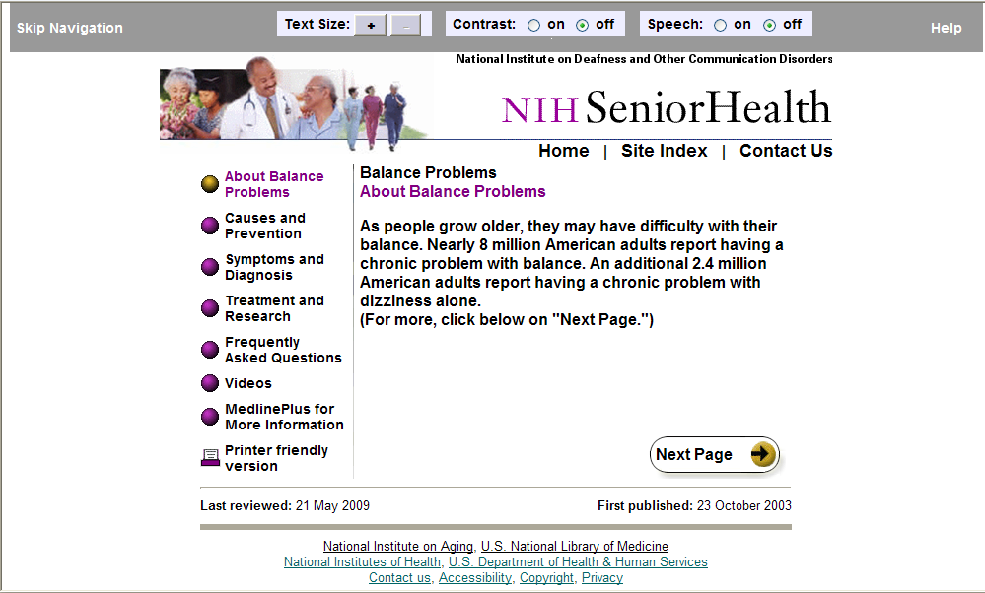
NIHSeniorHealth Topic Page

Slide 7
New Site-Wide Banner
Find content
50+ topics, 150+ videos
Search
Senior-friendly
Resize text
Change contrast
Use again later
Print
Bookmark/share
Sign up for email updates

Slide 8
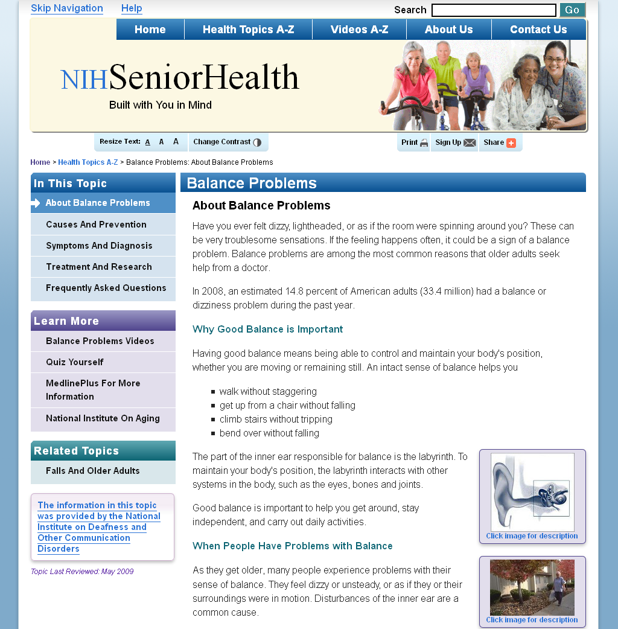
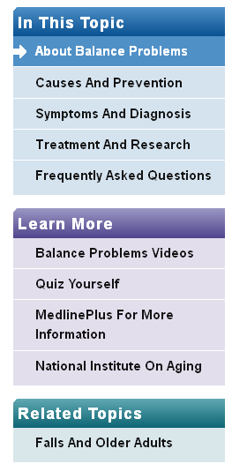
NIHSeniorHealth sidebar

Slide 9
NIHSeniorHealth search for shingles symptoms

Slide 10
MedlinePlus and MedlinePlus Connect

Slide 11
U.S. Visits to MedlinePlus.gov

Slide 12
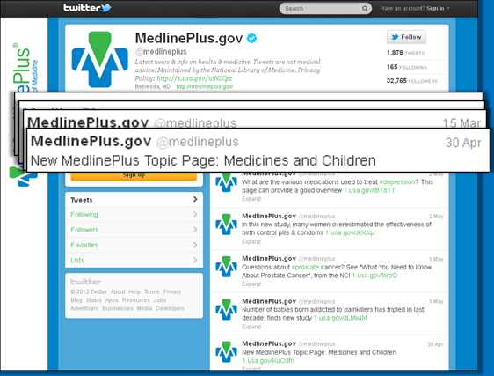
MedlinePlus Twitter page

Slide 13
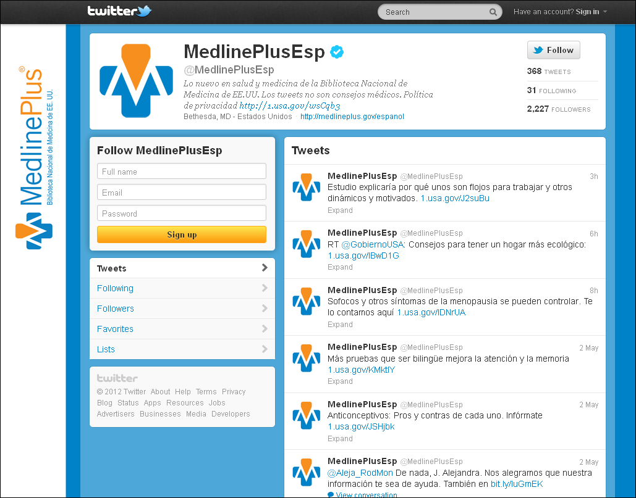
MedlinePlus Espanol Twitter page

Slide 14
MedlinePlus Twitter Followers @medlineplus and @medlineplusesp

Slide 15
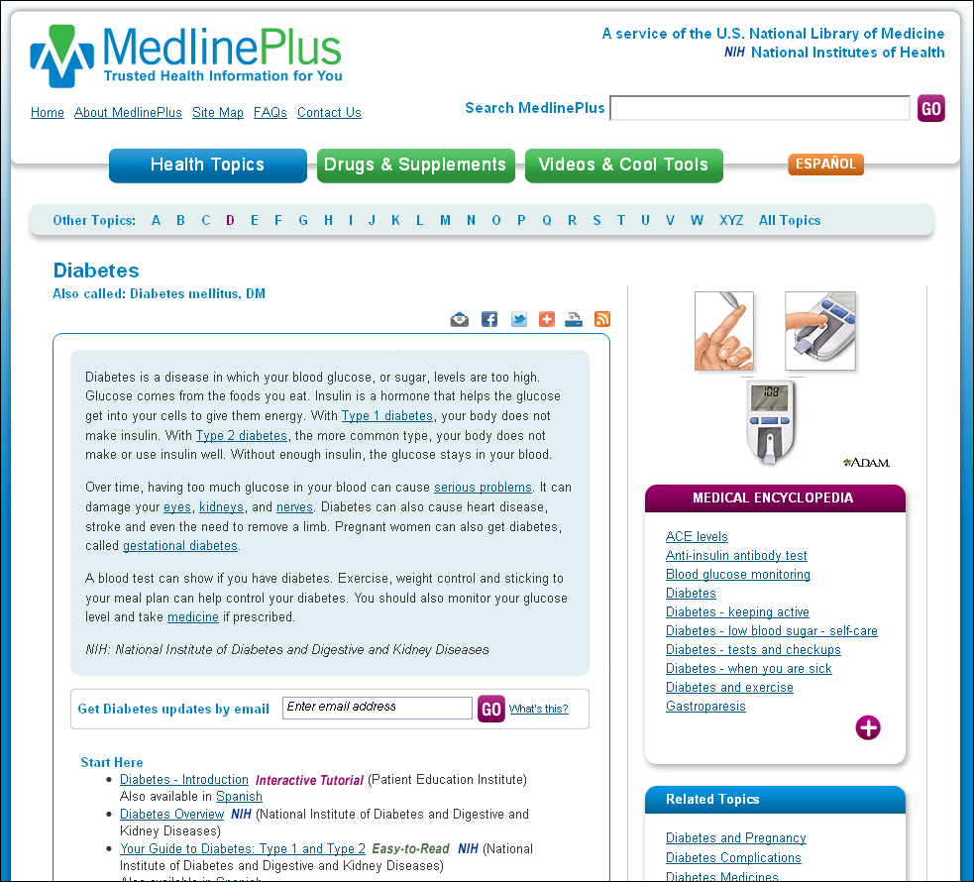
MedlinePlus Diabetes Topic Page

Slide 16
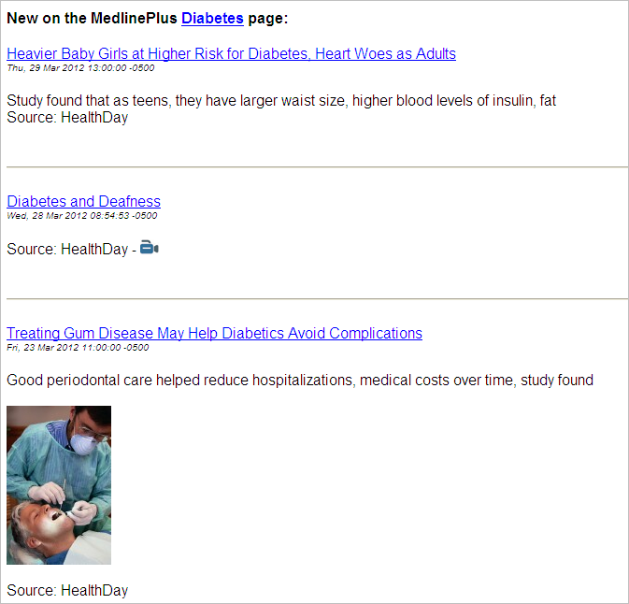
MedlinePlus Diabetes Subscription e-mail message

Slide 17
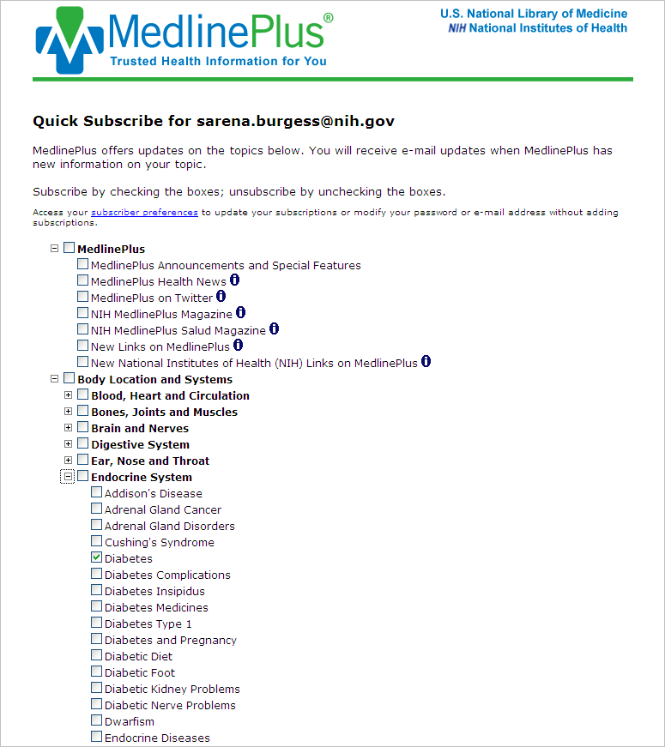
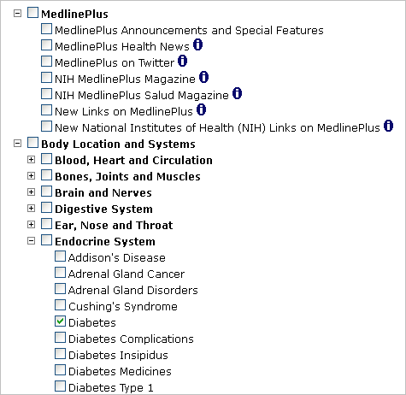
MedlinePlus Subscription Service Sign up topics

Slide 18
Subscribers and Subscriptions to MedlinePlus e-mail subscription service
Subscribers
Subscriptions

Slide 19
MedlinePlus social media options

Slide 20
MedlinePlus RSS Feed

Slide 21
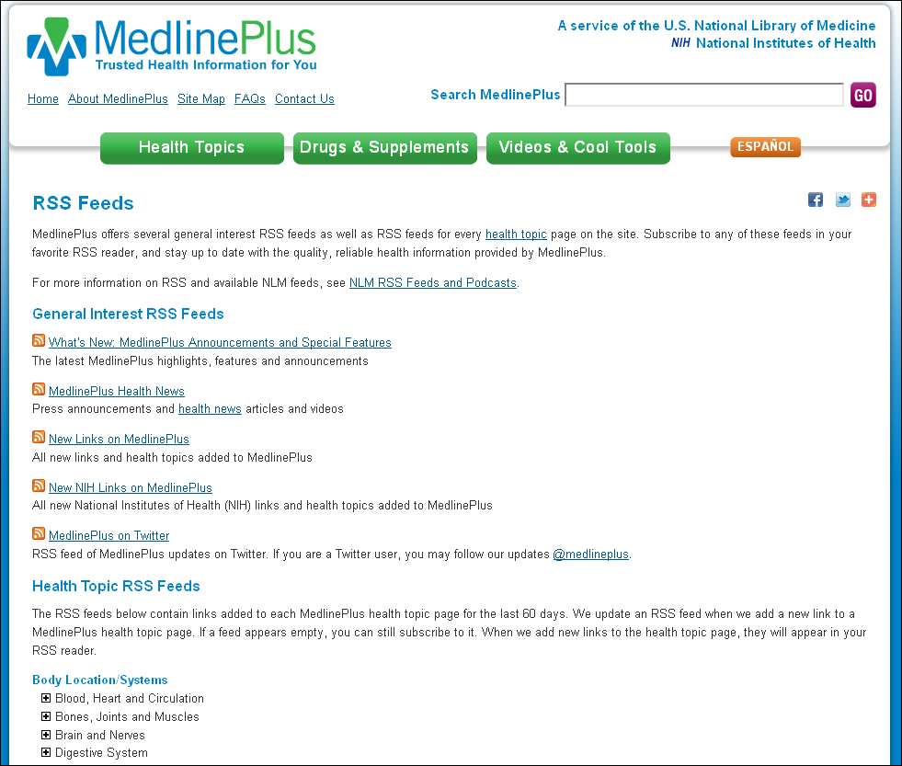
http://www.nlm.nih.gov/medlineplus/rss.html

Slide 22
MedlinePlus

Slide 23
MedlinePlus Links in Social Networks

Slide 24
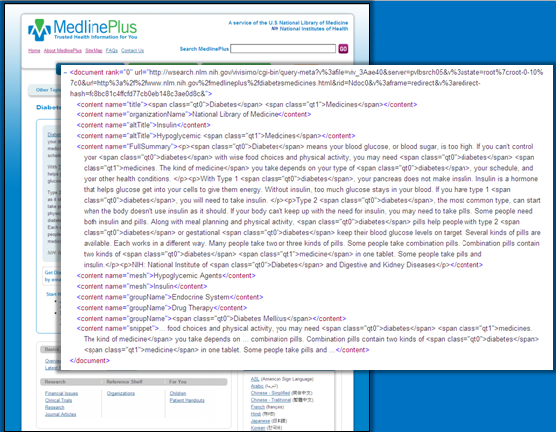
MedlinePlus

Slide 25
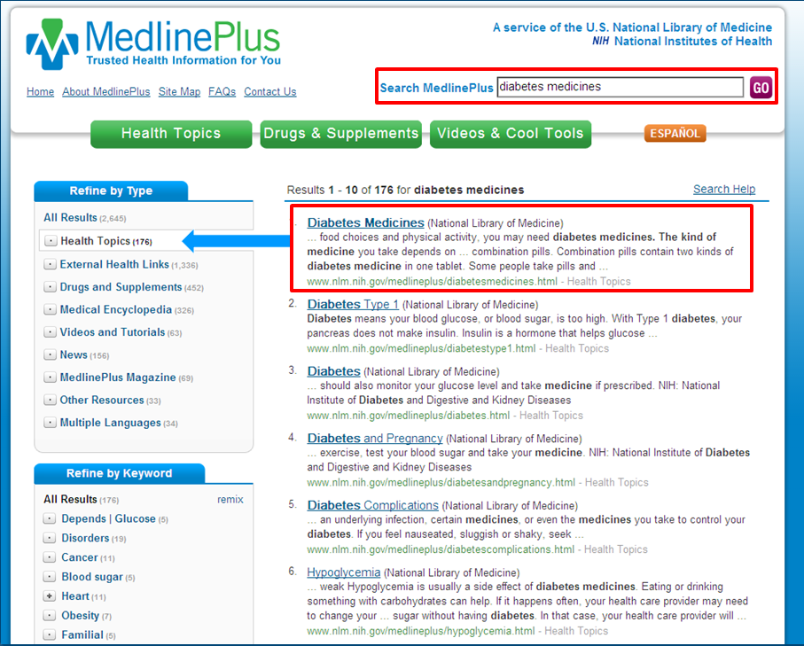
Health Topics Search Collection

Slide 26
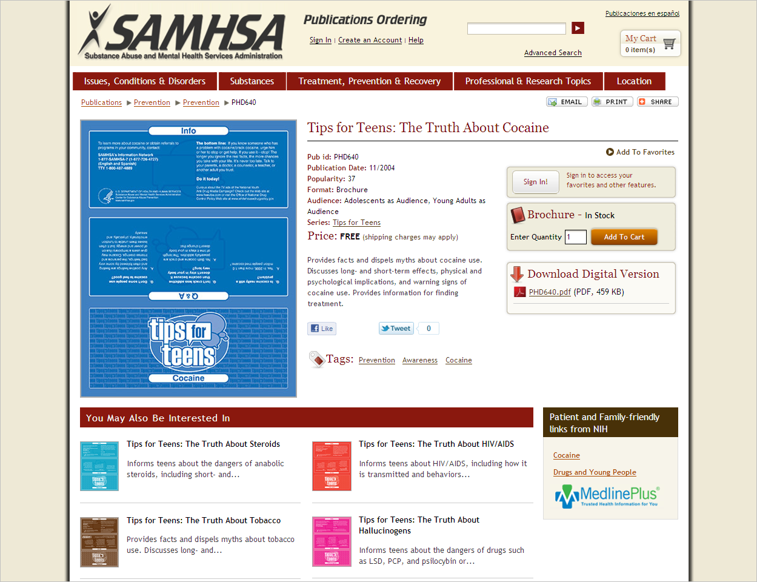
SAMHSA Store

Slide 27
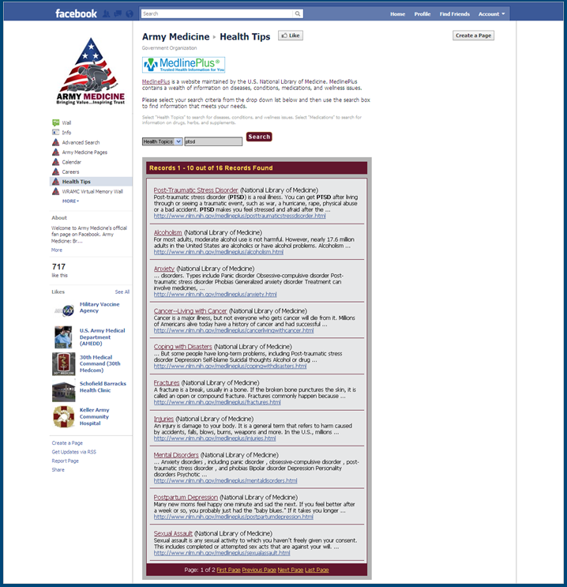
Army Medicine Facebook

Slide 28
MedlinePlus Health Topics Web Service Requests

Slide 29
MedlinePlus Connect

Slide 30
MedlinePlus Connect Requests
Type of Request | Code System | Languages
Diagnosis (Problem) | ICD-9-CM SNOMED CT | English Spanish
Medication | RXCUI NDC | English
Lab Test | LOINC | English Spanish

Slide 31
MedlinePlus Connect Requests

Slide 32
New MedlinePlus Topics
Aplastic Anemia
Balance Problems
Bile Duct Cancer
Biopsy
Bone Density
Bronchial Disorders
Cerebellar Disorders
Chest Injuries and Disorders
Childbirth Problems
Chronic Kidney Disease
Chronic Pain
Corns and Calluses
Diabetes Type 2
Ectopic Pregnancy
Eye Movement Disorders
Frostbite
Genital Herpes
Haemophilus Infections
Head Injuries
Kidney Cysts
Ovarian Disorders
Medicines and Children
Pancreatitis
Polycystic Ovary Syndrome
Potassium
Pregnancy and Nutrition
Pulmonary Rehabilitation
Rectal Disorders
Rh Incompatibility
Rotator Cuff Injuries
Speech and Language Problems in Children
Stroke Rehabilitation
Throat Cancer
Toilet Training
Tooth Decay
Tubal Ligation
Vasectomy

Slide 33
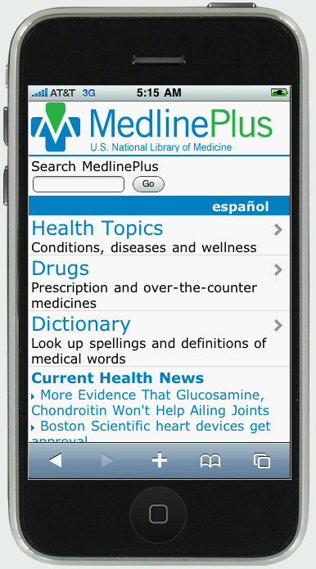
MedlinePlus Mobile
m.medlineplus.gov

Slide 34
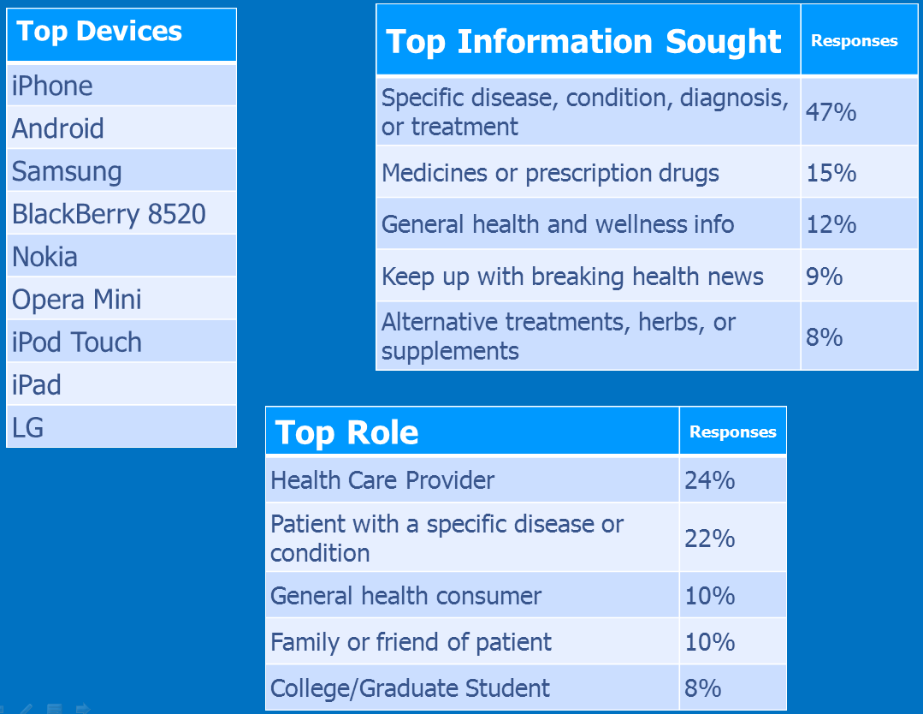
Top Devices, Top Information Sought, Top Role

Slide 35
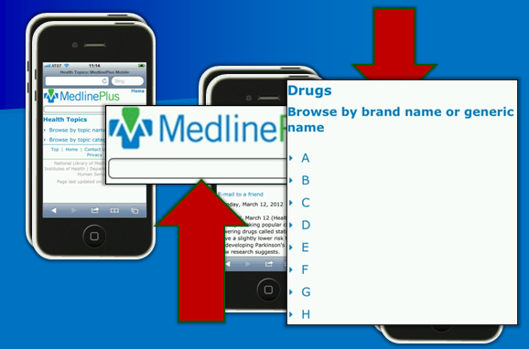
MedlinePlus Mobile

Slide 36
Next for MedlinePlus
Expanded results in the health topics Web service
Health topics Web service for mobile
Spanish medication responses within MedlinePlus Connect
Increase email newsletter offerings

