Slide 1
SIS Update
NLM Online Users Update
MLA, May 2012

Slide 2
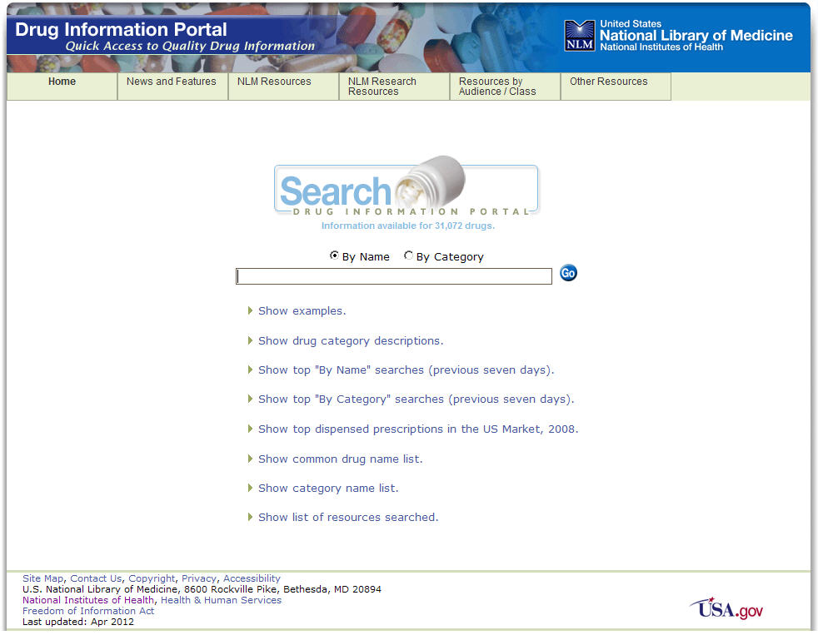
Drug Information Portal
Covers over 30,000 drugs
Search or browse drug names or categories
(i.e. albuterol or bronchodilators)
Provides spellcheck and autosuggest
Links to PubMed, MedlinePlus, ClinicalTrials, AIDSinfo and more
Displays structure images
http://druginfo.nlm.nih.gov
Notes:
The NLM Drug Information Portal gives users a gateway to selected drug information from NLM and other key U.S. government agencies.
Since it’s release in 2008, the number of drugs covered by the portal has doubled to over 30,000.
Drugs are covered from the clinical trial phase through U.S. approval and entry in the market. Results are sorted by level of detail and provide a summary of the drug type, usage, synonyms, structure and links to authoritative drug resources including NIH, FDA and CDC.

Slide 3
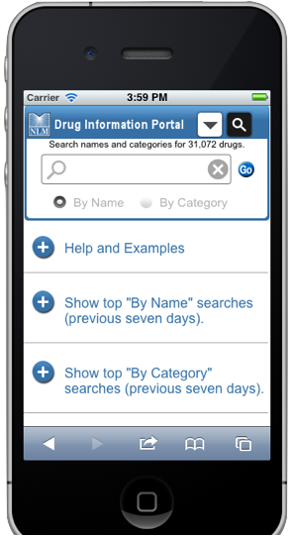
Drug Information Portal New Mobile Site
Provides same capabilities as full website
Links to mobile resources when available
(i.e. PubMed mobile, MedlinePlus mobile)
Provides seamless access to portal for various mobile devices
Notes:
The Division of Specialized Information Services (SIS) developed a new mobile web site for the Drug Information Portal. Pictured here is an example of the new mobile site compared to the full site homepage. The new mobile site:
- Is not a native app, but a mobile friendly version of the full site, so no need for a download on mobile device. Redirects automatically from the full site to the mobile site based on detection of the user’s browser width
-Provides an optimal user experience on mobile devices including smartphones and tablets including full site search and browse capabilities
--Allows users to return to the full site via a link from the mobile site
--Was just released in April 2012

Slide 4
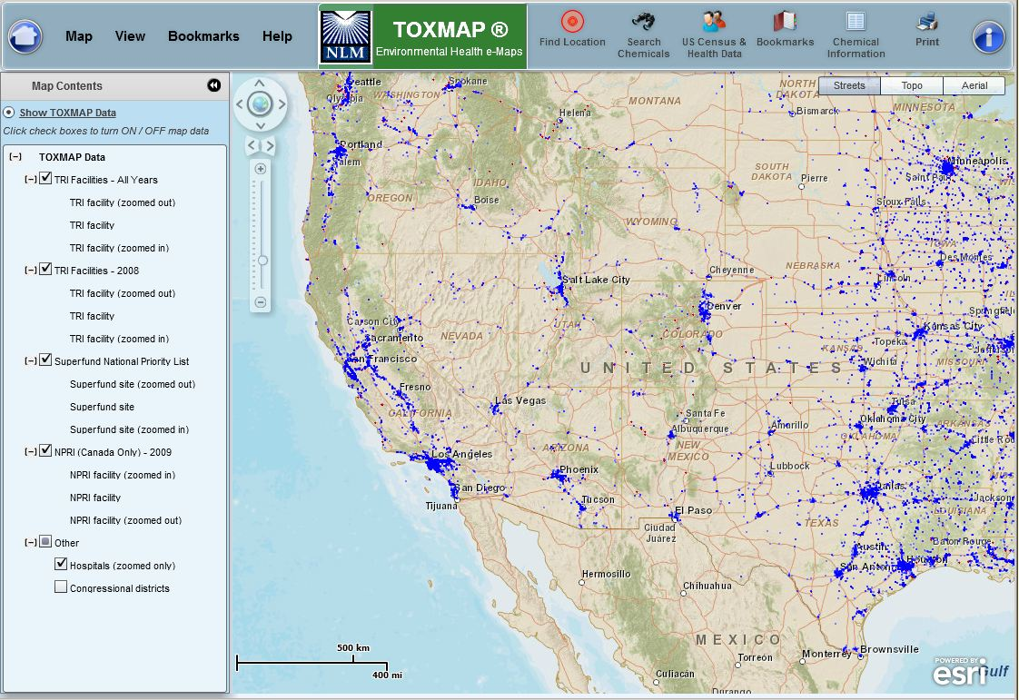
TOXMAP New look
New Look
Notes:
…with a new look in the coming months.

Slide 5
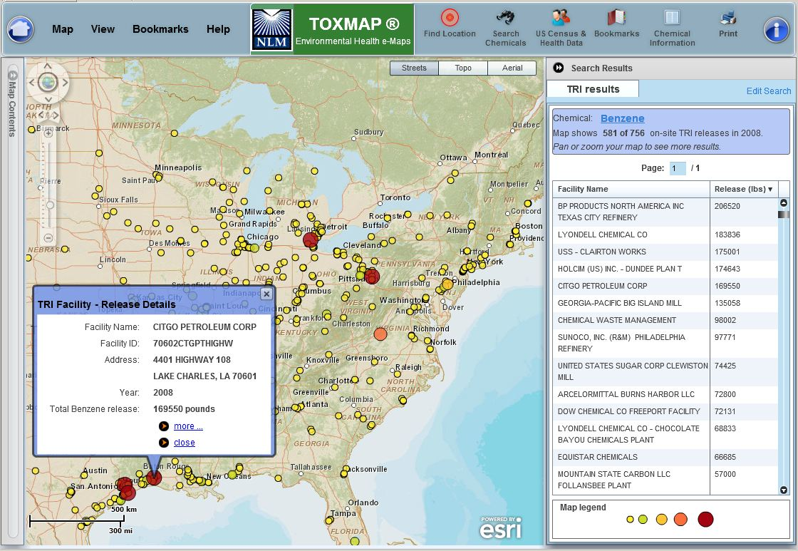
TOXMAP Search Results
Search Results
Notes:
Search results will display a bit differently, …

Slide 6
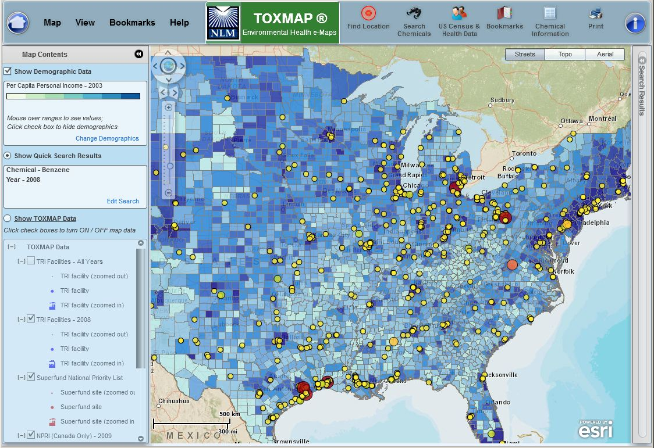
Demographics
Demographics
Notes:
As will the more than 200 demographic overlays (population, age, income, cancer and disease mortality).

Slide 7
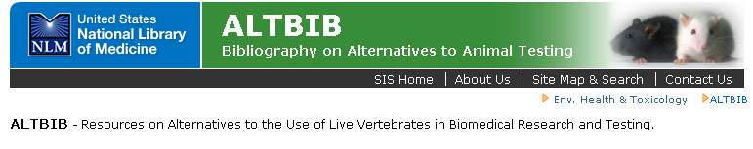
ALTBIB
Coming soon:
An updated enhanced version of the
ALTBIB® Web portal
Will provide better and broader access to information on in silico, in vitro, and improved (refined) animal testing methods
Also, information on the testing strategies incorporating these methods and other approaches.
Notes:
Coming soon:
NLM is in the process of developing an enhanced version of its ALTBIB® Web portal to provide access to publications in silico, in vitro, and refined animal testing methods. ALTBIB, by mid-2012, will offer a free searchable bibliographic collection on alternatives to animal testing including:
Citations/Links
articles, books, technical reports
in silico (via computer simulation); in vitro; improved (refined) animal testing methods; methods validated and undergoing validation
PubMed search strategies for animal testing alternatives
Links to 3Rs resources (reduction, refinement, replacement), animal testing alternatives, and other databases
ALTBIB will help identify methods/procedures in supporting development, testing, application, and validation, and ALTBIB will be searchable by term(s) or by one of 15 categories:
General Animal Testing Alternatives Carcinogenesis
Cytotoxicity
Dermal Toxicity
Ecotoxicity
Genotoxicity
Immunotoxicity/Immunology
Hepatic/Renal Toxicity
Neurotoxicity
Ocular Toxicity
Pharmacokinetic/Mechanistic Studies
Pulmonary Toxicity
Reproductive/Developmental Toxicity
Animal Welfare
QSAR

Slide 8
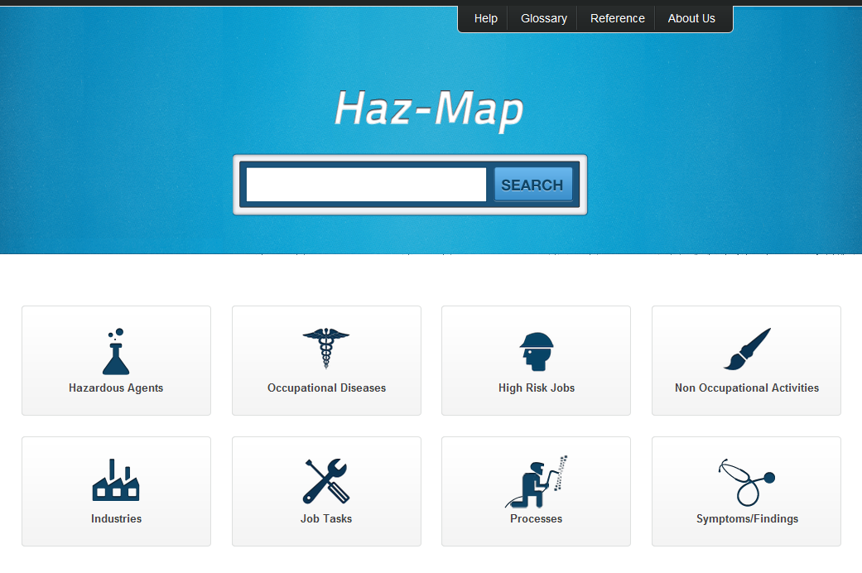
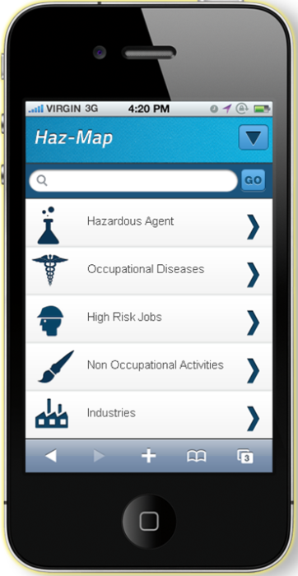
Haz-Map Redesigned - Web & Mobile
Notes:
Haz-Map is a relational database of hazardous chemicals, jobs and occupational diseases that was added to TOXNET in 2002.
Currently has almost 6,000chemical and biological agents, and 235 occupational diseases.
The Haz-Map web site was recently redesigned and adapts to both web and mobile browsers.
This version was released in May, 2012.

Slide 9
ToxLearn Update
Module II: Cells and Tissues: Injury and Repair
Part A: Introduction
Part B: Cells, Tissues, and Organs
Part C: Cellular Responses to Toxicity
Part D: Cell Damage and Tissue Repair
Module II is under final review by NLM Web Team and approval by SOT Council.
Anticipated public release June
Notes:
ToxLearn is an interactive modular learning tool to introduce toxicology principles and concepts
Several new modules for ToxLearn are under development by a ToxLearn Workgroup and Society of Toxicology (SOT) Education Committee.
Module 2 – Cells and tissues - is complete and waiting final review by SIS and the SOT Council and beta testing before release in June.

Slide 10
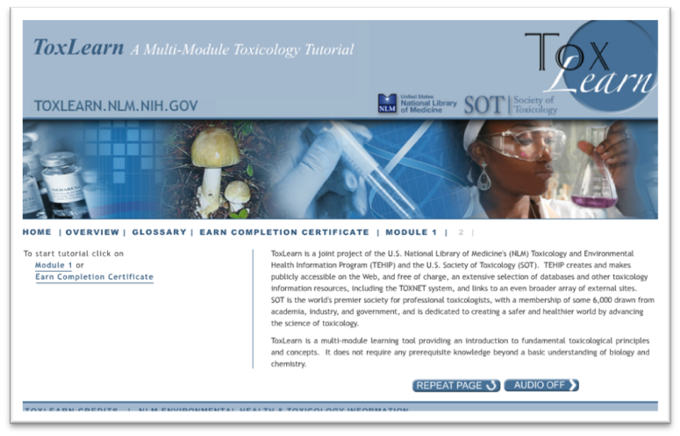
ToxLearn
Module III: Modes of Toxicity
Part A: Introduction
Part B: Local and Systemic Toxicity
Part C: Acute and Chronic Toxicity
Part D: Toxicity of Mixtures
Module IV:Toxicity to Organ Systems and Development)
Module V : Genotoxicity
Notes:
Here are the topics for Module III with an anticipated date of public release in the fall.
Module IV (Toxicity to Organ Systems and Development)
Module V (Genotoxicity) partially developed. Work will continue on these modules throughout 2012, with public release for are both planned for 2013.

Slide 11
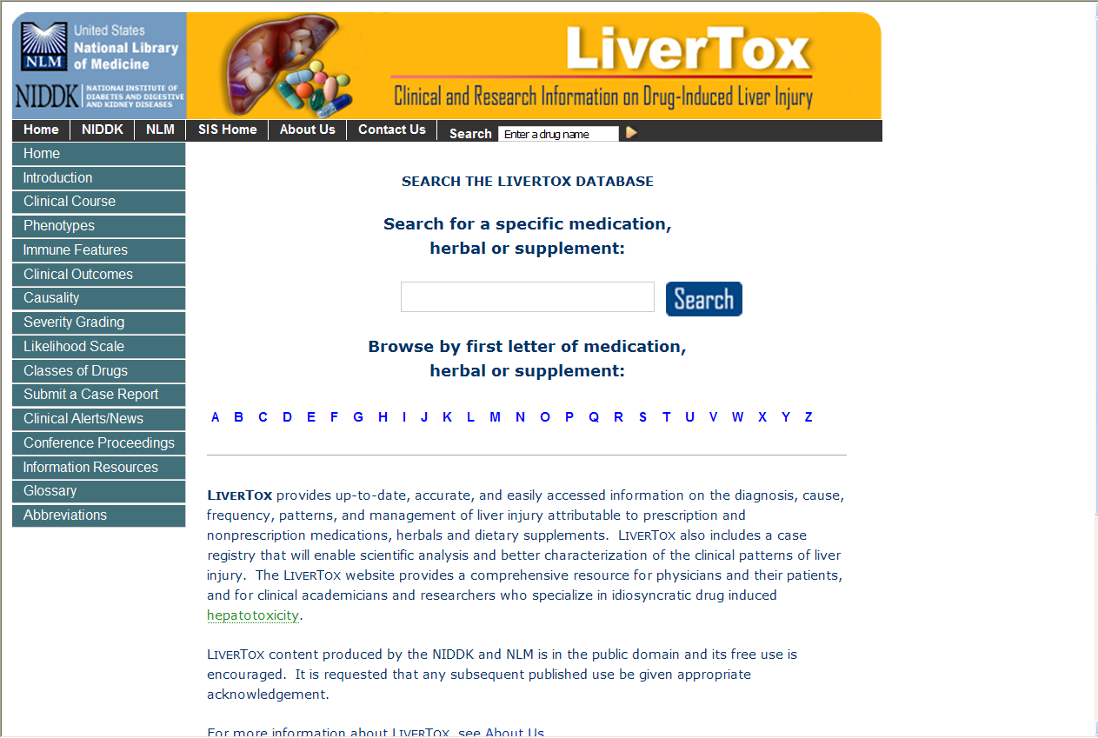
LiverTox Debuts http://livertox.nih.gov/
Notes:
LiverTox represents a collaborative effort by medical and scientific specialists
central repository of clinical information in support of clinical and basic research on the prevention and control of drug induced liver injury.
provides guidance to clinicians and healthcare providers on the diagnosis and management of this important cause of liver disease.
LiverTox has three major components:
• Introduction and overview of drug induced liver injury
• Specific drug records that provide concise data on the hepatotoxicity of medications, herbals and dietary supplements
• Case Submission Registry that allows users to submit clinical cases to the LiverTox system and U.S. Food and Drug Administration.
URL: http://livertox.nih.gov/

Slide 12
Tox Town
Designed to educate users about toxic substances found in their environment with information on how substances can affect human health
Target audience: high school and college students, educators, and concerned public
Over 70 locations; Over 40 chemicals/hazardous substances
Six scenes/neighborhoods:
1. City 4. Farm
2. Town 5. US Border Regions
3. Port 6. US Southwest
Notes:
Interactive Web site
Tox Town Will celebrate it’s 10th anniversary on October 4.
English and Spanish version
45 chemicals and hazardous substances
77 locations
6 scenes

Slide 13
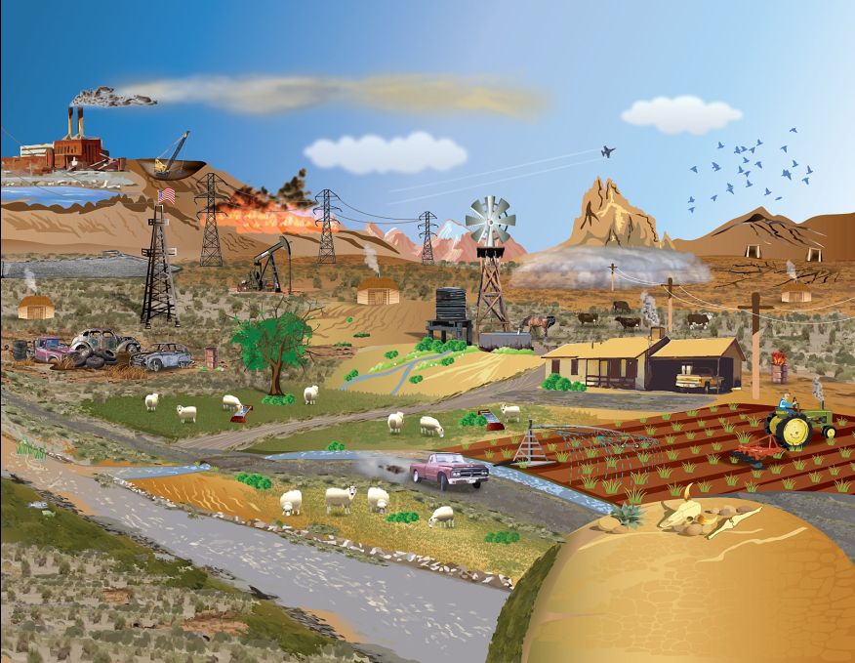
Tox Town US Southwest Scene
Notes:
The new Tox Town Southwest scene was developed in collaboration with Diné College, a tribal college for the Navajo Nation. The scene accurately depicts a Southwest landscape and highlights the unique environmental health concerns of the region. There are 10 new locations specifically showcased in the SW scene .

Slide 14
US Southwest Locations
Abandoned Mines
Coal-Fired Power Plants
Dust Storms
Hydraulic Fracturing
Irrigation Canals and Ditches
Oil and Gas Fields
Sheep Ranching
Uranium Tailings
Water Wells
Windmills
Notes:
SIS worked with Dine College staff to develop a list of 10 locations specific to the Southwest Scene listed here.

Slide 15
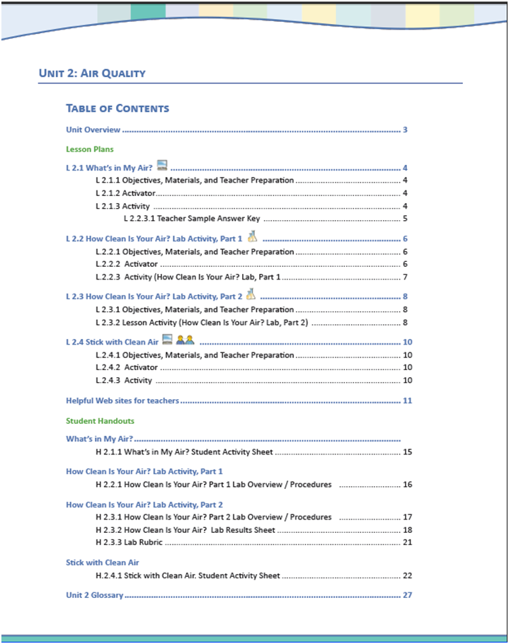
Coming Soon – After School Activity Club
Developed by cross curriculum middle school teachers
2 Science
1 English
1 Social Studies
Tox Town as core research tool
Pick and choose lessons/units for the classroom
Science inquiry integrated with social action

Slide 16
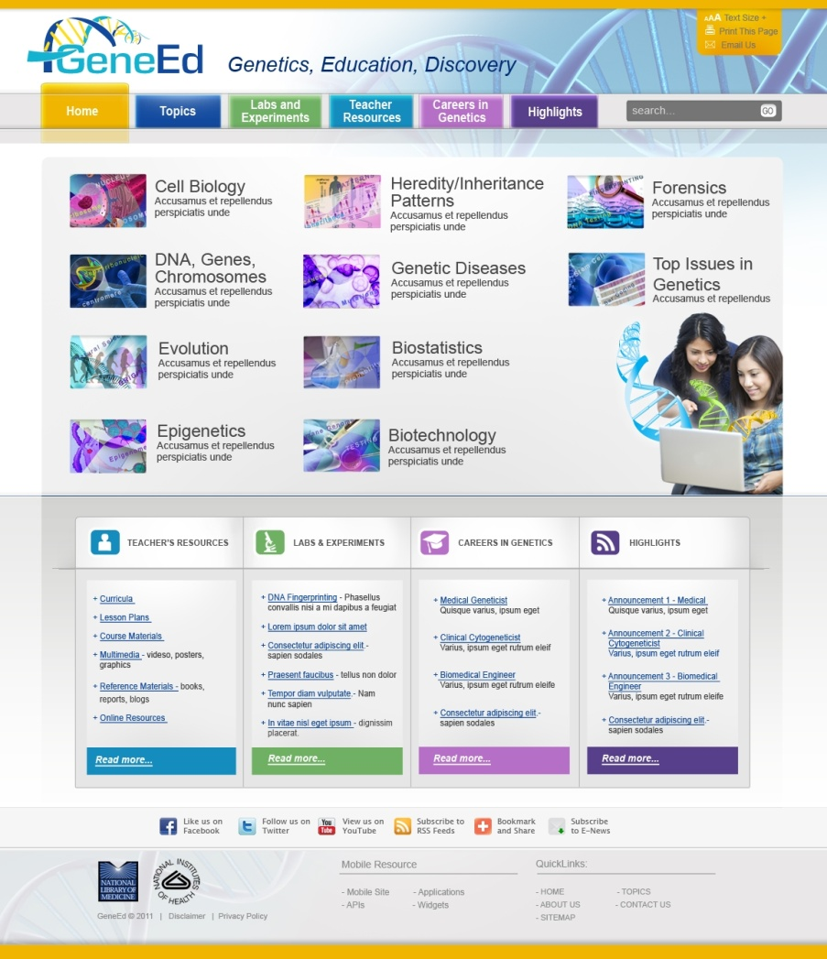
GeneEd
Portal of genetic resources for high school students and teachers
National Association of Biology Teachers survey defined the need
Partnership between:
SIS
NCBI
Genetics Home Reference
ICF Genetics subject experts
Launching in 2012

Slide 17
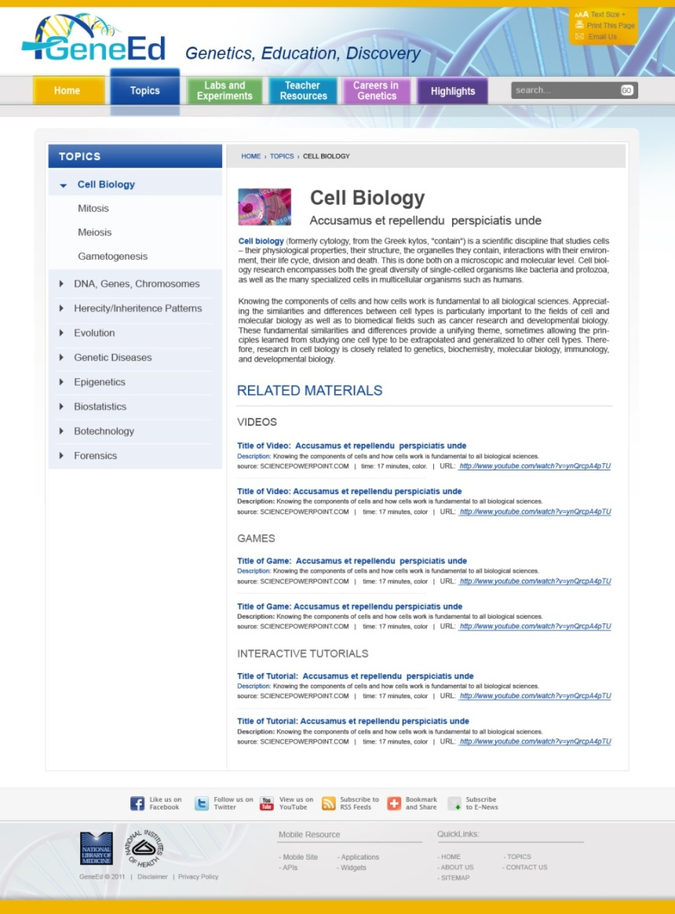
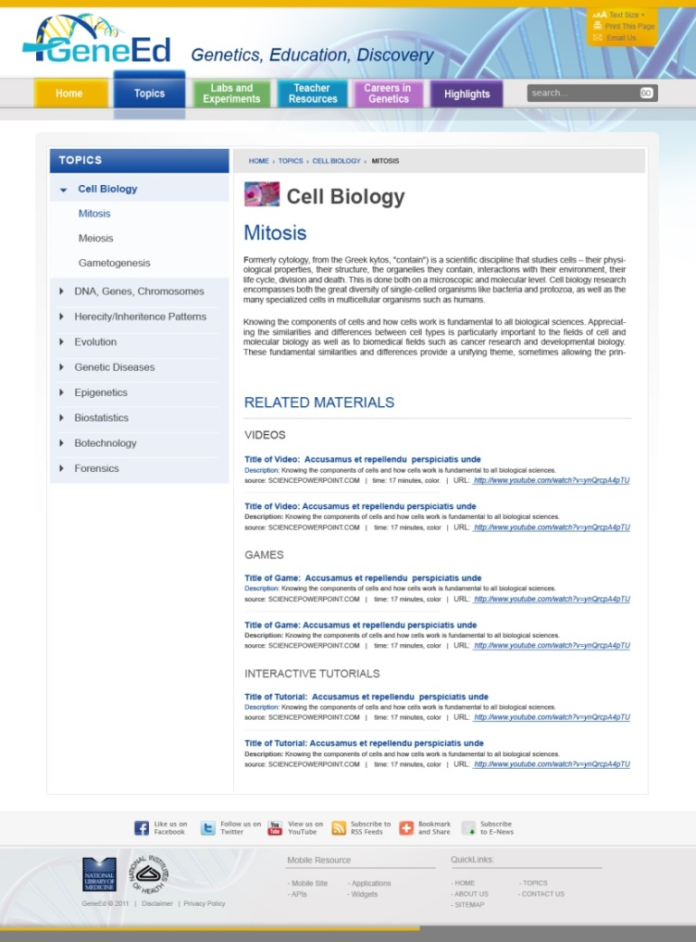
GeneEd homepage

Slide 18
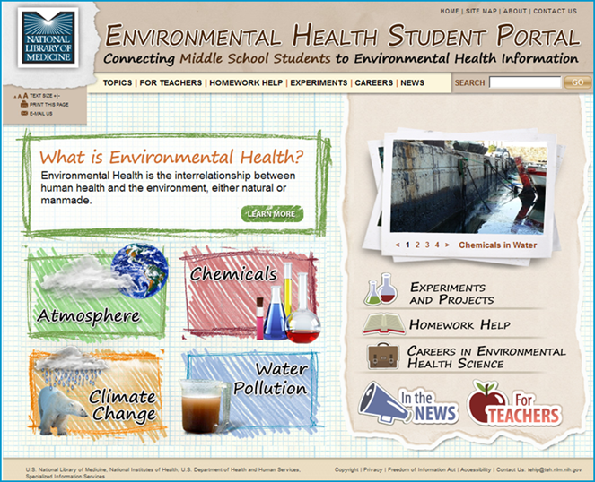
Reaching Middle School Teachers and Students
NLMs environmental health portal is designed to help students understand how the environment can effect our health
Each topic contains an introduction inviting students to learn more about the subject with subtopic pages introducing different types of resources such as:
Read About It
Games and Activities
Videos
Experiments and Projects
http://kidsenvirohealth.nlm.nih.gov

Slide 19
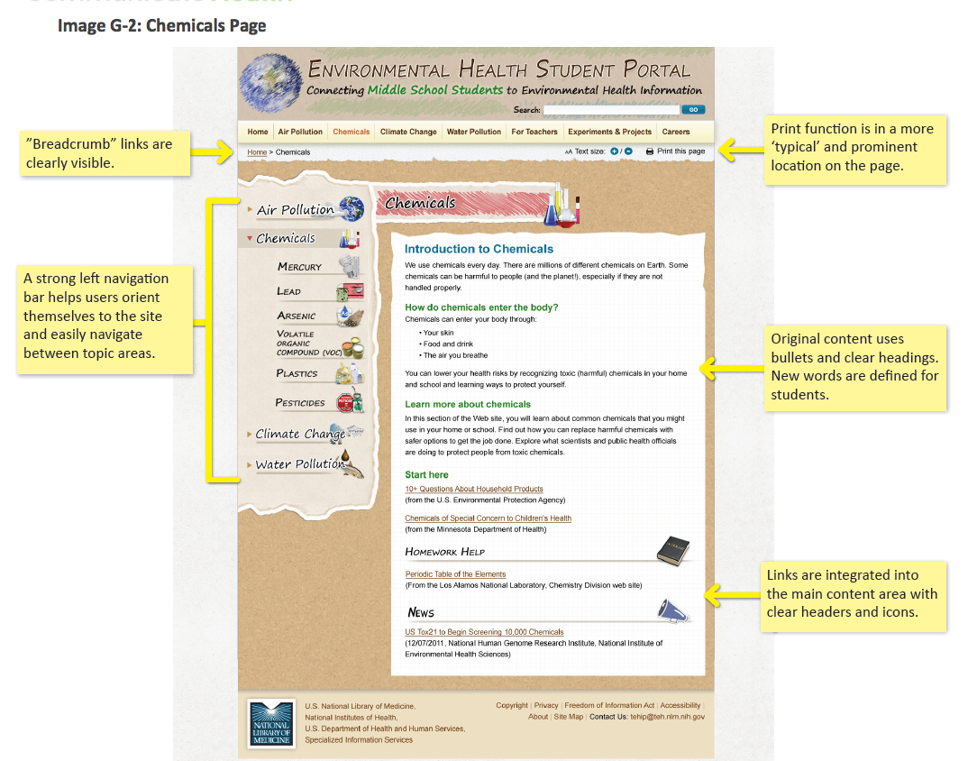
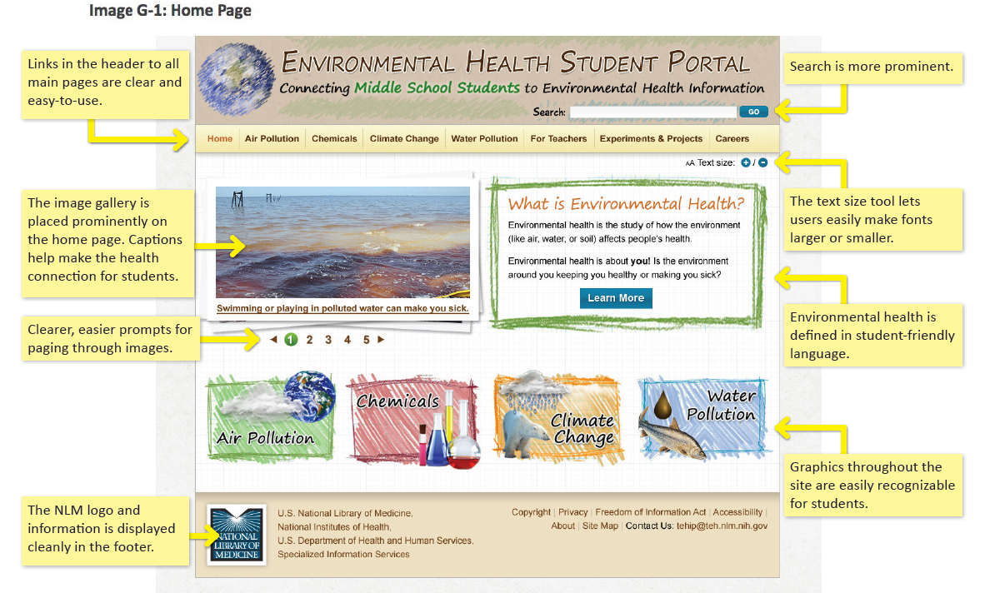
Environmental Health Student Portal
Changes to the site:
Home Page
Reposition the images and buttons found on the Home page
Make the search more prominent
NLM logo and information moved to the header
Topic Page
Move navigation to the left side of the page.
Use headings and bullets to break up the text
Integrate links into the main content with clear headers and icons
Notes:
The port underwent a usability study with middle school teachers and students from across the country. As a result of that study SIS will be making changes to the home and topic pages. Changes include: (see slide)

Slide 20
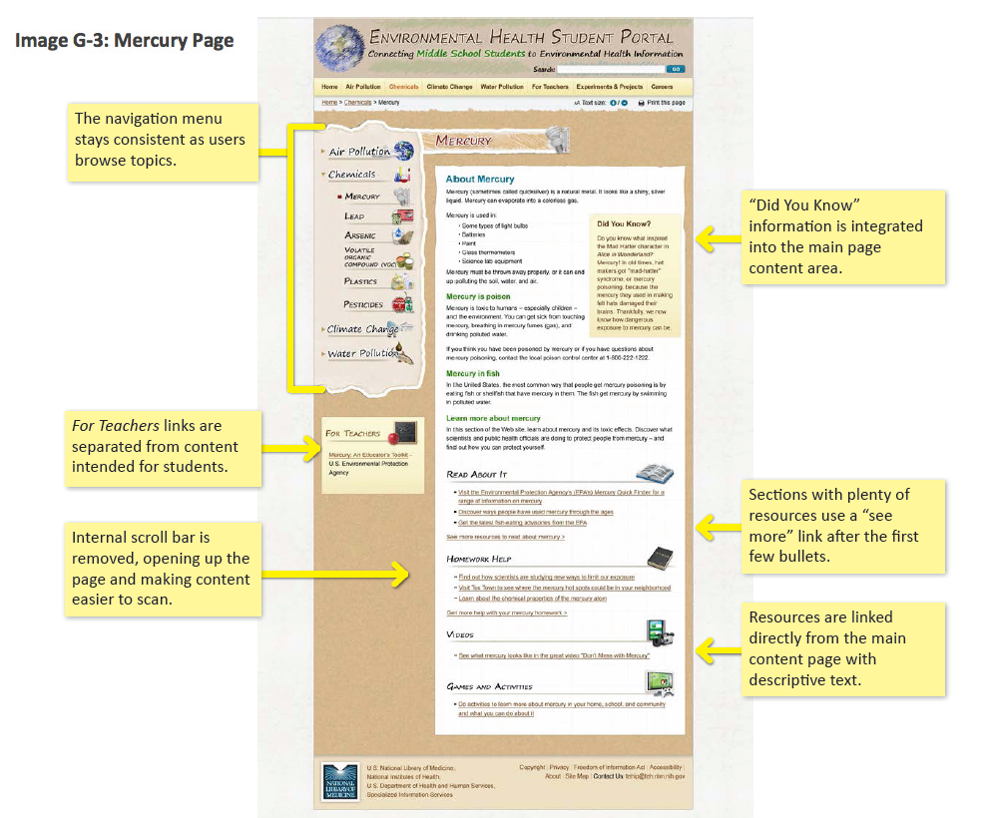
Sub-Topic Pages
Sub-Topic Pages:
Move navigation to the left side of the page.
Use headings and bullets to break up the text
Integrate links into the main content with clear headers and icons
Incorporate “Did you Know” section into the main page content area

Slide 21
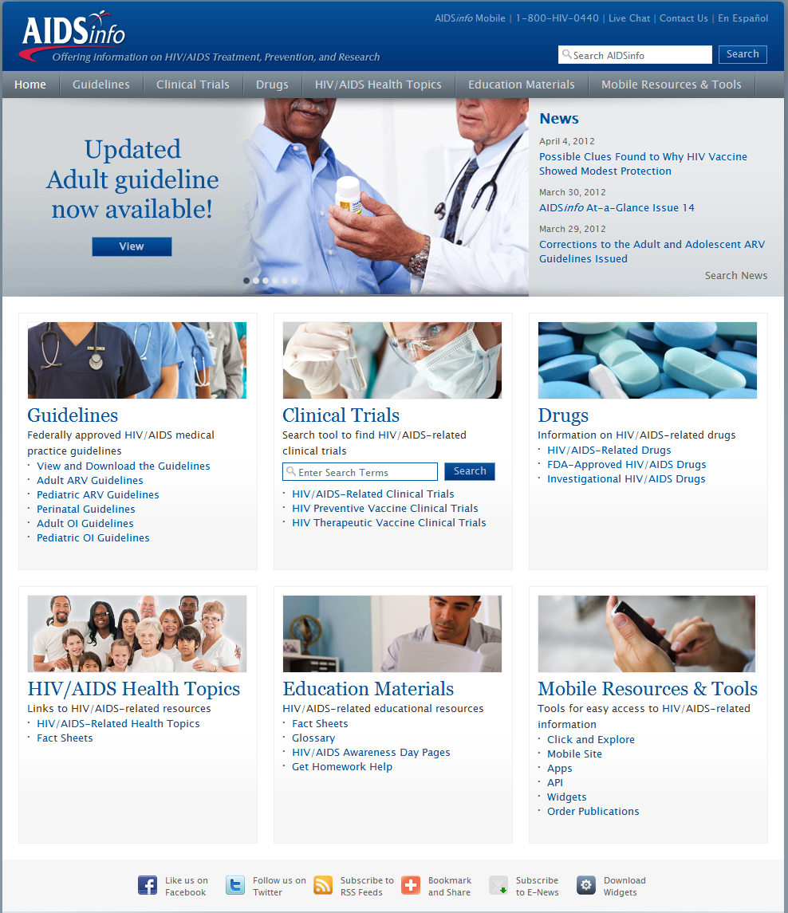
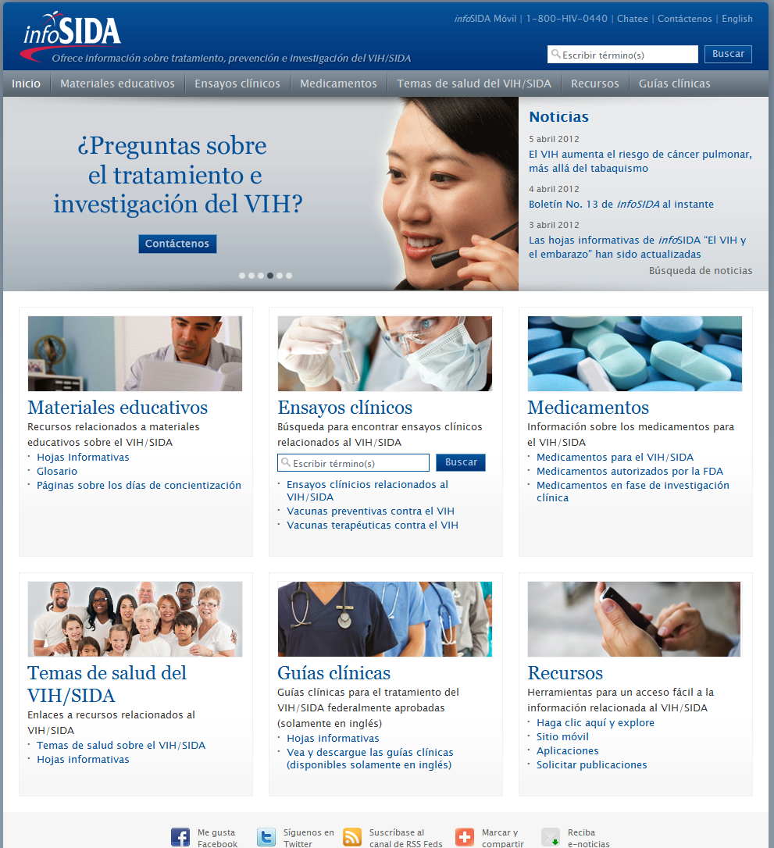
AIDSinfo and infoSIDA Homepage
Notes:
AIDSinfo and its Spanish language companion site, is an HHS information service managed by NLM. It provides access to information about treatment, prevention and research related to HIV/AIDS. It is the dissemination point for the official HHS HIV/AIDS clinical practice guidelines. This design was released on World AIDS Day, December 1, 2011 and provides access to every part of the web site directly from the home page through the use of mega menus that drop down and show links to the contents of each major section as well as search boxes for those sections.

Slide 22
HIV/AIDS Information Projects 2012
Improve information access for HIV/AIDS patients, affected community and caregivers
Information retrieval, skills development, Internet access, resource development, mobile technologies or new media
12 months projects - $40,000
RFQ was released May 15
Proposals due June 18
Notes:
NLM has continued its HIV/AIDS- related outreach efforts to community-based organizations, patient advocacy groups, faith-based organizations, departments of health, and libraries. This program provides support to design local programs for improving information access for HIV/AIDS patients and the affected community as well as their caregivers. Since 1994, NLM has awarded more than 300 organizations with funding in an effort to eliminate disparity of information access in the HIV/AIDS Community.
Emphasis is on providing information or access to health and medical information in a way meaningful to the target community, and increasing the awareness and utilization of NLM online health and medical resources in the HIV/AIDS Community. Projects must involve one or more of the following information access categories: information retrieval, skills development, Internet access, and resource development. Also, NLM is interested in feedback regarding the penetration of mobile devices in specific populations, and the effective use of social media and mobile phone technologies to increase the awareness and utilization of NLM online and mobile HIV/AIDS resources.
The 2012 Request for Quotations (RFQ) was released on April 24 and proposals are due June 4. Community Information Outreach Projects was announced in in the Federal Business Opportunities (FedBizOpps) website at www.fbo.gov

Slide 23
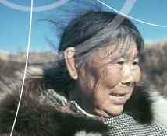
Arctic Health “Climate Change”
Effects of climate change on human health
Northern communities – resilience and adaptation
Witnesses to change – traditional knowledge
Changing ecosystems
Ice and climate
http://www.arctichealth.org/climatechange.php
Notes:
A new “Climate Change” section has been added to the Arctic Health Web portal with over 1,000 links to literature, books, articles, audio and video recordings, and Web resources. This new section has information on events, news, effects of climate change on human health, resilience and adaptation in Northern communities, traditional knowledge and witnesses to change, changing ecosystems, ice and climate, and more. Arctic Health is also adding the full text of the Greenpeace report Answers from the Ice Edge: The Consequences of Climate Change on Life in the Bering and Chukchi Seas.
Newly redesigned Arctic Health Portal will be launched in early summer.

Slide 24
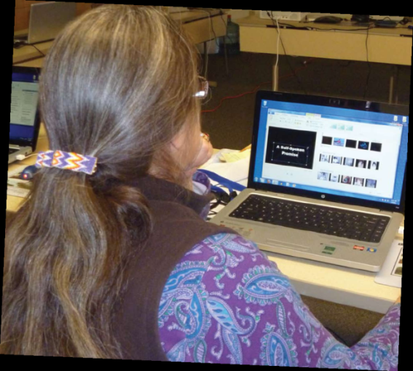
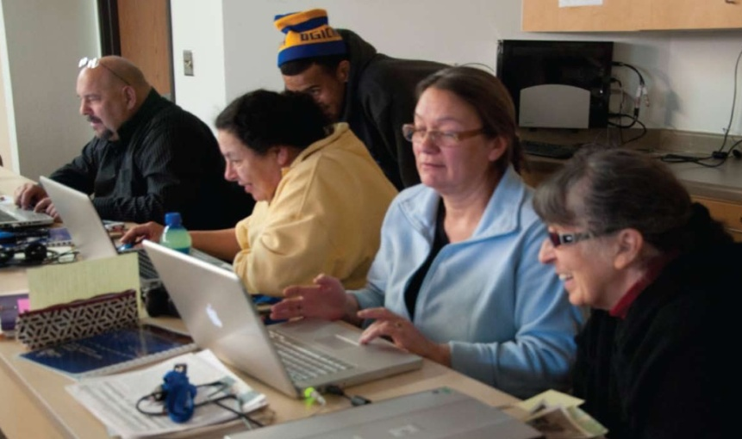
American Indian Health
Personal and cultural health and wellness experiences with:
Fond du Lac Human Services
Inter-Tribal Council of Michigan
Shoshone Women’s Society
Montana Wyoming Tribal Leaders Council
With permission, “Our Stories” will be added to the American Indian Health Portal and the NLM YouTube channel.
Notes:
Digital story telling is a community-based, learner-centered approach that combines first person narrative with digital images and music. Digital stories provide alternative views and perspectives that demystify stereotyped representations about indigenous peoples.
The 2-5 minute personal narratives are being created by numerous individuals including family members, health specialists, educators, artists, traditional healers, and tribal leaders and include stories being created by youth, adults and elders from our reservations, villages, pueblos, and urban centers.
NLM began working with nDigiDreams , a native company, to build capacity in the collection of community health and wellness stories for future generations.
Through the project, nDigiDreams provided a 3-day training where participants received training in digital storytelling methods and how to use basic equipment and software. Each participant finishes the training by completing production on their own digital story. Some participants have decided to have their story made available on the American Indian Health Web Portal and the NLM YouTube Channel.
nDigiDreams has completed four trainings with:
Fond du Lac Human Services,
Inter-Tribal Council of Michigan,
Shoshone Women’s Society,
and Montana Wyoming Tribal Leaders Council for a Veteran’s project.

Slide 25




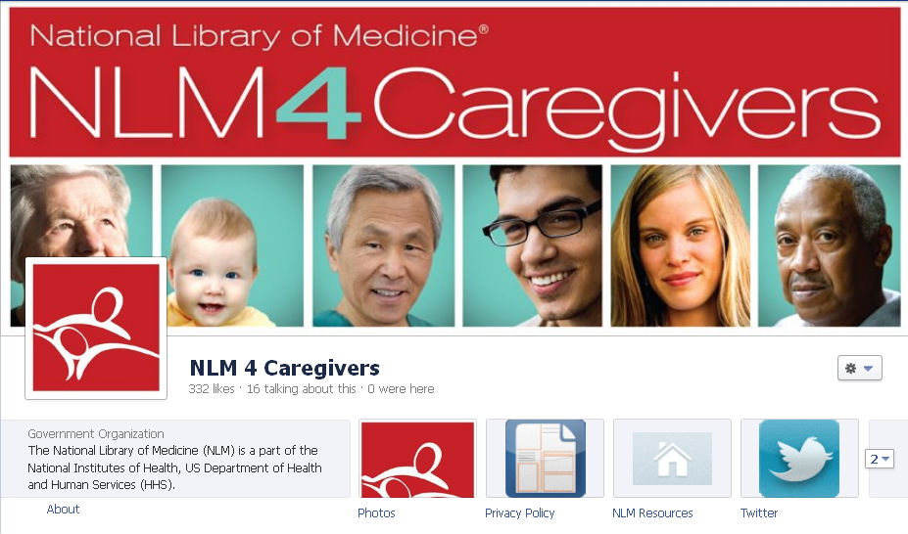
NLM 4CareGivers
NLM 4Caregivers
Notes:
SIS’s Outreach and Special Populations Branch developed a social media pilot project, NLM 4Caregivers, to learn more about the use of social media as a viable option for health information delivery.
The pilot project is designed to increase awareness of the NLM resources among family caregivers who are already active users of online health information and are comfortable using social media tools for discussing and exploring health issues.
For the purposes of this project, we understand family caregivers as problem solvers embedded in a social network. Thus the optimal targets are groups that support family caregivers, individuals who act as health information gatekeepers for their social network, and family caregivers themselves.
You can follow the NLM4Caregivers on Facebook and Twitter.

Slide 26
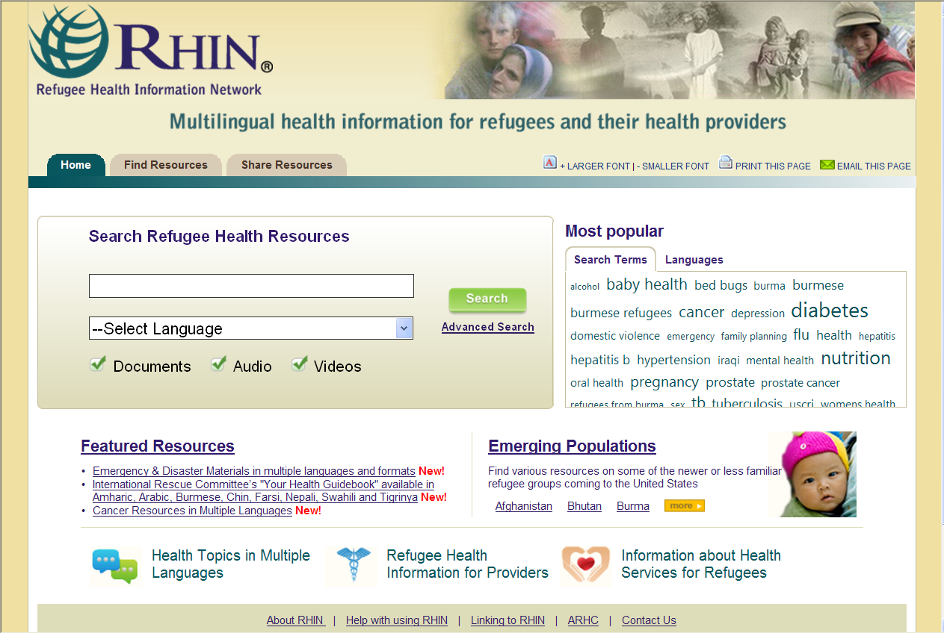
RHIN Redesigned
Notes:
RHIN is a database of quality multilingual, public health resources for those providing care to resettled refugees and asylees. Resources include:
•Health education materials in various languages and formats (brochures, fact sheets, videos)
•Provider tools (including information on refugee populations and cultures)
•Links to related Web sites
The redesign focuses attention on the multilingual aspect of the resource.
Highlights featured resources and emerging populations
and has a Twitter handle of @refugeehealth

Slide 27
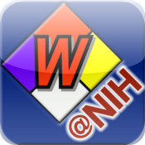
Wireless Information System for Emergency Responders (WISER) Features/Capabilities & Platforms
Features/Capabilities :
Search Known Substance
>400 Chemicals
~20 Radiologicals
CDC Category A Biological agents
Help Identify Unknown Chemical
Protective Distance Mapping
Biological Imagery
Chemical Reactivity
Platforms :
WISER for Windows
WebWISER – covers connected versions for :
Blackberry
iPhone
Android
iPhone app
Android app
Currently working on enabling all features on all the platforms!
Link to WISER: http://www.wiser.nlm.nih.gov/
Notes:
WISER is now about eight years old as an NLM resource!
Key Strategic Objectives include:
Designed to be easy to use, intuitive
Have information tailored to the specific needs and roles of emergency responders
Have reliable, complete, and trustworthy information
A focus on unknown substance identification capabilities
To provide a platform that can be expanded to support other emergency response needs
Have rich, stand-alone capability with enhanced connected (wireless) capabilities
Have a cross-platform, multi-device architecture, keeping up with the latest platforms, e.g., iPhone and Android!
Have accessibility 24/7 if Internet access is available

Slide 28
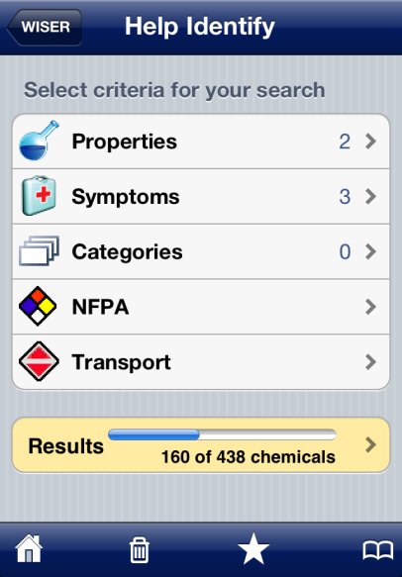
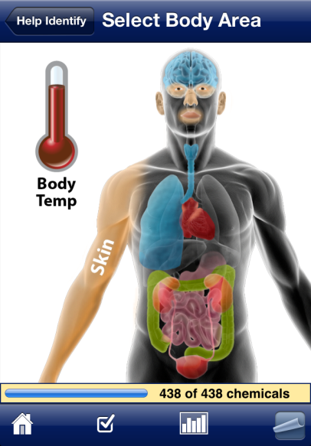
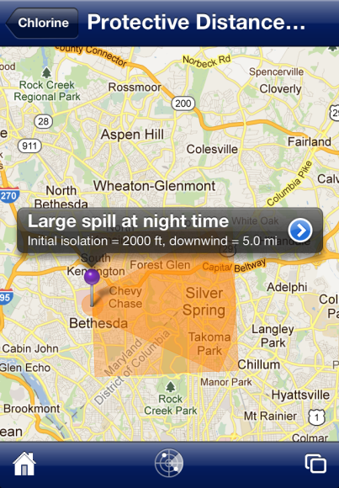
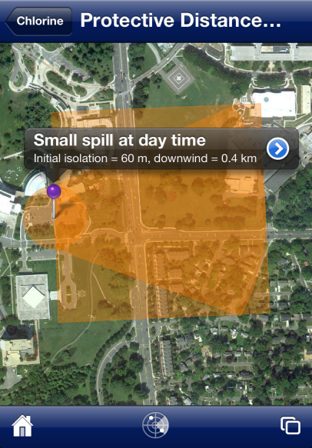
WISER Update – iPhone app Enhancements
Help Identify
Downloads :
Windows = >191,000
BlackBerry (released July 2010) = >30,000
iPhone (released June 2010) = >67,000
Android (released Sept. 2011) = >23,000
Protective Distance Mapping
Now on WebWISER also!
Notes:
WISER’s latest update (March 2012) includes the following :
WebWISER – addition of Protective Distance Mapping capability (previously, this feature was only on WISER for Windows).
iPhone/iPod touch app – addition of Help Identify an unknown chemical feature + Protective Distance Mapping capability.
We are currently working on a Universal iOS app – an app that will work on iPhone/iPod touch & iPad (since many users are getting iPads to use).
The focus for the next year is to enable all the features/capabilities on all the different platforms/devices, & for some CHEMM/WISER integration.

Slide 29
Disaster Apps

Slide 30
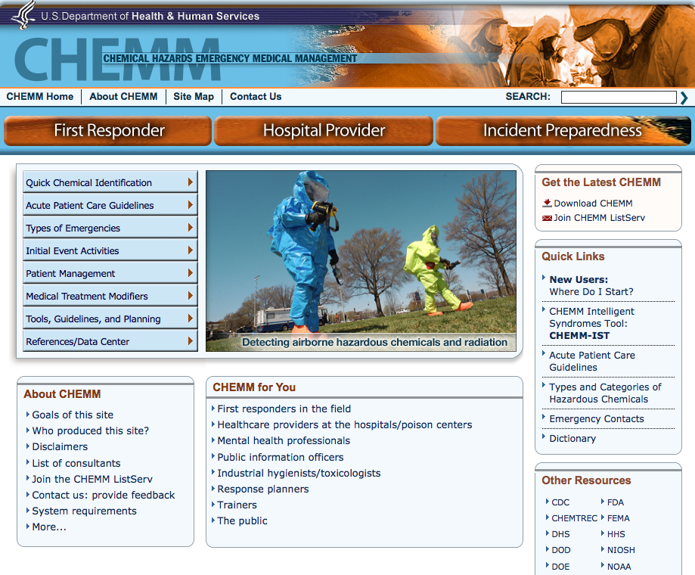
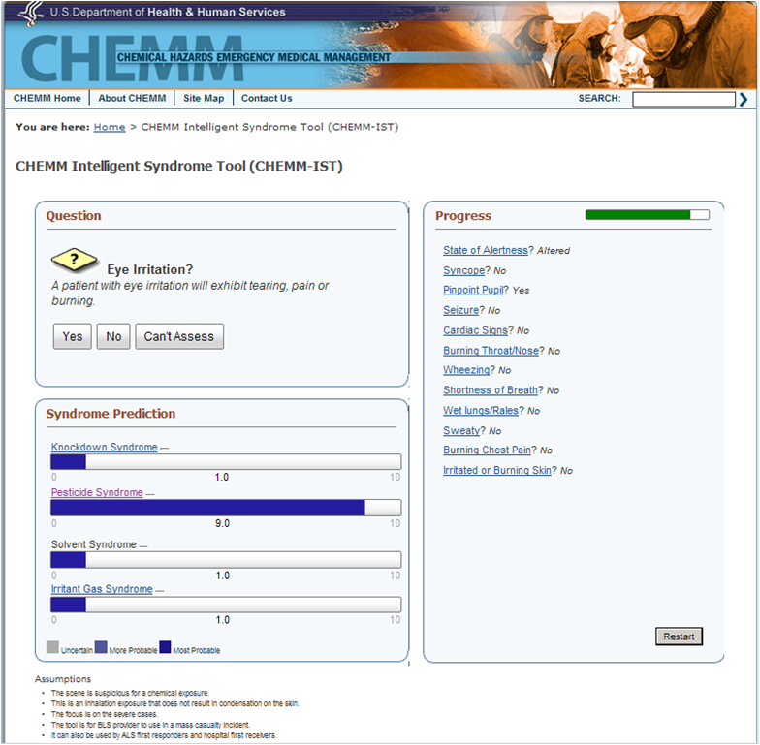
Released in mid-2011: Chemical Hazards Emergency Medical Management (CHEMM)
URL for CHEMM: http://chemm.nlm.nih.gov/
Notes:
Goals of CHEMM:
Efforts and Components of CHEMM:
Extensive existing content being identified and added to CHEMM.
New types of content compared to other resources: Pediatric/specific population medical management guidelines
New: Mental Modeling/Expert Modeling – working out what each user group needs to know & the format that is most intuitive.
New: Toxic syndromes tool (CHEMM-IST) – tool for identification & treatment in hazardous incidents via chemical groups/syndromes.
CHEMM was released in July, 2011. It has already received one risk communication award and very favorable comments in news stories and from users.
"Risk Communication Excellence Award” for CHEMM from Alliance for Chemical Safety (January, 2012)

Slide 31
Follow us
RSS feed
http://sis.nlm.nih.gov/rss/sisnewsfeed.rss
Listservs
NLM-Tox-Enviro-Health-L Listserv
DISASTR-OUTREACH-LIB Listserv
NLM_OSP-L
Facebook
NLM 4Caregivers
Women’s Health Resources
AIDSInfo
Twitter
@NLM_SIS
@NLM_OSP
@NLM_DIMRC
@NLM4Caregivers
@AIDSInfo

