Slide 1
Medical Library Association Annual Meeting NLM Update May 22, 2012 Seattle, WA Sheldon Kotzin kotzin@nlm.nih.gov

Slide 2
1968 Associate

Slide 3
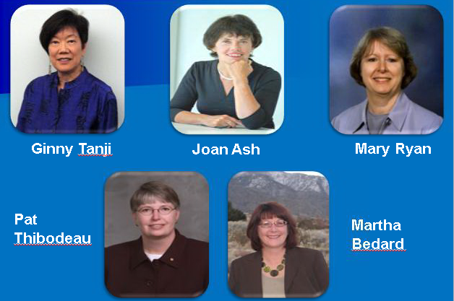
Group Photo

Slide 4
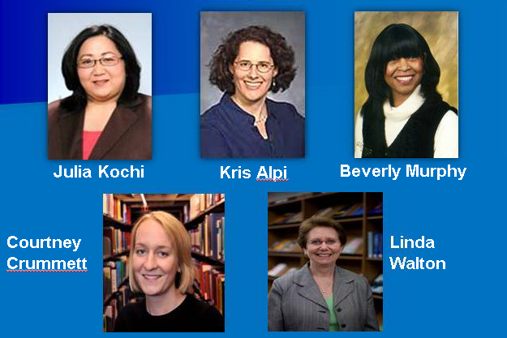
Kochi, Alpi, Murphy, Crummett, Walton

Slide 5
What NLM Systems Provide

Slide 6
Dependence on NLM Systems
Continuous Access
MEDLINE & other data licensees
External search engines
Computer applications
Information systems

Slide 7
2012 edition MeSH

Slide 8
Rx Norm

Slide 9
PubMed overview

Slide 10
PMC Content – March 2012

Slide 11
NIH Public Access Policy

Slide 12
Journal Article Tag Suite

Slide 13
NIHSeniorHealth – Why redesign?

Slide 14
Usability

Slide 15
Reaching Seniors: Visitors FY11

Slide 16
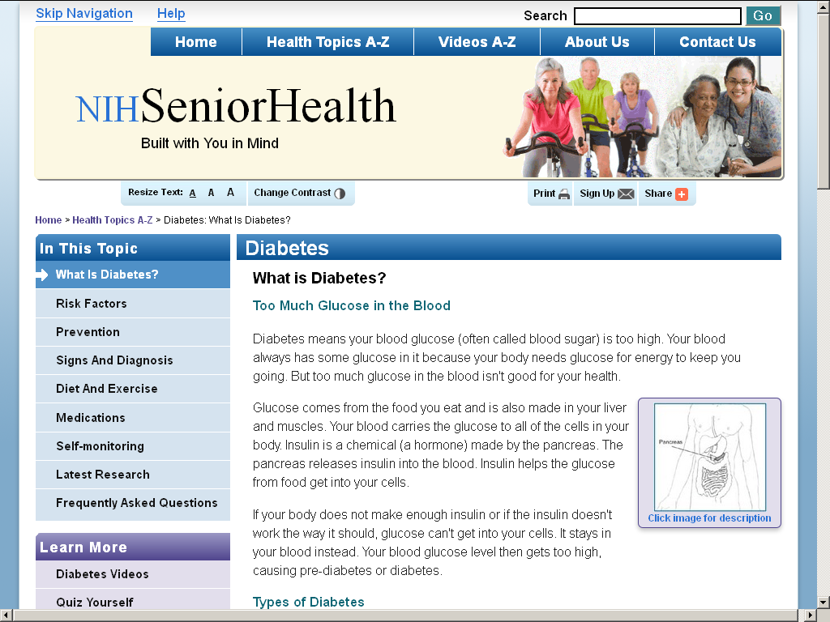
NIHSeniorHealth

Slide 17
Training

Slide 18
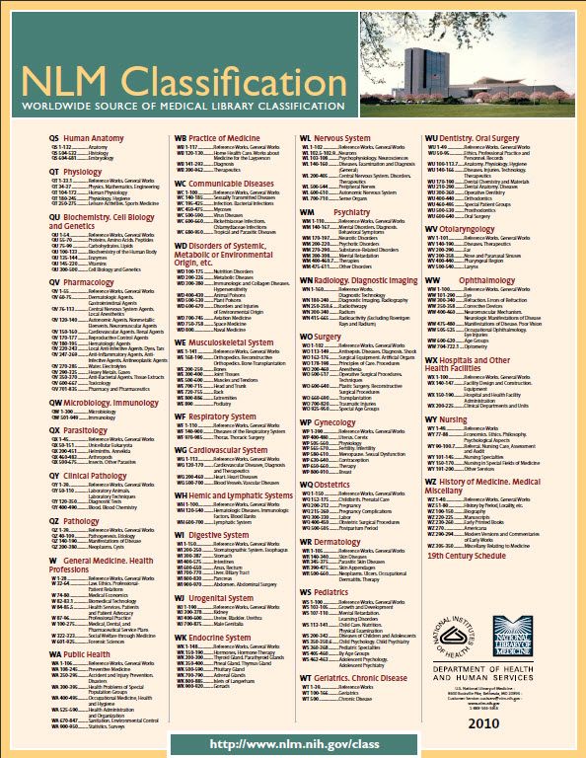
NLM Classification

Slide 19
Vocabulary Activities

Slide 20
Genetics Home Reference

Slide 21
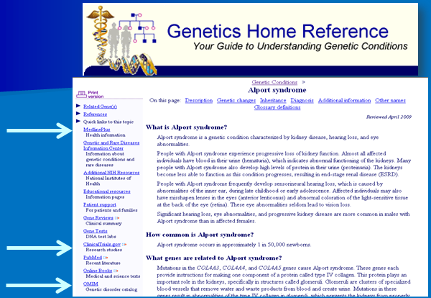
Genetics Home Reference Record

Slide 22
ClinicalTrials.gov

Slide 23
Three Key Problems
Not all trials are published
Publications do not always include all prespecified outcome measures
Unacknowledged changes are made to the trial protocol
e.g., changes to the prespecified outcome measures

Slide 24
Rate of New Registrations

Slide 25
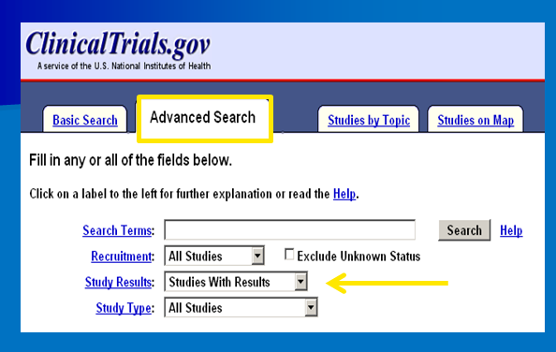
ClinicalTrials.gov Advanced Tab

Slide 26
PubMed Efficiencies

Slide 27
DOCLINE

Slide 28
Tox Town US Southwest Scence

Slide 29
GeneEd

Slide 30
Drug Information Portal

Slide 31
LiverTox Debuts http://livertox.nih.gov/ LiverTox Debuts http://livertox.nih.gov/

Slide 32
Disaster Information Specialization

Slide 33
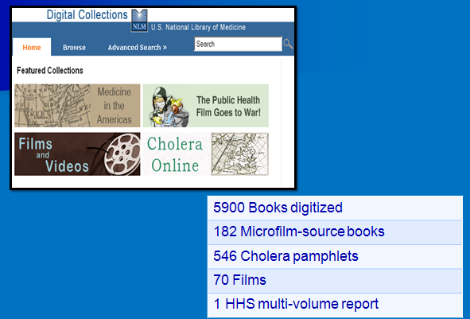
Digital Collections

Slide 34
Margaret Heckler

Slide 35
Black & Minority Health

Slide 36
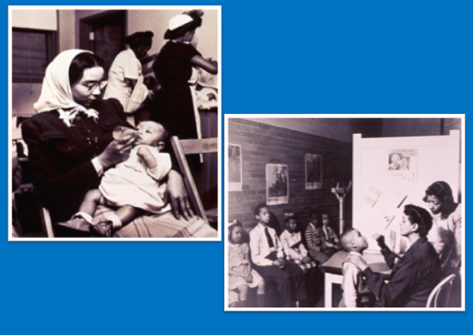
Disparities between health of white and minority American.

Slide 37
Army Medical Library and Museum

Slide 38
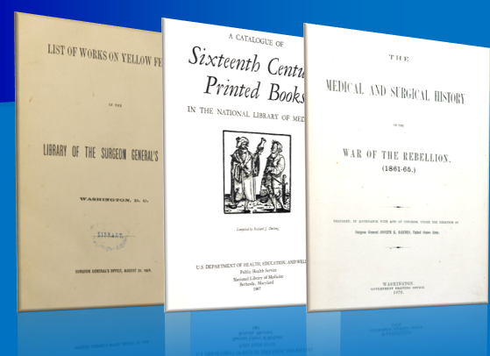
Historical Reports

Slide 39
Where does the repository program go from here?

Slide 40
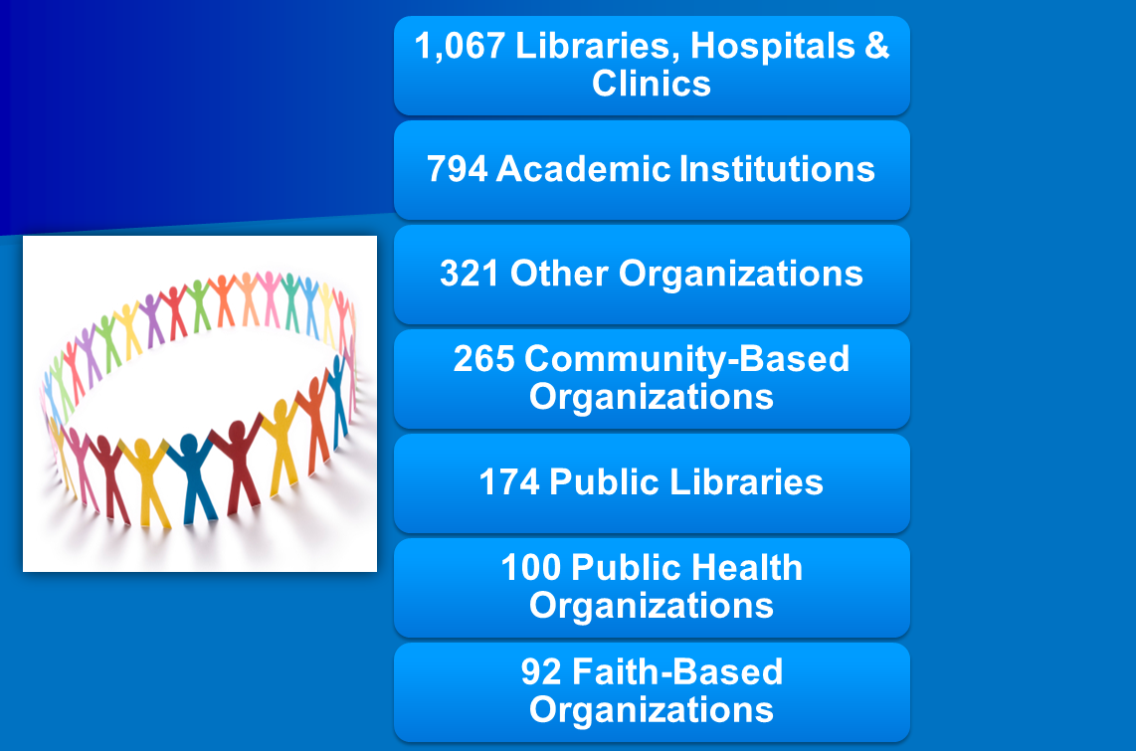
Participants

Slide 41
Awards, Training Sessions, Trained

Slide 42
Woods Hole Oceanographic Institution

Slide 43
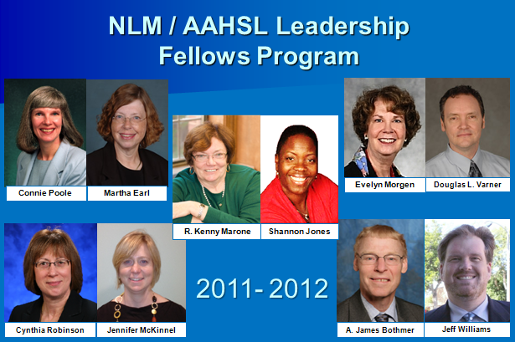
NLM/AAHSL Leadership Fellows Program

Slide 44
NLM / AAHSL Leadership Fellows Program

Slide 45
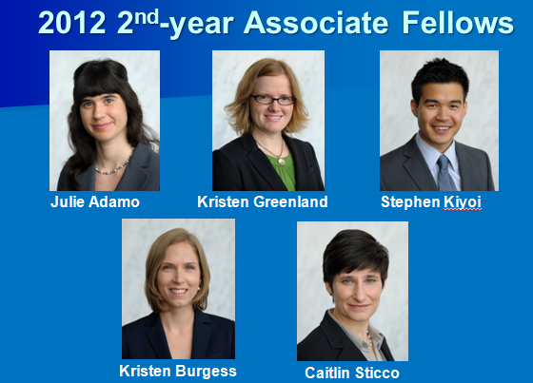
2012 2nd year Associate Fellows

Slide 46
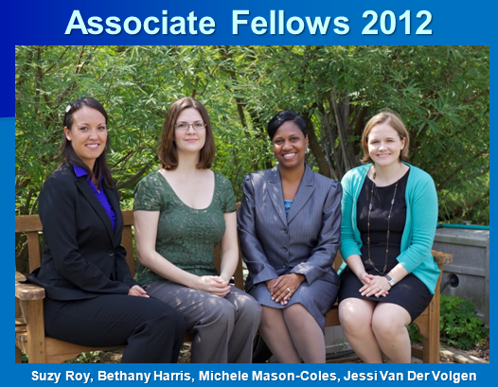
Associate Fellows 2012

Slide 47
Former Associate Directors for Library Operations

Slide 48
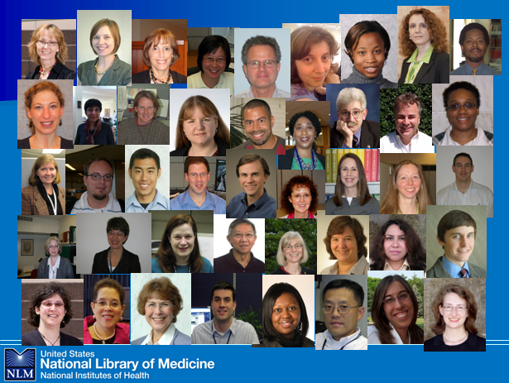
NLM Employees

