Slide 1
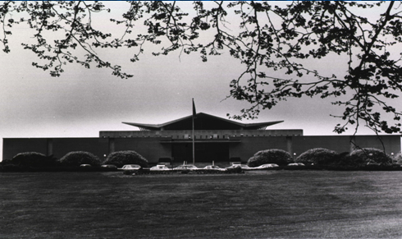
Collection Space
NLM’s Plan to Expand
Collection Space
May 6, 2013 MLA Sunrise Seminar
Martha Fishel
Chief, Public Services Division
DHHS, National Institutes of Health
        National Library of Medicine
Notes:
Good morning – I’m Martha Fishel, Chief of the Public Services Division at NLM. This Division of NLM covers a wide range of services from Reference and Web services, creation and maintenance of MedlinePlus, NLM’s main web site, access to the collection onsite and offsite, maintaining and updating DOCLINE, and Preservation activities, most of which are now related to digitizing collections rather than microfilming, though we still take care to bind our serials, and store the materials in environmentally safe surrounding. Like many of you, NLM has had to re-assess how we use the limited space in our building over the years. But, unlike what has happened in many academic libraries, NLM has not, and will not discard older runs of serials or much of anything at all in our print collection. In our case, we’re always looking for mre shelve space, not what to do with freed up space.

Slide 2
NLM was built in 1962; designed to store 1.5M Volumes
Notes:
This presentation is completely about the analog world – it’s about our physical space and NLM and what we are doing to shore up this space to accommodate twice as much material as it was ever designed for.
NLM was built in 1962 with a vision to hold about1.5 million volumes of material, and that worked out well until the late1970.’s. Many of us remember having offices in the lower levels of the original building , and even the computing center was in this building – now all of that extra space is compact shelving or other collection space.
When Congress appropriated 26m in 1976 to build the Lister Hill Nat’l Ctr for Biomedical Communications)). It was designed for 428 employees, the computing center, an AV studio and much more, but not for collection growth.
The Lister Hill Building took care of much of the staff that was eased out of the original building, but our rate of acquisition caught up with us once again in the 1990s.

Slide 3
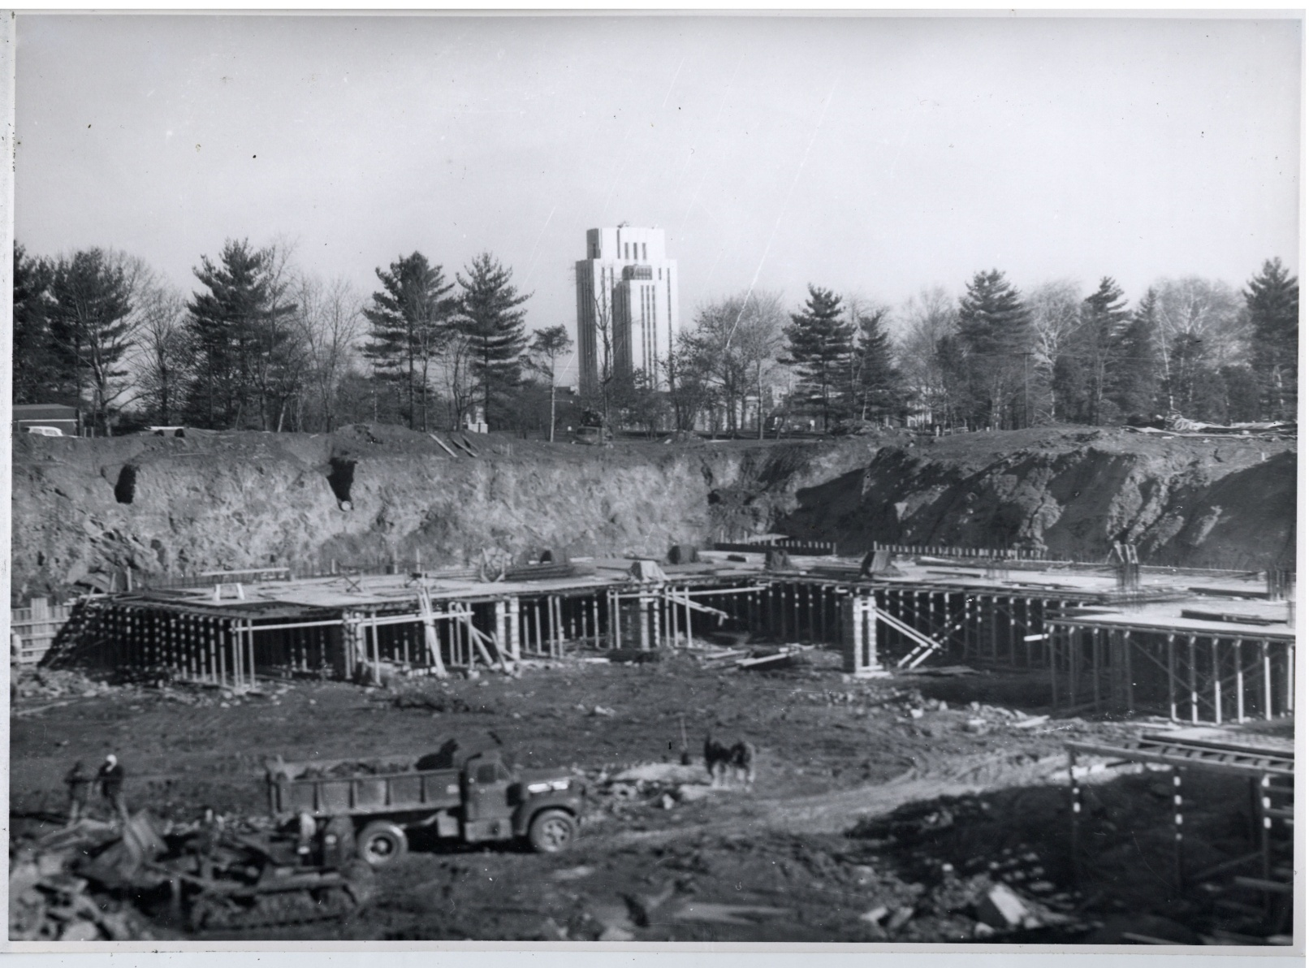
Underground stack floors being constructed in 1961
Notes:
If only we could go back in time and ask them to dig a deeper hole, we wouldn’t be in our current predicament.

Slide 4
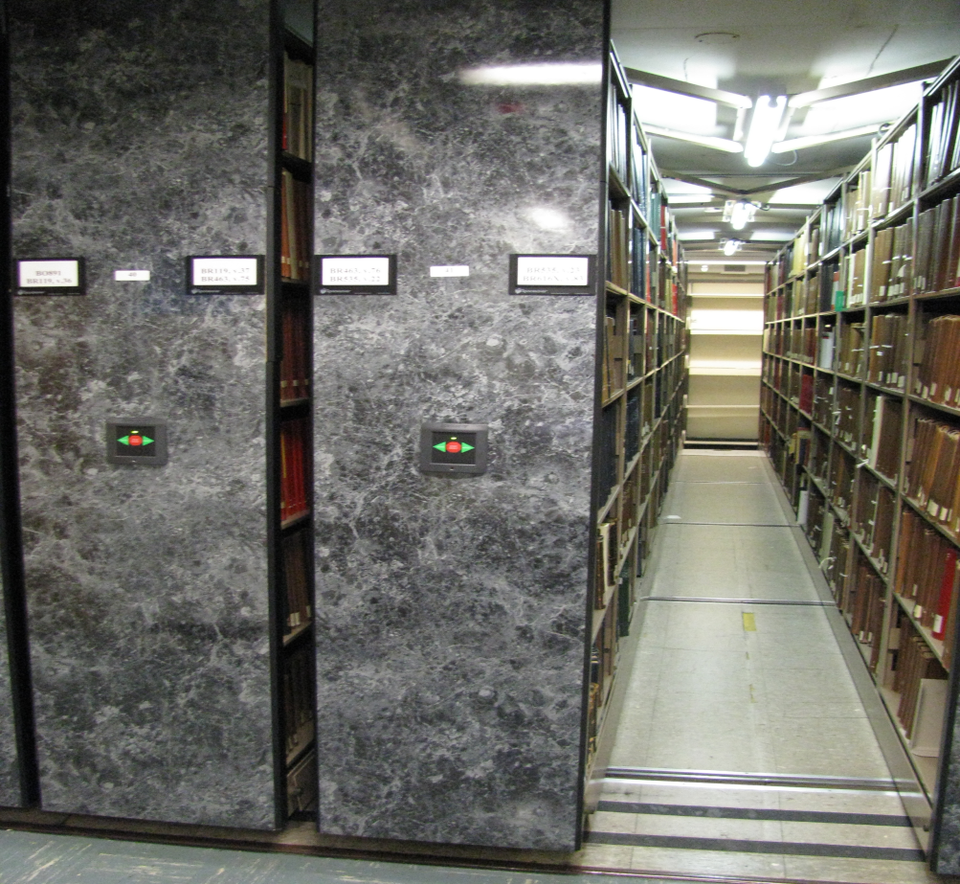
Today NLM Holds 2.6m Volumes
17.5 million items
Located:
NLM Stacks
University of Maryland (manuscripts)
Offsite Storage (Rockville MD)
Notes:
Currently, NLM houses or stores over 2.6m volumes or 17.5 million items. Unlike most of you, NLM still adds over 110,000 serial print issues to our shelves each year.
Not everything though is currently in the building.
Over 8500 linear feet of unprocessed modern manuscripts are stored at the UMD Health Sci and Human Services library in Baltimore, and over 16,000 little used items are in an offsite storage location in Rockville MD.
Our goal is to bring everything back to 8600 Rockville Pike under one dry roof with adequate fire suppression and environmental conditions.

Slide 5
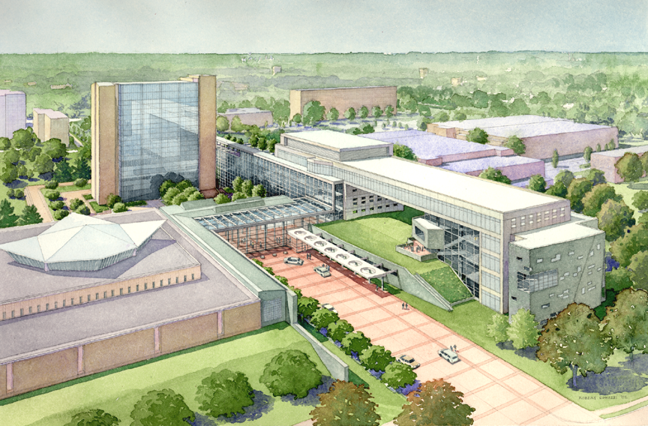
Artist’s Rendition of New Building
C. 2002
Notes:
Some of you may remember that about 15 years ago plans were drawn up for another NLM Building to house NCBI, a collabratorium, and most importantly for our collections, which was to add another another 203,000 sf of collection storage.
Looking at this drawing, the underground storage was to extend under the paved walkways between the 2 buildings out from 2 of our underground floors. Those drawing also included bringing all LO staff under one roof, so in fact, a large piece of the existing collection space was to be given over to staff.
All of this became a moot point when several years later it became clear that congress would not support another building for NLM, and yet, we still had to solve the problem of what to do about our collection space needs.

Slide 6
Two Options
Store materials permanently off-site
  Examined several off-site facilities in 2007
              OR
Install additional compact shelving
on the middle floor of the 3 stack levels
Notes:
Essentially – this came down to 2 options: Find permanent offsite storage at a locally convenient site, or Install additional compact shelving on the middle floor of the 3 stack levels.

Slide 7
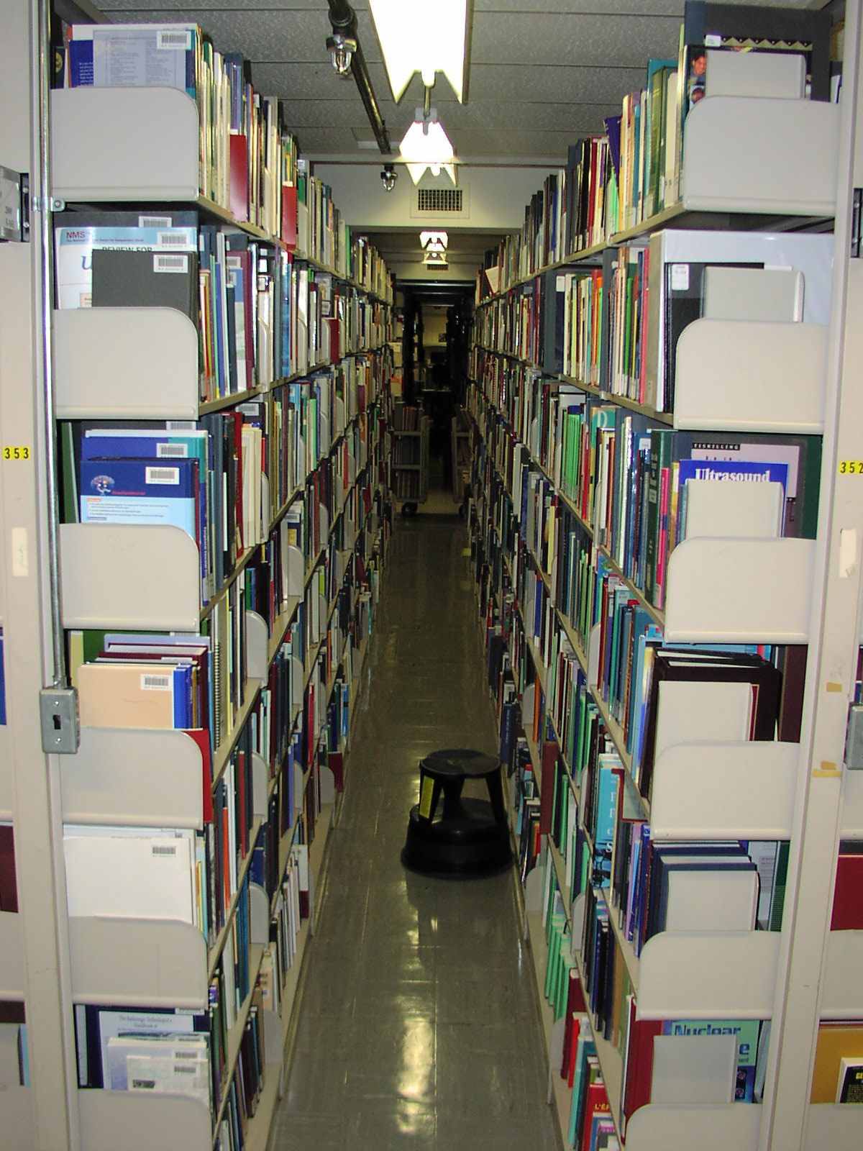
Crowded stacks on second level
This floor could not support compact shelving
Notes:
Here is a picture from a few years ago showing monographs stored on our second floor.
We have 3 floors of shelving. – and our popular descriptive phrase is that each is the size of a football field.
When it became clear that we needed to install compact shelving on not just the lowest level, 3 separate engineering reports provided conflicting information about whether or not the floor could support it. Somehow it didn’t seem right to accept the reports that said the floor could support fully loaded compact shelving when other reports said no. So, armed with yet another final report from NIH engineers confirming the floor would NOT support compact shelves, we are undertaking a program to strengthen the floors and ultimately install compact shelving throughout.

Slide 8
Let’s Avoid this Possibility

Slide 9
Eight Year Plan
Store low use collections offsite
Strengthen 2nd level
Install compacts
Upgrade lighting and sprinklers
Reduce Temp/RH in stack areas

Slide 10
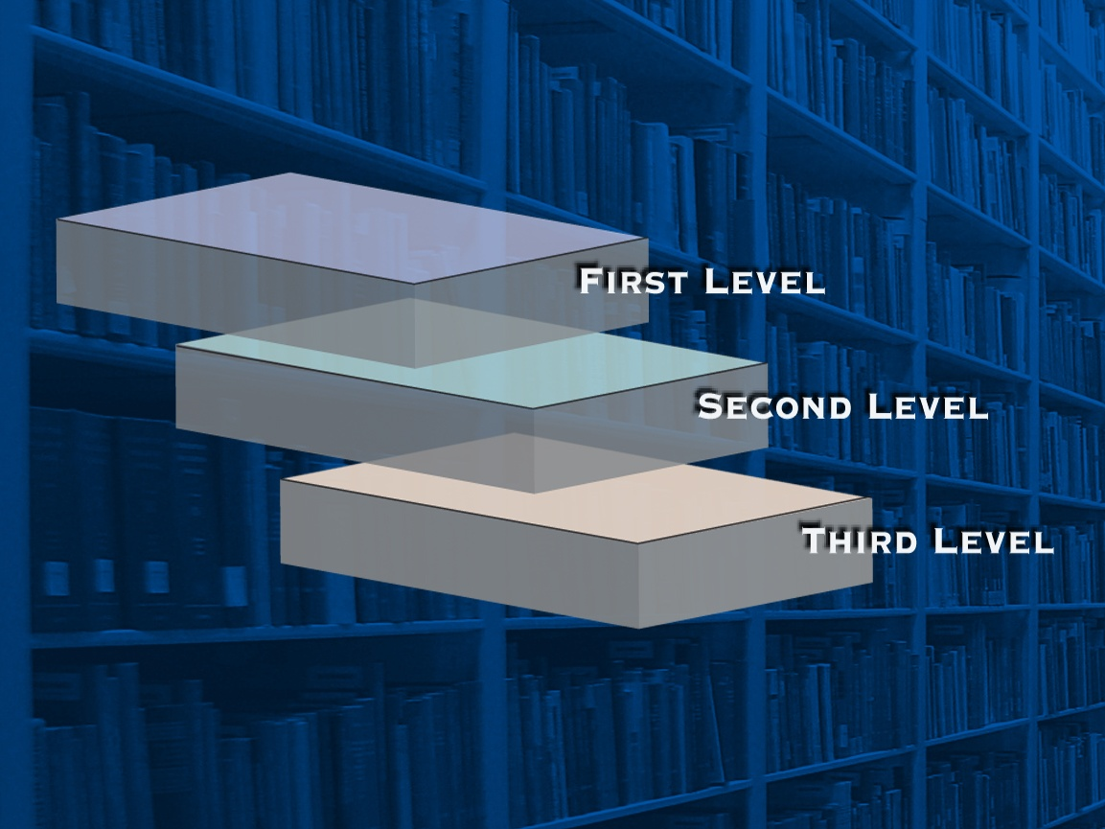
Strengthen floor and ceiling

Slide 11
Steps to strengthen floor and ceiling
Floor and ceiling tiles removed
Surfaces sanded
Fiber reinforced polymer (FPR) composites bonded to surfaces with an epoxy adhesive
  Thin laminate of high strength fibers of glass, kevlar and carbon embedded in a resin matrix
Notes:
Working in quadrants of the Library at a time, and with many details left out of this sketch of the process, these are the steps we are taking to make the second level safe for compact shelving
Show Kevlar sample

Slide 12
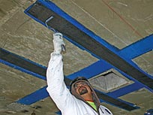
Strengthen 3rd floor ceiling

Slide 13
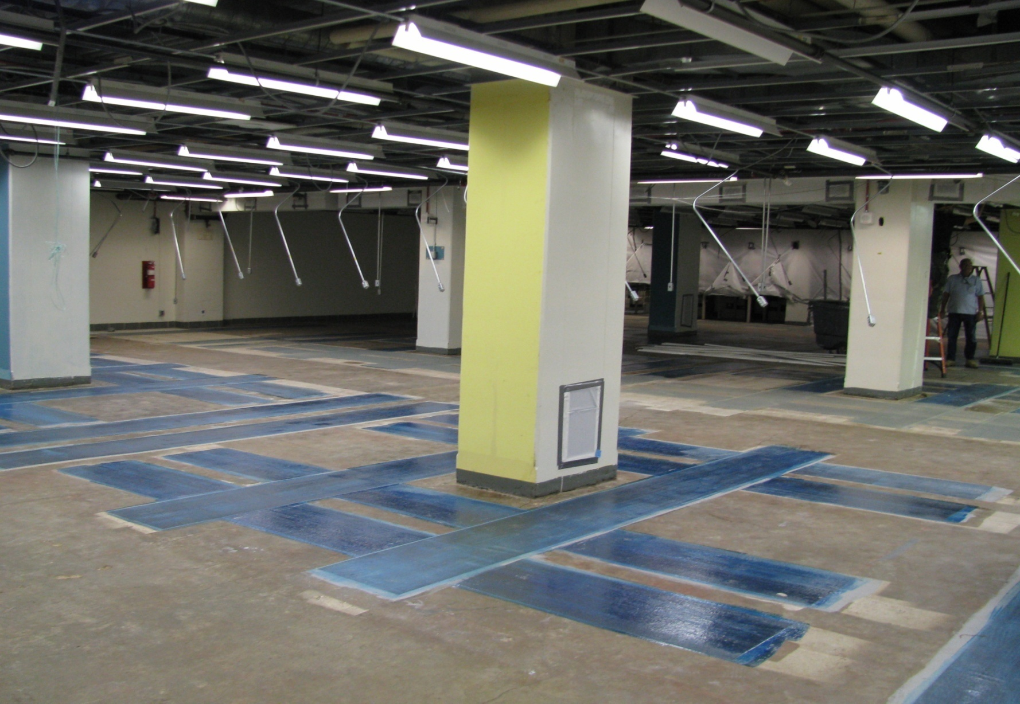
NLM 2nd Level – floor strengthening

Slide 14
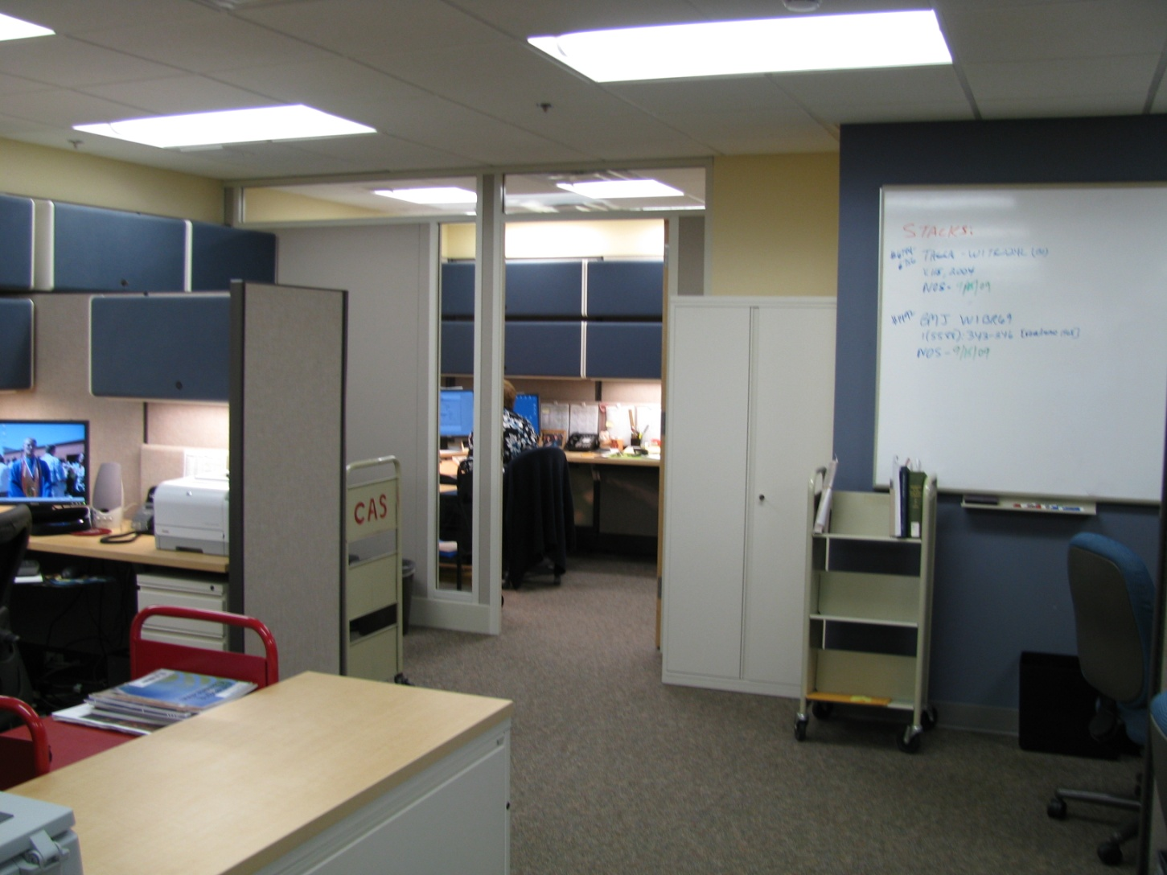
New Office Space for Preservation Staff
Notes:
We also got some really nice office space on the B2 level for our Preservation and Collection Management staff, and later in the process, the History of Medicine Division staff will have renovated space on this floor.

Slide 15
2013 Plans
B-3 construction and compact shelving upgrade in former HMD space
Z and Limited collections return from offsite storage to renovated B-3 space
Compact shelving at offsite location is returned and reinstalled on B-2 level for General Collections

Slide 16
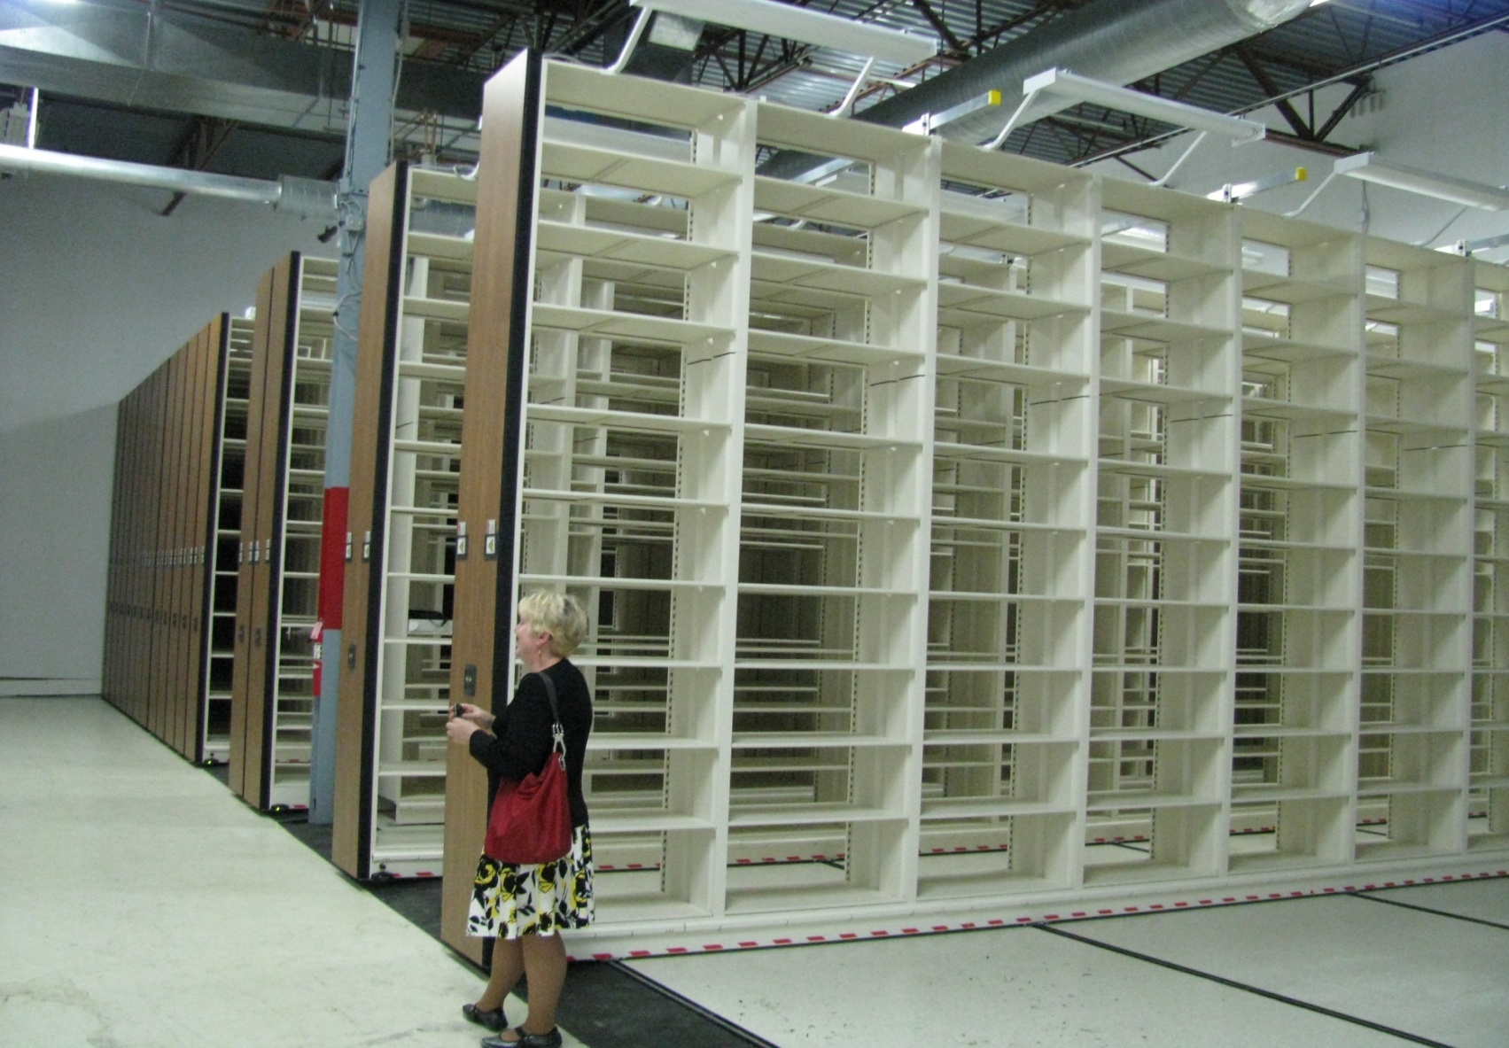
Compacts with 10 tiers in offsite facility

Slide 17
During 2014-2015
Rare books move to more secure and better environmental conditions on B-2
HMD staff move to renovated space on
B-1 and B-2 levels
Complete installation of new compacts on
B-2 for HMD collections

Slide 18
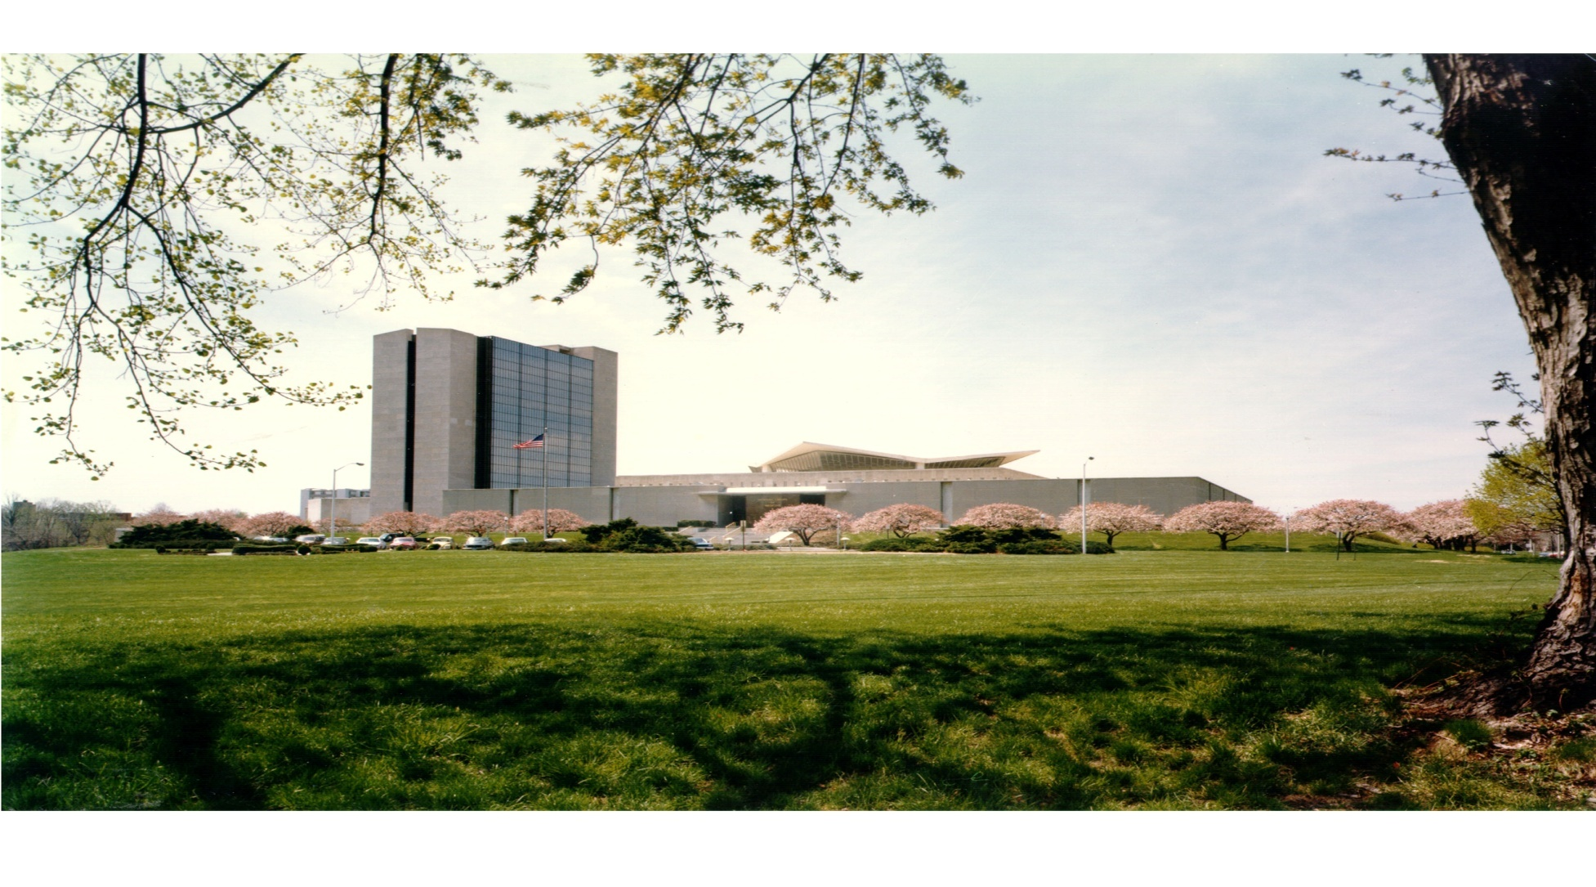
By end of 2016 NLM’s storage capacity will have doubled to hold over 3M volumes

