Slide 1
NLM Digital Programs
Loren Frant
May 6, 2013

Slide 2
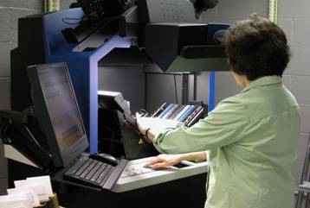
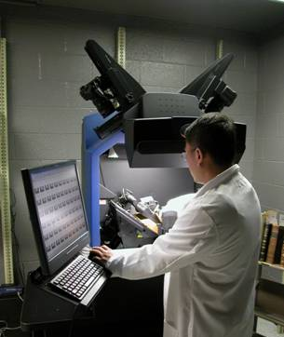
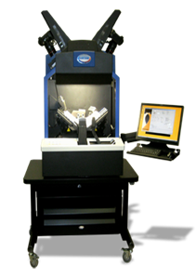
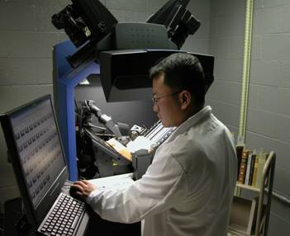
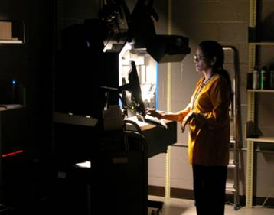
Images of Scientist working on digitization

Slide 3
Diagram of digitization working groups
Digital Projects Selection Group
Digital Repository Working Group
Digital Program Oversight Group
Scanning Working Group

Slide 4
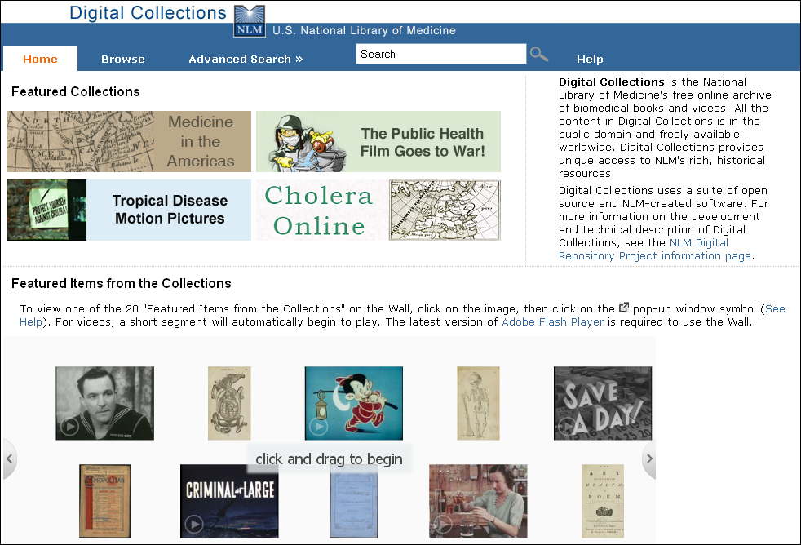
Image of the digital collections home page
collections.nlm.nih.gov

Slide 5
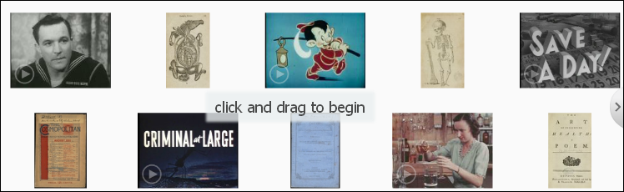
Image of the digital collections home page with arrows on browse and search
collections.nlm.nih.gov

Slide 6
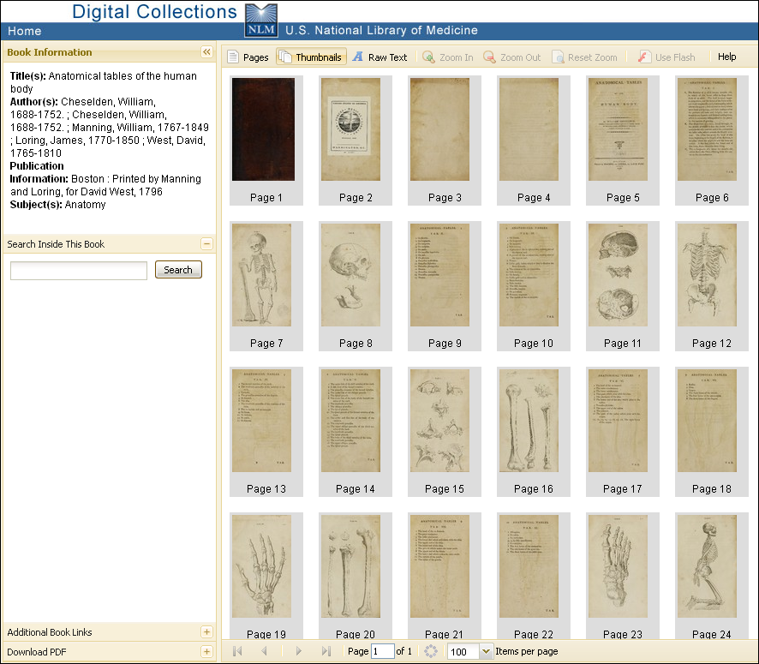
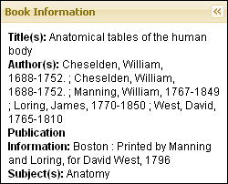

Image of digital collections book information record

Slide 7
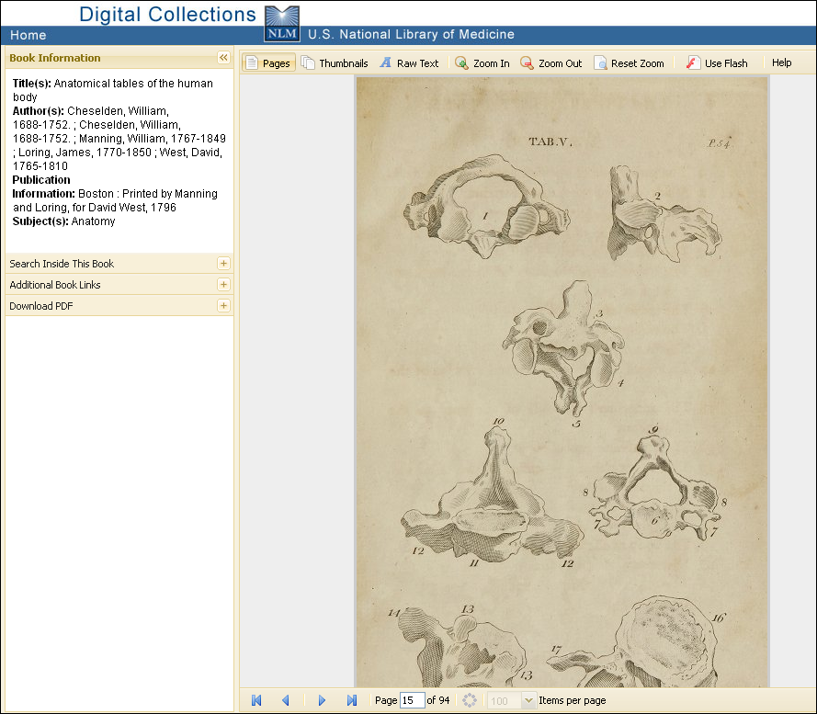
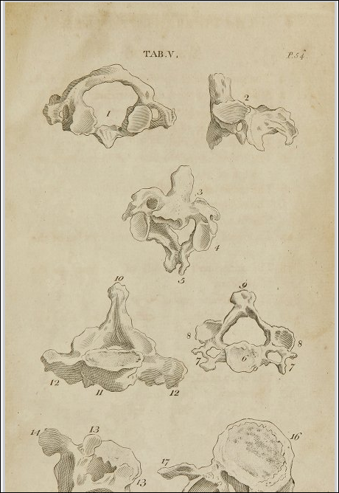
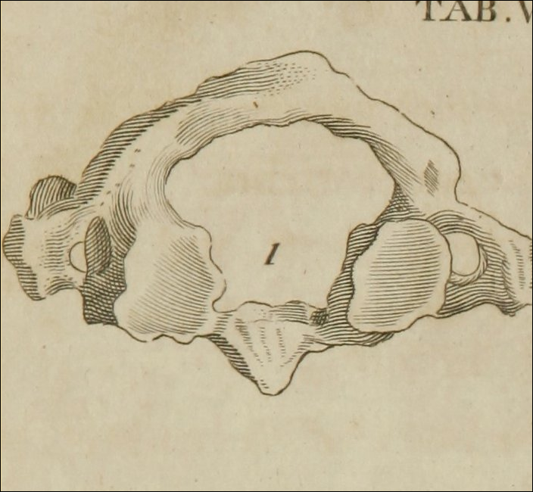
Image record from digital collections

Slide 8
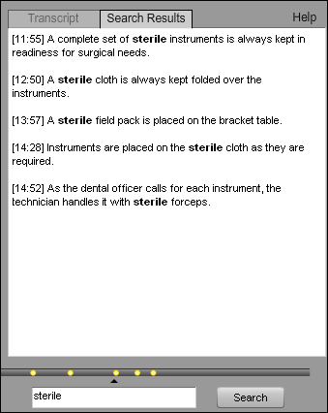
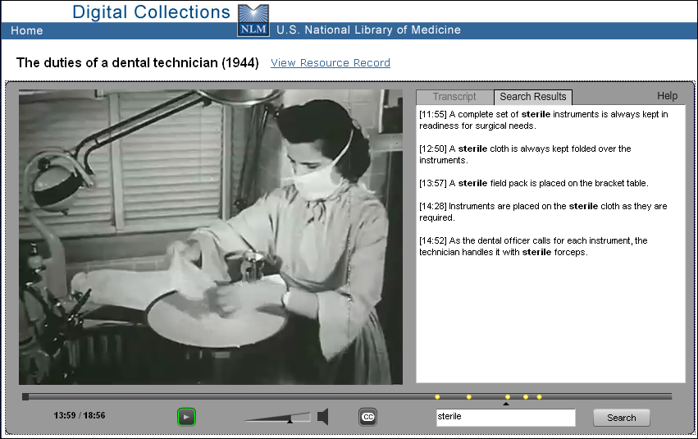
Image of search results from digital collections

Slide 9
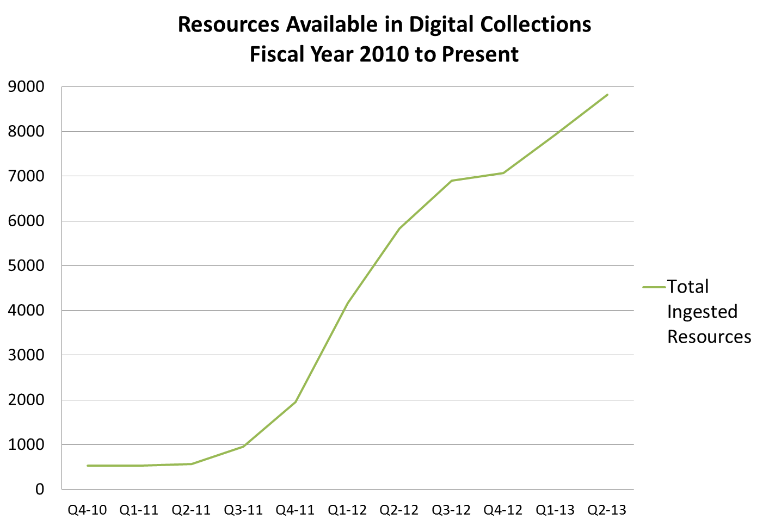
Chart of Resources Available in Digital Collections FY 2010 to present

Slide 10
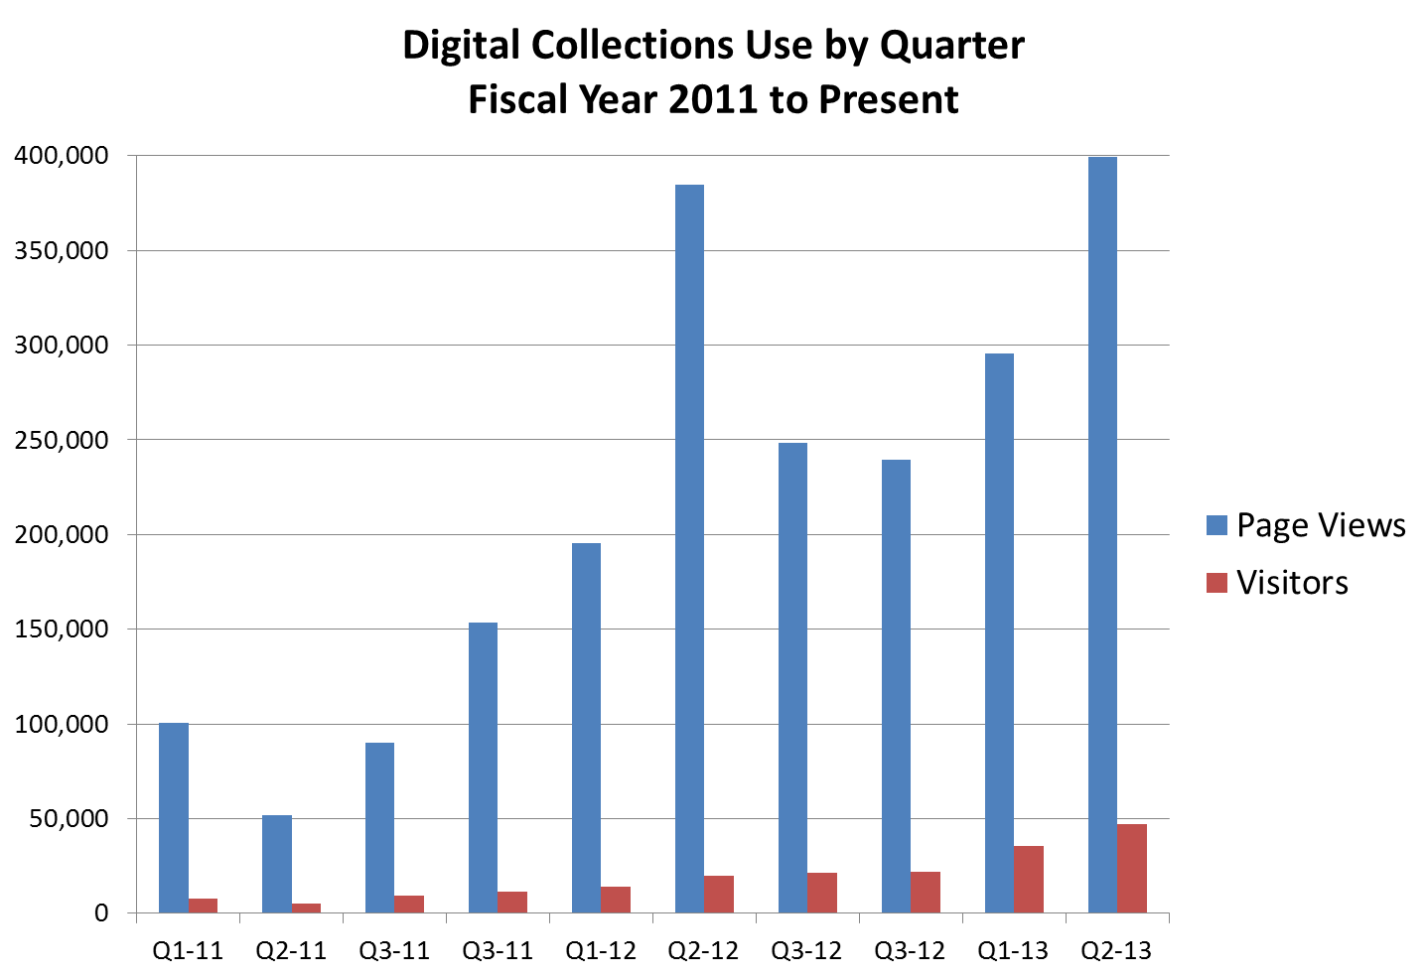
Chart of Digital Collections Use by quarter FY 2011 to present

Slide 11
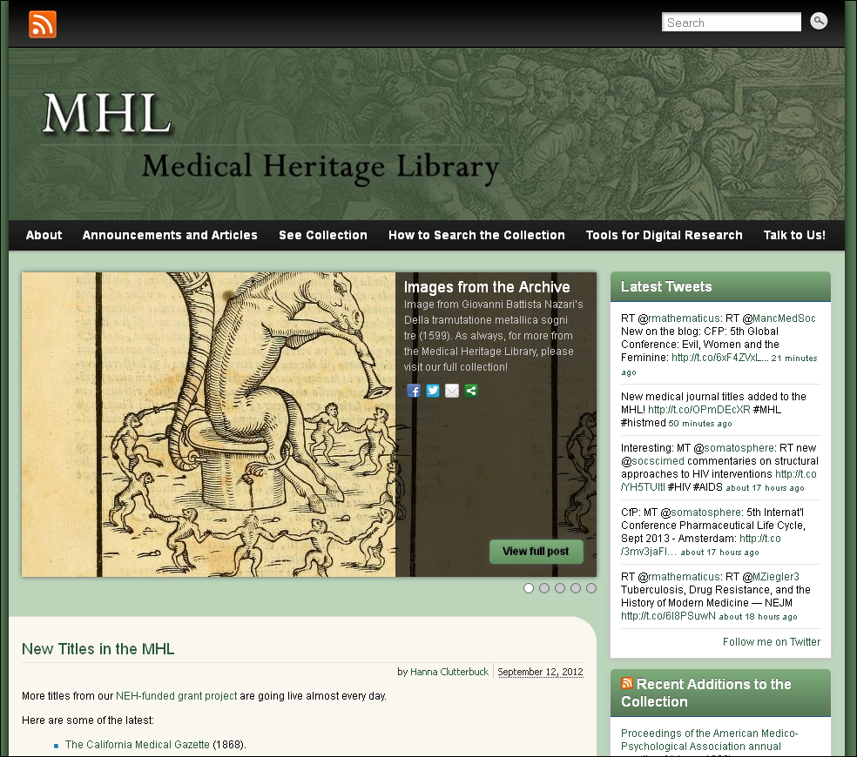
Image of the Medical Heritage Library home page
medicalheritage.org

Slide 12
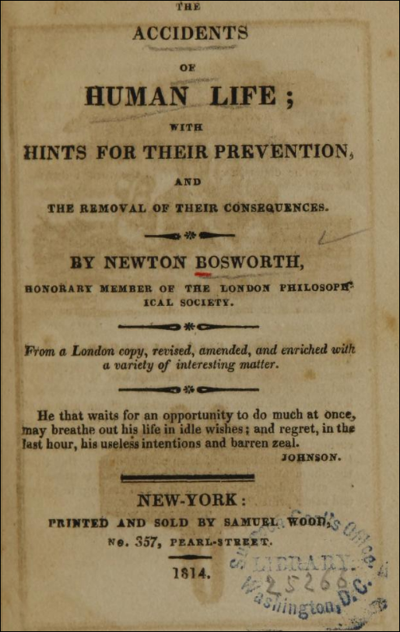
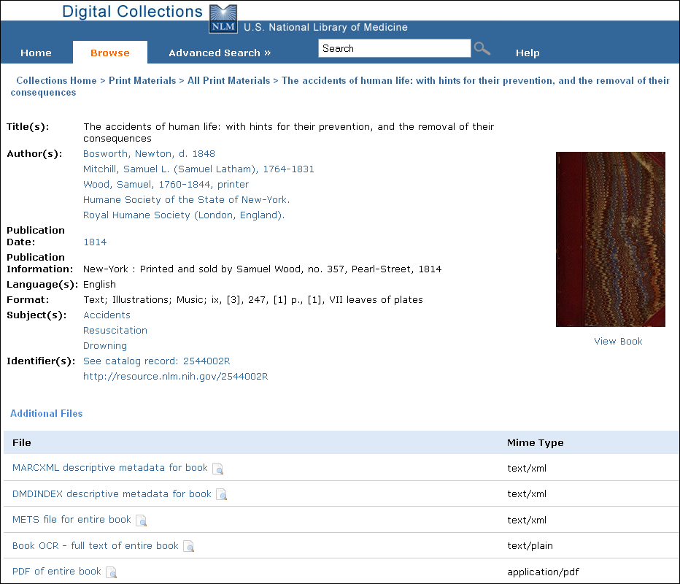
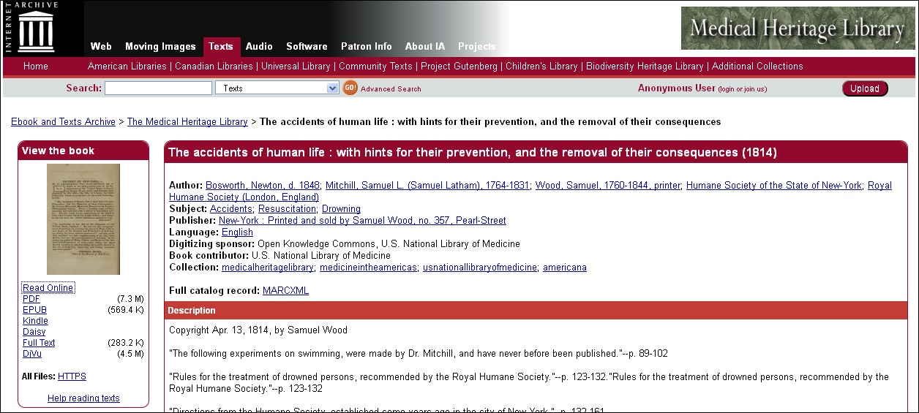
Image of a digital collections record under the browse tab

Slide 13
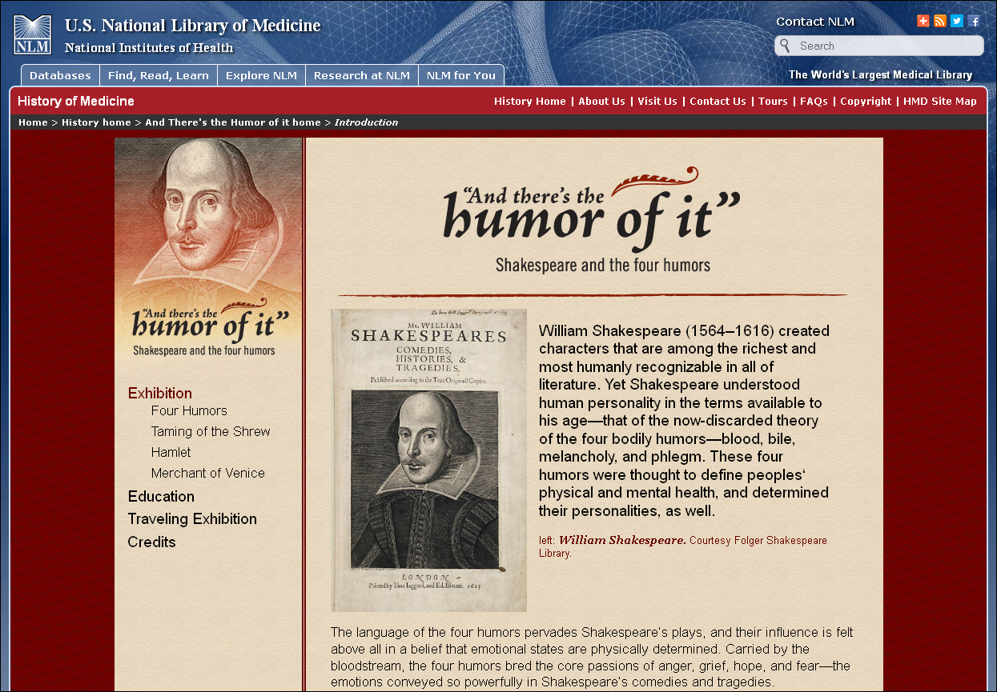
Shakespeare and the Four Humors

Slide 14

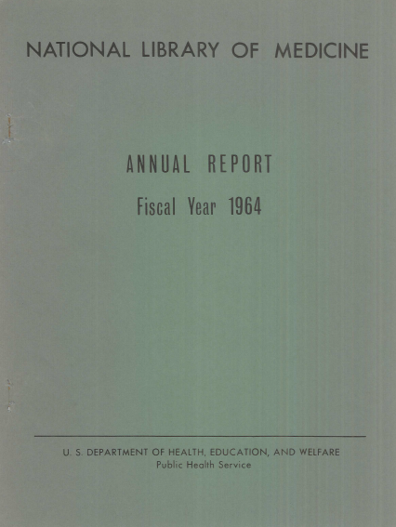

NLM Monograph Publications

Slide 15
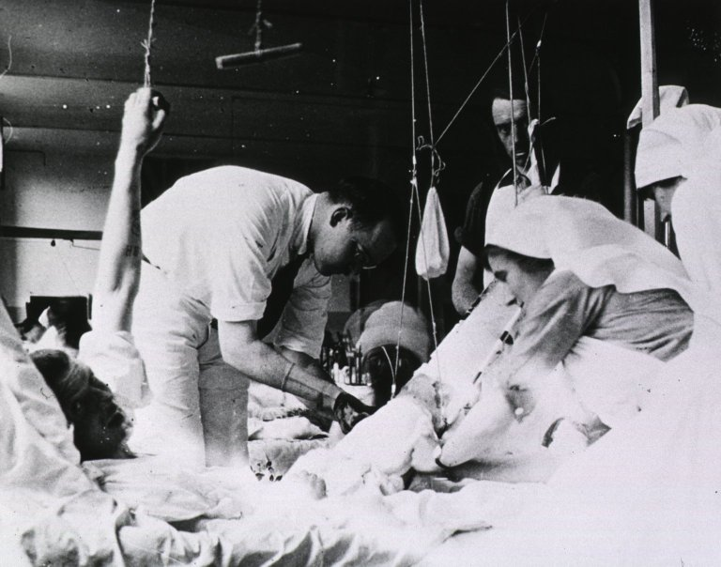
WWI Materials

Slide 16
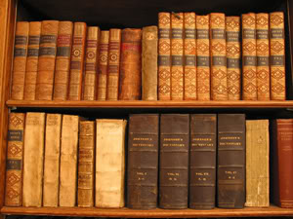
General Collection Monographs 1914-1922

Slide 17
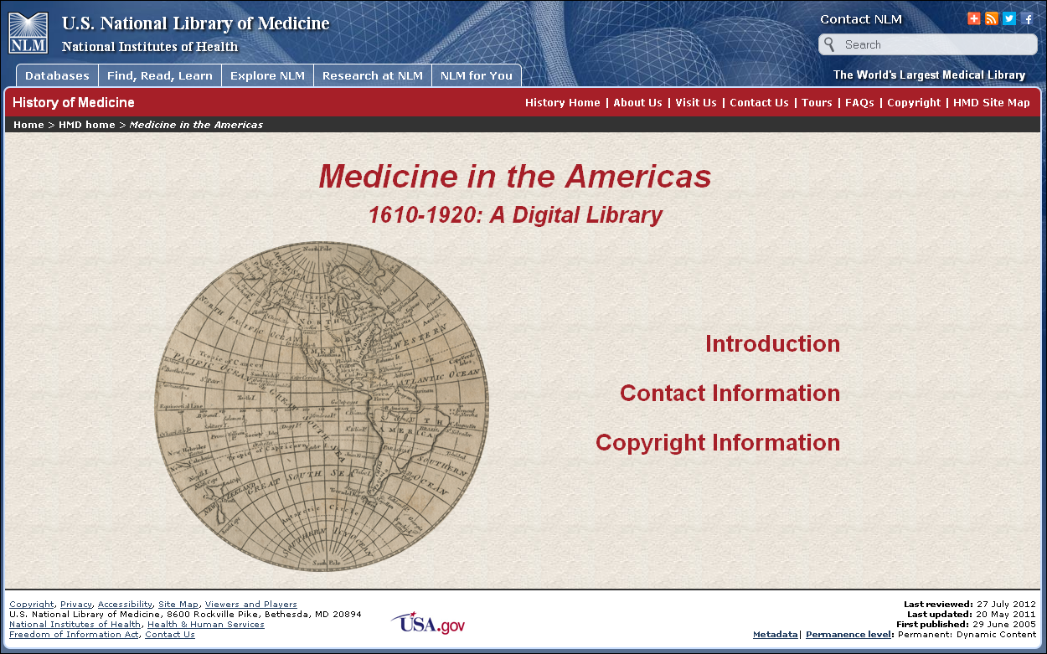








Medicine in the Americas Phase II

Slide 18
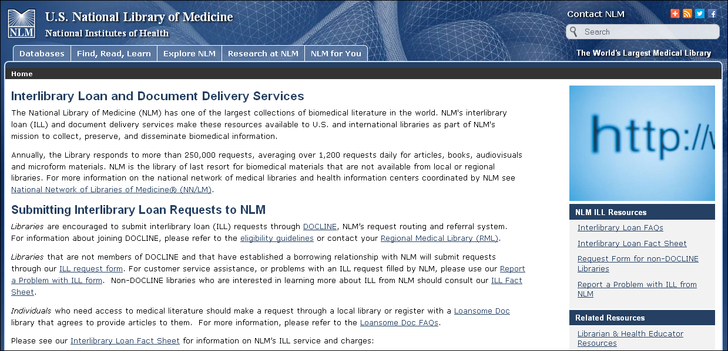
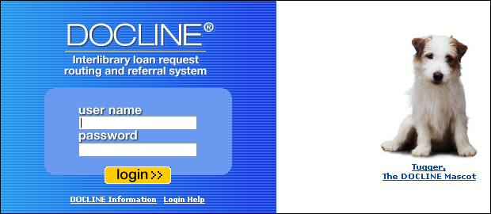
Scan on Demand

Slide 19

Fair Use at NLM

Slide 20
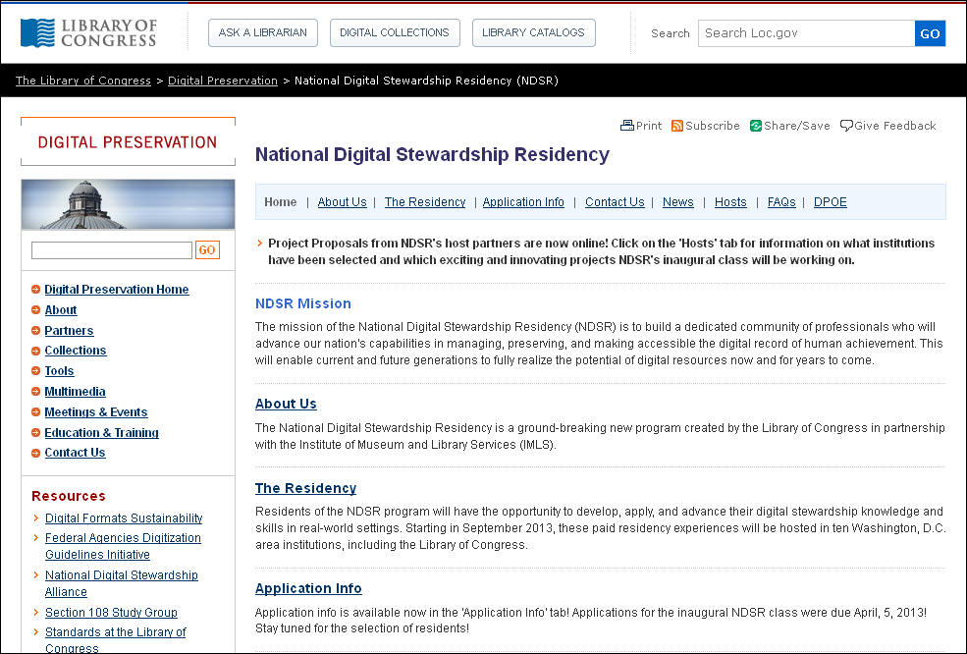
National Digital Stewardship Residency

