Slide 1
Connecting Communities to History:
The Exhibition Program at NLM
Stephen J. Greenberg, MSLS, PhD
History of Medicine Division
National Library of Medicine
National Institutes of Health
U.S. Department of Health and Human Services

Slide 2
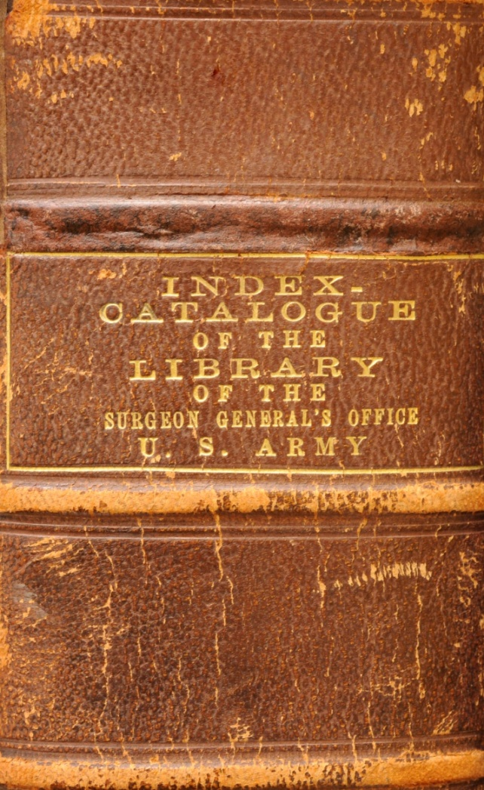
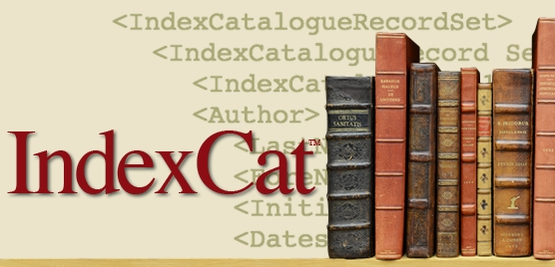
IndexCat
XML data now available for 3.7 million citations:
http://www.nlm.nih.gov/hmd/indexcat/indexcatxml.html
Notes:
XML data now available for 3.7 million citations:
http://www.nlm.nih.gov/hmd/indexcat/indexcatxml.html

Slide 3
Native Voices
http://www.nlm.nih.gov/nativevoices/

Slide 4
Native Voices Interviews
Available from the
App Store

Slide 5
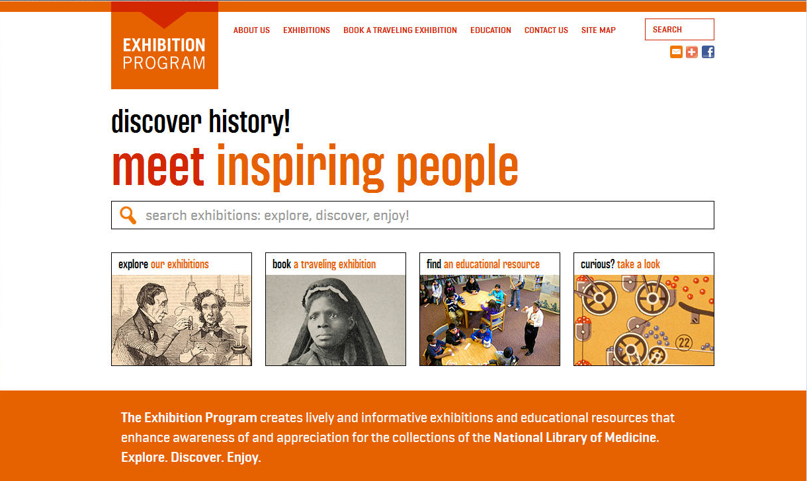
Travelling Exhibition Program
http://www.nlm.nih.gov/hmd/about/exhibition/index.html

Slide 6
NLM Traveling Exhibitions have been booked and/or hosted by 457 institutions in 48 states, the District of Columbia, and international locations including Guam, Canada, Turkey, France, Germany, Argentina, Northern Mariana Islands-South Pacific, Venezuela, and the United Kingdom.
Currently 22 copies of 11 exhibitions are traveling throughout the United States and abroad, with several new exhibitions in development.
NLM traveling exhibitions have been seen by over 1,800,000 people.
142 venues have hosted and/or booked more than one of the exhibitions; 41 venues have hosted and/or booked 5 or more exhibitions; 4 venues have hosted more than 10 exhibitions.
Between April 2012 and April 2013, 51 new venues signed up to host one or more traveling exhibitions.

Slide 7
Healing the Nation Stories from the Civil War

Slide 8
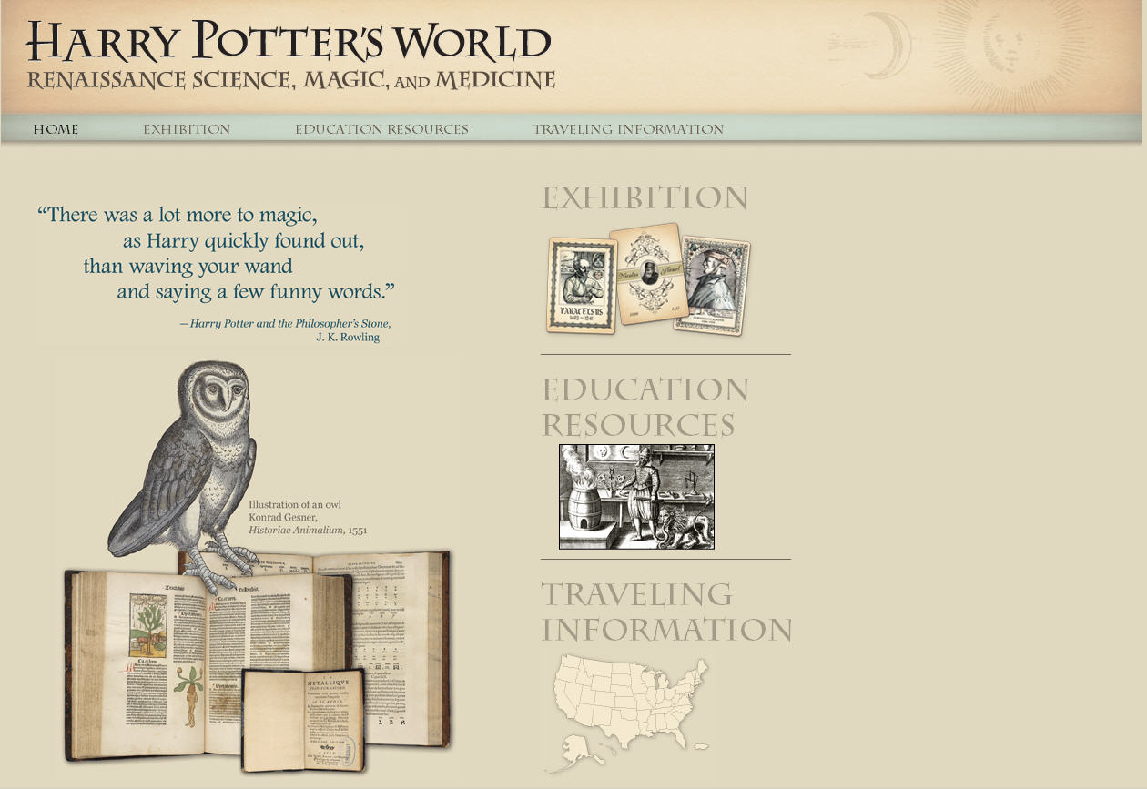
Harry Potter’s World
http://www.nlm.nih.gov/exhibition/harrypottersworld/

Slide 9
George Washington’s Mount Vernon Estate, Museum and Gardens
Brand new, in cooperation with
George Washington’s Mount Vernon Estate,
Museum & Gardens

Slide 10
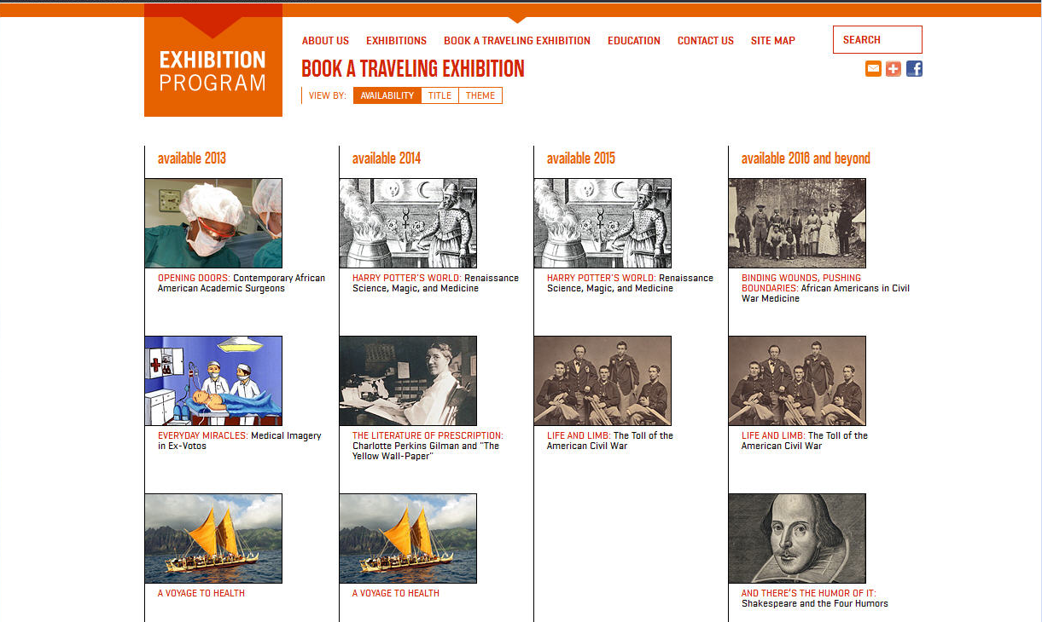
How to Book an Exhibition
http://www.nlm.nih.gov/hmd/about/exhibition/booktraveling.html

Slide 11
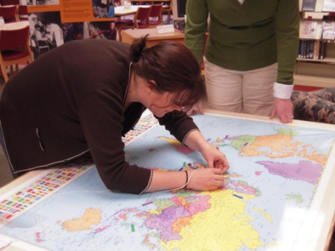
Against the Odds: Making A Difference in Global Health
Against the Odds: Making A Difference in Global Health
University of Michigan Taubman Medical Library, Ann Arbor, MI
March 10 - April 13, 2009
Companion online exhibit bringing together NLM Resources, University of Michigan’s Global Reach Video Challenge and an interactive map showing locations of University of Michigan’s global health projects
Physical map of the world with opportunity to add personal accounts of global health experiences
Created special bookmarks to place in materials related to the exhibition

Slide 12
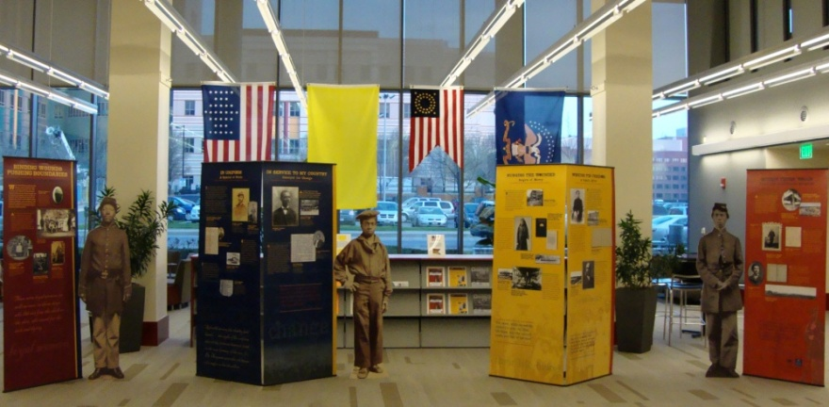
Binding Wounds, Pushing Boundaries: African Americans in Civil War Medicine
Binding Wounds, Pushing Boundaries: African Americans in Civil War Medicine
Wayne State University, Detroit, MI
March 19, 2012 - April 28, 2012
Hosted a community education program in conjunction with the exhibition including a panel discussion
Extensive online resources centered on the Binding Wounds, Pushing Boundaries exhibition and African American medical personnel in the Civil War including presentation of History of Medicine images, links to NLM resources, and links to other NLM Civil War related exhibitions including Life and Limb
Addition of lifesize cut-outs of African American sailors and soldiers

Slide 13
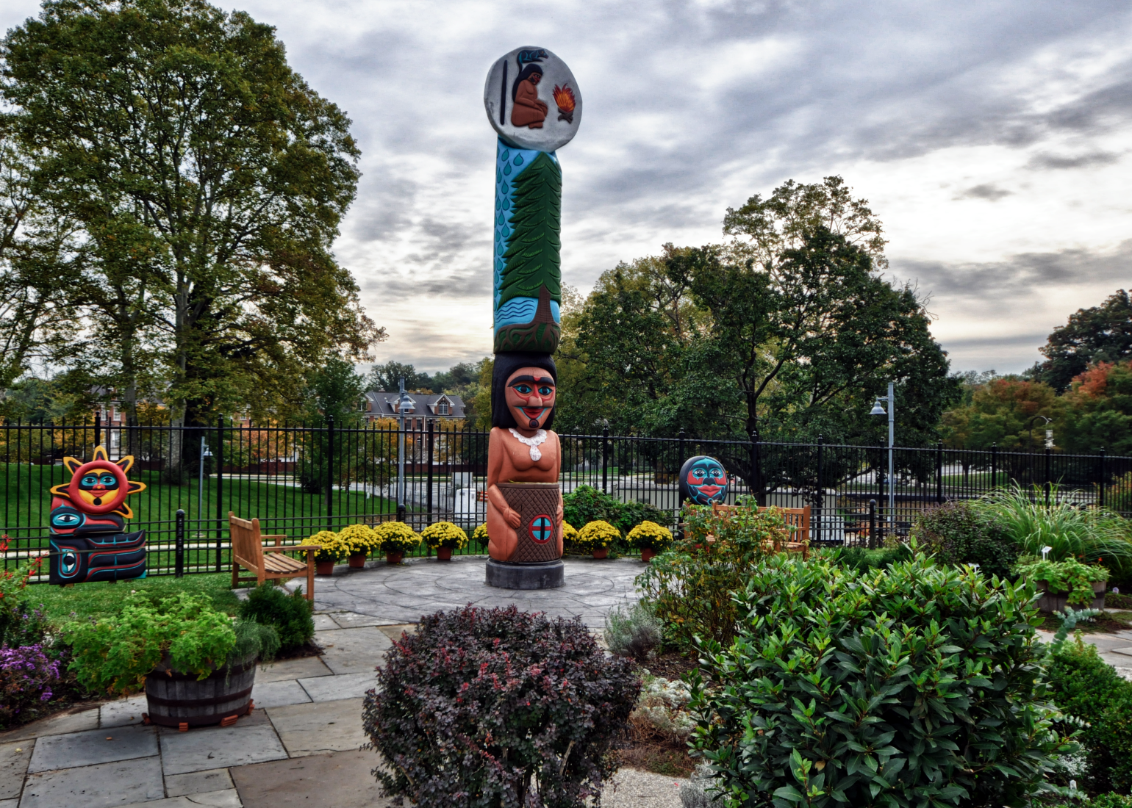
Thank you
Thanks for listening! greenbes@mail.nih.gov
United States
National Library of Medicine
National Institutes of Health, Health and Human Services

