Slide 1
Library Operations Update - 2014
Joyce E. B. Backus
Associate Director for Library Operations
National Library of Medicine
National Institutes of Health
U.S. Department of Health and Human Services
Notes:
Library Operations Update – 2014
Joyce E. B. Backus
Associate Director for Library Operations
National Library of Medicine
National Institutes of Health
U.S. Department of Health and Human Services

Slide 2
Overview
Resource sharing
You’re going mobile, we’re going mobile
Machines taking big bytes
National Network of Libraries of Medicine and RFI
Exhibitions come to you
Collections come to you
Local news
Keep in touch
Notes:
This morning, I’m going to share a few updates with you to include what we’re thinking about interlibrary loan based on the feedback you gave us last year; how we’re adapting our web sites to go mobile, the change in the way our information is being used by computers, the current request for information that is out for your national network of libraries of medicine. I’ll cover the ways in which you’re hosting our exhibitions and how you can get to our collections, will share a bit of local news and also suggest ways we can keep in touch.

Slide 3
Update on resource sharing
Notes:
Update on resource sharing

Slide 4
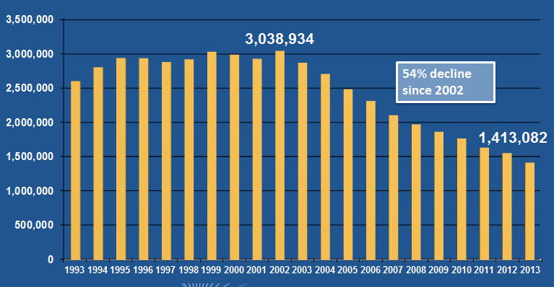
DOCLINE Requests
Notes:
You’re all aware the overall DOCLINE use is down. Well here are the numbers that show network docline transactions are down 54% since 2002.

Slide 5
Report: Future of Resource Sharing
DOCLINE use down 54% since 2002 due to: Open access, public access
  30% of PubMed articles since 2010 available free online
  93% since 2010 online free or subscription
Users prefer immediately available articles
In addition to ILL, librarians choosing
  Open/public access
  Purchase
  Requests to email lists
  Contact corresponding author
  Other ILL systems (OCLC, consortia)
Librarians stated that ILL will remain a preferred method for obtaining articles
Notes:
This decline, however, doesn’t mean DOCLINE will be going away any time soon. 1.4 million requests still shows strong need from you and your practitioners and scientists. However, your survey responses and your focus group feedback gave us many of the reasons for the decline of ILL in DOCLINE.
You told us
more journal literature is available free via public access initiatives and open access, and here are the current figures. For the publication since 2010 in PubMed, 30% is available free online and 93% is available electronically.
more journal literature is accessible to users online through “big deal” packages and/or consortia buying, so needs are met with available library resources
end-users prefer items available immediately, online and free and you’re working to meet those expectation when they can’t do so themselves by
Finding open source / free online sources
Purchasing articles, in lieu of borrowing
Requesting items on email distribution lists
Contacting the author of an article
Last, the survey results revealed that in addition to DOCLINE, librarians are using other ILL systems such as OCLC and consortia arrangements.

Slide 6
Report: Future of Resource Sharing Slide 2
Recommendations:
  Allow more flexible NN/LM membership and participatory levels in DOCLINE
  Proposed system improvements including out of office options, batch holding upload, more help options
Further Investigation: licensing issues, interoperability,
Notes:
So we’re working with the National Network of Libraries of Medicine on some proposed changes.
The first is to allow you greater flexibility in how often and at what level you participate in DOCLINE – including less than daily participation and borrow only.
We are looking to implement system changes to support more infrequent users including changes to out of office options, offering batch holding information upload, improving system interface including a simplified request option for infrequent users, and enhancing help options with short videos.
We will be investigating further some other issues that came up in the surveys and focus groups including the situation around your e-journal licensing
system changes to DOCLINE to support some level of interoperability with other ILL management and other ILL request systems like OCLC.

Slide 7
You’re going mobile, we’re going mobile
Notes:
We use lots of use data to improve our products and we’ve noticed something. You and the rest of the world have gone mobile. How many of you have at least one mobile device here with you today? So, we’re improving accordingly.

Slide 8
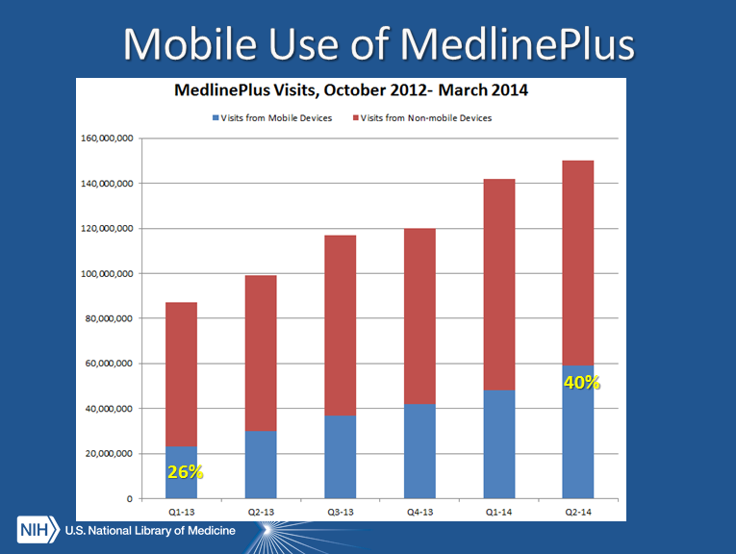
Mobile Use of MedlinePlus
Notes:
This chart shows that the use of MedlinePlus from mobile devices has grown from 26% to 40 percent in just 18 months and we don’t know where the trend will end.

Slide 9
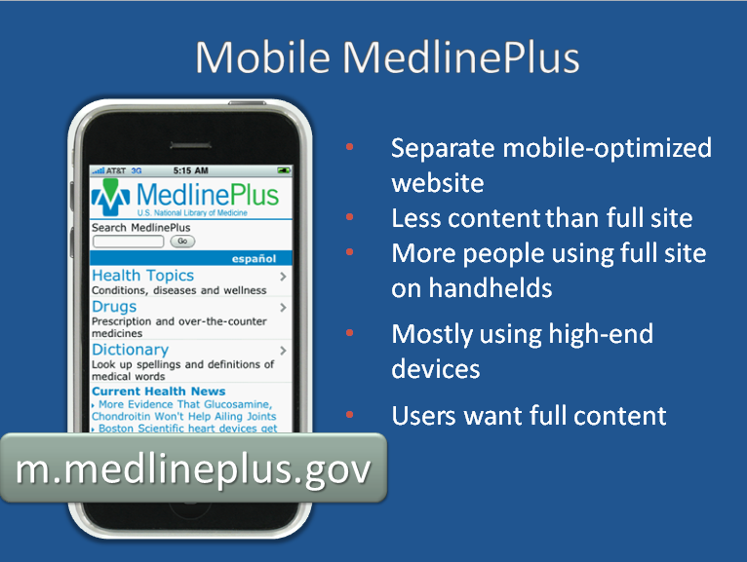
Mobile MedlinePlus
Notes:
Mobile MedlinePlus
We have mobile MedlinePlus, but it’s not really meeting people’s needs these days
Separate mobile-optimized website
Less content than full site
More people using full site on handhelds
Mostly using high-end devices
Users want full content

Slide 10
Responsive Design
A flexible, grid-based layout that responds to user needs
Delivers content in the best size for the device or browser window
Notes:
So, we’re moving many of our information products to a flexible design that requires re-programming on the backend to deliver information appropriately to any screen size.

Slide 11
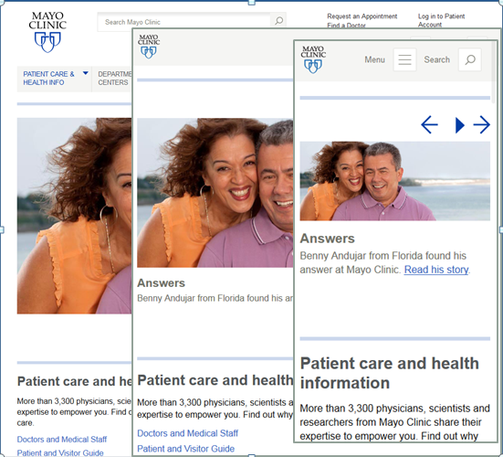
Responsive Design Example
Notes:
the mayo clinic is a great example of a responsively designed web site. It effectively delivers information on any size screen.

Slide 12
MedlinePlus & Responsive Design
Planning and programming has begun
2014: Phased approach
  One column – push to mobile site later this year
  Two column
  Three column
2015:
  Launch M+ responsive site to replace full site
  Retire m.medlineplus.gov
Notes:
so, by this fall, you’ll see a one column version of MedlinePlus and by next year the site will look great on any size screen and we’ll retire the dedicated mobile version.

Slide 13
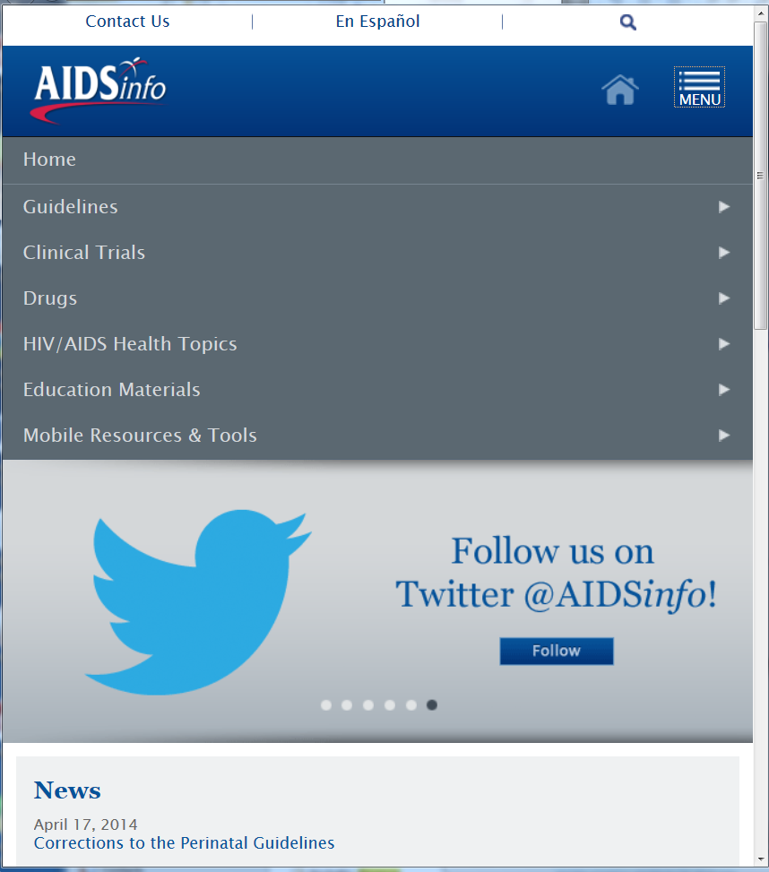
AIDSinfo Responsive Design
Notes:
AIDSinfo and infoSIDA are being redesigned to be responsive to the platform so that these web sites will be easily viewable on any size device - a full-sized monitor, a table, or a smartphone.

Slide 14
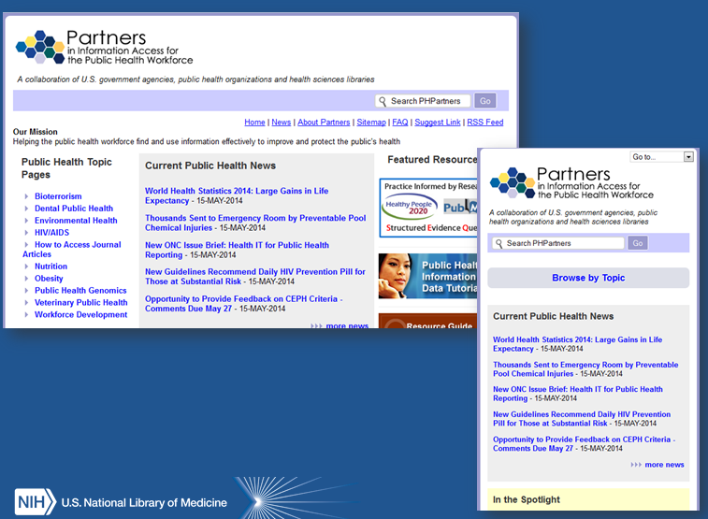
Partners in Information Access for the Public Health WOrkforce
Notes:
Pictures of Partners in the Information Access for the Public Health Workforce webpage

Slide 15
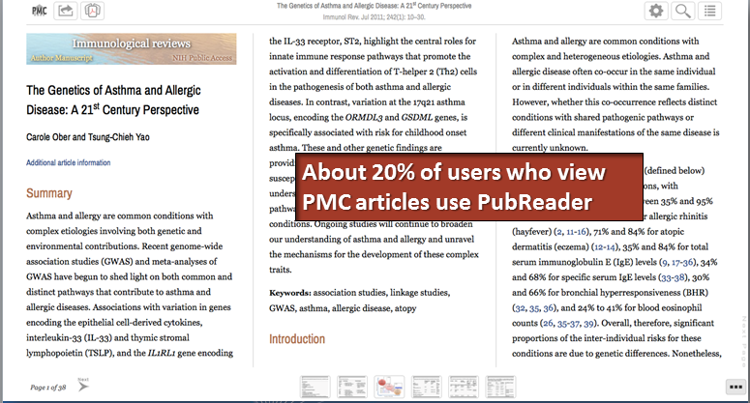
PubReader (HTML 5)
Notes:
About 20% of users who view PMC articles use PubReader

Slide 16
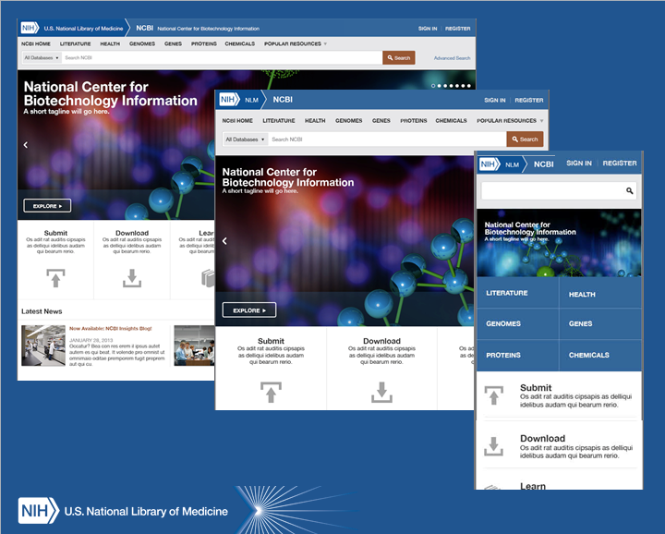
National Center for Biotechnology Information Homepage
Notes:
National Center for Biotechnology Information webpage

Slide 17
Machines taking big bytes
Notes:
As of June 2, pubmed will be updated with publisher content feeds seven days a week. We have been updating five days a week, but new science is constantly published and we know it’s important to you and your users to have the records available.

Slide 18
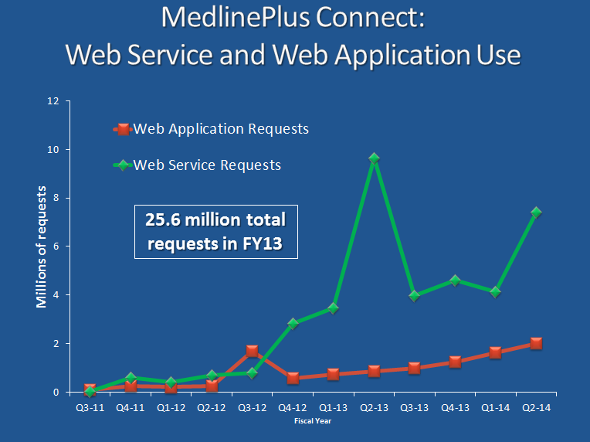
MedlinePlus Connect:
Web Service and Web Application Use
Notes:
There were a total of 25.6 requests to MedlinePlus Connect in FY 2013.
You can see from this chart, which shows Web Service requests in green and Web Application requests in Red, that use has been increasing. Most interesting is that use of the Web Service outweighs use of the Web Application.

Slide 19
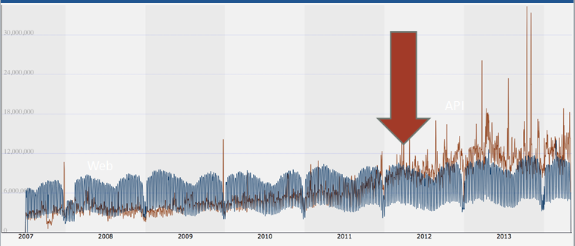
PubMed Use – People (web in blue) and Machines (API in brown)
Notes:
PubMed Use – People (web in blue)
and Machines (API in brown)

Slide 20
National Network of Libraries of Medicine
Notes:
As of June 2, pubmed will be updated with publisher content feeds seven days a week. We have been updating five days a week, but new science is constantly published and we know it’s important to you and your users to have the records available.

Slide 21
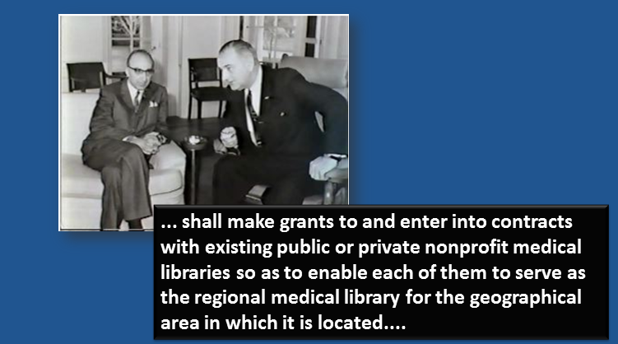
Medical Library Assistance Act (MLAA) - 1965
Notes:
In 1965, President Johnson signed the Medical Library Assistance Act (MLAA) establishing the Regional Medical Library Program. The Act resulted from the findings and recommendation of the President’s Commission on Heart Disease, Cancer and Stroke, chaired by Dr. Michael DeBakey show here with Johnson.

Slide 22
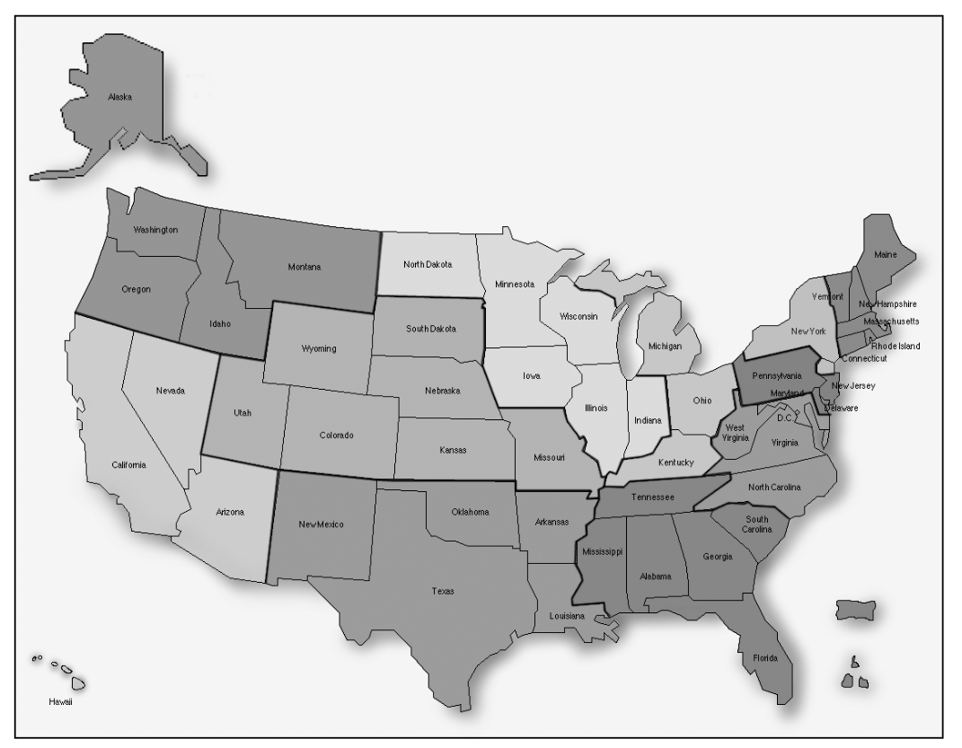
Regional Medical Library Network
1967 - 11 Regions
Notes:
The first Network had 11 regions, each with an institution serving as a Regional Medical Library or RML and Resource sharing was a major focus of the Network.
Subsidizing interlibrary loans was the most visible and popular service provided by the RML Network in its first years of operation.
In 1982, the Network was reconfigured to 7 Regions.

Slide 23
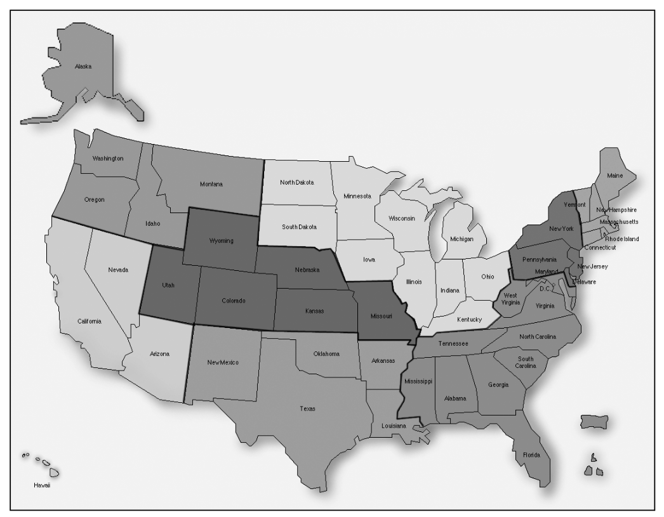
National Network of Libraries of Medicine
1991 to the present, 8 regions
Notes:
Then, in 1991 New England reemerged as a separate region and the Network was reconfigured to 8 Regions as it has today.
It was renamed the National Network of Libraries of Medicine or NN/LM and outreach became a major part of the contracts.
In 2006, in addition to the 8 RML’s leading the network, we established three centers
NLM Training Center (NTC)
Outreach Evaluation Resource Center (OERC)
Web Services Technology Operations Center (Web-STOC)
Images from JMLA 2002 90(1):8-16 Humphreys, BL

Slide 24
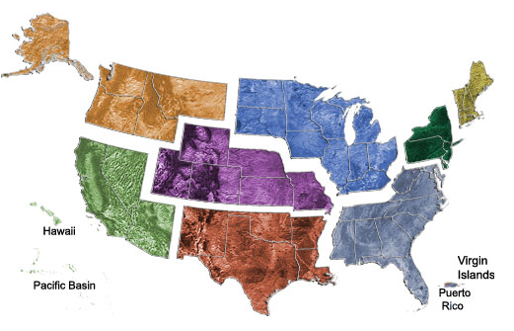
2011-2016
Middle Atlantic Region, University of Pittsburgh, Health Sciences Library System
Southeastern/Atlantic Region, University of Maryland, Baltimore, Health Sciences and Human Services Library
Greater Midwest Region, University of Illinois at Chicago, Library of the Health Sciences
MidContinental Region, University of Utah, Spencer S. Eccles Health Sciences Library
South Central Region, Houston Academy of Medicine-Texas Medical Center Library
Pacific Northwest Region, University of Washington, Health Sciences Libraries and Information Center
Pacific Southwest Region, University of California, Los Angeles, Louise M. Darling Biomedical Library
New England Region, University of Massachusetts Medical School, The Lamar Soutter Library
Notes:
Here is our current configuration and the excellent institutions who work with all of you to bring information and education about NLM resources to you and your users.

Slide 25
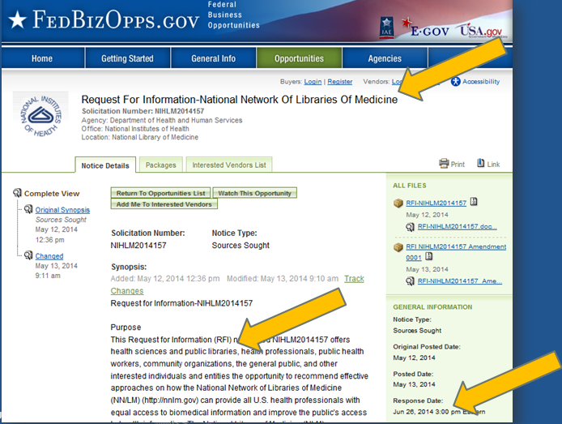
Request for Information on FedBizOps webpage
Notes:
As we look forward to the RML program beyond 2016, we’re asking for your thoughts. One way the government does this is through an RFI or request for information. It looks a little scary, but what we’re asking is for you to send us a word doc with your thoughts about how the network can serve you and your users in the future. You may have already gotten an email, but if not, just go to fedbizops.gov, search NLM and and you’ll find this page. Please do share it with anyone who you think can give us helpful feedback. We need to hear from you by June 26.

Slide 26
Priorities, Strategies, Partnerships
Priorities, Strategies, Partnerships
1. What priorities should the Network address? Provide recommendations.
2. What strategies should be used to reach varied populations, including minorities and the underserved?
3. What are the most effective ways to partner with libraries, health, information, community organizations to reach health professionals, public health professionals, and the general public?
Notes:
Specifically, we’re asking you to consider up to 10 questions, but you can answer just one, two, three, or all 10. We’re asking you about the overall priorities, reaching the underserved and how to best partner to do this.

Slide 27
Outreach, Programs Training, Resource Sharing
Outreach, Programs Training, Resource Sharing
1. What new outreach roles and/or untapped outreach opportunities should be considered? What are barriers and opportunities in these new roles?
2. Which Network programs should receive less emphasis or be considered for elimination? Why?
3. What are the most effective strategies to support health sciences librarians in their knowledge and ability to support NLM products and services?
4. What role should resource sharing (Interlibrary Loan) play in supporting the Network's mission to promote access to biomedical and or health information?
Notes:
We asking you how we should work with you to do outreach, if there are programs you feel we can stop doing, what kind of training we can provide to support you in your role, and your thoughts about the future of resource sharing.

Slide 28
Membership, Network Structure, Service Coordination
Membership, Network Structure, Service Coordination
1. What should be the responsibilities of Network membership? What should be the benefits?
2. What type of Network advisory structure is needed?
3. Will the geographical configuration of the Network meet future needs? What services of the Network could be coordinated nationally? What services are best coordinated at a local or regional level?
Notes:
And lastly, we’re asking you about the structure of the network, what it should mean to be a member, how you should advise it and when is geography important and perhaps when it isn’t as important.

Slide 29
Please respond
“NLM will use the information submitted in response to this RFI for planning purposes”
Share RFI with others
Address 1, 2, 3 or all of the 10 questions
No more than 20 pages
Send via email by June 26
Notes:
We’ll be spending the summer reading and summarizing your feedback and using it to put together our next contract for the RML program.

Slide 30
Exhibitions come to you
Notes:
Exhibitions come to you

Slide 31
Exhibitions Come To You: In Banners & Online
Notes:
The traveling exhibition program is a good example of NLM coming to you, and you making it your own. Since 132 of you in network libraries have hosted an NLM traveling exhibition in these locations with just over a third of taking place since last May (2013).
Thanks to all of you who have hosted one (or more!) of our exhibitions!

Slide 32
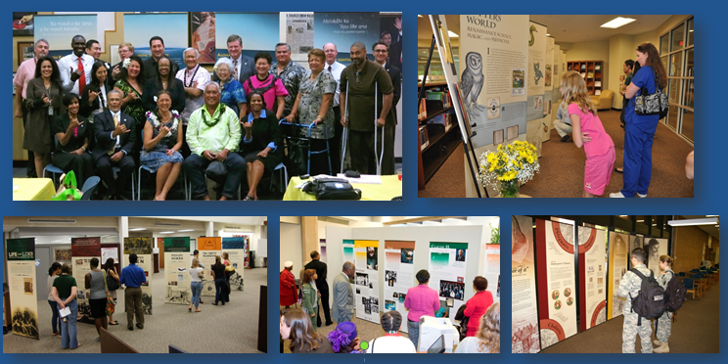
Exhibitions Come To You: In Banners & Online Slide 2
“[making] libraries more relevant, welcoming places.”
Notes:
Whether you’ve hosted “voyage to health,” “life and limb,” or any of the other traveling exhibitions, you’ve planned lectures and events and added exhibits from your local area. We think this quote from a recent article by Bridget Faricy-Beredo, a clinical medical librarian at the University of Toledo sums it up when she says an exhibition helps , “make libraries more relevant, welcoming places.”

Slide 33
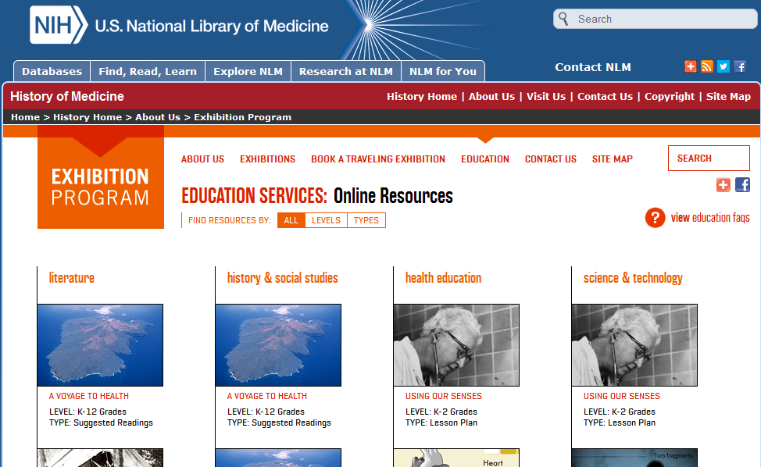
Exhibitions Come To You: In Banners & Online Slide 3
http://www.nlm.nih.gov/hmd/about/exhibition/education-resources-all.html
Notes:
You can also explore all of our exhibitions online and learn even more about them through their associated education resources.

Slide 34
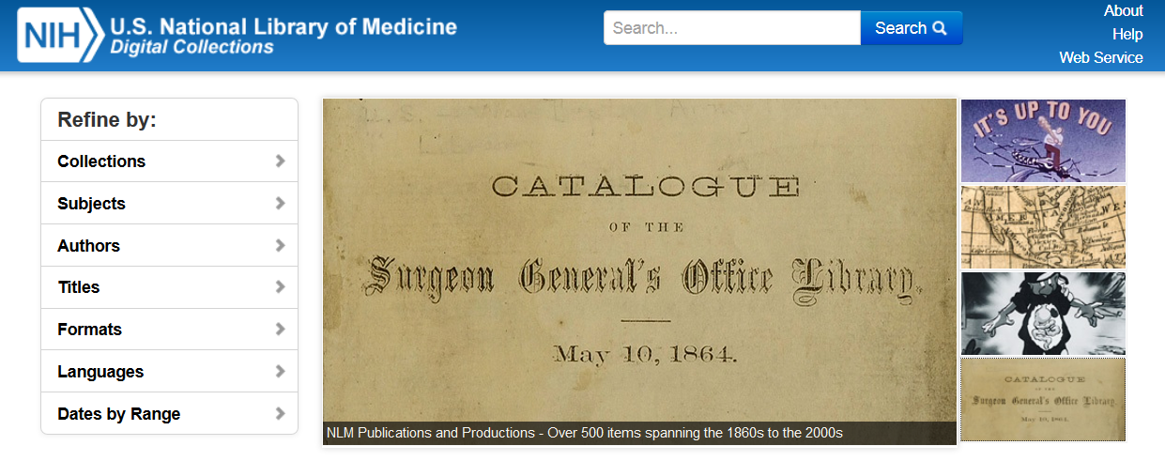
Collections Come To You: Digital Collections
http://collections.nlm.nih.gov/
Notes:
Our collections also come to you via our digital repository, Digital Collections. Launched in 2010, you can use Digital Collections to search over10,000 items from our collection included a recently added set of NLM publications. The items are also sent to the Internet Archive and will soon appear in the Digital Public Library of America. Digital Collections complements the PubMed Central collection of historic journal articles and speaking of those…

Slide 35

Collections Come To You:
More Historical Medical Journals
New partnership with Wellcome Library and Wellcome Trust, building on “Medical Journal Backfiles Digitization Project” (2004-2010)
Gift to NLM of £750,000 ($1.2 million)
3-year project, beginning later this year
Notes:
We’re pleased to be starting another partnership with the Wellcome Library and Wellcome Trust to make thousands of complete back issues of historically-significant biomedical journals freely available online in PMC and Europe PMC. The Welcome is sending NLM a gift of £750,000 ($1.2 million) to support the project which builds on the Medical Journal Backfiles Digitization Project (2004-2010)

Slide 36
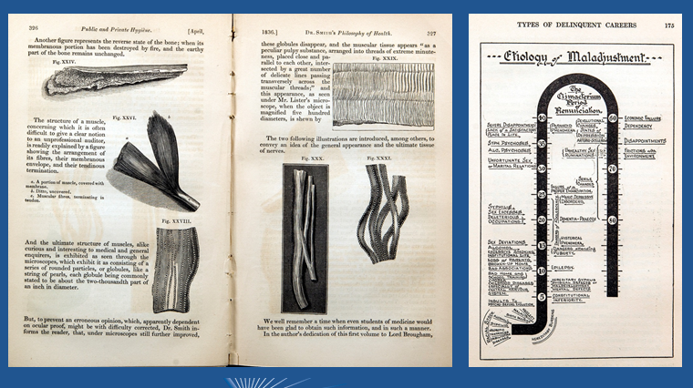
Collections Come To You:
More Historical Medical Journals Slide 2
Notes:
Journals to be digitized include: Mental Health, Mental Hygiene, Journal of Psychological Medicine and Mental Pathology, and the Indian Medical Gazette, examples of which you see here.

Slide 37
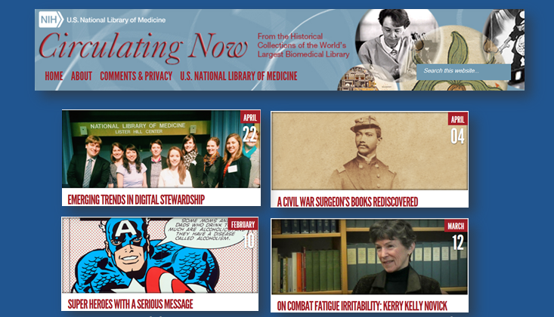
Collections Come To You: Circulating Now
http://circulatingnow.nlm.nih.gov/
Notes:
And finally, our collections come to you via the new blog of NLM’s History of Medicine Division. Circulating Now .
The blog spotlights NLM’s collections, people who use our collections, and people associated with our collections. We invite all of you to subscribe to learn what’s Circulating Now from the historical collections of the NLM!

Slide 38
Staff news
Notes:
Staff news

Slide 39
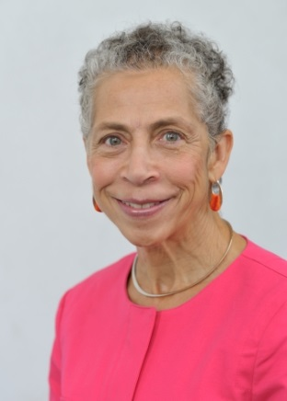
Retirement of National Network Office Head
Angela Ruffin, PhD
Notes:
We had one very major departure in February with the retirement of our National Network of Libaries of Medicine office head, Angela Ruffin.

Slide 40
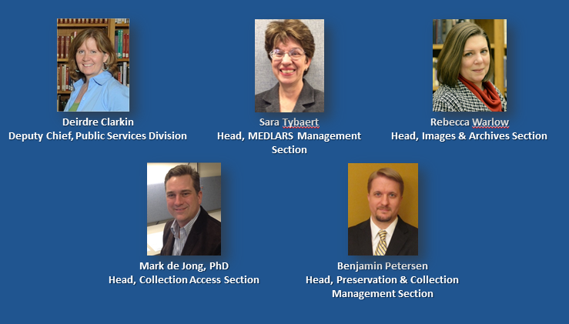
Library Operations Welcomes
Notes:
And we were pleased to welcome new staff and staff in new roles including – Dee Clarkin and Sara Tybaert who assumed roles of greater responsibility here at NLM, Rebecca Warlow who joined our History of Medicine Division, Mark de Jong who comes to use from the University of Maryland University College, and Benjamin Petersen who joined NLM from the Birmingham Public Library in Birmingham, Alabama.

Slide 41
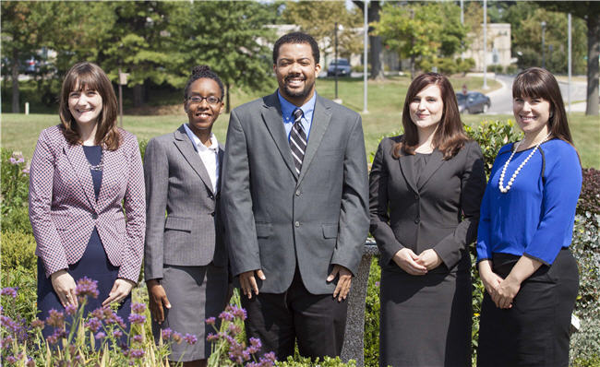
NLM Associate Fellows 2013-2014
Nicole Pettenati, Christian Minter, Don Jason, Kate Masterton, Holly Thompson
Notes:
NLM continues to support the career development of new professionals and I hope you’ve had a chance to meet this years associate fellows who are here with us at the meeting.
Nicole Pettenati, Christian Minter, Don Jason, Kate Masterton, Holly Thompson

Slide 42

NLM Associate Fellows 2nd year
Rose Mary Hedberg, Galter Health Sciences Library at the Northwestern University Feinberg School of Medicine, Chicago, IL
Diana Almader-Douglas, Arizona Health Sciences Library, Tucson, AZ
Karen Gutzman, Bernard Becker Medical Library at Washington University, St Louis, MO
Kevin Read, NYU Health Sciences Libraries, New York
Notes:
And also our second years who are also here from their host sites you see on the slide.
Rose Mary Hedberg, Galter Health Sciences Library at the Northwestern University Feinberg School of Medicine, Chicago, IL
Diana Almader-Douglas, Arizona Health Sciences Library, Tucson, AZ
Karen Gutzman, Bernard Becker Medical Library at Washington University, St Louis, MO
Kevin Read, NYU Health Sciences Libraries, New York

Slide 43

2nd Year Host Proposals for NLM Associate Fellows 2014-2015
Notes:
We tried a new model for the second year host sites, asking them to cover the salary of the fellow for the year and am thrilled that these five libraries put forward proposals to sponsor one of this years fellows next year. We don’t have the results in yet as to which sites will host a fellow, but we certainly appreciate that they have put forward the effort and the offers.

Slide 44
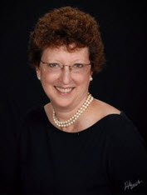
Literature Selection Technical Review Committee
CABELLO, Felipe C., M.D.
New York Medical College, Valhalla, NY
CALIS, Karim, Anton, Pharm D, M.P.H., FASHP, FCCP
National Institutes of Health, Bethesda, MD
CHEUNG, Dorothy, M.D.
Allergy-Immunology Medical College of Wisconsin, Milwaukee, WI
COURTNEY, Karen L., Ph.D., R.N.
University of Victoria, Victoria, BC, Canada
CRUMMETT, Courtney, M.L.S., M.S
MIT Libraries, Cambridge, MA
DELCLOS, George L., M.D., Ph.D.
University of Texas-Houston, Houston, TX
GWINN, Marta, M.D., M.P.H
Centers for Disease Control and Prevention, Atlanta, GA
JOE, Jennie R., Ph.D., M.P.H., M.A.
University of Arizona College of Medicine, Tucson, AZ
NGUYEN, Thu, Annelise, Ph.D., M.B.A.
Kansas State University, Manhattan, KS
OGUNYEMI, Omolola, Ph.D.
Charles R. Drew University of Medicine and Science, Lynwood, CA
PASCOE, John M., M.D., M.P.H.
The Children's Medical Center of Dayton, Dayton, OH
PASCOE, John R., BVSc, Ph.D.
University of California, Davis, CA
PHILLIPS, William R., M.D., M.P.H.
University of Washington, Seattle, WA
RAO, Jaya, M.D.
American College of Physicians, Philadelphia, PA
TANNERY, Nancy, H., M.L.S.
University of Pittsburgh, Pittsburgh, PA
Notes:
Lastly, I want to mention and thank Nancy Tannery of Pittburgh who is an MLA member on our current LSTRC roster of adivsory board members to recommend journals for MEDLINE.
Before I close, I’d like to ask any NLM staff here at the meeting to please stand so I can join Dr. Lindberg and Betsy and the membership and thank you for your service. I’d also like to ask the RML and centers staff who are here to also stand as they work hard to serve our community as well.

Slide 45
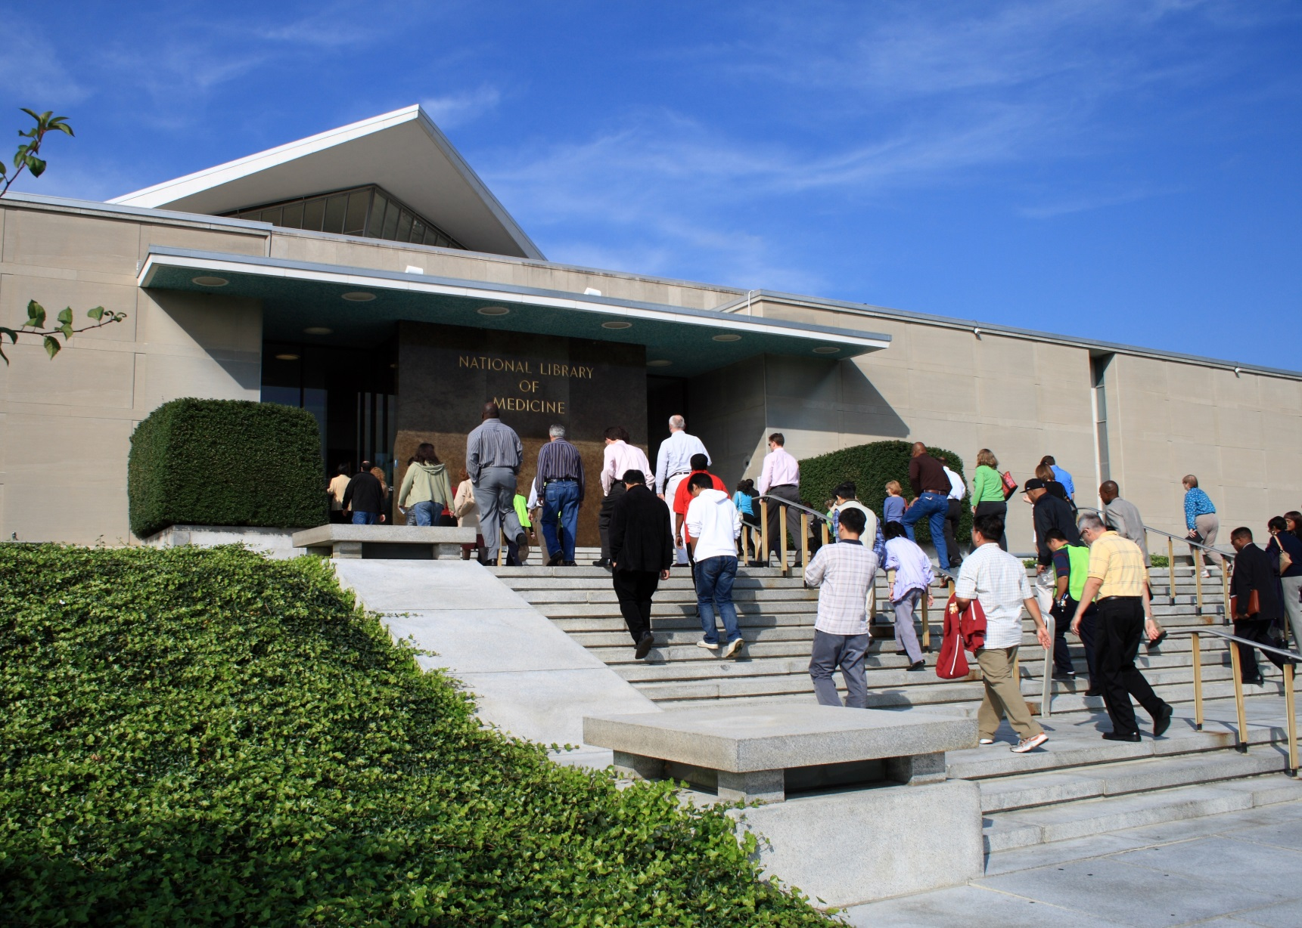
Picture of National Library of Medicine
Notes:
Picture of National Library of Medicine

Slide 46
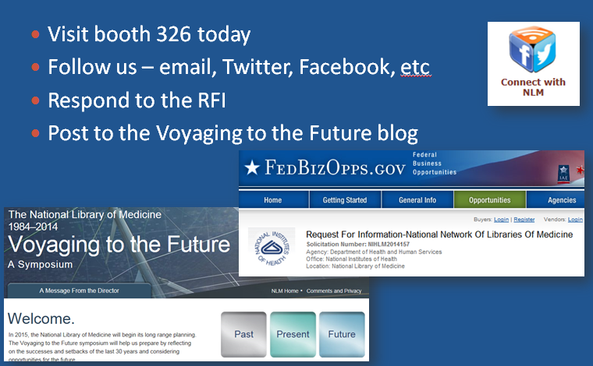
Keep in touch
Notes:
And, I believe MLA president Dixie Jones has something she wants to tell us.

