Slide 1
Building Our Information + Data Future The NLM Update – Part 2
Betsy L. Humphreys, MLS, FMLA
Deputy Director
National Library of Medicine
National Institutes of Health
U.S. Department of Health and Human Services
blh@nlm.nih.gov
Notes:
Building Our Information + Data Future The NLM Update – Part 2
Betsy L. Humphreys, MLS, FMLA
Deputy Director
National Library of Medicine
National Institutes of Health
U.S. Department of Health and Human Services
blh@nlm.nih.gov

Slide 2
Data Challenges
Data citation, discovery, cataloging, curation, standards, sharing, preservation, aggregation, linking, re-use, etc.
Why?
Transparency
Reproducibility
Maximizing return on investment
Appropriate scientific credit
Evolving mandates that can’t be ignored
How?
One size does not fit all
Many unknowns →Many opportunities
Notes:
Data Challenges
Data citation, discovery, cataloging, curation, standards, sharing, preservation, aggregation, linking, re-use, etc.
Why?
Transparency
Reproducibility
Maximizing return on investment
Appropriate scientific credit
Evolving mandates that can’t be ignored
How?
One size does not fit all
Many unknowns →Many opportunities

Slide 3
The Biomedical Research Digital Enterprise
Notes:
The Biomedical Research Digital Enterprise
http://bd2k.nih.gov
NIH Associate Director for Data Science
Philip Bourne, Ph.D (arrived at NIH 3/2014; ideas as of 5/2014)
Scientific Data Council*
External Advisory Board
Programmatic Theme: Sustainability, Education, Innovation, Process, Collaboration
Deliverable:
Commons*: Cloud – Data & Compute, Search, Security, Reproducibility Standards, App Store,
Training Center*: Coordinate, Hands-on, Syllabus, MOOCs
Big Data to Knowledge (BD2K)*: Community, Centers, Training Grants, Catalogs, Standards Analysis
Modified Review: Data Resource Support, Metrics, Best Practices, Evaluation, Portfolio Analysis
Communication: IC’s, Researchers, Federal Agencies, International Partners, Computer Scientists

Slide 4
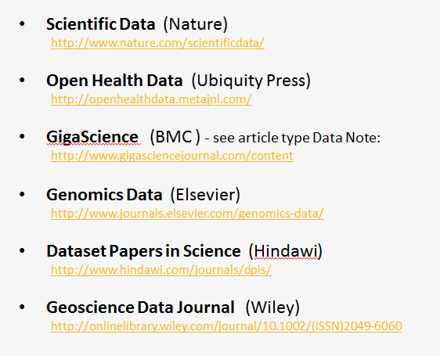
Data Journals - examples
Notes:
Data Journals - examples
Scientific Data (Nature)
http://www.nature.com/scientificdata/
Open Health Data (Ubiquity Press)
http://openhealthdata.metajnl.com/
GigaScience (BMC ) - see article type Data Note:
http://www.gigasciencejournal.com/content
Genomics Data (Elsevier)
http://www.journals.elsevier.com/genomics-data/
Dataset Papers in Science (Hindawi)
http://www.hindawi.com/journals/dpis/
Geoscience Data Journal (Wiley)
http://onlinelibrary.wiley.com/journal/10.1002/(ISSN)2049-6060

Slide 5
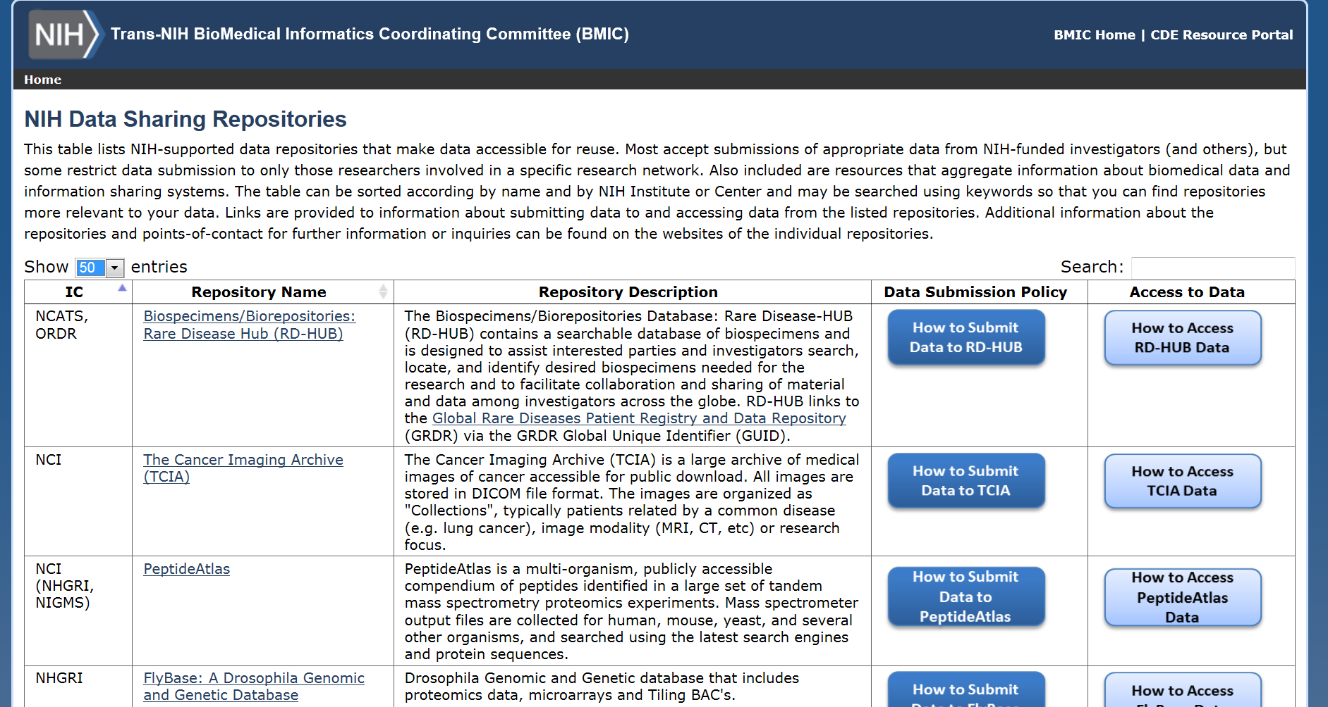
More data sharing requirements are coming – genomic, pre-clinical, clinical
Notes:
More data sharing requirements are coming – genomic, pre-clinical, clinical

Slide 6
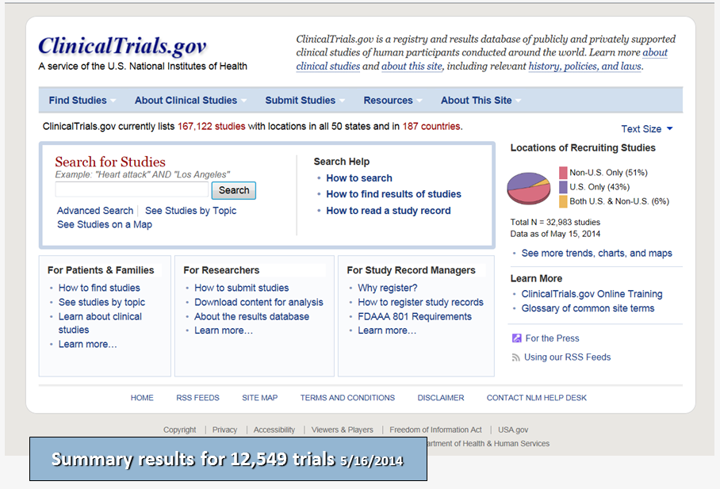
ClinicalTrials.gov Summary Results for 12549 trials 5/16/14
Notes:
Summary results for 12549 trials 5/16/14

Slide 7
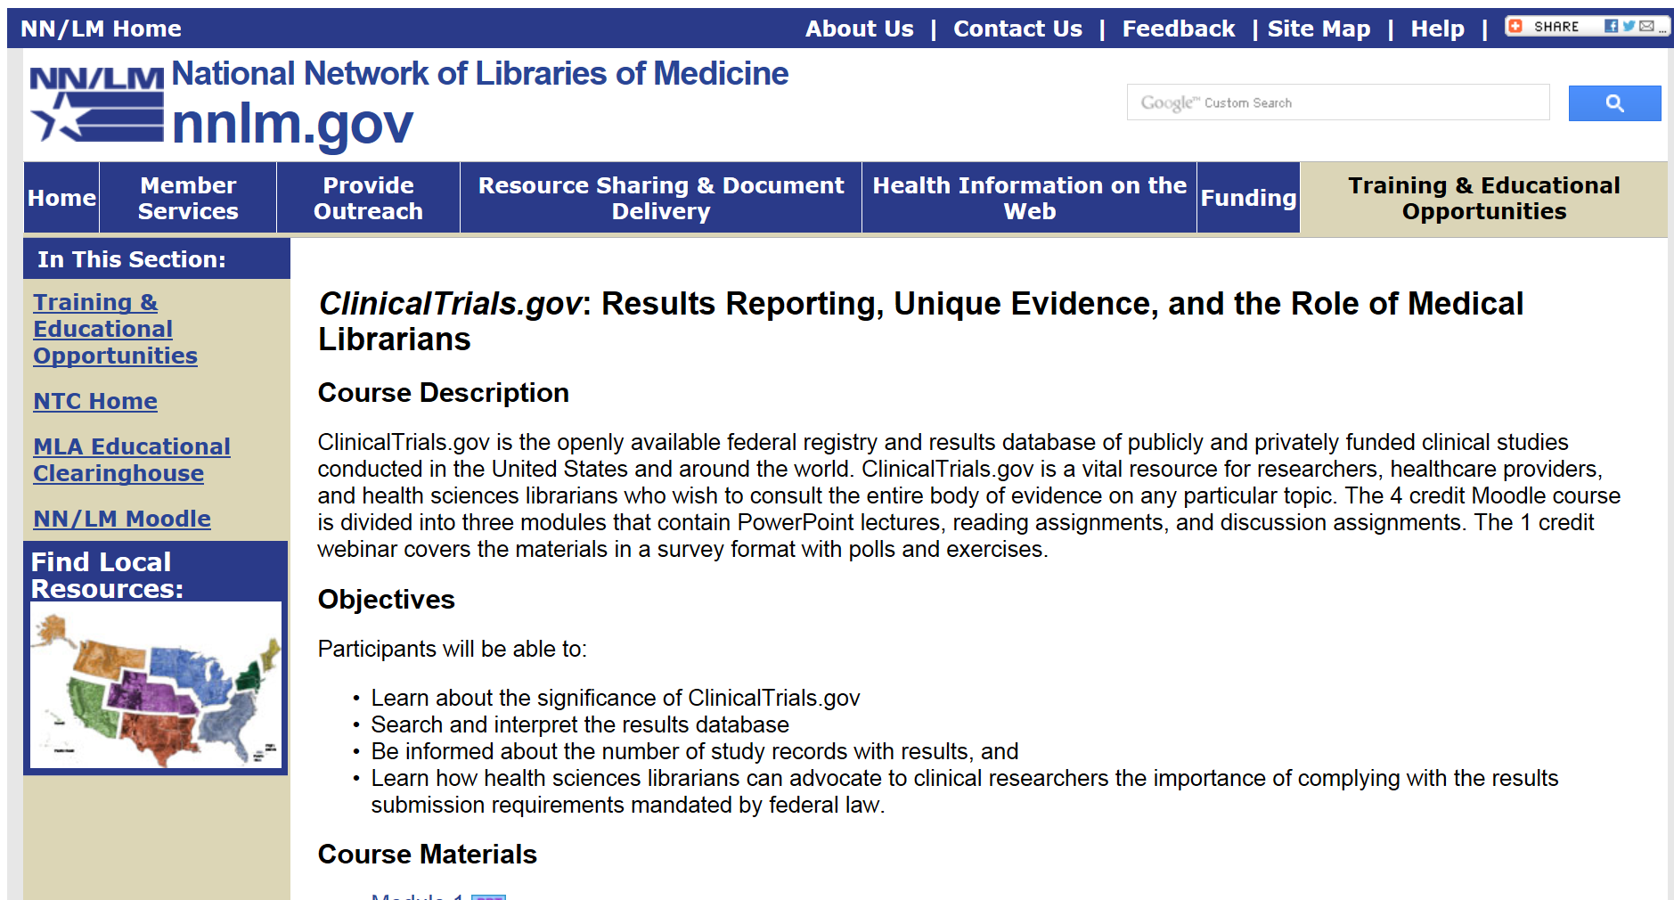
More results submission enhancements this summer
Notes:
More results submission enhancements this summer

Slide 8
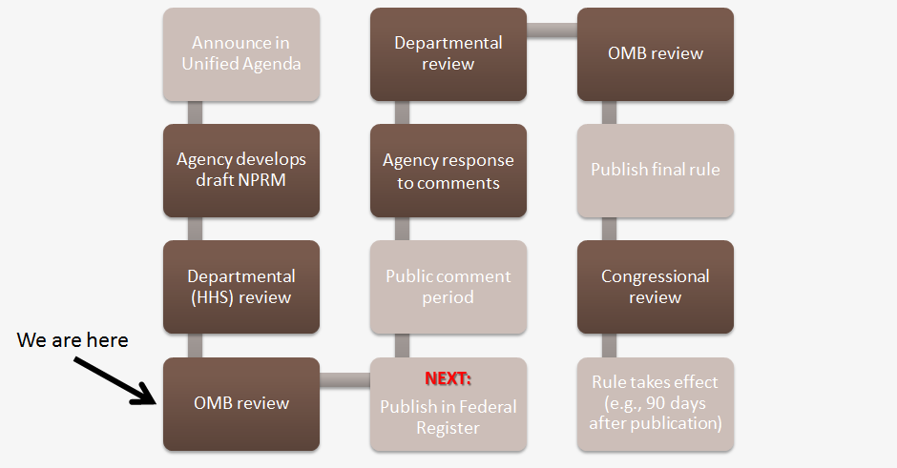
Clinical Trials Registration & Results Submission Rulemaking Process (2008-- )
Consistent with the Administrative Procedures Act [5 U.S.C. 533]
Notes:
Clinical Trials Registration & Results Submission Rulemaking Process (2008-- )
Announce in Unified Agenda
Agency develops draft NPRM
Departmental (HHS) review
We are here: OMB review
NEXT: Publish in Federal Register
Public comment period
Agency response to comments
Departmental review
OMB review
Publish final rule
Congressional review
Rule takes effect (e.g., 90 days after publication)
Consistent with the Administrative Procedures Act [5 U.S.C. 533]

Slide 9
Common data standards for health care & clinical research: an idea whose time may at last be coming ….
Notes:
Common data standards for health care & clinical research: an idea whose time may at last be coming ….

Slide 10
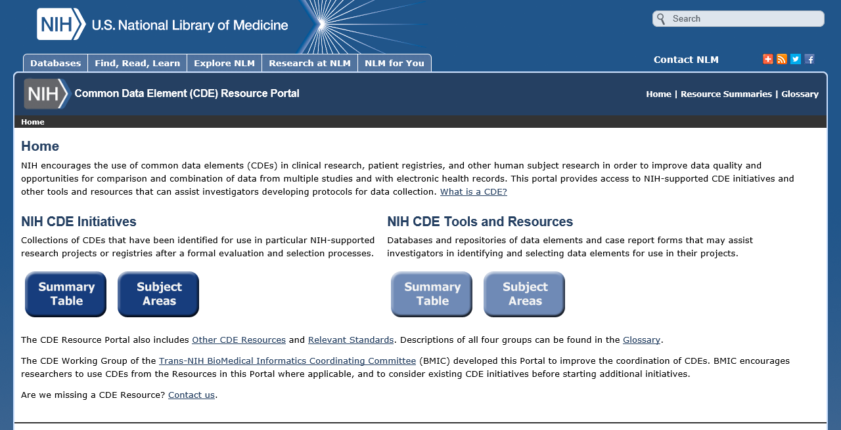
Another Safe Bet: more “encouragement” to use common data elements in research
Notes:
Another Safe Bet: more “encouragement” to use common data elements in research

Slide 11
Increasingly likely: standard vocabulary value sets to define research data elements
More about EHR resources at
1 pm at NLM Exhibit Booth
Notes:
Increasingly likely: standard vocabulary value sets to define research data elements

Slide 12
Whole Genome Sequencing (WGS) To Detect and Stop Foodborne Outbreaks
Notes:
Whole Genome Sequencing (WGS) To Detect and Stop Foodborne Outbreaks
Current prototype Network focused on isolates from sick people + from food production facilities, farms

Slide 13
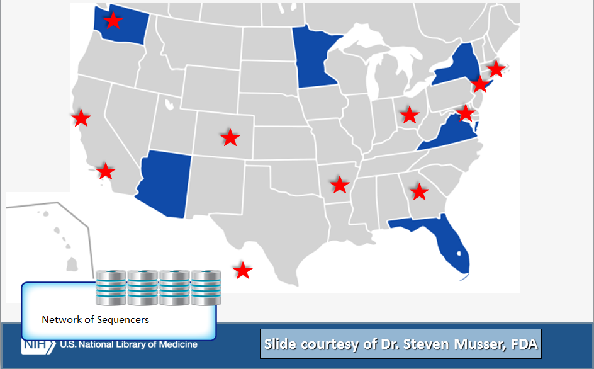
Current FDA Genometrakr network 7 state Laboratories + 11 FDA- Office of Regulatory Affairs
Notes:
Current FDA Genometrakr network
7 state Laboratories + 11 FDA- Office of Regulatory Affairs

Slide 14
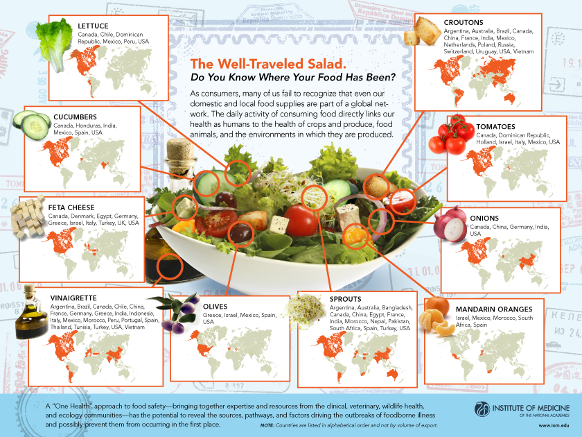
The Well-Traveled Salad
Notes:
The well traveled salad

Slide 15
Why WGS is a viable solution
Slide courtesy of Dr. Steven Musser, FDA
Notes:
15
Why WGS is a viable solution
Cost
Increasing ease of operation
Sample prep
Identical for all pathogens
Cost savings
One test for resistance, serotyping, virulence factors, more…
Most accurate and high resolution sub-typing technique

Slide 16
Current common methods lump and split
Current common methods lump and split
Notes:
Current common methods lump and split

Slide 17
CDC-FDA-NCBI Listeria Sequencing Project Success
The FDA, CDC and state and local officials investigated a multi-state outbreak of listeriosis linked to cheese products made and distributed by Roos Foods of Kenton, Delaware.
Whole-genome sequencing (WGS) of Listeria monocytogenes strains isolated from Roos Foods cheese products has been performed by the FDA and Virginia’s Division of Consolidated Laboratory Services. These strains were found to be highly related by WGS to the Listeria strains isolated from patients in this outbreak, adding further confidence that cheese products produced by Roos Foods were a likely source of the outbreak.
Compared with pulsed-field gel electrophoresis (PFGE), WGS provides clearer distinction between cases and foods that are likely part of a given outbreak and those that are not.
On April 18, 2014, the CDC reported that the outbreak appeared to be over.
First use of Genometrakr network and WGS approach to support regulatory action and positive public health outcome
Notes:
CDC-FDA-NCBI Listeria Sequencing Project Success
The FDA, CDC and state and local officials investigated a multi-state outbreak of listeriosis linked to cheese products made and distributed by Roos Foods of Kenton, Delaware.
Whole-genome sequencing (WGS) of Listeria monocytogenes strains isolated from Roos Foods cheese products has been performed by the FDA and Virginia’s Division of Consolidated Laboratory Services. These strains were found to be highly related by WGS to the Listeria strains isolated from patients in this outbreak, adding further confidence that cheese products produced by Roos Foods were a likely source of the outbreak.
Compared with pulsed-field gel electrophoresis (PFGE), WGS provides clearer distinction between cases and foods that are likely part of a given outbreak and those that are not.
On April 18, 2014, the CDC reported that the outbreak appeared to be over.
First use of Genometrakr network and WGS approach to support regulatory action and positive public health outcome

Slide 18
NCBI Infrastructure (>2500 isolates processed)
Intensive engagement with stakeholders
Improved bulk submission
High throughput genome assembly
Comprehensive uniform annotation
Presence/absence
Variety of tree/classification methods
Web and client-based presentation/analysis
Notes:
NCBI Infrastructure (>2500 isolates processed)
Intensive engagement with stakeholders
Improved bulk submission
High throughput genome assembly
Comprehensive uniform annotation
Presence/absence
Variety of tree/classification methods
Web and client-based presentation/analysis

Slide 19
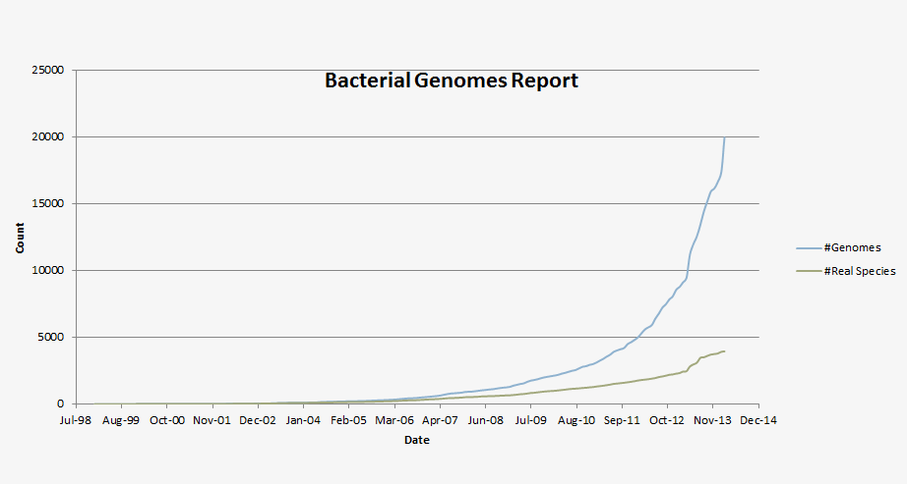
Bacterial Genomes Report
Notes:
Bacterial Genomes Report
Chart of count/date

Slide 20
Obscure Chemical Taints Water Supply
Notes:
January 9, 2014: Spill reported and NLM Specialized Information Services (SIS) was contacted by HHS Office of the Assistant Secretary for Preparedness and Response (ASPR) after no information about 4-methylcyclohexanemethanol (MCHM) was found in their searching of NLM databases. Timely effort, as described below, is an example of our (SIS) system in place that permitted a prompt and helpful response.
SIS suggested Hazardous Substances Data Bank (HSDB) could be an ideal home for a dossier.
NLM SIS staff and the HSDB contractors worked between January 10 - 16, including numerous interactions with ASPR, NIEHS, and others.
On January 16, the Scientific Review Panel (SRP) for HSDB reviewed and approved the HSDB record. However, the MCHM supplier released several more studies.
Overnight effort to have the new studies added to the HSDB record for an additional review by the SRP on January
SRP approved the revised HSDB record and the record went live that evening on our site and on the CDC’s "2014 West Virginia Chemical Release" Web page.
SIS continues to interact with ASPR and others.
http://cen.acs.org/content/dam/cen/92/7/09207-cover.pdf

Slide 21
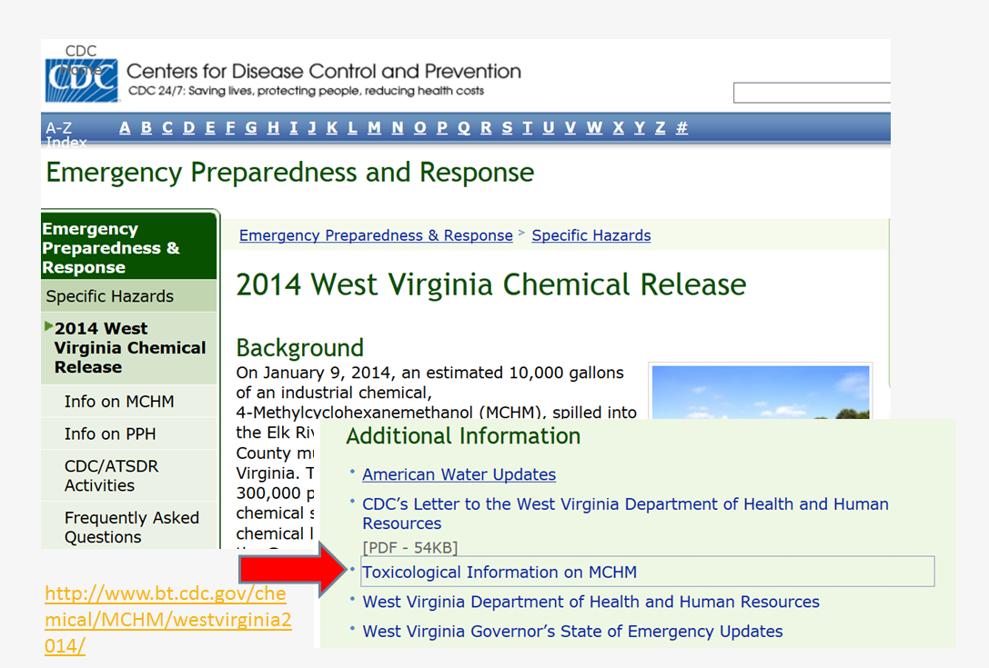
Centers for Disease Control Emergency Preparedness
Notes:
http://www.bt.cdc.gov/chemical/MCHM/westvirginia2014/
Centers for Disease Control Emergency Preparedness
2014 West Virginia Chemical Release

Slide 22
TOXNET gets a face lift
Notes:
TOXNET gets a face lift

Slide 23
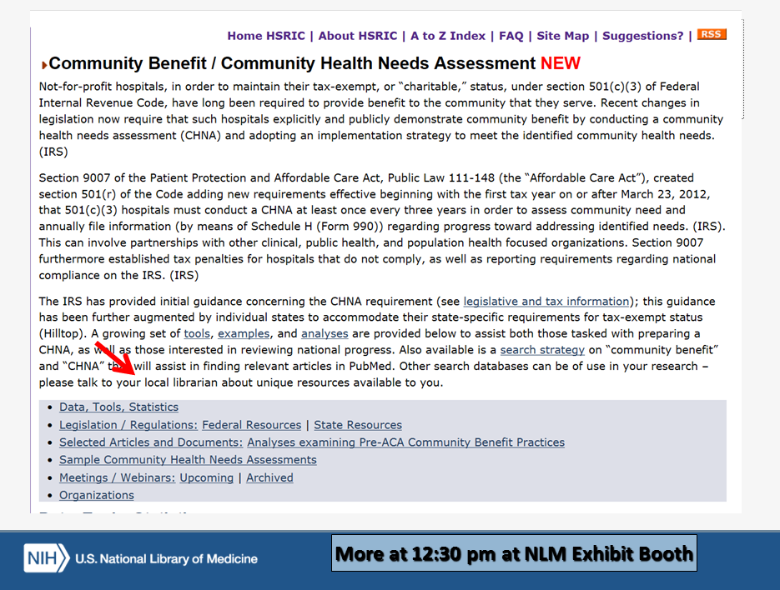
HSRIC
Notes:
HSRIC
Community Benefit/Community Health Needs Assessment

Slide 24
NLM Supplements to Research Grants for Informationist Services
In 2014 (so far), 9 supplement awards to research grantees of NIH Institutes of Aging, Arthritis, Deafness, Dental, & Mental Health
Awards bring 15 librarian information specialists into research settings, and measure the value of their contributions
2 librarians are former NLM Associate Fellows; 4 also involved in 2012 awards
5 new participating organizations; 3 institutions also involved in 2012 awards
Co-funding from Deafness, Mental Health, and Aging
Notes:
NLM Supplements to Research Grants for Informationist Services
In 2014 (so far), 9 supplement awards to research grantees of NIH Institutes of Aging, Arthritis, Deafness, Dental, & Mental Health
Awards bring 15 librarian information specialists into research settings, and measure the value of their contributions
2 librarians are former NLM Associate Fellows; 4 also involved in 2012 awards
5 new participating organizations; 3 institutions also involved in 2012 awards
Co-funding from Deafness, Mental Health, and Aging

Slide 25
Some 2014 Examples
R01 AR-062002 Allen, Matthew, IUPUI. Grant title: Enhancing Bone Strength Using Combination Drug Therapy. Elizabeth Whipple, Lilly Library
R01 AG-040211 Galvin, James, NYU. Grant title: Multicultural Community Dementia Screening. Alice Graff and Joseph Nicolson, NYUHSL.
R01 DE-022031 Hall, Steven, UCSF. Grant title: Mass Spectrometry Tools in Pursuit of Salivary Biomarkers of Sjogren’s Syndrome. Megan Laurance, HSL/Center for Knowledge Management
R01 DC-011329, Liebold, Lori, UNC-Chapel Hill. Grant title: Susceptibility to and Release from Masking in Infancy and Childhood. Barbara Renner, Barrie Hayes and Kathleen McGraw, HSL
R01 AG-041823 Reynolds, Angela, VCU. Grant title: Age Dependent Mechanical Ventilator-Induced Inflammation: Modeling and Experiments. Julie Arendt, John Cyrus, Margaret Henderson, Martha Roseberry
Notes:
Some 2014 Examples
R01 AR-062002 Allen, Matthew, IUPUI. Grant title: Enhancing Bone Strength Using Combination Drug Therapy. Elizabeth Whipple, Lilly Library
R01 AG-040211 Galvin, James, NYU. Grant title: Multicultural Community Dementia Screening. Alice Graff and Joseph Nicolson, NYUHSL.
R01 DE-022031 Hall, Steven, UCSF. Grant title: Mass Spectrometry Tools in Pursuit of Salivary Biomarkers of Sjogren’s Syndrome. Megan Laurance, HSL/Center for Knowledge Management
R01 DC-011329, Liebold, Lori, UNC-Chapel Hill. Grant title: Susceptibility to and Release from Masking in Infancy and Childhood. Barbara Renner, Barrie Hayes and Kathleen McGraw, HSL
R01 AG-041823 Reynolds, Angela, VCU. Grant title: Age Dependent Mechanical Ventilator-Induced Inflammation: Modeling and Experiments. Julie Arendt, John Cyrus, Margaret Henderson, Martha Roseberry

Slide 26
Lessons from 2011 Informationist Supplements
Notes:
Lessons from 2011 Informationist Supplements
www.youtube.com/user/nyuhsl

Slide 27
HEALTHDATAPALOOZA
HEALTHDATAPALOOZA
June 1-3, 2014, Washington, DC
Notes:
Being held June 1-3 in Washington, DC
Go to healthdatapalooza.org
Live streaming of Keynote Addresses
Great lineup of speakers including Francis Collins, Kathleen Sebelius, Todd Park

Slide 28
More data: 2014 Joseph Leiter NLM/MLA Lecture June 12, 2014, 1 pm "The BRAIN Initiative: Connecting the Dots" Terrence Sejnowski, PhD, Professor, Scientist, & Advisor to NIH Director
Terrence Sejnowski, PhD, Professor, Scientist, & Advisor to NIH Director
http://videocast.nih.gov
Notes:
More data: 2014 Joseph Leiter NLM/MLA Lecture June 12, 2014, 1 pm "The BRAIN Initiative: Connecting the Dots" Terrence Sejnowski, PhD, Professor, Scientist, & Advisor to NIH Director

