Slide 1
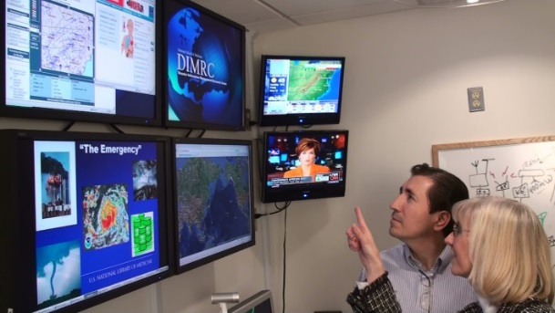
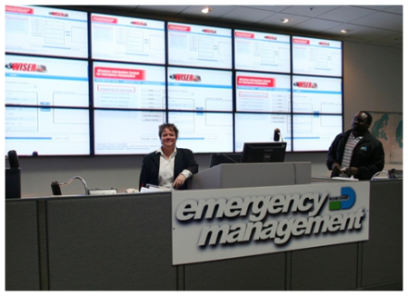
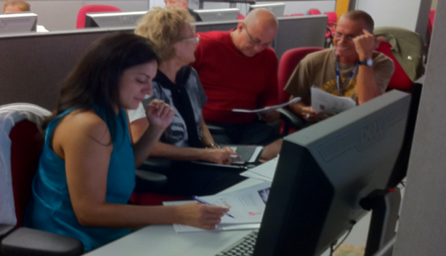
NLM Responds to Public Health Emergencies
Stacey J. Arnesen
Chief, Disaster Information Management Research Center
Specialized Information Services
Medical Library Association
NLM Update
May 17, 2016

Slide 2
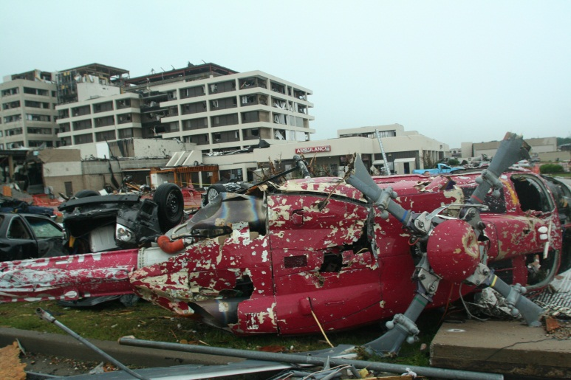
NLM Disaster Information Management Research Center (DIMRC)
Mission
To develop and provide access to health information resources and technology for disaster preparedness, response, and recovery
Connect people to quality disaster health information and foster a culture of community resiliency
St. John’s Hospital, Joplin, MO after 2011 tornado

Slide 3
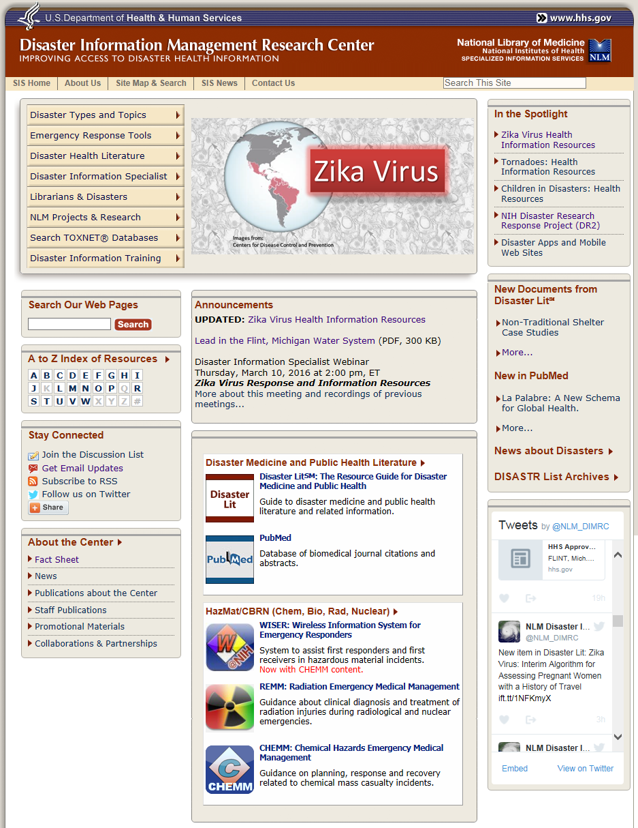
NLM Disaster Information Management Research Center (DIMRC)
NIH branch tasked to collect, organize, and disseminate information on public health emergencies and medical aspects of disasters
Work with SIS and other NLM divisions to coordinate and promote NLM resources
Connect with federal, state, local agencies, NGOs and others about public health emergency information

Slide 4
Disasters and Public Health Emergencies
Public Health Emergency: an occurrence or imminent threat of an illness or health condition, caused by bioterrorism, epidemic or pandemic disease, or a novel and highly fatal infectious agent or biological toxin, that poses a substantial risk of a significant number of human facilities or incidents or permanent or long-term disability.
Disaster: 1. A serious disruption of the functioning of a community or a society causing widespread human, material, economic or environmental losses which exceed the ability of the affected community or society to cope using its own resources (ISDR). 2. Situation or event, which overwhelms local capacity, necessitating a request to national or international level for external assistance (CRED).
World Health Organization: http://www.who.int/hac/about/definitions/en/
Notes:
I

Slide 5
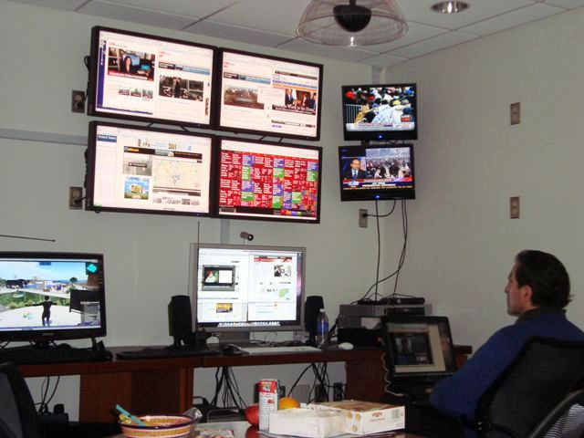
DIMRC Objectives
When it is quiet
Organize and provide access to disaster health literature and resources
Develop emergency preparedness and response tools
Conduct disaster informatics R&D
Maintain library operations
Develop partnerships
Be responsive to major
incidents and emerging
issues
Train librarians and others
as Disaster Information
Specialists

Slide 6
NLM has responded to a number of PH emergencies and disasters
Infectious diseases
Zika, Ebola, H7N9, H1N1, cholera
Chemical emergencies
Aliso Canyon gas leak, Lead in Flint, MI water supply, Gulf of Mexico oil spill, WV MCHM spill, TVA Kingston Fossil Plan Coal Ash spill
Earthquakes
Haiti, Chile, Japan
Hurricanes
Sandy, Katrina, Haiyan
Radiation emergencies
Japan earthquake, tsunami, radiation leak
Other disasters and related topics
Wildfires, Floods, Active shooter, Mass gatherings, Coping with disasters

Slide 7
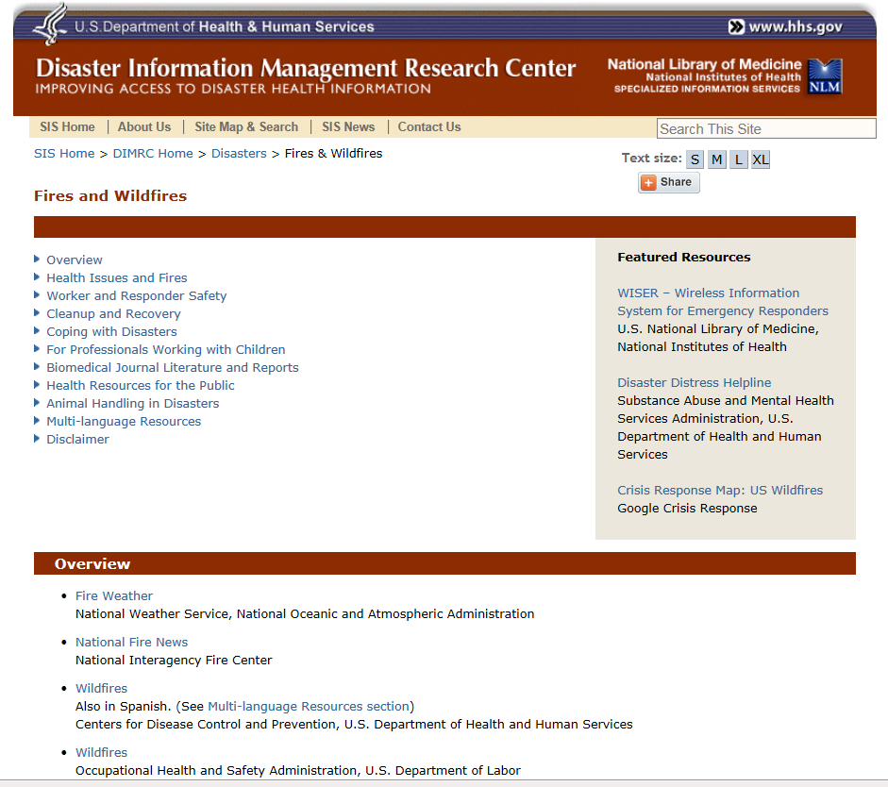
Topic Pages: Wildfires

Slide 8
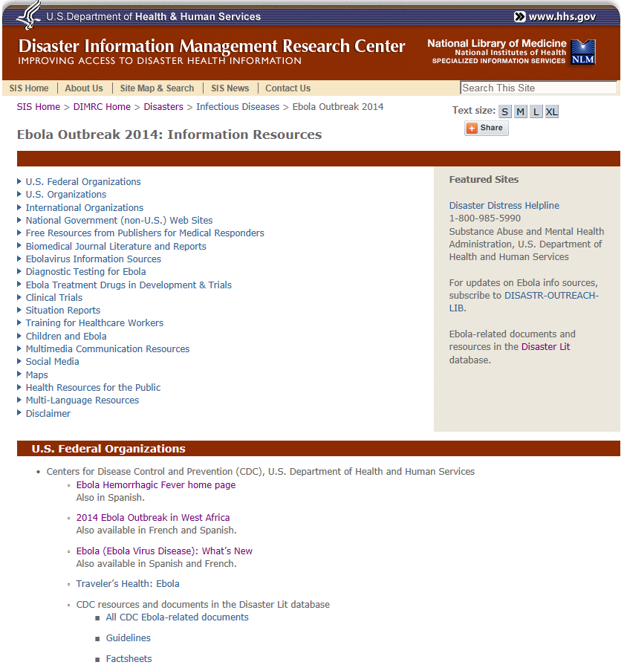
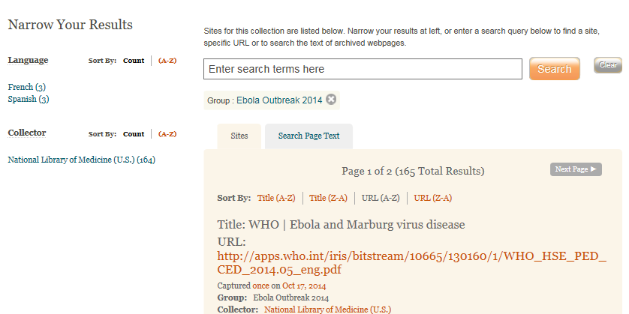
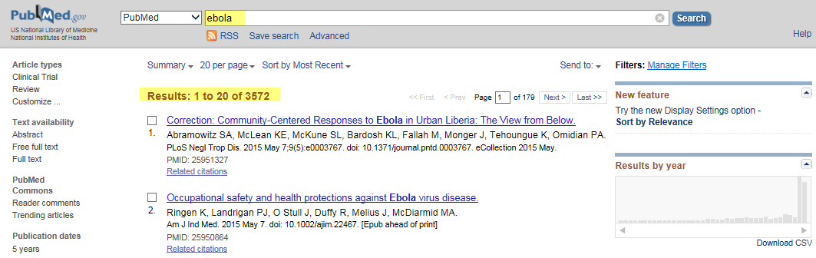
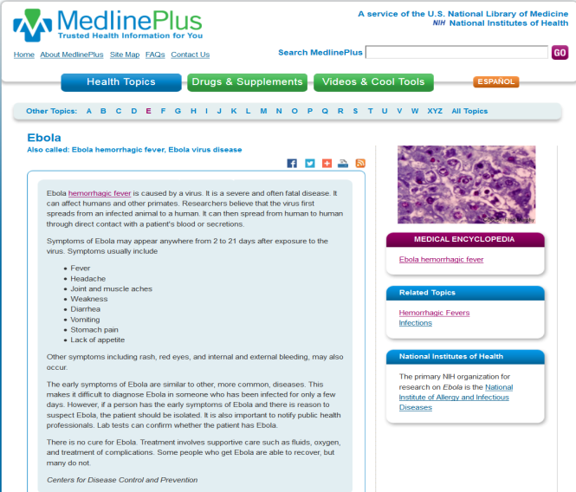
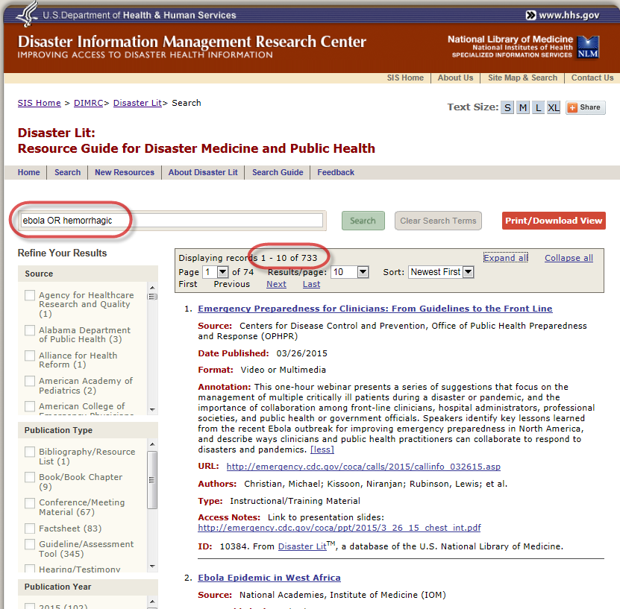
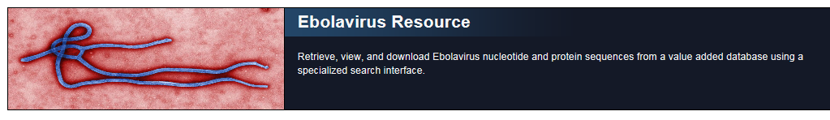
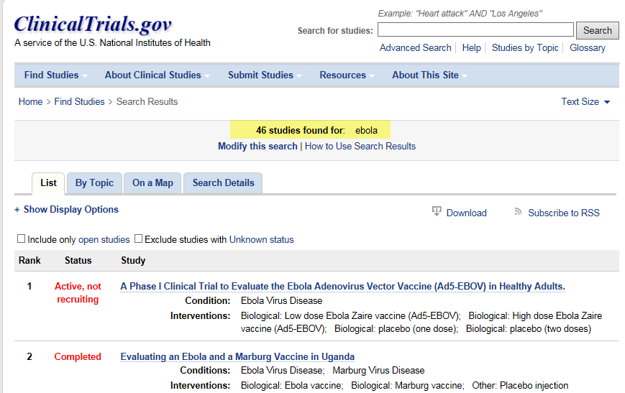
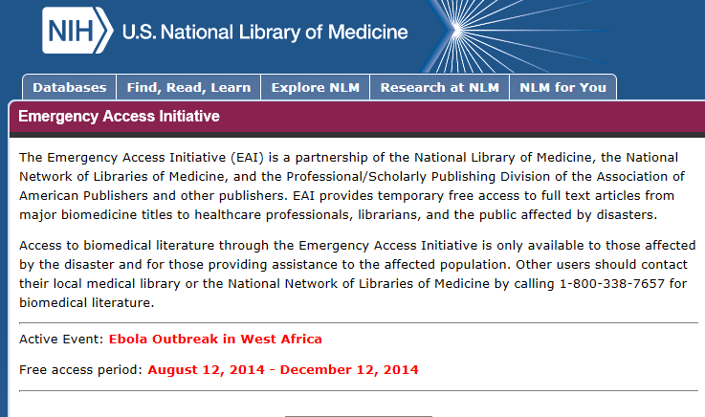
Example: Diverse NLM Resources on Ebola
Notes:
NLM has numerous resources that provide relevant and critical information in public health emergencies, as seen here. However, my boss said that this page is “difficult to look at”. That is somewhat intentional – to show the wide variety of resources NLM offers. But to help you better see this array of resources, please join us in the NLM Virtual Emergency Operation Center or EOC. I am joined by my colleague, Mr. Victor Cid, to help us on this tour.

Slide 9
Tour of NLM Virtual Emergency Operations Center
Notes:
Note: Video of NLM Virtual Emergency Operations Center not included in this set due to size.

Slide 10
Monitoring for incidents: How do we know an incident occurred?
When do we decide to be responsive?
NLM is always responding via normal activities
  PubMed, Disaster Lit, Clinical Trials, etc.
Situational awareness: DIMRC monitors key sources including Social Medial
Collaborate and coordinate with emergency managers and responders
  Federal agencies
  International organizations
  NGOs
Triage list that includes:
  Major incident with high impact on human health
  Involves US federal response, especially HHS agencies
  Level of activation of HHS emergency operation centers
  NLM has unique resources

Slide 11
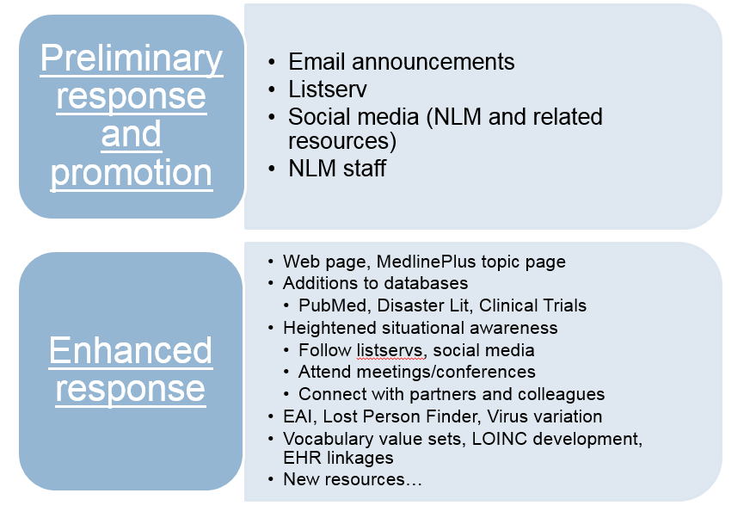
How to be responsive

Slide 12
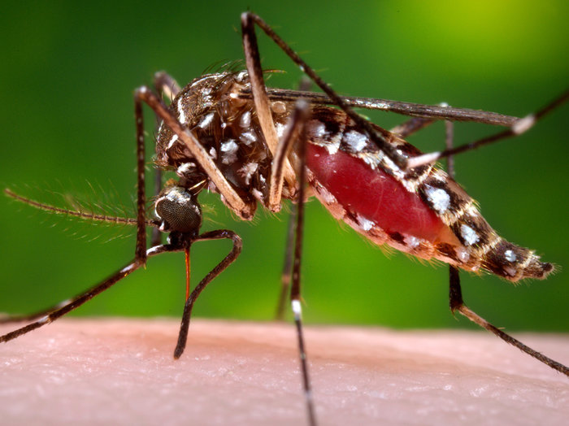
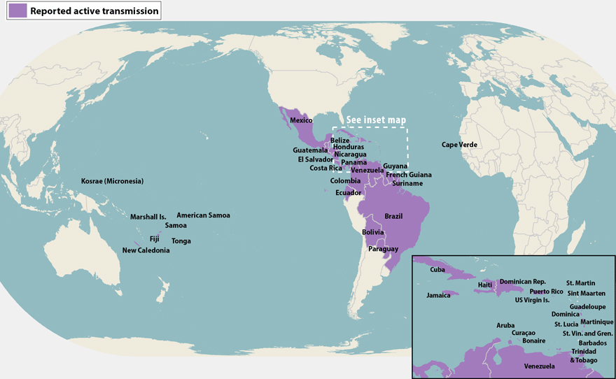
Case Study: Zika Virus
Notes:
Lets look at the most recent and current global public health emergency: zika virus disease. For the next few minutes, I will use Zika as an example of the role NLM plays in providing access to critical information during emergencies.

Slide 13
What IS Emerging Infectious Disease Information ?
Basic research
Genetic sequencing
Public health practices
Clinical care and treatment
Complications
Infection control
Prevention
Acute and chronic health effects
Vaccine development
Therapeutics development
Impact on the availability of health care for other needs
Implications for family well-being and the functioning of society
Emotional well-being of caregivers, family and friends, survivors
Stigma
More…
Notes:
Zika,, Ebola and other emerging diseases encompasses many subtopics with a number listed here. Depending on your role, one or more of these may be areas where you need information – from basic research studies and genetic sequencing to clinical care, treatment, complications or development of countermeasures or vaccines or distribution and dispensing of countermeasures and vaccines

Slide 14
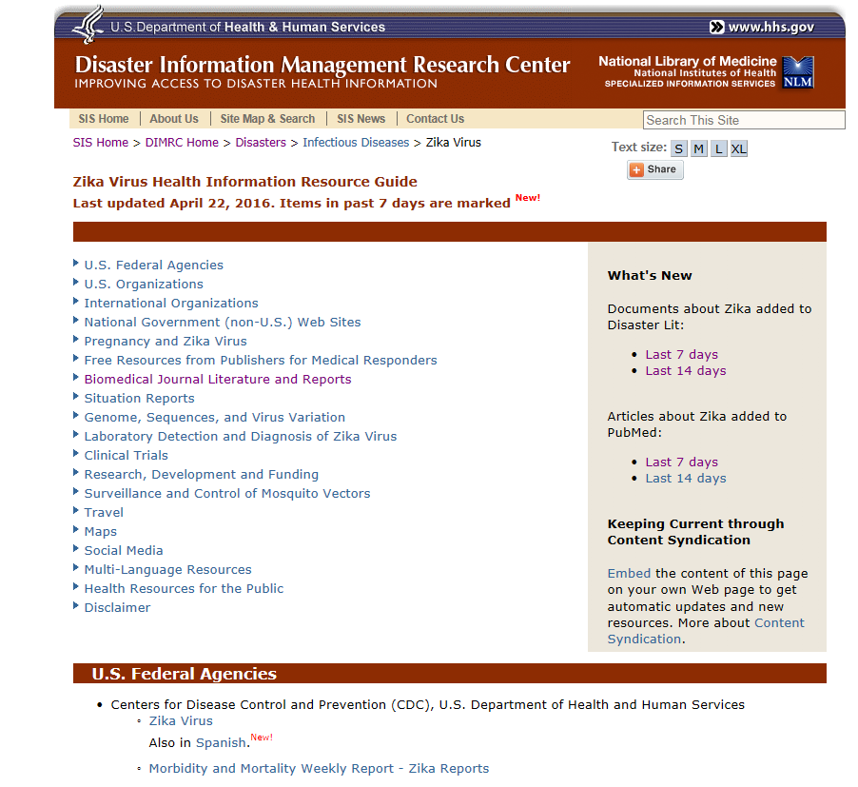
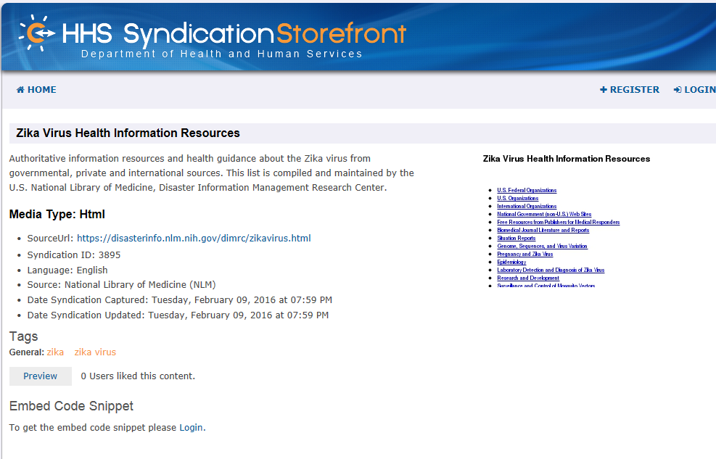
Information for Public Health Emergencies: Zika Virus
Notes:
So, where can NLM start. As I described earlier, NLM Disaster health staff are collecting info on disasters and PH emergencies daily and therefore are monitoring for new/emerging issues. For major incidents we create a web page on the topic linking not only to NLM resources but to other key players as I mentioned earlier. In addition, to avoid duplication of effort, NLM syndicates its pages, meaning other organziations can host our content on their web page, instead of creating their own pages – with due credit, of course.

Slide 15
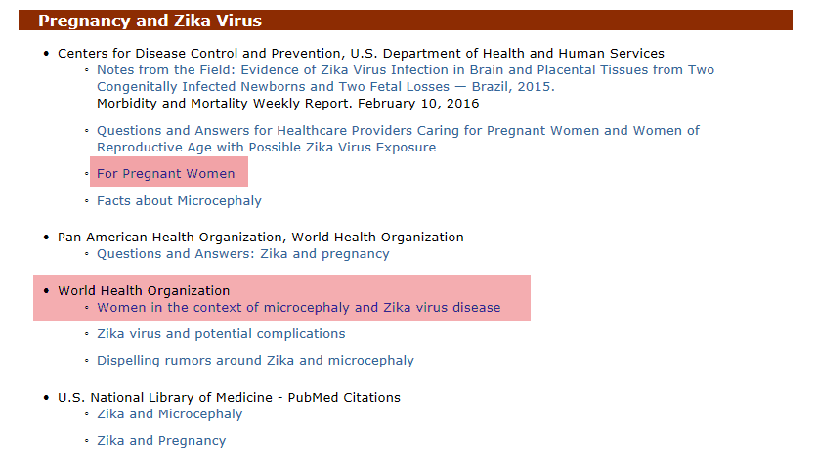
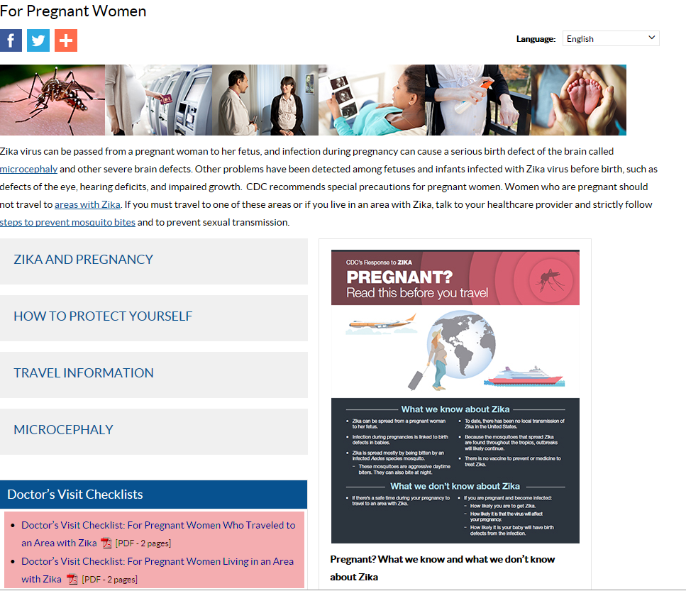
Information Resources: Examples
Notes:
Here is an example. From the Pregnancy and zika virus section of the page we link to resources from the CDC as seen in the second image as well as WHO. These are two main health organizations providing guidance on the management of zika virus disease in pregnant women and working with others to coordinate research efforts to answer the many unknown questions.

Slide 16
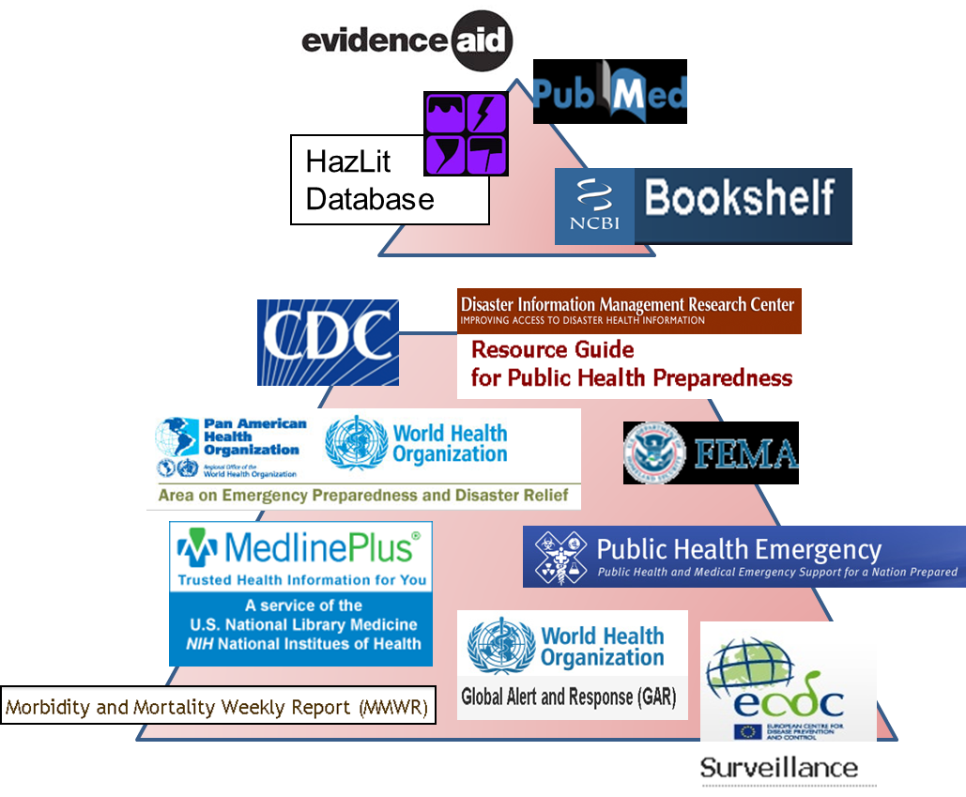
Disaster health literature
Peer-reviewed scholarly literature
  Journal articles
  Books
“Grey” Literature
  Reports
  Guidelines
  Surveillance data
  Training materials
  Conference proceedings
Notes:
Let’s take a look at the literature. We have the peer-reviewed literature in journals and books and everything else – government reports, guidance documents, tools, training materials – this info is key in PH emergencies as it is often published on th eweb before 9if ever) making it to the journal literature and pubmed

Slide 17
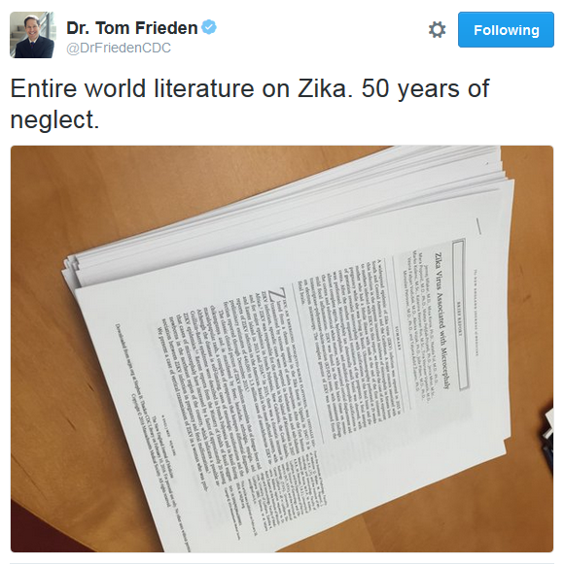
Disaster and Public Health
Emergency Research
“All research begins and ends in the library”
Literature on Zika:
1952 – 2014 (62 years):
  105 references
2015 – April 2016 (16 months):
  over 575 references
Notes:
Here is a tweet from Dr. Frieden, CDC director from back in March. A relatively small pile of papers (105) represented the known literature in pubmed on Zika. In the last 16 months, over 575 references can be found in PubMed and a companion database for the non-journal literature.
Now most of these are not basic or clinical research, case studies or epi – in fact in a review of 200 of these “recent references”, only 35 were research, case studies or epi, 30 were literature reivews, and over 100 were news, opinions, editorials.

Slide 18
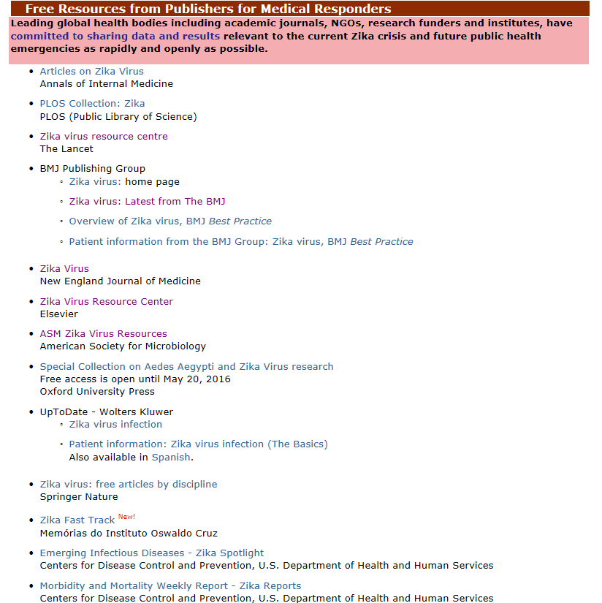
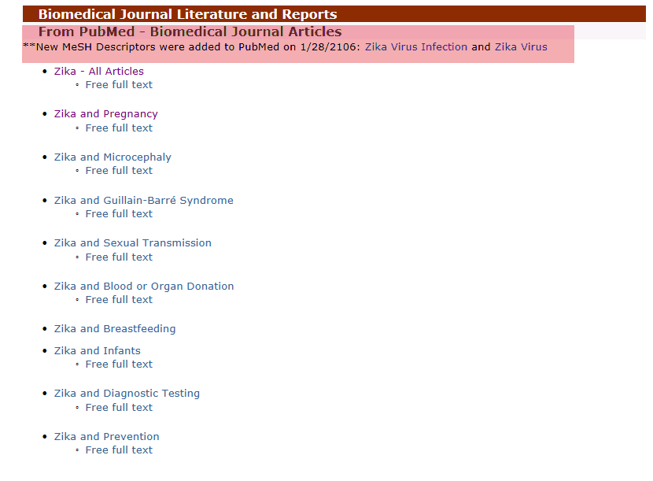
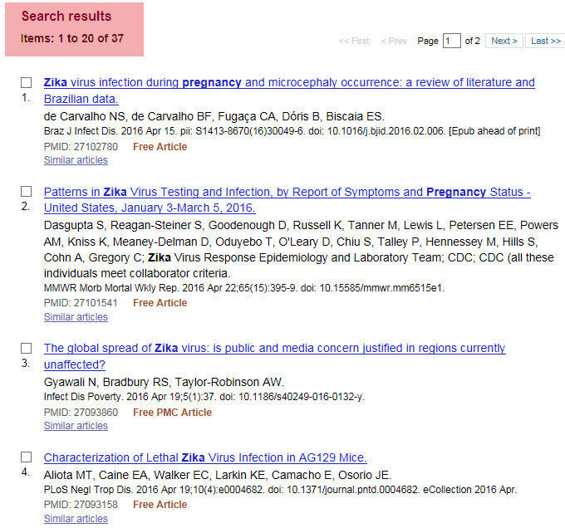
Free full-text journal articles
Free full text from Publishers and in PubMed
Notes:
To aid in finding relevant articles, we can go back to the information guide I mentioned earlier where we have developed pre-formulated searches of PubMed and Disaster Lit on a variety of topics and link specifically to free-full text. In addition, many publishers are providing temporary free access to articles they publish on Zika and a list of these journals and publishers can be found on the information resource guide.

Slide 19
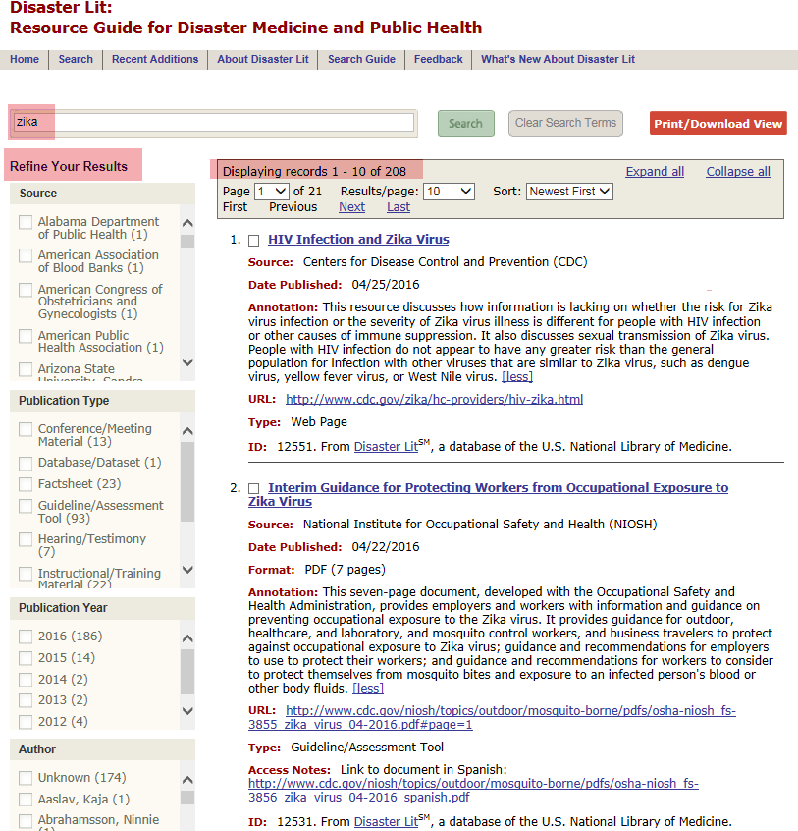
Disaster Lit:
Zika Resources
Refine Your Results:
Source
Publication Type
Year
Author
Notes:
So, what about all the other literature that I mentioned – guidelines, government reports and documents, training classes, situation reports, webinars – these are critical in times of PH emergencies and disasters so we collect them and include them in the Disaster Lit: The Resource Guide for Disaster Medicine and Public Health database. It is searchable much like pubmed, though the scope is much narrower. As you can see here, we have already added over 200 items on Zika virus in the past 5 months.
Another example of the need to collect this “grey” literature can be found in the Ebola literature. CDC published over 100 guidelines on Ebola – guidelines on donning and doffing personal protective equipment, guidelines for the airline industry, guidelines for pregnant woment, for children, etc. None of these guidelines are in PubMed as they were published on the CDC web site – all of these, plus guidelines from WHO and other key players, are cited in Disaster Lit.

Slide 20
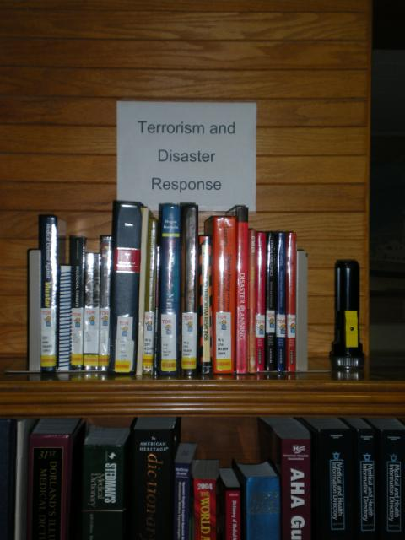
What can you do…
  Expand collections of disaster-related resources
  Become a Disaster Information Specialist (take NLM/MLA courses) and teach emergency responders and managers about NLM and other disaster info resources
  Participate in disaster drills – real and virtual
  Participate in social media monitoring and curation
  Collaborate with local disaster medicine and
  public health workers and emergency
  responders and managers
  Update local information resources and
  scan for emerging issues
  Support researchers information needs
Notes:
So, what does NLM do related to disasters on a regular basis. We add relevant info to PubMed, collect non-journal literature for the Disaster Lit database, train librarians to support the information needs of disaster professionals
A few examples include:
Collect, organize and disseminate disaster materials from non-commercial sources, peer-reviewed literature, social media
Expand collections of disaster-related resources
Support hospital emergency planning activities
Teach responders about REMM, WISER
Participate in disaster drills
Host community preparedness events
Support researchers’ information needs
Network with local emergency operations, public health
Update Web sites, blogs, and library guides on disaster topics
As noted earlier, in most situations, being prepared with information or knowing the sources is key in a disaster situation, when even seconds may count. Nicely crafted PubMed searches might not be what is needed.

Slide 21
Thank you
SIS Staff
  Gale Dutcher
  Janice Kelly
  Victor Cid
  Cindy Love
  Elizabeth Norton
  Siobhan Champ-Blackwell
  Jen Pakiam
  Bert Hakkinen
  Shannon Jordan
  Stephanie Publicker
Betsy Humphreys
Dr. Steve Phillips
Many other NLM staff working on disasters and public health emergencies
Notes:
I owe a great deal of gratitude to many people at NLM who help with these activities and with this presentation. Thanks to Betsy Humphreys for providing this opportunity for me to present to you today, Gale Dutcher and Janice Kelly, our division director and deputy and the SIS and many other NLM staff who work with us. Lisa Lang and NICHSR

