Slide 1
National Library of Medicine Update
Patricia Flatley Brennan, Director
Joyce E.B. Backus, Associate Director for Library Operations
Amanda J. Wilson, Head, National Network Coordinating Office of the National Network of Libraries of Medicine
Notes:
National Library of Medicine Update
Patricia Flatley Brennan, Director
Joyce E.B. Backus, Associate Director for Library Operations
Amanda J. Wilson, Head, National Network Coordinating Office of the National Network of Libraries of Medicine

Slide 2
Patricia Flatley Brennan, RN, PhD Director
Notes:
Patricia Flatley Brennan, RN, PhD Director

Slide 3
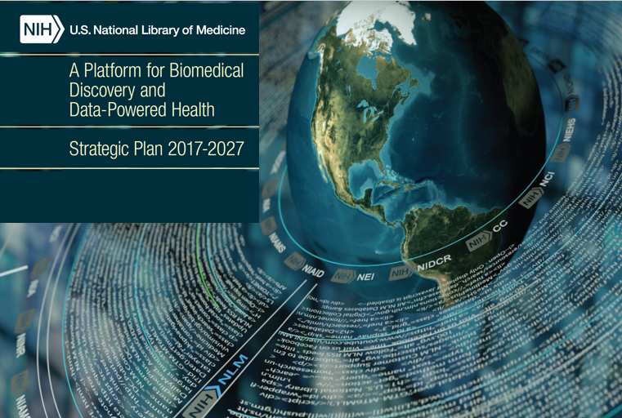
NLM Strategic Plan 2017-2027
Notes:
National Library of Medicine Strategic Plan 2017–2027: A Platform for Biomedical Discovery and Data-Powered Health
Image of the earth with NIH institute names and text circling around it. Image is the cover of the printed publication National Library of Medicine Strategic Plan 2017–2027: A Platform for Biomedical Discovery and Data-Powered Health.

Slide 4
Transforming Information into Discovery
Notes:
Transforming Information into Discovery
Accelerate discovery and advance health through data-driven research
Reach more people in more ways through enhanced dissemination and engagement
Build a workforce for data-driven research and health

Slide 5
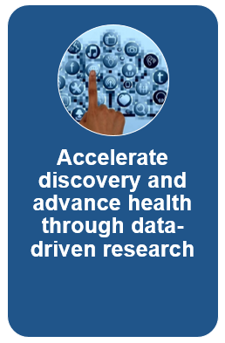
Goal 1
1.1 Connect the resources of a digital research enterprise
1.2 Advance research and development in biomedical informatics and data science
1.3 Foster open science policies and practices
1.4 Create a sustainable institutional, physical, and computational infrastructure
Notes:
Goal 1
1.1 Connect the resources of a digital research enterprise
1.2 Advance research and development in biomedical informatics and data science
1.3 Foster open science policies and practices
1.4 Create a sustainable institutional, physical, and computational infrastructure

Slide 6
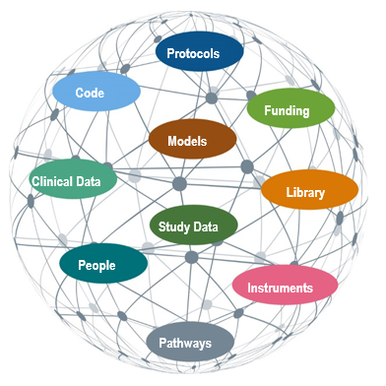
Fostering a ecosphere of discovery digital research objects
Notes:
NIH, NLM Fostering a ecosphere of discovery digital research objects
A comprehensive research data infrastructure for NIH connecting NLM and NIH Research Infrastructure
connecting:
protocols
code
models
funding
clinical data
study data
library
people
instruments
pathways

Slide 7
Goal 2
Reach more people in more ways through enhanced dissemination and engagement
2.1 Know NLM users and engage with persistence
2.2 Foster distinctiveness of NLM as a reliable, trustable source of health information and biomedical data
2.3 Support research in biomedical and health information access methods and information dissemination strategies
2.4 Enhance information delivery
Notes:
Goal 2
2.1 Know NLM users and engage with persistence
2.2 Foster distinctiveness of NLM as a reliable, trustable source of health information and biomedical data
2.3 Support research in biomedical and health information access methods and information dissemination strategies
2.4 Enhance information delivery

Slide 8
Data-powered health requires new approaches to deliver NLM information
Notes:
Data-powered health requires new approaches to deliver NLM information

Slide 9
Goal 3
Build a workforce for data-driven research and health
3.1 Expand and enhance research training for biomedical informatics and data science
3.2 Assure data science and open science proficiency
3.3 Increase workforce diversity
3.4 Engage the next generation and promote data literacy
Notes:
3.1 Expand and enhance research training for biomedical informatics and data science
3.2 Assure data science and open science proficiency
3.3 Increase workforce diversity
3.4 Engage the next generation and promote data literacy

Slide 10
Engage the next generation & promote data literacy

Slide 11
NLM & NIH Budget Enacted (FY17), Enacted (FY18), Proposed 2019
 | NLM |  | NIH
FY 2017 Final | $406,604,000 |  | $34,229,139,000
FY 2018 Omnibus | $ 428,553,000 |  | $ 37,311,349,000
FY 2019 President’s Budget | $ 395,493,000 |  | $ 34,766,707,000
Notes:
NLM & NIH Budget Enacted (FY17), Enacted (FY18), Proposed 2019
NLM FY 2017 Final $406,604,000
NIH FY 2017 Final $34,229,139,000
NLM FY 2017 Omnibus $428,553,000
NIH FY 2017 Omnibus $37,311,349,000
NLM FY 2017 President’s Budget $395,493,000
NIH FY 2017 President’s Budget $34,766,707,000

Slide 12
NLM & NIH Budget Enacted (FY17), Enacted (FY18), Proposed 2019
 | NLM |  | NIH
FY 2017 Final | $406,604,000 |  | $34,229,139,000
FY 2018 Omnibus | $ 428,553,000 |  | $ 37,311,349,000
FY 2019 President’s Budget | $ 395,493,000 |  | $ 34,766,707,000
$22M for new investments:
Data Science, Accelerated training for librarians, stabilize platforms

Slide 13
Key Accomplishments since February
Key Accomplishments since February
Initiated implementation of the Strategic Plan
Enhanced access to Toxicology resources
Launched MEDLINE 2022
Contributed to the NIH HEAL (Helping to End Addiction Long-term)
Assured an energy-efficient data center
Expanded uses of deep learning and neural networks, improving image interpretation and efficient algorithm deployment
Led the NIH in Identity and Access management needed to move data to commercial clouds
Notes:
Key Accomplishments since February
Initiated implementation of the Strategic Plan
Enhanced access to Toxicology resources
Launched MEDLINE 2022
Contributed to the NIH HEAL (Helping to End Addiction Long-term)
Assured an energy-efficient data center
Expanded uses of deep learning and neural networks, improving image interpretation and efficient algorithm deployment
Led the NIH in Identity and Access management needed to move data to commercial clouds

Slide 14
NLM trusted

Slide 15
Reaching NLM
@NLM_NEWS
@NLMdirector
patti.brennan@nih.gov

Slide 16
Joyce E.B. Backus, MSLS Associate Director for Library Operations

Slide 17
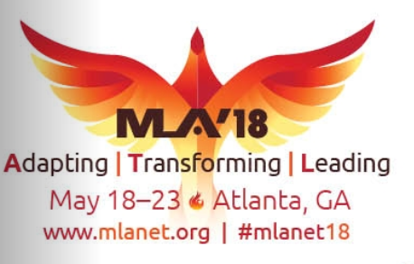
Next topics
Strategic planning initiatives – MEDLINE 2022 and TOXNET
PubMed Labs
PubMed Health
MedlinePlus
People - Fellowships, advisors
National Network of Libraries of Medicine

Slide 18
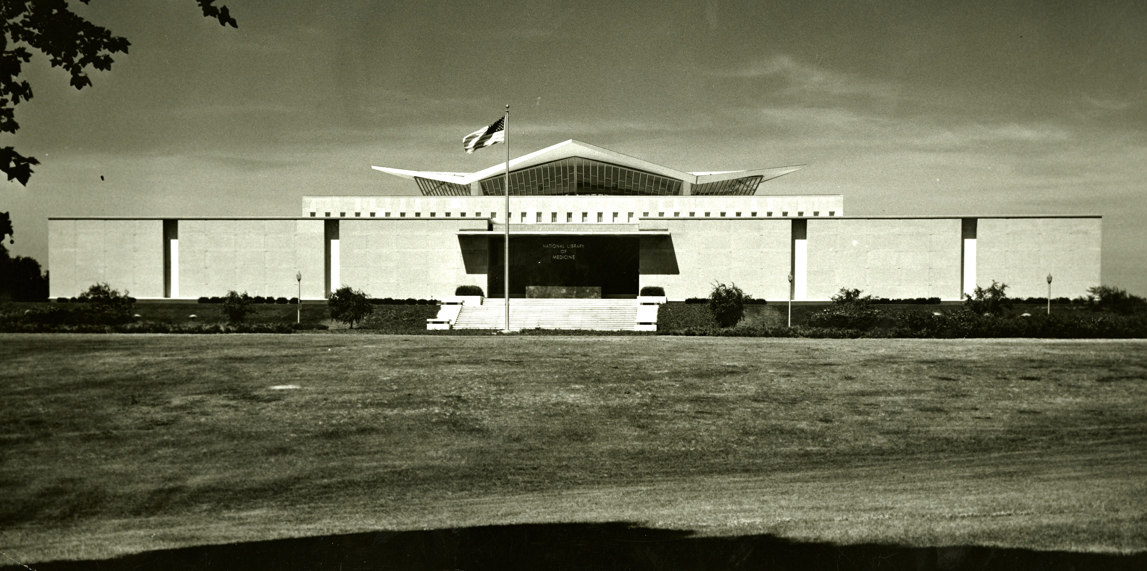
Strategic planning activities and outcomes

Slide 19
Strategic planning activities and outcomes
This Photo by Unknown Author is licensed under CC BY-ND

Slide 20
PubMed Content
MEDLINE 2022
Notes:
PubMed Content
Percentages are approximate
92% MEDLINE – citations from journal reviewed and recommended for indexing by LSTRC’ articles indexed with MeSH (Medical Subject Headings) and curated with funding, genetic, chemical, and other metadata
1% Book s- Citations from books, chapters, and reports
15% PMC journals and publisher programs – Citations from journals reviewed and selected by NLM for archiving; publishers have formal agreements with NLm for archiving this content
2% PMC author manuscripts – Citations of peer-reviewed manuscripts accepted for publication in a journal that falls under a PMC-participating funder’s open or public access policy
Source – Data from PubMed, December 2017

Slide 21
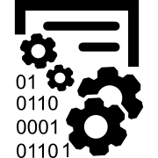
MEDLINE 2022 Joyce Backus & Jim Ostell
Curation at Scale
Expanded Metadata
Efficient and Connected
1 million or more citations indexed per year, to keep pace with publishers
Optimized metadata to support access to ClinicalTrials.gov and other trial registries
Publishers supply metadata and allow metadata extraction from full text
Citations indexed
within 24 hours, to meet user needs for discovery
Comprehensive genetic metadata to support the scientific research community
MeSH vocabulary and workflow enhancements support user needs
Automated indexing applied, to ensure efficient processing
Improved chemical metadata spanning pharmacological/
toxicological research areas
Authoritative vocabularies in addition to MeSH increase access
Expert human curation applied, to ensure indexing accuracy and quality
Enhanced funding metadata
to support research portfolio analysis
Links to datasets support NLM and NIH data science goals
Notes:
MEDLINE 2022 Project
Three column table
Column 1, Column title: Curation at Scale
Column 1, Row 1: 1 million or more citations indexed per year, to keep page with publishers
Column 1, Row 2: Citations indexed within 24 hours, to meet user need for discovery
Column 1, Row 3: Automated indexing applied, to ensure efficient processing
Column 1, Row 4: Expert human curation applied, to ensure indexing accuracty and quality
Column 2, Column title: Expanded Metadata
Column 2, Row 1: Optimized metadata to support access to ClinicalTrials.gov and other trial registries
Column 2, Row 2: Comprehensive genetic metadata to support the scientific research community
Column 2, Row 3: Improved chemical metadata spanning pharmacological/toxicological research areas
Column 2, Row 4: Enhanced funding metadata to support research portfolio analysis
Column 3, Column title: Efficient and Connected
Column 3, Row 1: Publishers supply metadata and allow metadata extraction from full text
Column 3, Row 2: MeSH vocabulary and workflow enhancements support user needs
Column 3, Row 3: Authoritative vocabularies in addition to MeSH increase access
Column 3, Row 4: Links to datasets support NLM and NIH data science goals

Slide 22
MEDLINE 2022
Stacey Arnesen - SIS
Evan Bolton - NCBI
Jessica Chan - NCBI
Florence Chang - SIS
Dan Cho - LO
David Cissel - LO
Marie Collins - NCBI
Dina Demner-Fushman - LHC
Kin Wah Fung - LHC
Katie Funk - NCBI
Jeanne Goshorn - SIS
Rob Guzman - LO
Nick Ide - NCBI
Brandi Kattman - NCBI
Preeti Gokal Kochar - LO
Stella Koppel - LO
Francois Lang - LHC
Daniel Le - LHC
Zhiyong Lu - NCBI
Kate Majewski - LO
Patrick McLaughlin - LO
Jim Mork - LHC
Carlo Nuss – LO
Deborah Ozga - LO
Jim Pash - LO
Olga Printseva - LO
Will Rogers - LHC
John Rozier - OCCS
Susan Schmidt - LO
Valerie Schneider - NCBI
Conrad Schoch - NCBI
Jules Shore - LO
Rebecca Stanger - LO
Karen Steely - LHC
Caitlin Sticco - LO
Annemieke van der Sluijs - LO
Janice Ward - LO
Sarah Weis - NCBI
Beth Weston - LO
Erin Zellers - NCBI
Team 1 - Vocabularies
Team 2 - Indexing Methods
Team 3 - ClinicalTrials.gov
Team 4 - Chemical Information
Team 5 - Funding Information
Team 6 - Gene Information
Team 7 - Data Science
Team 8 - Journal Requirements
Notes:
MEDLINE 2022 Teams
Team 1 - Vocabularies
Team 2 - Indexing Methods
Team 3 - ClinicalTrials.gov
Team 4 - Chemical Information
Team 5 - Funding Information
Team 6 - Gene Information
Team 7 - Data Science
Team 8 - Journal Requirements
NLM staff involved with the project:
Stacey Arnesen - SIS
Evan Bolton - NCBI
Jessica Chan - NCBI
Florence Chang - SIS
Dan Cho - LO
David Cissel - LO
Marie Collins - NCBI
Dina Demner-Fushman - LHC
Kin Wah Fung - LHC
Katie Funk - NCBI
Jeanne Goshorn - SIS
Rob Guzman - LO
Nick Ide - NCBI
Brandi Kattman - NCBI
Preeti Gokal Kochar - LO
Stella Koppel - LO
Francois Lang - LHC
Daniel Le - LHC
Zhiyong Lu - NCBI
Kate Majewski - LO
Patrick McLaughlin - LO
Jim Mork - LHC
Carlo Nuss - LO
Deborah Ozga - LO
Jim Pash - LO
Olga Printseva - LO
Will Rogers - LHC
John Rozier - OCCS
Suan Schmidt - LO
Valerie Schneider - NCBI
Conrad Schoch - NCBI
Jules Shore - LO
Rebecca Stanger - LO
Karen Steely - LHC
Caitlin Sticco - LO
Annemieke van der Sluijs - LO
Janice Ward - LO
Sarah Weis - NCBI
Beth Weston - LO
Erin Zellers - NCBI

Slide 23
Next generation
Curation by SIS toxicology and chemical information team
Enhance the content
Expand the collections
Service by NCBI platforms
PubMed, PubChem, Bookshelf
Web search interface
API

Slide 24
Pubmed Llabs usage
28+ million citations
2.5 million daily users
~ 3 million daily searches
9 million daily page views
Europe
23%
Asia
25%
North America
40%
Africa
4%
South America
4%
Oceania
4%
Notes:
PubMed

Slide 25
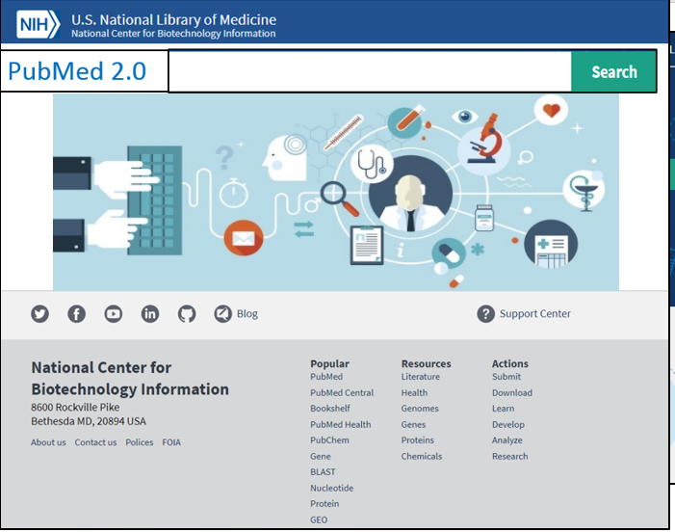
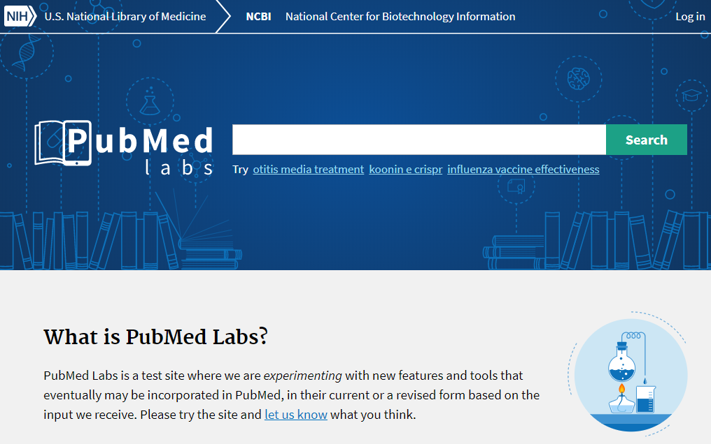
Create an outstanding design and user experience for PubMed 2.0
?

Slide 26
PubMed Labs supports the NLM Strategic Plan
GOAL 2: Reach more people in more ways through enhanced dissemination and engagement pathways
Objective 2.1: Know NLM users and engage with persistence
Objective 2.4: Enhance information delivery
Notes:
GOAL 2: Reach more people in more ways through enhanced dissemination and engagement pathways
Objective 2.1: Know NLM users and engage with persistence
Objective 2.4: Enhance information delivery

Slide 27
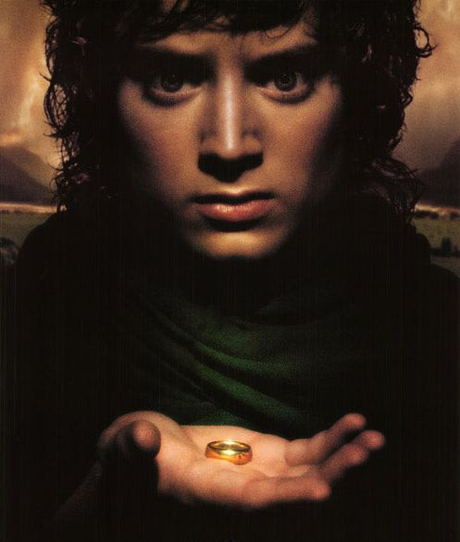
PubOne XML format
PubOne
One XML Format
To Rule Them All
Notes:
PubOne
One XML Format
To Rule Them All

Slide 28
PubOne XML format
A common XML format unifying metadata from PubMed, PMC, and Bookshelf
All 3 databases are converted to the PubOne format; records describing the same document are then merged into one single record
The merging process uses best data,e.g. MeSH terms from PubMed enhanced by reference citations from PMC
Pub One
One XML Format
To Rule Them All
Notes:
PubOne
One XML Format
To Rule Them All
A common XML format unifying metadata from PubMed, PMC, and Bookshelf
All 3 databases are converted to the PubOne format; records describing the same document are then merged into one single record
The merging process uses best data,e.g. MeSH terms from PubMed enhanced by reference citations from PMC

Slide 29
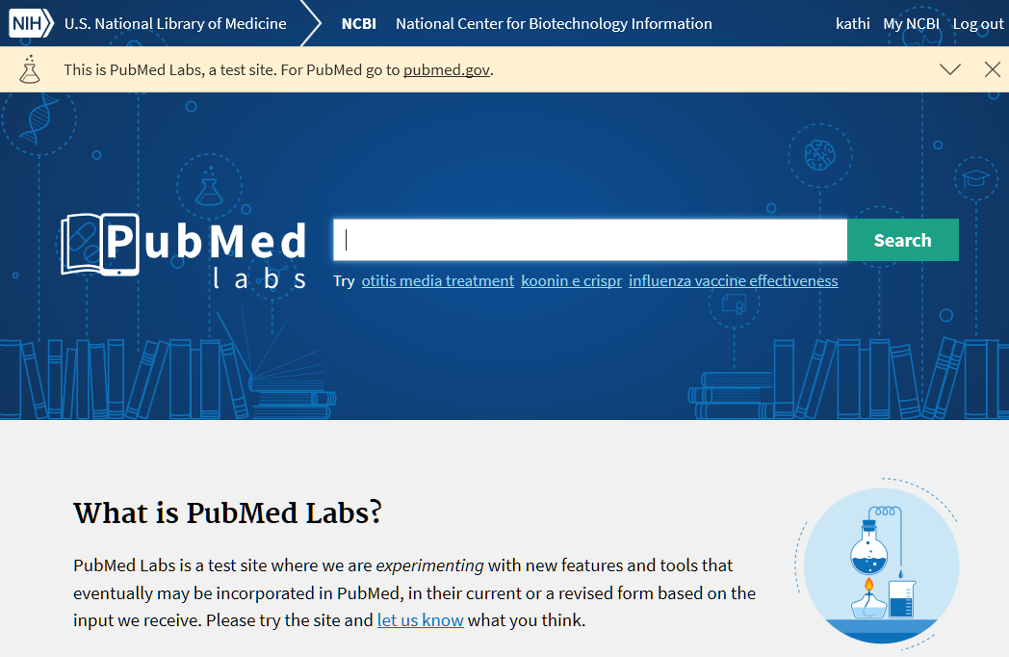
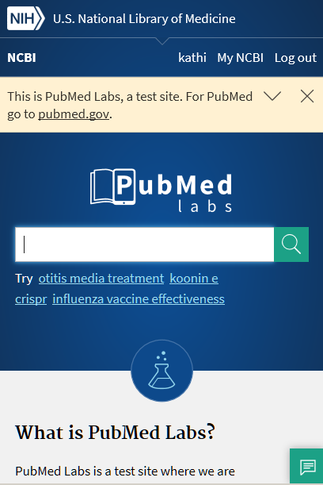
PubMed Labs launched in October 2017

Slide 30
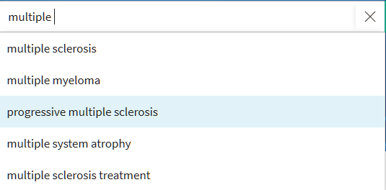
PubMed Labs search

Slide 31
Overwhelmingly Positive Feedback!
Very straightforward and pleasant. You reinvented the pleasure to browse through the bibliography. Many thanks.
Love the layout and readability of the test website.
I love the new website design
The new pubmed labs format is very fast, simple and amazing thank you
I prefer this layout than the official version. Actually, the mobile version looks very good. Sometimes the simpler the better. Thanks for good work!
Good job this version is more efficient than the old one. I am using only this PubMed Labs version and advising it to my colleagues.
I love this new layout! Modern look and feel.
Nice job with new design, works well with Mac and iPhone browsers.

Slide 32
Hey, where is the feature…?
I use the history of my queries (advanced search) to combine queries I cannot find this function on the test platform.
I suppose the Lab version does not show the definitive layout with all the options available, since some essential features are missing -Search history.
We need advanced searching!
How will Advanced Search be accessed in the new interface?
We are listening and
we are working on it!

Slide 33
PubMed 2.0 release roadmap and beyond
Oct 2017
Mar 2018
June 2018
Dec 2018
Gather Feedback from Labs Users
18F engagement Phase I
PubMed Labs
Transition
Apply Designs
18F engagement Phase II
By the end of 2018, we will release a version of PubMed 2.0 that will satisfy 90% of user needs.
Public release

Slide 34
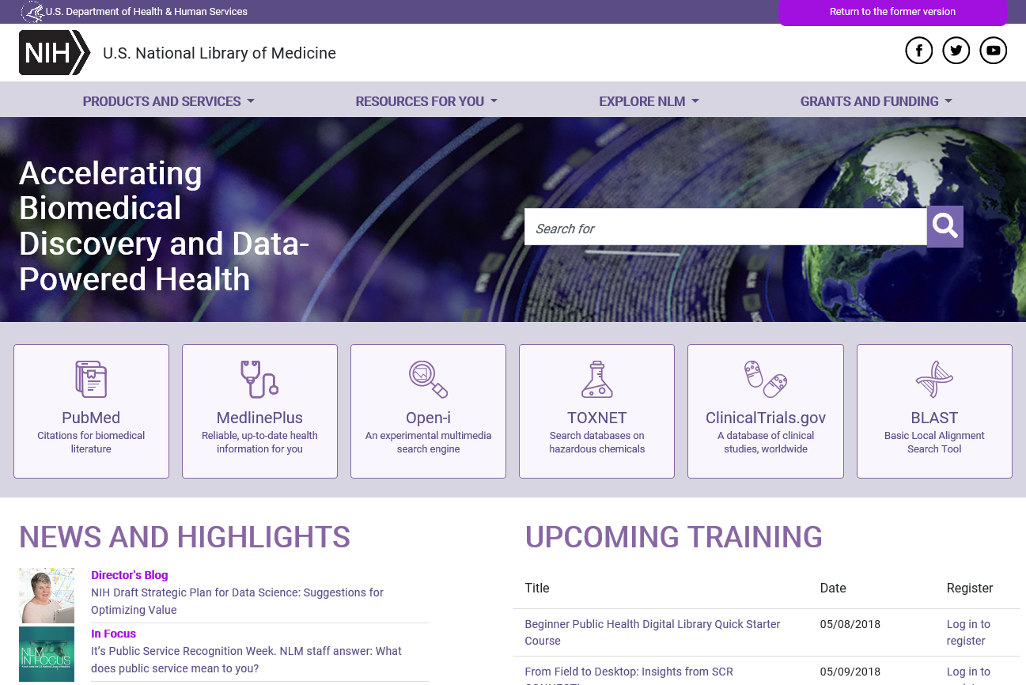
Redesigned NLM homepage

Slide 35
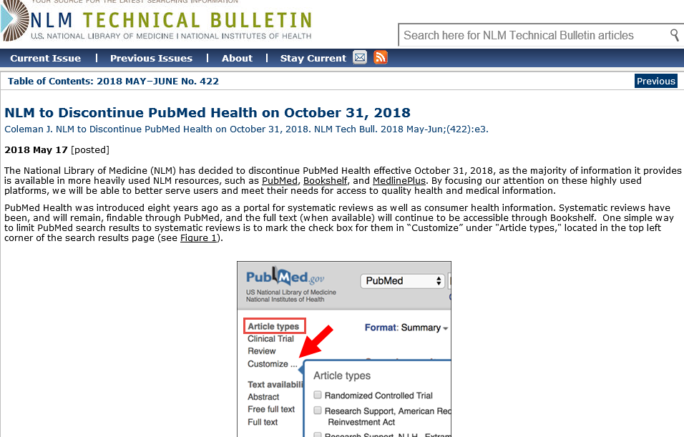
PubMed Health will be discontinued on October 31, 2018
Systematic reviews remain in Bookshelf and MEDLINE and searchable in PubMed
We will be enhancing systematic review searching (see PubMed Labs above)
MedlinePlus providing information for patients, families, etc

Slide 36
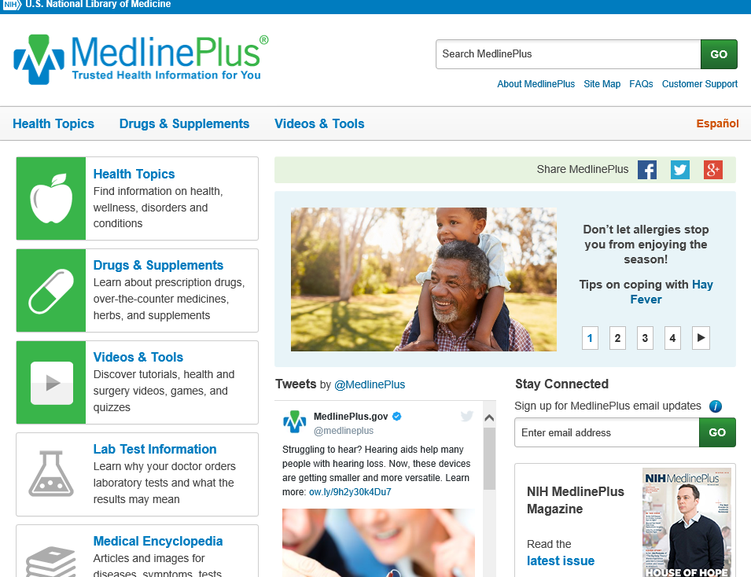
MedlinePlus Lab Test Information
Gap identified in Connect and search requests
Currently 62, eventually ~100
Health writers, NIH and other authoritative information
Consistent structure
References to sources

Slide 37
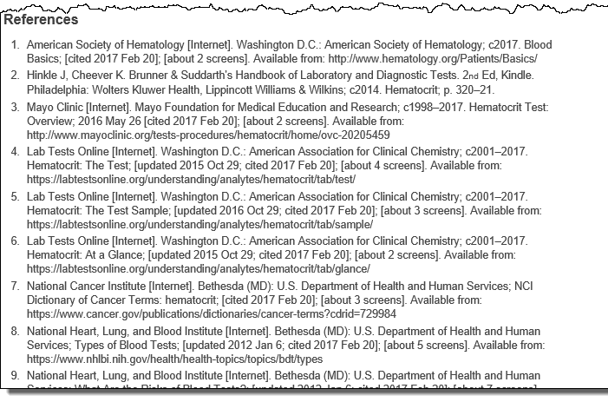
MedlinePlus Lab Tests

Slide 38
National Library of Medicine

Slide 39
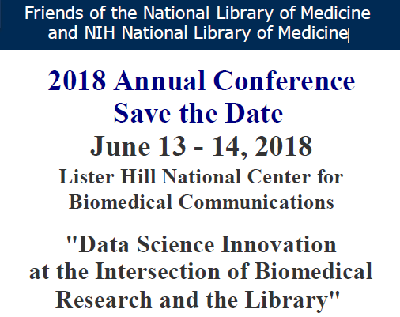
Key Speakers
Patti Brennan (National Library of Medicine)
Brian D. Athey (University of Michigan)
John Glaser (Cerner)
Alexa McCray (Harvard)
Rajni Samavedam (Booz Allen Hamilton)
Craig Venter (J. Craig Venter Institute)
Anju Gupta (Syngenta)
Paul Wester, (National Agricultural Library)
Elaine Martin (Harvard University)
Justin Starren (Northwestern University)
Neal Sarkar (JAMIA Open)
Joyce Backus (NLM)
Chris Winchester (Oxford PharmaGenesis)
Wendy Chapman (University of Utah)
Heather Piwowar (University of Pittsburgh)
Noemi Elhadad (Columbia University)
fnlm.org

Slide 40
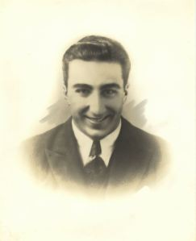
Michael E. DeBakey Fellowship in the History of Medicine
Applications for 2019 due Sept 28
Blog posts from 2017 Fellows:
Justin Barr, PhD, “Michael E. DeBakey and the Education of American Surgeons”
Kurt Dasse, PhD, “Inside the Creative Mind of Michael E. DeBakey”
Craig Miller, MD, “A Time for All Things” Michael E. DeBakey - the Tulane Years.”
Heidi Morefield, MSc, “Tinkering with Profitability: Michael E. DeBakey and the Affordable Blood Transfusion Instrument”
Andrew Simpson, PhD, “The Power of a Name: Michael E. DeBakey and the Changing Business of American Medicine.”

Slide 41
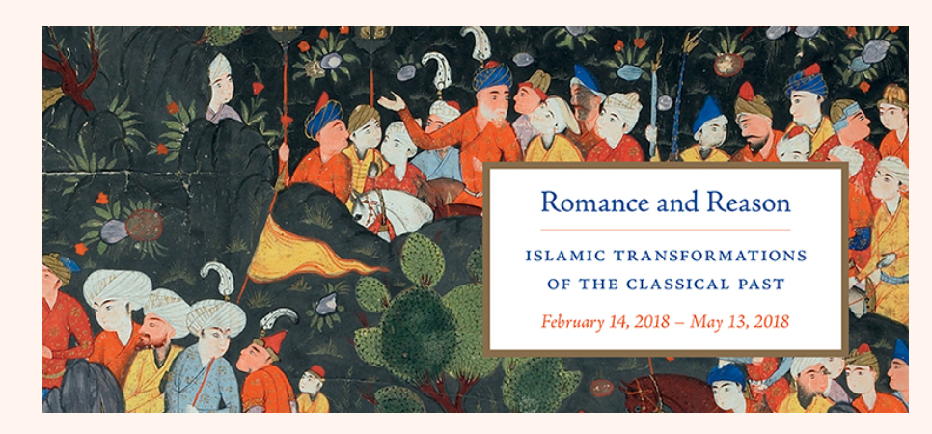
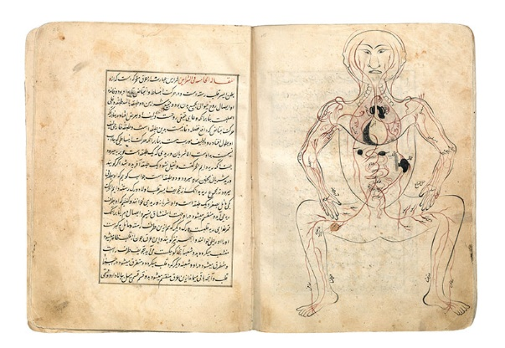
Loan of Rare Books to New York University's Institute for the Study of the Ancient World
11 NLM books and manuscripts included in Romance and Reason exhibition
Explored the transformation of the Greek classical hero Alexander the Great into a figure exhibiting Islamic visual styles
NLM’s largest and most significant loan to date

Slide 42
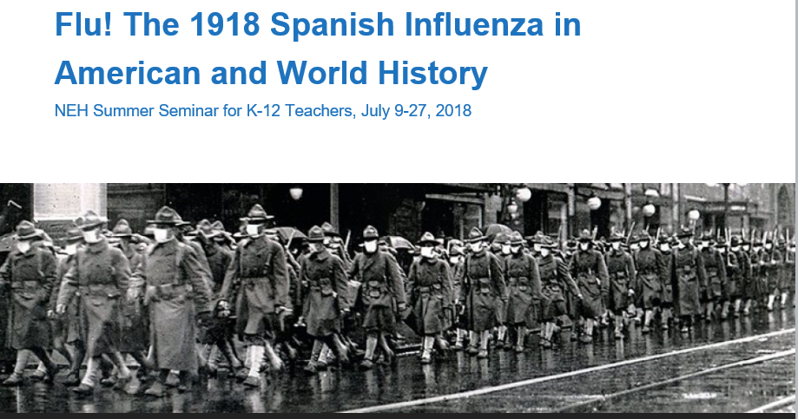
Blue! The 1918 Spanish Influenza in American and World History

Slide 43
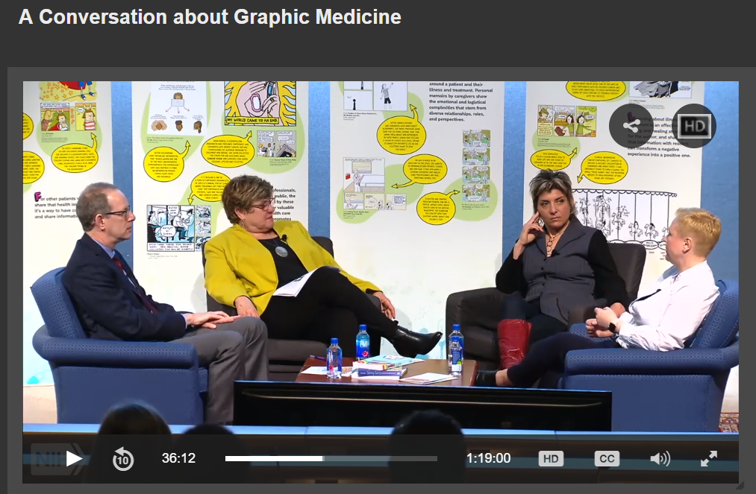
A Conversation about Graphic Medicine

Slide 44
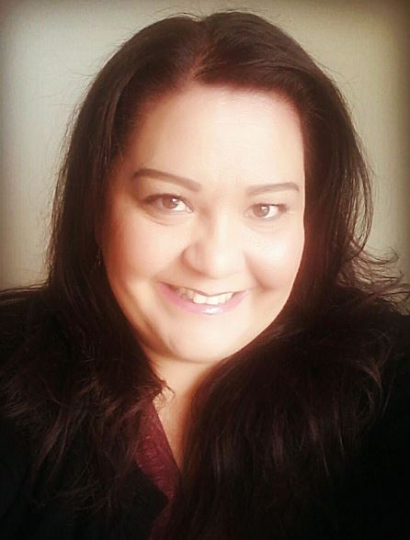
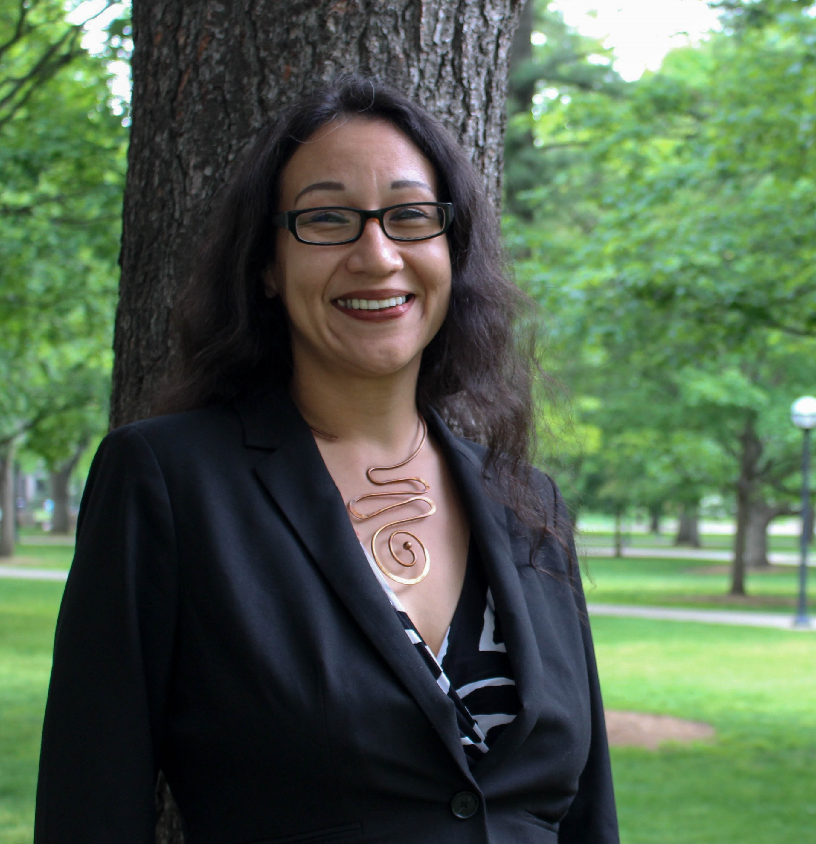
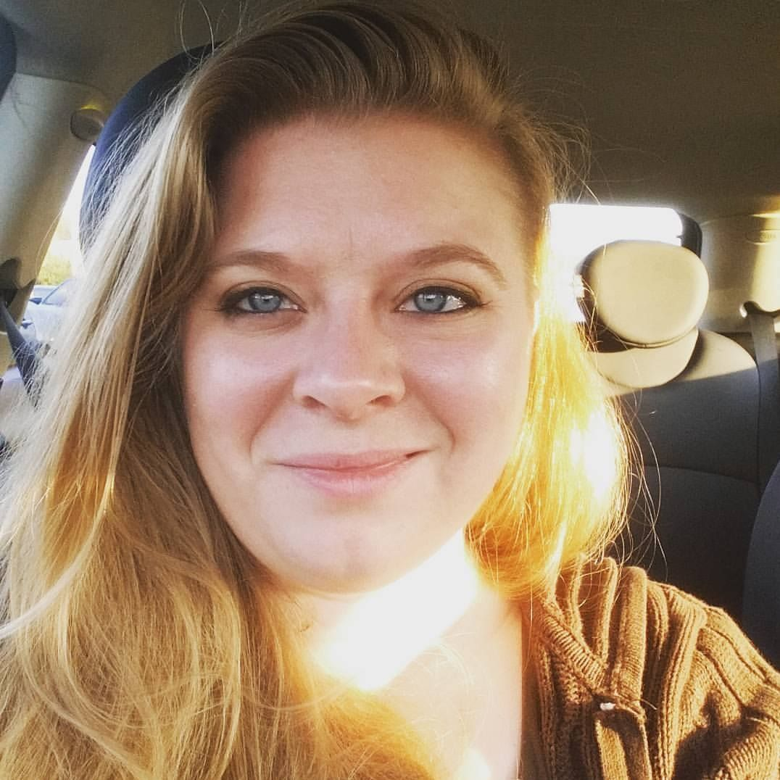
Library & Information Science Students
Isabel Soto-Luna
ALA/MLA/NLM Spectrum Scholar 2017
Ruby Nugent
Knowledge River Scholar
University of Arizona
Jasmine Pawlicki
ALA/MLA/NLM Spectrum Scholar 2017
Cindy Butor
University of Kentucky
Alternative Spring Break student
Amy Curtis
University of Kentucky Alternative Spring Break student

Slide 45
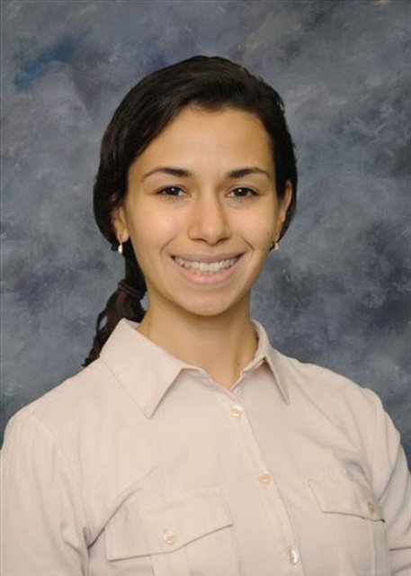
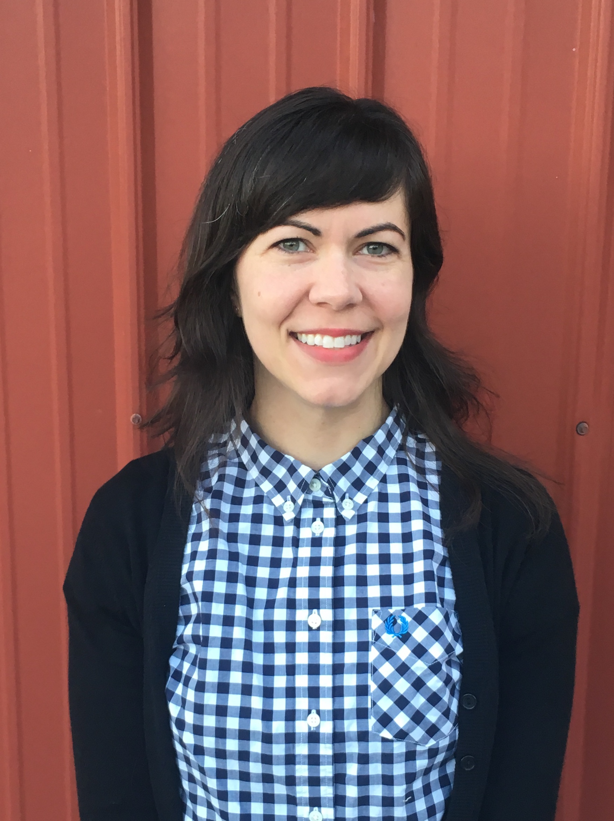
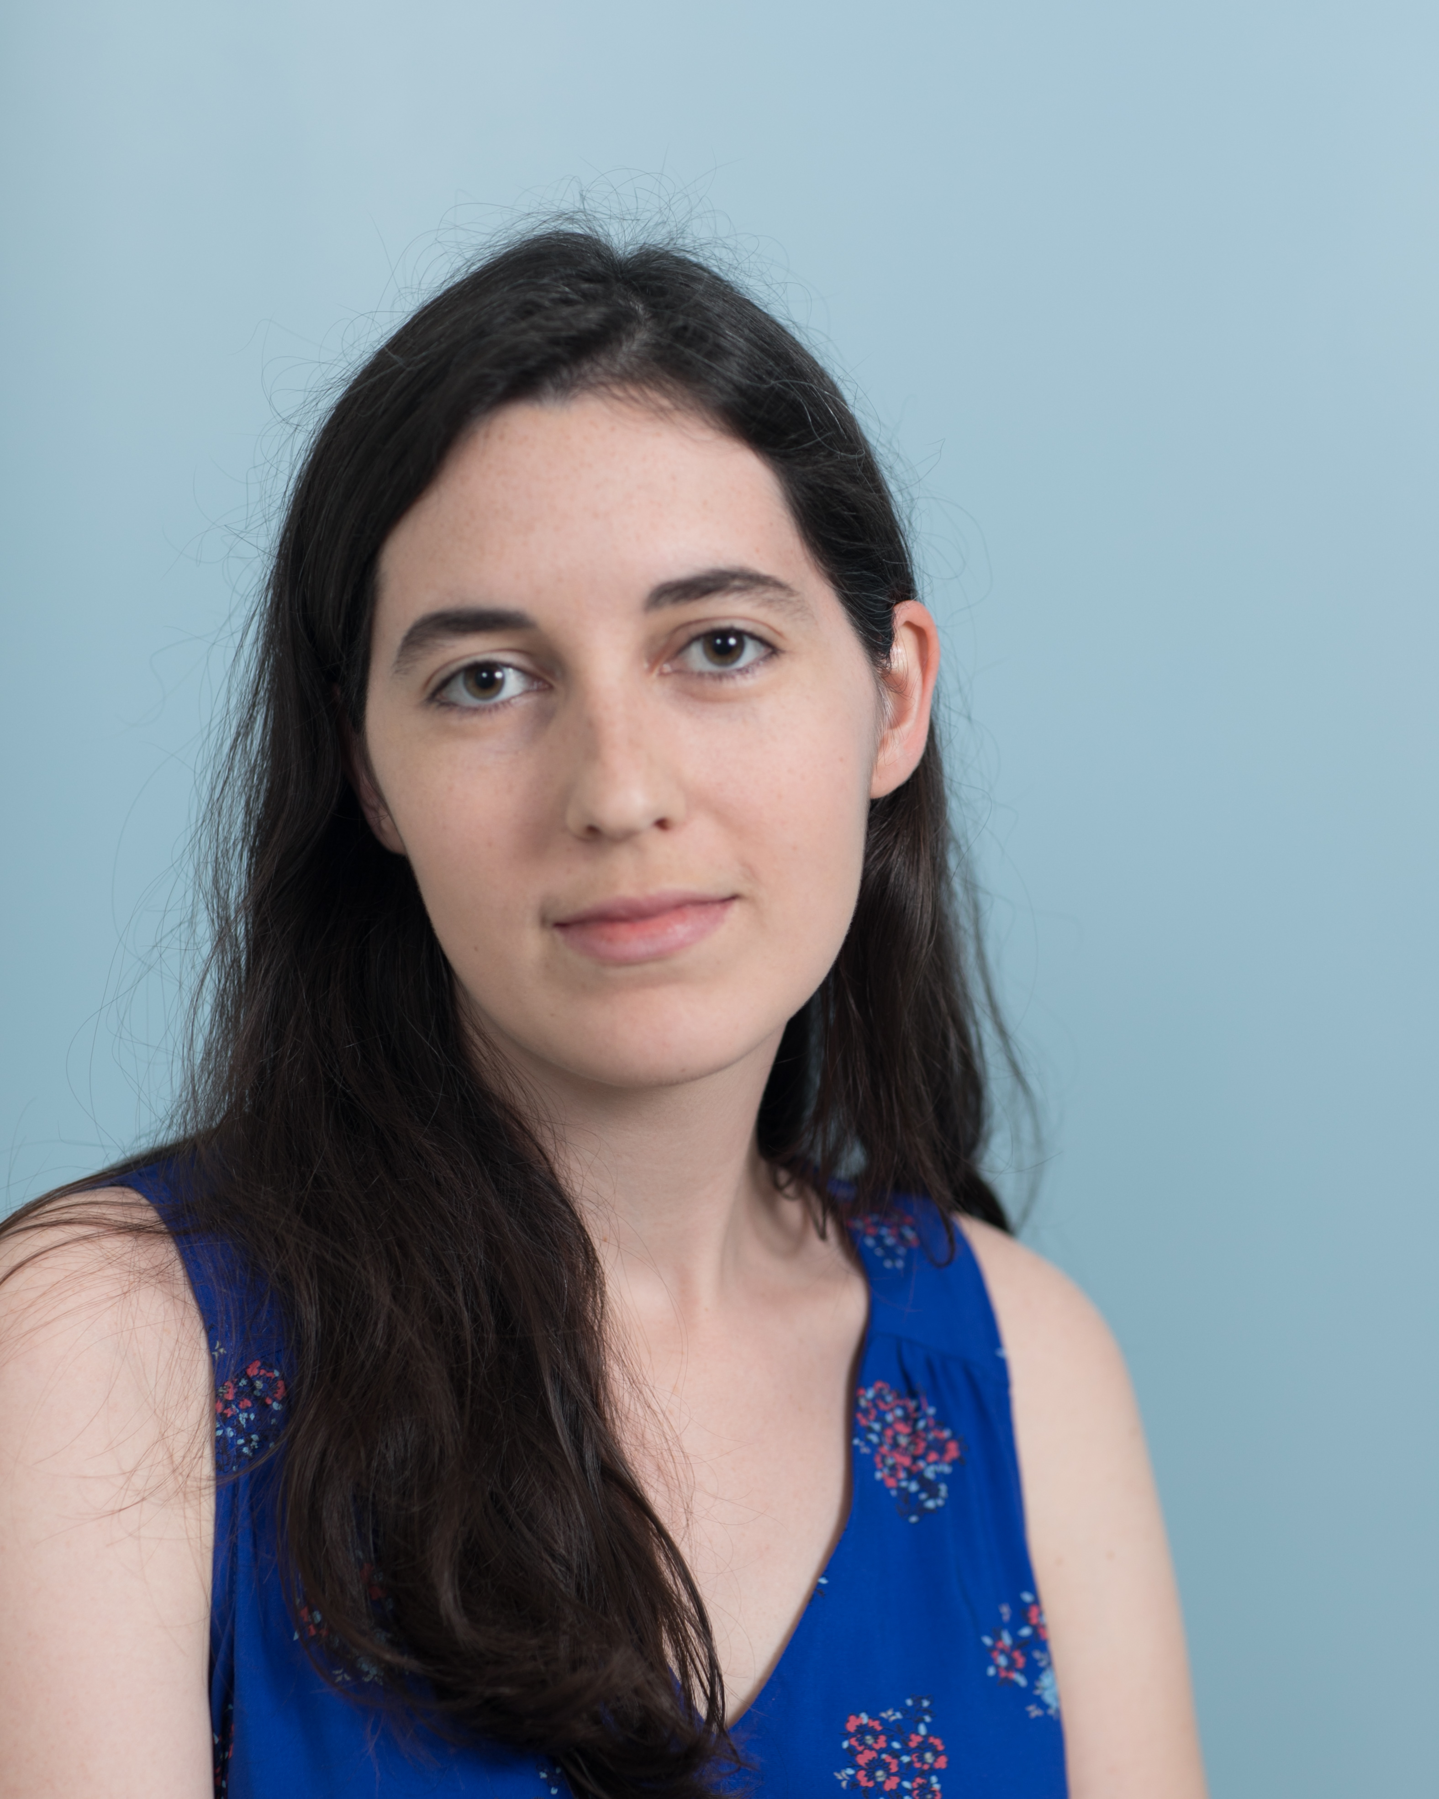
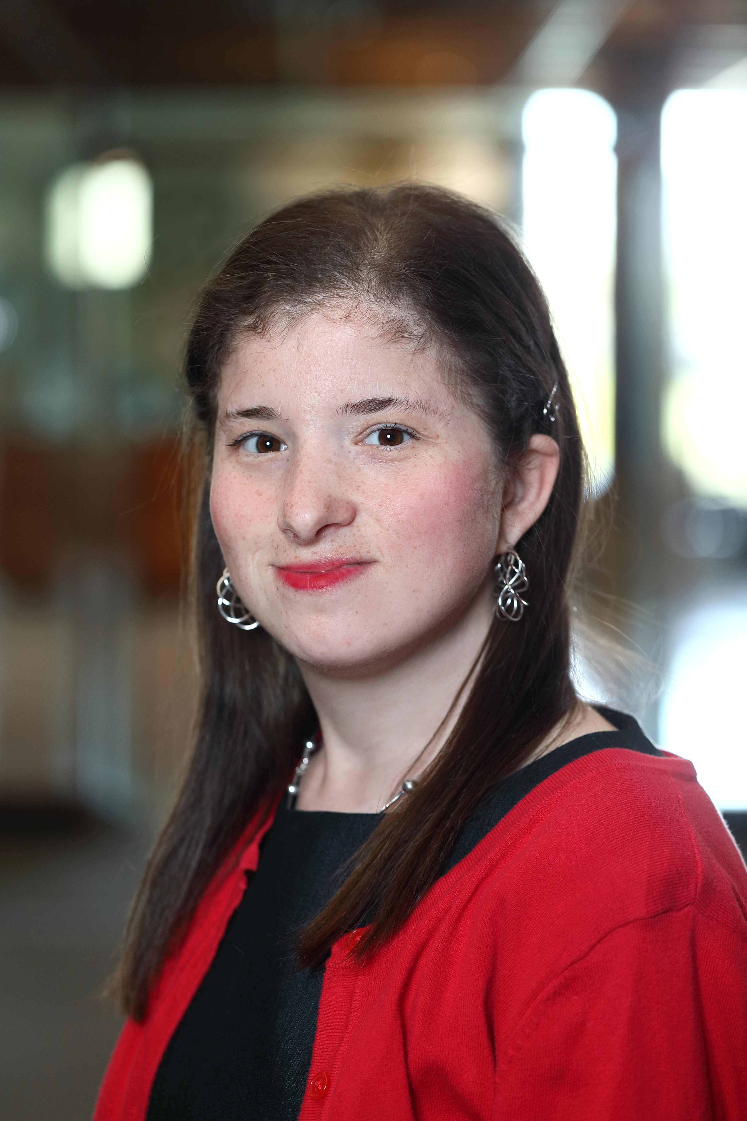
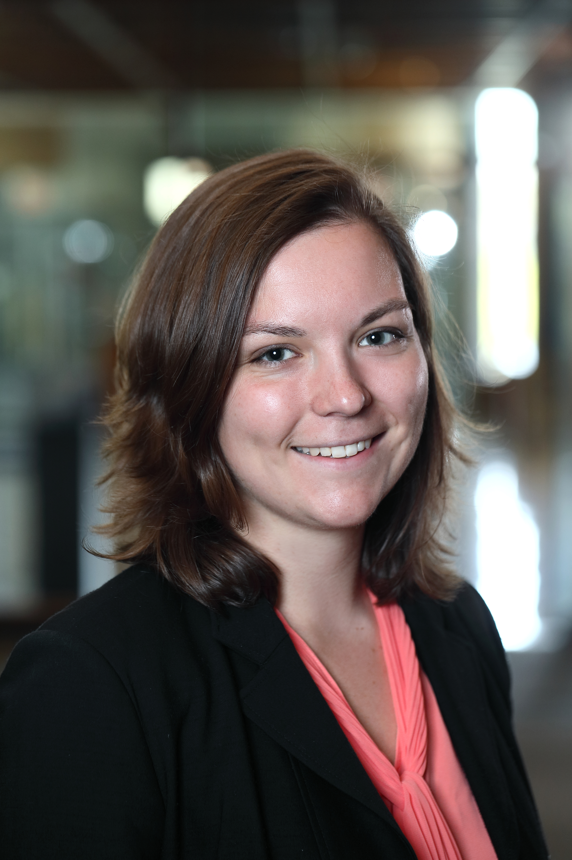
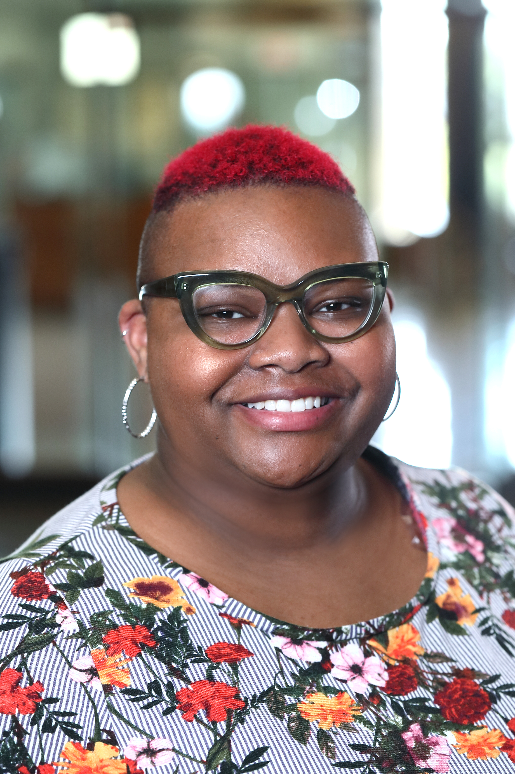
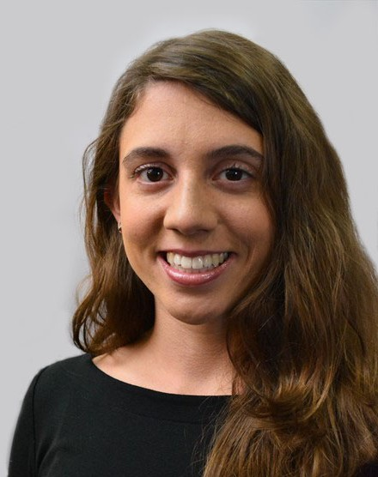
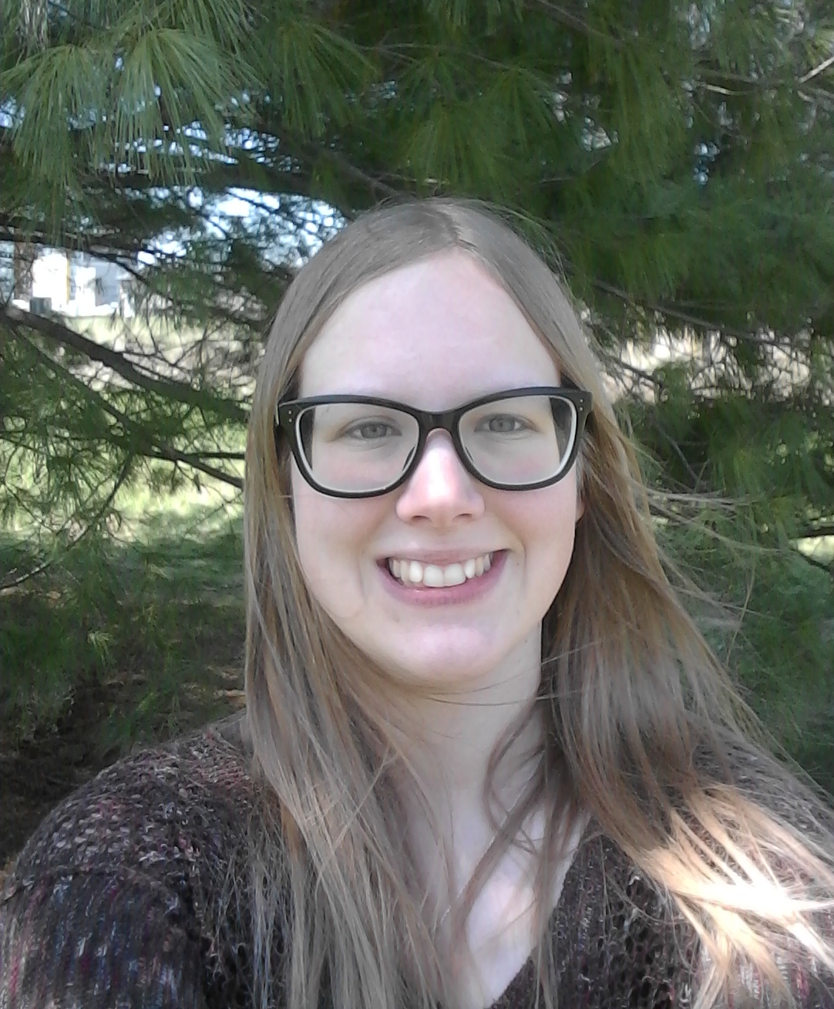
NLM Associate Fellows
Stacy Brody Sarah Clarke Amelia Llorens
Gabrielle Barr
Shannon Sheridan
Nicole Strayhorn
Cecelia Vetter Paije Wilson
2017-18
2018-19

Slide 46
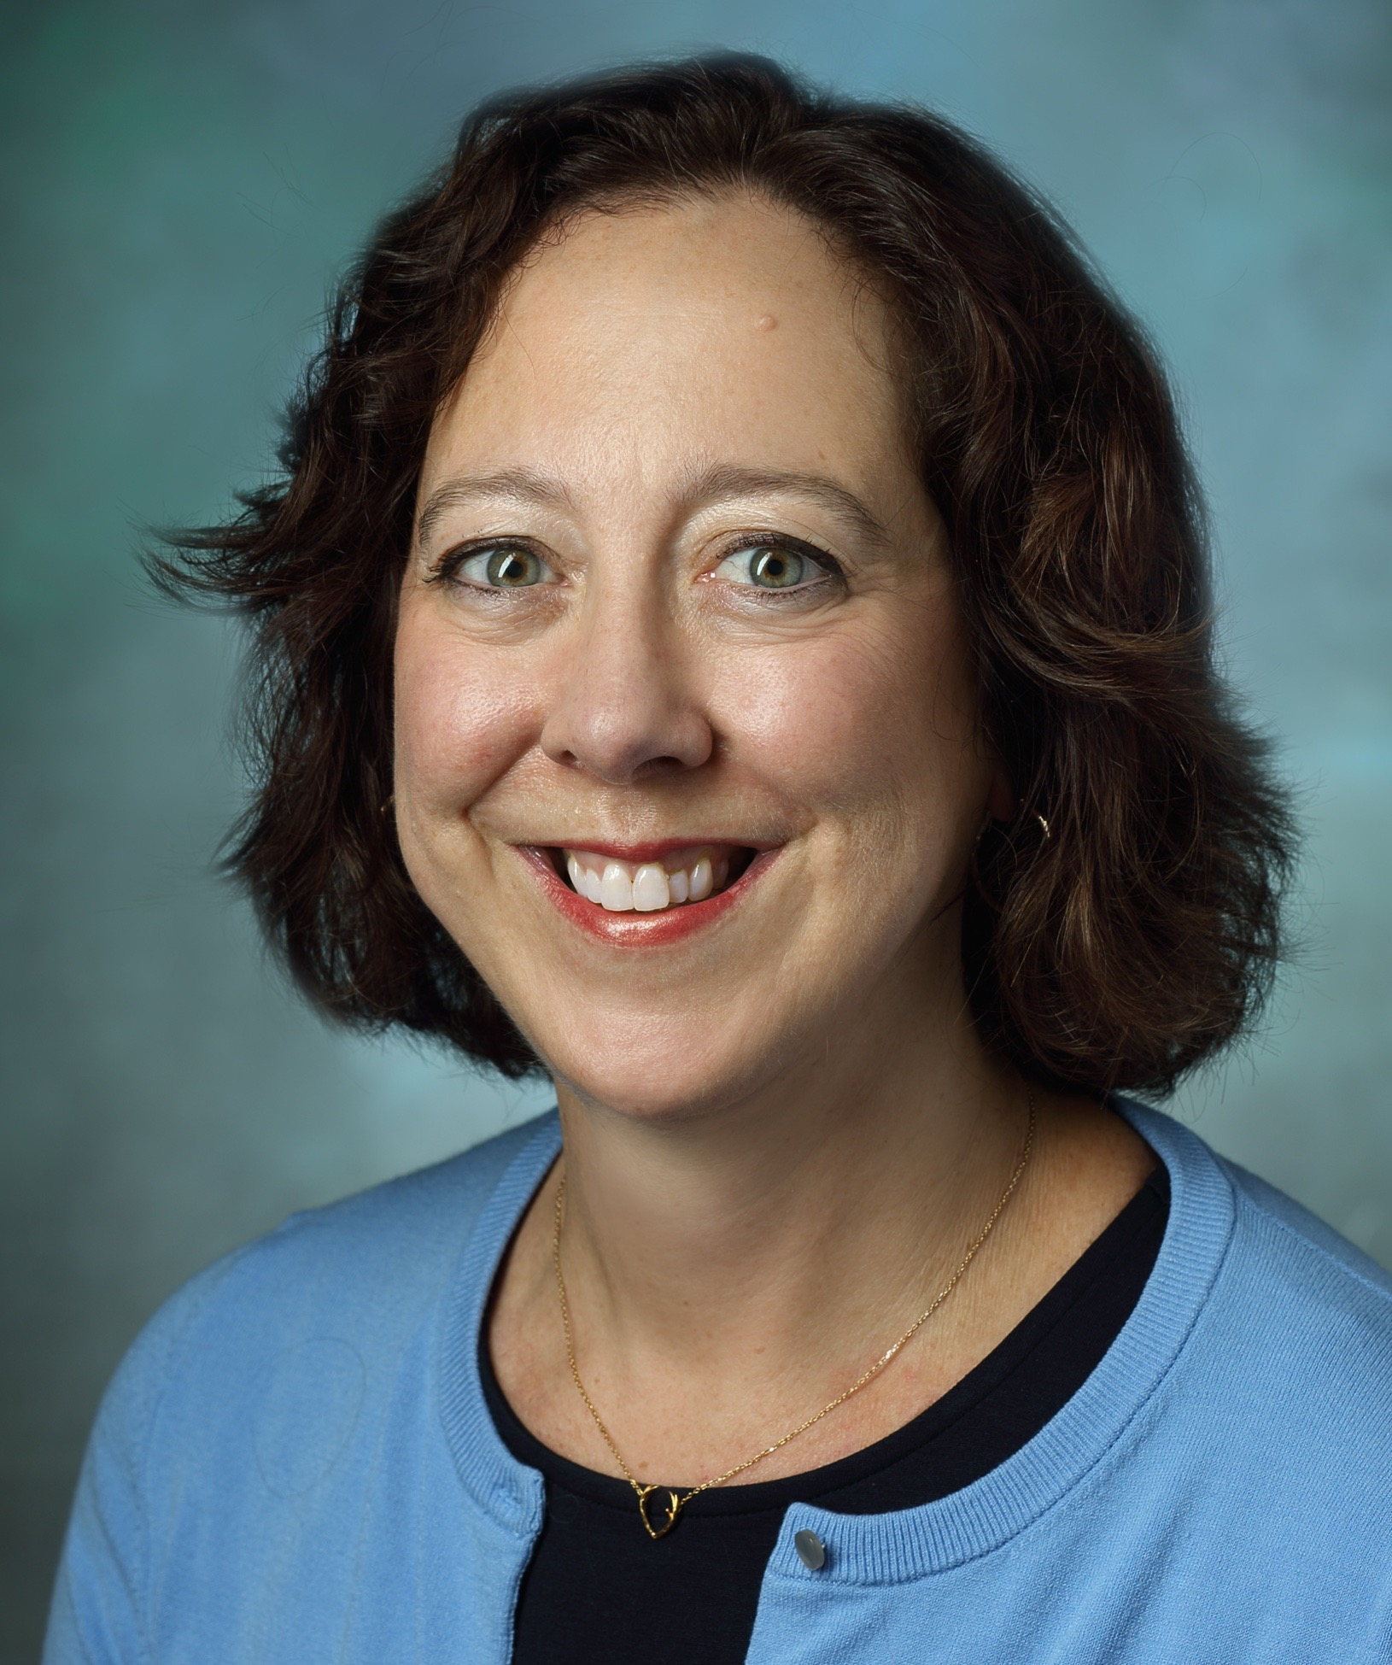
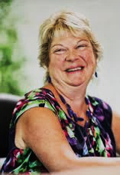
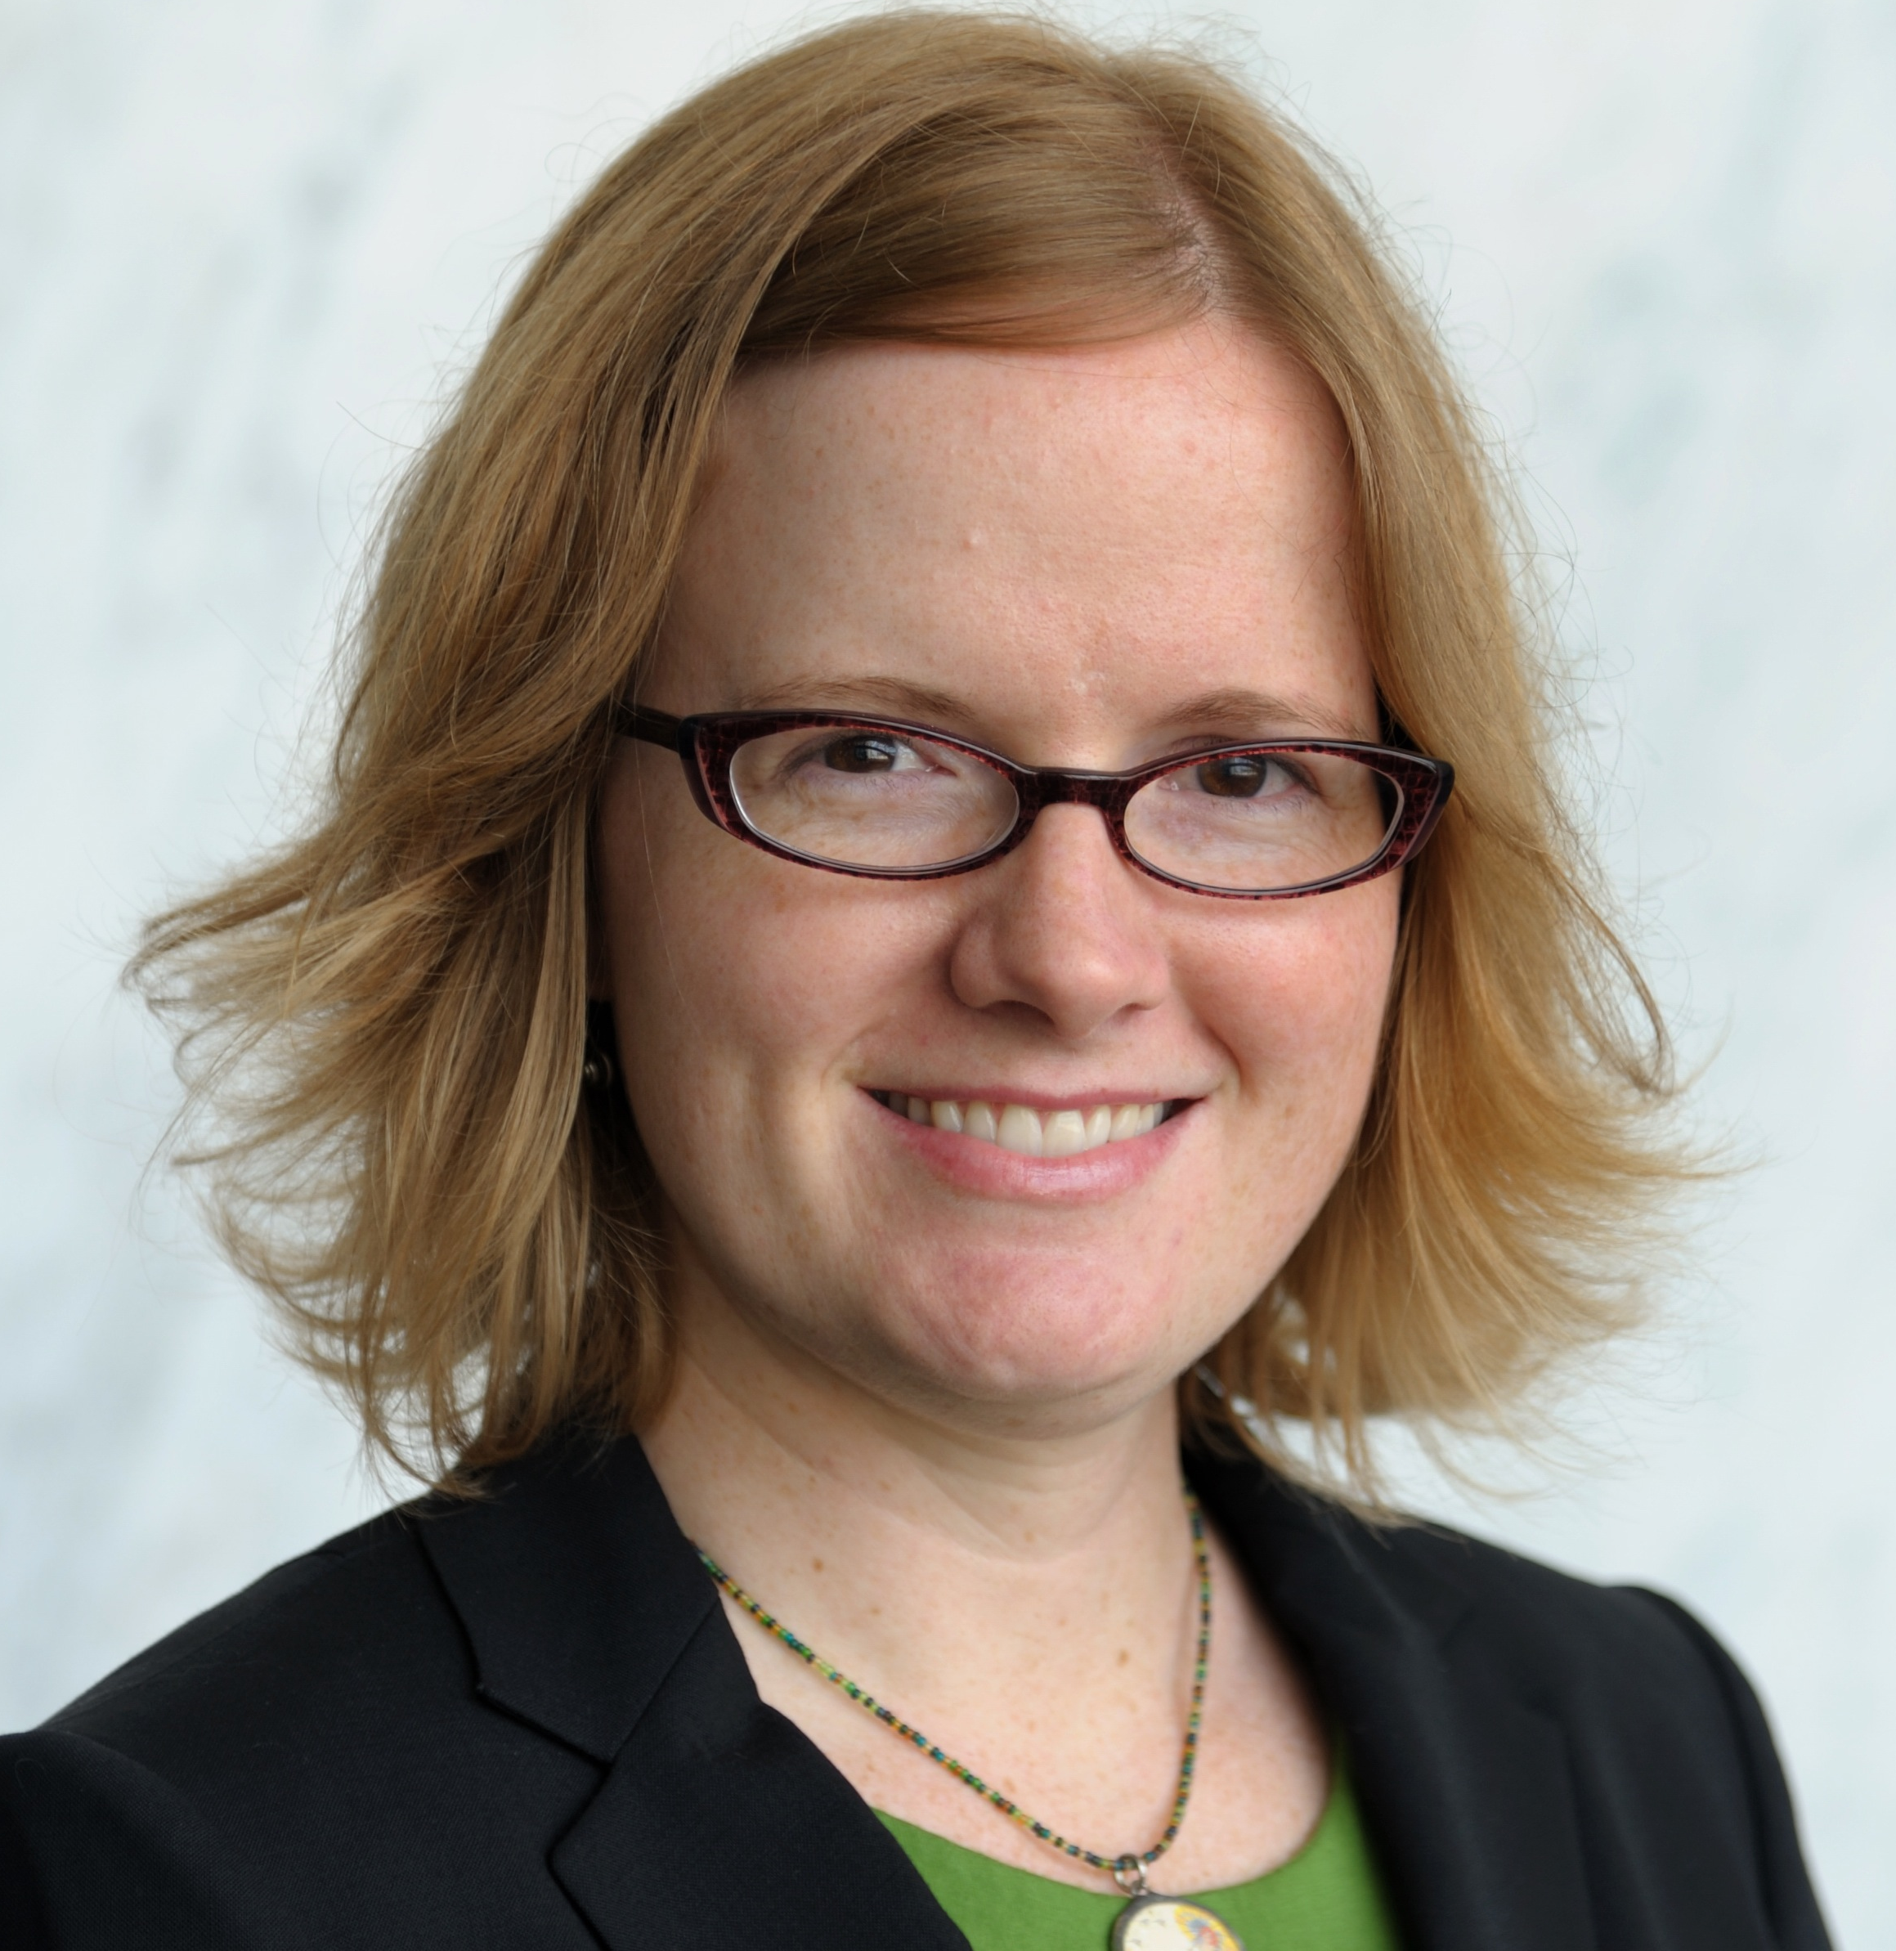
Advice and guidance from the library community
Jane Blumenthal
Taubman Health Sciences Library Univ. of Michigan
Sandra Martin
Shiffman Medical Library, Wayne State Univ.
Marisa Conte
Taubman Health Sciences Library Univ. of Michigan
Anne Seymour
Welch Medical Library
Johns Hopkins Univ.
Jean Shipman
Elsevier; and Center for Medical Innovation, University of Utah
Kristen Greenland Keefe Science Library Amherst College
Notes:
BLUMENTHAL, JANE L (08/03/2020) ASSOCIATE UNIVERSITY LIBRARIAN DIRECTOR, TAUBMAN HEALTH SCIENCES LIBRARY
Board of Regents
CONTE, MARISA L (06/30/2019) ASSISTANT DIRECTOR RESEARCH AND INFORMATICS TAUBMAN HEALTH SCIENCES LIBRARY UNIVERSITY OF MICHIGAN
LSTRC
GOLLOP, CLAUDIA J , PHD (06/30/2020) ASSOCIATE PROFESSOR SCHOOL OF INFORMATION AND LIBRARY SCIENCE UNIVERSITY OF NORTH CAROLINA AT CHAPEL HILL
BLIRC
GREENLAND, KRISTEN B. , PHD (06/30/2020) SCIENCE LIBRARIAN KEEFE SCIENCE LIBRARY AMHERST COLLEGE
LSTRC
MARTIN, SANDRA I. , MSLS (08/03/2018) DIRECTOR SHIFFMAN MEDICAL LIBRARY WAYNE STATE UNIVERSITY DETROIT, MI 48201
BoR
SHIPMAN, JEAN PUGH , MSLS (06/30/2019) HEALTH SCIENCES LIBRARIAN EXEC. DIRECTOR, SPENCER S. ECCLES HEALTH SCI. LIB. DIRECTOR FOR INFORMATION TRANSFER CENTER FOR MEDICAL INNOVATION UNIVERSITY OF UTAH
BLIRC

Slide 47
Amanda J. Wilson, MSLS Head, National Network Coordinating Office of the National Network of Libraries of Medicine
Notes:
.

Slide 48
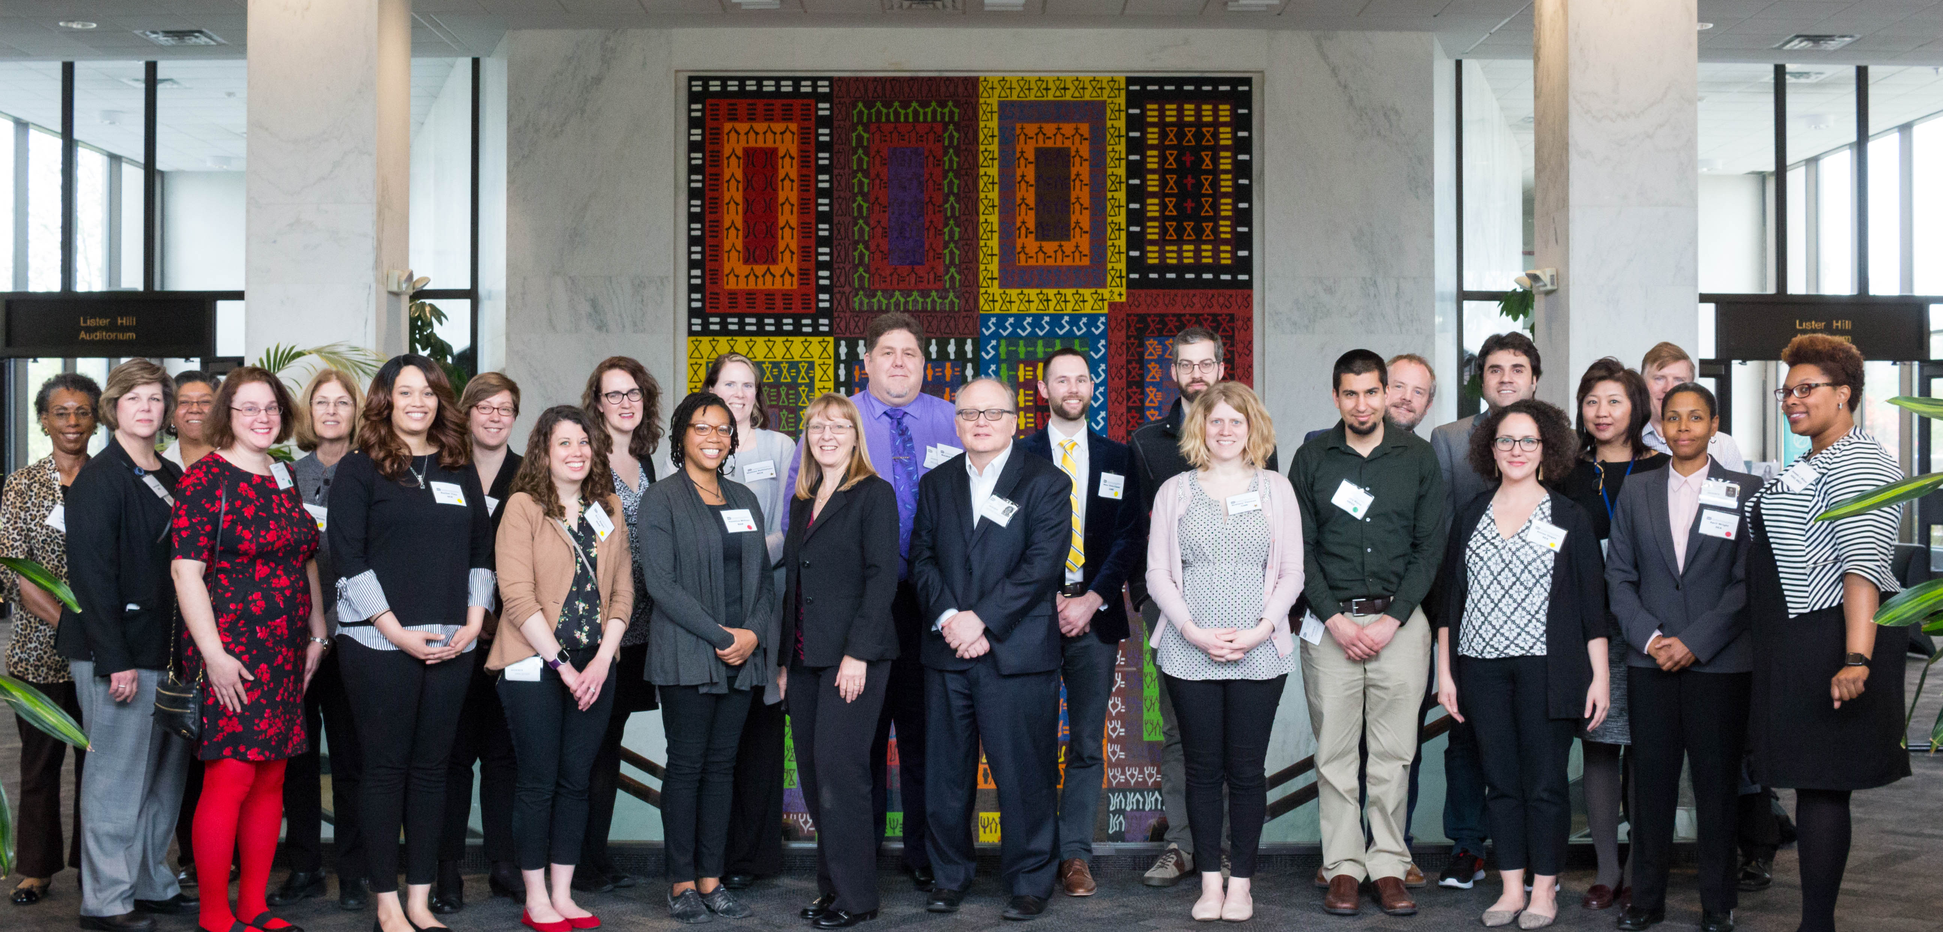
Group of people

Slide 49
NNLM Operating Structure: National Network Steering Committee (NNSC) May 1, 2016 – present
Regional Medical Libraries (RMLs)
NNLM Offices
National Initiatives & Committees
DOCLINE Coordination (NDCO)
Web Services (NWSO)
Evaluation (NEO)
Public Health Coordination (NPHCO)
Training (NTO)
Research Data Management WG
Collaborative Summer Library Program
NNLM All of Us Community Engagement Center (CEC)
All of Us Training and Coordinating Center (TEC)
Greater Midwest (GMR) Pacific Northwest (PNR)
MidContinental (MCR) Pacific Southwest (PSR)
Middle Atlantic (MAR) South Central (SCR)
New England (NER) Southeastern / Atlantic (SEA)
Notes:
Regional Medical Libraries (RMLs)
Greater Midwest (GMR) Pacific Northwest (PNR)
MidContinental (MCR) Pacific Southwest (PSR)
Middle Atlantic (MAR) South Central (SCR)
New England (NER) Southeastern / Atlantic (SEA)
NNLM Offices
DOCLINE Coordination (NDCO)
Evaluation (NEO)
Public Health Coordination (NPHCO)
Training (NTO)
Web Services (NWSO)
National Initiatives & Committees
Research Data Management WG
Collaborative Summer Library Program
NNLM All of Us Community Engagement Center (CEC)
All of Us Training and Coordinating Center (TEC

Slide 50
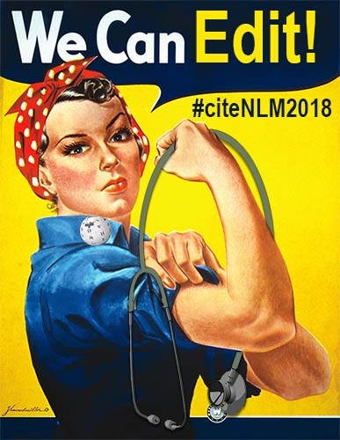
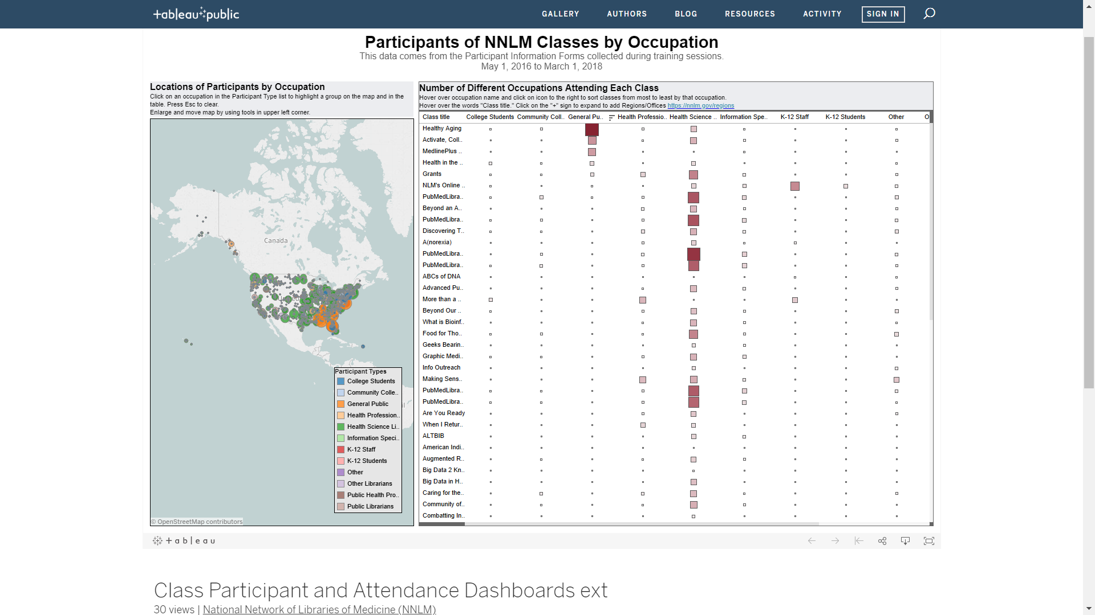
The year in 60 seconds…
Notes:
ALA NNLM Libraries Transform Health Literacy Toolkit: http://www.ilovelibraries.org/librariestransform/health-literacy-toolkit-intro
NNLM Pacific Northwest Region and New England Region co-sponsor and support the 2017 Comics and Medicine conference: https://www.graphicmedicine.org/2017-seattle-conference/
NNLM South Central Region providing Hurricane Relief Support; NNLM SEA also contributed to ALA’s Disaster Relief Fund to support Libraries in PR and USVI
More visual NNLM data: https://nnlm.gov/about and https://public.tableau.com/profile/national.network.of.libraries.of.medicine#!/
#CiteNLM2018 Wikipedia Edit-a-thon: https://nnlm.gov/wiki and https://infocus.nlm.nih.gov/2018/04/10/getting-it-right-on-rare-diseases-the-national-network-of-libraries-of-medicines-first-citenlm2018-edit-a-thon-on-april-17/

Slide 51
PSR Resource Library: The University of Arizona
Notes:
MLA members are critical in the Network’s mission to provide equal access to trusted health information and improve the public’s health… Many of you are familiar with our resource libraries – here’s one such example…
Video URL: https://www.youtube.com/watch?v=lUUDQXQa-Ns
Transcript:
[Music]
[Nat sound]
[Yamila El-Khayat]
I have a pretty unique role here at the University of Arizona. As their outreach librarian I fulfill the land-grant mission, which is our responsibility to serve all communities in the state of Arizona. My end goal is to increase health literacy in the whole state.
[Jerry Perry]
The University of Arizona Health Sciences Library is the resource library within the National Network of Libraries of Medicine for the State of Arizona. It's a role that we've had for a very long time and we're very proud of that and we work very hard on that work knowing that it has an impact on our citizens here in the state. So our areas of focus really align with what's unique and specific and special about this part of the country. We do border health work - in that capacity focusing on Spanish language instruction. We also work with indigenous peoples - the various tribal communities - we also have a focus on K-12. One of the things that really excites me about the outreach work that we do is that intersectionality when all three communities come together. That's one of the specific and unusual things about the region where we live, that we have these populations and that there is that opportunity and that engagement with all three.
[Yamila El-Khayat]
The Mexican Consulate was a very strong partner that I identified when doing work with the Spanish-speaking community. “Promotores” are lay workers that have been identified by the community as leaders that can help them navigate the health system. We have promotores that work in clinics, we've got promotores who are community promotores, and that model actually started off in Mexico so it's a very interesting concept and very kind of unique to our region. In today's particular session they were very interested in learning more about social determinants of health so we did a little bit of activity to kind of get that going and define it ourselves. I tied in a lot of the cultural aspect by bringing in music that is very popular in that particular community, and really kind of getting them to think about health topics and how our ambience really affects our health. And then went ahead and introduced them to some of the National Library of Medicine resources as a way for them to introduce those resources to the clientele that they work with but also empower them to question a lot of the things that are going on in their environment and to really be their own advocates when it comes to health.
[Jerry Perry]
Where would we be without the resources of the National Library of Medicine? It's critical for the constituencies that we serve. Many of the groups with which we work are traditionally underrepresented in the health care environment—underserved populations.
[Kay Deeney]
The Pacific Southwest region of the National Network of Libraries of Medicine covers over six time zones. We have many different populations and we make use of some of the academic medical centers as kind of leverage for our outreach program. And we can offer them some funding that helps support the work that they do in their regions.
[Yamila El-Khayat]
A lot of the communities that I've worked with are really impressed or hadn't heard of these resources before and they're very appreciative to the National Library of Medicine for putting those out there for their use.
[Music]

Slide 52
Biomedical Research Data Management for NNLM members
NNLM RD3: Resources for Data Driven Discovery (nnlm.gov/data)
Biomedical RDM Training Program
Cohort 1

Slide 53
Funding Pilot Projects: GMR’s Wash and Learn
Notes:
A second way we accomplish our mission is through funding proof of concept or pilot projects or new partnerships, both within health sciences libraries and in communities throughout our region.
This example of the GMR partnering with Libraries Without Borders – a national organization – can be replicated across the nation with partners who are willing.
Video URL: https://www.youtube.com/watch?v=IoJJmj-F5ME
Transcript:
[Music]
[Jeff Gardner]
Watch and learn is a combination of libraries and laundromats coming together with communities to promote literacy and help early childhood learning in spaces that might not normally be traditionally thought of as libraries.
[Melvin Carter]
I'm really excited to be here today this morning on a Saturday morning in a Saint Paul public library. We're partnering with Libraries Without Borders to ensure that all of our children and families in our community have access to books and literacy and that, you know, two hours spent on a Saturday morning washing are also two hours spent on a Saturday morning learning.
[Adam Echelman]
NNLM worked with us Libraries Without Borders, to pilot our first ever laundromat event in Minnesota. And with some of the learnings from that program we said why can't we do this across the state and now we're working in five different counties, seven different laundromats, to really think about how do we get information to people where they are. How do we ensure that NNLM resources reach the families that they're intended to serve.
[Pang Yang]
This is a very natural space for families to already be and to go to weekly and so we figured let's destroy the transportation barrier, or the time barrier, or whatever the obstacle is and then come to where they are so that we can provide them the resources that we have.
[Adam Echelman]
When people come into the laundromat they're not thinking about learning. They're not thinking about addressing their concerns about diabetes or hypertension or cancer. They're washing their clothes. And so what we're trying to do is to transform the 90 minutes—the wash and dry cycle that you're doing every week—into a different kind of experience, into one that's actually enriching.
[Jennifer Nelson]
Digital literacy is fundamental to being successful in the world today and I think many of us take for granted the fact that we have computers at home, that we have access to Wi-Fi. The National Library of Medicine—a lot of people aren't aware of the degree and nature of the resources that they put out to make learning about topics related to medicine really accessible to people, so we've got some websites that are set up to the NLM site, I should say, where people can look for information about nutrition. Some of the resources are directed toward kids so they're really friendly, more of a game-like environment.
[Jose Gonzales]
It was really fun because I got to play on the computer. It was nice of them for putting all the stuff up.
[Daryl Johnson]
It's a way to give back. Simply put, if I can serve my community, in the end that's gonna be good for me, but the reality of it is, it's just good for the community.
[Music]

Slide 54
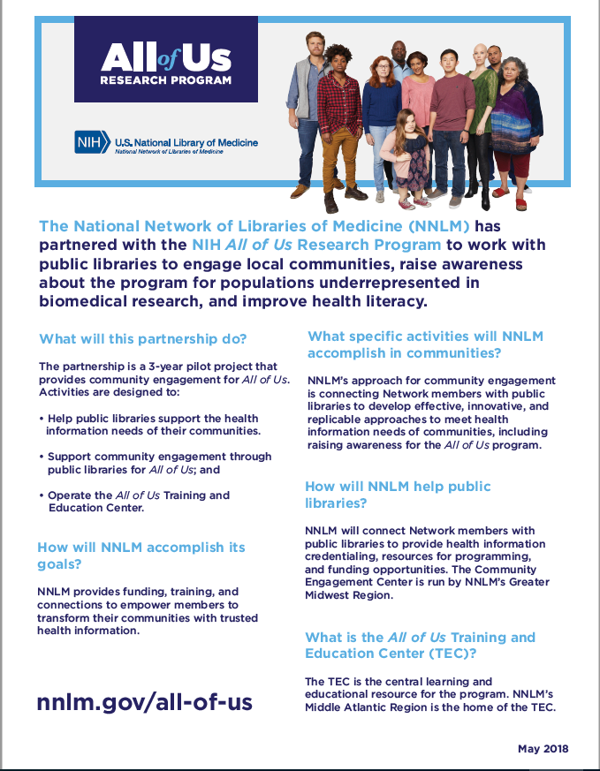
NNLM All of Us National Program
Notes:
NIH All of Us Research Program:
joinallofus.org
May 6, 2018 – Program Launch https://launch.joinallofus.org/
NNLM All of Us Community Engagement Center: https://nnlm.gov/all-of-us
Component of NNLM’s ongoing partnership with Public Library Association
All of Us Training and Education Center: https://allofustec.nnlm.gov/
Text of Fact Sheet pictured:
The National Network of Libraries of Medicine (NNLM) has partnered with the NIH All of Us Research Program to work with public libraries to engage local communities, raise awareness about the program for populations underrepresented in biomedical research, and improve health literacy.
What will this partnership do?
The partnership is a 3-year pilot program to support All of Us. Activities in the pilot are designed to:
• Help public libraries in supporting the health information needs of their users.
• Support community engagement through public libraries for All of Us; and
• Operate the All of Us Training and Education Center.
How will NNLM accomplish its goals?
NNLM provides funding, training, and connections to empower members to transform their communities with trusted health information.
What specific activities will NNLM accomplish in communities?
NNLM’s approach for community engagement is connecting Network members with public libraries to develop effective, innovative, replicable approaches to meet health information needs of communities, including raising awareness of the All of Us program.
How will NNLM help public libraries?
NNLM will connect Network members with public libraries to provide health information credentialing, resources for programming, and funding opportunities. The NNLM Community Engagement Center is housed in the NNLM’s Greater Midwest Region.
What is the All of Us Training and Education Center (TEC)?
It is the home for training and resources about and related to the Program. NNLM’s Middle Atlantic Region is the home of the TEC.
Who is the All of Us Training and Education Center intended for?
The All of Us Training and Education Center will have resources for consumers, researchers, health professionals, and Participants.
What is the All of Us Research Program?
The All of Us Research Program is a large research program. Its goal is to help researchers understand more about why people get sick or stay healthy. By looking for patterns, researchers may learn more about what affects people’s health.
How do people join All of Us?
The All of Us Research Program is now in beta testing. Once the program is fully launched in Spring 2018, there will be three ways to join:
• Visit the All of Us website joinallofus.org;
• Download the All of Us app; or
• Through an affiliated health care provider organization.
Because All of Us is research, people will be asked to complete an informed consent process. This process tells more about what is involved, and the risks and benefits of joining.
What will people have to do?
If someone decides to join All of Us, they will be asked to share different kinds of information. The program will ask for basic information such as name and address and questions about the person’s health, family, home, and work. It will also ask for access to electronic health records. It might ask for blood or urine samples.
How long will All of Us last?
All of Us may last for at least 10 years. Participants can withdraw (“quit”) at any time without penalty.
What will All of Us accomplish?
Through a greater understanding of why people get sick or stay healthy, researchers hope to discover:
• Better tests to see if people are sick or are at risk of getting sick;
• Better mobile apps to encourage healthy habits; and
• Better medicine or information about how much of a medicine is right for each person.
How will All of Us protect people’s privacy?
The following are a few steps the program will take:
• Information will be stored on protected computers with tracked and limited access.
• All direct identifiers (like date of birth and name) will be removed from the information and replaced with a code.
• Researchers must promise not to try to find out who you are.
• The program will inform participants of a data breach.
• The All of Us Research Program has Certificates of Confidentiality from the U.S. government. This will help them fight legal demands (such as a court order) to give out information that could identify someone.
Learn more about the NNLM All of Us National Program at nnlm.gov/all-of-us
All of Us, NNLM, and National Network of Libraries of Medicine are service marks of the US Department of Health and Human Services

Slide 55
Building on Our Past as We Look Toward the Future
Data Management / Data Science for NNLM members
Existing Members + New Partners/Activities/Ideas = Exciting Future
Equipping you and your communities with NLM resources
Notes:
Citation for article pictured:
Speaker, S.L. (2018). An Historical Overview of the National Network of Libraries of Medicine, 1985-2015. Journal of the Medical Library Association (JMLA), Apr; 106(2), 162-174 2018
[full text via JMLA | PubMed]
On the horizon for 2018-19: citizen science & the NIH HEAL initiative (https://www.nih.gov/news-events/news-releases/nih-launches-heal-initiative-doubles-funding-accelerate-scientific-solutions-stem-national-opioid-epidemic and https://www.nih.gov/heal-initiative)

Slide 56
NNLM Partnering for Success: MAR’s Escape the Unit with UPMC Hospital
Notes:
Video: https://www.youtube.com/watch?v=9iV0bx-_Ug4
Transcript:
[Music]
[Olivia Glotfelty]
Our nurse residency program is what this grant project was about and halfway through our first cohort we started to notice that they needed some more hands-on out of the classroom learning and that really led us to think of this really cool escape room idea.
[Stephanie Chlosta]
The groups meet once a month for four hours and I try to cover topics that they may not have covered in school or nursing orientation there were skills that we noticed they were lacking out on the floor that were related to patient safety and their own safety.
[Nurse]
What is that you have?
[Patient]
You are not taking these.
[Ian Cummins]
There's a kind of a fun part to it where it's you know I'm playing a patient in that specific room but you're also learning as well and I think I think you it really does hit home a lot more than sitting in a lecture.
[Nicole Gravante]
This is actually one of the more creative learning tools that we've done and also it's learning but it's also been nice to get you in a like cooperative fun environment with your coworkers it goes beyond sitting in a classroom with people and discussing getting to know them into it like we're actually interacting together and working as a team.
[Olivia Glotfelty]
We’re fortunate to have our mid-atlantic region office in Pittsburgh. The staff there are just absolutely incredible. They’re such wonderful resources.
[Kate Flewelling]
We are essentially the major outreach arm of the National Library of Medicine and we are the boots on the ground going into libraries of all kinds including Health Sciences libraries but also public libraries, school libraries, community-based organizations. We do a lot of promotion of our available funding we encourage potential applicants to talk to us about projects that they're thinking about before they apply we do grants and proposal writing training to really teach to the application. We really want to make sure that we're funding successful applications that are going to advance the goals of NLM.
[Olivia Glotfelty]
Originally in my funding application I hadn't applied for funding for any escape room materials or anything like that so we were able to revise our grant part of the way through and get funding for our escape room which has been one of the biggest parts of this project.
[Kate Flewelling]
This is a great example of a project where Olivia had a fantastic idea to begin with and then she heard more from her target population and the people here and so she was super flexible about then thinking about more creative ways to meet their needs. And we were part of that discussion because it's not like we just say here here's your money and let us know in a year how you've done.
[Olivia Glotfelty]
It's been really really successful, honestly more than I ever could have anticipated. The grant that I received was for a year-long project and the year is out so this really was seed money for building up our nurse residency program and it's opened so many doors for me here and within the UPMC system.
[Nurses]
It worked! Perfect! Right here. We’re free! We escaped the unit!
[Music]

Slide 57
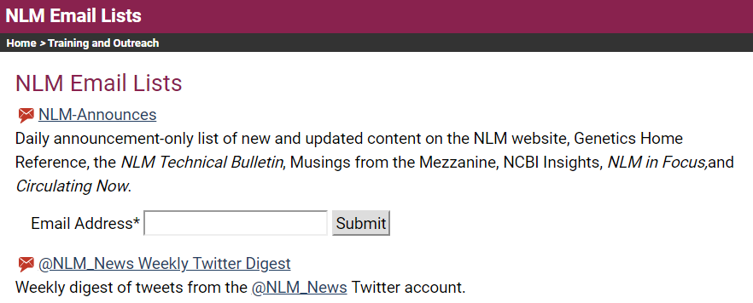
Connect with us

Slide 58
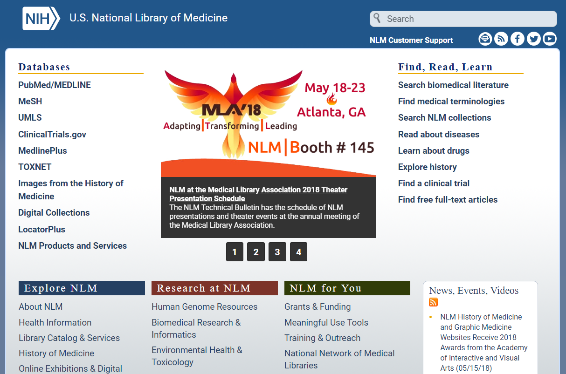
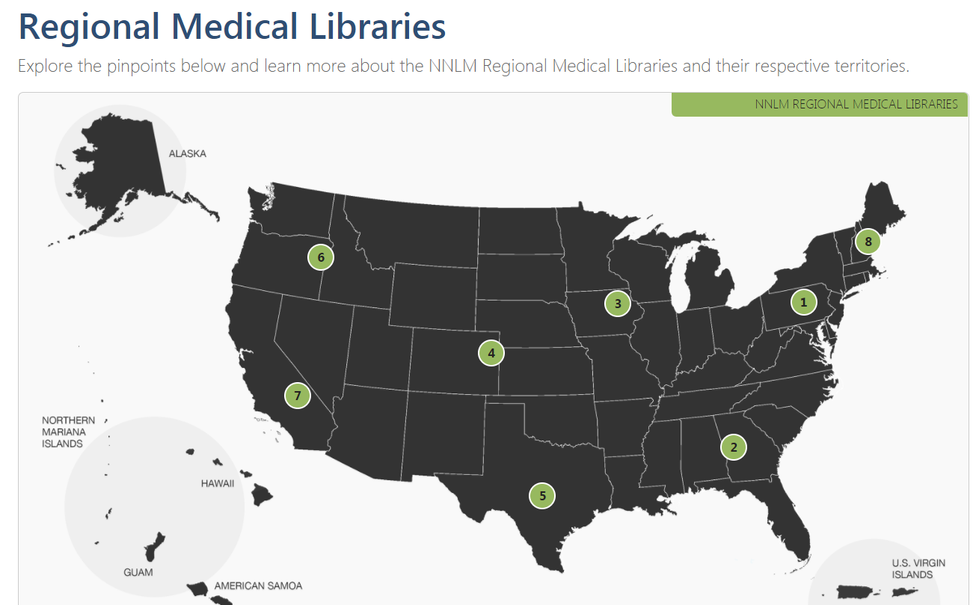
NLM and RML Staff

