Slide 1
National Library of Medicine Update
  Jerry Sheehan
  Deputy Director
  Janice Kelly
  Acting Deputy Director, Specialized Information Services
  Joyce Backus
  Associate Director, Library Operations
  Amanda J. Wilson
  Head, National Network Coordinating Office of the National Network of Libraries of Medicine
  MLA 2019, Chicago

Slide 2
Title card for first speaker
Jerry Sheehan
Deputy Director

Slide 3


NLM Strategic Plan

Slide 4



Accelerating Discovery & Data-Powered Health
Accelerate discovery & advance health through data-driven research
Reach more people in more ways through enhanced dissemination
& engagement
Build a workforce
for data-driven
research & health

Slide 5


Accelerate discovery & advance health through data-
driven research

Slide 6
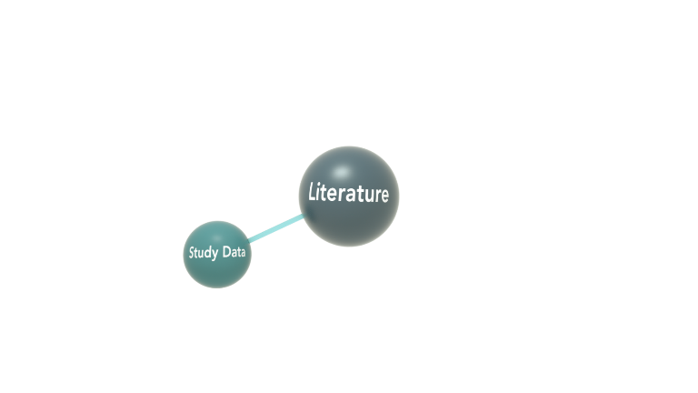
Accelerate discovery & advance health through data-
driven research

Slide 7
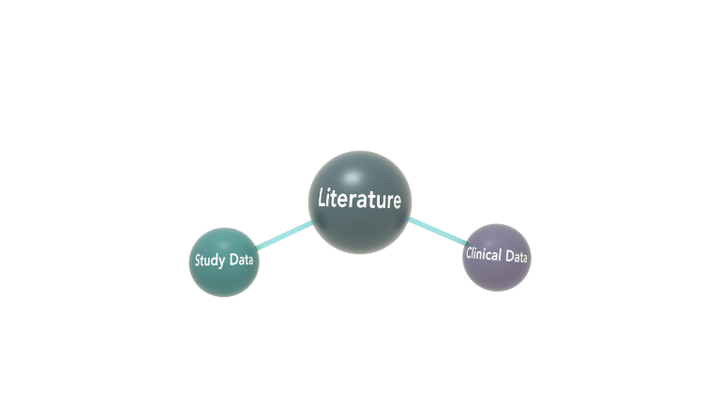
Accelerate discovery & advance health through data-
driven research

Slide 8
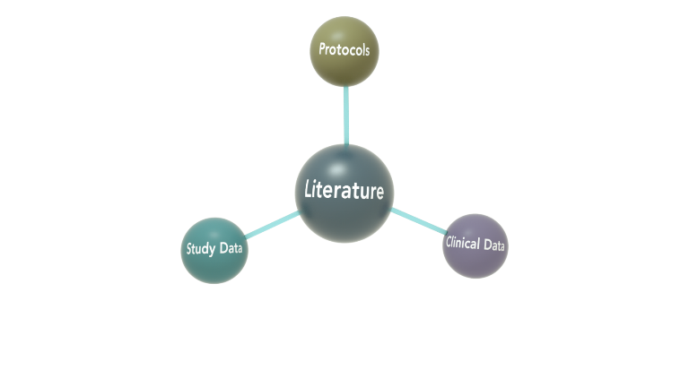
Accelerate discovery & advance health through data-
driven research

Slide 9
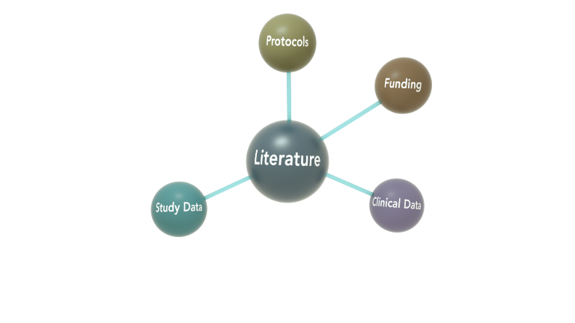
Accelerate discovery & advance health through data-
driven research

Slide 10
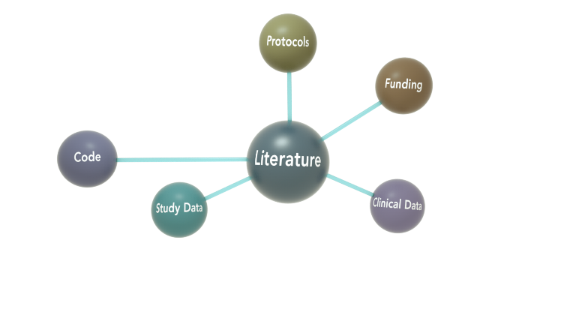
Accelerate discovery & advance health through data-
driven research

Slide 11
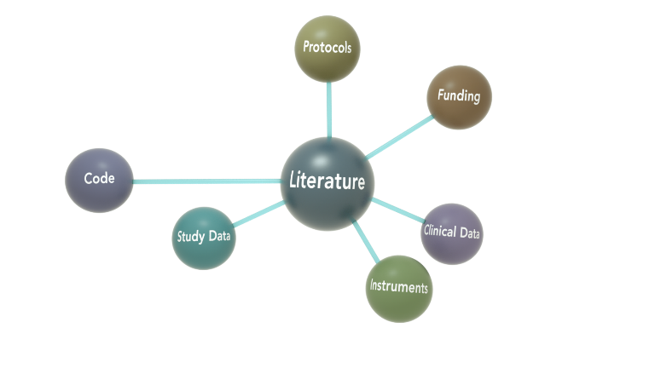
Accelerate discovery & advance health through data-
driven research

Slide 12
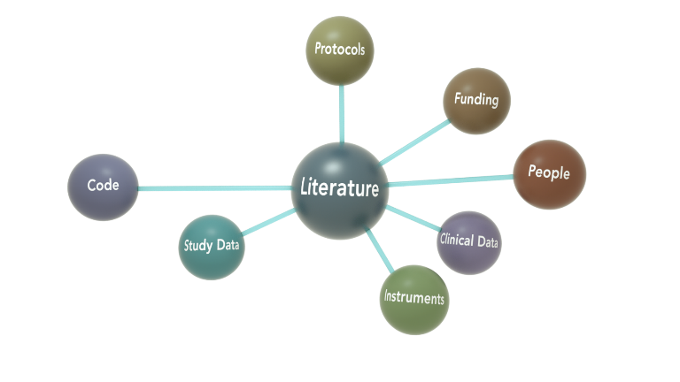
Accelerate discovery & advance health through data-
driven research

Slide 13
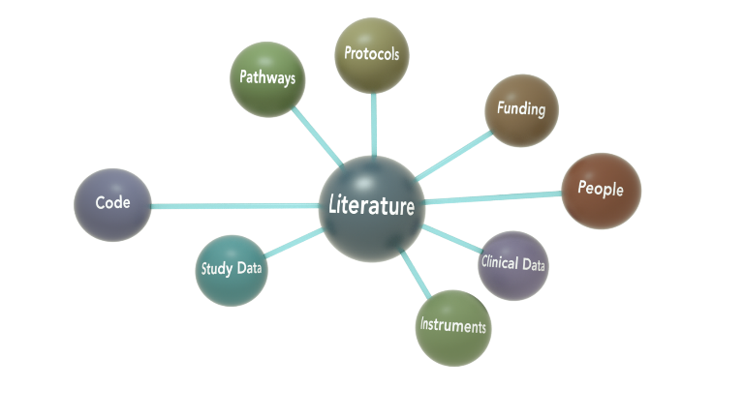
Accelerate discovery & advance health through data-
driven research

Slide 14
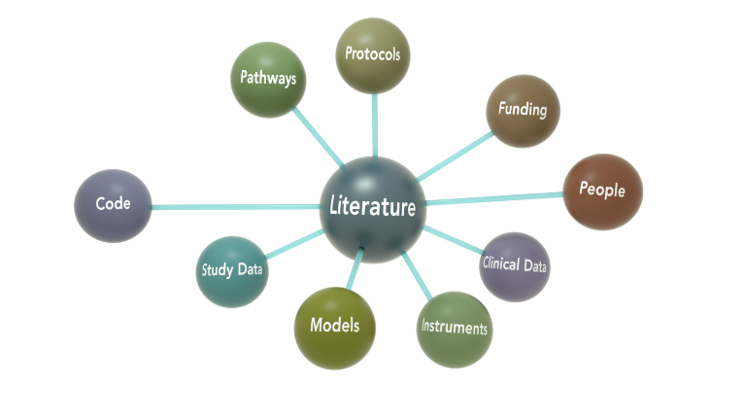
Accelerate discovery & advance health through data-
driven research

Slide 15
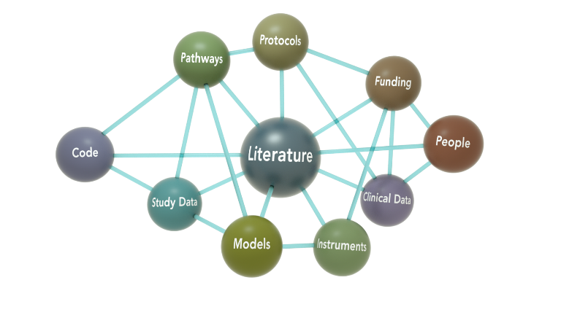
Accelerate discovery & advance health through data-
driven research

Slide 16
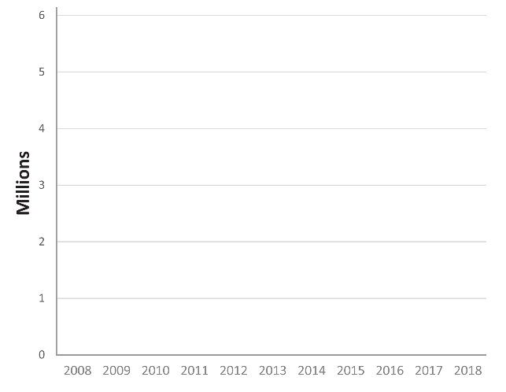
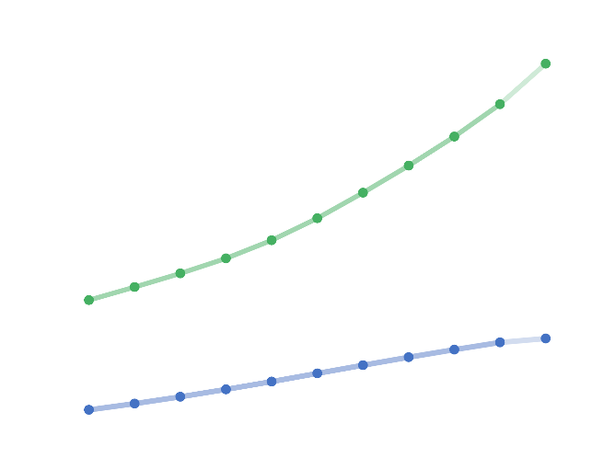
Open Science Policy and Practice
Open Science Policy and Practice
Public Access Articles
> 5.4 Million total articles
Accelerate discovery & advance health through data-
driven research
2.5 Million daily users
~ 3 Million daily searches
9 Million daily page views
> 1 Million NIH-funded articles

Slide 17
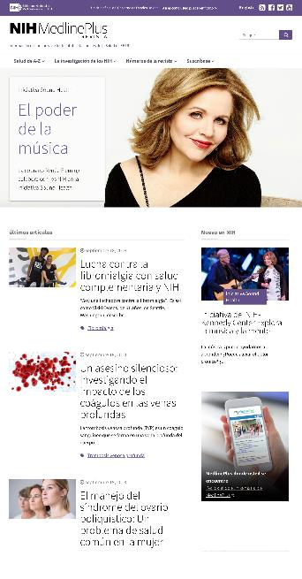
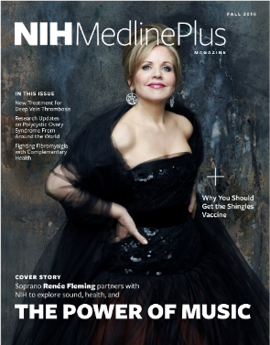

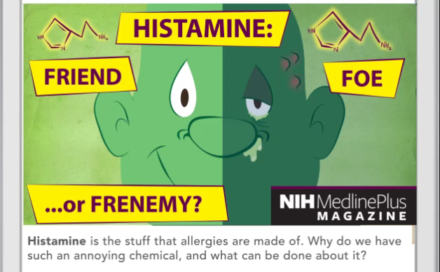
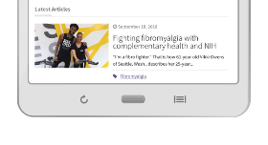
Enhanced Engagement
Reach more
people in more ways through enhanced dissemination
& engagement
Enhanced Engagement
  MedlinePlus Magazine launches an online Spanish website

Slide 18
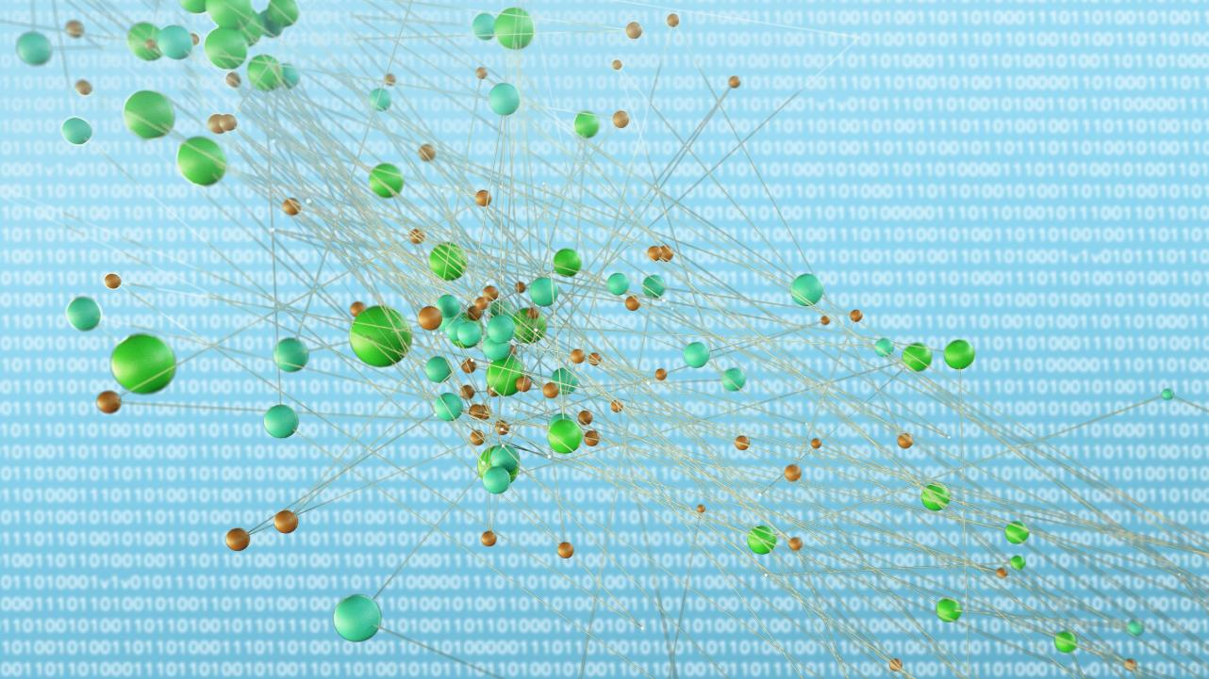
Workforce & Training
Build a workforce
for data-driven
research & health
Workforce & Training
Data management
Data science
PhD-level training
Librarians as informationists

Slide 19

Positioning NLM for data-driven discovery
Comprehensive Review of Products, Services, Organization
Create Common Technical Platforms
Maintain Quality & Integrity
Eliminate Unnecessary Organizational Boundaries
Align Functions and Staff Expertise

Slide 20
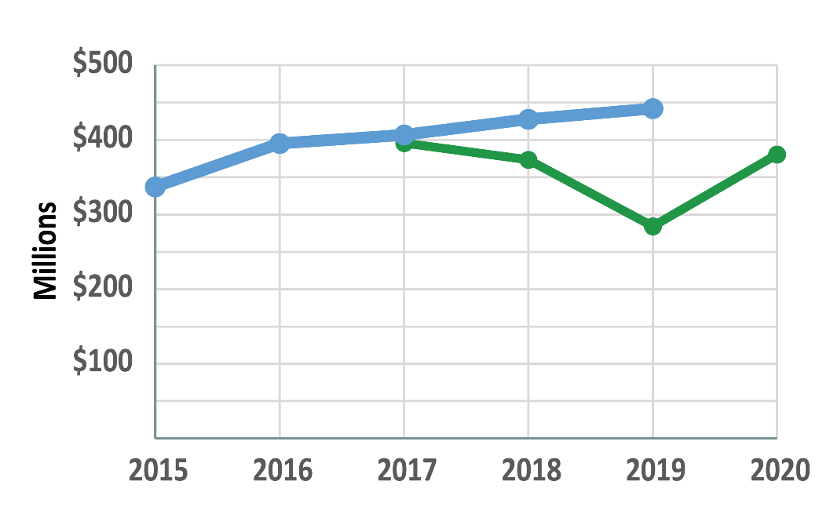
NLM Budget
NLM Budget
$442M
Appropriations
President’s Budget
Request

Slide 21

NLM organization chart 1
Board of
Regents
Office of the
Director
Director
Deputy Director
Deputy Director for Research & Education
Chief Health Data Standards Officer
Scientific Director
Office of
Administration
Office of
Computer & Communications Systems
Office of
Strategic Initiatives
Office of
Communications & Public Liaison
Office of
Health Information Programs Development
Division of
Library Operations
Division of
Extramural Programs
Lister Hill National Center for
Biomedical Communications
National Center for
Biotechnology Information
Division of
Specialized Information Services

Slide 22
NLM organization chart 2
Board of
Regents
Office of the
Director
Director
Deputy Director
Deputy Director for Research & Education
Chief Health Data Standards Officer
Scientific Director
Office of
Administration
Office of
Computer & Communications Systems
Office of
Strategic Initiatives
Office of
Communications & Public Liaison
Division of
Library Operations
Division of
Extramural Programs
Lister Hill National Center for
Biomedical Communications
National Center for
Biotechnology Information
Division of
Specialized Information Services
Audiovisual Program Development Branch
APDB

Slide 23
NLM organization chart 3
Board of
Regents
Office of the
Director
Director
Deputy Director
Deputy Director for Research & Education
Chief Health Data Standards Officer
Scientific Director
Office of
Administration
Office of
Computer & Communications Systems
Office of
Strategic Initiatives
Office of
Communications & Public Liaison
+ APDB Staff
+ APDB Staff
Division of
Library Operations
Division of
Extramural Programs
Lister Hill National Center for
Biomedical Communications
National Center for
Biotechnology Information
Division of
Specialized Information Services
Audiovisual Program Development Branch
APDB

Slide 24
NLM organization chart 4
Board of
Regents
Office of the
Director
Director
Deputy Director
Deputy Director for Research & Education
Chief Health Data Standards Officer
Scientific Director
Office of
Administration
Office of
Computer & Communications Systems
Office of
Strategic Initiatives
Office of
Communications & Public Liaison
+ APDB Staff
+ APDB Staff
+ SIS Staff
+ SIS Staff
Division of
Library Operations
Division of
Extramural Programs
Lister Hill National Center for
Biomedical Communications
National Center for
Biotechnology Information
Division of
Specialized Information Services
+ SIS Staff
+ SIS Staff

Slide 25
NLM organization chart 5
Board of
Regents
Office of the
Director
Director
Deputy Director
Deputy Director for Research & Education
Chief Health Data Standards Officer
Scientific Director
Office of
Administration
Office of
Computer & Communications Systems
Office of
Strategic Initiatives
Office of
Communications & Public Liaison
+ APDB Staff
+ APDB Staff
+ SIS Staff
+ SIS Staff
Division of
Extramural Programs
National Center for
Biotechnology Information
Division of
Library Operations
Lister Hill National Center for
Biomedical Communications
National Center for
Biotechnology Information
+ SIS Staff
+ SIS Staff

Slide 26
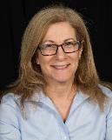





New Appointments
New Appointments
Jody Nurik
Director, Office of Communications and Public Liaison
Dr. Michael Huerta
Director, Office of Strategic Initiatives
Dr. Dina Paltoo
Assistant Director, Policy Development
Dr. Clem McDonald
Chief Health Data Standards Officer
Dr. Olivier Bodenreider
Acting Director, Lister Hill National Center for Biomedical Communications
Amanda J Wilson
Head, Office of Engagement and Training

Slide 27
Janice Kelly
Acting Deputy Director
Specialized Information Services

Slide 28
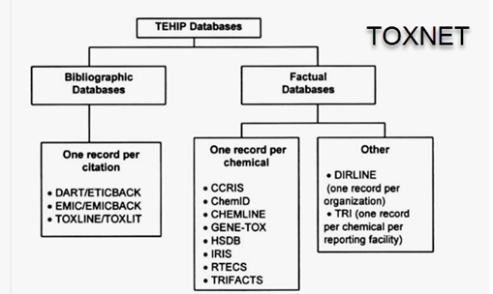

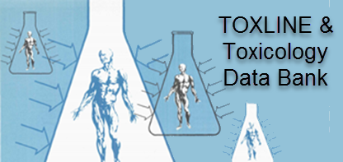
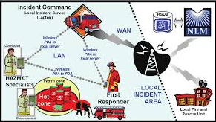









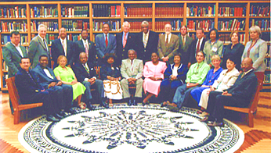
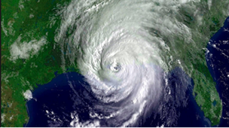


















Specialized Information Services, 1967-2019
1960
1970
1980
1990
2000
2010
2020
1967
1972 -1978
1985
1998
2005
2011 - 2018
Toxicology Information Program established at NLM in SIS
Toxicology databases, e.g. TOXLINE and TDB started
TOXNET: an online toxicology information resources
TOXNET: free Web resource
WISER: First NLM mobile app for first responders
Consumer health and K-12 information
1989
2000
2008
AIDS Clinical Trials Information Services
Office of Outreach & Special Populations
Disaster Information Management Research Center

Slide 29
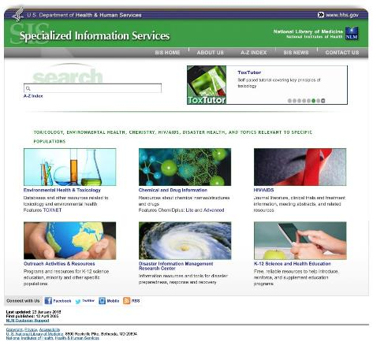

SIS Websites

Slide 30
Changes are coming
Resource evaluation
  Sunset
  Integration into other resources
Some content will be available through FTP and other distributions
Watch for news:
  Messages on product homepages
  Notices on NLM social media, NLM publications
  Notices in Technical Bulletin

Slide 31
Joyce Backus
Associate Director, Library Operations

Slide 32

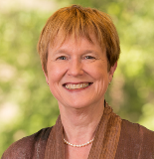

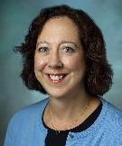

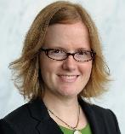
Advice and Guidance from the Library Community
Jane Blumenthal
Taubman Health Sciences Library (Retired) University of Michigan
Neil Rambo
Health Sciences Library (Retired)
New York University
Marisa Conte
Taubman Health Sciences Library
University of Michigan
Anne Seymour
Welch Medical Library
Johns Hopkins University
Jean Shipman
Elsevier and Center for Medical Innovation University of Utah
Kristen Greenland
Keefe Science Library
Amherst College

Slide 33
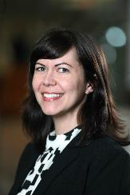
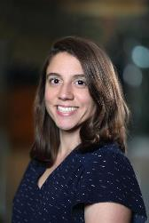
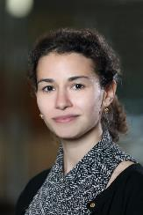
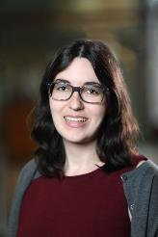
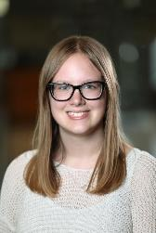
NLM Associate Fellows 2018 – 2019
Stacy Brody
Sarah Clarke
Amelia Llorens
Cecelia Vetter
Paije Wilson

Slide 34
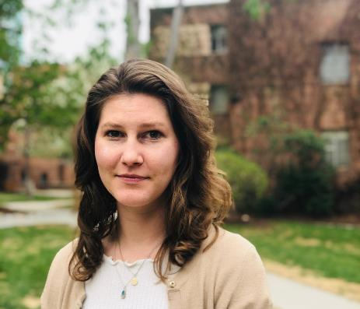
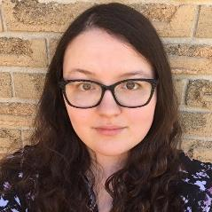
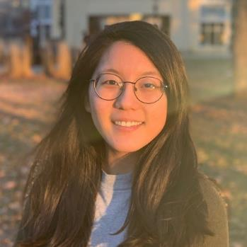
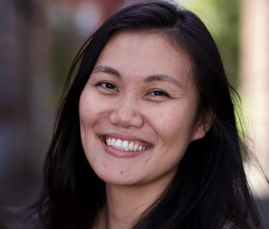
NLM Associate Fellows 2019 – 2020
Brenna Cox
University of Denver
Sharon Han
University of Illinois–
Urbana-Champaign
Eden Kinzel
Western University
Louise To
University of Hawai’i at Manoa

Slide 35
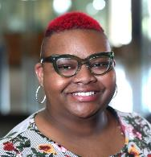

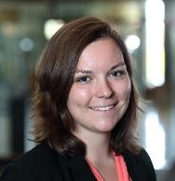

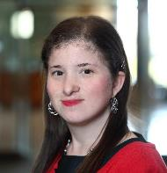

NLM Associate Fellows – Second Year
Nicole Strayhorn
American Dental Association
Shannon Sheridan
Drexel University Libraries
Gabrielle Barr
Galter Health Sciences Library, Northwestern University

Slide 36
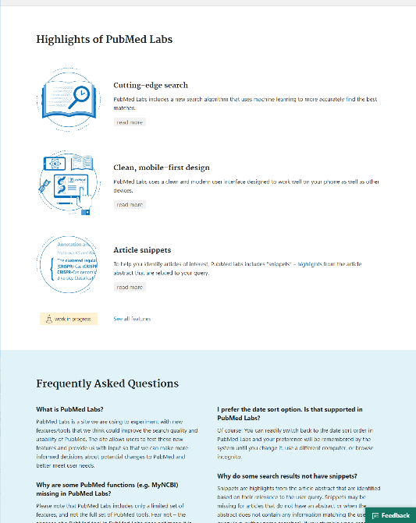
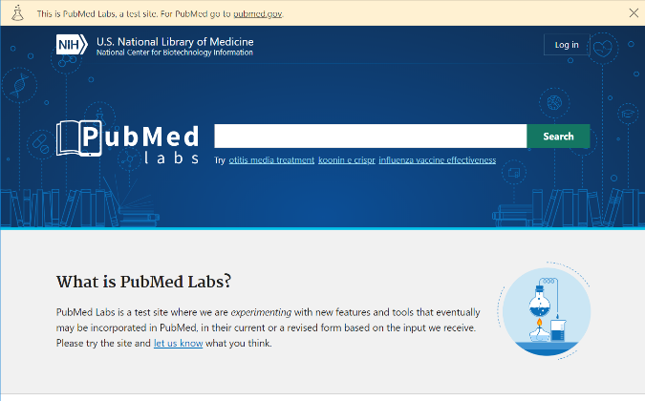
PubMed Labs

Slide 37
PubMed Accomplishments
PubOne data model: simplified and cloud-ready
Validated new and existing PubMed features with users, prioritized and aligned features for new PubMed development with user needs
Researched use of advanced search, developed alternative prototypes, and tested prototypes with librarians
Improved browser performance
Promoted PubMed Labs responsive design as an alternative to current, separate PubMed mobile site
25% of mobile users voluntarily opt-in to PubMed before redirect (and don't opt back out)

Slide 38
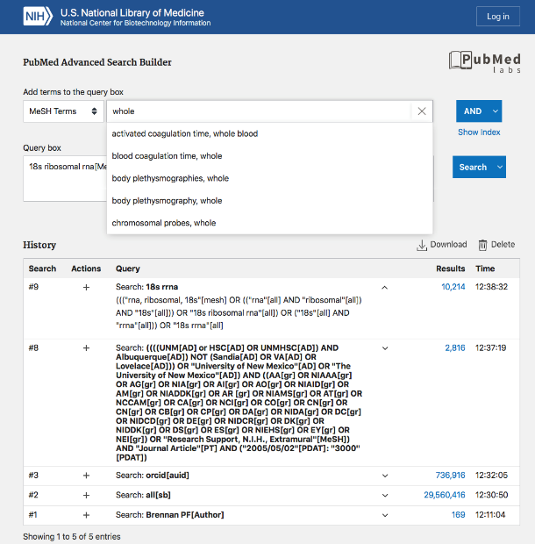
Redesigned Advanced Search
Query builder
Find the right syntax
Build query via Boolean operators
See indexed item counts
Query box
Editable at any time
Send queries directly to History table (quickly craft systematic search strategies)
Query history
See results for multiple queries, simultaneously
Delete, save, or run individual searches
Download entire table as csv file for reports, etc.

Slide 39
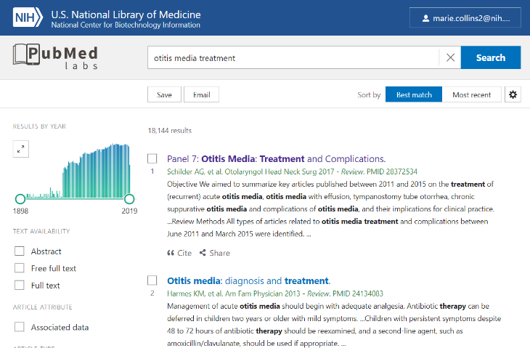
New Look
Results by Year
Snippets with Highlights
Cite & Share
Best Match – Default
Filters

Slide 40
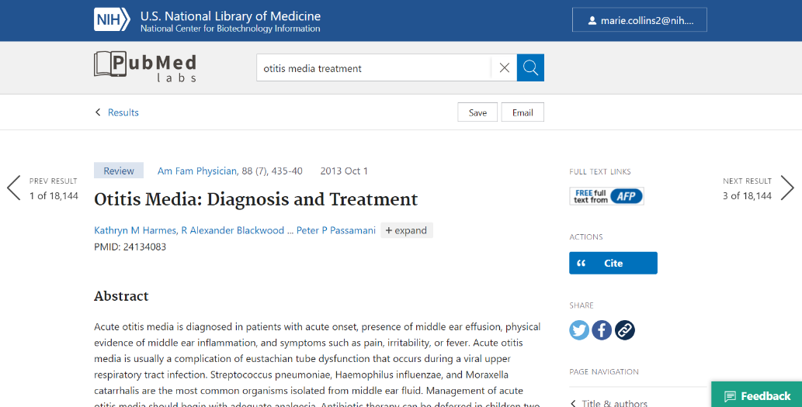
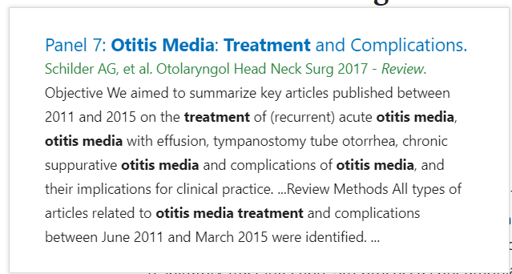
Navigation

Slide 41
PubMed Succession Roadmap
PubMed Succession Roadmap
we
are
here
Sept 2019
Jan 2020
PubMed Labs
New Production PubMed
Current Production PubMed
Archived, available
=default
8

Slide 42
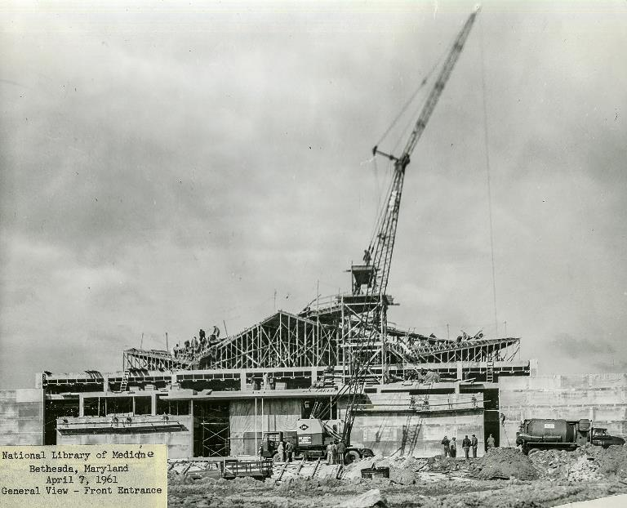
In the beginning or 1961

Slide 43
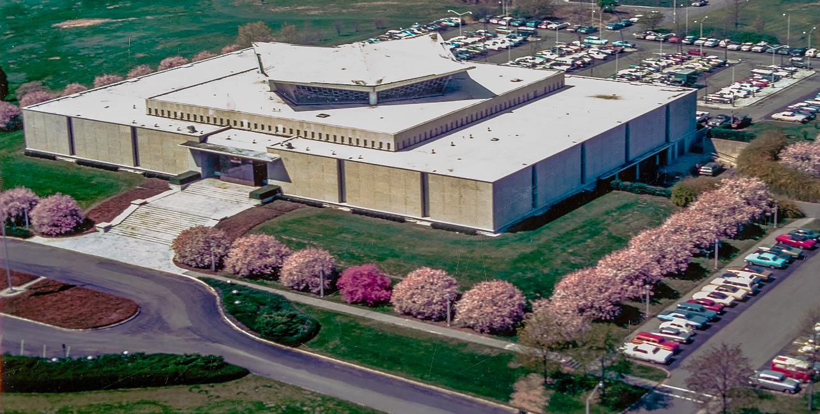
Aerial view of NLM

Slide 44
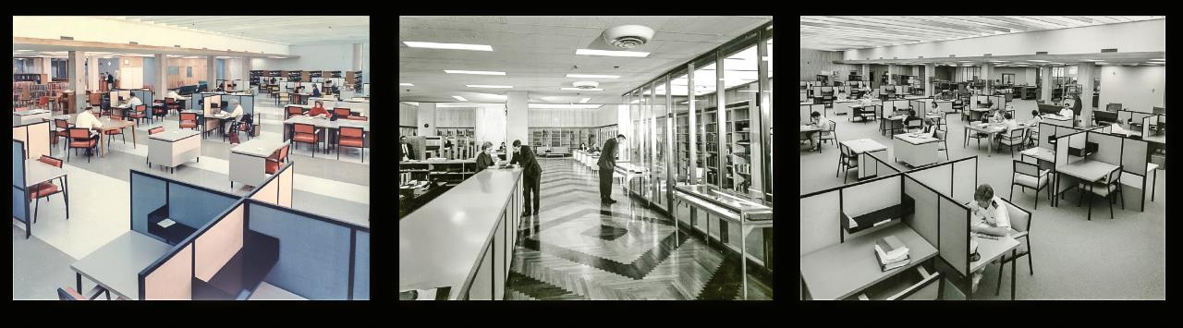
Yesterday

Slide 45
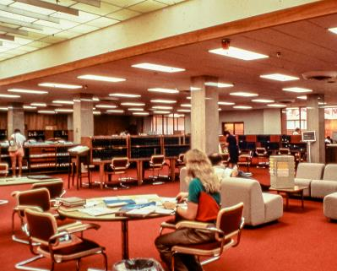




In the following decades…
In the following decades…

Slide 46



Transformed our physical collection space
Binding program
Environmental monitoring and controls
Floor strengthening
Compact shelving

Slide 47

Public spaces
Public spaces

Slide 48

New public spaces
Public spaces

Slide 49

Concept Plan for First Floor
2020-2022
3 year, 3 phase project
Planning for temporary public service space
Planning for staff moves
All services continue
Building 38 – Level 1 Concept Plan

Slide 50



Tomorrow
Retain key historic features
Better service for on-site patrons
Improve meeting and collaboration space
Inspiring design for NLM’s 3rd century

Slide 51

The Working Group to the NIH Director recommended that a ‘functional audit’ of all NLM programs and subcomponents is needed

Slide 52


Outreach Audit Findings
Activities matched well to the old strategic plan’s outreach plan
Major activities involved
  Communications
  Training
  Exhibits
By the numbers (FY16-FY17)
  317 projects
  14,817,796 users reached
  $21.7M spent (program, staffing, organizational funding)
    $12.1M spent (program costs)
  267,316 staff hours spent

Slide 53

Recommendation 1
Align activities with
new NLM strategic plan

Slide 54

Recommendation 2
Create an organizational home
Assigned leader
Authority
NIH/HHS Liaison
Marketing
Branding
Acquisitions

Slide 55

Recommendation 3
Improve outreach activity data capture,
metrics & evaluation
Web based
Common vocabulary
Normalized fields
Defined roles
Customized reporting
Data visualization
Meets security specs

Slide 56

Recommendation 4
Implement Communities of Practice
[It is the] “passion of our staff to see how people use our resources and to teach the resources to others.”

Slide 57

Office of Engagement and Training

Slide 58
Amanda J. Wilson
Head, National Network Coordinating Office of the National Network of Libraries of Medicine (NNLM)

Slide 59

Train
Fund
Connect
Train
Fund
Connect
National Network of Libraries of Medicine
National Network of Libraries of Medicine

Slide 60

NNLM: Where Are We Now?
Membership
# Members: 7,690
(increase of 546 over 2018)
Top Member Org Types:
Hospital Libraries
Health Sciences Libraries
Public Libraries
Academic Libraries

Slide 61





NNLM: Where Are We Now?
New NNLM Staff

Slide 62

NLM Funding for Outreach Projects

Slide 63

NNLM Training and Professional Development
“The presenter is one of the best instructors who values the facilitation process and sharing! In particular, she offered exercises or tools to support proper understanding of current and future perspectives about the significance of health literacy and compared the variations of literacy.”
—Attendee feedback, April 2019

Slide 64



#CiteNLM

Slide 65



NNLM Summer Reading Program Activities go live for 2019!
NNLM Exploring Genetics with Kids and Teens Kit

Slide 66


NNLM Public Health Coordination Office (NPHCO)

Slide 67



DOCLINE

Slide 68


All of Us Research Program

Slide 69


NNLM All of Us Training and Education Center
https://joinallofus.org/conversations

Slide 70


NNLM All of Us Community Engagement Network
Brittney Thomas,
Coordinating Center Manager

Slide 71



National Health Observances Content
National Health Observances Content

Slide 72




#NEGraphicMedCon

Slide 73

nnlm.gov/data

Slide 74
NNLM Anticipating the 3rd Century of NLM
May 2019
Your feedback informed changes made for the 2016-2021 grant cycle, including:
Transition to cooperative agreement grant mechanism (was contracts from 1970-2016)
Refocus of existing and establishment of 2 new national offices
Implementation of a national steering committee
No membership levels

Slide 75
NNLM Anticipating the 3rd Century of NLM
May 2019
June/July 2019
Request for Information (RFI): https://grants.nih.gov/funding/

Slide 76
NNLM Anticipating the 3rd Century of NLM
May 2019
June/July 2019
Request for Information (RFI): https://grants.nih.gov/funding/
Analysis of RFI responses begins
Aug/Sept 2019

Slide 77
NNLM Anticipating the 3rd Century of NLM
May 2019
June/July2019
Request for Information (RFI): https://grants.nih.gov/funding/
Analysis of RFI responses begins
Planning for the next iteration of NNLM
Aug/Sept 2019
Winter/Spring 2020

Slide 78
NNLM Anticipating the 3rd Century of NLM
May 2019
June/July 2019
Request for Information (RFI): https://grants.nih.gov/funding/
Analysis of RFI responses begins
Planning for the next iteration of NNLM
Funding Opportunity Announcement (FOA) for 2021-2026 cycle
Aug/Sept 2019
Winter/Spring 2020
Fall 2020

Slide 79
NNLM Anticipating the 3rd Century of NLM
May 2019
June/July 2019
Request for Information (RFI): https://grants.nih.gov/funding/
Analysis of RFI responses begins
Planning for the next iteration of NNLM
Funding Opportunity Announcement (FOA) for 2021-2026 cycle
Applications responding to FOA due to NLM
Aug/Sept 2019
Winter/Spring 2020
Fall 2020
Late Fall 2020/Early 2021

Slide 80


NLM and RML Staff

Slide 81



Connect with us

Slide 82

Thank you!

