Slide 1
VSAC Users’ Forum
Thursday, August 28 2:00 – 3:00 EDT

Slide 2
Today’s Agenda
Review of July forum topics
HL7 code sets; UMLS CUIs; Text format downloads
Introduction to upcoming VSAC Collaboration site
Intensional Value Set Development
Send your example statements for queries into SNOMED CT, RxNorm and LOINC
Notes:
Coming end of September: User-requested HL7 code systems
HL7 v3 code systems,
ActStatus 2.16.840.1.113883.5.14 LanguageAbilityProficiency 2.16.840.1.113883.5.61 LivingArrangement 2.16.840.1.113883.5.63 RoleStatus 2.16.840.1.113883.5.1068 Observation Interpretation 2.16.840.1.113883.5.83 RoleCode 1.14.4.1.111
Also coming end of September:
UMLS concept unique identifiers (CUIs) in VSAC, CUIs will link out to UTS.
Text-formatted value set downloads (in addition to the current Excel and XML we currently offer)

Slide 3
HL7 Code Systems Coming to VSAC
HL7 v3 code systems:
ActStatus 2.16.840.1.113883.5.14 LanguageAbilityProficiency 2.16.840.1.113883.5.61 LivingArrangement 2.16.840.1.113883.5.63 RoleStatus 2.16.840.1.113883.5.1068 Observation Interpretation 2.16.840.1.113883.5.83 RoleCode 2.16.840.1.113883.5.111
Notes:
Coming end of September: User-requested HL7 code systems
HL7 v3 code systems,
ActStatus 2.16.840.1.113883.5.14 LanguageAbilityProficiency 2.16.840.1.113883.5.61 LivingArrangement 2.16.840.1.113883.5.63 RoleStatus 2.16.840.1.113883.5.1068 Observation Interpretation 2.16.840.1.113883.5.83 RoleCode 1.14.4.1.111
Also coming end of September:
UMLS concept unique identifiers (CUIs) in VSAC, CUIs will link out to UTS.
Text-formatted value set downloads (in addition to the current Excel and XML we currently offer)

Slide 4
VSAC Collaboration
Value set discussion/collaboration repository
Soliciting discussion and user needs now.
Beta release available: end of 2014
Notes:
Every value set has its own site in VSAC Collaboration, and each value set site has its own dashboard customizable by its owner or steward.
Each VSAC Collaboration user can have their own dashboard and they can join whatever value set sites they are interested in. Those value set sites will appear in that user’s dashboard.

Slide 5
VSAC Collaboration
Value set discussion/collaboration repository
Soliciting discussion and user needs now.
Beta release available: end of 2014
Notes:
Every value set has its own site in VSAC Collaboration, and each value set site has its own dashboard customizable by its owner or steward.
Each VSAC Collaboration user can have their own dashboard and they can join whatever value set sites they are interested in. Those value set sites will appear in that user’s dashboard.

Slide 6
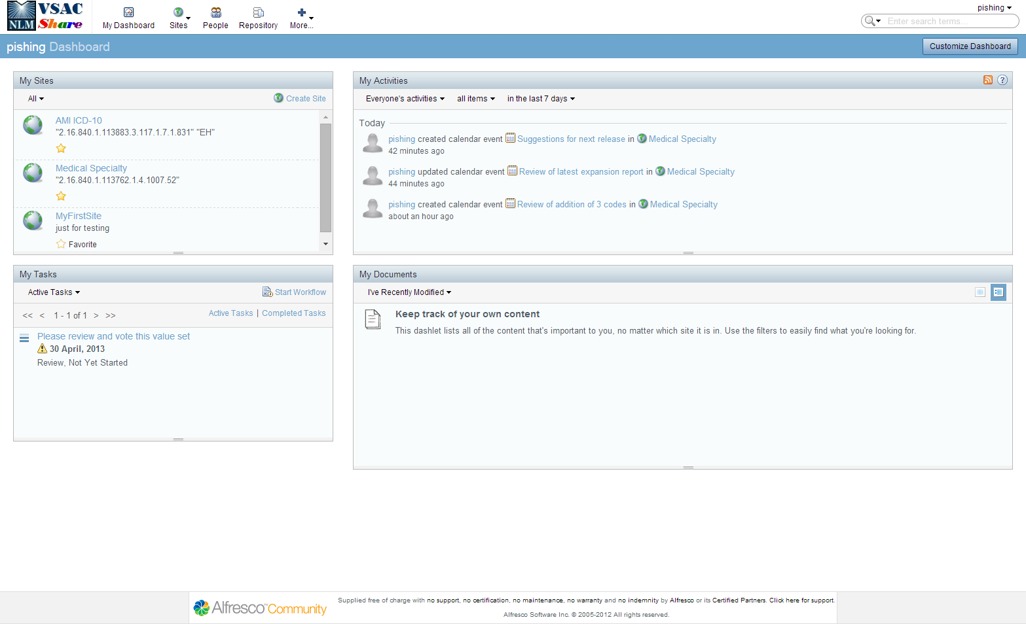
VSAC Collaboration
Notes:
This is a preliminary view of the VSAC Collaboration site. It is subject to change as we collect user feedback, use cases, and user workflows. VSAC Collaboration is a permanent repository for value set discussions and collaborations, voting, user documents, and notifications to users who belong to each value set user group.
Every value set will have a site in VSAC Collaboration. Users can join any value set group. Users can also create sites for other purposes: perhaps a site for a group of value sets, perhaps a site for discussing uses of particular codes, or even discussions about creating the best Purpose statements for value sets.
This slide displays the “Personal” Dashboard. Every user will have their own personal dashboard. Users can customize their Dashboard according to their needs. Notice the [Customize Dashboard] button in the top blue header bar. Your user name displays at the left of this blue header bar. This user’s dashboard is customized to show “My Sites,” “My Activities,” “My Tasks,” and “My Documents.”
It is possible for an external user to request membership from site owners.
Depending on user needs and feedback we receive, we can set up VSAC Collaboration for the community so that we initially prepopulate the members for each value set site with that value set’s assigned author and steward group people. However, maintenance of a VSAC Collaboration site’s members will fall upon the owner of the site there after, if the members change over time. We predict the user community would want the value set steward to be the “owner” of each value set site.
For example: If I am a member of the AMA-PCPI steward group, and one of the AMA-PCPI authors creates a new value set and clicks the [Submit] button, within the VSAC Authoring Tool, VSAC can push that value set to VSAC Collaboration along with an Alert in “My Tasks” that might say “Please review this value set.”
Next we will dive into a specific “Site” within the “My Sites” area of this Person Dashboard screen. For today’s presentation, we will click on the (fake, non-public) Medical Specialty value set within the My Sites area.

Slide 7
VSAC Collaboration
Notes:
Here you see a view of a Value Set Site. We call this the Site Dashboard. This is the Site Dashboard for the Medical Specialty value set site we clicked on in the previous screen, the Personal Dashboard. Again, like the Personal Dashboard, this is very customizable.
Notice the “Site Links” area in the bottom right of the screen. For this preview, we populated Site Links with examples of links that could be useful for you: UTS and VSAC. These are just examples. By the time we launch the public VSAC Collaboration site, we hope to have feedback from the community on the most useful URL links with which we can prepopulate this area. Otherwise, these links are completely customizable by you. You can include links here to specific ONC Jira issues that relate to a particular value set discussion contained in VSAC Collaboration. It is also possible for us to make rules such that if the value set site contains a (for example) SNOMED CT value set, we can automatically populate the “Site Links” area with a URL for the US Content Request application for SNOMED CT. This would involve more development for VSAC, and we would only implement this if there is a strong user request for this.
We caution you to be careful of having to manage conversations in two separate locations. ONC may develop some guidance on this for the use of the ONC Jira which is mainly for the purpose of Meaningful Use Measures.
Notice some links in the top blue bar. Members link– click on this link and you see all members who can view this site. The value set site owner can invite everyone if they do not want to restrict members.
Next, we will view the Documents that have been stored for this example value set site. In the top blue bar, you will click the “Document Library” link.

Slide 8
VSAC Collaboration
Notes:
Here you will see an example Document Library for a value set site, in this case, it is the value set site for our example Medical Specialty value set.
This is a place where users who belong to this value set site (authors, stewards, and any one else who has been invited by current users) can permanently and centrally store documents for this value set. This Document Library will also contain an Excel spreadsheet for the value set. The use case and workflow we envision is that when an author [Submits] a value set within the VSAC Authoring Tool, VSAC will push to the VSAC Collaboration Document library the Excel spreadsheet for that submitted value set’s definition and expansion.
A final item we would like to point out to you is the text search box (long oval) in the top right area, above the blue bar. You can use this to search by terms, OIDs, value set names, site conversations, etc. throughout all of VSAC Collaboration.
And, finally, we present this here to you today to prompt you to give us feedback about your expectations and use cases and workflows.
So, let’s open the floor for discussion and questions.

Slide 9
Intensional Value Set Development
Discussion topic for September 18 Forum
We need example queries.
Send examples to custserv@nlm.nih.gov (place VSAC in the subject line)

Slide 10
Example Intensional Queries
Make a SNOMED CT value set using all the active descendants of code 284009009 “Route of administration (qualifier value)”
Using RxNorm: Get prescribable oral tablet SCDs with ingredient=11289|Warfarin
We are interested in your thought processes and real use cases. Not necessary for you to provide formal queries at this time.

Slide 11
Questions
Send comments, questions, ideas and intensional value sets to:
custserv@nlm.nih.gov (place VSAC in the subject line)
Upcoming VSAC Users’ Forums: September 18, 2014 October 16, 2014 November 13, 2014

