Slide 1

VSAC Users’ Forum
Thursday, September 18
2:00 – 3:00 EDT

Slide 2
Today’s Agenda
Review of August Forum Topics
  Introduction to VSAC Share Collaboration Site
  Introduction to Intensional Value Set Development
Upcoming VSAC Release: September 30
  User-requested UMLS CUIs in VSAC
  User-requested HL7v3 in VSAC
  User-requested Text Download Format
Intensional Value Set Development
  Participate! Give us your example statements for queries into SNOMED CT, RxNorm and LOINC
Notes:
Coming end of September: User-requested HL7 code systems
HL7 v3 code systems,
ActStatus 2.16.840.1.113883.5.14
LanguageAbilityProficiency 2.16.840.1.113883.5.61
LivingArrangement 2.16.840.1.113883.5.63
RoleStatus 2.16.840.1.113883.5.1068
Observation Interpretation 2.16.840.1.113883.5.83
RoleCode 1.14.4.1.111
ParticipationMode 2.16.840.1.113883.5.1064
Also coming end of September:
UMLS concept unique identifiers (CUIs) in VSAC, CUIs will link out to UTS.
Text-formatted value set downloads (in addition to the current Excel and XML we currently offer)

Slide 3
HL7 Code Systems Coming to VSAC
Review of August Forum Topics
  Introduction to VSAC Share Collaboration Site
  Introduction to Intensional Value Set Development
Upcoming VSAC Release: September 30
  User-requested UMLS CUIs in VSAC
  User-requested HL7v3 in VSAC
  User-requested Text Download Format
Intensional Value Set Development
  Participate! Give us your example statements for queries into SNOMED CT, RxNorm and LOINC
Notes:
Coming end of September: User-requested HL7 code systems
HL7 v3 code systems,
ActStatus 2.16.840.1.113883.5.14
LanguageAbilityProficiency 2.16.840.1.113883.5.61
LivingArrangement 2.16.840.1.113883.5.63
RoleStatus 2.16.840.1.113883.5.1068
Observation Interpretation 2.16.840.1.113883.5.83
RoleCode 1.14.4.1.111
ParticipationMode 2.16.840.1.113883.5.1064
Also coming end of September:
UMLS concept unique identifiers (CUIs) in VSAC, CUIs will link out to UTS.
Text-formatted value set downloads (in addition to the current Excel and XML we currently offer)

Slide 4
VSAC Share
Value set discussion/collaboration repository
Soliciting discussion and user needs now.
Beta release available: end of 2014
Notes:
Every value set has its own site in VSAC Share, and each value set site has its own dashboard customizable by its owner or steward.
Each VSAC Share user can have their own dashboard and they can join whatever value set sites they are interested in. Those value set sites will appear in that user’s dashboard.

Slide 5
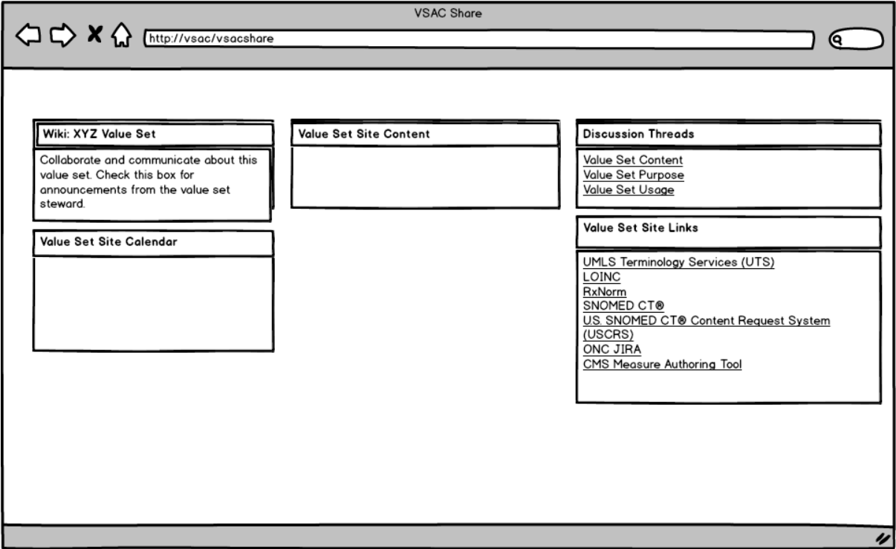
VSAC Share (to be renamed)
Draft Mockup
Notes:
Every value set has its own site in VSAC Share, and each value set site has its own dashboard customizable by its owner or steward.
Each VSAC Share user can have their own dashboard and they can join whatever value set sites they are interested in. Those value set sites will appear in that user’s dashboard.

Slide 6
VSAC Share Beta Test Volunteers
Volunteer to be a beta tester for the VSAC Share Collaboration site. We need your input in order to make a good tool for you.
Testing will require only a couple hours and will take place during 2 weeks in November.
Sign up now: maureen.madden@nih.gov
Notes:
Every value set has its own site in VSAC Share, and each value set site has its own dashboard customizable by its owner or steward.
Each VSAC Share user can have their own dashboard and they can join whatever value set sites they are interested in. Those value set sites will appear in that user’s dashboard.

Slide 7
Poll
Can you help test-drive and give feedback for the new VSAC Share Collaboration Tool?
Notes:
Every value set has its own site in VSAC Share, and each value set site has its own dashboard customizable by its owner or steward.
Each VSAC Share user can have their own dashboard and they can join whatever value set sites they are interested in. Those value set sites will appear in that user’s dashboard.

Slide 8
Intensional Value Set Definitions
Currently you have the ability to author value sets in VSAC by importing an enumerated list of codes or by choosing codes in the VSAC Authoring Tool.
NLM is building additional tooling in VSAC for you to define and build value sets by logical queries into code systems: Intensional Value Sets.
We need your thought processes and real use cases for how you build value sets.
Notes:
Every value set has its own site in VSAC Share, and each value set site has its own dashboard customizable by its owner or steward.
Each VSAC Share user can have their own dashboard and they can join whatever value set sites they are interested in. Those value set sites will appear in that user’s dashboard.

Slide 9
Example Intensional Queries
Make a SNOMED CT value set using all the active descendants of code 284009009 “Route of administration (qualifier value)”
Using RxNorm: Get prescribable oral tablet SCDs with ingredient=11289|Warfarin
C-CDA Value Set: Problem 2.16.840.1.113883.3.88.12.3221.7.4
A value set of SNOMED CT codes limited to terms descending from the Clinical Findings (404684003) or Situation with Explicit Context (243796009) hierarchies http://ccda.sitenv.org/Value+Sets+Used+in+C-CDA
Notes:
Every value set has its own site in VSAC Share, and each value set site has its own dashboard customizable by its owner or steward.
Each VSAC Share user can have their own dashboard and they can join whatever value set sites they are interested in. Those value set sites will appear in that user’s dashboard.

Slide 10
Questions?
Send comments, questions, ideas and intensional value sets to:
custserv@nlm.nih.gov
(place VSAC in the subject line)
Upcoming VSAC Users’ Forums:
October 16, 2014
November 13, 2014
Notes:
Every value set has its own site in VSAC Share, and each value set site has its own dashboard customizable by its owner or steward.
Each VSAC Share user can have their own dashboard and they can join whatever value set sites they are interested in. Those value set sites will appear in that user’s dashboard.

