Slide 1
VSAC Users’ Forum
Thursday, January 15 2:00 – 3:00 PM, EST

Slide 2
Today’s Agenda
Upcoming VSAC Code System Updates:
RxNorm 2015-01, LOINC 2.50, CPT 2015, CDT 2015, CVX 2015, HCPCS 2015, ICD-10-CM 2015, ICD-10-PCS 2015
Creating and Updating your Value Sets

Slide 3
VSAC Support Center

Slide 4
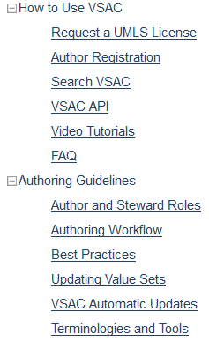
VSAC Support Center

Slide 5
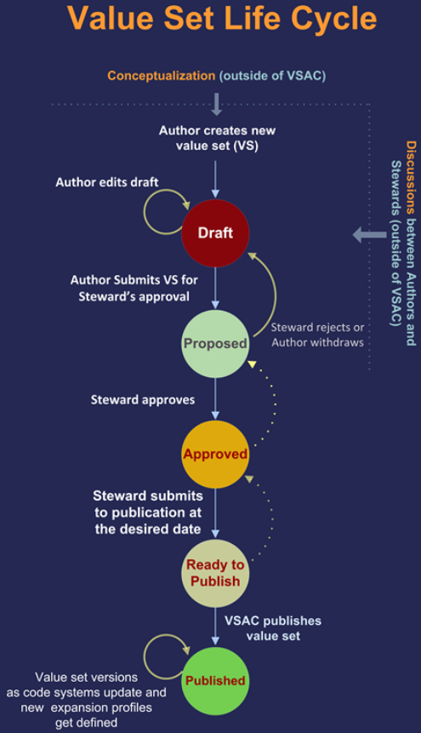
VSAC Support Center: Authoring Workflow

Slide 6
VSAC Support Center: Video Tutorials
Updating Value Sets
Adding Queried Codes to Value Sets
Importing Multiple Codes into Value Sets
Manually Adding Codes to a Value Set

Slide 7
VSAC Support Center: Best Practices
Building High Quality Value Sets
Types of Value Sets
Value Set Quality Criteria
Clinical Validity, Metadata Completeness, Non-redundancy
All Value Set Codes Are Valid in the Code System
Descriptors Match Code System Descriptors
Code List Completeness, Logical Correctness
Proper Terminological Hierarchies
Concept Property Similarity, Code System Alignment to Standards
Value Set Name
Value Set Purpose
Clinical Focus
Data Element Scope
Inclusion Criteria
Exclusion Criteria

Slide 8
VSAC Support Center: Terminologies and Tools
VSAC Terminologies (each name links to source Web page)
CDT, CPT, CVX, HCPCS, HL7, ICD-10-CM, ICD-10-PCS, ICD-9-CM, LOINC, RxNorm, SNOMED CT®, SOP
Tools
NLM Tools for EHR Certification and Meaningful Use
UMLS Terminology Services
U.S. SNOMED CT® Content Request System (USCRS)

Slide 9
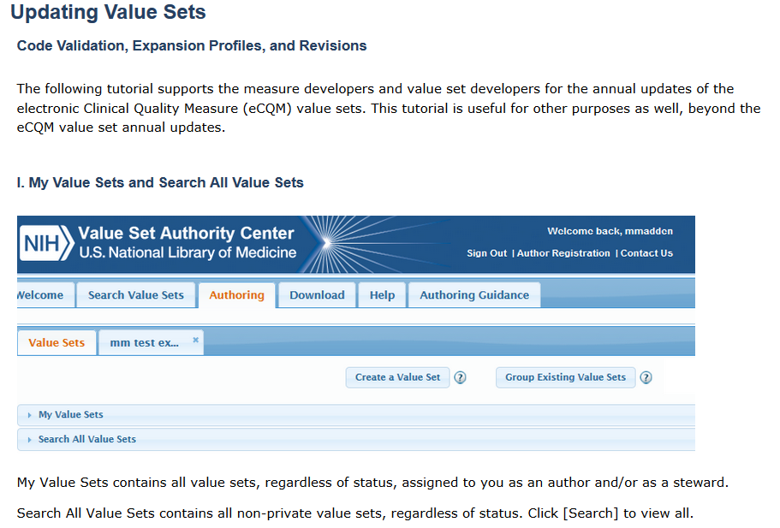
VSAC Support Center: Updating Value Sets

Slide 10
VSAC Authoring Tool Demonstration
Creating and Updating Value Sets
Example Value Set
Value Set Validation
Expansion Profiles
Value Set Publication

Slide 11
VSAC Collaboration Beta Test Volunteers
Volunteer to be a beta tester for the VSAC Collaboration site. We need your input in order to make a good tool for you.
Testing will require only a couple hours and will take place in February.
Sign up now: maureen.madden@nih.gov

Slide 12
Questions?
Send comments, questions, ideas to:
custserv@nlm.nih.gov (place VSAC in the subject line)
Upcoming VSAC Users’ Forum: February 19, 2015

